Slide 1
CS4984/CS598:
Big Data Text Summarization
Final Presentation (11/29/2018)
Team 3 - Hurricane Matthew
Professor: Edward A. Fox
Areeb Asif, Michael Goldsworthy, Brendan Gregos, Thoang Tran
Virginia Tech, Blacksburg, VA 24061

Slide 2
Contents
Introduction
Tools used
Cleaning
Important Results
Word count and POS tagging
LDA filtering
Regex and Template Summary
Conclusions
Analysis of tools
Takeaways and future work

Slide 3
Introduction

Slide 4
Tools and Environments
Zeppelin
Hadoop
Spark
Python
NLTK
Git
SpaCy
Scikit learn
Gensim

Slide 5
Cleaning
Remove HTML code
Remove empty articles
Remove duplicate articles
Remove articles that have less than 3 sentences
Remove articles that have high strength in bad LDA topics

Slide 6
Important Results

Slide 7
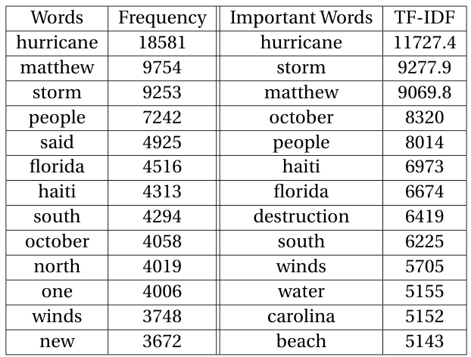
Word Frequency
Remove punctuation
Remove stop words and custom stop words

Slide 8
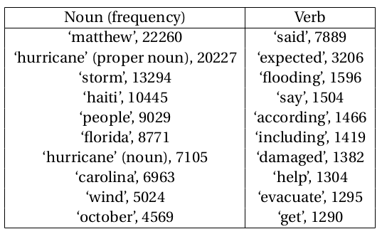
POS Noun and Verb Frequency
Initially: tagged words from word count list in unit 1
Better: NLTK POS tagger on words in context

Slide 9
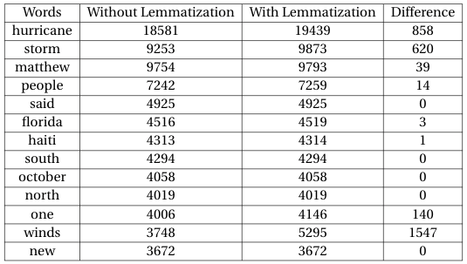
Word Lemmatization
Use “Words Lemmatization” in NLTK
Compare the results between words frequency with and without lemmatization

Slide 10
LDA Topics
Used Gensim to make multiple LDA topic models, pick model with highest coherence score
Useful for cleaning documents with high strength in bad topics
After cleaning, run again, sentences extracted based on topic strength

Slide 11
LDA Topic examples:
Good topics:
Bad topics:
(4, u'0.033*"hurricane" + 0.027*"matthew" + 0.019*"carolina" + 0.019*"county" + 0.014*"north" + 0.013*"home" + 0.012*"photo" + 0.010*"power" + 0.010*"flooding" + 0.010*"october"')
(6, u'0.033*"hurricane" + 0.028*"storm" + 0.021*"matthew" + 0.019*"florida" + 0.015*"wind" + 0.011*"coast" + 0.008*"beach" +0.008*"south" + 0.007*"friday" + 0.007*"area"')
(1, u'0.014*"trump" + 0.011*"election" + 0.010*"state" + 0.010*"clinton" + 0.008*"voter" + 0.008*"court" + 0.007*"vote" + 0.006*"president" + 0.006*"political" + 0.006*"white"')
(7, u'0.039*"news" + 0.033*"health" + 0.014*"disease" + 0.011*"blog" + 0.010*"google" + 0.010*"report" + 0.009*"zika" + 0.008*"french" + 0.008*"update" + 0.007*"site"')

Slide 12
LDA Sentences:
Good sentence:
Bad sentences:
Share Share Content brought to you by Mike Moss Sept.
Hide Caption 23 of 80 Photos: Hurricane Matthew's path of destruction Adam and Alec Selent watch waves crash over a retainer wall at the Ocean Club condominiums in Isle of Palms, South Carolina, on October 7
After passing Jamaica and Haiti, Matthew's centre was expected to pass about 50 miles (80 kilometres) east of the US Navy base at Guantanamo Bay, Cuba, where authorities evacuated about 700 spouses and children of service members on military transport planes to Florida.

Slide 13
Extractive Summary
Uses TextRank Summariser in Gensim package
Divides the collection into groups of 300 documents
Performs the summarization on groups of documents
Combines the results into into a text file
Summarizes the text file to obtain extractive summary

Slide 14
Extractive Summary Result
Residents across four states on the east coast are bracing for impact as Hurricane Matthew continues to make its way toward the U.S. The storm headed toward Florida on Wednesday after causing severe devastation across Haiti and bringing heavy rainfall and strong winds to the entire Caribbean region.
Hurricane Matthew pummeled the Florida coast this morning with powerful winds, potentially devastating storm surges and torrential rain.
United States: Downgraded to a Category 3 storm, Hurricane Matthew made landfall as evacuation orders were issued in Florida, Georgia and South Carolina.
More than two million people have been evacuated from Florida, Georgia, North and South Carolina as the United States prepares for Hurricane Matthew to hit.
At 5 p.m. EDT Friday, the National Hurricane Center said Matthew had sustained winds of 110 mph, making it a very powerful Category 2 storm.
Piers in Florida and South Carolina were damaged by storm surge and heavy surf from Hurricane Matthew. Hurricane Matthew has moved on to South Carolina where it made landfall as a Category 1 storm with sustained winds of 75 mph.
Update: Hurricane Matthew has weakened slightly to a Category 2 storm with 110 mph winds off Florida and Georgia coasts.

Slide 15
Named Entity
Used spaCy to extract named entities from each article
Created a file with each word followed by entity type or POS
Used Python’s multiprocessing library to speed up creation

Slide 16
Named Entity Results
Almost RB
all DT
mobile JJ
homes NNS
in IN
its PRP$
path NN
were VBD
obliterated VBN
. .
At least 40 CARDINAL
people NNS
were VBD
killed VBN
in IN
Florida GPE
. .
The DT
hurricane NN
rolled VBD
across IN
the DT
sparsely RB
populated JJ
tip NN
of IN
Cuba GPE
overnight TIME

Slide 17
Template Summary
Groups named entity results into sentences
Wrote a method that searches sentences with an input regex and containing a given named entity or POS type.
Inserts most common result(s) into template.

Slide 18
Template Summary Result
Hurricane Matthew, a category 4 hurricane, made landfall on Tuesday in Haiti. The wind speeds were measured at 140mph, and the hurricane caused 11 deaths as it traveled onto land. The largest amount of damage took place in Haiti, Florida, Fla., Cuba, Roseboro, Baracoa, and Nassau. millions homes lost power. AP, UN, Reuters, Facebook, FEMA, U.N., and NOAA were working to document the damage and assist the victims. There were also reports of looting in Haiti. 175,000 people were evacuated from their homes by authorities in anticipation of the storm.

Slide 19
Conclusion and Takeaways

Slide 20
Analysis of Tools
Most Useful:
Python
NLTK
Git
SpaCy
Gensim

Slide 21
Takeaways
Cleaning data and filtering irrelevant documents is key
Explore and use multiple tools and libraries
Don’t waste time on methods that are not working, adapt and work around

Slide 22
Future Work
Try to classify the collection using supervised machine learning
Improved template with more slots
Deep Learning

Slide 23
Thank you!

