Slide 1
Computational Modelling of Solidity Effects on Blade Elements with an Airfoil Profile for Wind Turbines
Department of Mechanical Engineering
University of Calgary
Alberta, Canada
Haoxuan Yan
Supervisor: Dr. David Wood
June.08 2015
Notes:
Solidity effect
Pitch angle
Lift-drag ratio

Slide 2
Outline
Overview
Solidity effect
Analysis of cascade forces
Review of the Mesh
Fluent settings
Current results
Future work

Slide 3
Overview
Objective: to investigate the aerodynamic performances of NACA 4415, especially solidity effect, including isolated airfoil and cascade blades
Motivation: Standard Blade Element Theory (BET) for wind turbines assumes zero solidity, however, it is NOT zero for wind turbines in reality
Obstacle: It would be very hard to perform accurate wind tunnel tests at low solidity
Method: CFD simulation
Tool: ICEM and FLUENT 15.0

Slide 4
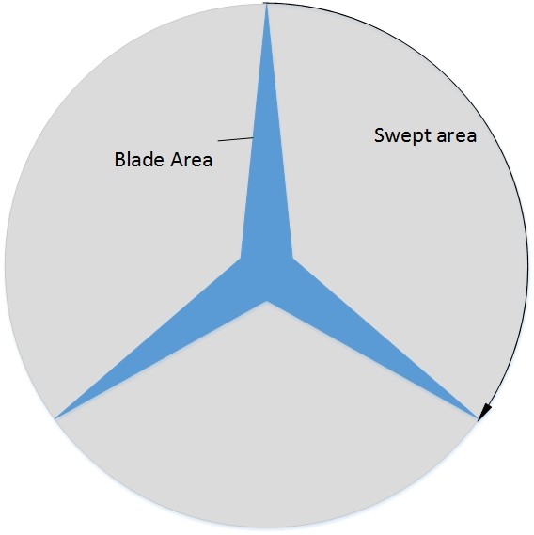
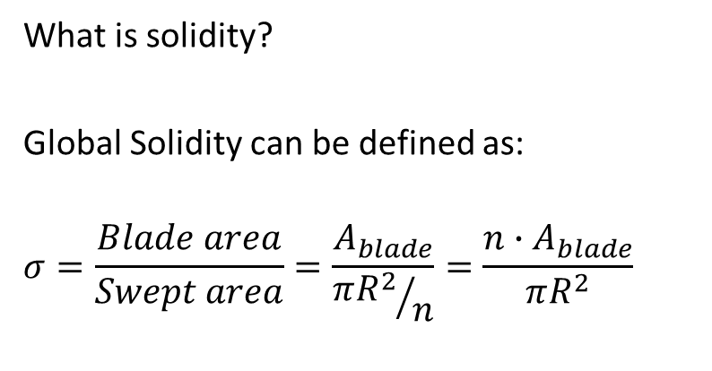
Solidity Effect
What is solidity?
Global Solidity can be defined as:
$$σ=\frac{Blade area}{Swept area}=\frac{A_{blade}}{{πR^{2}}/n}=\frac{n∙A_{blade}}{πR^{2}}$$
Solidity: 0.11
Typical range for 3-blade HAWT:
0.021 (at the tip) -0.11 (at the hub)
Low solidity (<0.1): High speed, Low torque
Example: wind turbine
High solidity (>1.0): Low speed, High torque
Example: wind mill, propeller
Solidity: 0.021

Slide 5
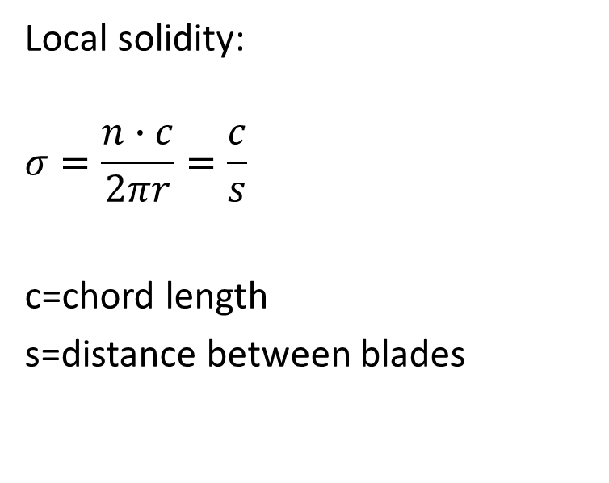
Solidity Effect
Solidity can also be defined that blades are symmetrically placed along one direction where solidity equals the chord length divided by the distance, noted as S.
Local solidity:
$$σ=\frac{n∙c}{2πr}=\frac{c}{s}$$
c=chord length
s=distance between blades
S
Source: small wind turbines
Notes:
symmetrically superimposed

Slide 6
Solidity Effect
Solidity Effect:
If the solidity is adequately high, the lift and drag coefficient would be impacted as well as lift-to-drag ratio
Delay the stall partially
Mean angle of attack would be altered correlation of Lift and Drag
Questions:
  How the solidity would influence the coefficients?
  What is the sufficient solidity to cause the change of lift and drag coefficient?

Slide 7
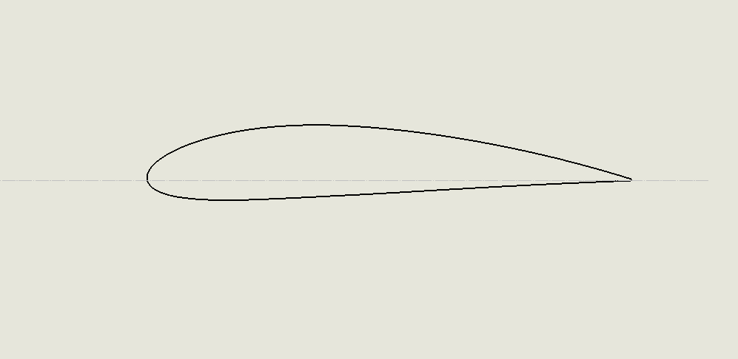

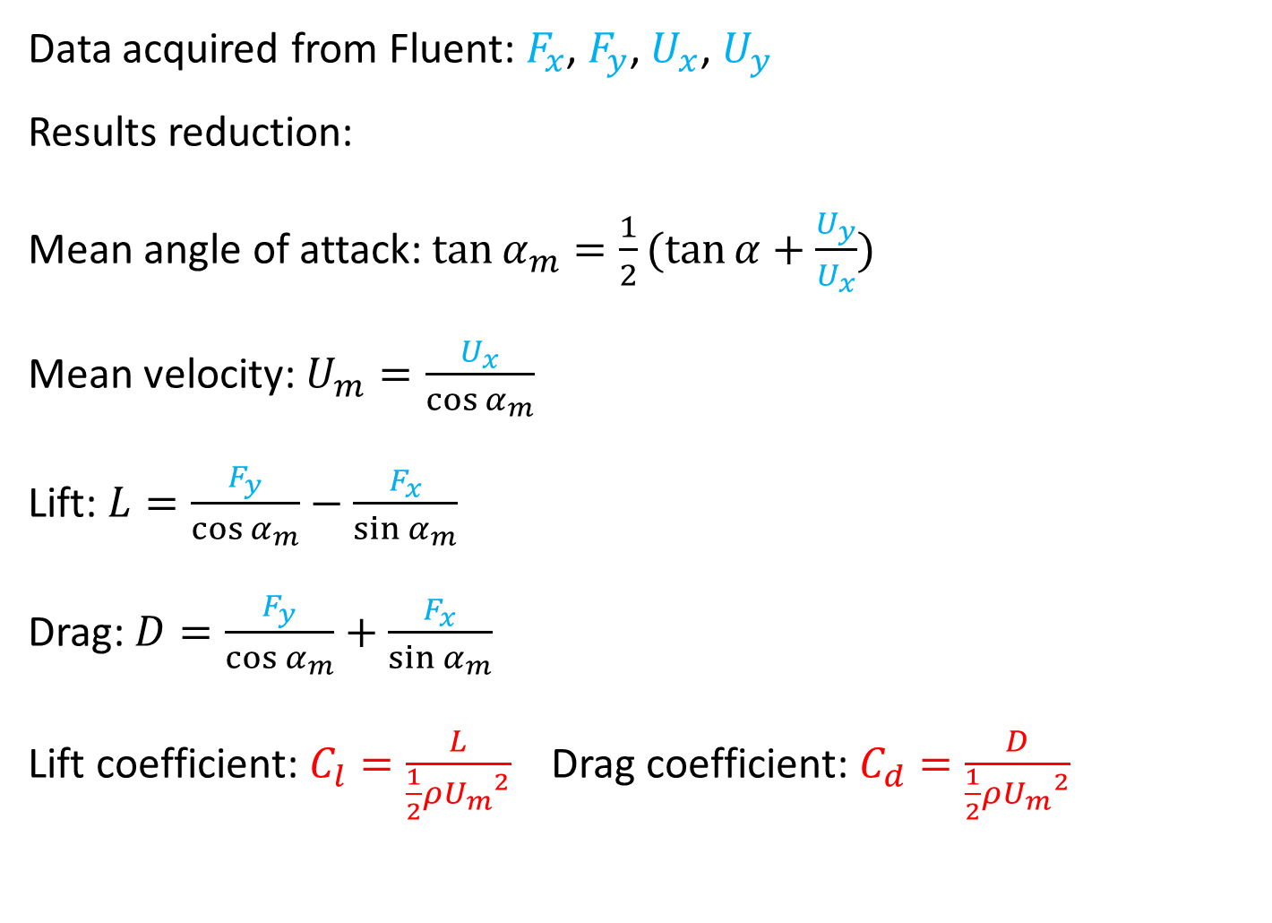



Analysis of Cascade Forces
Data acquired from Fluent: $F_{x}$, $F_{y}$, $U_{x}$, $U_{y}$
Results reduction:
Mean angle of attack: $\tan{α_{m}}=\frac{1}{2}(\tan{α}+\frac{U_{y}}{U_{x}})$
Mean velocity: $U_{m}=\frac{U_{x}}{\cos{α_{m}}}$
Lift: $L=\frac{F_{y}}{\cos{α_{m}}}−\frac{F_{x}}{\sin{α_{m}}}$
Drag: $D=\frac{F_{y}}{\cos{α_{m}}}+\frac{F_{x}}{\sin{α_{m}}}$
Lift coefficient: $C_{l}=\frac{L}{\frac{1}{2}ρ{U_{m}}^{2}}$ Drag coefficient: $C_{d}=\frac{D}{\frac{1}{2}ρ{U_{m}}^{2}}$
$$L$$
$$F_{y}$$
$$D$$
mean
velocity
$$F_{x}$$
inlet velocity

Slide 8
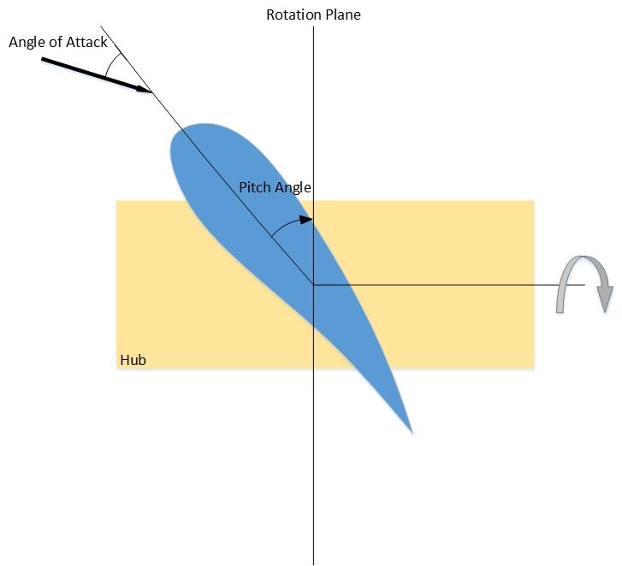
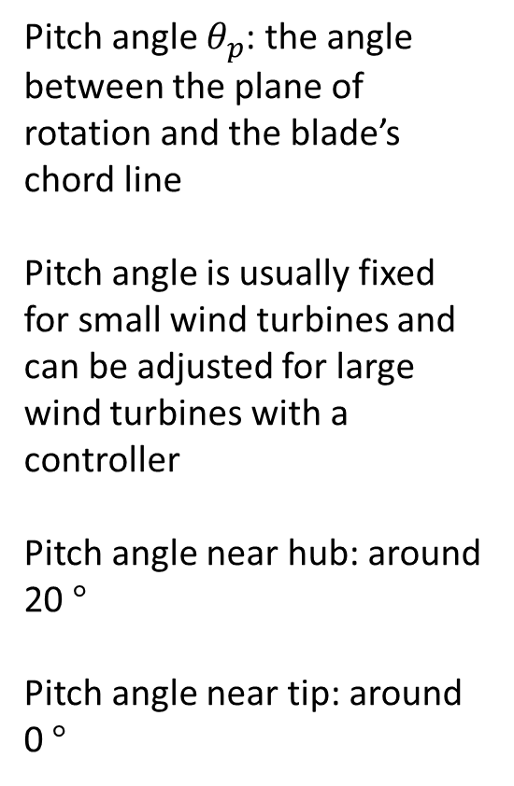
Pitch Angle
Pitch angle $θ_{p}$: the angle between the plane of rotation and the blade’s chord line
Pitch angle is usually fixed for small wind turbines and can be adjusted for large wind turbines with a controller
Pitch angle near hub: around 20 $°$
Pitch angle near tip: around 0 $°$

Slide 9

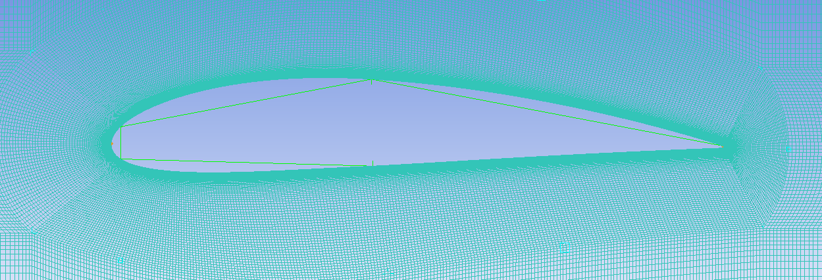
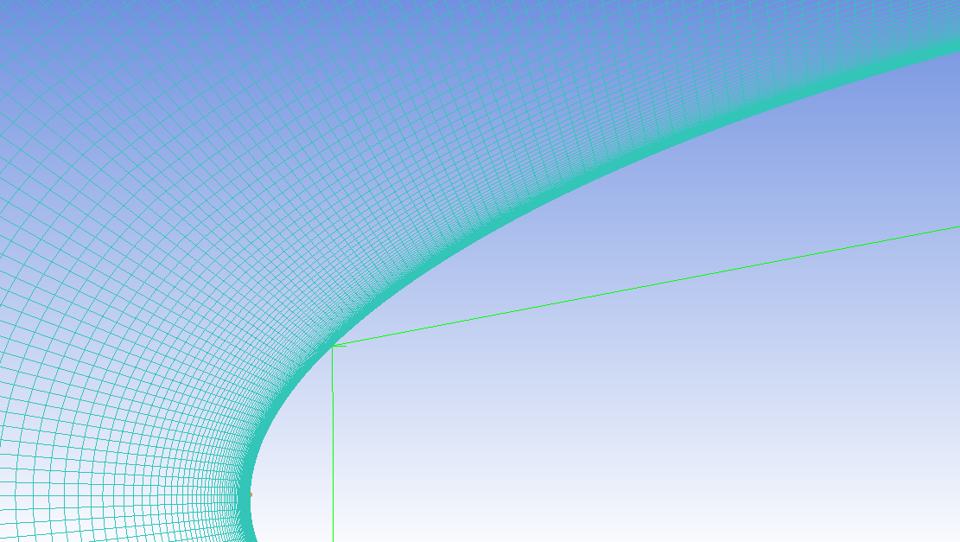
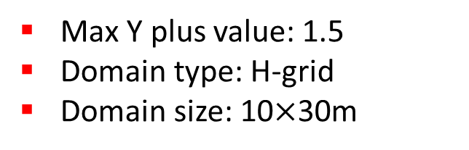
Review of the Mesh
Tool: ANSYS ICEM 15.0
Mesh size: 150182 elements
Elements type: Hexahedra
Max Y plus value: 1.5
Domain type: H-grid
Domain size: 10$×$30m
10m
Airfoil
10m
20m
Zoom-in views of the airfoil mesh

Slide 10
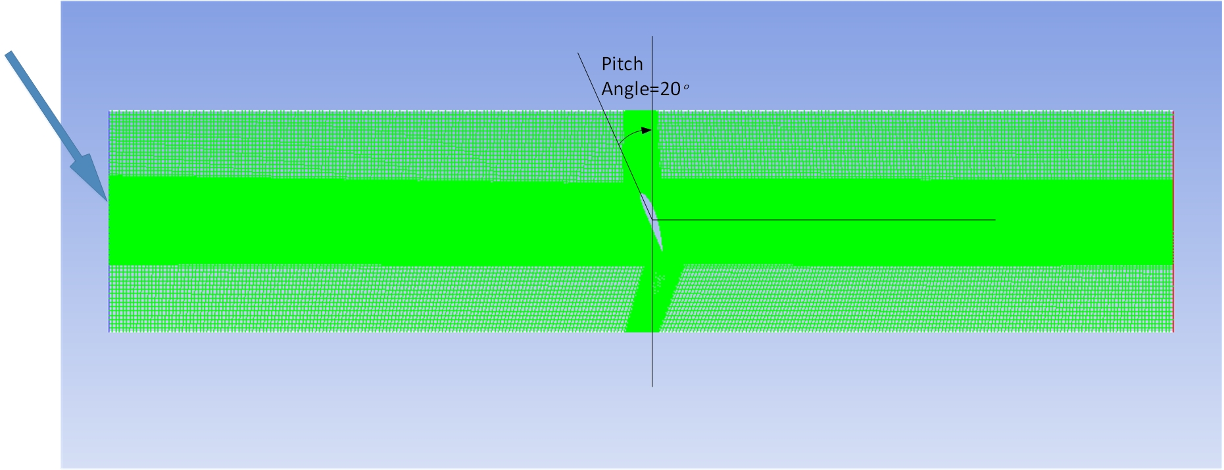

Review of the Mesh
Pitch angle = 20 $°$
Inlet velocity
Inlet
Pressure outlet
Periodic boundaries: nodes must be matched

Slide 11

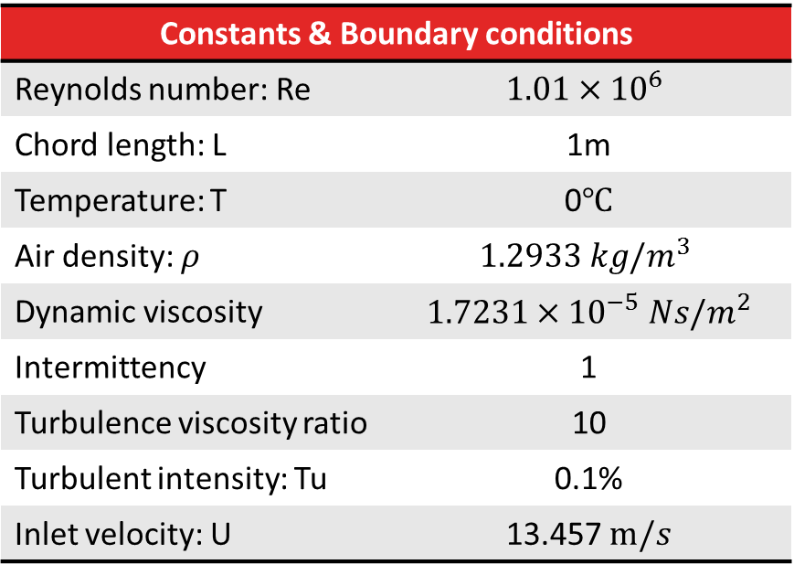
Boundary Conditions
Constants & Boundary conditions
Reynolds number: Re | $$1.01×{10}^{6}$$
Chord length: L | 1m
Temperature: T | 0$℃$
Air density: $ρ$ | $$1.2933 kg/m^{3}$$
Dynamic viscosity | $$1.7231×{10}^{−5} Ns/m^{2}$$
Intermittency | 1
Turbulence viscosity ratio | 10
Turbulent intensity: Tu | 0.1%
Inlet velocity: U | 13.457 $m/s$
The Reynolds number was calculated according to the Ohio State University’s experimental data
$Re=\frac{ρUL}{μ}$

Slide 12
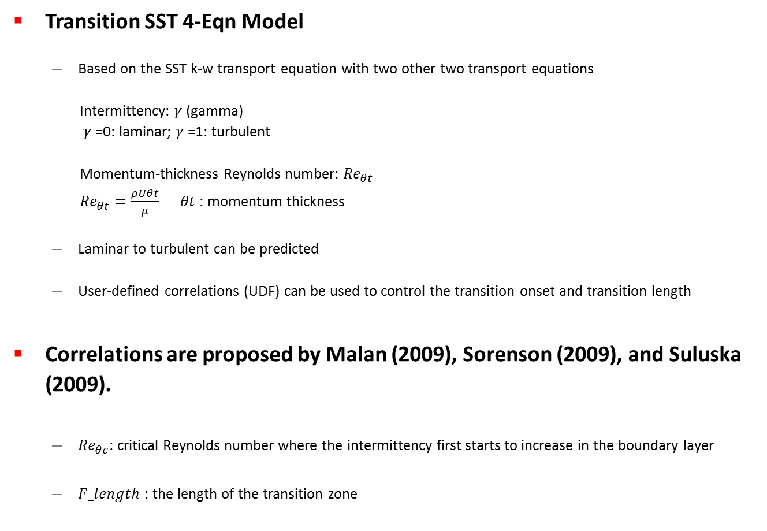
Turbulence Model
Transition SST 4-Eqn Model
  Based on the SST k-w transport equation with two other two transport equations
  Intermittency: $γ$ (gamma)
  $γ$ =0: laminar; $γ$ =1: turbulent
  Momentum-thickness Reynolds number: ${Re}_{θt}$
  ${Re}_{θt}=\frac{ρUθt}{μ}$ $θt$: momentum thickness
  Laminar to turbulent can be predicted
  User-defined correlations (UDF) can be used to control the transition onset and transition length
Correlations are proposed by Malan (2009), Sorenson (2009), and Suluska (2009).
  ${Re}_{θc}$: critical Reynolds number where the intermittency first starts to increase in the boundary layer
  $F_length$: the length of the transition zone

Slide 13
Experimental Data
Wind Tunnel Comparison
 | Ohio State University | NACA
Test Year | 1996 | 1945
Wind tunnel | OSU | NACA LTT
Turbulence level | 0.1% | 0.03% (unbelievable!)
Re range | 0.75-1.5 million | 0.7-1.5 million
Surface | Smooth | Smooth
Model aspect ratio | 3 | 3.8
Data | Cl, Cd, Cp | Cl, Cd

Slide 14
Results of Isolated Airfoil
Results Comparison
 | Max Cl | Max Cl/Cd ratio | Stall angle
OSU | 1.354 | 106.5 | 14.3
Stuttgart | 1.36 | 105.4 | 13.5
Xfoil | 1.64 | 127.8 | 16.2
Menter | 1.59 | 108.1 | 15.3
Sorenson | 1.65 | 111.0 | 14.3
Max ratio at 6.2

Slide 15
Results of Cascaded Blades
@11.2 | Cl | Change
S=0 | 1.5136 | -
S=0.1 | 1.5016 | -0.79%
S=0.2 | 1.4745 | -2.58%
S=0.3 | 1.4430 | -4.66%

Slide 16
Results of Cascaded Blades
@11.2 | Cd | Change
S=0 | 0.01977 | -
S=0.1 | 0.01716 | -13.2%
S=0.2 | 0.01698 | -14.1%
S=0.3 | 0.01625 | -17.8%

Slide 17
Results of Cascaded Blades
 | S=0 | S=0.1 | S=0.2 | S=0.3
Max Cl/Cd | 111 | 121 | 123 | 119
AOA | 6.2 | 6.5 | 6.9 | 7.3

Slide 18
Results of Cascaded Blades
Pressure side
Suction side

Slide 19
Conclusion and Outlook
Validation:
  Lift has not good agreement at high angle of attack. Drag has good agreement with experimental data
  Sorenson’s correlation was used because it has the same stall angle as the experimental results
Solidity Effect
  It can reduce both of lift and drag
  But it rises the lift to drag ratio and delay the stall
  Solidity of 0.1 could have significant impact on aerodynamic performances of the blade, especially on drag
Future work:
  Improve the accuracy of lift at high angles
  Simulate the case of pitch angle=0 with solidity varying from 0.1 to 0.3
  and pitch angle=20 with solidity varying from 0.1 to 0.3

Slide 20
Reference
C. Bak, “The DTU 10-MW Reference Wind Turbine”, Danish Wind Power Research, 2013
I. H. Abbott, A. E. Von Doenhoff, Theory of Wing Sections, Dover, 1958
D. Wood, Small Wind Turbines Analysis, Design, and Application, Springer, 2011
S. L. Dixson, Fluid Mechanics and Thermodynamics of Turbomachinery, Elsevier, 1998
T. Burton, D. Sharpe, N. Jenkins, E. Bossanyi, Wind Energy Handbook, Wiley, 2001
F. R. Mentor, R. B. Langtry, “A Correlation-Based Transition Model Using Local Variables—Part 1: Model Formulation”, Journal of Turbomachinery, Vol (128), pp 413-422
M. J. Hoffmann, R.R. Ramsay, G. M. Gregorek, “Effects of Grit Roughness and Pitch Oscillations on the NACA 4415 Airfoil”, Airfoil Performance Report, 1996

Slide 21
Thank you for the attention!
Any questions?
hayan@ucalgary.ca

