Slide 1

How to Get Started with
Open Educational Resources
Abbey Elder, Open Access & Scholarly Communication Librarian
Iowa State University
Notes:
“How to Get Started with Open Educational Resources” by Abbey Elder, licensed under a Creative Commons Attribution 4.0 International license is adapted from:
“Getting Started with OER”, licenced CC BY 4.0, by Abbey Elder,
“OTN Training Slides” by David Ernst, available under a Creative Commons Attribution 4.0 International license,
“OER Basics” by Kelsey Smith, available under a Creative Commons Attribution 4.0 International license, and
“Finding and Evaluating OER” by Mahrya Burnett and Abbey Elder, also available under a Creative Commons Attribution 4.0 International license.

Slide 2
Why this discussion?

Slide 3
Students
Can’t Learn
From Books They
Can’t Afford
Notes:
Source: PBS NewsHour: https://www.pbs.org/newshour/education/can-professor-forced-assign-180-textbook

Slide 4
Open
Educational
Resources can help

Slide 5
Open Educational Resources are teaching resources that are free of cost and access barriers, and which also carry legal permission for open use, which allows anyone to freely use, adapt, and share the resource.
-SPARC

Slide 6
Open =
free + permissions

Slide 7
What kind of permissions?
Retain - make, own, and keep a copy
Revise - edit, adapt, and modify your copy
Remix - combine your copy with other existing material
Reuse - use your original, revised, or remixed resource
Redistribute - share copies with others
Notes:
Usually conferred through a CC license

Slide 8

Explicit through licensing
Image from OER Basics by Kelsey Smith, licensed CC BY 4.0.

Slide 9



This is a broad definition for a reason.
Notes:
OER come in many types, and restricting them to a specific format or license can be stifling and also restricting to instructor innovation in creating or adapting materials effectively.
Icons from undraw.co, licensed CC BY 3.0.

Slide 10
What isn’t OER?
Anything that isn’t BOTH free and open with 5R permissions:
Library-licensed resources: free (to you) and not open
Most blogs & websites: free but not (always) open
Images you find on Google: free but not open (check for a license!)
Open access monographs: free and open (may not be remixable)
If something isn’t an OER, that doesn’t mean you can’t use it!

Slide 11
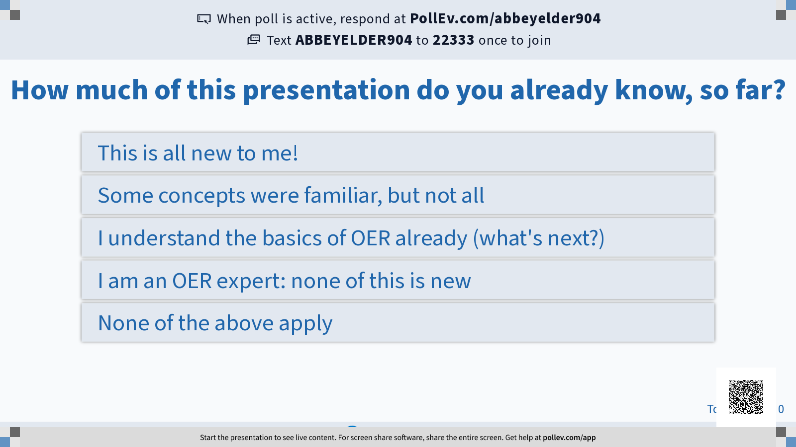

Slide 12
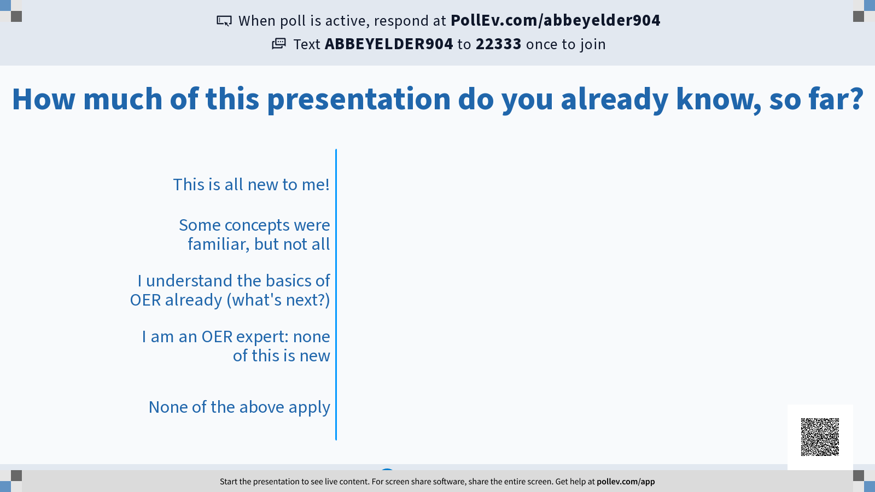

Slide 13
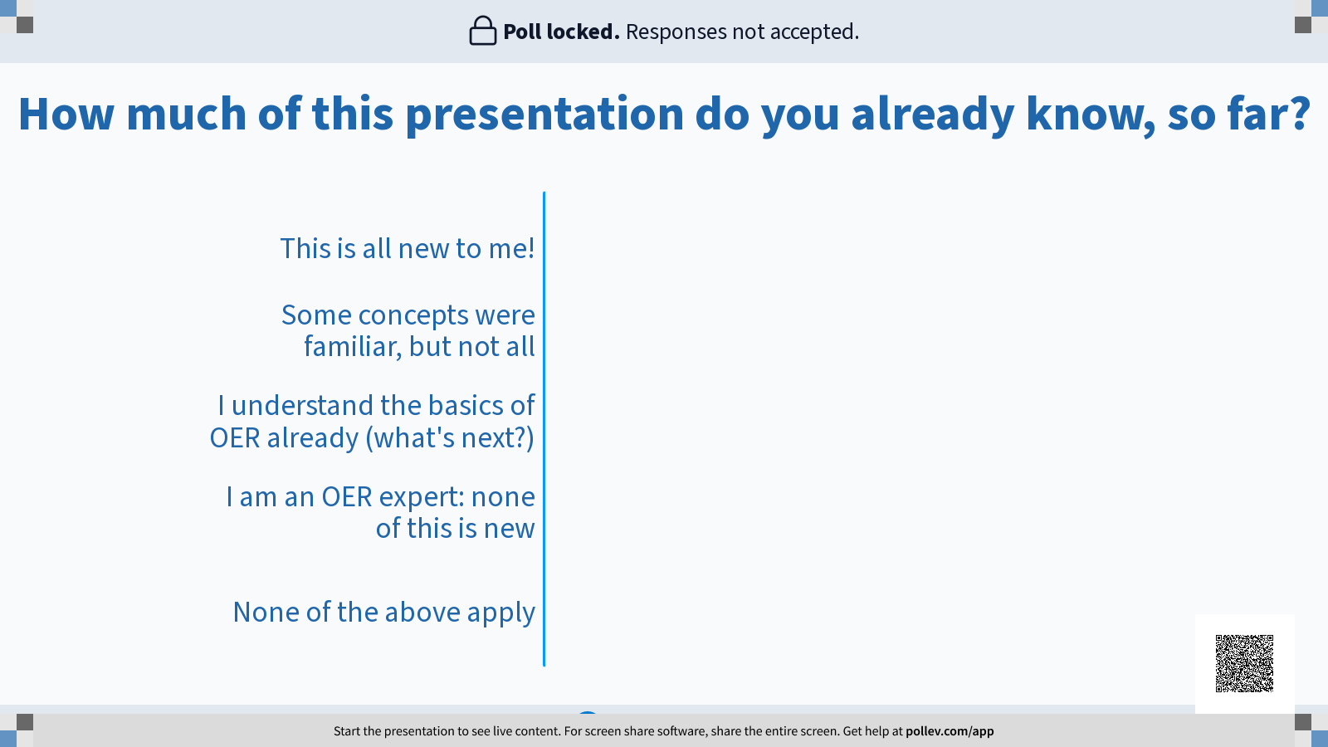

Slide 14
How do I adopt OER?
Notes:
This presentation is adapted from OER Basics by Kelsey Smith, licensed Creative Commons Attribution 4.0 International except where otherwise indicated.

Slide 15
Before you begin
Consider what you need
Consider what you have already

Slide 16
Remember, OER can be any educational material, so long as it is freely shared and openly licensed.

Slide 17





OER Repositories

Slide 18
The search process
Identify keywords
Search broadly (OASIS, BCCampus, Google)
Start general and then get specific
Curate content
Reflect and repeat

Slide 19
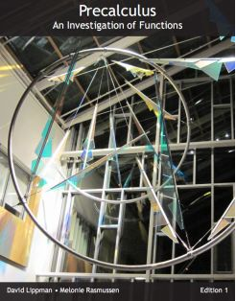
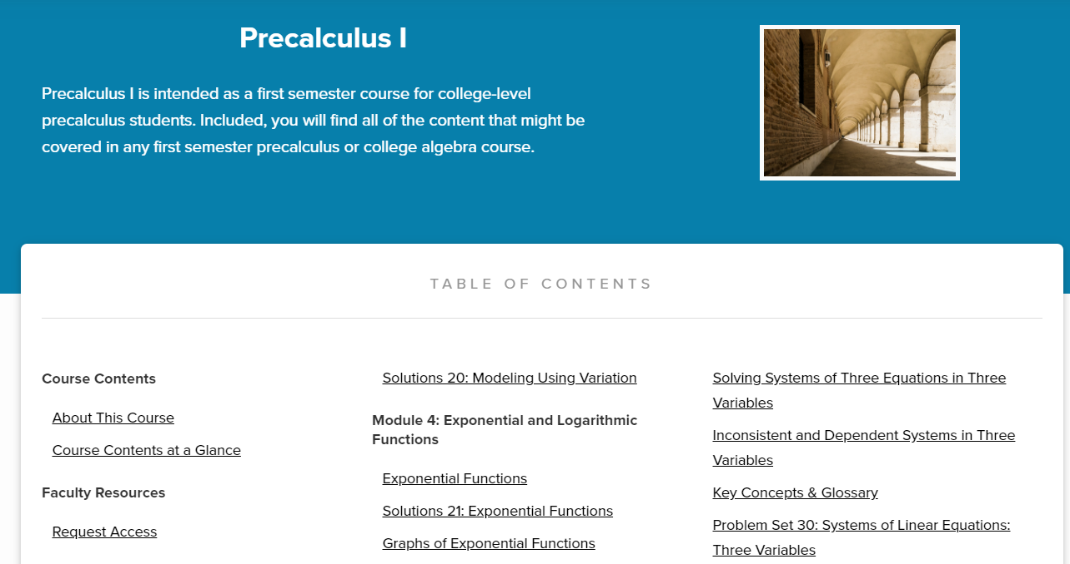
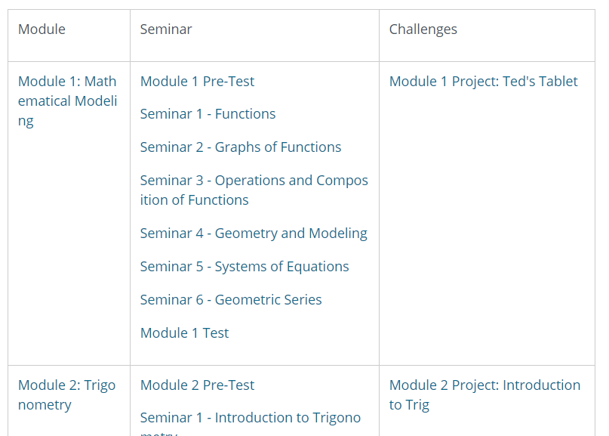

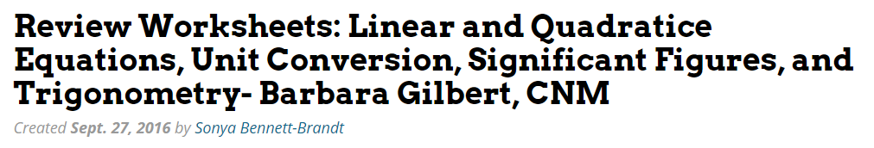
You may find a lot...

Slide 20
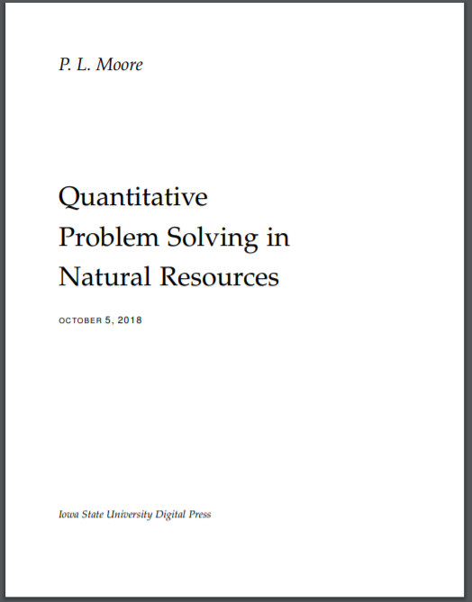
You may find a lot...
You may find a little.
Notes:
https://open.umn.edu/opentextbooks/textbooks/775

Slide 21


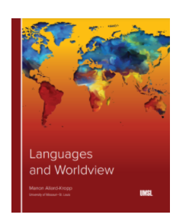


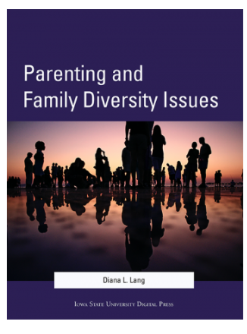
Check in regularly for updates

Slide 22
OER Treasure Hunt Worksheet
For a guided walkthrough of this process, download a copy of my worksheet:
bit.ly/oertreasurehunt

Slide 23
You have options
Open Educational Resources (OER)
Course Reserves
Textbook rentals
Used books
Course packs
And more!

Slide 24
You have options
This is not an either/or conversation.
You can adopt some OER without jumping in completely!
Start small and innovate!

Slide 25
Open Educational Practices
Replace your textbook with an open one
Integrate ancillary OER as self-study materials
Use open pedagogy to create OER with your students
Do research on OER and their impact(s)

Slide 26
How do I create OER?

Slide 27
Project planning considerations
Who is your audience?
What Learning Objectives do you need to meet?
What training do you need?
What support is available?

Slide 28
This is not a comprehensive guide. What you do will heavily depend on the resources available to you and what you want to create.

Slide 29
Creation tools
Tips
Use what you have
Use what you know
Platforms
Word
Overleaf
Pressbooks
Wordpress
Your LMS (Canvas, Blackboard, Moodle, etc)

Slide 30
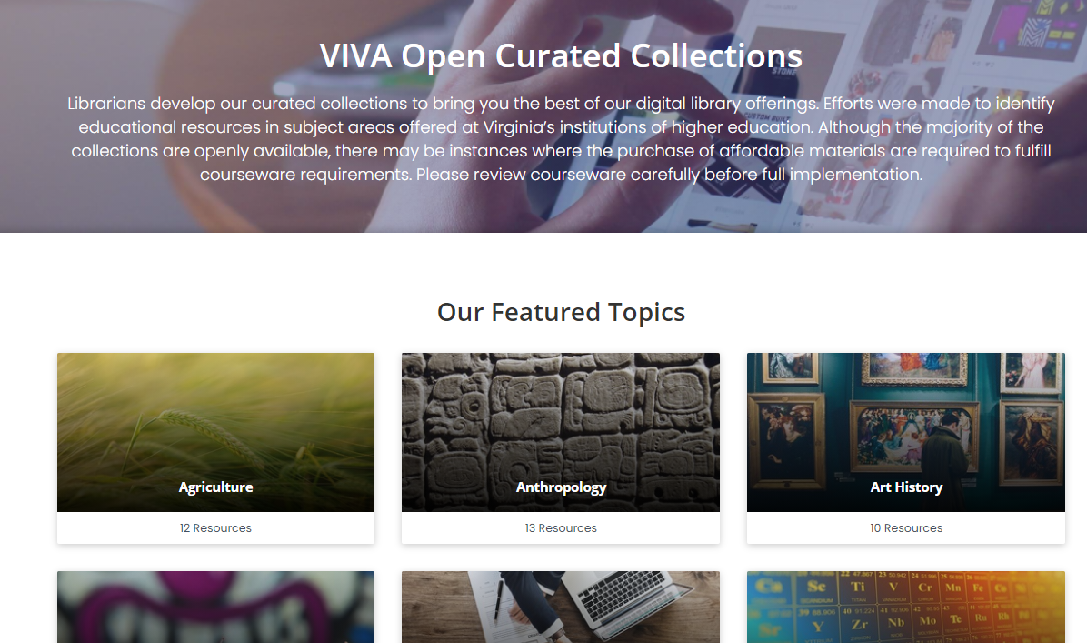
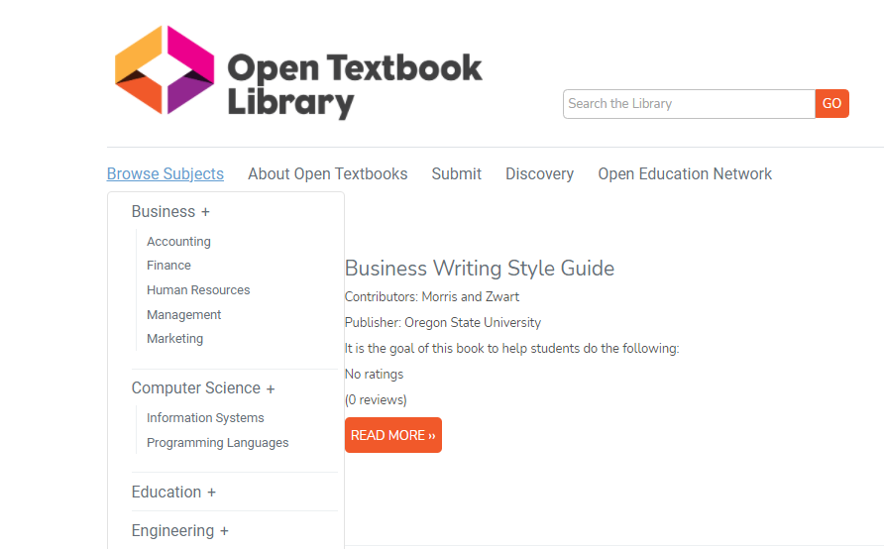
Figure out if you want where you want to host your content, and where it can be shared

Slide 31
Hosting & Sharing tools
Hosting and creating
Pressbooks
LibreTexts
Wordpress
Your LMS
OER Commons vivaopen.oercommons.org
Hosting, not creating
Your institutional repository
Manifold
Sharing, but not hosting
Open Textbook Library
OER Commons can do this, too

Slide 32
Project planning considerations
Interoperability:
Aim for modular, customizable content formatting and design
Digital accessibility:
Build accessibility in from the start; ask for help!
Sustainability:
Plan ahead for future updates

Slide 33
Encourage downstream use
Access to Editing Tools
Is the open content published in a format that can be revised or remixed using tools that are freely available and run on all major platforms (e.g., OpenOffice)?
Level of Expertise Required
Is the open content published in a format that requires a minimum level of technical expertise to revise or remix (e.g., Word)?
Meaningfully Editable
Is the open content published in a manner making its content easy to revise or remix (e.g., a text file)?
Self-Sourced
It the format preferred for consuming the open content the same format preferred for revising or remixing the open content (e.g., HTML)?
The ALMS Framework, David Wiley, http://opencontent.org/definition/
Notes:
This material is an adaptation of Defining the "Open" in Open Content and Open Educational Resources, which was originally written by David Wiley and published freely under a Creative Commons Attribution 4.0 license at http://opencontent.org/definition/

Slide 34
Ask for help!
Search for campus copyright, accessibility experts
Talk to IDs, librarians, OER professionals
Use the support available in your community
To identify the system or campus OEN leaders for your campus, see bit.ly/va-oer-contacts

Slide 35
Get help!
Funding and content hosting are available:
4-VA Grants
VIVA Grants
VIVA funding for open textbook reviews
Listservs are available through VIVAOER, OpenVA, and others
Institutional support may be available-- just ask!
To see these resources and more available in Virginia, visit
bit.ly/va_oer

Slide 36
How do I adapt OER?

Slide 37
Remember those permissions?
Retain - make, own, and keep a copy
Revise - edit, adapt, and modify your copy
Remix - combine your copy with other existing material
Reuse - use your original, revised, or remixed resource
Redistribute - share copies with others

Slide 38
Considerations for adapting
What needs changing?
What software/tools do you have?
What training do you need?
What support is available for your work?
Some of this should sound familiar.

Slide 39
Approach adaptation like editing
Think of OER like a first draft someone has shared for you.
Don’t be afraid to make changes! You adapt for your course.
Consider reaching out to the original author to share your work.
Always give attribution. It’s the law.
Notes:
Important note: Adapting a resource does not override or alter the original.

Slide 40

Attribution
Here is an example of attribution for an image by Flickr user Lukas Schlagenhauf (on the right).
This is an ideal attribution because it includes the:
Title: “Furggelen afterglow”
Author: “Lukas Schlagenhauf“
Source: “Furggelen afterglow“
License: “CC BY-ND 2.0”
Provide links for each to help users find the original.
“Furggelen afterglow” by Lukas Schlagenhauf is licensed under CC BY-ND 2.0.
This information is from Creative Commons at creativecommons.org/use-remix/, licensed under a
Creative Commons Attribution 4.0 International license.

Slide 41
What can you change?
Format
Updates
Additions
Deletions
Accessibility
Language

Slide 42
What can you change? Why change?
Format
Updates
Additions
Deletions
Accessibility
Language
Ease of access
Production of print copies
Alignment with CLOs
Better diversity, equity, and inclusion
“I don’t teach that chapter in this class”

Slide 43
Small changes can make for big results

Slide 44
Remix projects
Take multiple resources and combine them with your own
Combine two resources to fill a gap identified in one
Create a “reader” or “resource list” by taking chapters or articles and compiling them into an open course pack
Remixing can happen in many ways!
Notes:
Important note: Adapting a resource does not override or alter the original.

Slide 45
Open Pedagogy projects
You can adapt during your class, too!
Open pedagogy is the process of engaging students in the co-creation of content as part of their learning, either as a way of demonstrating learning or as a way of encouraging it.
Students can annotate, comment on, or suggest edits to an open resource as part of an open pedagogy project
Learn more at openpedagogy.org
Notes:
Important note: Adapting a resource does not override or alter the original.

Slide 46
Key Takeaways
You have options!
You can adopt, adapt, or create content for your course
You can fully integrate OER or adopt only ancillaries
Start broad when searching, then expand your search
Use the resources at your disposal
You don’t have to do this alone

Slide 47
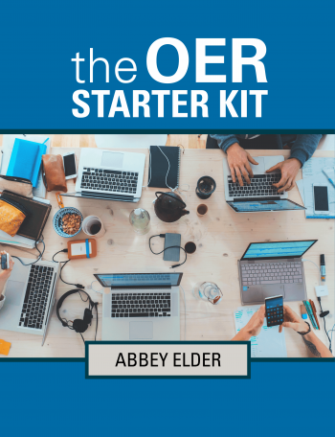
Learn More
Use one of the many resources available to learn more about OER and how you can integrate them into your course!
bit.ly/oerstarterkit

Slide 48

Share your questions!
Access these slides at
bit.ly/va-oer-starter
You can contact Abbey at aelder@iastate.edu
or via Twitter @OpenAccessElder

