Slide 1
Contemplative Campus
Bringing Focus, Awareness, Presence, and Attention
to Virginia Tech

Slide 2

Background
What are contemplative practices?
How can these help our daily lives?
What does Virginia Tech already have?

Slide 3


Goals
Website
Create an informative website
Easy to navigate
Simple to edit
Video
Show testimonials
Explain relevance to Virginia Tech
Summarize the conference

Slide 4

Work Completed
Website is complete and themed
Web server and Wordpress are upgraded
Video Storyboard is finished
Draft of video completed, revisions pending

Slide 5
Website Features
Gallery for pictures and videos
Calendars for VT and Blacksburg Events
Widgets for news, events, search and more
Information for Students and Faculty
(Research, Useful Links, Organization info)

Slide 6
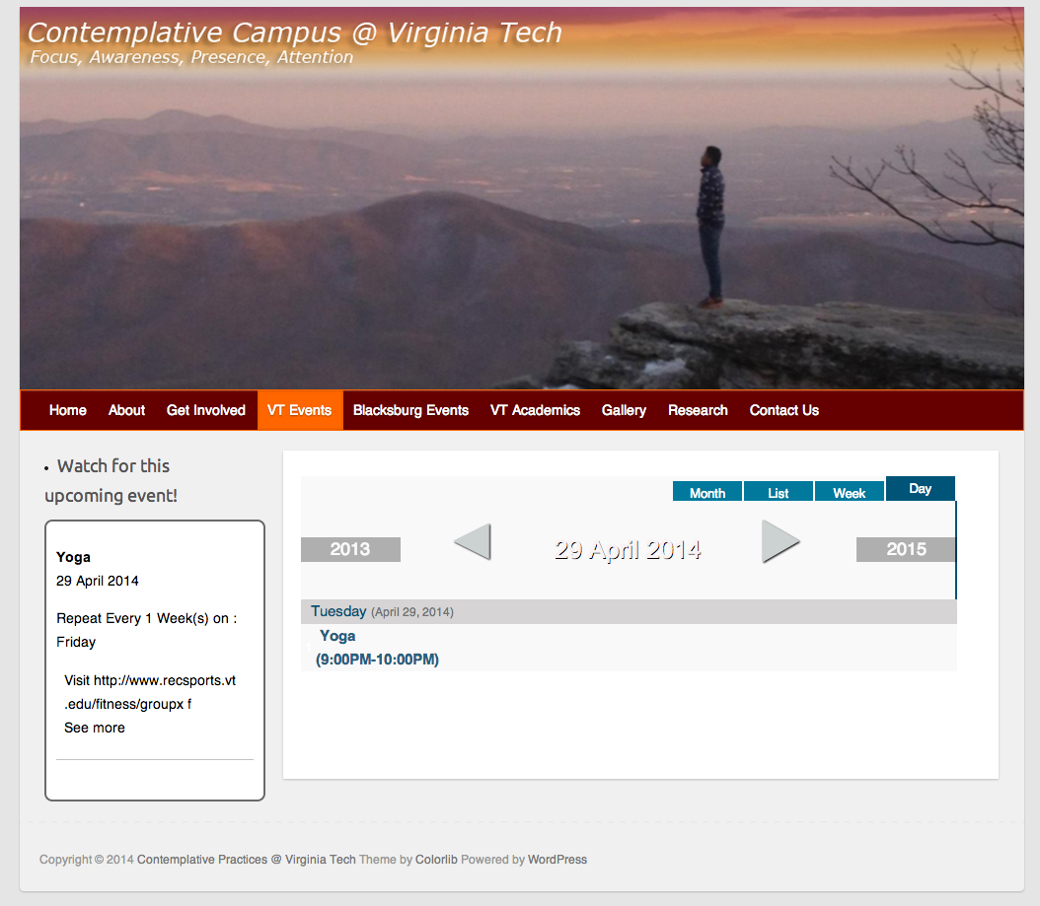
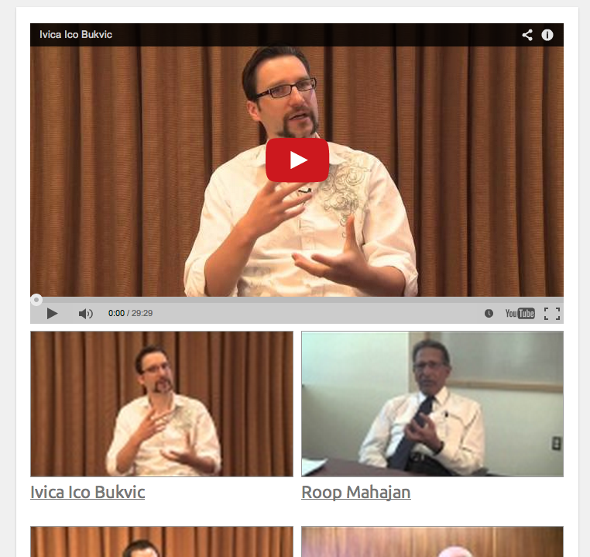
Final Website
http://www.contemplativecampus.dlib.vt.edu/

Slide 7
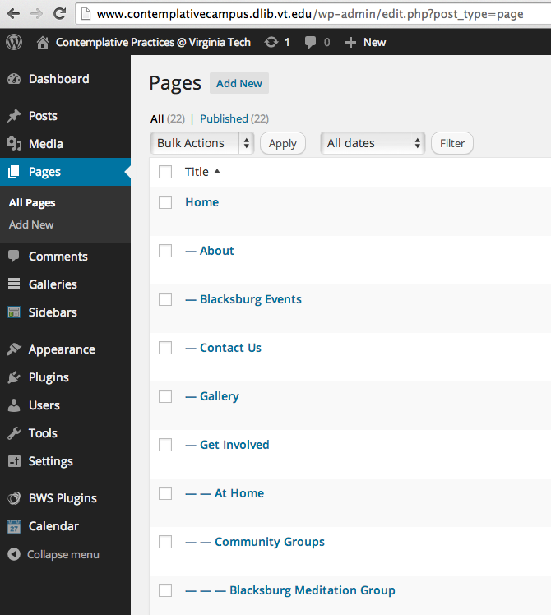
Website Administration
Editing and adding content is fairly simple

Slide 8

Work to be done
Video Finalization
  Selection of final clips
  Add B-Roll footage
  Adjust sound levels
  Render and Upload the Video
Final report
  User & Developer Manual
  Lessons Learned
  References

Slide 9

Questions?

