Slide 1
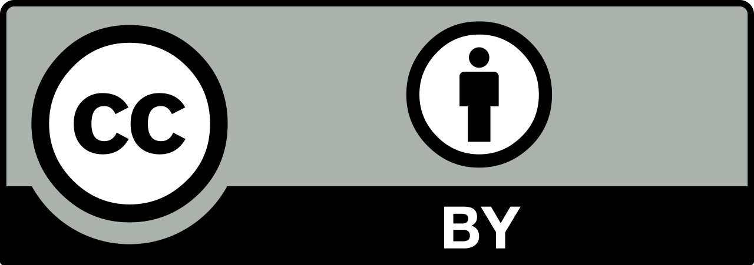
Potential Strategies for Preserving Complex DH Projects
Corinne Guimont | Digital Scholarship Coordinator
Alex Kinnaman | Digital Preservation Coordinator
Best Practices Exchange 2020

Slide 2
Introduction
What is a DH project? What levels might we engage with? What project components can be identified?
What are early preservation-centric decisions and planning strategies?
What are potential pieces of documentation and planning measures?
VT Case study
Notes:
So here is a rough outline for our presentation going forward. We want to start with thinking about what makes up a digital humanities project, what are the pieces we need to think about preserving. And then think about how we preserve these projects and plan for preservation early on. And then discuss the different documentation and planning measures we can employ. And finally look at a project we are both currently working on.

Slide 3
Types of Projects
Notes:
Types of Projects. When working with multiple DH projects, I like to think of categorizing them in 3 broad areas: small, medium, and large. This has helped me personally in terms of thinking about my workload as well as others involved and also the types of output the project is creating.

Slide 4
Small Projects
Out of the box CMS (Omeka, WordPress, or Scalar)
Little development
Online exhibits
Student support provided
1-2 semesters
Notes:
The way I’ve defined small projects is thinking about projects built on out of the box content management systems or tools. I’ve seen a lot of small projects built on Omeka and Wordpress, and more recently Scalar. These typically require little development and use existing features and plugins. Often times for me, I’m working with a researcher who is either doing the work themselves or has a student, maybe a research assistant, supporting them in the development. These also tend to have a quick turnaround time of about 1-2 semesters.

Slide 5
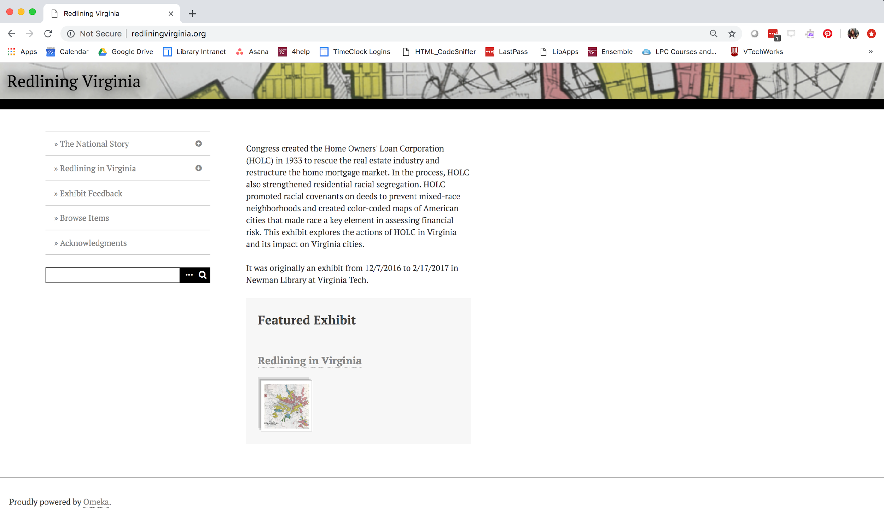
Notes:
So for example, this is a project at Virginia Tech called Redlining Virginia. It was originally a physical exhibit in our library presenting data and maps from a larger project at the University of Richmond Digital Scholarship Lab, Mapping Inequality. A professor in history, LaDale Winling who is part of that project worked with one of his classes to specifically examine maps in Virginia. After the physical exhibit, he had 2 graduate students work on compiling images and content for a digital version of the exhibit build on Omeka.

Slide 6
Medium Projects
Built on Content Management Systems or basic HTML
A little more customization / development
More hands on work
1-2 years
Notes:
For medium projects, I think of these as a step or 2 above the out-of the box tools. They may be based off of a common tool or system like Omeka or Wordpress, but have a bit more customization. These projects also tend to have more hands on work from me and my colleagues in the library. And these typically take 1-2 years to develop.

Slide 7
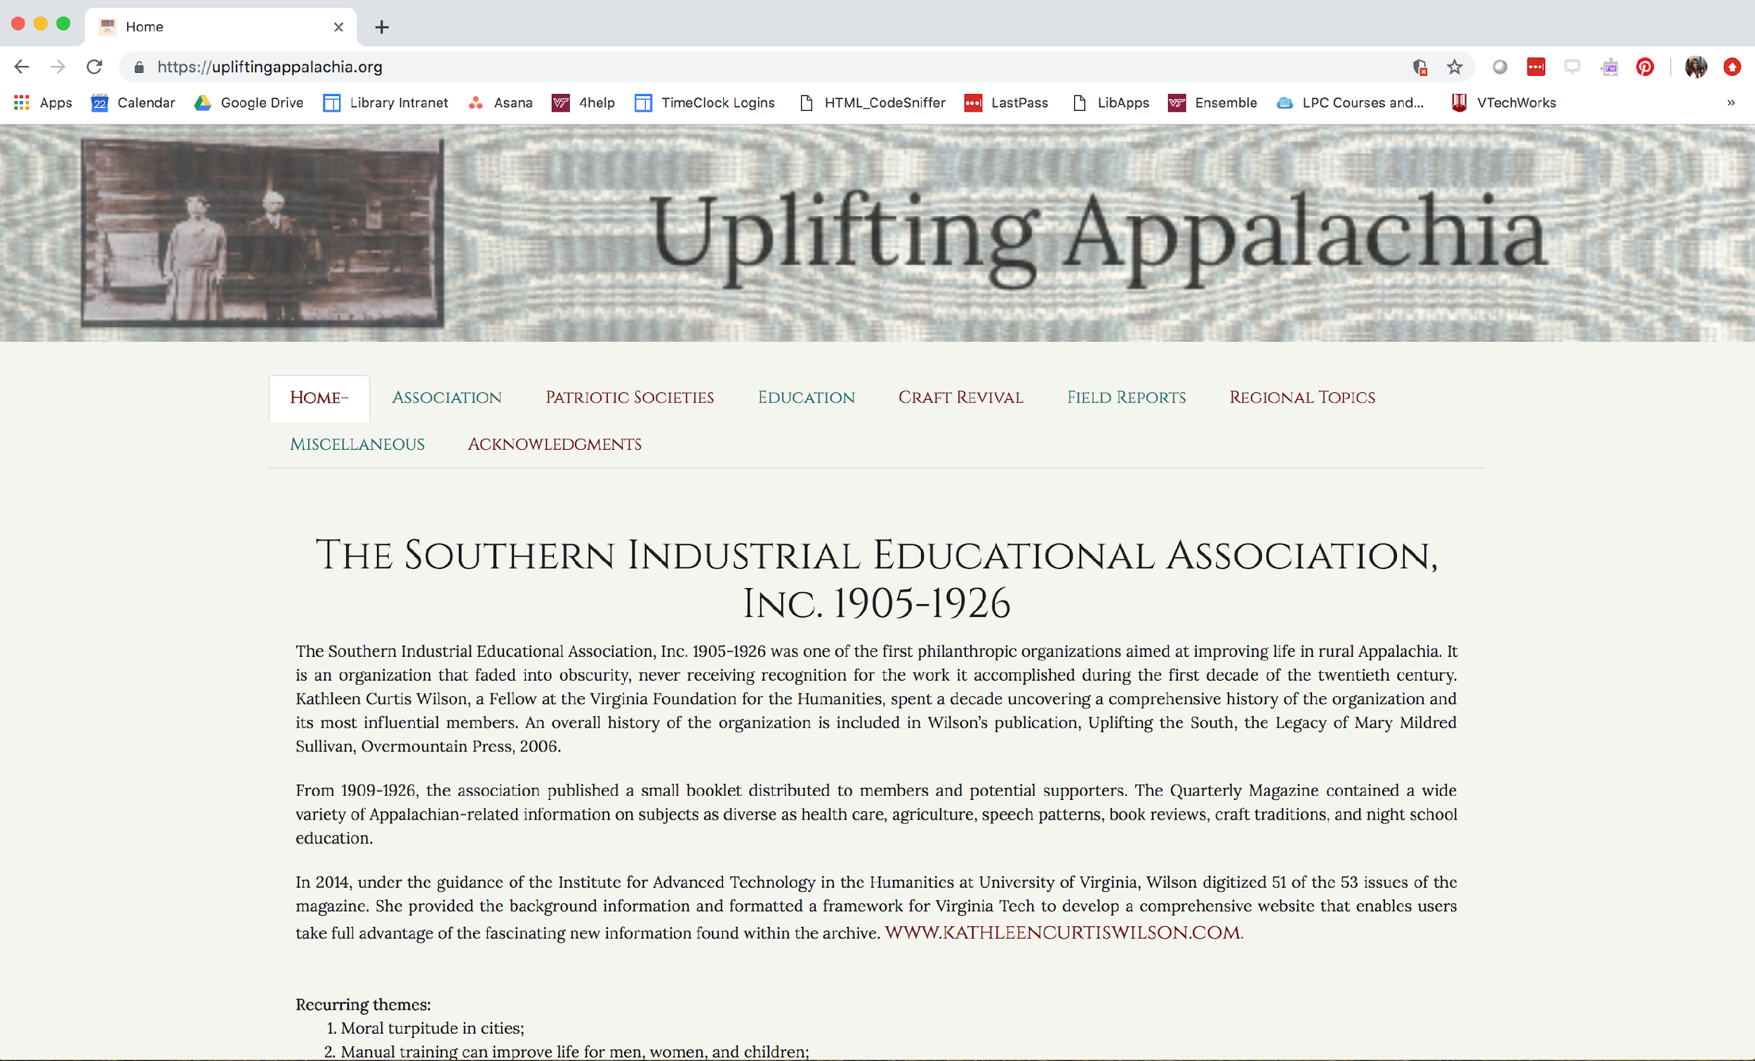
Notes:
So this is a project that is a basic HTML interface to link to materials held in VTechWorks, our institutional repository. Myself and a student employee, Chloe Kim, worked to design and develop the site based on the materials provided.

Slide 8
Large Projects
Very customized
Typically grant funded
Multi-year projects
Large amounts of data
Notes:
The large projects are where it gets really messy. They are very customized, often times developing their own platform, typically funded externally, and take multiple years to complete, and sometimes they never really feel complete. These projects generate large amounts of data in the form of text, images, and so on. And also require a lot more time to support in terms of project management, data management, sustainability, preservation, and so on.

Slide 9
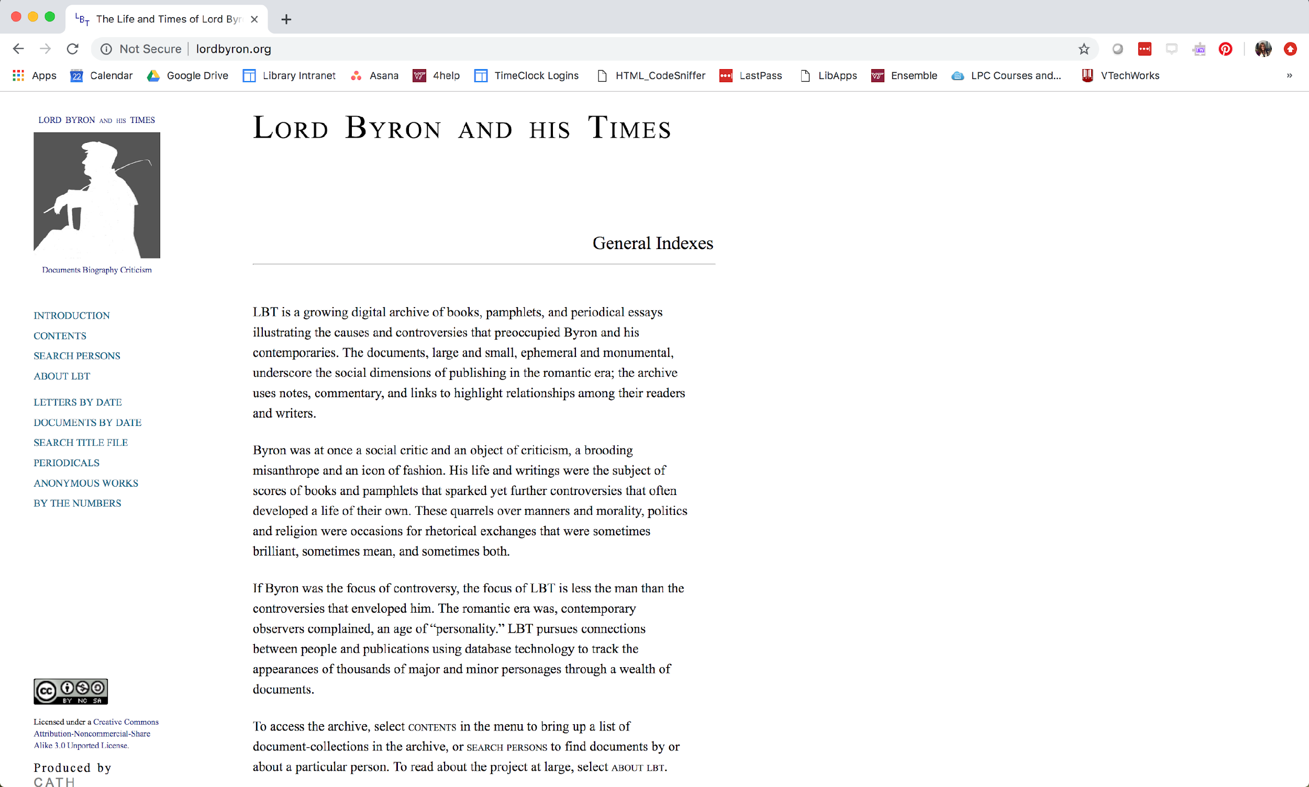
Notes:
An example of a large project at Virginia Tech is Lord Byron and his Times. This was created by David Radcliffe in our department of English and is a collection of journals and letters from Lord Byron marked up in TEI. Radcliffe has spent decades on the research related to this project and has actually spun up a new project that is the basis for the case study we will be presenting later. Additionally, several people in the library have been involved on this project in one way shape or form, from IT to data services to special collections to digital scholarship.

Slide 10
Identifying Project Components
Notes:
As you can see all of these types of projects generate different components each with their own preservation needs.

Slide 11
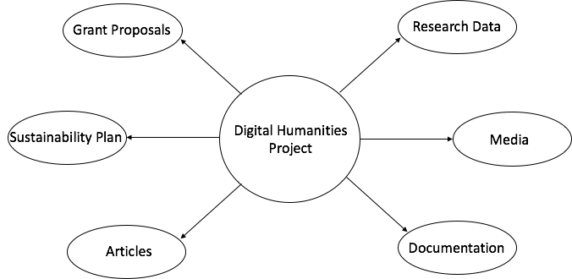
Common Components
Notes:
I tend to think of the project site being the main piece and then the different components that build that site being a very vital separate entity connected to that main site.

Slide 12
Components: What are they?
Research Data:
CSV files
XML
Text
Media:
Images
Video
Audio
Documentation:
Text
PDF
Articles:
Text
PDF
HTML
Sustainability Plan:
Text
Grant Proposals:
Text
PDF
Overall Project Website:
HTML/CSS
Other code
Look and feel of the site
Notes:
So here are some common formats that come out of these general components. Obviously there are a lot more but these are the ones I see most often, especially when we’re thinking of humanities based project that tend to focus on some form of artifact, for example literature, letters, historical items, audio, and so on, and are really text or image heavy.

Slide 13
Preservation
Notes:
Enter preservation strategies! The publishing department invited me to participate in tackling the challenge of sustaining these sorts of projects, and I will give an overview of our early planning and preservation strategies.

Slide 14
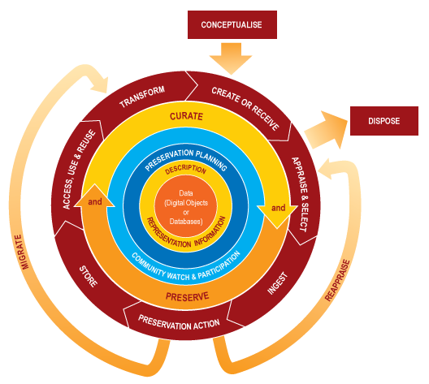
Preservation Challenges
DH projects are their own ecosystem
Require their own mini preservation system
Notes:
DH projects are their own complex ecosystem, they’re like a small repository with content, metadata, scope, technological infrastructure, and so on, and therefore they essentially require their own mini-preservation system that might deviate from a standard workflow for a traditional repository.
Image source: http://www.ijdc.net/article/download/69/48/0

Slide 15
Preservation Challenges: Broad
Technical support & funding
Various types of content to manage
File format migration
Ongoing project backups and preservation
Older projects need to be sunsetted
Hosting, management, and general ownership
Notes:
DH projects pose some fairly broad challenges to preservation. First, there’s always some issue with getting and maintaining technical support and funding, which is sometimes impossible. There might be a wider rage of content types to manage at once that are all embedded together. This lends to the issue of file format migration and how to monitor all of the content types or plan for format obsolescence overall. There also the ongoing back up and preservation of project still in-progress to consider and how that is managed. On the opposite end are the older projects that may need to be sunsetted but still need core content preserved. Finally, just sorting out who is really hosting, managing, and in so many words “owning” the project can be challenging, particularly when the project creator has ownership but the Library requires that changes be implemented for better curation and preservation.

Slide 16
Preservation Challenges: Project Types
Small
Lack of documentation, metadata
Less ongoing support
Possibly meant to be temporary
Time limitations
Medium
Limited documentation, metadata
Less ongoing support in the long-term
Time limitations
Large
Larger amounts of content
Higher content type diversity
Multiple versions
Older technologies
Too much documentation to unravel
Grant limitations
Copyright limitations
Ownership: Faculty members vs Library
Notes:
On a more granular level, there are additional challenges to consider based on the size of the project. Small and medium projects that are more short term may have a general lack of documentation or thorough metadata, less ongoing support, and can also have time limitations, like the end of a semester or a funding shortage. This is especially relevant to smaller projects that are possibly meant to be temporary and need to be preserved quickly.
Larger DH projects are their own monster, especially those that have existed for long periods of time. There’s likely to be larger amounts of content that may require additional appraisal, and possibly a higher diversity of content type to consider. Multiple versions may exist, particularly if they were built on older technologies and migrated or still existing on older technologies (and then you have the technologies to deal with). Versioning applies to any documentation as well, which can either be non-existent or be overwhelming to unravel. There might also be grant limitations on these larger projects that have certain requirements and strict timelines, and copyright limitations that prevent us from taking on a project at all.
We’ve also run into the issue of working with the faculty members who created the project and want to simultaneously pass the project off and also be hands-on and have a say in any decision-making. We’re actually experiencing this right now with a faculty member with his hands-off but actually hands-on approach to collaborating with the library.

Slide 17
Early Preservation Strategies
Preservation planning & documentation
DMP
Preservation Profile
Succession Plan (in progress)
Component-focused preservation
Evaluation of each component of a project for preservation challenges
Ongoing, regular preservation of projects segments as they are completed
Web archiving
Notes:
The way that we’re handling these challenges is through early planning. (I say early but of course some of these projects are longstanding and will be transitioned to us, rather than co-developed with Library guidance, but early planning before a transition or development in either is is important). All of these challenges need to be considered early on, even if you don’t know what the solution is or can’t make a decision yet. The first step is understanding what content you have and beginning to document. We started with a data management plan, a preservation profile to determine uniqueness and understanding of the content as well as the level of involvement the library has with it; and beginning a succession plan.
Another aspect we’re working toward is component-focused preservation, meaning that we identify and evaluate each unique component of a project for any potential preservation challenges, and prepare for each as its own entity rather than trying to tackle the big final project as a whole. This is an ongoing process and will be re-evaluated for each benchmark of the project that is completed. This is less central to this talk, but the initial and ongoing evaluations of what you’re working with can help make decisions along the way.
We also have a web archive for Virginia Tech content that is currently crawling all complete DH projects, and something we also want to implement for project benchmarks, such as crawling a Git repository of data that has just been published, which we will be implementing as soon as our first major publishing benchmark is reached.

Slide 18
Planned Preservation Strategies
Hosting projects at the Library
Test exports from common DH tools like Omeka to develop standard workflows
Develop DH-specific Levels of Preservation
Appraisal
Balance resources
Template workflow
Metadata and website-building requirements
Notes:
As we develop our DH preservation strategies beyond early planning, we’re looking to move to a deeper level of sustainability with improved hosting, tested workflows, and appraisal.
Slowly we are moving towards hosting projects at the Library. We are in discussion with IT to begin transfer the management of current DH projects that exist on a server managed by current and previous faculty members, to the library for long-term maintenance and technical support.
Further, in the next 6 months we are planning to do a test export of content from one or two of our existing DH projects, package them up, and then try to reconstruct the project. This will inform a more specific workflows for actually organizing and preserving the content.
Finally we are developing DH-specific levels of preservation to help us with appraisal, to determine what level of engagement the library is at with any given project so that we can provide resources accordingly; and to implement any metadata, digitization, and website-building requirements.

Slide 19
Documentation & Planning
Notes:
This is where we move into documentation and planning. We heard earlier today from a lot of folks on this, from Amy Rudersdorf on the importance of documentation for assessment, and from Heather Barnes on the importance of documenting decisions and copyright in documentary preservation, and just before us from the NARA crew on preservation actions plan, and also share the belief that documentation is vital to any successful preservation workflow.

Slide 20
Documentation & Planning
How do you plan documentation for new projects?
What do you do when a project comes in with no documentation?
When do you start thinking about preservation planning?
Notes:
As we move into documentation and planning, we considered what to do with our main case study here at Tech, which we’ll describe at the end, and which is both an existing project, being transitioned to a new project built on the same content. As we decided how to even take on this project we considered, How do we create new documentation, what do we do since there is little other documentation, and how soon is too soon to start thinking about preservation planning? And honestly we don’t have the end-all-be-all answer to these, but we have started trying to answer them.

Slide 21
Documentation & Planning
Project development
Planning storage and backups
Data management planning early
Succession planning
Decisions and general project documentation
Ongoing project
Preservation planning and goals for each project segment
Continue revising your DMP, succession plan
Engage with any technical support you have
Notes:
Despite my personal love for preservation documentation, not all documentation and planning is preservation-centric, but all of it will support long-term access and preservation overall. Early documentation development might occur around these areas.
Plan storage and backups early - if you don’t have somewhere to put the content and a way to back it up, there are always risks.
Same with data management planning - you need to know what content you’re working with before you can decide what preservation actions are ideal.
Succession planning at this stage might sound early, but doesn’t need to be complete at the beginning of the project, and it’s useful to have a plan in place for if the project isn’t successful, or if it is only partially completed.
Once the project starts and gets going and you have an idea of what kind of content there is, you can start thinking about preservation planning and developing preservation goals for each project segment. You’ll be constantly updating your DMP and succession planning as the project evolves. This is also the point where you might want to engage any technical support you have to discuss the viability of your preservation goals, and any additional resources.

Slide 22
Why is this important?
Understand your content
Communication with stakeholders/project managers on roles, time commitments
Grant requirements
Review past decisions and maintain continuity
Ability to accurately reconstruct or repair a project later
Notes:
These early decisions and early documentation and planning are essential to a successful, preservable DH project. On a basic level, the documentation improves the understanding of the content and the goal of the project. There’s a need to communicate with stakeholders, project managers, and your library that can be conveyed through reports and documentation. This also extends to grant requirements that can be met with things like the DMP or technical plans.
Further, maintaining continuity as projects pass hands is an issue we all have faced, and at least having some sense of what happened can help that transition.
Finally, and most relevant to preservation in the long-term, is that having documented the purpose, scope, and goal of a project enables you to accurately repair or reconstruct a project and maintain the integrity of the original.

Slide 23
Case Study
Notes:
As I mentioned earlier, we do have a case study built off of the Lord Byron and his Times project.

Slide 24
Social Networks in Georgian Britain
Built from previous project, Lord Byron and his Times (lordbyron.org)
30,000 individual records collected over the past couple of decades
Ultimate Goal: Build an interactive social network that will allow users explore the data in both its raw XML format as well as through visualizations in a user interface
Short term Goal: Publish the raw XML files in a public Git Repository
Notes:
As Radcliffe marked up the text in TEI he also created records of individual people referenced within the text. After that he began collecting records from other people from that time and now has roughly 30,000 records collected over the past couple of decades. This will ultimately build an interactive social network that will allow users to explore the data in both its raw XML/TEI format as well as through a searchable interface with visualizations. Currently, we are aiming to clean and organized the raw data and then publish it in a public Git Repository.

Slide 25
Social Networks in Georgian Britain
XML data
Schemas
ReadMe files
Grant proposal
Data Management Plan
Documentation
Preservation/Sustainability Plan
Succession Plan
Visualizations
Final Website
Archived Site
Notes:
With that the pieces we’ve generated especially where documentation is important are mainly with the raw data and long term planning. We currently have a data management plan and an early preservation plan that will further develop over time. We are in the process of documenting the schema and controlled vocabularies used with the data and also creating ReadMe files to explain how to use the data within the git repository.

Slide 26
Social Networks in Georgian Britain
Documentation and early planning has lead to:
Developing a standard schema that has revealed errors within data
Eased the grant writing / fundraising process
Ease decision making and conversations with faculty
Choosing a platform that allows for public access to data and documentation
Notes:
Through incorporating documentation in the early planning phases we have been able to identify pieces of the data that are out of place or may not follow the schema or controlled vocabulary. The early data management plan and preservation plan have eased the grant writing process, since we were able to adapt our existing plans to fit the specific grant requirements. We have also found that by creating this documentation early and planning for preservation of the different project components we’ve been able to ease the decision making process in regards to what and how long we can preserve things. Additionally, by making the documentation a key aspect of this project we’ve made the decision to choose platforms that allow us share that documentation publicly alongside the content of the project.

Slide 27
Questions?
Corinne Guimont gcorinne@vt.edu
Alex Kinnaman alexk93@vt.edu

