Slide 1
Intelligent QA/Chatbot for Transportation
Ethan Do, Aneesh Sunkarapalli, Rami Ghaleb, Neil Akalwadi, Aarush Patil
Group: 11
CS4624
Mohammed Farag
Virginia Tech, Blacksburg VA 24061
4/1/2025

Slide 2
Presentation Outline
3 - Problem
4 - Motivation
5 - Project Description
6 - Requirements/Deliverables/Features
7 - Approach/Plan
8-9 - System Architecture Diagram
10 - Technologies and Frameworks
11-12 - Backend
13-17 - Frontend
18 - Database
19 - Docker Containerization
20 - User Manual
21 - Developer Manual
22 - Challenges We Faced
23 - Improvement/Next Steps
24 - Timelines and Milestones
25 - Roles
26 - Client
27 - References

Slide 3
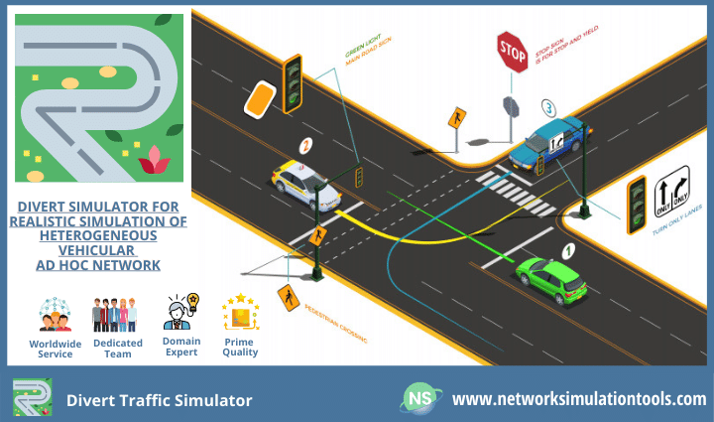
Problem
Traffic engineers struggle with having to read through long and confusing manuals to learn how to effectively run traffic simulations.
Looking for a specific detail in traffic simulations from a paper manual will be highly time consuming and inefficient.
Engineers may have personal difficulties that cannot be easily solved through a standard manual.
Following a question, there may be additional questions that arise related to the previous queries.

Slide 4

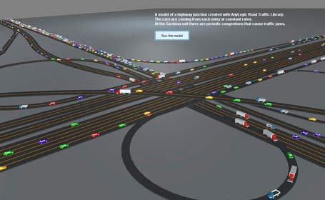
Motivation
Our team wants to make a change and improve efficiency for traffic engineers.
We want to allow a personalized experience for traffic engineers to get help catered to their needs.
We’d like to enhance workflow by being able to have follow up questions.
Create an accessible and convenient experience for traffic engineers.

Slide 5
Project Description
We are building a web application-based QA (question-answering) chatbot that assists traffic engineers in understanding how to run traffic simulations
Utilizes Large language models (LLMs) and Retrieval-augmented generation (RAG) loaded with traffic simulation manual data to generate responses within the context of the user-requested question by extracting related information from the data and providing assistance on running a simulation
The homepage of the web app contains collections, essentially chat logs, collections are stored, allowing users to look at their chat history and revisit previous conversations with maintained context (such as a specific network)
Users require login authentication in order to access their profile on the web app

Slide 6
Requirements
Deliverables
Features
Build a chatbot that assists traffic engineers
Create a pipeline for a full chatbot flow, including prompts, retrievers, and LLM models
Implement retrieval-augmented generation using LangChain and an open-source LLM
A full-stack web application for users to run the QA/Charbot, complete with the following features:
  Responsive web UI
  Hosted application on a dedicated web server
  User authentication to store conversation history
Use ChromaDB to chunk, vectorize, and store data efficiently for the LLM
Implement memory modules to allow follow ups/conversation

Slide 7
Approach/Plan
To ensure smooth progress, we will utilize an iterative process while implementing our project.
Integrate LangChain with ChromaDB to retrieve data from the manuals
Determine the most efficient LLM for our use case
Build our backend to handle API requests for prompts
Design a user-friendly UI for users to input questions
Include authentication to save user information
Add a memory module to store conversations and allow continuous conversations

Slide 8
Diagram for system architecture/design

Slide 9
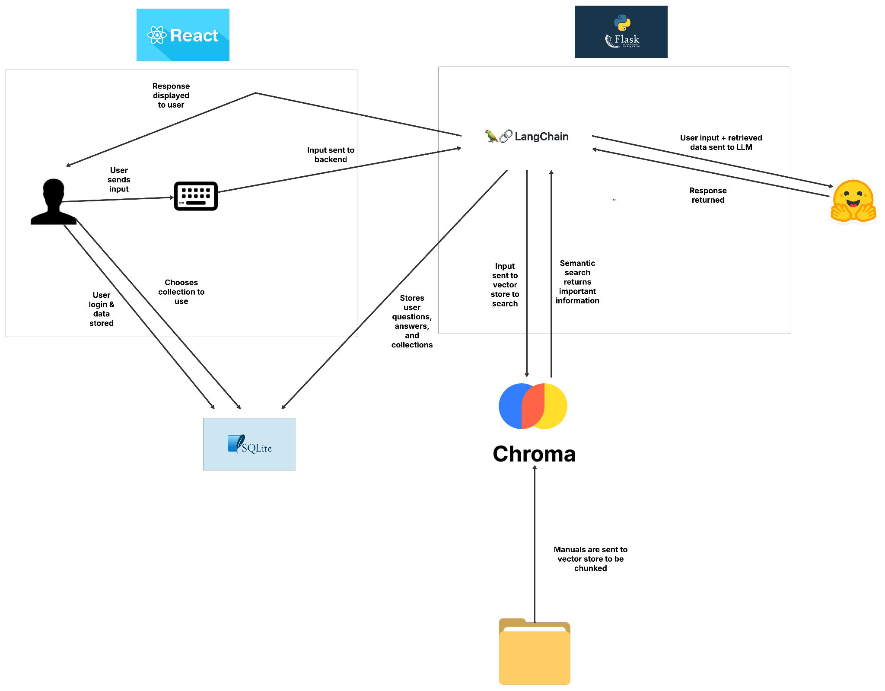

Slide 10


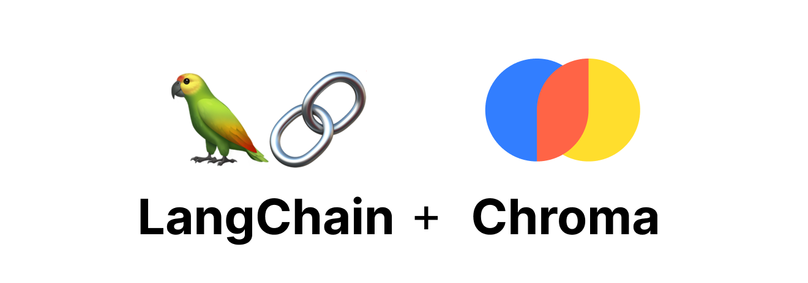


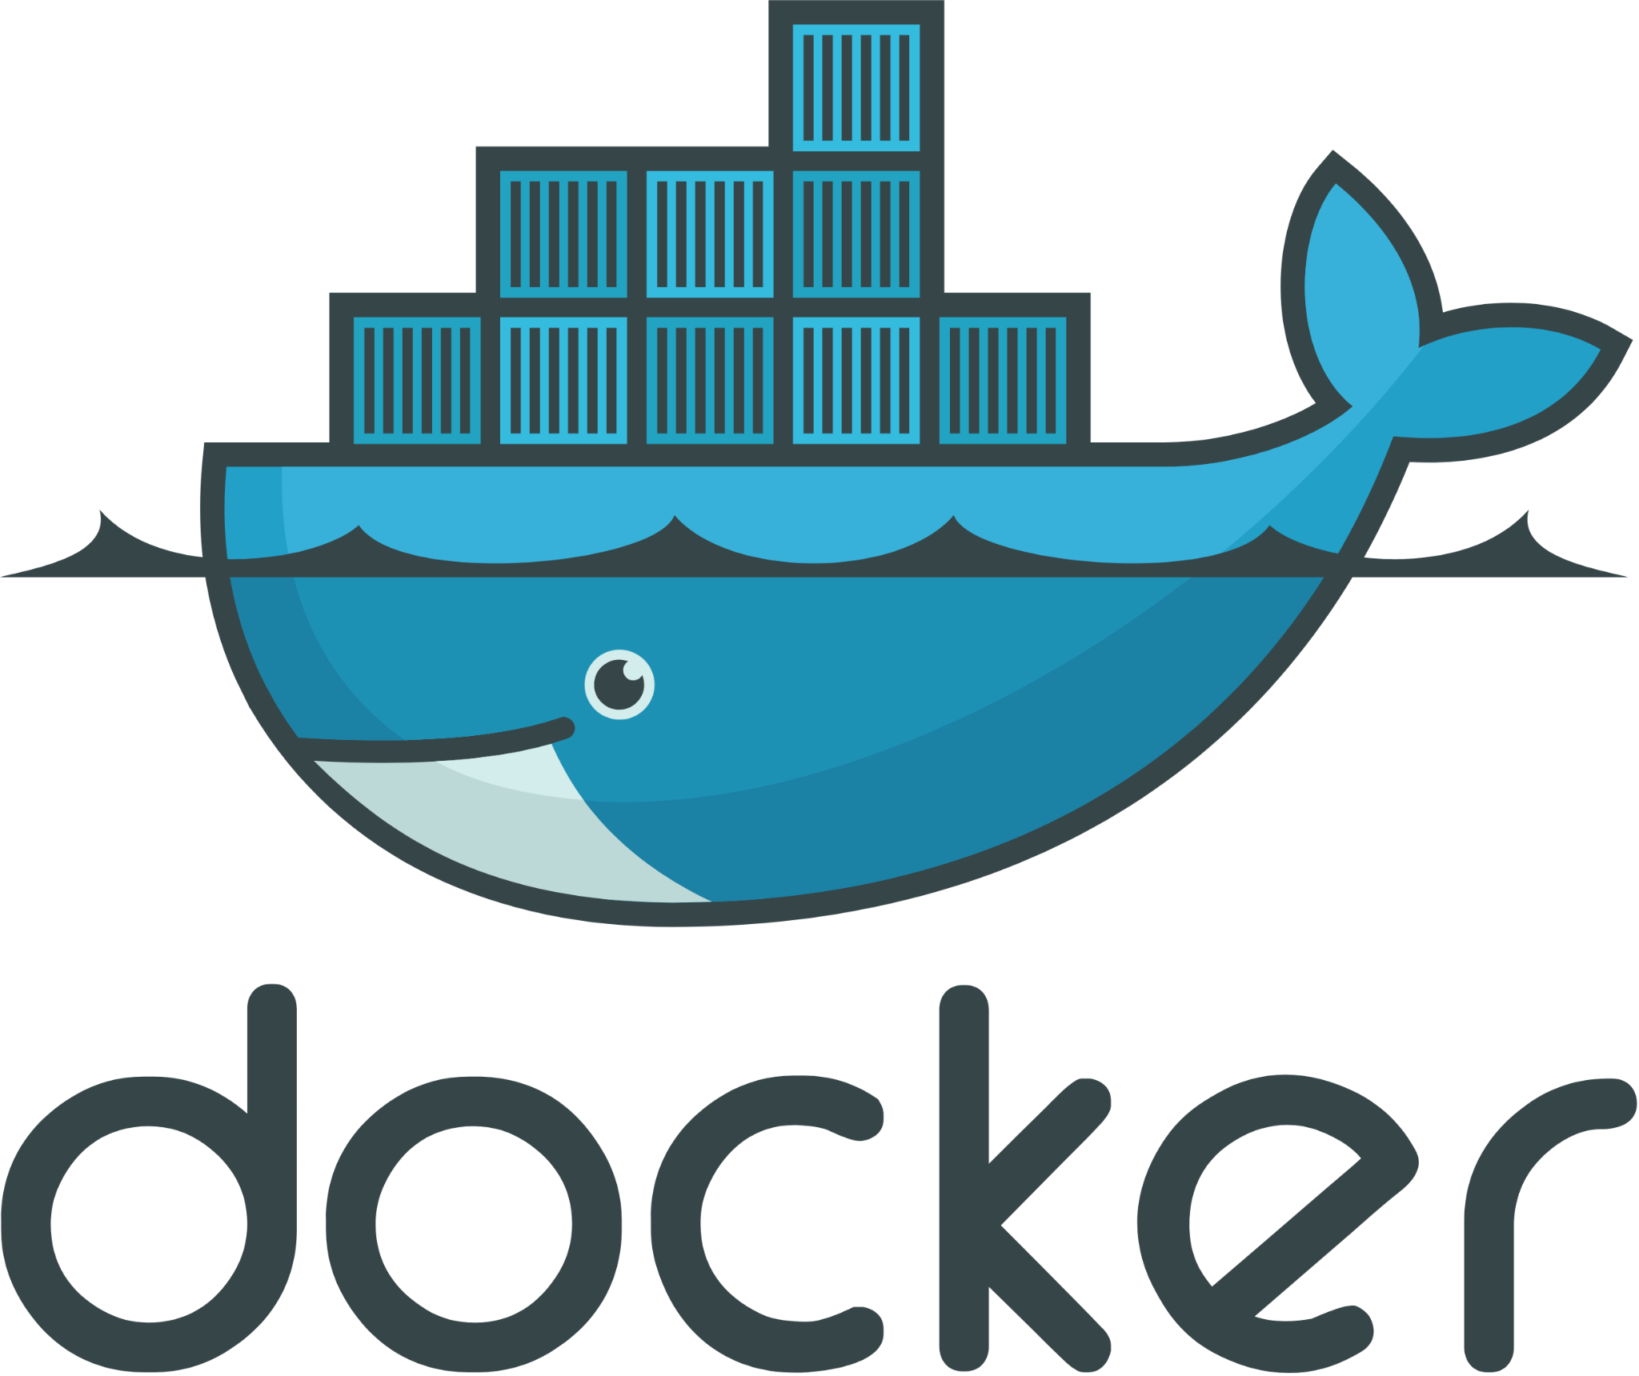

Technologies and Frameworks
Frontend: React, Tailwind CSS
Backend:
  Flask: For API and managing communication between frontend, database and LLM
  ChromaDB: Store the manuals into chunks, and retrieve relevant chunks efficiently.
  SQLite: Store user credentials and past conversation context.
  LangChain: Integrates ChromaDB’s relevant manual chunks, past conversation context from MongoDB with the LLM.
  Hugging Face Models: Find a good model from hugging face to answer user questions.
Development & Testing Tools:
  Google Colab: Test different LLMs
  Postman: Testing backend APIs
  Docker: Containerize the application for easier deployment
Notes:
Aarush
Slide 5: Technologies, Languages, and Frameworks
Backend: Flask
Lightweight and flexible Python web framework, ideal for handling API requests.
Manages communication between the frontend, database, and LLM.
Handles authentication using JWT tokens for secure user sessions.
Frontend: React
JavaScript library for building interactive and dynamic UI components.
Ensures a seamless user experience when interacting with the chatbot.
Manages user authentication and chat history display.
Additional Tools:
Tailwind CSS or Material UI for modern UI components.
Redux Toolkit for state management if needed.
Database: MySQL
Stores user credentials, authentication tokens, and chat logs.
Ensures persistent user sessions and access to past conversations.
Manages structured data efficiently with relational schema design.
Vector Database: ChromaDB
Stores document embeddings to enable efficient semantic search.
Retrieves the most relevant chunks of information based on user queries.
Ensures high-speed retrieval and scalable storage of domain-specific documents.
LLM Integration: LangChain + Hugging Face Models
LangChain: Provides abstraction layers to integrate vector databases, memory, and LLM pipelines.
Hugging Face Transformers: Hosts various open-source LLMs (e.g., Llama, Mistral, Zephyr) that can be fine-tuned for QA tasks.
Facilitates prompt engineering and retrieval-augmented generation (RAG).
Allows loading models locally with LlamaCpp for efficiency.
Authentication & User Management
JWT (JSON Web Tokens): Used for secure user authentication and session management.
Users can log in, maintain chat history, and access past interactions.
Ensures private and persistent conversations.
Development & Testing Tools
Google Colab: Used for prototyping and testing different LLMs before deploying.
Postman: Useful for testing backend APIs and ensuring proper data flow.
Docker: Can be used for containerized deployment of the application.

Slide 11
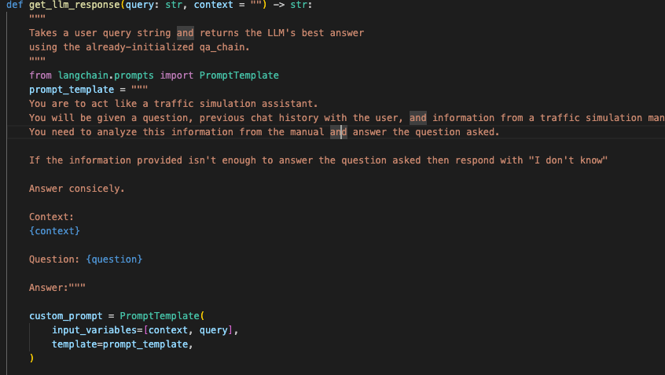
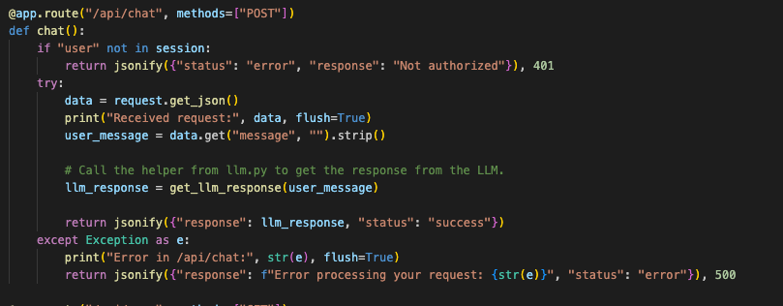
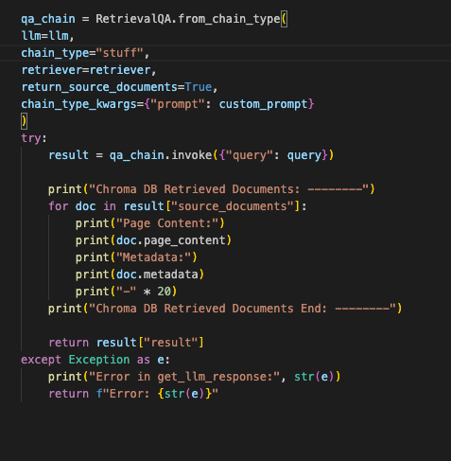
Backend(LLM)
Take query and information from ChromaDB and get response from LLM
API Endpoint to query a response
Send user query into ChromaDB vector storage to get relevant information

Slide 12
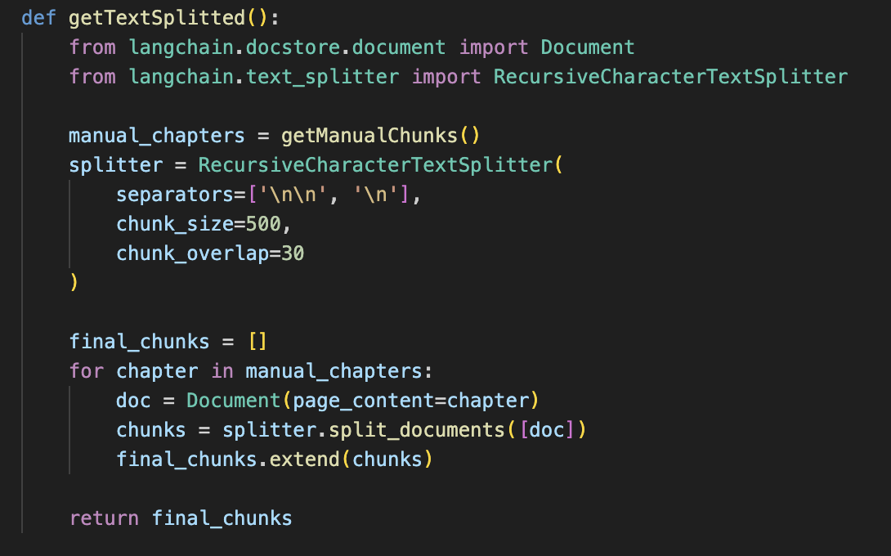
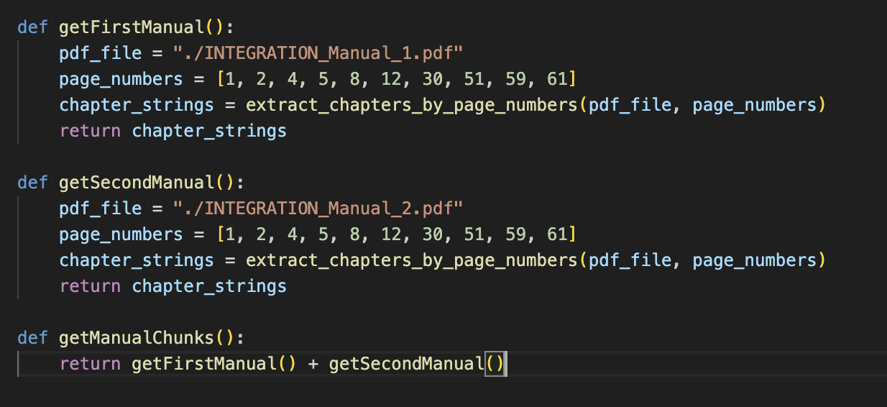
Backend(Chapter Chunking)
Further Chunking Within Chapters
Chunking The Manuals By Chapter

Slide 13
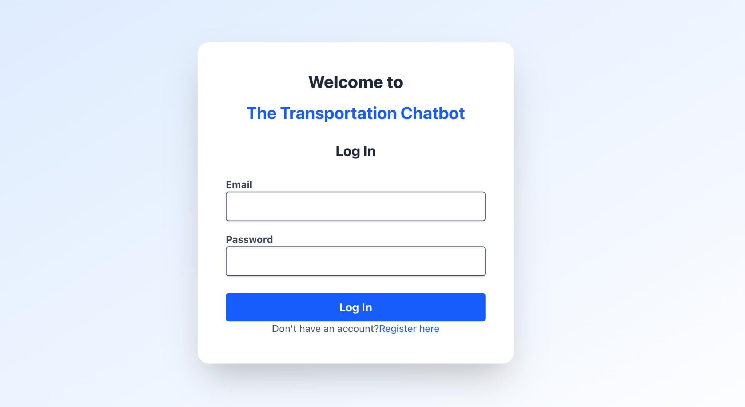
Frontend

Slide 14
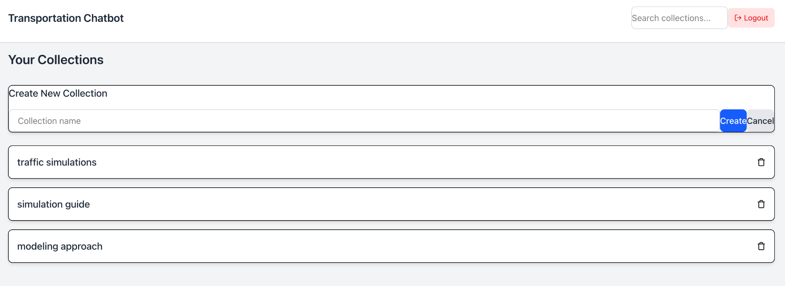
Frontend

Slide 15
Frontend
Search Collections
Logout
Create New Collection
Existing Collections

Slide 16
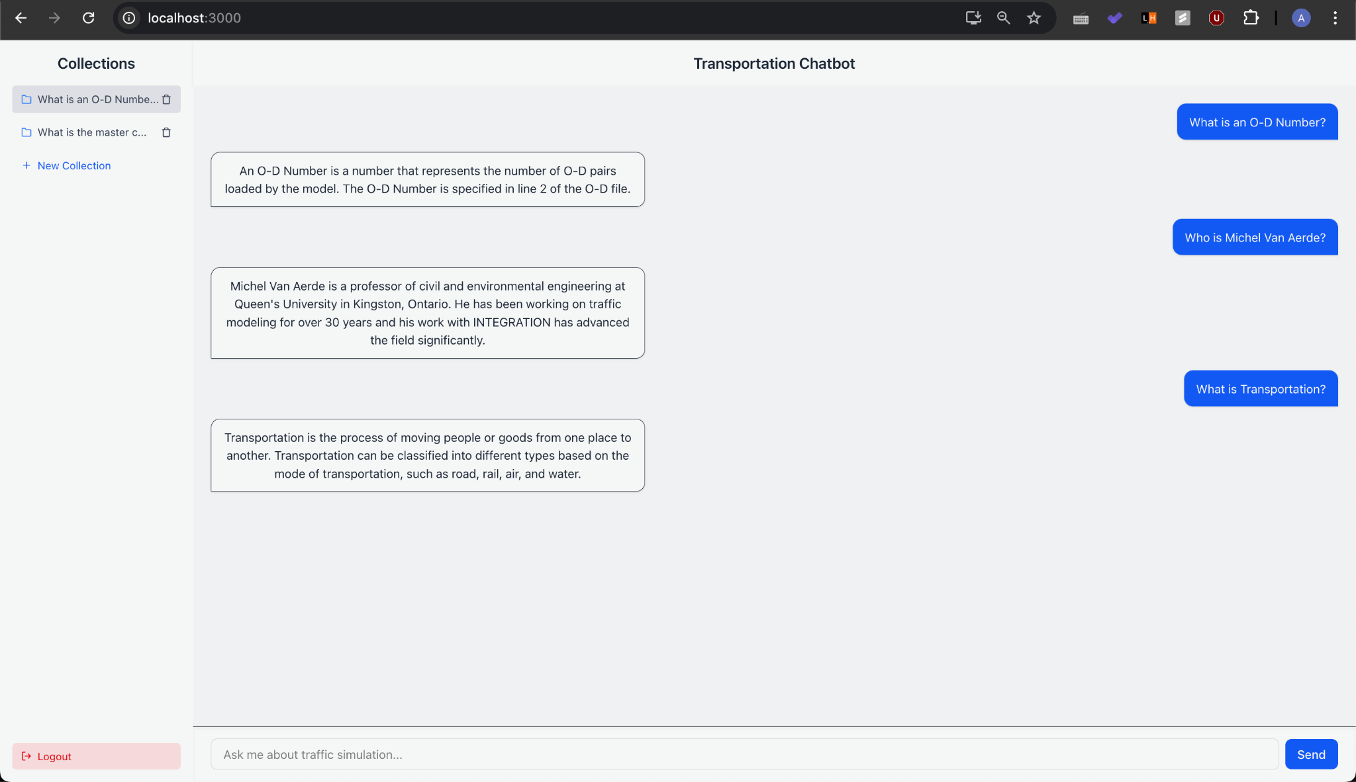
Frontend

Slide 17
Frontend
User collections
Conversation with chatbot
Users can submit questions
Logout functionality

Slide 18
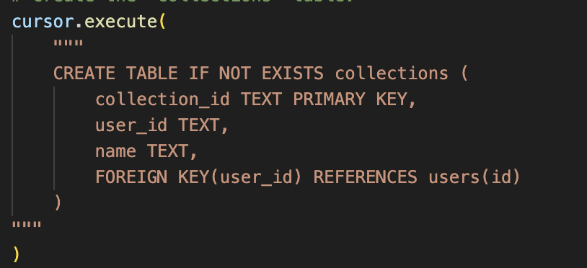
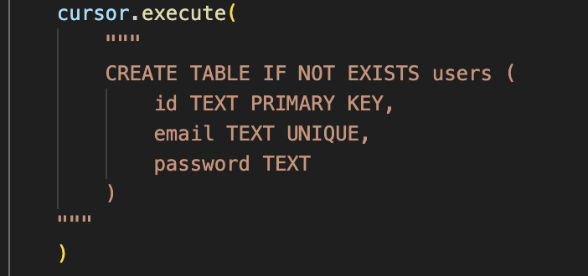
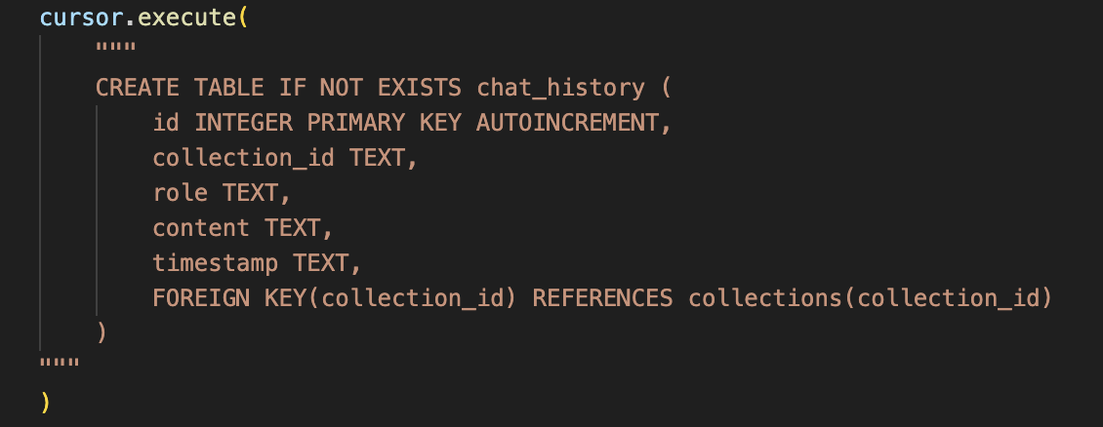
Database
Collections Table
Users Table
Chat History Table

Slide 19
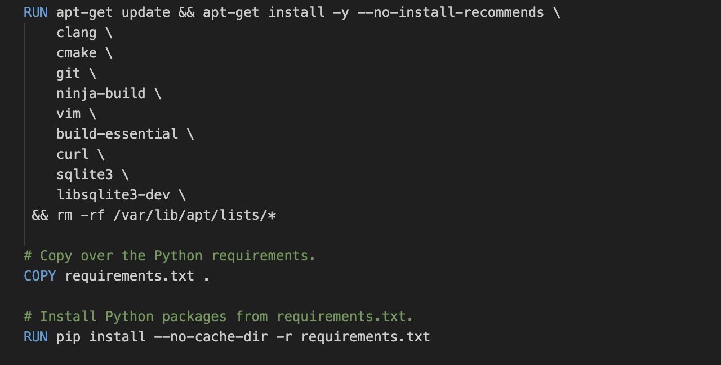
Docker Containerization
Single docker file for both the backend and frontend

Slide 20
User Manual
Navigate to the URL of the project
Create an account using email and password
Upon account creation the user will automatically be logged in
Create a new collection by clicking the “new collection” button on the top right
Enter a collection by clicking on the corresponding box
Ask the chatbot any questions regarding traffic simulations!

Slide 21
Developer Manual
Clone the repository at https://github.com/aarushpatil/Capstone
Build a docker image for the project (docker build -t chatbot ./)
Run both the backend and frontend servers
Frontend: docker run -p 3000:3000 -v $(pwd):/app -it chatbot /bin/bash
cd frontend
npm install
npm run start
Backend: docker run -p 5050:5050 -v $(pwd):/app -it chatbot /bin/bash
cd backend
Python main.py

Slide 22
Challenges We Faced
Chunking Data:
Effectively chunking data by chapter to ensure accurate and in-depth responses
Formatting information such as tables and charts
RAG Pipeline:
Difficulty creating our ChromaDB and LangChain pipeline
After running on Google Colab, there were issues in being able to run the LLMs locally due to dependency issues.
Optimizing speed and accuracy of our model responses
Full-Stack Integration:
Connecting our backend to our frontend via API endpoints

Slide 23
Improvements/Next Steps
Improve Response Accuracy:
Evaluate various LLMs (Llama, Mistral, Zephyr, etc.) to determine the most optimal choice
Fine-tune prompt template with more in depth context for better results
Chunk data by chapters rather than fixed-sized
Speed Up Query Time:
Utilize quantized models to reduce latency
Optimize ChromaDB for quicker indexing

Slide 24
Timeline and milestones
Milestone 1:
  Gather project requirements, research NLP tools and RAG frameworks, and create an initial presentation
  Set up a basic LLM test in Google Colab to validate the planned workflow
Milestone 2:
  Process and chunk data for efficient retrieval, choose an embedding model, and implement ChromaDB as a vector store
  Run initial tests to evaluate the retriever’s performance
Milestone 3:
  Select the best-performing Hugging Face LLM through comparative testing
  Integrate the model into a LangChain pipeline with ChromaDB retrieval
  Build the full RAG pipeline to generate responses from user queries
Milestone 4:
  Develop a SQLite backend to store and retrieve user chat history
  Create a React-based frontend with chat and session management
  Conduct user testing to improve interface usability and navigation
Milestone 5:
  Containerize the full stack with Docker and prepare for deployment
  Run system-wide tests for backend, frontend, and overall chatbot performance
  Conduct user testing to improve interface usability and navigation
  Analyze test results and deploy final build
  Prepare final documentation and demo materials for project delivery

Slide 25





Roles, who is doing what
Aneesh:
Implementation, Frontend
Ethan: LangChain/LLM/Database
Neil:
Implementation, Backend/API
Rami:
Implementation, Frontend
Aarush:
Implementation, Backend/LLM

Slide 26

Client
Dr. Farag
Ph.D. in computer science from Virginia Tech
Research Associate for The Center for Sustainable Mobility
Interests include intelligent transportation systems, connected/automated vehicles, C-V2X, machine learning, large-scale data analysis, large-scale system analysis and design, big data, and information retrieval

Slide 27
References
https://colab.research.google.com/drive/1Zs70RvMVBnn4VFUfS-Rst4dG0fojnEaT(Yusuf Elnady)
Dr. Farag

