Slide 1
Stock Trading with Microblog Sentiments
Authors: Joseph Watts, Nick Anderson, Joseph Mehr, Connor Asbill
Client: Saurabh Chakravarty
Professor: Edward Fox
Virginia Tech - Blacksburg, VA 24061
CS 4624: Multimedia, Hypertext, and Information Access, Spring 2017
May 2, 2017
Notes:
More descriptive metadata

Slide 2
Project Overview / Goal
Implement multiple trading strategies
Maximize profit over the course of one year
Data sources:
Stock Twits (Tweets) | Provided
Yahoo/Google Finance (Daily stock price data) | Found
Wharton Research Center Data Services (Intraday stock price data) | Found
Notes:
Break first bullet up to make faster to read
Make three bullets into a table (found, collected, etc.)
Maybe make this the purpose silde

Slide 3
Trading Simulation Software
Computes buy/sell based on sentiment/strategy
Returns positive or negative sentiment value
Written in Scala
Sentiment Analysis
Trading Strategy
Virtual Portfolio
Stock Twits
Stock Prices
From Yahoo/Google Finance
Uses Hadoop/HBase
Notes:
Can almost be taken out and shown in diagram

Slide 4
Plan
We chose 11 stocks to watch:
  AAPL, FB, GILD, KNDI, MNKD, NQ, PLUG, QQQ, SPY, TSLA, VRNG
Set up the following strategies:
  Baseline
  S&P 500 (buy and hold the S&P 500 index)
  Moving Average
  Moving Average with Sentiment
  Selection by Sentiment (One Stock): n = 1
  Selection by Sentiment: n = 3
  Selection by Sentiment (All Stocks): n = 11
Notes:
Put the list of 11 earlier

Slide 5
Trading Strategies
Strategy | Stocks/Portfolio | Decision-Making
CrowdIQ Strategy | 1 portfolio for each 11 stocks | Based on bullish/bearish sentiment
Moving Average | 1 portfolio for each 11 stocks | Based on 5 and 10 day price trends.
Moving Average with Sentiment | 1 portfolio for each 11 stocks | Based on 5 and 10 day price trends and sentiment
Selection by Sentiment | 1 portfolio shared by 11 stocks | Based on bullish/bearish sentiment
Buy and Hold | Only uses 1 Stock S&P 500 | Control: buys once at start then hold for entire year.

Slide 6
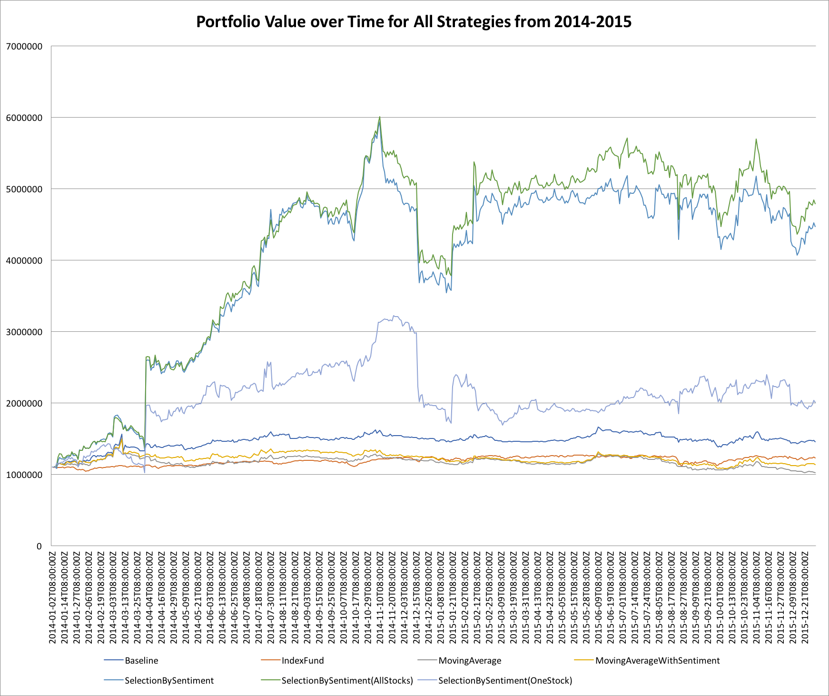
$7 million
$6 million
$5 million
SelectionBySentiment(AllStocks)
SelectionBySentiment
$4 million
$3 million
$2 million
SelectionBySentiment(OneStock)
Baseline
IndexFund
$1 million
MovingAverageWithSentiment
MovingAverage
Jan
Feb
Mar
Apr
May
Jun
Dec
Jul
Jan
Feb
Mar
Apr
May
Jun
Dec
Aug
Sep
Oct
Nov
Jul
Aug
Sep
Oct
Nov

Slide 7
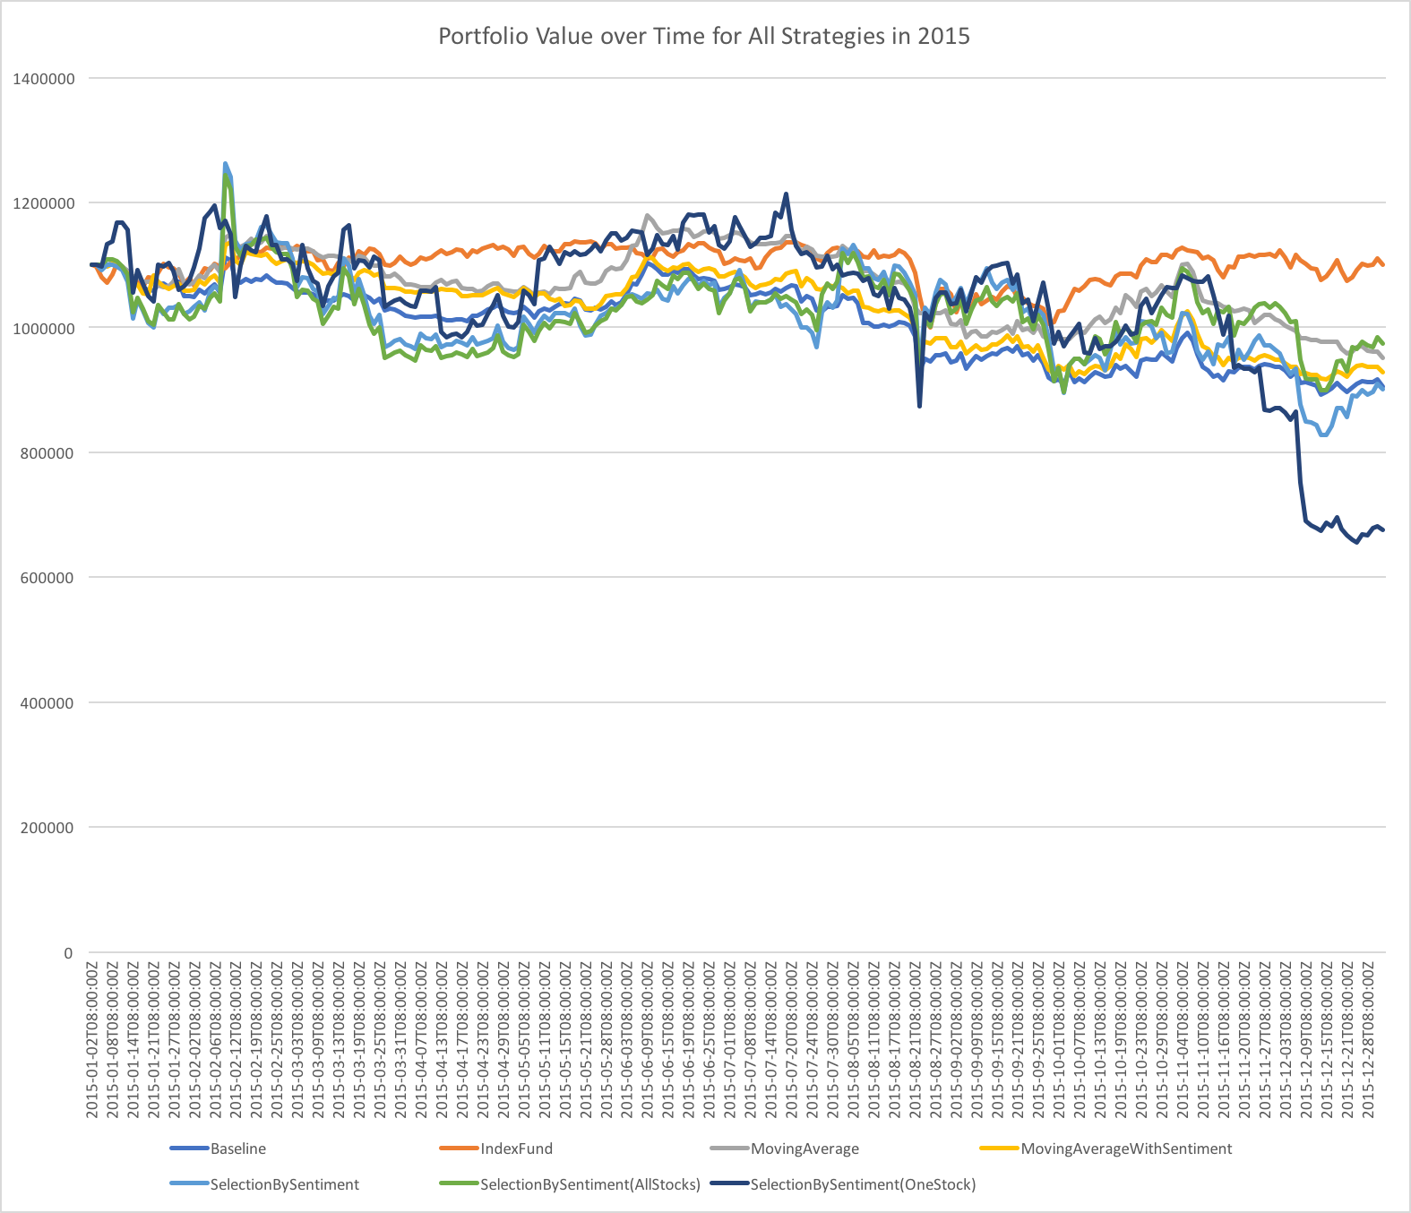
$1.4 million
$1.2 million
IndexFund
$1 million
SelectionBySentiment(AllStocks)
MovingAverage
MovingAverageWithSentiment
Baseline
$800,000
SelectionBySentiment
SelectionBySentiment(OneStock)
$600,000
$400,000
$200,000
Jan
Feb
Mar
Apr
May
Jun
Dec
Jul
Aug
Sep
Oct
Nov

Slide 8
Issues
2014-01-06T09:42:00Z VRNG 3.15
2014-01-06T09:43:00Z VRNG 3.12
2014-01-06T09:44:00Z VRNG 3.11
2014-01-06T09:45:00Z VRNG 3.11
2014-01-06T09:46:00Z VRNG 3.12
2014-01-06T09:47:00Z VRNG 1.09
2014-01-06T09:48:00Z VRNG 3.11
2014-01-06T09:49:00Z VRNG 3.13
2014-01-06T09:50:00Z VRNG 3.13
Unreliable data caused our day trading strategies to perform unreasonably well, so those results have been omitted.

Slide 9
Future work
Use accurate source of high-resolution bid/ask quotes for day trading
Obtain data for 2013 and 2016, testing on each
  Will help to explain the difference between our 2014 and 2015 results
Test with live data (and integration with real trading platforms)
Implement slippage models in simulation software which factor in trading volume
More robust sentiment analysis with advanced text normalization techniques
Experimentation with Machine Learning-based strategies that factor in more than just aggregated sentiment

Slide 10
Acknowledgements
Saurabh Chakravarty
  Client
  saurabc@vt.edu
Eric Williamson
  Created sentiment analysis
  ericrw96@vt.edu
Dr. Weiguo Fan
  StockTwits Data
  wfan@vt.edu

