Slide 1
VTechWorks Video Accessibility
Client: Keith Gilbertson
Cassidy Heath, Tucker Legard, Edna Morales,
Bradley Retterer, Michael Supanich
CS 4264, Virginia Tech, Blacksburg, VA
5/6/2014

Slide 2
Project Description
VTechWorks and Event Capture Group
  Video accessibility
  Transcription and captioning
  Full-text searchable
Manual and software transcription
Transcription assistance

Slide 3
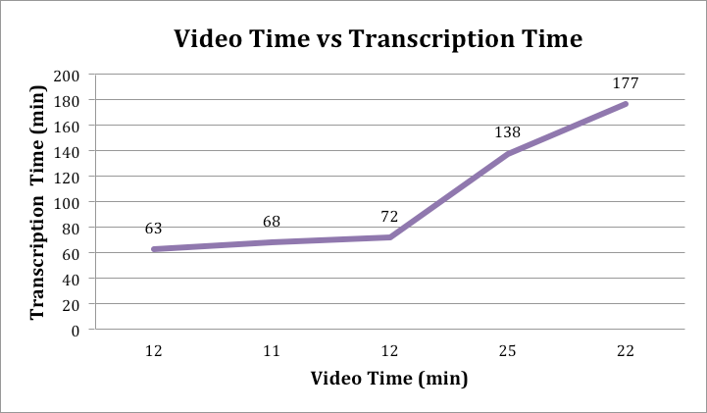
Manual Transcription Findings

Slide 4








System: Details

Slide 5
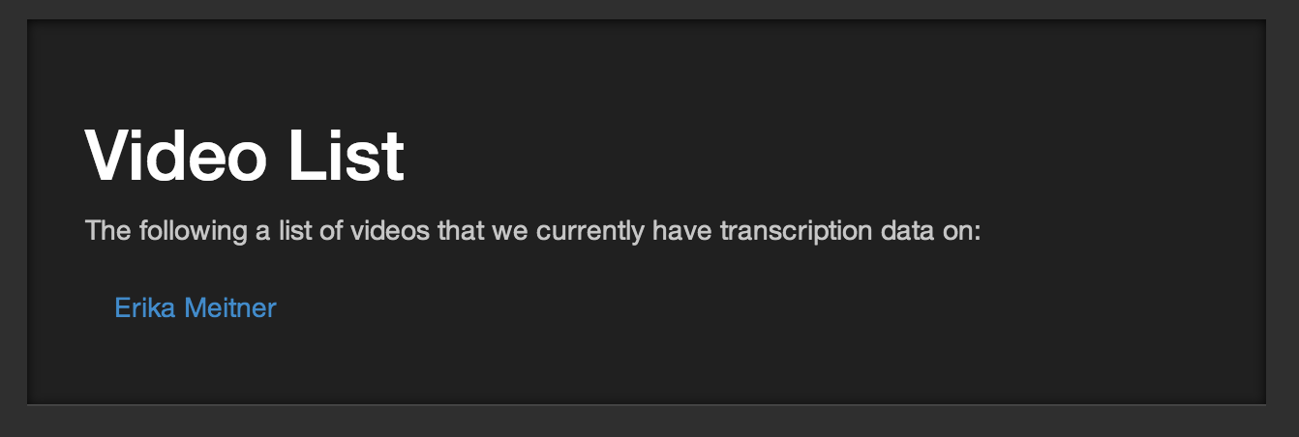
System: Interaction

Slide 6
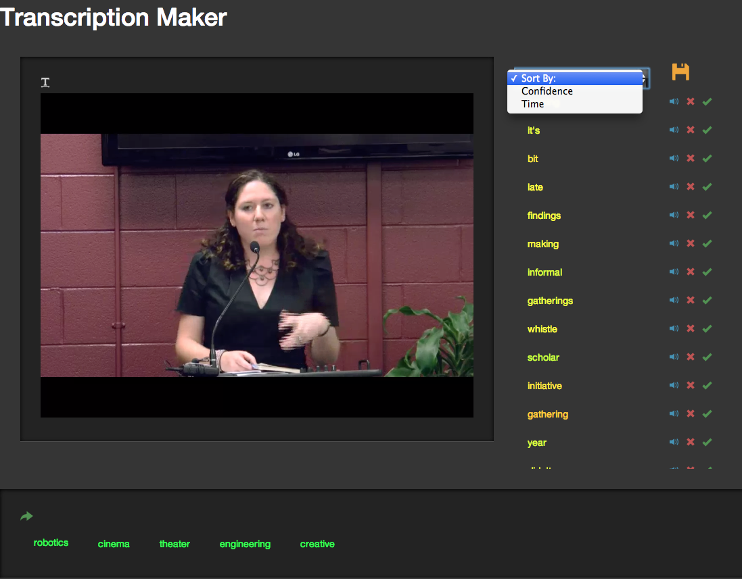
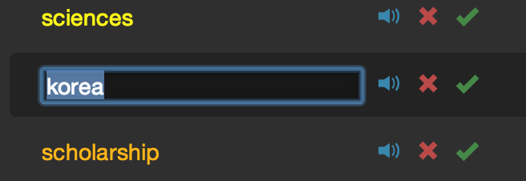

System: Interaction

Slide 7
Lessons Learned
Research and ideation process is iterative
Automatic transcription is hard
  English is ambiguous
Manual transcription is tedious
  Often quite frustrating as well
Complete transcription is unnecessary
  Keywords suffice for project scope

Slide 8
Questions?

