Slide 1

Virginia Cooperative Extension
Smart Money
Management
Extension is a joint program of Virginia Tech, Virginia State University, the U.S. Department of Agriculture, and state and local governments.
Virginia Cooperative Extension programs and employment are open to all, regardless of race, color, national origin, sex, religion, age, disability, political beliefs, sexual orientation, or marital or family status. Equal Opportunity Employer.
Financial Education for Adults 2018
1
Notes:
Introduce yourself to the your class. Welcome the participants.
Call on them by Name (nameplates optional)
Encourage students to ask questions and offer words of wisdom.
Acknowledge that it is not possible to fully address every aspect of financial management within the allotted time.
We will only be scratching the surface.

Slide 2

Smart Money Management
Preparing for the future
Protecting against risks
Using credit wisely
Defining your goals
Creating an Action Plan
Managing debt
Achieving Savings
Connecting to Resources
Using Financial Tools
Developing financial decision making skills
Financial management principals and tools to empower and improve your financial decision making
Developed By
Master Financial Educators
Ken Savage, Joe Botta,
Tom Cronauer,
&
Victoria Neeley, Program Manager
Updated July 2018
2
Notes:
4
4
What is SMM?
It is more than balancing the checkbook
It is all about a mindset that enables us to live well within our means.
It is about anticipating future needs and taking steps to prepare for them.
It is about reducing risks that could damage or destroy our financial well-being.
It is about not taking on more debt than we can expect to repay in a timely manner.
And it is about learning to use credit wisely.
Tonight we are going to look at Smart Money Management in some detail.
Our goal is to provide you tools to help you make the best possible use of your financial resources
Its an on-going process of learning and applying methods to make better financial decisions for your financial situation.

Slide 3


Financial Future
You Control your Financial Future
Evaluate
Plan Spending
Determine Expenses
Determine Income
Find Net Worth
Identify Resources
Adjust
Set Goals
Get Organized
Follow these 8 steps to manage spending
Notes:
Would you like to have more control of your money?
Are you finding your income is not covering your living expenses?
Have you needed to borrow money or use savings or retirement to meet regular monthly expenses?
Reaching your financial goals will require careful planning. Like making a list before heading to the grocery store – then sticking to the list.
It will take focusing on self-discipline and the ability to say no to unplanned spending.
The ability to manage money is something you will want to practice on a daily basis.
There are eight (8) steps to successful money management that we will be discussing tonight
The final step is to Evaluate where you are and Adjust what you are doing.

Slide 4
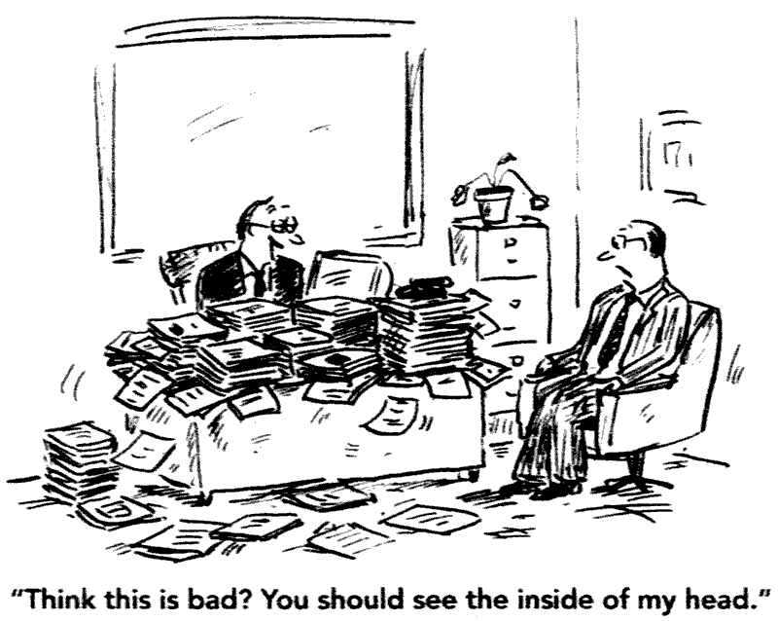

Get Organized
Set up an ‘office’ to take care of financial business.
Keep only the records you need.
Keep your tax records in one place.
Create an organization system for your files.
Safeguard your permanent records.
1
Notes:
INTERACTIVE – Handout 1 Personal and Financial Records
The very first step is to become organized
Start files and begin to keep all your important papers
Best practices are to designate one location in your home

Slide 5
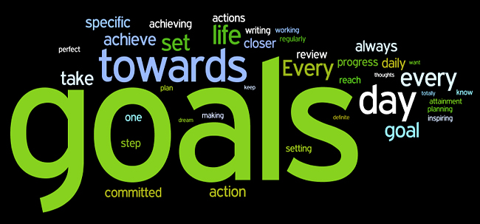
Set Goals
Notes:
5
We as a society are naturally goal-oriented. Think: sports, getting driver’s license, graduation, and so on
INTERACTIVE: Would anyone like to share a goal they reached and how you achieved it?
Setting goals is a powerful method to get things accomplished. Writing down goals placing them where you see them often for motivation.
They especially need to be SMART goals.

Slide 6

SMART Goals
SMART Goals
Specific – Pinpoint something you want to change or achieve.
Measurable - You can measure or count a SMART goal.
Action-oriented - Develop a plan of action.
Realistic - Must be balanced between safety and risk.
Time-conscious - Set milestones and schedules for your goals.
Undefined Goal: My goal is to save more money.
SMART Goal: My goal is to save $100 per month for the next 2 years so I can purchase a new John Deere L118 riding lawnmower.
Discussion
Notes:
6
A clearly defined goal: A SMART goal is:
S specific. It pinpoints something you want to change to achieve.
M measurable. You can measure or count a SMART goal.
A action-oriented. The most important step in the goal-setting process is developing a plan of action.
R realistic. Must be balanced between safety and risk. How far can you stretch yourself without overdoing it. It is a highly personal consideration.
T time-conscious. Set milestones and schedules for your goals and be sure to allow yourself ample time to complete one goal before you move on to the next.
Interactive: Anyone want to share their goal and make it a SMART goal?

Slide 7

Identify Resources
Look at Your Resources
Time
Skills
Knowledge
Community Services
Family and Friends
Professionals or Consultants
Notes:
Attaining your goals is going to involve the use of resources, not all of which are monetary.
Time is a resource you will need to accomplish goals. Time can be on your side, or in some cases work against you.
Skills and Knowledge to follow your career path. Acquiring those skills and knowledge may take time (and money.)
Community Services - VCE offers free Financial Assessments and financial coaching
Family and Friends - are a great resource as they may know someone who is a subject matter expert
Professional assistance from a certified financial advisor or consultant is often worth the cost.

Slide 8
Net Worth
Assets – Liabilities
= Net Worth
Net Worth is a snapshot at a point in time giving you a picture of where you are now with your finances.
2
Notes:
INTERACTIVE: Give Handout 2 on Current Assets & Liabilities
It may be a good first step to evaluate your financial situation to determine what has to be done in order to achieve these goals.
How much is your Net Worth in terms of dollars? Add up everything you own and subtract everything you owe Do you come out ahead?
INTERACTIVE: Have the class list things people own that have value and put them on the White Board or flip chart.
List where people might owe money. You may want to throw in some dollars to give an example of Net Worth.
Net Worth is a calculation of the market value of everything you own –Minus everything you owe.
It can be positive (own more than you owe). It can be negative (owe more than you own). It can also be zero.
Net Worth provides an indication of your ability to survive an economic downturn. It is an important measure of your progress toward achieving your financial goals.
It is a snapshot – a point in time – of our overall financial well-being. Next, we want to look at income and expenses.

Slide 9
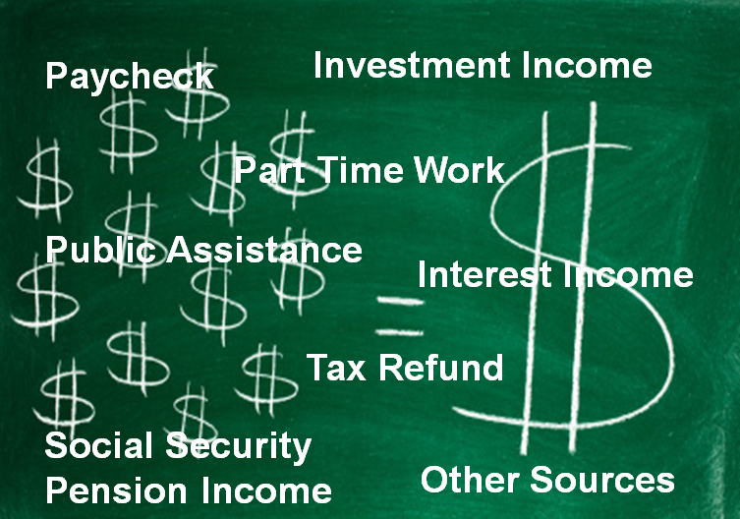
Determine Income
3
9
Notes:
INTERACTIVE – Pass out Handout 3- Income Worksheet
Example in Handout for your review at home.
Continuing your evaluation, you’ll need to determine where the money comes from to finance your lifestyle and achieve your goals.
Knowing how much income you will have coming in should help you decide where your money should go.

Slide 10

Determine Expenses
Fixed Expenses | Variable Expenses | Periodic Expenses
Mortgage/rent | Occur Regularly but vary, such as: | Occur occasionally
Retirement/savings | Clothing | Medical
Emergency savings | Groceries | Car repairs
Car payments | Dining Out | Appliance repairs
Cable/Subscription | Entertainment | Taxes
Internet | Transportation | Home repairs
Insurance | Personal care | Emergencies
Student Loans | Daily spending
Cell Phone | Utilities
4
Notes:
INTERACTIVE – Pass out Handout 4 - Expenses Worksheet - Review the example given
Most people have a pretty good idea of where their money comes from, but only a vague idea of where it goes.
If you want to gain better control of your finances, you will need to track your expenses.
Expenses fall into two main types:
Regular Fixed expenses - that do not change in amount month to month Fixed expenses - are predictable
Regular Variable - they are monthly, but vary in the rate depending on use -
Irregular Expected and Periodic expenses – may include quarterly water bill, annual dues, car maintenance
Irregular Unexpected or emergency expenses - home repairs, hospital bills
You may not be able to predict all expenses, but you are able to plan for them.
Interactive: What are some ways you can think or that you have used to track your expenses?
Anyone use a Journal? Excel Spreadsheet? Saving Receipts Monthly?

Slide 11

Spending Plan Process
Plan your Spending
Goals and Spend Plans
Guidelines for Planning
20-35%
15-30%
4-7%
6-20%
3-10%
2-8%
2-4%
4-6%
20%
Make Tradeoffs
Housing
Food
Utilities
Transportation
Clothing
Health
Personal Care
Insurance
Savings/Goals
Debt Payments
Put Plan Into Action
Track Income
& Expenses
Evaluate and Adjust
5
Notes:
INTERACTIVE: Pass out Handout 5 Creating a Spending plan
This is to do AT HOME - these give a picture of your current financial situation.
Example – to get the most out of a drive across country – you will want to plan where to stop and what to see.
To get the most out of your finances and grow them – you will want to plan your spending and set goals.
Setting Goals and Planning Expenditures: use your income and expenses. Set up spending guidelines.
Include debt payments and savings as part of the plan, and don’t forget those bills that don’t occur each month.
Make Tradeoffs: How do we prioritize? What expenses may be able to be cut?
Put Plan Into Action: Even the best thought out plan will not succeed unless you implement it.
Track Income & Expenses : You can’t begin to assess how well your plan is working without doing this.
Evaluate and Adjust: Real life experience is your test. Try it for a month.

Slide 12
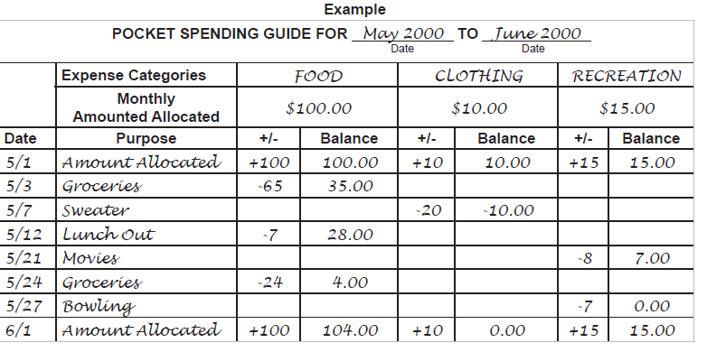

Set a Spending Plan
Plan your Spending
A
Notes:
Create a list of everything you plan to spend money on each month. (Use Handout B to track weekly spending)
At the end of the month, see if you kept with I your plan.
If not, then you need to make some adjustments.

Slide 13
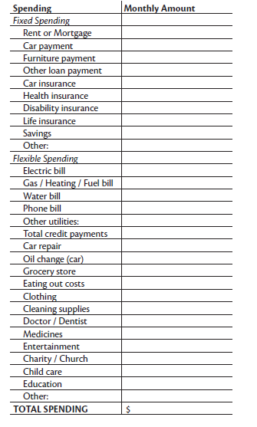
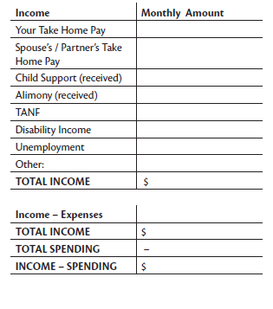

Track What You Spend
Plan your Spending
B
Notes:
Track your Spending every single time you buy something, then try to categorize it.
Do this for 3 -4 weeks to see where you may be overspending
Once you know what you spend money on, Go back to the spending plan and set a budget on your Flexible spending

Slide 14

Cash Flow
Money In
Money Out
= Cash Flow
Notes:
Now that you have a picture of your Net Worth, or income and expenses
Step two is to review how you are doing at living within your means
A good measure of that is what we call a Cash Flow Analysis Cash Flow is determined by calculating:
Inflows of money from all sources using a one month time frame for measuring
Sources may include your pay, pensions, Social Security, investments, public assistance, and other sources
Outflows may include monthly expenses including housing, transportation, food, clothing,
personal care, medical expenses, child care, paying down debt - over that same one month period.
If your cash flow is positive, your income exceeds your expenses. If it is negative, you are spending more money than is coming in.
Analyzing your cash flow gives you information to support the planning that will take place next in the process.

Slide 15
Needs vs. Wants
NEEDS
WANTS
Discussion
Notes:
https://www.youtube.com/watch?v=el40d2gyWaI
https://www.youtube.com/watch?v=i-JlfPIQHUg
On white board – review monthly expenses – ask the class to give you monthly expenses and then let them tell you if
They are needs or wants.
Needs: basics of life we cannot live without - the necessities.
Wants: the items, activities or services that increase our quality of life.

Slide 16

The Choices you make today impact your future financial health.
Choices
Invest
Later
Save
Now
Live For Today
Build Wealth For Tomorrow
Save Later
Invest Now
Notes:
Living in the present while preparing for distant tomorrows presents some conflicting priorities.
Determine the right mix for you. Choices now, impact your financial future.
These are things many people are preparing for –
higher education for their children
a comfortable home
a reliable car
retirement
Reaching your long term financial goals requires commitment, time and possibly some sacrifice.

Slide 17

Savings
Identify a target savings amount and make it a high priority expense.
Small changes in spending habits can lead to big savings over time.
Look at all non-essential expenses.
When you receive a pay increase, turn it into savings.
Option: Set up automatic deductions from your paycheck into savings, then don’t even think about it.
Discussion
Notes:
If you’re having trouble finding ways to pay yourself first, try these ideas to get into the habit.

Slide 18
Savings
Save Now
Amy, 25, puts $5000/year for 40 years in savings account earning average of 1.5% interest.
Result: Her $200,000 grows into $282,921.44 by age 65
http://www.bankrate.com/calculators/savings/simple-savings-calculator.aspx
Discussion
Notes:
Note for simplicity we are using one interest rate over time.
Note: Resource tool to figure out interest over time – you may want to try Bankrate.com
Helps when calculating investment income over time.
Ask the class to use their cell phones to do another example.
Amy - good saver, risk averse she elects to save only in savings accounts. She deposits $416.67 monthly for 40 years.

Slide 19
Savings Tools
Individual Development Accounts
The VIDA program is currently not accepting new savers.
Eligibility
Eligible saver applicants must:
Be a U.S. citizen or legal resident and Virginia resident
Be 18 years old or older
Meet eligible VIDA Income Guidelines and household net worth limits
Have earned income from full-time, part-time or self-employment
Be able to complete the program within six to 24 months
VCE offers assistance in applying for your VIDA matched savings account. More info email us at smartmoney@pwcgov.org.
Notes:
See Handout 8 for Websites, apps and Resources

Slide 20
Why Saving Early matters:
Investing Choices
Jane, 25, invests $5000/year for 10 years, earning a 6% return. Stops investing after 10 years with continued growth.
Invest Now
Result: Her $50,000 grows to
$466,030.42 by age 65
John, waits 10 years till he is 35 to invest, then invests $5000/year for 30 years, earning a 6% return.
Invest Later
Result: He invests $150,000 just 30 years
it grows to $448,664 by age 65
Notes:
Note this is a simplified version to illustrate the impact of outcomes of investing sooner.
Jane - more of a risk-taker and invests her money first. Then stops, but leaves her money in the investments for the next 30 years. Ends up investing a total of $50,000, after the 40 year period, has quite a nest egg at 65.
John does not start investment program until 10 years later. At 35 years of age, invests $5000 per year over the next 30 years. Ends up investing a total of $150,000 over that 30 year period, with the same interest rate - still has less than Jane.
Discuss: What is the cost of the 10 year delay?

Slide 21
Saving vs Investing
Saving
Investing
No Risk – Savings, Insured, Minimal Returns
Use -short term needs, emergencies
Savings accounts, Money Market accounts, Certificates of Deposit
Risk – Not Insured, Potential Of Greater Returns but greater losses as well
Use - for longer term goals, retirement
401k, 457, 403b, IRA, TSP
Mutual Funds, Stocks, Bonds
Discussion
Notes:
The primary difference between saving and investing is the element of risk.
Savings are insured by the FDIC. Therefore, the risk of loss is near zero.
However, because there is virtually no risk involved with these savings, the returns earned by these vehicles are relatively low.
The best use of this type of saving is for short-term goals.
Investments all have some level of risk associated with them.
Market volatility - You risk losing some or all of your investment depending on when you chose to sell.
However, because of the risk, the rewards can be higher, compared to savings.
The best use of this type of saving is for the longer term goals.
INTERACTIVE: Why would you want to invest when the risk of loss is high, compared to savings?
Low return on savings not sufficient to fund long term goals, such as retirement.
Higher returns from investments increase wealth faster than pure savings.

Slide 22
Smart Debt Management
Guidelines
Manage your debt. Start by being aware of your
Credit worthiness.
Check credit reports every 4 months (3 x / year)
https://www.annualcreditreport.com
Credit Scoring companies:
Experian – www.experian.com
Equifax - www.equifax.com
Transunion – www.transunion.com
They only know what credit companies report. Most likely there will be errors. It is your responsibility to check for and dispute any errors.
6
Notes:
INTERACTIVE – Handout 6 What is in Your Credit Report
If we are going to go into debt, which most of us will, start by managing the debt. Here are some tools to help.

Slide 23
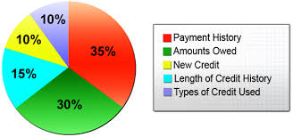
Smart Debt Management – What affects your credit score
Guidelines
35% - Payment History
30% - Amount of Debt
15% - New Credit
10% - Length of Credit History
10% - Types of Credit used
6
Discussion
Notes:
INTERACTIVE - Know where you are in your credit in order to start improving your score.
Recommend you keep your credit card debt and under 30% of the limit for a high score and no more than 50% of the limit.
Ask question about If your credit is $1000 on Credit Card 1 and $2000 on credit card 2 – where do you need to be on these cards to maintain a good credit score?

Slide 24
Smart Debt Management
Guidelines
Know and use the right type of debt
  Installment loans – Auto / Student
  2nd mortgages - Line of credit v. loan
  Revolving credit – Credit cards, lines of credit
Be proactive - Contact your creditors before they call you
Beware of Fraud - Take steps to protect your credit
Avoid transferring credit balances for a temporary low rate
Pay on time – Remember 35% of credit score is payment history
Avoid Predatory Lending
  Car title and payday loans
  Refund anticipation loans from tax preparers
  Rent-to-own lenders
Notes:
Review:
Installment loans
Second mortgages or equity line of credit
Revolving credit
Discuss:
Car title or Payday loans
Refund anticipation loans
Rent-to-own lenders

Slide 25
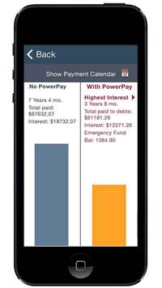
Smart Debt Management
Guidelines
Have a plan to repay loans and credit cards – Check out PowerPay Debt Elimination plans and apps. www.powerpay.org. Created by our partners at Utah State Extension.
PowerPay 5.0 will give you the tools to develop a
personalized, self-directed debt elimination plan.
Notes:
Powerpay.org Created by Utah State Cooperative Extension – You can even create spending plans, savings plans and debt elimination plans on their website, or using their new App on your phone.
Best App out there for managing Debt Reduction
Virginia Cooperative Extension recommends www.powerpay.org!

Slide 26
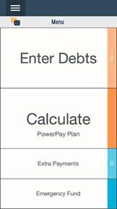
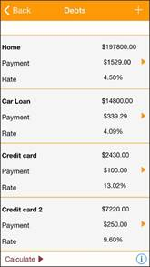
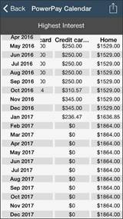
Smart Debt Management
Guidelines
Helping Debtors become Savers!
Notes:
Action: Enter debts – Calculate – pay monthly – reduce debts faster
Average subscriber using Powerpay.com saves $15,000 dollars over the life of the loans and pays them off an average of 10 years faster!

Slide 27


Credit Cards
Helpful? or Dangerous?
Credit Cards
“Credit cards are like weapons – dangerous in the wrong hands, but sometimes you’re glad you have one.”
Stephen Vanderpool
Notes:
People in US love their credit cards – 156 million cardholders in 2009, racking up 1.94 Trillion in purchases.
Ever wonder how our grandparents ever got along without them?
Credit cards are both good and bad for us and the Smart Money Manager will use credit to take advantage of the good and avoid the bad.

Slide 28
Credit Cards
Credit Card Advantages
Convenient
Purchasing power
Buy now and pay later, gives you more time
Build credit by keeping current with your payments
Emergency use can “save the day”
Better federal protections against fraud than debit cards.
Credit Card Disadvantages
Pay back with interest may drag you deeper in debt
It becomes too easy to spend Money
Some cards have Annual Fees
Become detached from spending
Pay interest on interest; a circle of debt
May send credit score into a downward spiral
Discussion
Notes:
A poor credit history may have a negative impact on your employability, insurance rates, and lending rates
Did you know if you want to reduce your car insurance rate – a great step is to improve your credit score!

Slide 29
Credit Cards
Buy Now – Pay Later
$6,375
18%
$100
17 Years, 6 Months
$14,643
Average Credit Card Debt
Typical Interest Rate
Minimum Payment
Years to Pay Off . . . . . .
Total Paid . . . . . . . . . . . . . . . . . . . . .
*
*Federal Reserve Statistics – June 2018
Discussion
Notes:
As a nation, the U.S. is not great about paying off our balances every month.
*An analysis of Federal Reserve statistics and other government data indicate that the average US household is carrying $7327 in credit card balances
If we assume that the typical rate on the card is 18% and the minimum payment is the government-mandated 4% of the outstanding balance each month
Paying minimum would take over 12 years to pay it off – and that is without adding any additional charges to the card.
In other words, credit users are paying approximately 58% more for those purchases than if they had paid in cash.
DISCUSSION – Discuss the value of the cost of Credit Card debt? What about future cost in reducing disposable income?
*June 2015 Federal Reserve statistics and other government data.

Slide 30
Pay off $6375 @ 18% interest and $100/month
Credit Cards
Notes:
This Chart shows the amount of interest you accrue the longer you carry a debt

Slide 31
Smart Credit
Smart Credit Management
Pay on time
Pay more than minimum, preferably in full
Avoid cash advances & courtesy checks
Reconcile your bill each month
Avoid having a large number of cards
Know your credit score; review credit reports
Protect your card info
Rethink charging; set spending action plan
Idea - Try 30 days of Cash Only
Notes:
on time – Of the factors that go into your credit score, payment history counts the most – 35%
more than the minimum – Going back to the preceding example, if you paid more than the minimum each time, for example, continuing to pay the initial minimum payment amount ($293) each month, you could reduce the payoff time by 2 years, 8 months and cut your interest payments by more than half.
cash advances or courtesy check –interest rate is higher, and starts immediately (no grace period).
reconcile monthly –helps you spot and dispute fraudulent and erroneous charges.
avoid too many cards –hard to manage and keep track of, may negatively affect your credit score.
get and review Credit Report – One from each but not at the same time. (Trans Union, Experian, Equifax) in 4 month intervals (one each). You are checking for accuracy.
protect card info – not wise to share credit info over the phone with unknown parties. Be cautious where you give your credit card.
Review your statements monthly looking for extra charges or errors.
in trouble? – good rule of thumb: Keep your debt to under 15% of your monthly income.

Slide 32

Preparation against Risk
Insurance
Job Loss
Injury
Disability
Death
Illness
Natural Disaster
Financial Emergency
Lawsuit
Divorce
Notes:
Leader: Ask class to name some examples of unexpected issues that could affect their financial situation.
LIFE HAPPENS - the unexpected will almost inevitably threaten to upset your financial stability.
Learn to expect the unexpected and take steps to protect yourself and your loved ones against crippling financial setbacks.
Set aside funds by establishing emergency savings.
For larger emergencies, consider buying insurance to protect your family - your life, health and property should be insured.
The topic of insurance is important enough to take an additional class to discuss.
You will want to research and understand exactly what you are buying and whether that fits your specific need.

Slide 33
Plan your Financial Success
Summary
Smart Money Management
Manage your finances
Plan your spending; set personal goals
Save and invest now for a more secure future
Research the benefits of insurance to reduce risks
Make your financial goals your priority.
VCE offers classes that support your financial goals. Check out our calendar at www.ext.vt.edu/calendar
Follow us on Twitter @FinEdVCE
Notes:
Action: Make a commitment to yourself to improve your financial future, start by finding out where you are now.
Sign-up for a free and confidential Financial Assessment to get your financial snap-shot!

Slide 34

Next Steps
Smart Money Management
Determine your financial health to improve it for the future.
Next Steps:
We are available for personal and confidential financial assessments, financial counseling or coaching, by appointment. Call or email below
For First Time Home Buyer’s Certificate program please send us an email to schedule your Home Ownership Seminar followed by setting up a 1-1 Financial Assessment
Email: smartmoney@pwcgov.org
Call: 703-792-6287 for appointment
Visit our Website: www.pwcgov.org/money
VCE - there is never a fee for our services.
7
Notes:
See Handout 7 for Websites, apps and Resources
Consider using the free services offered with the Virginia Cooperative Extension – we can help you through the process
We Provide: Education, Coaching, and Resources, always with Confidentiality
**We never share your information with any credit bureaus or credit agencies**
Action: Hand-out class survey: Please also fill out our class survey – tell us how we did and what class topics you would like to attend in the future.

Slide 35
Notes - Last updated - January 2016 Slide 14; Slide 17 and 18
Updated Jan 24, 2016 Slide 14 Needs vs. Wants Interactive
Updated July 2018 VIDA Account info hidden 2018
Shorten version Handouts quick review in class
Edited slides Feb 29, 2016 Credit score chart
Edited March 22 2016 Remove Logo; insert quote
Edited July 2018 Typos & credit check info
June 2016 Logos and Indicia

