Slide 1
DLRL CLUSTER
CS4624 Spring 2014
Virginia Tech
Blacksburg, VA
Client: Sunshin Lee
Adam Lech
Joseph Pontani
Matthew Bollinger

Slide 2
Outline
Deliverables
Data Preprocessing
Hive
HBase
Impala
Mahout
Future Work

Slide 3
Deliverables
Tutorials
Video demos
Report generation
  HBase
  Hive
  Impala
  Mahout

Slide 4
Data preprocessing
Needed to preprocess data for meaningful analysis
  source
    strip excess URL information
    <a href="http://tapbots.com/tweetbot" rel="nofollow">Tweetbot for iOS</a>
    tapbots.com
  tweet date
    separate into fields for year, month, and date
  tweet text
    remove stop words (‘the’, ‘and’, etc.)
Input CSV into Python script
Dumped out to CSV file for use

Slide 5
Preprocessing Challenges
Tweets are from two different sources
  twitter-stream
  twitter-search
Different formats
  <a href="http://tapbots.com/tweetbot" rel="nofollow">Tweetbot for iOS</a>
  &lt;a href=&quot;http://twitter.com/download/android&quot;&gt;Twitter for Android&lt;/a&gt;
Full of weird characters that threw script off
Large datasets take FOREVER to process

Slide 6
Hive
Importing pothole dataset to Hive
Statements similar to loading data in MySql
Data still stored in file
Queries transformed into MapReduce jobs
Hive table
MySql Table
dumped into
imported into
CSV FILe
imported into
Hadoop Distributed File System

Slide 7
HBase
Importing pothole dataset to HBASE
HBase requires KEY_ROW for exactly one column
HBase organizes fields into column family
MapReduce jobs performed - ImportTsv tool used
HBase table
MySql Table
imported into
dumped into
CSV File
imported into
Hadoop Distributed File System

Slide 8
Impala
Setup tables in Impala with new datasets
Create benchmark queries to test Impala vs Hive
select count(*) as num_tweets, from_user from twitter group by from_user order by num_tweets desc limit 15;
select count(*) as num_tweets, source from twitter group by source order by num_tweets desc limit 15;
select count(*) as num_tweets, created_at from twitter group by created_at order by num_tweets desc limit 15;
select count(*) as num_tweets, month from twitter group by month order by num_tweets desc limit 15;
select count(*) as num_tweets, day from twitter group by day order by num_tweets desc limit 15;
select count(*) as num_tweets, year from twitter group by year order by num_tweets desc limit 15;

Slide 9
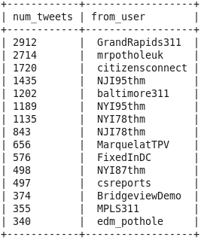
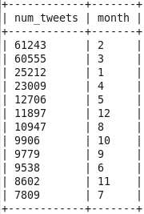
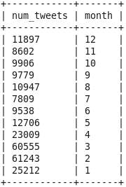
Impala - Example Report
select count(*) as num_tweets, from_user from twitter group by from_user order by num_tweets desc limit 15;
select count(*) as num_tweets, month from twitter group by month order by num_tweets desc limit 12;
select count(*) as num_tweets, month from twitter group by month order by month desc limit 12;

Slide 10
Mahout
How to use Mahout
  preprocess dataset
    remove ‘stop words’ and other unnecessary text
  import dataset to HDFS
    pothole and shooting dataset are 1 tweet per line
  datamine using FPGrowth algorithm to get frequent patterns
    specify word separator, in this case a space
  view/dump results
Deliverable: Tutorial (PDF) and Demo video (Youtube)
  tweets about potholes, 20MB CSV file
  how to run Mahout with FPGrowth on a dataset
Finally, run FPG on actual cluster with a much larger dataset
  tweets about shootings, 8GB CSV file

Slide 11
Mahout
Issues with ‘Shooting’ dataset
  FPG only needs the tweet text, how to preprocess dataset to remove all other columns, 8GB CSV file took forever to preprocess via Python script
    solution was to just export only the tweet from MySQL
  Java heap space is exhausted when running Mahout using mapreduce on a large dataset
    lower the requested heap size (top k values are kept) when running FPG via the k switch (from -k 50 to -k 10) and increase minimum groupings via s switch (from -s 3 to -s 10)

Slide 12
Future Work
Preprocess tweets on their way in, not after the fact
Leverage different technologies for specific tasks in DLRL Cluster

