Slide 1
DH Preservation Strategies in Action: A Case Study
Corinne Guimont, Digital Scholarship Coordinator
Alex Kinnaman, Digital Preservation Coordinator

Slide 2
Recap from last year
Potential Strategies for Preserving Complex DH Projects
  Preservation and Data Management Planning
  Documentation
  Preservation Profile
  Evaluate project components
  Ongoing preservation throughout project life cycle
  Web Archiving
Notes:
Last year at BPE we presented on Potential Strategies for Preserving Complex DH Projects. We discussed a need to plan early for preservation and data management by creating written plans and documentation such as a preservation profile. We talked about the different components of DH projects and how we could evaluate those to determine some preservation strategies for each component in order to preserve the project as a whole. And we talked about about continuing these processes throughout the project lifecycle. After that presentation we went on to run a case study and take additional steps for how we could begin implementing these strategies at Virginia Tech. Today we will first discuss that case study and strategies that came out of the case study.

Slide 3
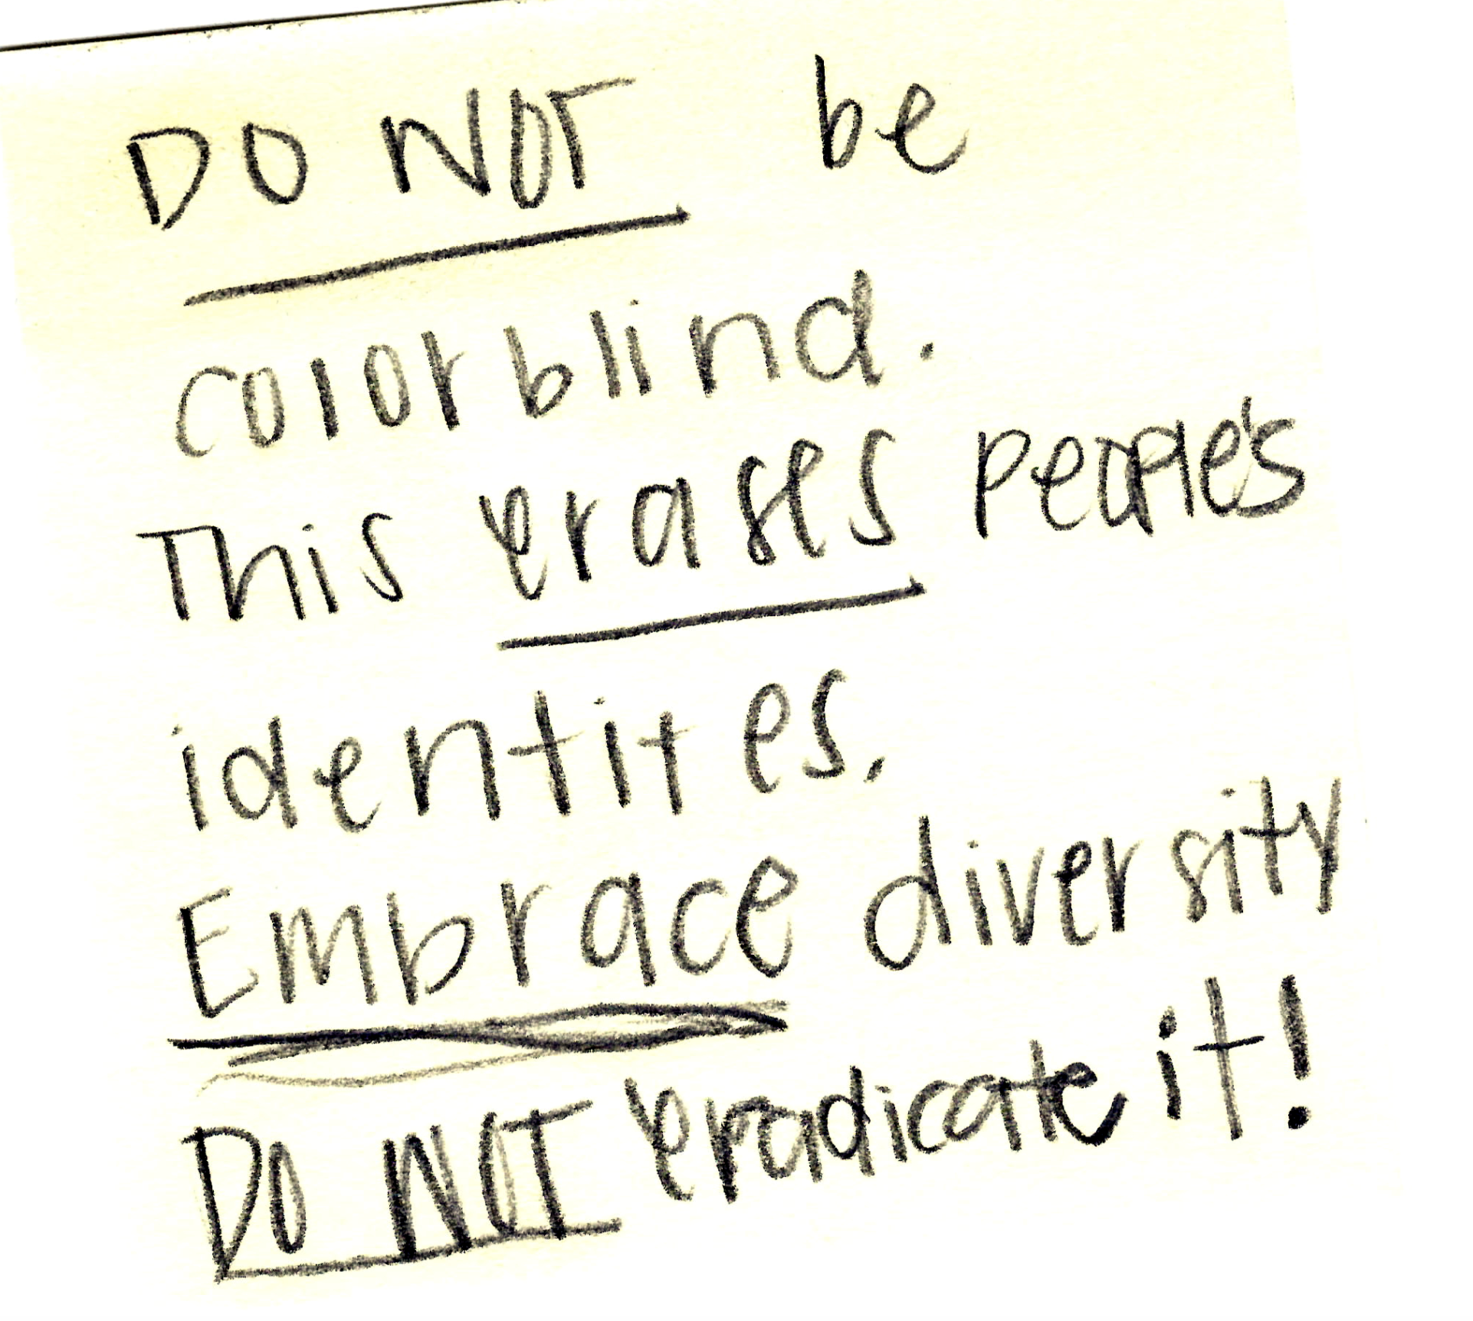
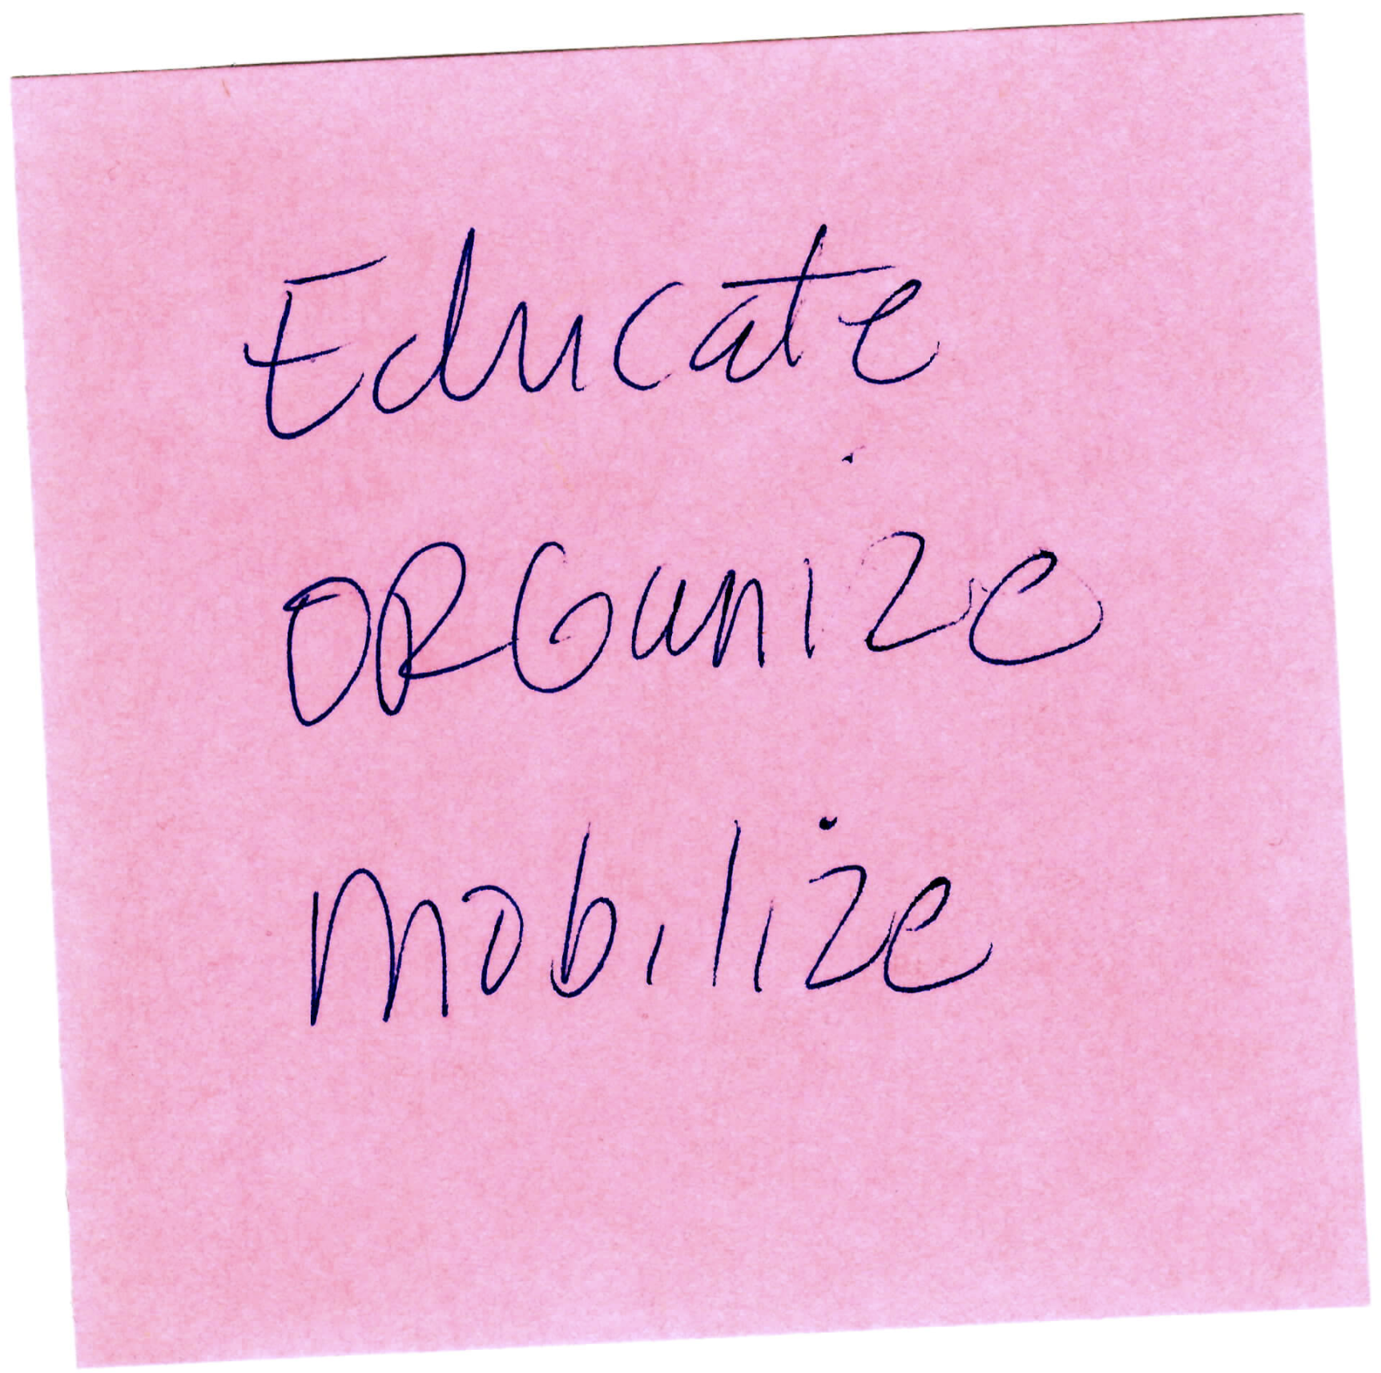
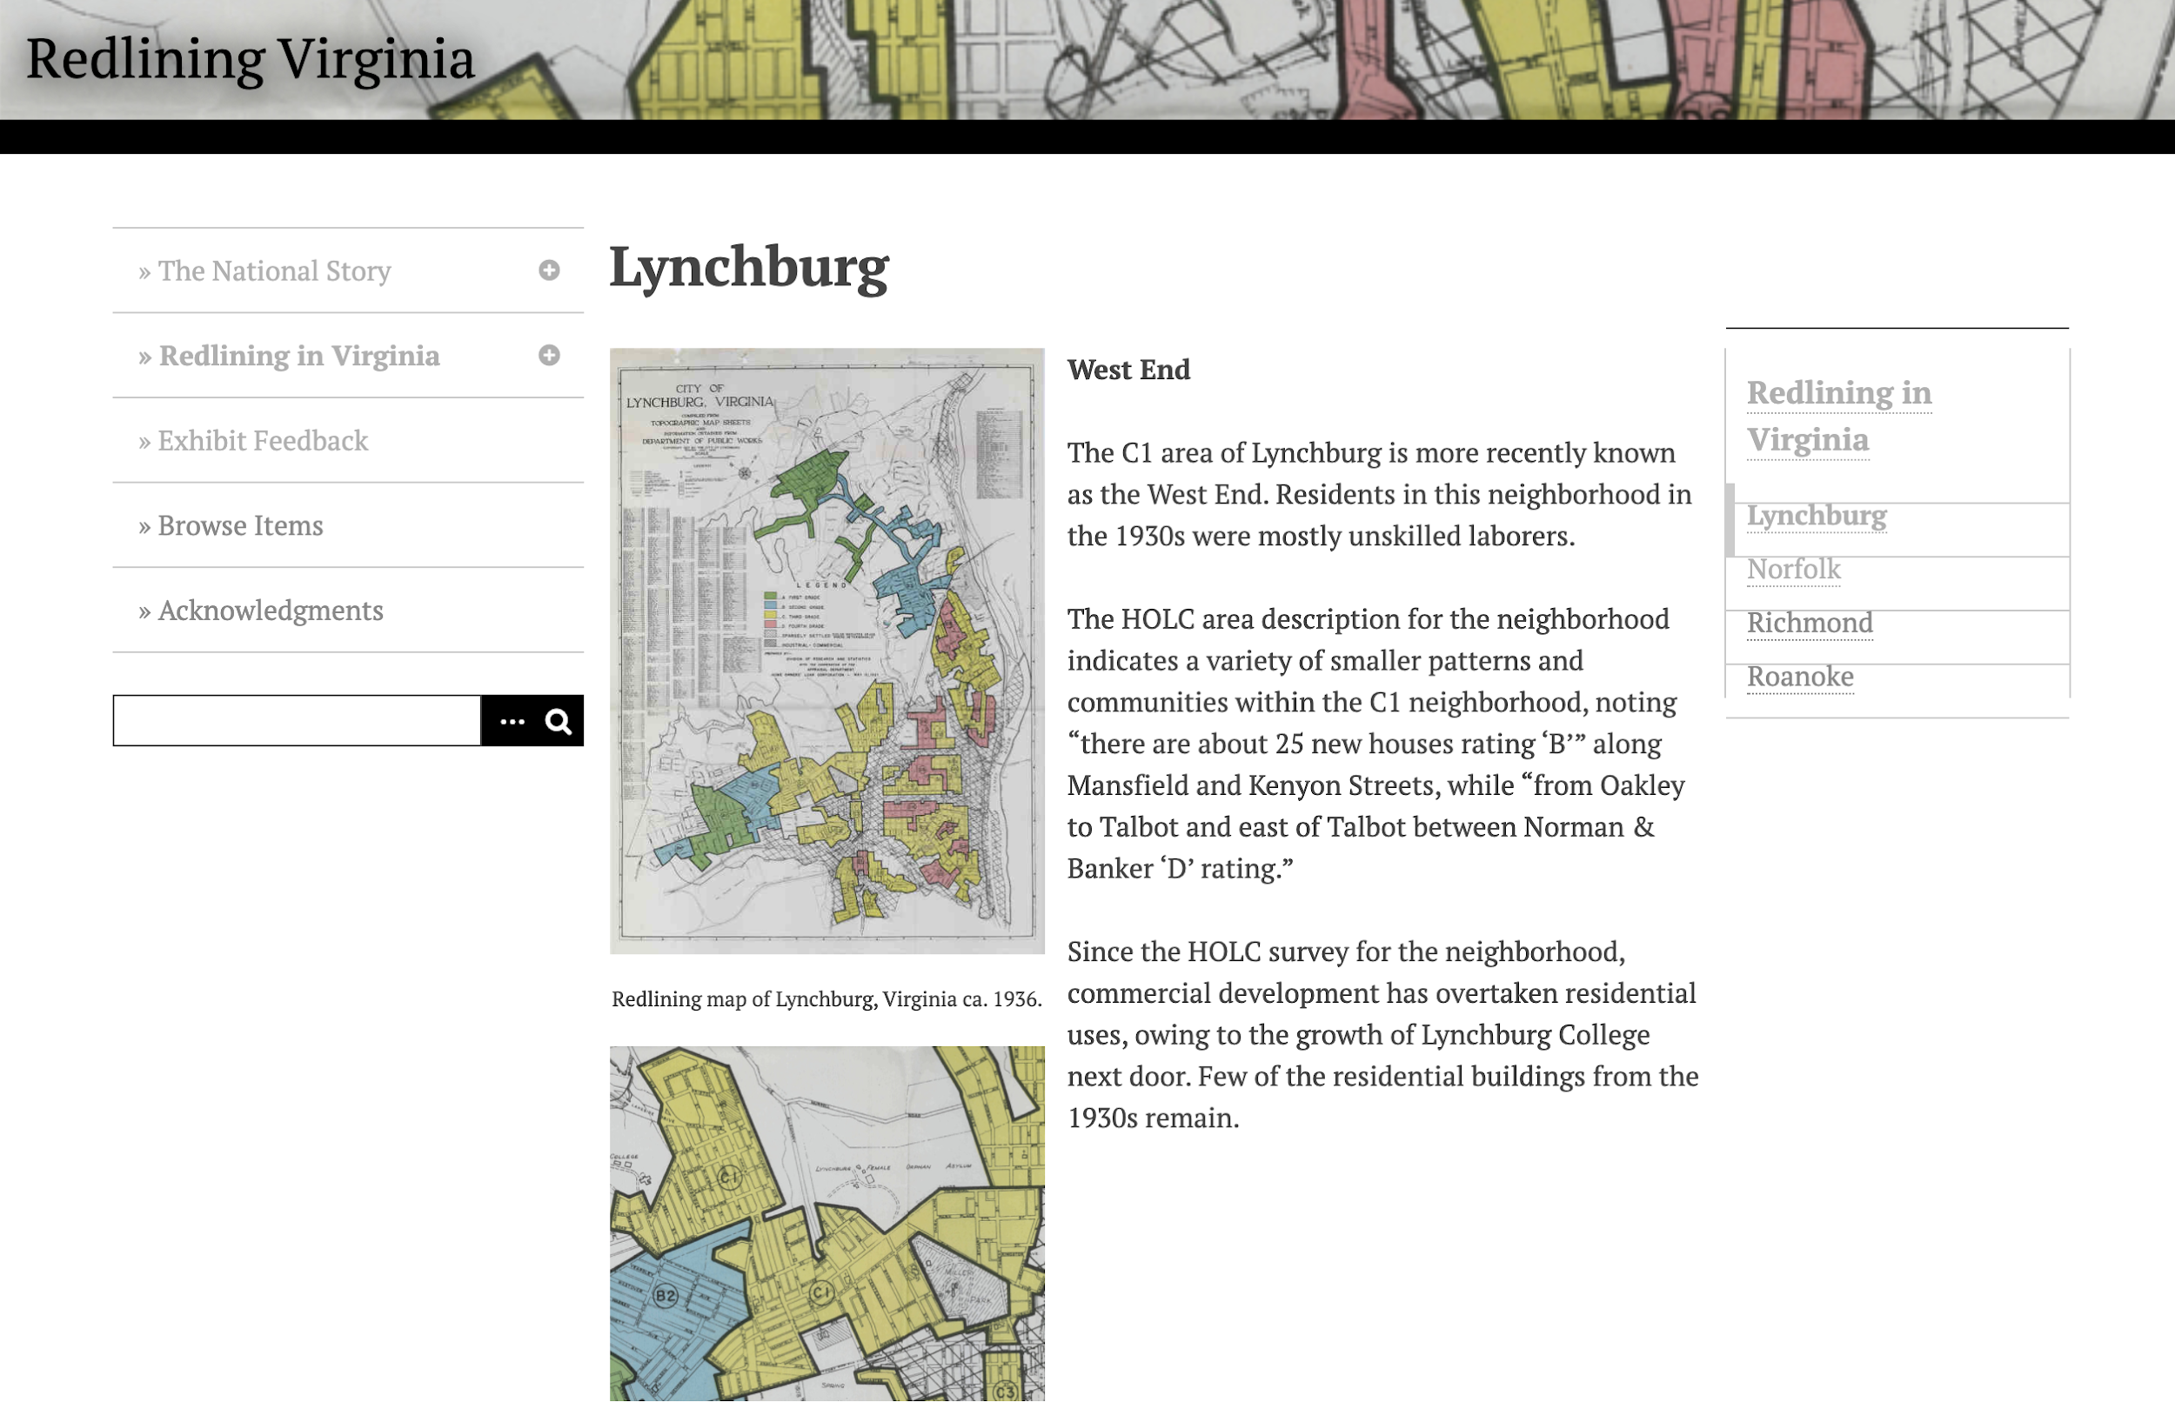
A Case Study - Redlining Virginia
Redlining VA: “explores the actions of Home Owners' Loan Corporation (HOLC) in Virginia and its impact on Virginia cities.” [bottom right]
Parent Project Mapping Inequality
Physical Exhibit at VT Libraries [example top right]
Faculty Researcher: Professor LaDale Winling
Notes:
The project we chose is Redlining Virginia. This is an online exhibit built in Omeka from a researcher in the History Department, LaDale Winling, that looks at maps from the Home Owners’ Loan Corporation to see how different areas in major cities throughout Virginia were redlined. The work is part of a larger project, Mapping Inequality at the University of Richmond that LaDale is a part of. One of his undergraduate history classes compiled the project for a physical exhibit that was in the library in the winter of 2016-2017, then he had a graduate research assistant work on organizing all of the content including maps, text, videos, and post it notes that were an interactive piece of the exhibit, seen in the upper corner here.

Slide 4
A Case Study - Project Components
Data files
Area description Images -- JPG
Map scans -- JPG
Georectified Maps -- TFW, TIF, XML, OVR
Shapefile bundles -- CPG, DBF, PRJ, SHP, SHX
Website
Text -- HTML
Images (exhibit feedback) -- JPG
Videos -- MP4
Physical Exhibit
Images -- JPG
New components
Preservation profile
Digital Exhibits Metadata Application Profile (MAP)
Shapefile bundle metadata
Documentation on all components and information on opening/reuse
Notes:
So once we were really digging into this project and its various components, I wanted to get a sense of the file formats we were working with to see if there were any special considerations that needed to be made in terms of preservation. This list is to give you a basic idea of what we are working with. There are some common formats for image, text, and video, but more importantly were the data files that generate the georectified maps that are a primary component of Redlining Virginia. We also created new components, namely the preservation profile and a Digital Exhibits Metadata Application Profile, both at the collection level; as well as generating metadata for the Shapefile bundles at the item-level; and documentation on all of the components that include information on opening and reuse. This was especially important for the various data files listed.

Slide 5
A Case Study - Process
Locate all of the components
  Collected documentation, components in a Google Team Drive
Fill out the preservation profile and MAP
  Profile: Documents access points, rights, preservation needs
  MAP: Collection-level metadata
Research file formats for any necessary migrations and preservation best practices
  HTML text → TXT
  Video MP4 → MOV
  We did not migrate from JPG → TIFF
  Referenced LoC Recommended Format Statement and metadata schemas for Georectified maps and Shapefile bundles
Notes:
The workflow we designed followed this basic outline over the course of about 3 months.
First we located all of the components and collected as much existing metadata and documentation as we could and compiled it in a Team Drive.
With everything in one spot, we filled out the Preservation Profile (which includes preservation-specific information as well as contacts, degree of homogeneity, various access locations, and so one. We also updated the Digital Exhibits MAP.
Then I got to do some heavy lifting with the file formats. We migrated the HTML text to TXT and the MP4 videos to MOV, which didn’t take too long, and we opted not to migrate the JPG images to TIFFs because there were over 100 objects and the goal of this process was to be reasonable. Fortunately for us, the data files for the interactive maps are already in the ideal preservation format according to the most recent Library of Congress Recommended Formats Statement so major migrations didn’t need to happen there.

Slide 6
A Case Study - Process
Research metadata schemas for items without metadata and complete
  Shapefile bundles
Test out opening each component and document
  Shapefile bundles openable with a free ArcGIS account
  Georectified maps openable with a free QGIS download
Document our workflow for reuse on other projects
  Internal workflow
  External recommendations for new projects
Notes:
Next I looked into metadata schemas for the items without metadata, and the content with the most need were the Shapefile bundles. There were a few different standards I looked at and we opted for a simpler schema that was more reasonable to fill out for 8 different maps.
Simultaneously I wanted to test out how to open each component and document any successful outcomes. We did find several open source tools to open even the data files individually and pieced together, largely in GIS softwares.
Finally we documented these workflows for reuse on other projects. This included documentation that goes into the preservation package as well as an outline that will be used to recommend project building guidelines for new projects.

Slide 7
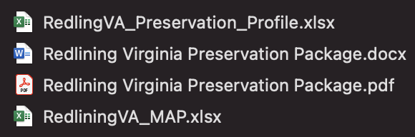
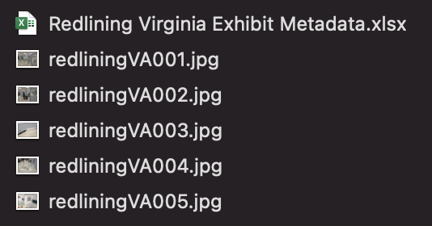
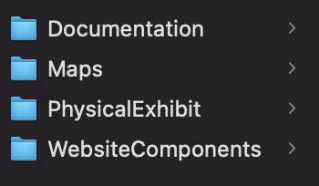
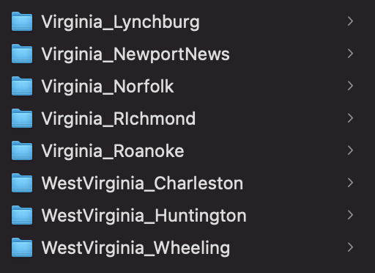
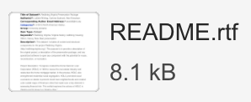
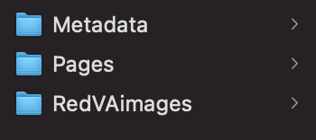
Documentation
Physical Exhibit
Main Components
Georectified Maps
Website Components
A Case Study - Organization
Notes:
With everything collected into one location with the additional new documentation created, which totaled over 500 digital objects, we needed to organize it and, more importantly, document the organization.
The final result was a zip folder with 4 main folders (in orange), 11 subfolders, and 549 objects (noted in each purple box). Each folder corresponds to the overarching component; Documentation, with collection-level metadata and organization and a preservation profile; the georectified maps, containing one subfolder for each location; Physical Exhibit images and corresponding metadata; and the Website Components containing item-level metadata, individual images, and PDFs of each website page. The Virginia Tech Data Repository also requires a corresponding README file to document the entire package’s metadata, scope, and organization.

Slide 8
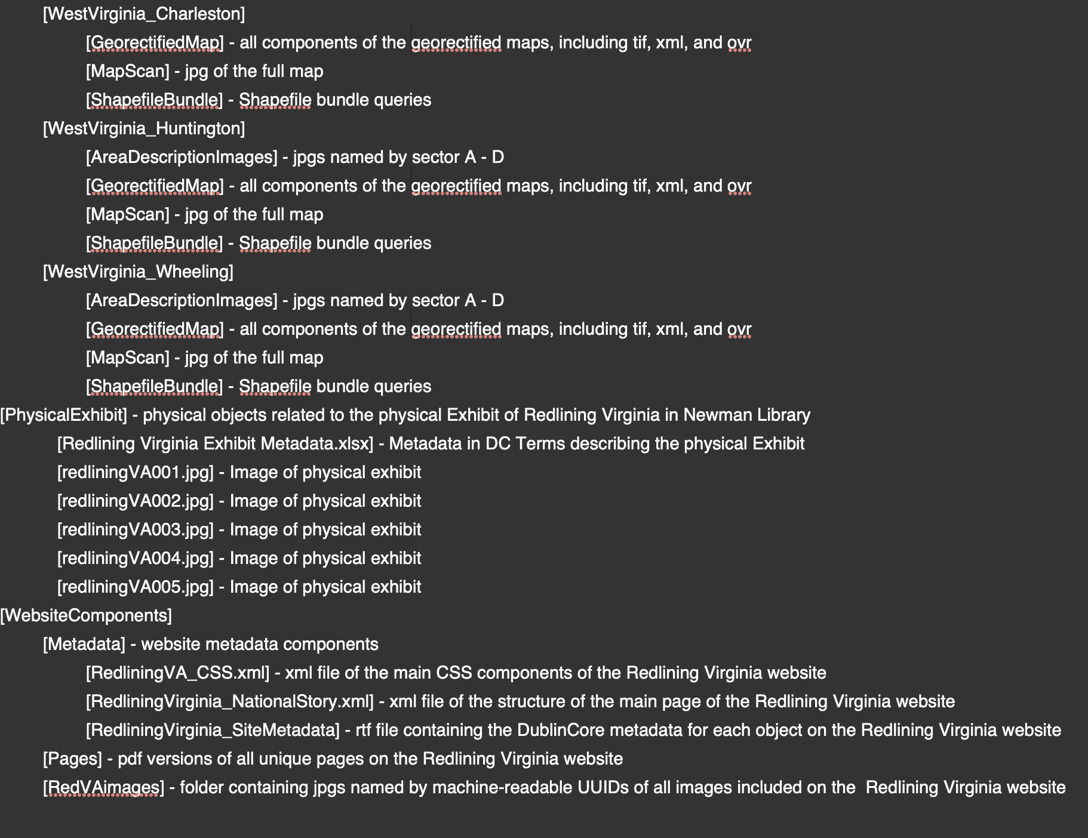
README
Required a detailed outline of document organization, file formats, and descriptions
Notes:
I know this isn’t very pretty, but I wanted to show what the required README file looked like for upload into the Virginia Tech Data Repository. This is a very new component that is required for upload to the Data Repository at Virginia Tech and basically forced us to do what we were already trying to do -- organize everything, understand the organization, and DOCUMENT. In addition to basic metadata about the dataset, the README required a detailed outline of the documents’ organization, their respective file formats, some basic filename information, and descriptions of each file or group of files. I secretly think we need a README like this for all collections and datasets, it was very useful for this type of project.

Slide 9
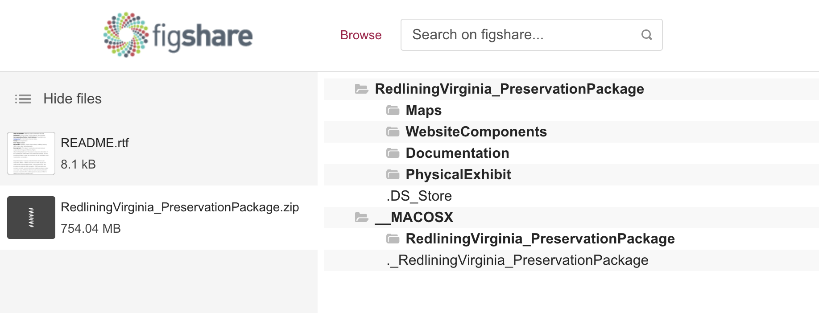
A Case Study - Uploading to VTD
https://doi.org/10.7294/14597751.v1
Notes:
We have everything collected and organized and documented, but now where to put it? There are several possibilities at Virginia Tech for content deposits, and we chose the Virginia Tech Data Repository. Essentially this treats the preservation package as a dataset. The Virginia Tech Data Repository (data.lib.vt.edu) recently migrated to Figshare. The Data Repository links to our scholarship repository VTechWorks and allows for additional references, links, and future updating to the content should we need to update and version some of the materials. There are no upload size limitations, and the Data Services team reviews each item for consistency and completion.
We wanted to get this package uploaded before this conference so that we could share the link with you, which is in this slide, and all materials are publicly accessible under a CC 3.0-BY license for viewing and download. I will say that generally we prefer a CC-BY but this aligned with the faculty member’s original dataset copyright. Shout out to our awesome Data Services team for accomplishing this migration to Figshare, and for helping us get this dataset uploaded and public in time for us to share it today!

Slide 10
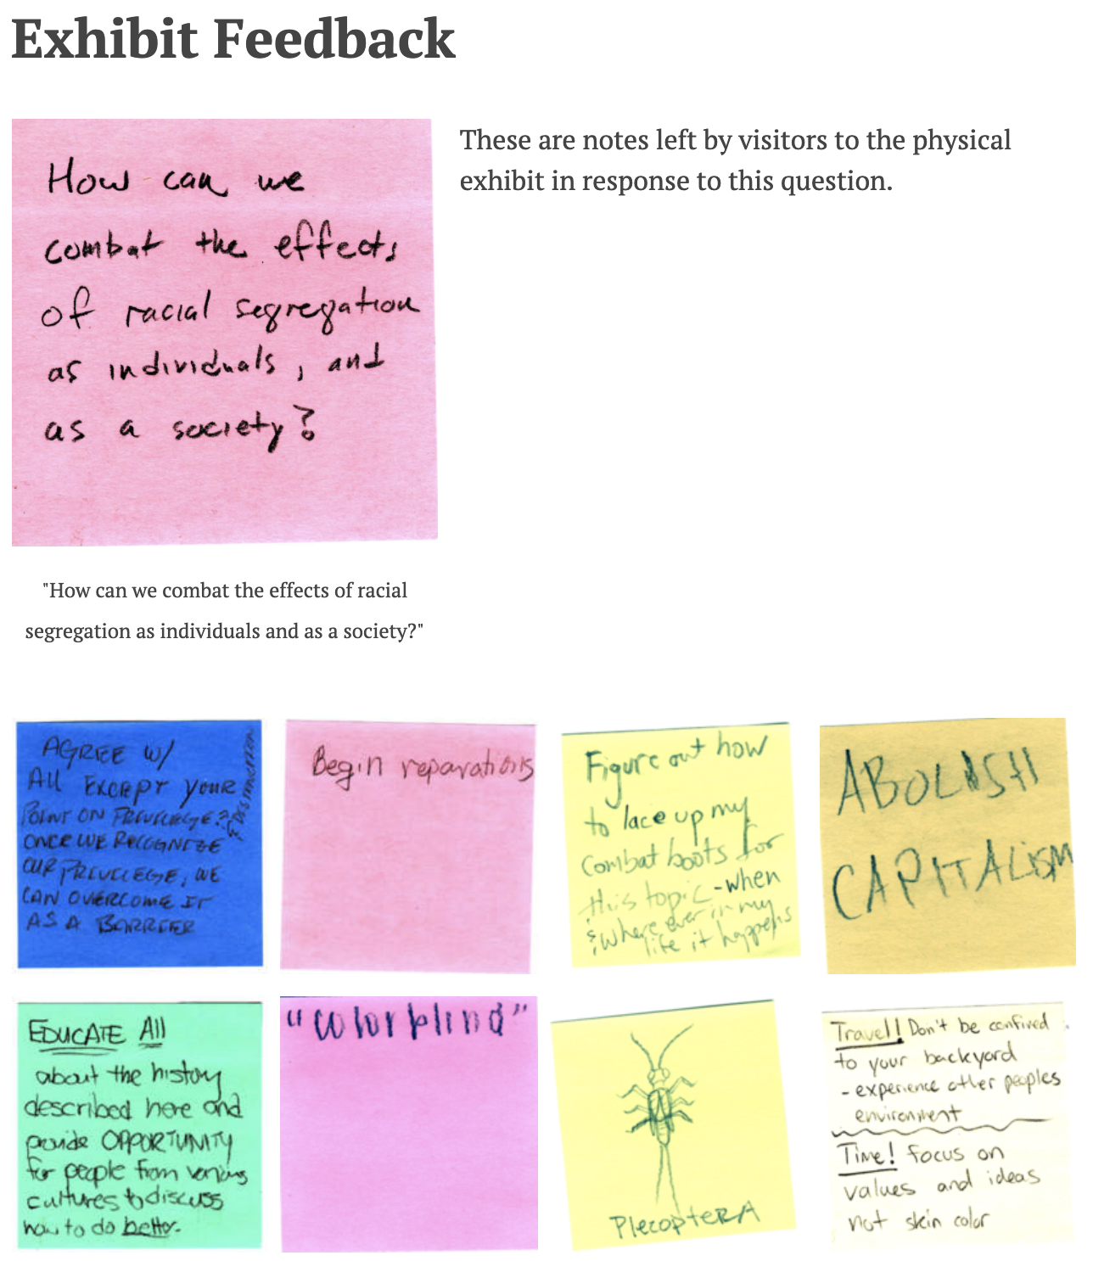
A Case Study - Challenges
The physical exhibit items [right] added an additional unexpected component
Nothing was in one location
Interactive maps added an additional unexpected component
Shapefile bundles are complex and require significant metadata for reuse
Cannot download from YouTube (legally)
Overall a very MANUAL process
Notes:
This project came with its challenges, some anticipated and others not.
The physical exhibit featured in Virginia Tech Libraries that we mentioned earlier was documented both in VTechWorks and on the website itself, archiving respectively the images of the exhibit and the post-it comments left by attendees (which are featured to the right). Fortunately both had some item level metadata that we could use.
Exactly nothing existed in a single location, there was content pertaining to this project spread out over 5 different locations, so we had to do a lot of digging and tracking to ensure we had all of the components without duplicating efforts.
The maps, which we knew existed, ended up being a challenge given their complex file bundles and lack of metadata. This was particularly relevant to the Shapefile bundles, which really do require some metadata and documentation if we want these items to be reused or reconstructed.
Finally, while we wanted to try to do this project without the aid of the researcher, which is the likely case for most of us trying to figure out what do with our DH projects, we cannot download videos from YouTube legally so we are working with the researcher for access to those.
Overall, this process was highly manual - half of the metadata was generated by hand; most of the various locations content could have been needed to be manually searched and appraised; and creating documentation that was accurate and complete was time-consuming, particularly the metadata.

Slide 11
A Case Study - Successes and Outcomes
Technical
We have a preservation package and documentation!
Need for preservation or other experts
More to consider than what is available on the website (e.g. interactive maps, external components)
How to represent the physical exhibit images and the post-it feedback on the website
Familiarization of backend interface
General
This was a manual process and could not automate everything
Learning what to ask for when involved in a project early on
Determined what may be needed for future projects
Because we weren’t involved at project creation, we accept that we won’t have everything
Notes:
Despite some challenges, we were successful and we do have a preservation package and comprehensive documentation put together and we’re very excited about that.
Some other outcomes include that we realized there is a need for a preservation professional, metadata, professional and/or other experts to make the goal for long-term access successful - it would be very difficult to do this sort of project without some expertise in at least one of those areas.
We also realized there is much more to consider than what is present on the primary website or project format, in our case the Redlining Virginia Omeka instance, and that various components may be present elsewhere accessibly. We had struggled with how to best represent the physical exhibit images and post-it feedback as we were building this package, because technically they are two different components with different metadata, but ultimately they ended up in the same folder within our file structure.
Finally we know that we need to have a level of familiarization with whatever platform the DH is hosted on in order to automate some of the content and metadata exporting.
We also found some general outcomes that weren’t really technical but are important to consider. First off, this was a very manual process and we could not automate everything due to the variety of content. We found that because of this, if we know what is needed from the researcher early on we can ask for those pieces before the project is complete in an organized format. This should help ease the process for future projects as we know what is needed. The main thing we learned (and maybe already knew but then experienced) is that because the Library was not involved at the point of project development and creation, we had to accept that we won’t have everything we want.

Slide 12
A Case Study - Limitations
General
This was just one project, others will have different components with new challenges
Smaller project
Static project
Access to the researcher helped fill in gaps - other projects may not have this
Technical
Bandwidth
Two faculty working on this
Limited tech support
No major migrations of file formats
From Omeka to Library managed platform
Attempted to compile the preservation package without the faculty researcher
Needed access to original YouTube videos
Notes:
Even after a single, fairly successful case studies, we noted some limitations. We know that this is just one project and that other projects will have different components with new challenges. Especially given that this was a smaller, more static project we know that a larger more complex project, perhaps something that is built on a custom platform, will pose a much larger set of challenges. We also know that for this project we have access to the researcher to ask questions. For some of our other hosted projects, the projects are a bit older and the researchers have left, and even if we were to get in touch with the researcher we can’t guarantee what they still have.
Technical
Bandwidth was another limitation we faced. It was just the two of us available to do the work and given the current state of the world, our developers and tech support were not easily available.
One preservation-specific limitation that we chose was to limit the migration of file formats. We were lucky that most of the content was in a preservation format (even if not the best preservation format), but we considered it unreasonable if we wanted to repeat this workflow on a dozen other DH projects. We also did not migrate the Omeka instance to a Library-managed platform so access to the original website is still the responsibility of the researcher.
Finally as I mentioned earlier, we attempted to compile our preservation package with no assistance from the researcher, but the videos are vital to the context and integrity of the project so we needed to include them and are still in the process of getting access to these items.

Slide 13
Next Step: Another Case Study?
13 known Virginia Tech DH projects
Need for permanent, ongoing support for DH projects
~35 hours each
2 humans
Nope
Notes:
All in all the two of us spent approximately 35 hours on this project over the course of several months. We were successful, but there are some sustainability factors to consider. We know that we have at least 13 DH projects that need attention, which does not include the Digital Scholarship projects that extend beyond DH, nor does it include the projects we don’t even know about. We also know that there is a need for support for these DH projects that extends beyond extra available time from two people. (Please forgive my ignorance of math, I’m sure this is not theoretically correct).

Slide 14
How do we prioritize for another Case Study?
Dozens of requests from VT faculty to host and maintain digital scholarship projects, some <10 years old
What qualifies as a digital scholarship project that the Library is prepared to support?
What procedures and workflows does the Library need to support any projects?
Notes:
We went back and forth on how we would try to even choose a second case study. There are dozens of requests from VT faculty to host and maintain, several of which are over 10 years old. Then we need to consider what even qualifies as a digital scholarship or digital humanities project, what is the Library prepared to support, and at what level of support? If we can support projects, then what procedures, processes, policies, and workflows do we also need to maintain consistency and track the projects and maintain them regularly? And I’ll pass it to Corinne to explain our hopeful solution to these questions.

Slide 15
Digital Scholarship Technical Review Committee
Charge: To serve as an advisory and implementation body for legacy and new Digital Scholarship and web-based projects hosted by the University Libraries. This committee will develop and implement workflows, policies, and technical infrastructure for hosting digital scholarship. This will also include the appraisal and prioritization of migrating and developing projects.
Notes:
Magically, we had the opportunity to bend the ears of several administrators in our Library who recognized that digital scholarship projects should be supported by the Library and cannot thrive on a team of two.
We developed a standing committee, the Digital Scholarship Technical Review Committee, to set appraisal methods and levels of available support we can provide; to develop and implement the workflows and policies necessary to support; and to develop a system for maintenance and tracking.
We opted for a technical scope so that the infrastructure support would be built-in from the beginning of our planning.

Slide 16
DSTRC Makeup
Digital Scholarship Coordinator (liaison to project stakeholders)
Digital Preservation Coordinator (sustainability and preservation strategy)
IT member (website development)
IT member (systems)
SCUA member (digital archives)
Data Services member (data/metadata management)
Notes:
We wanted to keep this committee fairly small and tightly scoped. Since we chose to focus on the technical (as opposed to content development or website development), the members we sought have technical backgrounds. The Digital Scholarship Coordinator (myself, serving as a co-chair) liases to project stakeholders and Library administration to bring in the projects. The Digital Preservation Coordinator (Alex, also serving as a co-chair) provides sustainability and preservation strategy support to ensure that all components with special preservation needs are accounted for. We wanted 1 IT member in website development to support branding and analytics, and 1 IT member on the systems team to facilitate the development of a streamlined migration plan for selected projects. We also wanted a member from our Special Collections and University Archives department for insight on digital archive development and policy and for a broader range of project collection as well as to bring up any projects that may come their way. Finally, we wanted a Data Services member for support in data and metadata management, and also to bring any relevant projects they might be working on to the committee.

Slide 17
Advocating for DH Support
Start small and slowly add people
More people advocating = attention from administration
  Added bonus of several University faculty members contacting Library administration for support
Long-standing history with several projects that never have enough support
Committee = sustainable support and member compensation
Notes:
So how did we manage to just set up a committee? Good question! Mostly we got lucky. We also started small and slowly got more people on board. We’ve had several University faculty members contact Library administration for support, and we have a long history with several of the older projects that have never had the level of support the Library ideally wants to offer. Given our current resources, a committee is the most efficient method for ensuring sustainable support and compensation for people on the committee through active service. Once we had more people advocating, administration signed off on the committee and we hit the ground running. We’re hoping to have some concrete structure on appraisal, workflows, and guidance by this time next year.

Slide 18
Thank you!
Corinne Guimont: gcorinne@vt.edu
Alex Kinnaman: alexk93@vt.edu

