Slide 1
Receive $1500 for Publishing Your Next Article
VT’s OPEN ACCESS SUBVENTION FUND
Gail McMillan
Director, Scholarly Communication
University Libraries, Virginia Tech
NLI, Oct. 19, 2015
Notes:
Thanks
Who am I?
Featured activities in Scholarly Communication
What is OPEN ACCESS: Open-access (OA) literature is digital, online, free of charge, and free of most copyright and licensing restrictions. What makes it possible is the internet and the consent of the author or copyright-holder
(“A Very Brief Introduction to Open Access” by Peter Suber http://legacy.earlham.edu/~peters/fos/brief.htm)
Open Access Week activities: what’s already happened and what’s coming up
AUDIENCE: introduce yourselves. Any experience with OA?
How did you learn about this session?
How many of you don’t have tenure yet?

Slide 2
Reputation Economy in Academia
Publishing models need to change
Libraries promoting change
  Hosting
  Publishing
  Subvention funds
Notes:
There are high expectations at academic institutions for faculty to publish in scholarly journals. The more prestigious journals are considered to have a high impact factor, and often have excessively high subscription rates for academic libraries. Library’s collections budget: $9 mil. Library spends on serials: $7 mil
Libraries are balking at this strain on their budgets and responding in a variety of ways.
One way is by expanding library services to include publishing. VT has hosted electronic journals and also hosts open source software that manages the editorial workflow for journals, conference proceedings. If you’d ask us, we’d help with monographs too.
Publishing models are changing in light of various factors, including the international open access movement and the expanding federal mandates to make the results of government funded research available to the public.
Virginia Tech’s University Libraries, with support from the Provost, established the open access subvention fund to help everyone in the university community get their articles published in peer-reviewed scholarly journals that charge article processing fees to make their articles publicly accessible.

Slide 3
VT’s Open Access Subvention Fund
Article Processing Charges
OA journals
  All articles are publicly available
Hybrid journals
  Some OA articles
  Some subscription-only articles
Notes:
An increasing number of open access journals are supported through article processing charges. These are still rigorously peer reviewed scholarly journals that are in the whole or in part funded by the authors of the articles.

Slide 4
Where do the funds come from?
Pilot project FY2013-2014: $24,000/year
  Dean of University Libraries
  Provost
  Vice President for Research
  FY 2016: $60,000, FY 2015: $50,000
  Dean of University Libraries
  Provost
Notes:
Pilot project: FY13 – FY14
Administered by University Libraries, Virginia Tech’s Open Access Subvention Fund has increased every year since the first pilot in FY2013 when the Provost, the VP for Research and the Dean of Libraries each contributed $8,000.

Slide 5
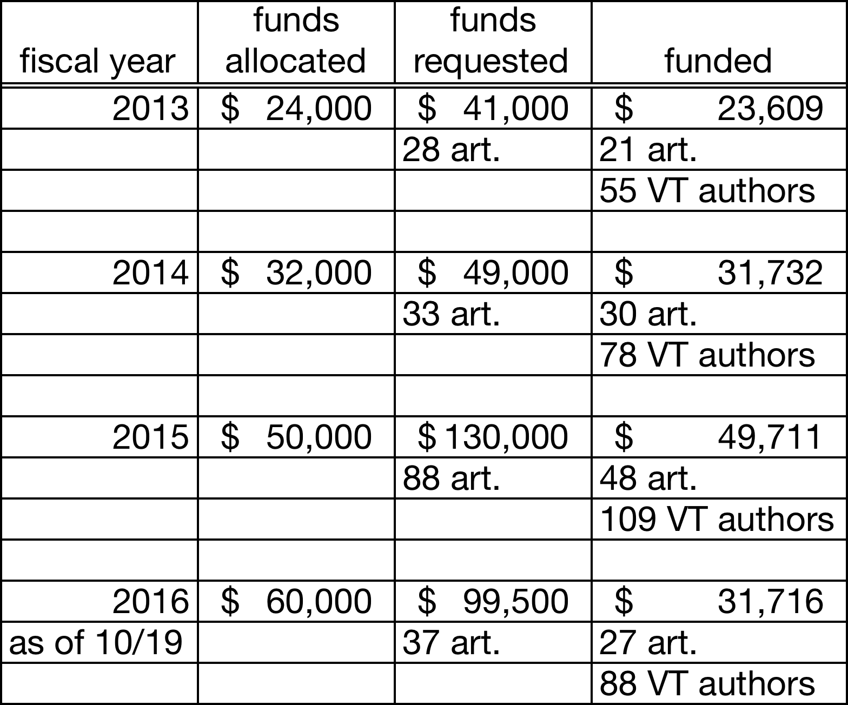
What has the VT OASF supported?

Slide 6
How is the OASF allocated?
To authors that do not have any other source of funding
$1500.00 per article x 2/yr
  Max $3000 per author per year
  Prorated for multiple VT co-authors
    $1500 distributed among the VT co-authors
    3 authors of one article subsidized at $500 each
Notes:
Yes, but, authors must not have any other sources of funding. OASF is not available for articles resulting from research sponsored by agencies that allow allocations for open access fees like the NIH.
Support is limited to $1500.00 per article and $3000.00 per author per year. For papers with multiple Virginia Tech co-authors, the program would still subsidize the same total amount of up to $1,500 per article but it would be prorated among each of the authors for the purposes of calculating amounts towards the annual limit for individuals, for example, 3 Virginia Tech authors would be allocated $500 each.
Some sources of external funding for publication of research results include: Howard Hughes Medical Institute, Rockefeller Foundation, NIH, NSF. Gates Foundation?

Slide 7
Who can you take advantage of the
VT OASF?
The entire Virginia Tech community
  Faculty
  Staff
  Graduate students
  Undergraduate students
Notes:
Everyone in the Virginia Tech community is eligible--all faculty, staff, graduate, and undergraduate students.
Faculty
P&T
AP
Staff
Graduate students and Post docs
Undergraduate students

Slide 8
Who has used the FY2016 OASF to date
Notes:
Not so different from FY 2015
Other = Assoc Dean, Instructor (2), Lab Manager, Post Doc, Research Associate/specialist/scientist

Slide 9
Stipulations
Peer-reviewed article accepted for publication in open access or hybrid journal
Open Access Scholarly Publishers Association, COPE, or similar code of conduct
Journals registered in an OA directory, such as
  Directory of Open Access Journals
  SHERPA/RoMEO
Hybrid journal publishers reduce institutional subscriptions
Funds allocated in order requests received
Invoice received by library w/in 30 days
Notes:
How to qualify for funding
GO TO OASPA (Think. Check. Submit. Just found it today)
journal's publisher must be a member of the Open Access Scholarly Publishers Association (OASPA) or comply with OASPA's Code of Conduct.
reputable OA publisher (i.e., not on Beall’s list)
clear contact info
peer-review
editorial or governing board of recognized experts
clear about fees
markets appropriately
clear copyright license
clear instructions
website has high standards
has a means of reporting misconduct
For hybrid OA journals, the publishers must have reduced institutional subscription prices, or plan to reduce prices next year, based on the number of open access publications in the journals.

Slide 10
Request OASF https://aqua.lib.vt.edu/oa-subvention.php
Name
PID
Department and college
Co-authors
Status (e.g., faculty, graduate student, another university, etc.)
Article: title, journal, publisher
Publisher’s fee
Funding amount request
Link to journal’s OA policy
No alternative sources of article support
Notes:
Status: faculty, undergraduate or graduate student, staff,

Slide 11
Review, vet, prioritize, notify
Applications reviewed by team of librarians
  Gail McMillan, fund manager
Funds
Eligibility
Guidelines
Email notification (10 days)
Notes:
The online application is sent to a team in University Libraries that reviews applications and vets and prioritizes them based on criteria for eligibility, guidelines, and available funding.
Gail McMillan, fund manager
Leslie O’Brien
Julie Speer
Philip Young

Slide 12
Last steps
How are APCs paid?
  Award to corresponding author includes
    Congratulations!
    Where to have the invoice sent, or
    Proof of payment for reimbursement
Acknowledge VT OASF in your published article
Submit article to VTechWorks
  http://www.vtechworks.lib.vt.edu
Notes:
Payment
After the OASF application is received and the author is sent notification of approval, the author informs the journal to send University Libraries an invoice. Or, the author can send proof of payment and University Libraries will reimburse the department, for example, if it paid the Article Processing Charges..

Slide 13
Colleges of Funded Authors FY16 to date
Notes:
37 requests
27 funded
About73% of the requests have been funded.

Slide 14
FY2016 Funded Publisher | Journal
BMC | BioMedical Engineering OnLine
BMC | Biotechnology for Biofuels
BMC | BMC Genomics
BMC | Clinical Epigenetics
BMC | Human Genomics (2)
Dove Medical Press | International Journal of Nanomedicine
Elsevier | New Negatives in Plant Science
Frontiers | Frontiers in Terrestrial Microbiology
Hindawi | Abstract and Applied Analysis
Hindawi | Journal of Computational Medicine
Hindawi | Journal of Robotics
Hindawi | Stem Cells International
NAS | Proceedings of the National Academy of Sciences
Nature | Scientific Reports (2)
OMICS | International Journal of Biomedical Data Mining
PLOS | PLoS One (7)
STEM Education and Research Institute | Journal of STEM Education: Innovations and Research
Taylor & Francis | Journal of Plant Interactions
Wiley | Food Science & Nutrition

Slide 15
VT Open Access Subvention Fund
https://aqua.lib.vt.edu/oa-subvention.php
Gail McMillan
  gailmac@vt.edu
  540-231-9252
  421 Newman Library

Slide 16
https://aqua.lib.vt.edu/oa-subvention.php
Open Access Scholarly Publishers Association, COPE, or similar code of conduct
Open access journal directories
  Directory of Open Access Journals
  SHERPA/RoMEO
Notes:
Questions?
Feel free to go to the OASF web page and test or complete an application.
Or, perhaps you like to see if a journal you’re familiar with is registered in the DOAJ or w/Sherpa/Romeo.
Or, find a new journal through these registries that you may not be familiar with.

