Slide 1

Social Interaction around Electronic Resources: Making eReserves Social
Anita Walz, Open Education and Online Learning Environments Librarian
Charla Gilbert, Director of Assessment and Library Access Services
Virginia Tech Libraries
arwalz@vt.edu charla70@vt.edu
Virginia Library Association Professional Associates Forum
Richmond, VA - May 20, 2014
This presentation is licensed as exclusive of images.
Notes:
[intro needs help] I’m Anita. I’m Charla. We’re from Virginia Tech and we’d like to tell you about a project we’ve been working on that relates to promoting Social Interaction around electronic resources – in this case “eReserves”. – specifically journal articles and book chapters, with the hopes of someday etextbooks.

Slide 2
We will discuss . . . .
What we mean by “making electronic resources social”
Project rationale (context & problems)
Dreams of something better
Pilot projects and findings
Current status

Slide 3
Making Electronic Resources “Social”
Enable virtual “conversation around a text [electronic resource]”
Encourage deeper student understanding of documents
More quickly consolidate student questions
Efficient sharing one-to-many (and many to one)
Promote deeper conversations between students, and between students and instructors
Notes:
Due to increased “online” learning and “flipped classroom” models.
Sometimes we hear from students (online) that we’d not hear from in a regular F2F class.

Slide 4

© S.C. Asher via Compfight CC 2.0 BY-NC-SA http://creativecommons.org/licenses/by-nc-sa/2.0/
Notes:
A very brief history of Reserves

Slide 5
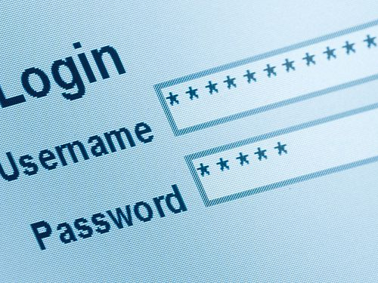
eRESERVES
© Albaniaman, 2012. CC BY-SA 3.0
http://creativecommons.org/licenses/by-sa/3.0/deed.en

Slide 6
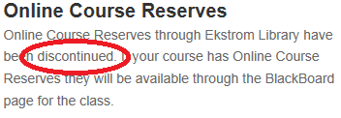
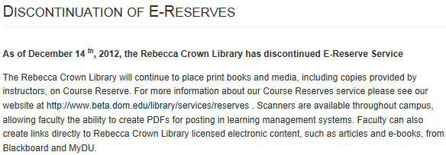
Current Status of Course Reserves
Usage of course reserves is way down
Many institutions have moved reserves to LMS
Potential copyright issues?
Library cut out of process
Library loss of usage metrics
http://louisville.edu/library/services/reserves_searching.html
https://lib.ku.edu/electronic-reserves
http://beta.dom.edu/library/help/discontinuation_of_e-reserves

Slide 7
Why?
VT Faculty using other methods of transmission
  Learning Management System
  Possibly using other types (non-library) materials
  Linking directly to library-subscribed resources
Notes:
Why not just let it go and close the “Reserves” service?

Slide 8
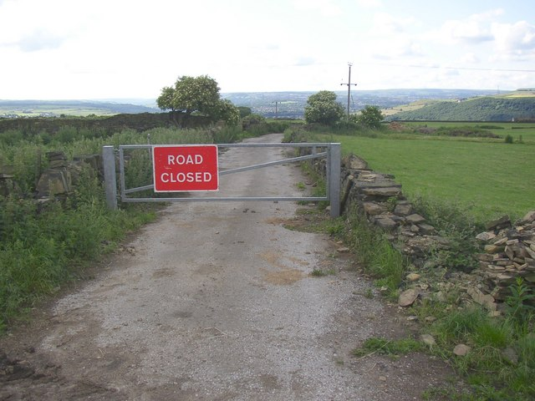
Why (and why do we care)?
© Humphrey Bolton CC BY- SA http://www.geograph.org.uk/photo/470682

Slide 9
Why (and why do we care)?
Opportunity serve students
  High quality, vetted materials
  New opportunities to leverage technology for learning
Opportunity to work with Faculty
  Encourage good practice re: Copyright
  Inform regarding new ways of teaching & learning
  Utilize “Reserves” exemption afforded by Copyright law
Desire to put the library back into the learning process.

Slide 10


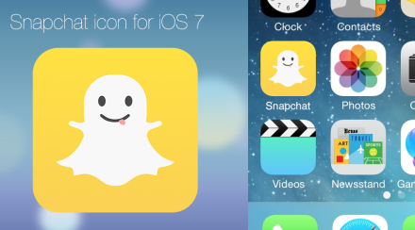
How incoming students communicate
Snapchat
Text Messaging
Twitter
Facebook
Email
© Jhaymesisviphotography CC BY http://www.flickr.com/people/jhaymesisvip
© Gabrielchihonglee, CC BY NC
http://commons.wikimedia.org/wiki/File:Twitter_circle.png
© Boonzeet CC BY NC
http://boonzeet.deviantart.com/art/Snapchat-iOS-7-App-icon-377666576

Slide 11
New options for instructors/student communication
Instant Messaging
Online Office Hours
Discussion forums and blogging
Conversations around digital resources
Notes:
Increasingly digital. Enables instructors to avoid massive amounts of email. More comfortable/familiar for students.

Slide 12
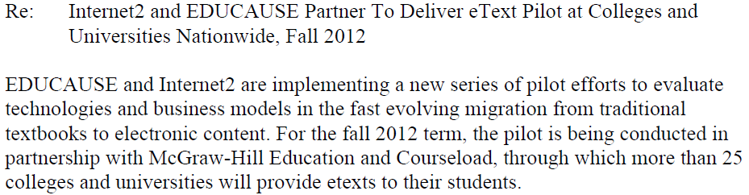
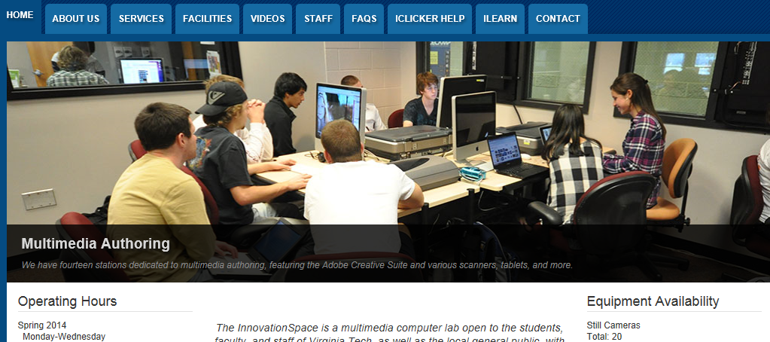
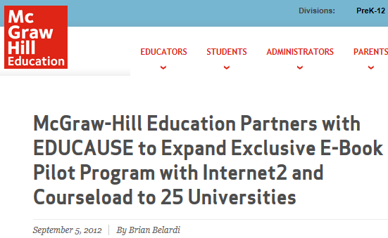
Following up on a Pilot project
Notes:
Pilot between InnovationSpace, Courseload (with McGraw Hill) inspired by the EDUCAUSE structure with IU. Unique because content is paid for by the institution. Courseload did not have the infrastructure to have the Library administer uploads. In the meantime McGraw Hill pulled out of the pilot and a small team of Library & InnovationSpace people began to meet to look at alternatives.

Slide 13

Dreams of something better
© Luca Lorenzi, CC BY SA

Slide 14
Dreams of something better
(aka: “Our Vision”)
Relevant to how students communicate now
Social learning aspect
Local course management
Easy/automated document uploading/removal
Stable URLs
Integration with institution systems
Search-enabled eText
508 Compliant
Printable and retainable texts
Mac / PC compatible

Slide 15
Software ‘Must have’ features
Ability to comment on shared documents
Intuitive to users
Easily accessible to users
Ease of administration
Notes:
Easy access = ability to link from LMS to login screen

Slide 16
Software ‘Nice to have’ features
Ebook compatible
Mac / PC compatible
Images (jpg, gifs etc.)
Inexpensive

Slide 17
Social Software Reviewed
Hylighter
Courseload
Google Drive
Piazza
Vtext – Using Microsoft OneNote

Slide 18
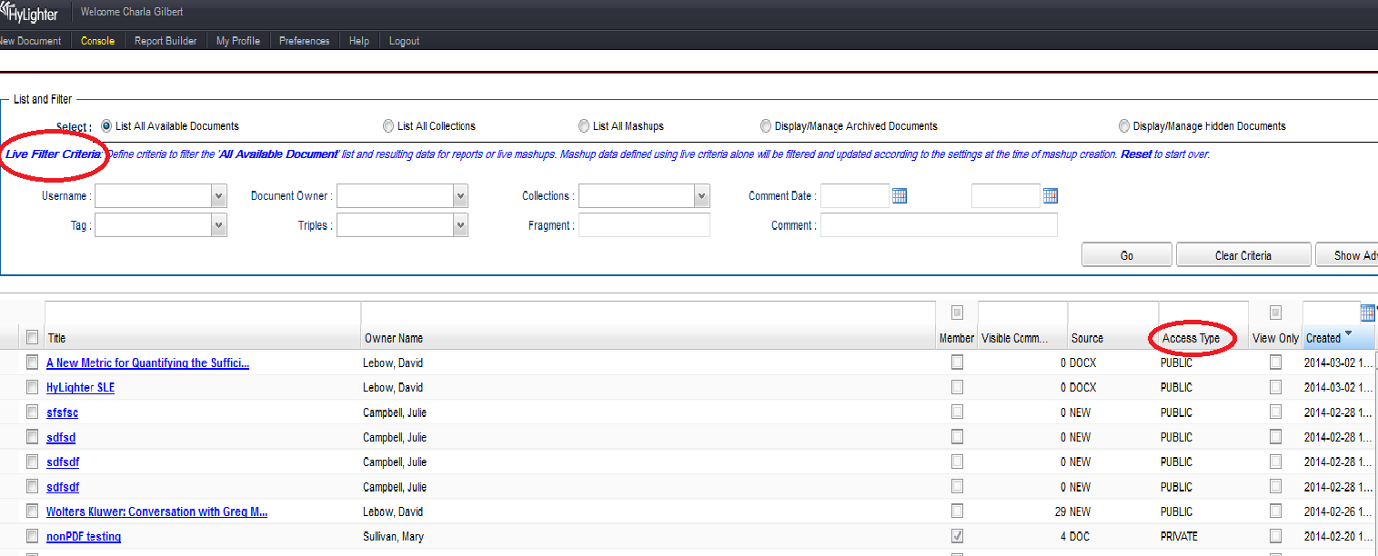
Hylighter Home Page

Slide 19
Hylighter Pro’s and Con’s
Pro’s
Collaboration/comments
Sharing documents
Searching for documents filter
Can collaborate on jpg’s
Good for future work on Thesis/Dissertations
Company is easy to work with
Has a walk through ‘how to’
Con’s
Problems with Word document uploads
Not an intuitive organizational structure
PDF’s must use OCR scanned documents
Unsure of ebook collaboration abilities (Epubs will work)
Not easy to manage (users and admins)

Slide 20
Hylighter Home Page

Slide 21
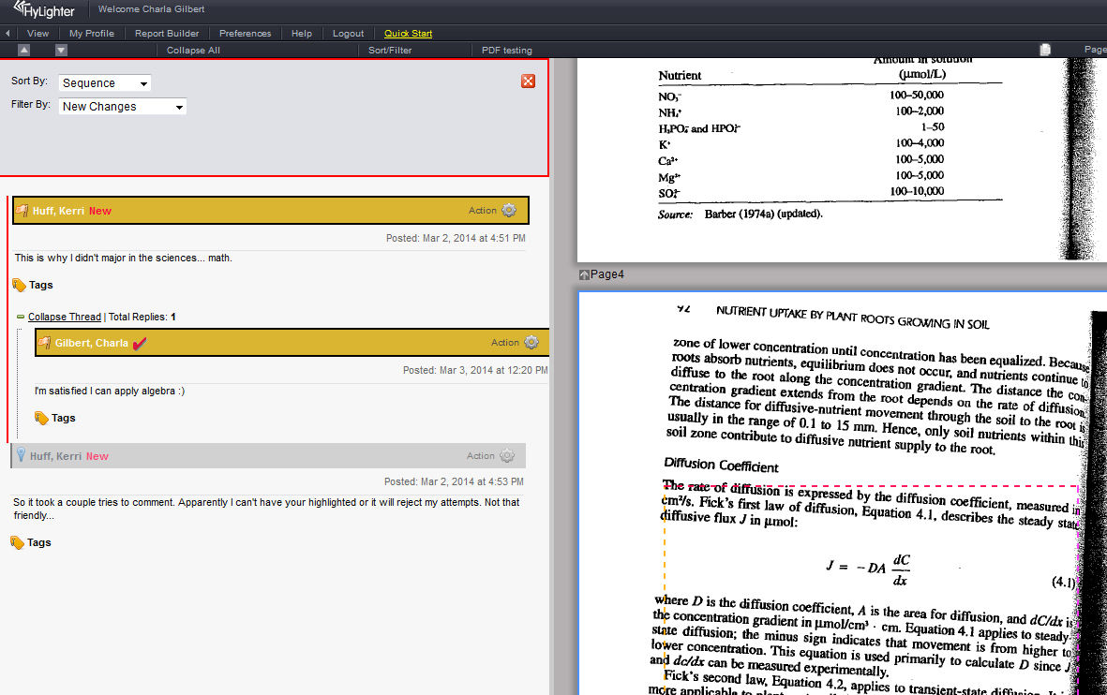
Hylighter Comment

Slide 22
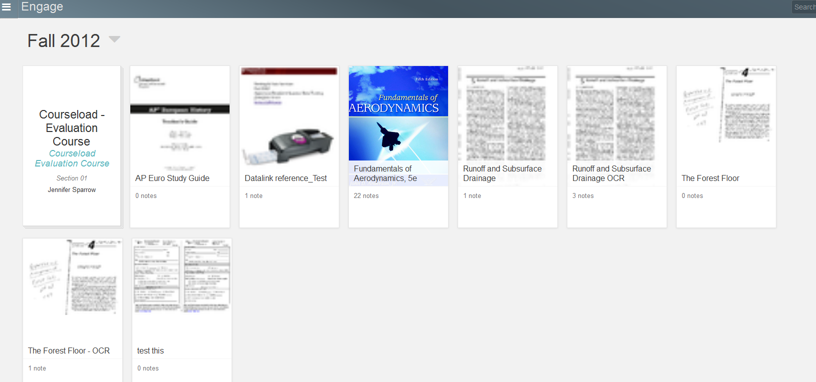
Courseload Home Page

Slide 23
Courseload Pro’s and Con’s
Pro’s
Collaboration/comments
Has e-book comment/collaboration abilities
Con’s
Could use improvement in organizational structure
Sharing of documents was for instructor use only
PDF’s must use OCR scanned documents
Did not have management capabilities

Slide 24
Courseload Home Page

Slide 25
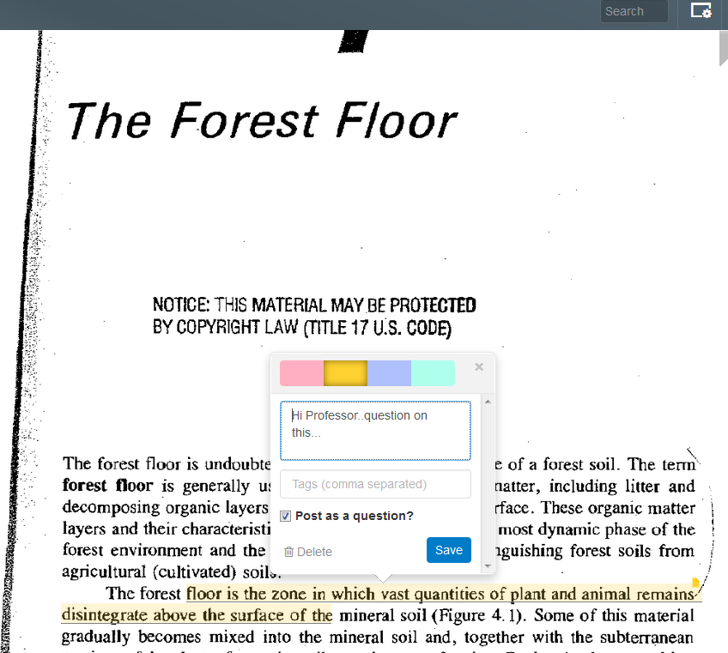
Courseload Comment
Notes:
You can tag the notes to look for specific topics either for yourself or if the instructor plans to use them.

Slide 26
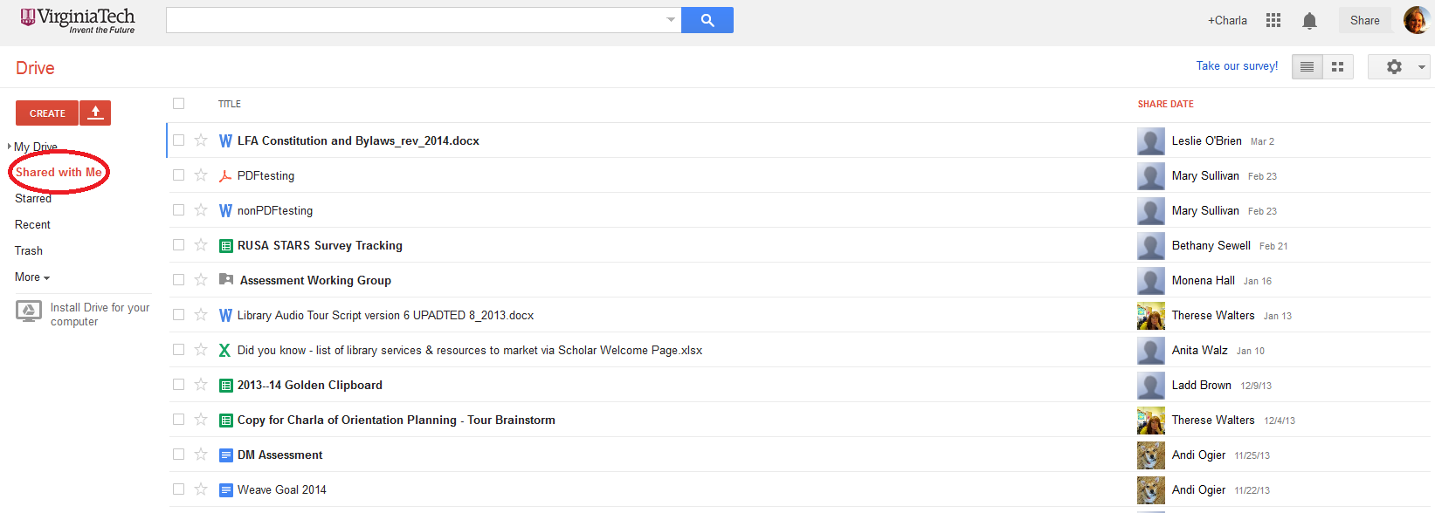
Google Drive Home
Notes:
How many familiar with google drive?

Slide 27
Google Pro’s and Con’s
Pro’s
Collaboration/comments
Sharing documents
Students are already familiar with the product
Easy to administer
FREE
Con’s
Must know to choose ‘open in Google Docs’ in order to comment
Problems with Word document uploads (with pictures and formatting)
No easily intuitive organizational structure
Unsure of ebook collaboration abilities
PDF’s must use OCR scanned documents

Slide 28
Google Drive Home

Slide 29
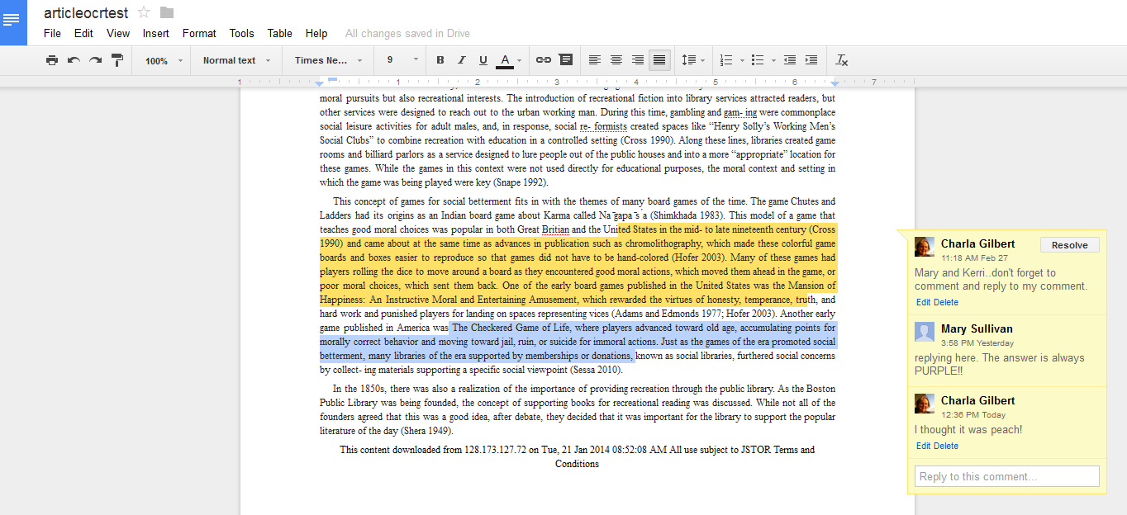
Google Comment

Slide 30
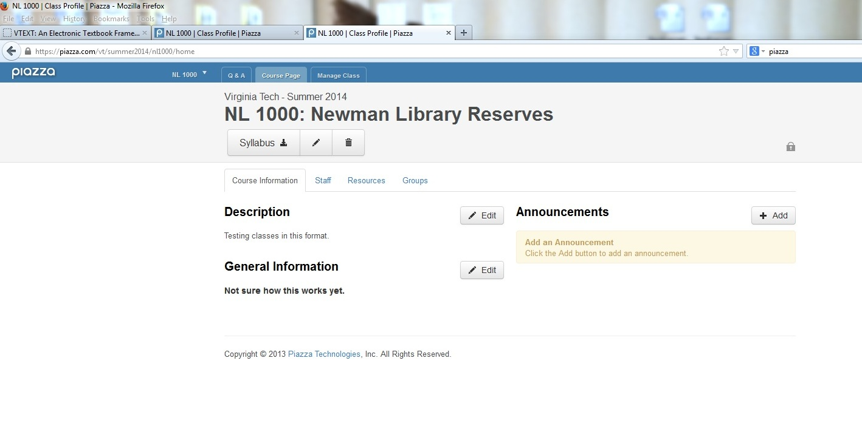
Piazza Course Page Home

Slide 31
Piazza Pro’s and Con’s
Pro’s
Easily intuitive organizational structure
No difficulty in uploading documents
Some places on campus are already using this
Easy to administer
Con’s
Collaboration/comments were outside the document
Unsure of ebook collaboration abilities

Slide 32
Piazza Course Page Home

Slide 33
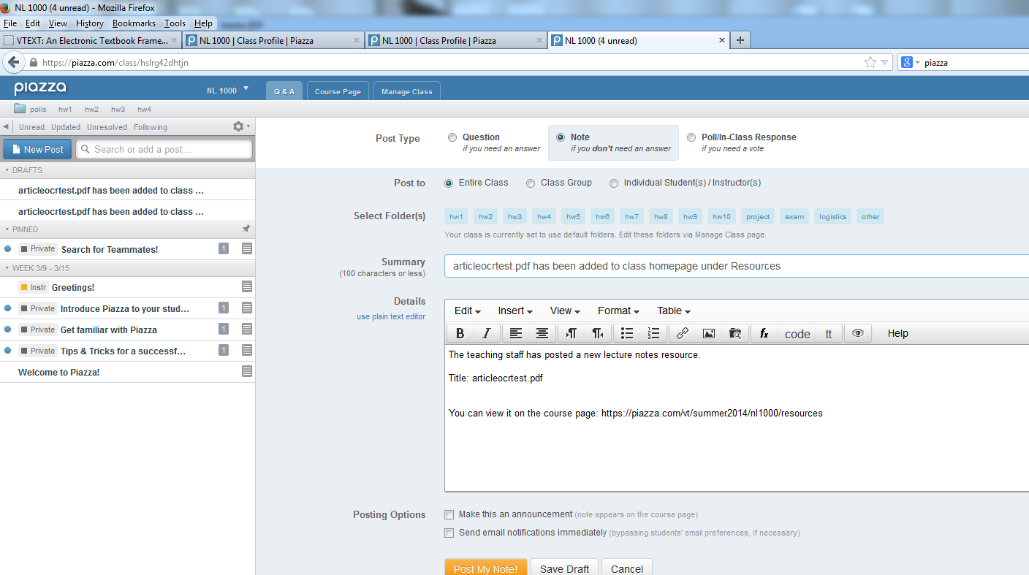
Piazza Comment

Slide 34
Pilot Project
Google E-reserves History course pilot
Embedding questions into the text
Mandating comments on the documents
Monitoring participant activities
For more information, contact Mary Sullivan marysull@vt.edu

Slide 35
More Information
Hylighter - http://www.hylighter.com/hybar/site/index.html
Courseload- http://www.courseload.com/e-textbook-and-digital-course-materials-solution
Google Drive - http://www.google.com/drive/
Piazza - https://piazza.com/
https://net.educause.edu/ir/library/pdf/ELIB1302.pdf

Slide 36
Questions and Thanks!
Anita Walz, Open Education and Online Learning Environments Librarian, arwalz@vt.edu
Charla Gilbert, Director of Assessment and Library Access Services, charla70@vt.edu

