Slide 1
Prep Lab
Steven McKim, Drew Bond, Nathan Kendrick
Multimedia/Hypertext - CS_4624 - Fox
Virginia Tech, Blacksburg, VA 24061
4/11/2019

Slide 2

Outline
Project Design
Current Progress
User Testing
Demo
Problems & Issues
Future Work
Lessons Learned
Acknowledgements
References

Slide 3
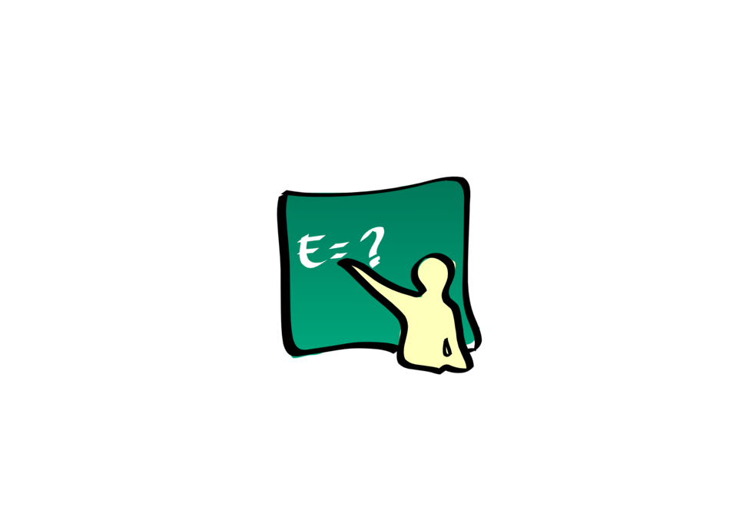
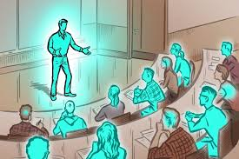



What is PrepLab

Slide 4




Project Design
Online repository to help instructors reuse and remix course material
Majority of use cases will be graduate students
Using React, CSS, and JSON
Development was done using GitHub repository, Atom IDE, and NodeJS

Slide 5
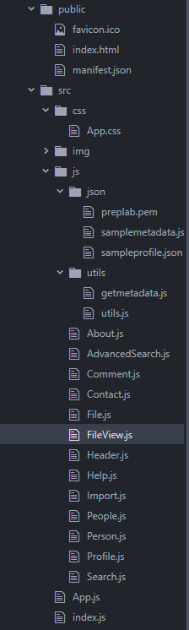
Current Progress
Pseudo Login
  User persist just for session (no back-end) for testing
  Hide Profile page, People page, as well as Upload Resource form behind login
Mobile friendly
Basic search functionality
  Is only be connected to our sample data
Add more fields to resources
  Class, class size, number of downloads, comments, tags, etc
Additional UI Improvements
Testing
Documented code for future PrepLab teams

Slide 6
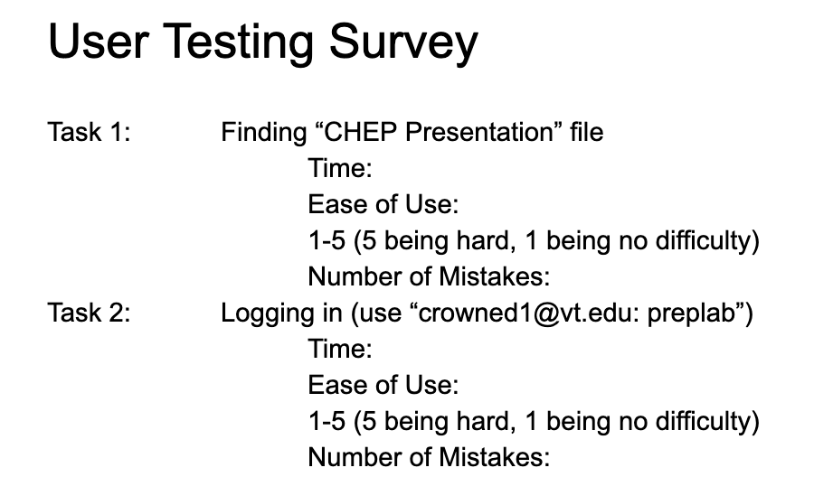
User Testing
Task 1: Finding “CHEP Presentation” file
Task 2: Logging in using a given login
Task 3: Viewing Own Profile
Task 4: Viewing a specific user’s profile
Task 5: Submitting a file with specific options
Task 6: Comment on “CHEP Presentation” file
Task 7: Delete “How PNG Compression Works”
Task 8: Edit “Example PNG File” file
Task 9: Logout
Task 10: Register an account to PrepLab
Overall, all tests passed our usability goals

Slide 7
Live Demo
Link: http://3.18.234.84:3000/home

Slide 8

Mobile Demo
Link: http://img.chartio.com/f1219dd4f269

Slide 9

Problems & Issues
Testing site without full functionality
Being able to test hooks properly
CSS can be fickle

Slide 10
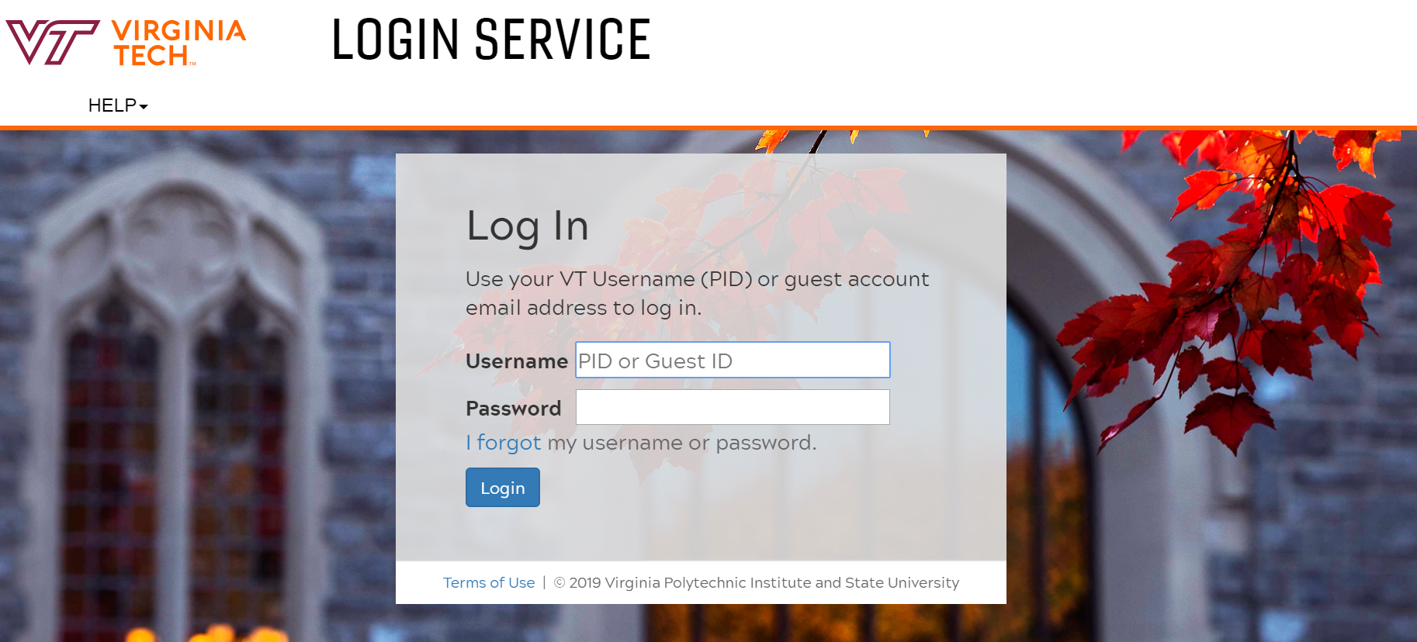
Future Plans
PrepLab 2 is complete
  Nothing left for our team to work on in code base
Setup Database
  NoSQL
Fully functional API
User Support
  Login
  Advanced Search
Expansion and Adoption
  Looking for GTAs to join

Slide 11

Lessons Learned
Creating a fully-formed idea of app with all functionality from the beginning
  More thoughtful design during early iterations
  Break down into more reusable components sooner
Have more solid deadlines
  Would have allowed more iterations
User test more frequently
  Catch bugs, design flaws, and not UX friendly designs sooner

Slide 12

Acknowledgements
Darren Maczka: Client - dmaczka@vt.edu
Rest of PrepLab Team: Leanna Ireland, Britton Hipple, Sara Donnelly
Dr. Fox: Professor of Computer Science - fox@vt.edu

Slide 13
References
How to host: https://www.sitepoint.com/getting-started-react-jsx/ 2016 - Shandeep
PandaReact: https://reactjs.org/docs/add-react-to-a-website.html 2019
ReactRouting: https://tylermcginnis.com/react-router-url-parameters/ 2018 - Tyler McGinnis
Sticky Footer: https://philipwalton.github.io/solved-by-flexbox/demos/sticky-footer/
Website Used for UI Reference: National Science Digital Library - https://nsdl.oercommons.org
Current PrepLab Blog - https://blogs.lt.vt.edu/preplab/

Slide 14
Questions or Comments?

