Slide 1


Lessons Learned from the National Collaborative for Research on Food, Energy, and Water Education
Hannah H. Scherer, PhD, Virginia Tech
This material is based upon work supported by the National Science Foundation under Grant No. 1856040 and 2242276 (ECR-EHR Core Research), National Institute of Food and Agriculture, U.S. Department of Agriculture, under award #1006539 and #2017-06281, and the Network of STEM Education Centers/APLU. Any opinions, findings, and conclusions or recommendations expressed in this material are those of the author(s) and do not necessarily reflect the views of these funding agencies.

Slide 2
Overview of our time together
What is NC-FEW?
Central grant-funded activities and structure of the network
Successes and challenges in fostering interdisciplinary collaboration
Q&A and open discussion
Notes:
What is NC-FEW – including overview of FEW Nexus and reason for starting a collaborative

Slide 3
Overview of our time together
What is NC-FEW?
Notes:
What is NC-FEW – including overview of FEW Nexus and reason for starting a collaborative

Slide 4
Major resource challenges are grounded in the
Food-Energy-Water-Nexus (FEW-Nexus)
Framework for natural systems and their human dimensions
=
coupled human-natural systems
≈
socio-ecological systems
Food systems
Energy systems
Water systems
Notes:
The only reason that this framework exists because humans rely on them and are implicated in resources challenges

Slide 5
Major resource challenges are grounded in the
Food-Energy-Water-Nexus (FEW-Nexus)
The FEW-Nexus affords a novel theoretical and analytical lens through which to understand and effectively foster teaching and learning.
Food systems
Energy systems
Water systems
Notes:
The only reason that this framework exists because humans rely on them and are implicated in resources challenges

Slide 6
Need for a collaborative to innovate education research
FEW-Nexus transcends disciplinary boundaries
Early efforts showed promise
Few efforts to study strategies, processes, and outcomes of FEW-Nexus-based education efforts
Research to understand teaching and learning in the FEW-Nexus was emerging
National Collaborative for Research on Food, Energy, and Water Education
NC-FEW
Notes:
NC-FEW – Relevant Goals
Synthesize current education research on educational programming grounded in the FEW-Nexus
Identify and promote best practices in education research on educational programming grounded in the FEW-Nexus

Slide 7
Support for network initiation: 2016-2018
USDA/NIFA Multistate Research Planning Committee NCDC231: Collaborative for Research on Food, Energy, and Water Education
Lead: Cory Forbes, University of Nebraska-Lincoln, 2016-2018.
Invited symposium held in 2017 in conjunction with the Water for Food Conference at the University of Nebraska-Lincoln
Multistate planning committee meeting at symposium
USDA/NIFA Multistate Research Committee NC1207: Collaborative for Research on Food, Energy, and Water Education
Lead: Cory Forbes, University of Nebraska-Lincoln, 2018-2021; Hannah Scherer and Christine Li, 2021-2023
Spring 2018 Conference: Innovating Teaching and Learning in the Food-Energy-Water-Nexus: Toward a National Collaborative for Food, Energy, & Water Systems Education (NC-FEW)
USDA-NIFA Higher Education Challenge grant program, APLU’s Network of STEM Education Centers Research Action Cluster grant program, the UNL Agricultural Research Division, and VT in the National Capital Region.

Slide 8
FEW-Nexus-based education is…
Defined by
NC-FEW
inherently inter-/trans-disciplinary
complex systems thinking
grounded in real-world sustainability challenges
involves stakeholders
local to global scales
argumentation/evidence-based reasoning
citizen science
equity and environmental justice
informed decision-making
STEM/FANH science literacy
civic engagement

Slide 9
FEW-Nexus-based education is…
Broader contextual factors
Limitations of educational structures
Lack of resources and support
Individual barriers
evolving to address challenges

Slide 10
NSF Research Coordination Network (RCN): 2019-2025 funding
“Supports networks that foster communication and new collaborations among scientists, engineers and educators who share a common interest…”
“RCN awards also do not support primary research. Rather, the RCN program supports
the means by which investigators can share information and ideas,
coordinate ongoing or planned research activities,
foster synthesis and new collaborations, develop community standards, and
in other ways advance science and education through communication and sharing of ideas.”
“Proposed networking activities directed to the RCN program should focus on a theme to give coherence to the collaboration, such as a broad research question or particular technologies or approaches.”
https://www.nsf.gov/pubs/2017/nsf17594/nsf17594.htm

Slide 11
National Collaborative for Research on Food, Energy, and Water Education (NC-FEW)
A hub for people who are interested in expanding and improving FEW-Nexus-based education through research and/or practice
Goals:
Synthesize current education research on educational programming grounded in the FEW-Nexus
Identify and promote best practices in education research on educational programming grounded in the FEW-Nexus
Foster collaboration among community members representing diverse disciplines, fields, expertise, and institutions
Enhance capacity for extramural funding in support of education research on educational programming grounded in the FEW-Nexus
Cultivate a community identity among NC-FEW participants

Slide 12
Overview of our time together
Central grant-funded activities and structure of the network
Notes:
What is NC-FEW – including overview of FEW Nexus and reason for starting a collaborative

Slide 13
NC-FEW Leadership Team
Postsecondary
Working Group
Leadership Team, Working Group Members, and Advisory Board are listed on our website
Working Group Chairs
NC-FEW Director & co-Directors
PK-12
Working Group
Informal/
non-formal
Working Group

Slide 14
NC-FEW Website: central hub
Project website - https://serc.carleton.edu/nc-few/index.html
Key Features
NC-FEW information
vision, mission, goals, and funding
List of NC-FEW leadership team and working group members
Events
Past conference information
Registration and logistics
Workspace for participants
Webinars and Newsletters
Archive
Registration for upcoming webinars
Suggest topics/speakers
Developed and hosted by the Science Education Resource Center (SERC)

Slide 15
FEW-Nexus-based education research and practice training series
Quarterly Web-based Series
Supporting participants in advancing education research and educational programming grounded in the FEW-Nexus
Emphasis on Design Based Research & Critical Research and Perspectives
Theoretical and analytical perspectives and approaches
Showcasing individual Nexus-focused educational programs/research
Synthesis document posted for each webinar

Slide 16
Newsletters
Quarterly
Highlighting information relevant to the community
Showcasing work of NC-FEW community members
Sharing information about relevant funding programs and conferences
Discussing and soliciting feedback on ongoing efforts
Community news and events

Slide 17
Invited Conferences
Example activities
Keynote speakers
Interactive poster sessions
Sharing and synthesis of working groups and community products
Fostering collaboration
Generating grant proposal ideas
Overall community-building

Slide 18
Workshops at professional conferences
9 total, each with different disciplinary audiences
NC-FEW member led
Workshop Objectives
Define and describe FEW-Nexus-based education
Identify and describe challenges with FEW-Nexus-based education
Ideate how [geography, geoscience, agricultural, etc.] education research can generate new knowledge to address these challenges
Artifacts analyzed as basis for new framework

Slide 19
Publications and Resources
An NC-FEW community vision for FEW-Nexus-based education
Working Group publications specific to educational contexts
FEW-Nexus-based Education Research and Practice briefs
Submissions from community, based on conference proceedings
Final report with stories, lessons learned, and recommendations for future research and networking

Slide 20
Overview of our time together
Successes and challenges in fostering interdisciplinary collaboration
Notes:
What is NC-FEW – including overview of FEW Nexus and reason for starting a collaborative

Slide 21
Challenges and advice
Distributed network
Incentivizing members to initiate projects
External forces
Having to pivot several times
Remain committed to goals
Disciplinary imbalance
Uneven representation
Use stakeholder matrix
Seed funding for new teams

Slide 22
Challenges and advice
Sustaining momentum: Strategies that worked
Formalized, funded roles
Honoraria for members in specific roles
Take time to build trust and reciprocity
Projects aligned with job expectations (e.g., scholarly publications for faculty)

Slide 23
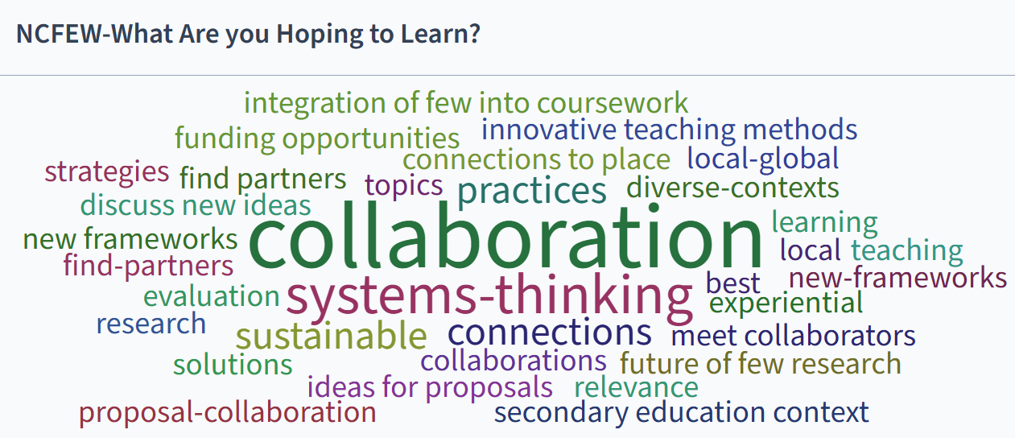
Successes

Slide 24
Successes
By the end of the NSF project period in summer 2025
432 members
92 different institutions
representing more than 50 different disciplines and sub-disciplines
Conferences were effective in kick-starting new collaborative projects – participatory design, fully funded expanded opportunity
Working group structure drove deep collaborations around publications and research efforts
Continued engagement through listserv, quarterly newsletters, virtual workshops sustained momentum

Slide 25
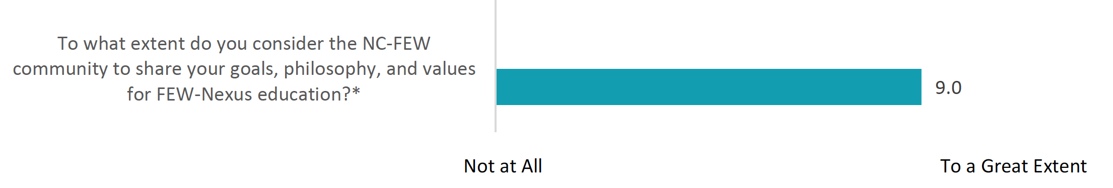
Successes: Evaluation insights
Those who participated most frequently in NC-FEW programming rated their general and FEW Nexus education research skills as stronger than those who attended fewer events

Slide 26
Overview of our time together
Q&A and open discussion
Notes:
What is NC-FEW – including overview of FEW Nexus and reason for starting a collaborative

Slide 27

Let’s chat!
NC-FEW Website: https://tinyurl.com/NC-FEW
Join listserv
See archives of materials
Synthesis of NC-FEW Efforts and Outcomes: 2019-2025
Hannah H. Scherer, PhD
Department of Agricultural, Leadership, and Community Education
Virginia Tech
hscherer@vt.edu

