Slide 1
Patent Data Analysis
Abhishek Jha, Boyan Tian, Matthew Cooper, Zifan Wang
CS 4624 Multimedia, Hypertext and Information Access, Dr. Edward A. Fox
Virginia Tech, Blacksburg VA 24061, 27 April 2021

Slide 2
Presentation Overview
Project Recap
Final Design
Term Frequency-Inverse Document Frequency
The Road Ahead
Lessons Learned
Acknowledgements

Slide 3
Project Recap
Question
Collect Data
Analyze
Three parts of data analytics
  Where do we fit in?
Deliver a Jupyter Notebook that scrapes Google Patents.

Slide 4
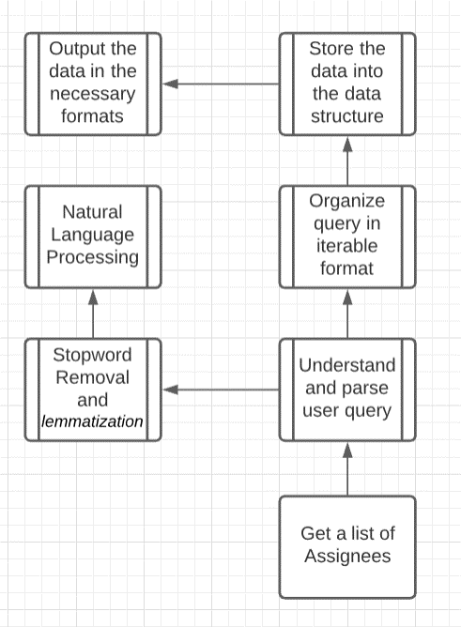
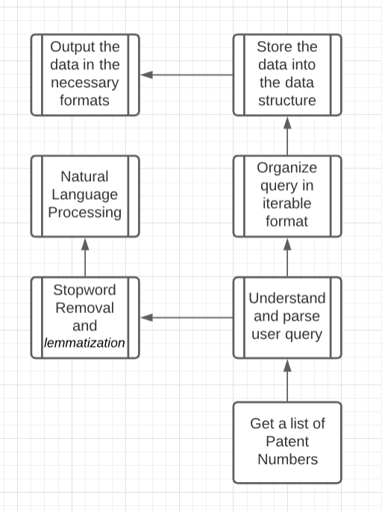
Final Design
Methodology 1
Methodology 2

Slide 5

Term Frequency-Inverse Document Frequency (TF-IDF)
What is TF?
What is IDF?
Why use them?
Allows classification based on the terms used in the patent itself.

Slide 6
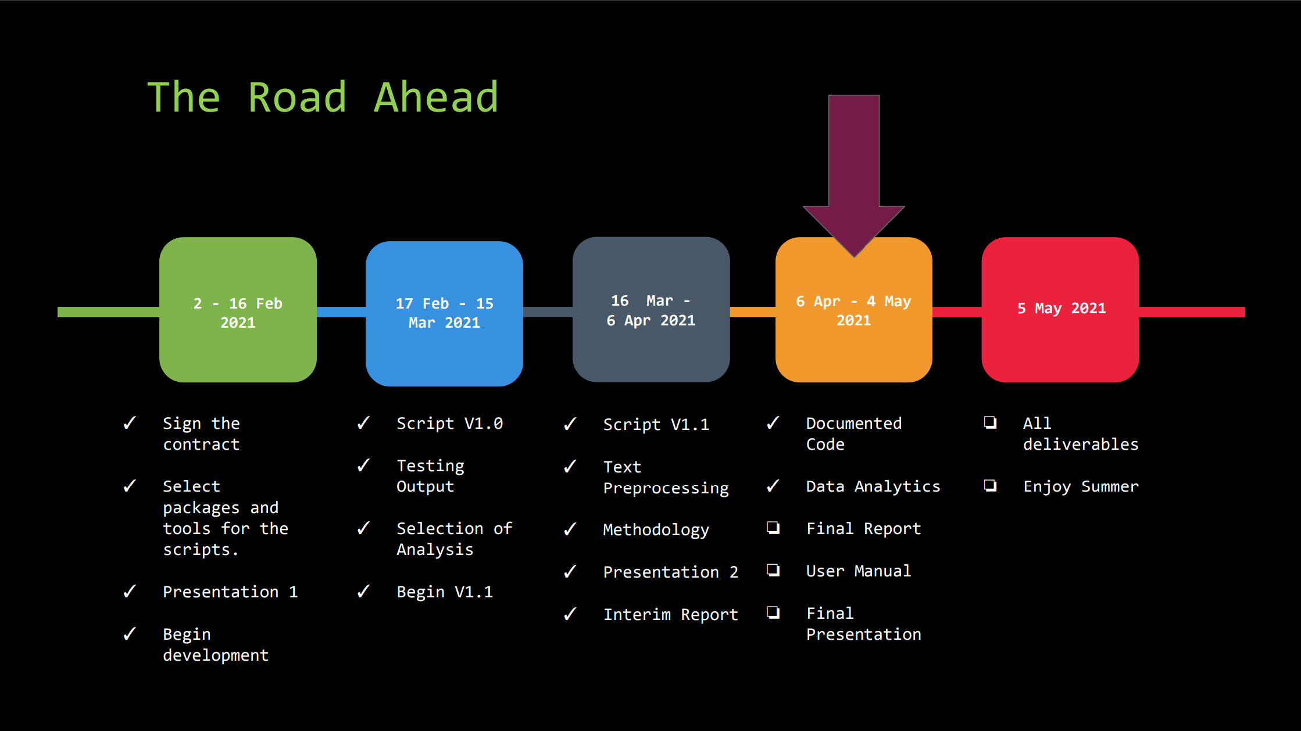

Slide 7
Lessons Learned
Constant communication is essential
Starting Early
  Baby step execution
  Keeping track of deadlines
We should buy an Agile Development handbook

Slide 8

Acknowledgments
Dr. Florian Zach
Howard Feiertag Department of Hospitality and Tourism Management
florian@vt.edu

Slide 9
Questions…

