Slide 1
Just Laugh it Off: Humor, VET Tv, and the Possibilities of Resilience
John E. Armenta

Slide 2
VET Tv
“an online streaming television network that creates humor for veterans, by veterans. Our content is both entertaining and therapeutic. We call it Parody with a purpose.” (VET Tv, n.d.)
“VET Tv creates targeted and therapeutic entertainment for the veteran community, in order to promote camaraderie and prevent veteran suicide.” (VET Tv, n.d.)

Slide 3
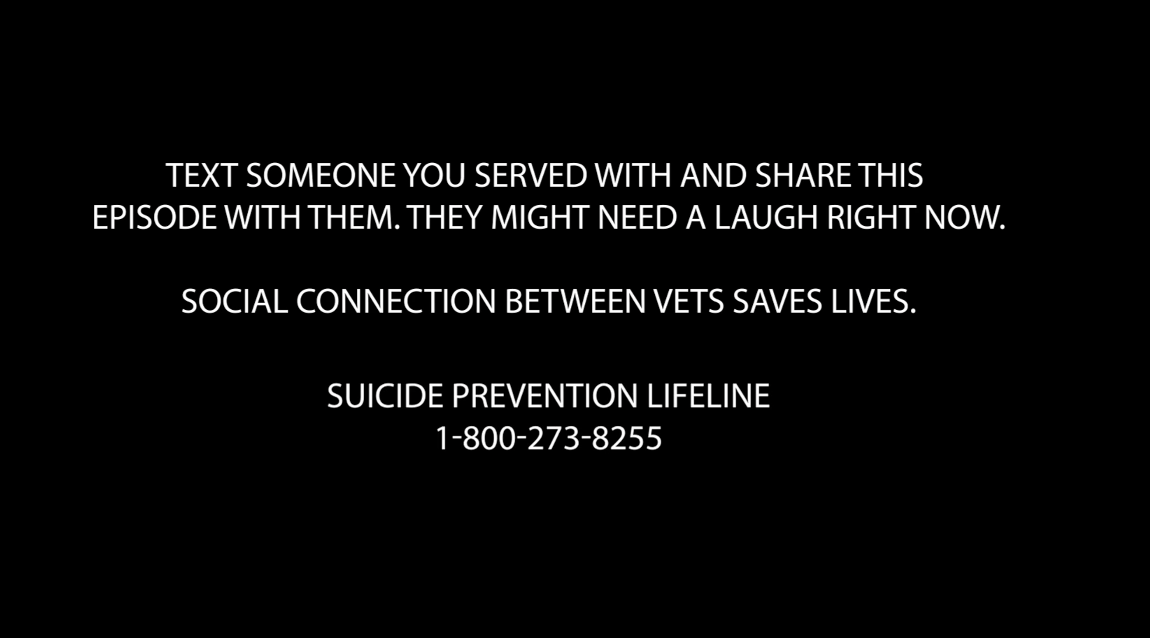

Slide 4
VET Tv
“an online streaming television network that creates humor for veterans, by veterans. Our content is both entertaining and therapeutic. We call it Parody with a purpose.” (VET Tv, n.d.)
“VET Tv creates targeted and therapeutic entertainment for the veteran community, in order to promote camaraderie and prevent veteran suicide.” (VET Tv, n.d.)
“dark, vulgar, offensive, inappropriate, irreverent, childish, and just plain wrong.” (O’Malley, 2016)

Slide 5
Humor, trauma, and resilience…
Humor can promote resilience, work through trauma
(Kugler and Kuhbandner, 2015)
Establish bonds with groups, trust with therapist
(Dziegielewski et al., 2003)
Positive coping mechanism
Garrick, 2006
Learning stand-up comedy enhances resilience
Olah et al., 2022

Slide 6
Humor, trauma, and resilience…
But maybe not “dark” or “gallows” humor
Perchtold et al., 2019
Self-enhancing humor helps coping, post-traumatic growth; self-defeating humor results in emotional regulation problems
Boerner et al., 2017

Slide 7
Military Humor
Focus on the ordinary

Slide 8
Military Humor
“Routine and standard operating procedure mark the military life in times of peace and become the source of much military humor in order to survive the boredom or tedium. Even in wartime, military humor will focus on the larger periods of inaction, the wasted days and years of performing duties that are unchallenging and seemingly unproductive.”
--Marvin Koller, Humor and Society, 233

Slide 9
Military Humor
Focus on the ordinary
Civilians may not “get it”
Some examples
Bill Mauldin, “Willie and Joe”

Slide 10
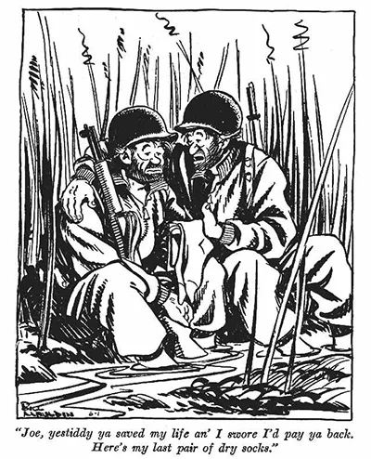

Slide 11
Military Humor
Focus on the ordinary
Civilians may not “get it”
Some examples
Bill Mauldin, “Willie and Joe”
Max Uriarte, “Terminal Lance”

Slide 12
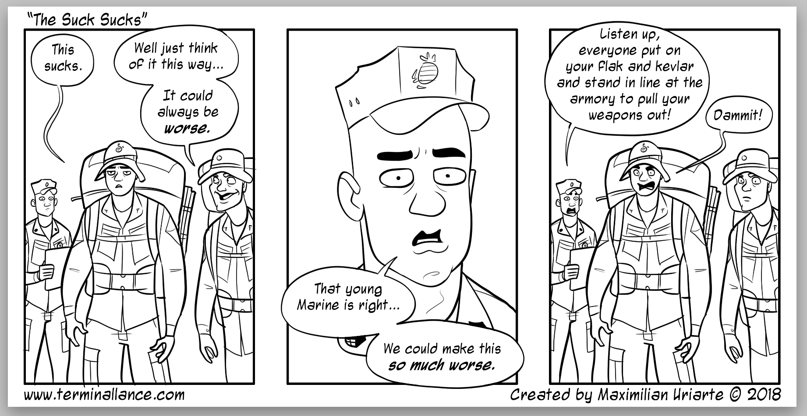

Slide 13
Military Humor
Focus on the ordinary
Civilians may not “get it”
Some examples
Bill Mauldin, “Willie and Joe”
Max Uriarte, “Terminal Lance”
Duffel Blog

Slide 14


Slide 15
Military Humor
Focus on the ordinary
Civilians may not “get it”
Some examples
Bill Mauldin, “Willie and Joe”
Max Uriarte, “Terminal Lance”
Duffel Blog
VET Tv

Slide 16


Slide 17
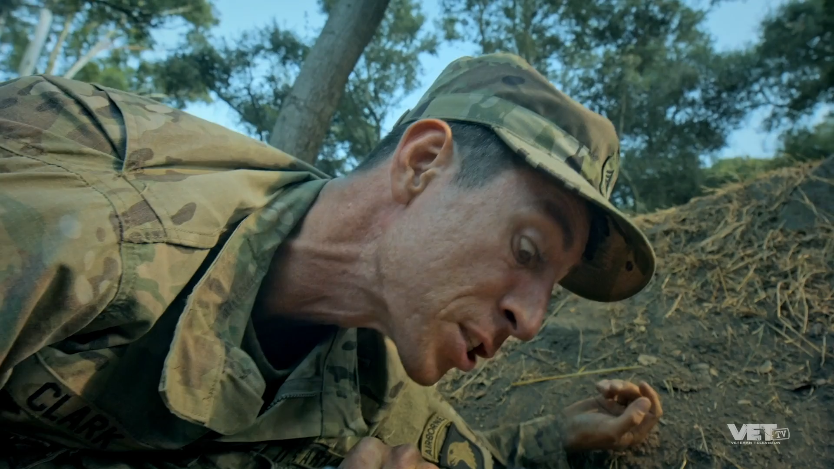

Slide 18
VET Tv
Started in 2016
by Donny O’Malley
Streaming Video On Demand
Post 9/11 veterans

Slide 19
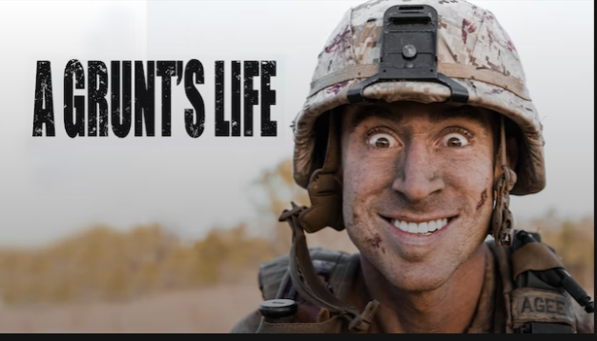
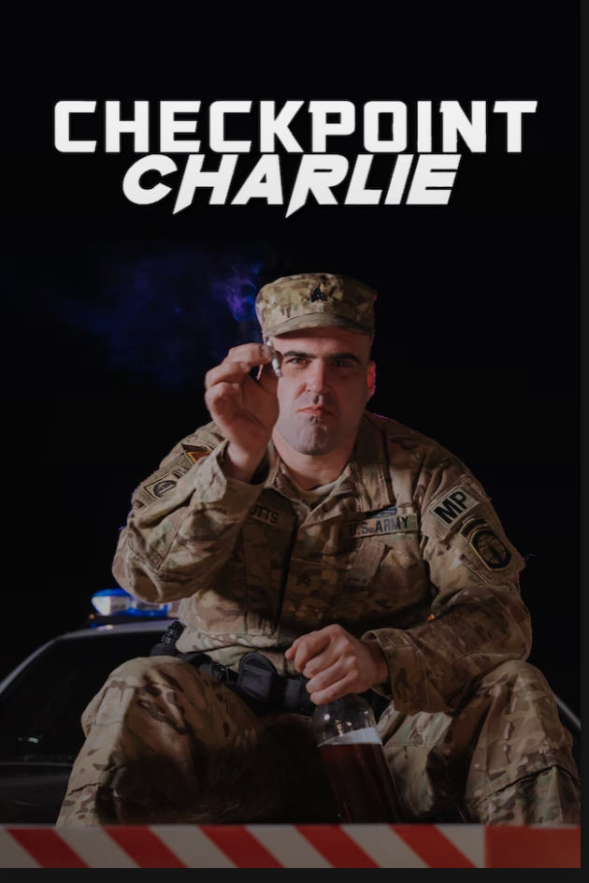

VET Tv

Slide 20
VET Tv
Comedy helps connection
Connection helps prevent suicide
Target audience demands comedy that is “offensive”

Slide 21
Humor and Communication
4 rhetorical functions of humor in communication (Meyer, 2000)
Audience gets to decide
Unification ←→ Division
Identification
Clarification
Enforcement
Differentiation
Social and moral performance (Mondal, 2019)

Slide 22
VET Tv, Humor, and Resilience
VET Tv walks an interesting line
Unify or divide…
Is it subversive?
Can comedy really help with resilience?

Slide 23
References
Boerner, M., Joseph, S., & Murphy, D. (2017). The Association Between Sense of Humor and Trauma-Related Mental Health Outcomes: Two Exploratory Studies. Journal of Loss and Trauma, 22(5), 440–452. https://doi.org/10.1080/15325024.2017.1310504
Dziegielewski, S. F., Jacinto, G. A., Laudadio, A., & Legg-Rodriguez, L. (2003). Humor: An Essential Communication Tool in Therapy. International Journal of Mental Health, 32(3), 74–90.
Garrick, J. (2006). The Humor of Trauma Survivors: Its Application in a Therapeutic Milieu. Journal of Aggression, Maltreatment & Trauma, 12(1–2), 169–182. https://doi.org/10.1300/J146v12n01_09
Gilbert, C. J. (2019). Bawdy Blows: VET Tv and the Comedy of Combat Masculinity. Women’s Studies in Communication, 42(2), 181–201. https://doi.org/10.1080/07491409.2019.1615020
Koller, M. R. (1988). Humor and society: Explorations in the sociology of humor. Cap and Gown Press.
Kugler, L., & Kuhbandner, C. (2015). That’s not funny! – But it should be: Effects of humorous emotion regulation on emotional experience and memory. Frontiers in Psychology, 6. https://www.frontiersin.org/articles/10.3389/fpsyg.2015.01296
Meyer, J. C. (2000). Humor as a Double-Edged Sword: Four Functions of Humor in Communication. Communication Theory, 10(3), 310–331. https://doi.org/10.1111/j.1468-2885.2000.tb00194.x
Mondal, A. A. (2018). Taking Liberties? Free Speech, Multiculturalism and the Ethics of Satire. In H. Davies & S. Ilott (Eds.), Comedy and the Politics of Representation: Mocking the Weak. Springer International Publishing AG.
Olah, A. R., Junkin, J. S., Ford, T. E., & Pressler, S. (2022). Comedy Bootcamp: Stand-up comedy as humor training for military populations. HUMOR, 35(4), 587–616. https://doi.org/10.1515/humor-2022-0007
O’Malley, D. (2016, June 18). VETv, Veteran Entertainment Television. Donny O’Malley. https://donnyomalley.com/vetv-veteran-entertainment-television/
Parkin, J. (2009). Humouring a lost cause. Journal of War & Culture Studies, 2(3), 275–288. https://doi.org/10.1386/jwcs.2.3.275/1
Sliter, M., Kale, A., & Yuan, Z. (2014). Is humor the best medicine? The buffering effect of coping humor on traumatic stressors in firefighters: COPING HUMOR. Journal of Organizational Behavior, 35(2), 257–272. https://doi.org/10.1002/job.1868

