Slide 1
CS 6604 Final Presentation
Computational Linguistics PJ
-Event Extraction from
Newswires and Twitter
Client:Mohamed Magdy
by Tianyu Geng, Wei Huang, Ji Wang, and Xuan Zhang
May, 1st, 2014
Blacksburg, VA

Slide 2
Table of Contents
Introduction
Approach & Results
Discussion
Conclusion

Slide 3
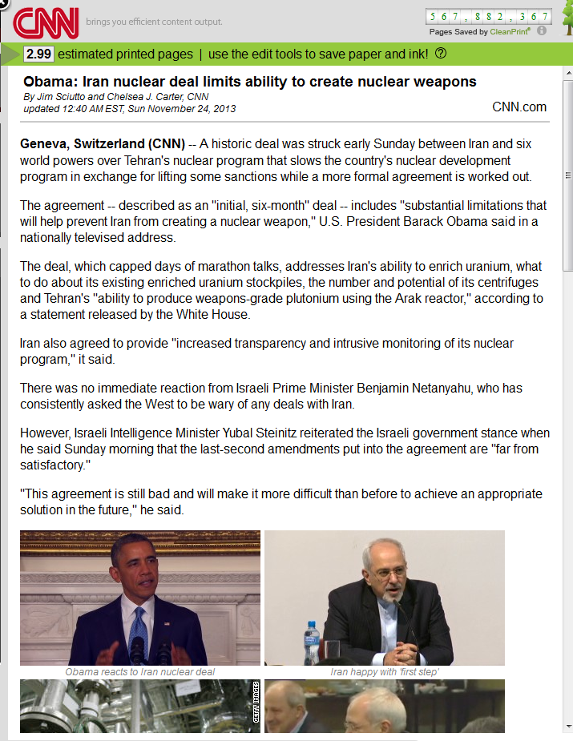
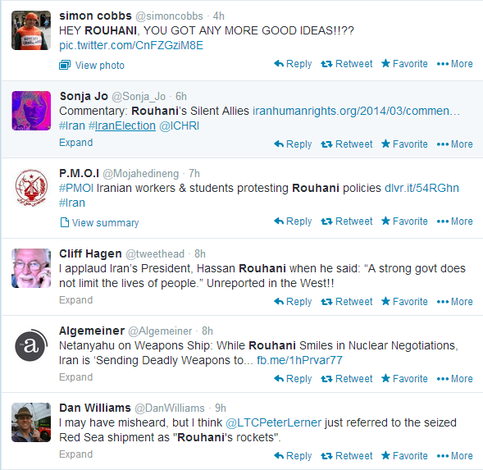
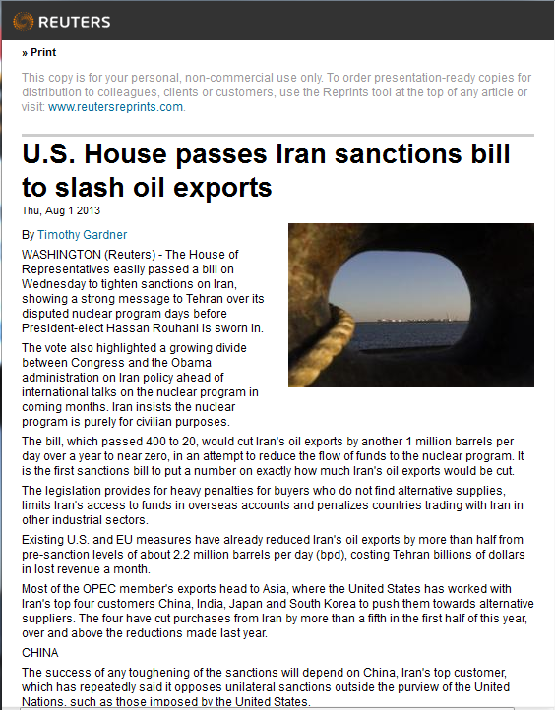

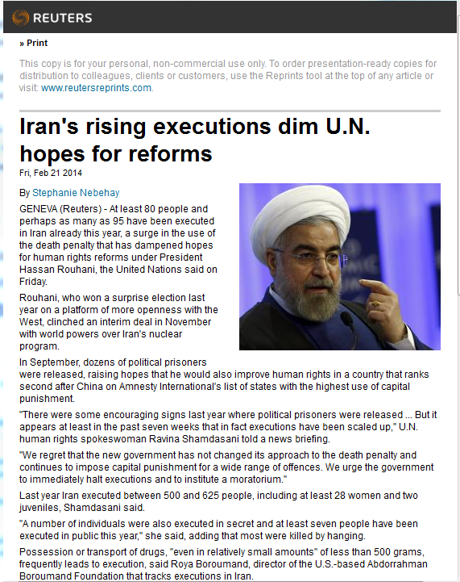
1. Problem to Solve
Motivation: Big data era, much news, much tweets, but…
Key info in news & tweets?
Relation between news & tweets?
Mainstream News
Tweets
Objects:
1. Summarize key events in news & tweets
2. Explore correlation between news & tweets

Slide 4
2. Approach Overview
Main Process
Fetch text from news & tweets respectively
Preprocess texts: stemming, stop-word…
Extract events from news and tweets
Event: [Topic, Named entities(who, where, when)]
Link Twitter Events to News events

Slide 5




2.1 Overall Architecture
Event 3
Event 3
Event 2
Who
Event 2
Who
Topic
Topic
Event 1
Event 1
Who
Topic
Who
Topic
When
When
Topic
Who
Who
When
Topic
When
Where
Where
Event Extraction Sys.
When
When
Event Extraction Sys.
Where
Where
Pre-processor
Where
Where
Pre-processor
LDA
LDA
NER
Correlation
NER

Slide 6




2.2 Data Set
Datasets (Feb, 18th ~ Apr, 18th):
1) 4084 news about “Ukraine Crisis” from Reuters.
4084
N/A
N/A
N/A
2) About 130,000 tweets about “Ukraine Crisis” from Twitter.

Slide 7
2.3.1 News Analysis Pipeline
Event: [Topic, Named entities(who, where, when)]
Fetch &
Parse
1. LDA
Topics
Event 2
Topics
Topics
Event 1
IMF
Who: IMF
News Articles
Russia
Who: Obama
Ukraine
Compose
Sanction
When: Mar, 20
2. NER
aid
When: Mar, 13
Obama
Where: Kiev
crisis
Topics
Where: Ukraine
Topics
Bank
Named Entities
LDA: Latent Dirichlet Allocation
NER: Named Entity Recognition

Slide 8
2.3.2 Topic Extraction (LDA)
Source:
News titles
Key paragraphs
Tools:
Mallet
JGibbLDA
News Titles
News Paragraphs most relevant with the Titles
Title 01
Paragraph 11
Paragraph 12
Paragraph …
Paragraph 1M
Title 02
Paragraph 21
Paragraph 22
Paragraph …
Paragraph 2N
Title …
Paragraph …
Paragraph …
Paragraph …
Paragraph …
Title X
Paragraph X1
Paragraph X2
Paragraph …
Paragraph XX
LDA
Topic 1
Topic 2
Topic 3
Topic …
Topic 10

Slide 9
Result of Topic Modeling
Extract topics from news titles
Strength: titles are good summaries of the news
Weakness: small data set
Extract topics from key paragraphs
Strength: large data set
Weakness: more noise
Our experience:
For news with homogeneous topics (e.g. Ukraine crisis news):
Titles are better choice
For news with heterogeneous topics (e.g. Monthly news of Apple Inc.):
Key paragraphs are better
Problems:
Overlap & Noise in about 25% topics

Slide 10
Efforts to Improve Topic Modeling
Cluster the news by their titles before LDA
No good result. News titles are short texts, thus the title vectors are too sparse to be clustered accurately.
Cluster the news by entire article before LDA
No good result. There is too much noise in the news body, which deteriorates the clustering result.
Split the entire dataset into datasets with shorter periods
Topics with finer-granularity obtained.
However, more noise emerged compared to topics from the entire data set.
Suggestions from Dr.Fox

Slide 11
2.3.3 Named Entity Extraction
Hard to find Named Entities (WHO,WHERE,WHEN) in topics.
We need to search NEs in relevant news paragraphs
Title 01
Paragraph 11
Paragraph 12
Paragraph …
Paragraph 1M
Title 02
Paragraph 21
Paragraph 22
Paragraph …
Paragraph 2N
Title …
Paragraph …
Paragraph …
Paragraph …
Paragraph …
Title X
Paragraph X1
Paragraph X2
Paragraph …
Paragraph XX
Search relevant paragraphs by Apache Lucene
LDA
Topic 1
Topic 2
Topic 3
Topic …
Topic 10

Slide 12
Extract Named Entities - Methods
Paragraphs ∈ Topic e
Stanford NER
When
Where
Who
Suggestion from client
Named Entities Set
Method 1
Method 2
FP-Growth
Count term-frequency for each NE
Frequent patterns
Combine patterns based on date,
Count each combination’s frequency
Top 5 When
Top 5 Where
Top 5 Who
High-frequency combinations

Slide 13
Extract Named Entities - Results
Topic: [crimea, ukraine, russian, troops, border]
Method 1: High-frequency 3W named entities
WHO: NATO; Oleksander Turchinov; Kerry; Lavrov; Vladimir Putin;
WHEN: Mar 15 , 2014; Thursday; Apr 16 , 2014; Mar 3 , 2014; Mar 24 , 2014;
WHERE: Ukraine; Crimea; Russia; U.S.; Kiev;
Method 2: High-frequency named entities combinations
[Mar 15 , 2014; Ukraine; Crimea; Donetsk; Kharkiv; Arbatskaya Strelka; Oleksander Turchinov]
[Mar 29 , 2014; Russia; Ukraine; Crimea; Lavrov; Vladimir Putin]
[Apr 12 , 2014; Russia; Moscow; Ukraine; Crimea; NATO]

Slide 14
Extracted Events on a Time Line
russia, bank, sanctions, ukraine, crisis, crimea
ukraine, tensions, data, rise, shares, china, stocks
ukraine, russia, talks, aid, crisis, sanctions, deal
ukraine, yanukovich, crisis, minister, sign, russian
gas, ukraine, russian, russia, europe, talks, energy
02/28
03/08
03/12
03/16
03/23
04/12
03/01
03/09
03/14
03/20
03/26
04/16
ukraine, crimea, crisis, putin, russia, minister
ukraine, house, imf, u.s, bill, white, aid
ukraine, aid, support, government, talks, house, russian
crimea, ukraine, russia, minister, referendum, vote
crimea, ukraine, russian, troops, border

Slide 15
Extracted Events Sample
2014/03/08 - 2014/03/14;
Topic: [crimea, ukraine, russia, minister, referendum, ukrainian, vote]
WHO: U.N. Security Council; Arseny Yatseniuk; Vladimir Kirichenko; Obama; Putin;
WHERE: Russia; Crimea; Ukraine; Kiev; China;
Combination: [Mar 9 , 2014; Russia; Ukraine; Crimea; United States; Vladimir Kirichenko; Obama]
Combination: [Mar 14 , 2014; London; Russia; Ukraine; West; Crimea; Moscow; Arseny Yatseniuk; Kerry; Russian Federation]
2014/03/20 - 2014/03/21;
Topic: [ukraine, house, imf, u.s, bill, white, aid]
WHO: IMF; Senate; White House; House of Representatives
WHERE: Ukraine; WASHINGTON; Kiev; United States;
Combination: [Mar 21 , 2014; Ukraine; U.S.; New York; Senate; Royce; House Foreign Affairs Democrat; Nita Lowey; Eliot Engel; House Appropriations Committee; IMF]

Slide 16
2.4.1 Approaches
Tweets are from IDEAL collection.
Assign topics to each tweet by LDA.
Apply Method 2 (FP-Growth) in the NER step of tweets analysis.

Slide 17
2.4.2 Results
News Facts:
Feb 18: The initial riots began
Feb 20: Ukraine Government Snipers Shooting protesters in Kiev
Who; Where
Topic 1
live, snipers, protests, control, here, watch, video
European Union; Ukraine
EU; Rome
European Union; Ukraine
Peter Brookes; Kiev
Hotel Ukraina; Kiev
02/18
02/21
03/06
02/20
02/22
Yanukovich; Kiev
Topic 2
today, president, storm, backed, threaten, forces, shooting
News Facts:
Feb 20/21: President Yanukovych signed a compromise deal with opposition leaders. Then, he left Ukraine.

Slide 18
Tweets Events Samples
Topic 1
  Keywords: live, snipers, protests, control, here, watch, video
  Events:
    {Feb 18, 2014; European Union; Ukraine}
    {Feb 20, 2014; EU; Ukraine}
    {Feb 20, 2014; Hotel Ukraina; Kiev}
    {Feb 22, 2014; Peter Brookes; Kiev}
    {Mar 06, 2014; EU; Rome}
Topic 2
  Keywords: today, president, storm, backed, threaten, forces, shooting
  Events:
{Feb 20, 2014; Yanukovich; Kiev}

Slide 19
2.5 Correlation between Twitter Events & News Events
News Event
Term 1
Term 2
Term 3
…
Term 7
WHO
WHERE
WHEN
Twitter Event
Term 1
Term 2
Term 3
…
Term 7
WHO
WHERE
WHEN
Word2Vec (by Google)
Event Similarity:
Distance between centroids
News event
Twitter event
Vectors in 200-Dimension hyper space

Slide 20
3.1 Issues & Lessons
--- News Analysis
Open Issues:
1. Overlap and noise in the extracted topics
2. Noise in the extracted named entities
3. Similarity model to link the Twitter events to news events
Lessons:
1. Collect more data from other news websites
2. Remove overlap in topics by splitting the data set
3. Remove duplicates from the frequent NE combinations

Slide 21
3.2 Issues, & Lessons
--- Tweets Analysis
There are very big noise in tweets themselves.
It’s not easy to extract Named Entities from tweets.
Lessons:
topic model tweets via LDA (Python Gensim)
extract name entities from tweets. (PyNER)
use FP-Growth algorithm to pick the most high frequency keywords combination in event description.

Slide 22
3.3 Potential Usages
1. A tool for event extraction and news summarization
2. A tool for the “Computational Linguistic” course
3. A component for the IDEAL project
4. A tool to extract pure text from archived web pages

Slide 23
4.1 Conclusion
Developed an effective tool for web page event extraction
Explored various methods regarding every step of the event extraction
More efforts are needed to link the tweets events to news events

Slide 24
4.2 Structure of Deliverables
1. Presentation slides
2. A project report (including tool manual)
3. Source code
News event extractor (in Java)
Twitter event extractor (in Python)
4. Data
Text version of news dataset
Output results

Slide 25
Appendix

Slide 26

4.3 Future Work: Opinion Mining
News Event 1
Event 1
Who
Opinion 1
Topics
Opinion 2
What
When
…
Where
Opinion N
Opinion Mining
News Event 2
Event 2
Who
Opinion 1
Topics
Opinion 2
What
When
…
Where
Opinion M

Slide 27
Topics from Clustered News Titles
Cluster 1:
Ukraine Russia say eastern update Russian hit
Ukraine Putin say leader WRAPUP Crimea send
Ukraine update crisis say tension police military
Crimea russian from order after lawmaker official
Cluster 2:
U.S. IMF gas aid bill reform Kerry
Ukraine EU help ukrainian gas crisis export
Cluster 3:
update Russia may Germany trade Merkel government
Ukraine talk House bank White german aid
sanction russian EU against Obama over energy
Russia EU Ukraine sanction Obama war agree

Slide 28
Topics from Clustered News Bodies
Cluster 1:
Russia Ukraine EU warn Moscow Crimea sanction
Russia Ukraine take call say Putin separatist
Ukraine after force U.N. putin vote fear
Cluster 2:
Ukraine after eye over rouble import gas
Crimea emerge bond Bank bank market more
russian say Ukraine gas hit may ukrainian
Cluster 3:
Putin Ukraine Obama call discuss Merkel White
Ukraine update against urge aid after leader
Ukraine minister Yanukovich gas Poland president polish
Ukraine force NATO pm security seize gas

Slide 29
Topics from Key Paragraphs
Topic [0]: [ukraine, reuters, Ukraine, russia, crisis, foreign, president]
Topic [1]: [reuters, kiev, yanukovich, president, viktor, ukrainian, ukraine's]
Topic [2]: [military, nato, reuters, ukraine, u.s, russia, crimea]
Topic [3]: [sanctions, crimea, russia, moscow, reuters, russian, referendum]
Topic [4]: [russian, reuters, crimea, ukraine, ukrainian, forces, military]
Topic [5]: [gas, ukraine, reuters, russia, russian, energy, moscow]
Topic [6]: [percent, ukraine, reuters, march, Ukraine, tensions, u.s]
Topic [7]: [ukraine, reuters, aid, billion, Ukraine, washington, international]
Topic [8]: [russia, putin, ukraine, russian, vladimir, war, president]
Topic [9]: [rating, fitch, ratings, bank, banks, currency, ukraine]

Slide 30
Topics from Splitted Data Sets
Data set 1:
Ukraine, Kiev, protesters, police, team, Games, square
Yanukovich, Ukraine, opposition, crisis, talks, deal, Ukraine's
Hryvnia, bank, assets, record, low, foreign, gains
Data set 2:
Ukraine, U.S, Russia's, war, discuss, crisis, Merkel
Crimea, Ukraine, Russia, Putin, force, back, troops
Ukraine, tensions, China, rise, stocks, tension, ease
Data set 3:
Ukraine, Russia, IMF, aid, crisis, talks, deal
Russia, Crimea, military, Crimea's, vote, Moscow, U.N
Ukraine, Russia, IMF, aid, crisis, talks, deal
Data set 3:
Russian, Ukraine, Ukraine's, military, embassy, agency, suspected
gas, Ukraine, Russia, talks, Europe, supply, debt
Ukraine, Putin, Russia, U.S, data, call, House

Slide 31
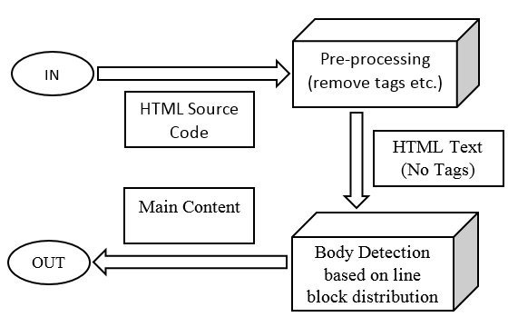
Progress: Text Extraction
Notes:
[ Automatic Text Extraction ]
Fast - Linear time complexity
General - No customized rules
Effective - Over 90% accuracy rate
Simple and Intuitive !
[ Premise behind the Algorithm ]
Webpage's body is text-dominated that contains relatively fewer tags
The body-related source codes are physical neighboring

