Slide 1
Smallholders, Sustainability and Food Security:
Conservation Agriculture in a Developing Country Context
M.D. Wilcox¹, E. Bisangwa¹, D.M. Lambert ¹, N. Eash ², F.R. Walker ², and M. Marake ³
¹ University of Tennessee Institute of Agriculture
Department of Agricultural & Resource Economics
Knoxville, Tennessee, U.S.A
² University of Tennessee Institute of Agriculture
Biosystems Engineering and Soil Science
Knoxville, Tennessee, U.S.A.
³ National University of Lesotho
Department of Soil Science
Maseru, Lesotho

Slide 2


Slide 3
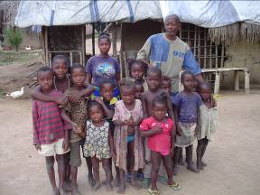
The MDG’s
Eradicate Extreme Poverty and Hunger
Achieve Universal Primary Education
Promote Gender Equality and Empower Women
Reduce Child Mortality
Improve Maternal Health
Combat HIV/AIDS, Malaria and other Diseases
Ensure Environmental Sustainability
Develop a Global Partnership for Development
2011 Millennium Development Goals Report – United Nations http://www.un.org/millenniumgoals/11_MDG%20Report_EN.pdf

Slide 4

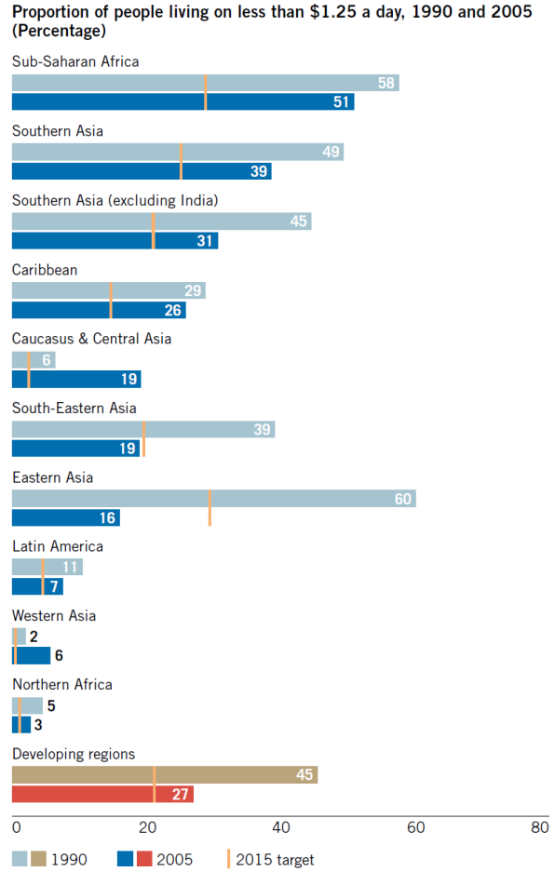
Eradicate Extreme Poverty and Hunger
Target
Halve, between 1990 and 2015, the proportion of people whose income is less than $1 a day
Target
Halve, between 1990 and 2015, the proportion of people who suffer from hunger.
2011 Millennium Development Goals Report – United Nations http://www.un.org/millenniumgoals/11_MDG%20Report_EN.pdf

Slide 5
Countries Requiring External Food Assistance
October 2011
Source: http://www.fao.org/giews/english/hotspots/map.htm

Slide 6
Factors Contributing to Food Deficits
Population growth
Political strife
Drought
Political neglect of agriculture
Lack of investment in rural infrastructure
Unfavorable terms of trade
Inadequate training base
Unavailability of agricultural inputs
Weak private sector
Environmental degradation

Slide 7
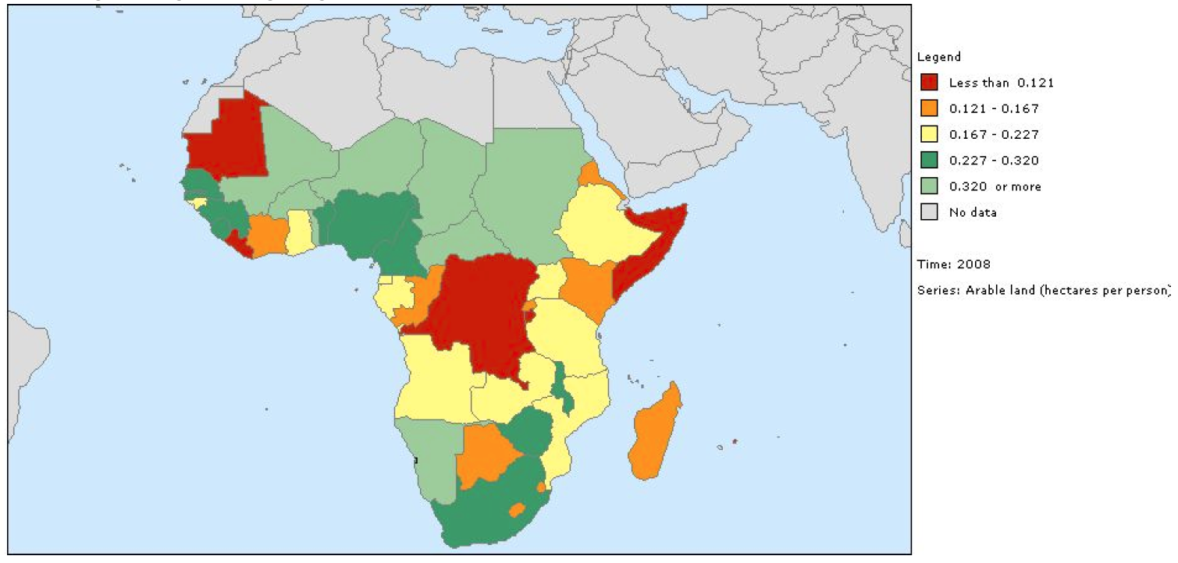
Arable Land (Ha/person) - 2008
World Development Indicators – World dataBank – World Bank - 2011

Slide 8
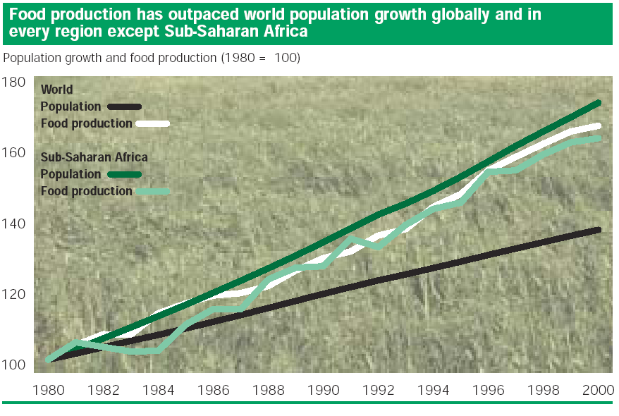
World Development Indicators – World Bank Atlas – World Bank - 2003

Slide 9
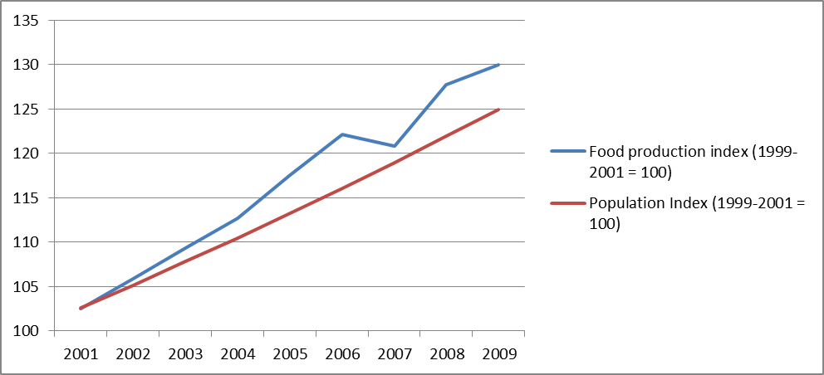
SSA – Population and Food Production Indicies
World Development Indicators – World dataBank – World Bank - 2011

Slide 10

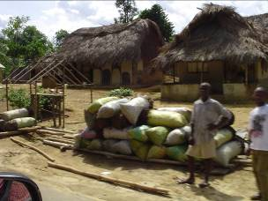
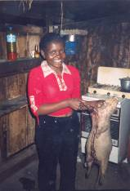

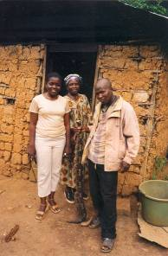
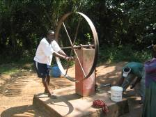
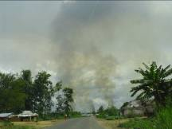
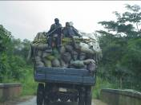
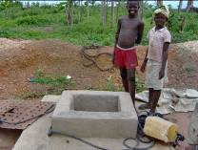

Ensure Environmental Sustainability

Slide 11
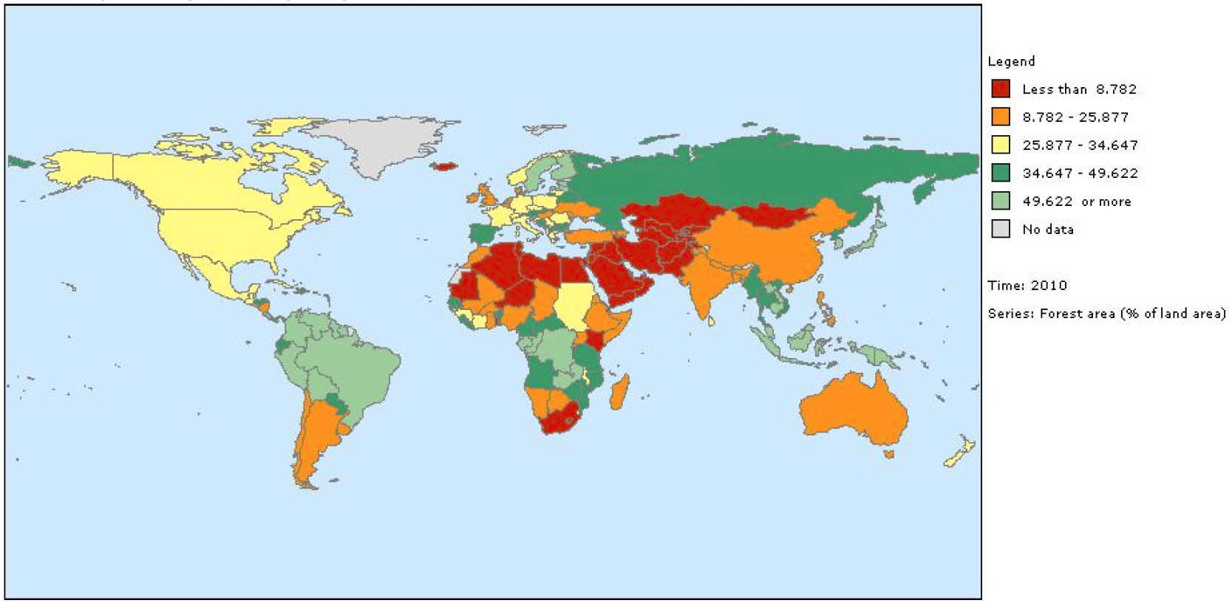
Forested Land
(% Land Area)
2010
CO2 Emissions (mt/person)
2007
World Development Indicators – World dataBank – World Bank - 2011

Slide 12
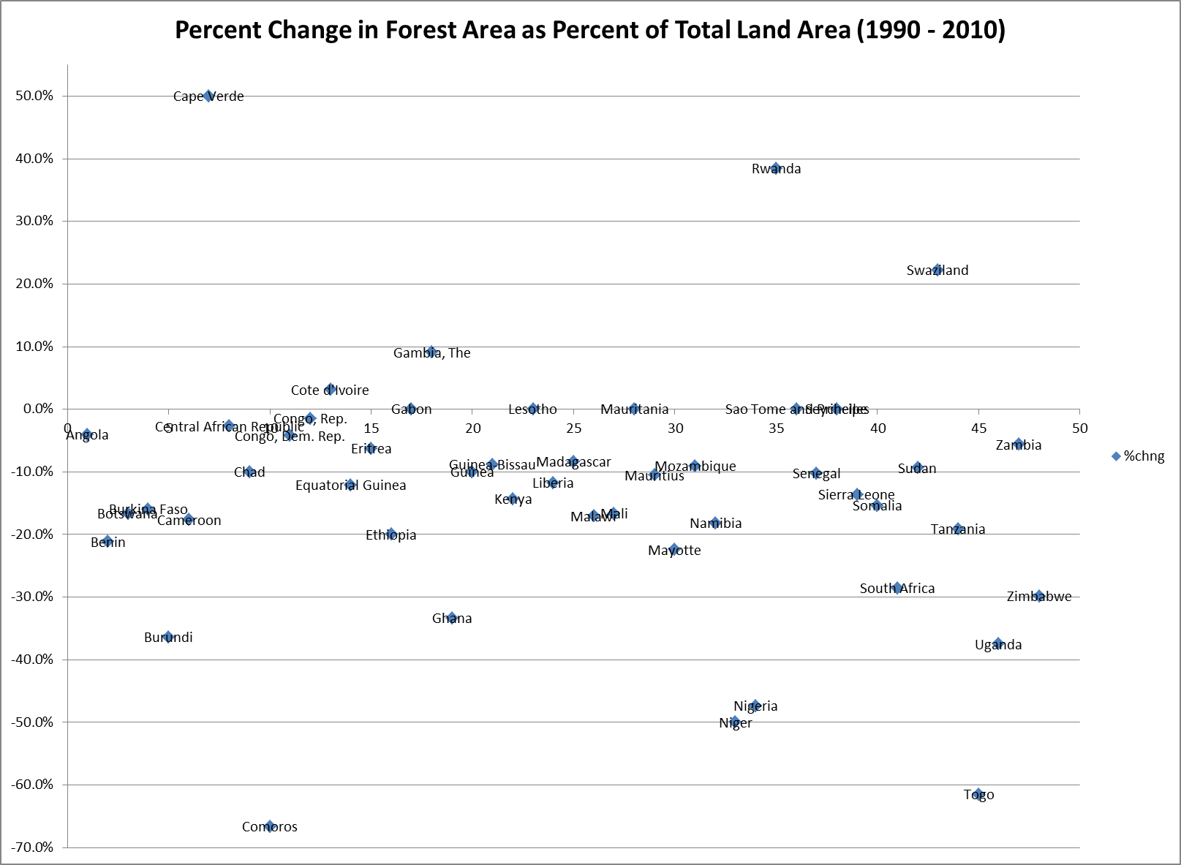
World Development Indicators – World dataBank – World Bank - 2011

Slide 13
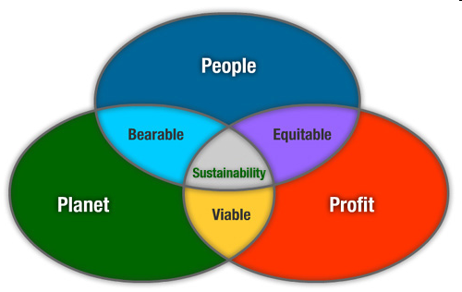
Triple Bottom Line
Elements of the bottom line:
Environmental
Social
Economic
Image source: http://www.greeninnovation.com.au/aboutGreenInnovation_sustainability.html

Slide 14
Lybbert and Sumner (Food Policy, 2012)
The core challenge of climate change adaptation and mitigation in agriculture is to produce:
(i) more food
(ii) using fewer resources
(iii) under more volatile production conditions, and
(iv) with net reductions in GHG emissions from food production, processing and marketing.

Slide 15
The Seven Community Capitals
Natural
Cultural
Human
Social
Political
Financial
Built
A Vibrant Community
Notes:
Instructions:
Read out loud the list of seven community capitals and then pose the question we have provided below. A few key points follow the question.
Script:
“The seven capitals are: Natural, Cultural, Human, Social, Political, Financial, and Built Capitals
Why should we even care about the seven forms of capital in a community or county? The reason is pretty straightforward. Research has shown that places that invest and strengthen these capitals help contribute to vibrant communities, including the development of strong economies and a high quality of life.”

Slide 16
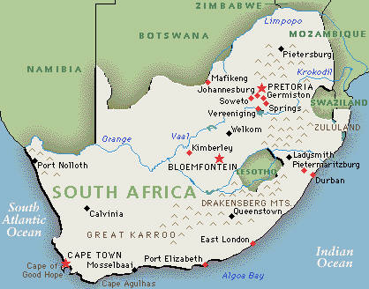
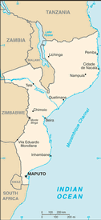
Background
Lesotho and Mozambique
Five year project
  Integrate cover crops into CA systems
  Identify optimal input management regimes for CA systems
  Characterize C:N soil/cover crop interactions
  Impacts of CA adoption on income, household economics, and gender equity
  Markets, input use, and adoption of CA
)
Biological Engineering and Soil Science
Agricultural and Resource Economics
Non-government Organizations
(Growing Nations, World Vision)
Lesotho
Mozambique

Slide 17

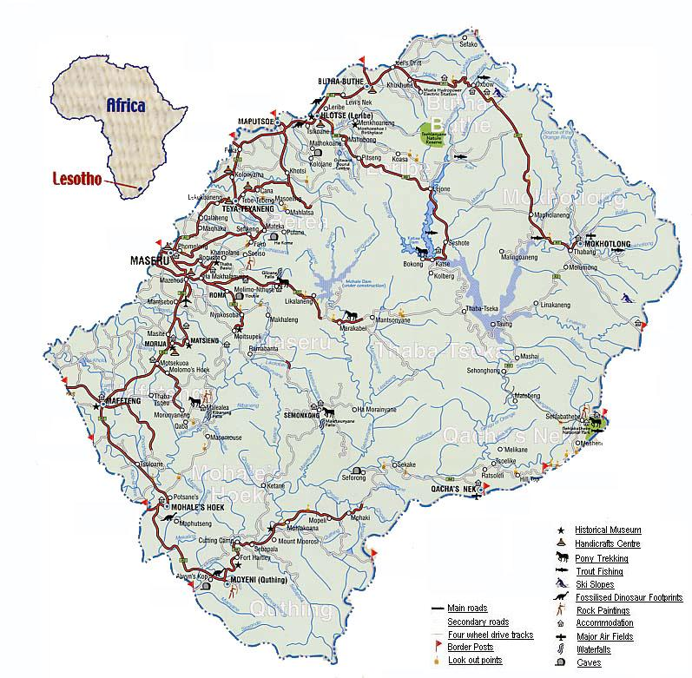
Lesotho
“Kingdom in the Sky”
Over 80% of the country lies above 5,900 ft
Surrounded by RSA
Population 2,3 million (81% rural)
23.6% incidence of HIV
0.4mt/ha maize yield
Subsistence farming
Dependence on food aid

Slide 18
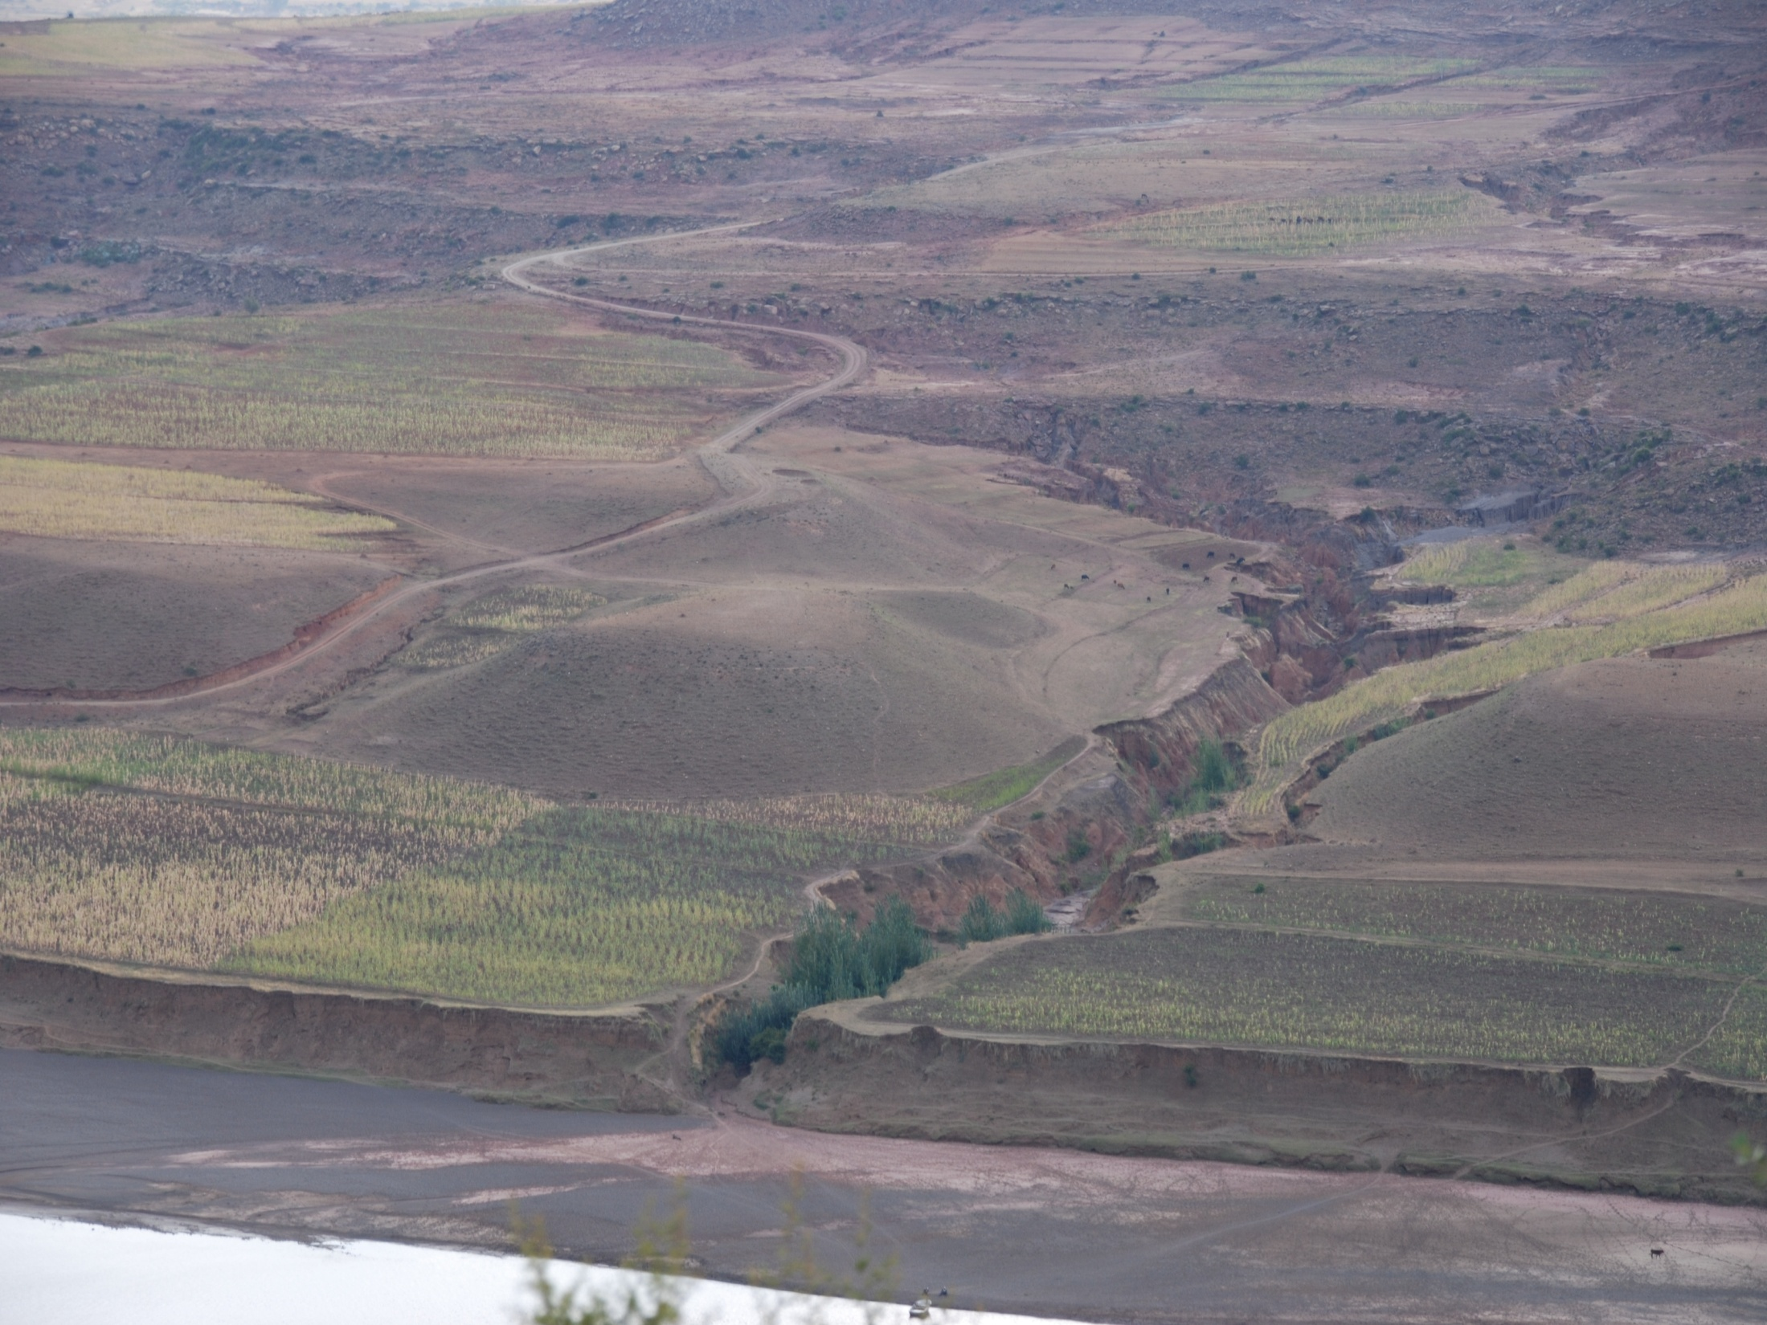
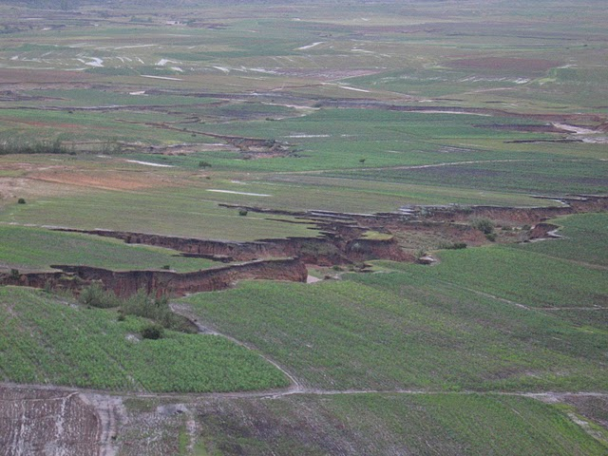
The Problem!

Slide 19
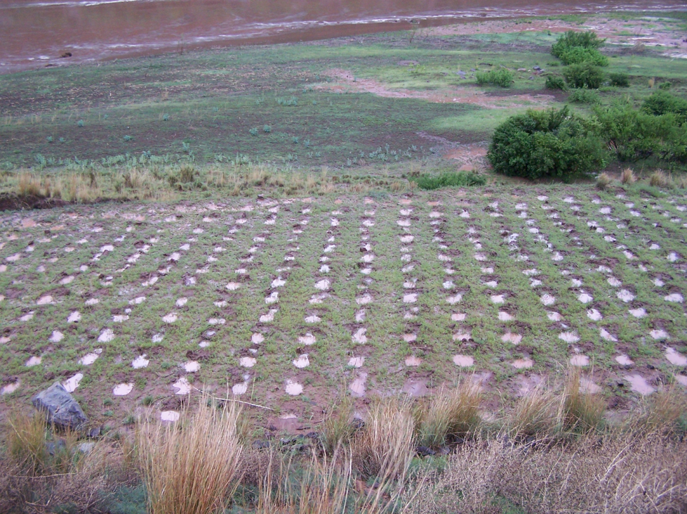
The Answer? Likoti?
Conservation Agriculture
minimize soil disturbance,
maintaining residue on soil surface and
mix/rotate crops
The method involves digging potholes that are approximately 20cm across and 15cm deep in a 75x75cm grid-like pattern. Seeds are directly planted in to the pothole (typically 1 to 3 seeds depending on the targeted plant population) along with some source of additional nutrients (inorganic or organic fertilizer).

Slide 20
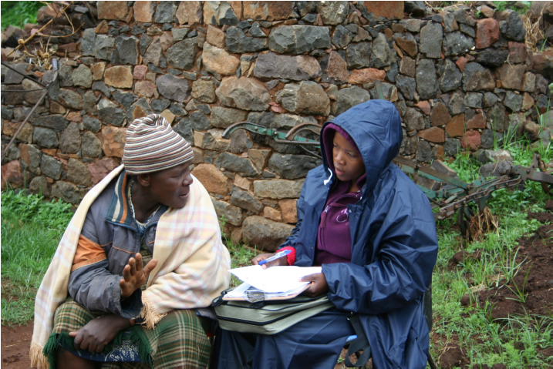
Baseline Survey – Botha Bothe District
Area of introduction for mechanized (no-till planters) and likoti conservation agricultural practices

Slide 21
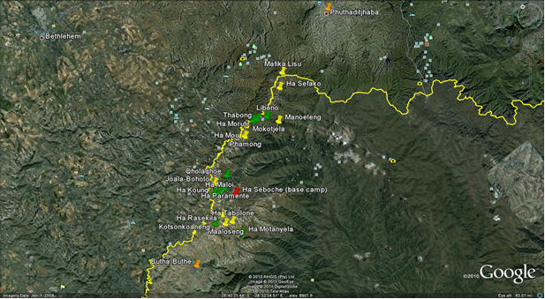
Sampling
Cluster based sampling strategy; villages as clusters.
List frame developed from NGO participant lists, villages randomly selected and all households surveyed (Lohr, 1999).

Slide 22
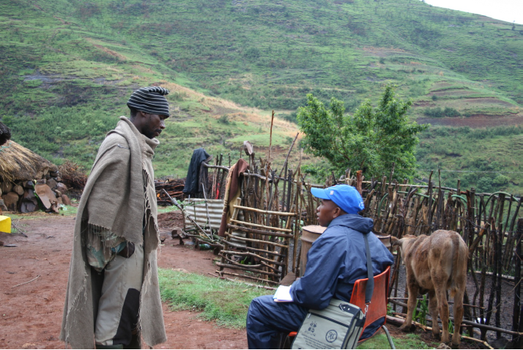
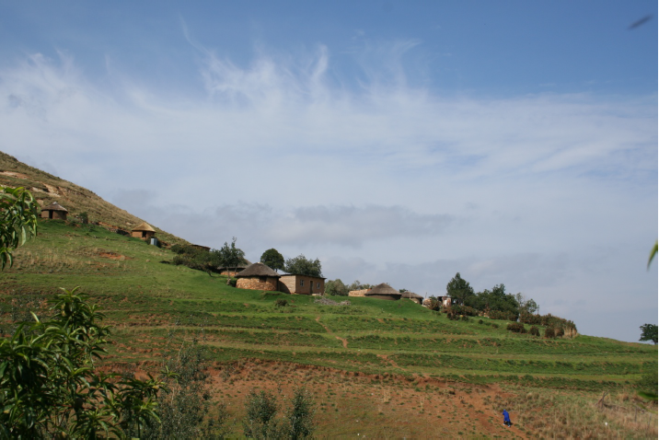
Survey
433 surveys in 10 villages
8 enumerators from Natl. Univ. of Lesotho
Nov/Dec 2010
Household profiles; asset mapping; agricultural production and marketing for 09/10; social capital; labor allocation; CA experience

Slide 23
Sample
Adoption of CA by Sampled Households
Item | Non-Adopter | CA Full Time | CA New | CA Abandon
Description of CA Adoption | Farmers who have not practiced any form of CA in the last two years | Farmers practicing CA methods on at least one field over the last two years | Farmers using CA techniques for the first time and not harvested yet from their fields | Farmers who used CA techniques but have since chosen to only use conventional methods.
Sample (% of 433) | 342 (79%) | 49 (11.3%) | 33 (7.6%) | 9 (2.1%)

Slide 24
Summary of Findings
CA Adopters are:
  More dependent on agriculture for food, employment and income
  Relatively well educated
  Grow a broader mix of staples
  More dependent on food aid
Opportunities and Challenges abound:
  Need to increase yields, mitigate effects of drought/flood, stop erosion, promote soil fertility and weed suppression
  Must increase emphasis on incorporating actors in the entire value chain
  Scaling-up needs to be addressed in the face of missing markets for inputs and outputs and a general hesitation to move beyond small-scale plots
  Research based on experimental plots needs to be taken on-farm in an effort to prove and disseminate technology

Slide 25
Thank you!
For a complete copy of the conference paper please email me at: mwilcox2@utk.edu

