Slide 1
Object Detection:
Andrew Leavitt, Annie Tran, Brian Dinh, Kevin Dinh
CS 4624: Multimedia, Hypertext, and Information Access | Dr.Edward Fox | Virginia Tech, Blacksburg, VA 24061 | 12/1/2022
Notes:
Andrew

Slide 2
01
Project Overview
02
Work Done / Annotation Done
03
Experimental Data / Evaluation Data
04
Future plans and Lessons learned
05
Acknowledgement and References
tl;dr of project
What work have we accomplished in terms of annotations
Results and Figures from past and ongoing experiments
Project reflection and future goals
Shoutouts
Notes:
Annie

Slide 3
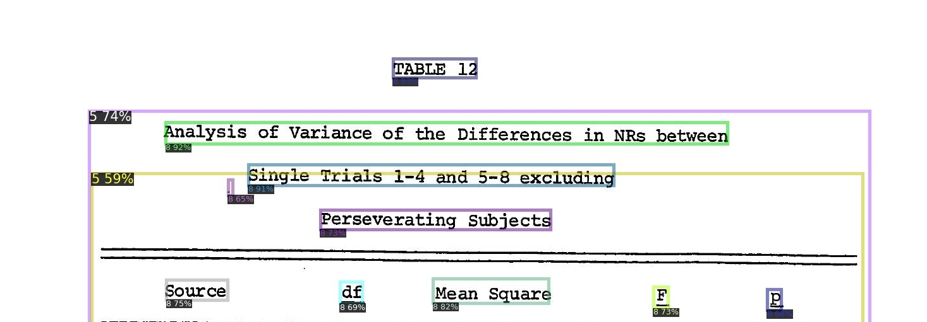
1. Project Overview
Quick review on our project
Using AI aided annotation tool, PyLabel, for ETDs
Evaluation of AI-Aided annotation efficiency
Weekly meeting with our client
Notes:
Annie

Slide 4
1: Timeline
Finish 20,00 images
Retrain and evaluate new model using new dataset
Finish ~10,000 images
Retrain and evaluate
Sep.
Oct.
Nov.
DEC
Complete pipeline
Finish ~5000 images
Finish ~19,000 images
Retrain and evaluate new training model
Notes:
Annie

Slide 5
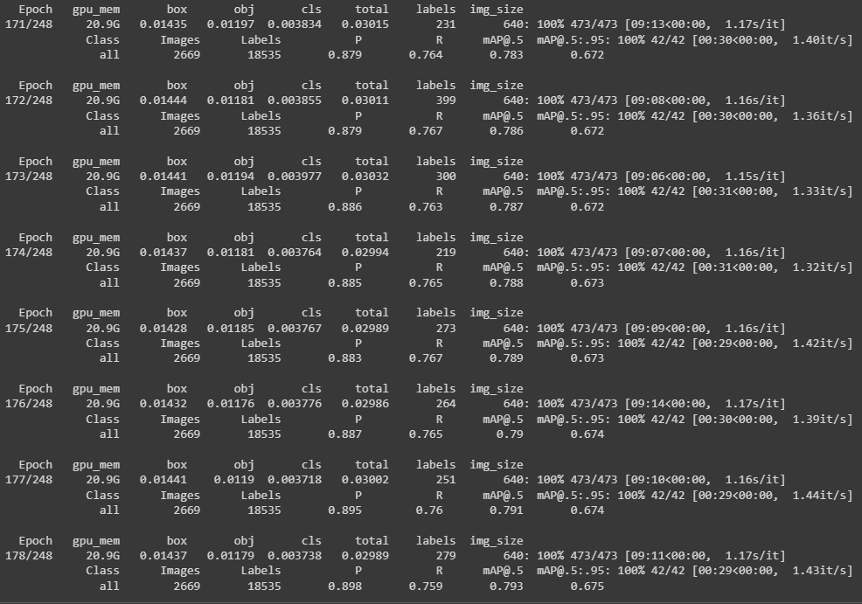
2: Work Completed
Created a pipeline to optimize data training process
Created a pipeline to create a new generation of the ETD Model
Small improvement to current pipeline
Annotated 20205 pages of data
Training with and without predictions
Notes:
Brian

Slide 6
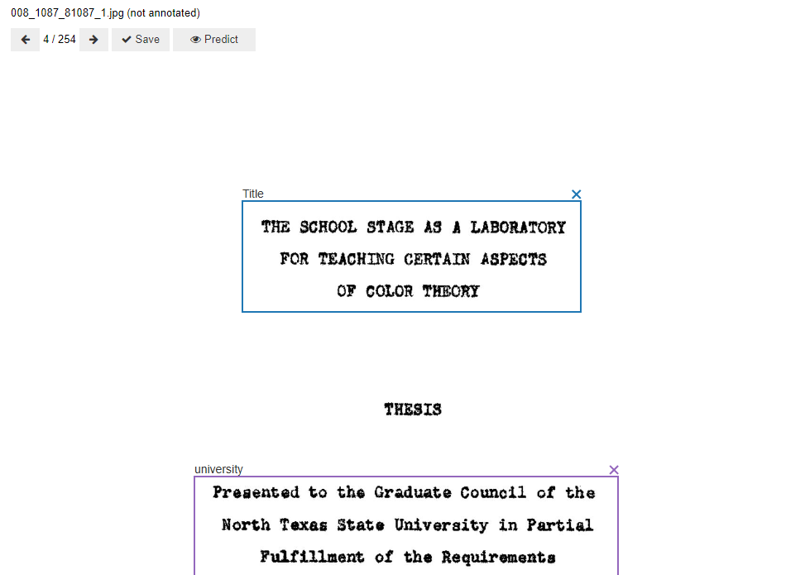
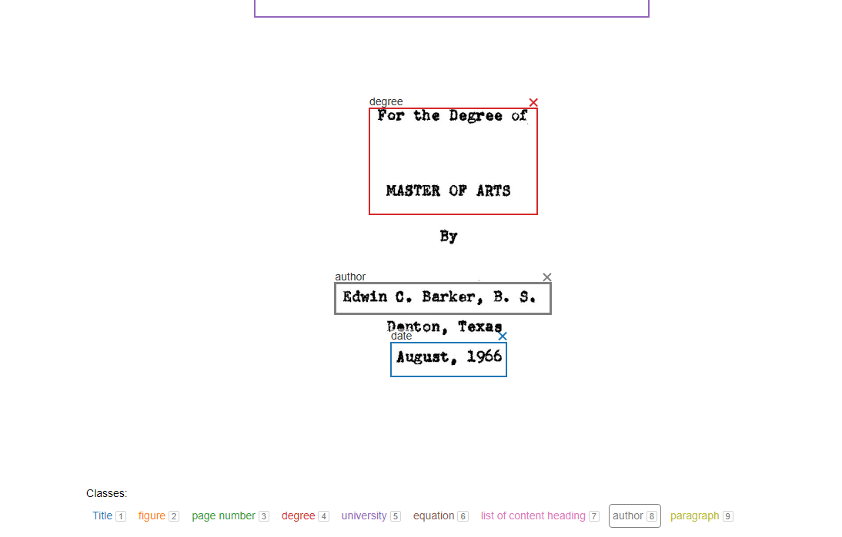
2. Annotating
Brian
What annotating Looks Like
Notes:
Brian

Slide 7
2. Annotation Pipeline
Split random sample data into 4 dataset objects
Select user and number of samples to annotate
Annotate new samples
Clear old sample data and populate with new samples with pages that contain a minority class
Save annotation data as YoloV7
Retrain model
Notes:
Brian

Slide 8
2. Model Training Pipeline
Split dataset 85:15 (Training:Val)
Download split training dataset
Train 100 epochs starting with old model
Test old model on validation dataset
Select best epoch run
Test new model on validation dataset
Notes:
Kevin

Slide 9
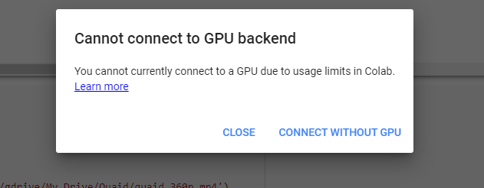
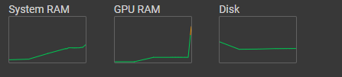
2. Model Training Observation
Slow and tedious
Model training takes a lot of GPU resources
Balancing acts between RAM and training efficiency
If too many batches per iteration (epoch) GPU memory runs out
Constant monitoring
Costly
Uses a lot of memory and compute units
Notes:
Brian

Slide 10
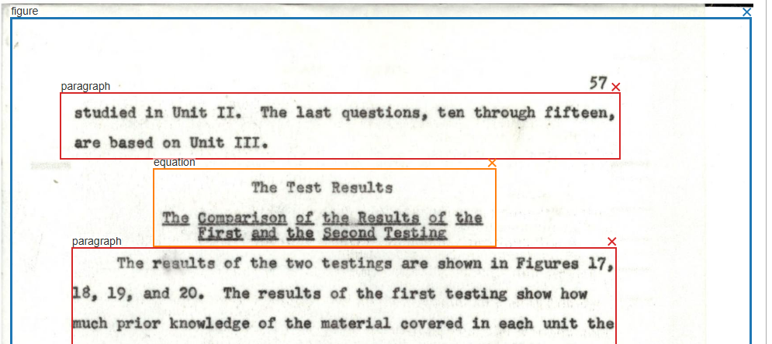


3. New Model Observations
Errors that the new model fixed
Double boxed page number
Scanned document recognized as figure
Equation number not being recognized
Notes:
Andrew

Slide 11
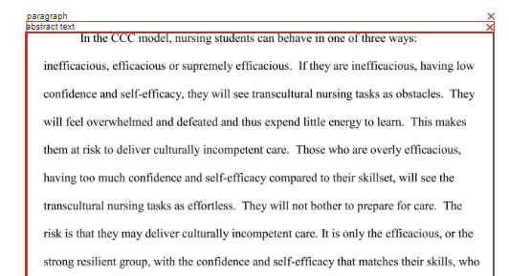
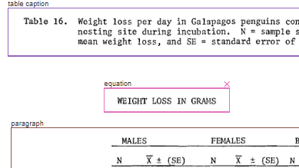
3. New Model Observations
Some common errors
Single paragraph page confusion
Labeling Centered text as equations
Notes:
Andrew

Slide 12

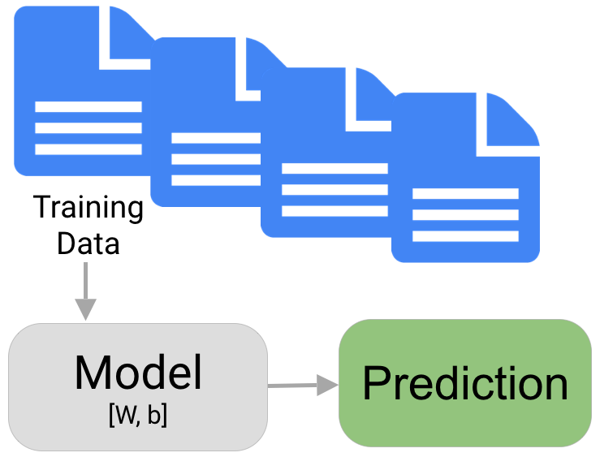
3. Current Objectives
Train New Model V2
Using Google Colab
Split 20,000 images
Create final model weight
Testing of new iterations of Models
Continue annotating
Exceed annotation objective
Notes:
Kevin

Slide 13
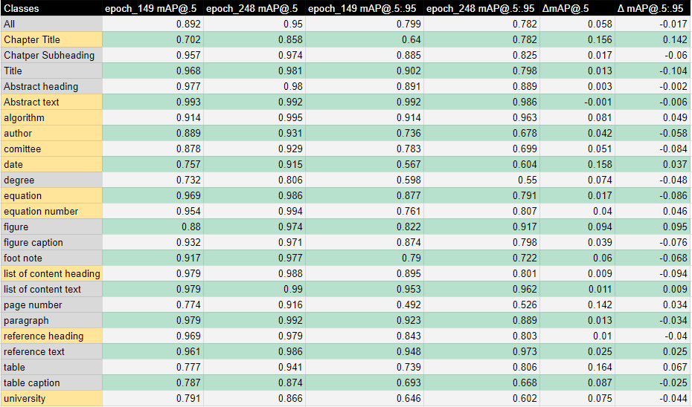
3. Model Evaluation
Model trained off 10k sample pages
mAP@.5 went up
mAP@.95 went down
Model training user error
Notes:
Kevin

Slide 14
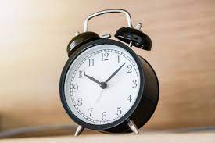
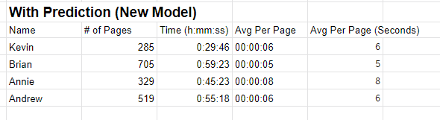
3. Experiment
Completed Experiment:
Comparing the time it takes to annotate using AI-aided annotation vs. manual annotations
50 samples of AI-aided annotations and 50 samples of manual annotations accomplished
New Experiment:
Comparing the new model vs. old model
Notes:
Annie

Slide 15
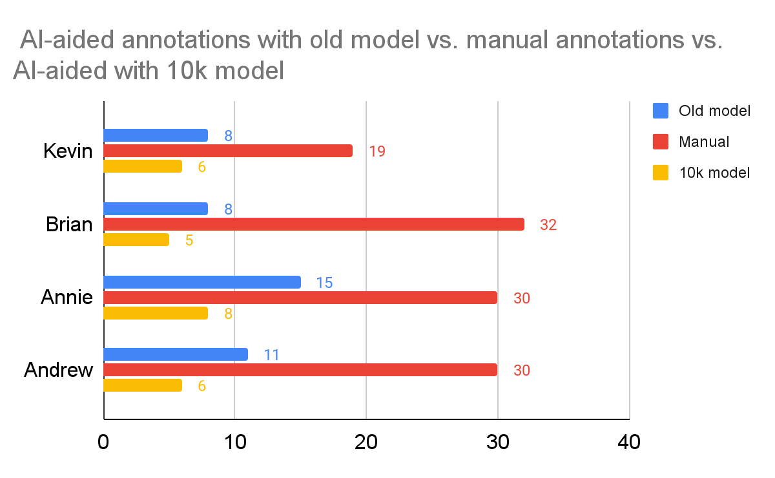
3. Experiment
Average time per page (sec)
Notes:
Annie

Slide 16
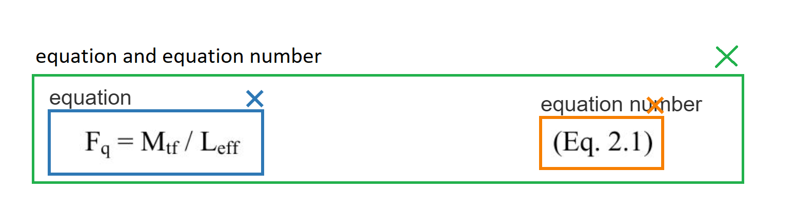
4. Potential Future Plans
New Annotation Group to help model train commonly found pairs
Equation + Equation Number
Figure + Figure Caption
Table + Table Number
Reference Heading + Reference Text
List of Content Heading + List of Content Text
Abstract Heading + Abstract Text
University + Degree
Notes:
Andrew

Slide 17
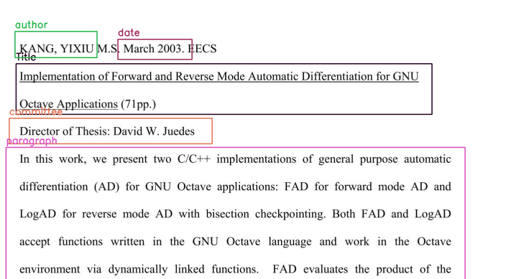
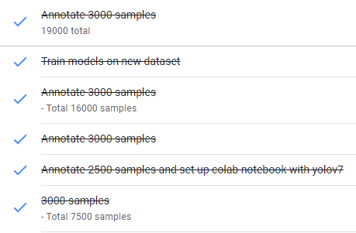
4.Lessons Learned
Annotation guidelines
Visuals of annotations for future teams
Weekly meetings and smaller sub-goals make larger tasks feel more attainable
Weekly 3000 page group annotations
Roles were taken too seriously, some tasks were not divided evenly (model training)
Notes:
Andrew

Slide 18
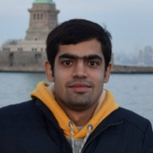
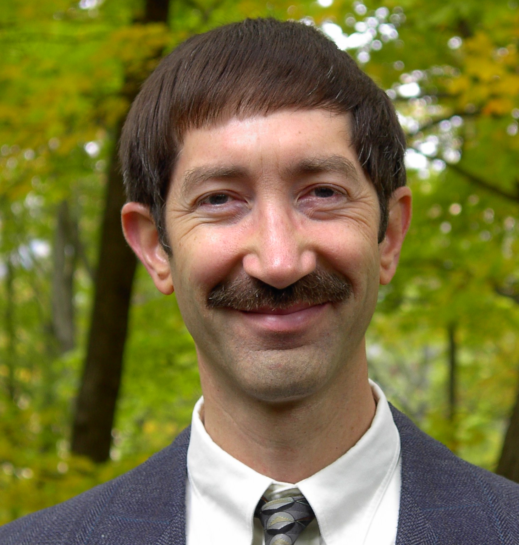
Acknowledgement
GOOD LUCK ON YOUR PHD PROPOSAL!!!
Aman Ahuja
Dr.Edward Fox
Source: https://people.cs.vt.edu/aahuja/
https://fox.cs.vt.edu/foxinfoOld.html
Notes:
ANNIE

Slide 19
Resources
Brian
Pylabel
https://github.com/pylabel-project/pylabel
Pytorch
https://pytorch.org/
pdf2image
https://pypi.org/project/pdf2image/
YOLOv7
https://github.com/WongKinYiu/yolov7
COCO
https://cocodataset.org/#home
Detectron
https://github.com/facebookresearch/detectron2
Previous Works
https://vtechworks.lib.vt.edu/handle/10919/109979
Notes:
ANNIE

