Slide 1
“How to Cook a Husband”
Household Management
in the
Culinary History Collection
Kira A. Dietz
Acquisitions and Processing Archivist
Special Collections, Newman Library
February 25, 2011

Slide 2
Special Collections
Rare Books
Manuscripts
University Archives
Historical Maps
Historical Photographs

Slide 3
Culinary History Collection
Currently contains more than 3,700 volumes
2,400+ of these are housed in Special Collections
Almost two dozen manuscript collections
Includes two subsets: The Peacock-Harper Collection and Ann Hertzler Children’s Cookbook and Nutrition Literature Collection

Slide 4
Collection Development
Emphasis on:
  Regional and community cookbooks and materials
  Brand-name pamphlets and product publications
  Menus, nutrition education, and kitchen planning
  Books documenting social, domestic, and economic history; changes in food behavior; food-related processing and technology
  Faculty papers
  Manuscript receipt (recipe) books

Slide 5
What are Manuscript Collections?
Handwritten and/or unpublished materials including:
  Receipt books
  Household accounts and ledgers
  Faculty papers
  Professional papers
  Papers from groups or organizations

Slide 6
Acquiring Materials Through Donation
Form the majority of the collection to date
Method of acquisition upon which the department is dependent
Most donations are books
“Wish list” for the collection: http://spec.lib.vt.edu/culinary/va_cookbooks_bib.html

Slide 7
Culinary Resources for Circulating Collections
Or, Why Some Donations
End Up in the Stacks

Slide 8
Policies & Such
A few policies guide interactions with donated or gifted materials:
  We ask to see an inventory of the items you’d like to donate before you bring the actual items over (http://www.lib.vt.edu/collmgmt/policies/donors.html)
  We endeavor to collect and maintain items in that support the University’s programs, offer timely/current information, represent historical value, and are in good physical condition
  More information and specific policies are available: http://www.lib.vt.edu/collmgmt/policies/

Slide 9
What Ends Up in the Stacks
Unfortunately, we are limited by space and other economic factors, and must select books that add direct value to the circulating collection
Books must be:
  In good condition
  Not a duplicate of materials already in the stacks, or sometimes, in Special Collections as well
  Relevant to Virginia Tech’s programs
  Relevant and of interest to the wider community served by Virginia Tech

Slide 10
If You Want to Donate
Rebecca will be happy to look at an inventory of items
  Considerations:
    Current holdings
    WorldCat (a union catalog of over 71,000 libraries worldwide) to see if other libraries nearby may have the item(s)
    Related University programs/Do item(s) support the University’s mission
    Shelf space

Slide 11
Acquiring Materials Through Purchase
No dedicated fund or endowment for general culinary materials in Special Collections
Endowment for Children’s Literature and Nutrition Collection materials
Example: “How to Cook a Husband,” purchased from a dealer specializing in Culinary materials

Slide 12
Recent Additions to the Culinary History Collection
Culinary, appliance, and food-related company pamphlets
3 handwritten household accounts/recipe books
More than 130 cook books, manuals, and children’s titles
Large collection of materials relating to seafood processing (in progress)

Slide 13
After Acquisition
Once we acquire culinary books and manuscripts,
what happens next?
It’s Decision Time!

Slide 14
Creating Access to Books
Books and other publications are cataloged in Technical Services, then returned to Special Collections stacks
Catalog records in the library’s catalog, Addison
Catalog records in OCLC’s WorldCat

Slide 15
Creating Access to Manuscripts
Materials are
  Accessioned and added to the processing queue
  Physically arranged and organized
  Intellectually organized and described
  Finding aids (Collection guides) created

Slide 16
Creating Access Online
Digitized books via Digital Library and Archives
Digitized manuscripts
Finding aids (collection guides) for manuscript collections on the Virginia Heritage Project website
  Ms2010-079
Short description on the Special Collections website
  Ms2010-079

Slide 17
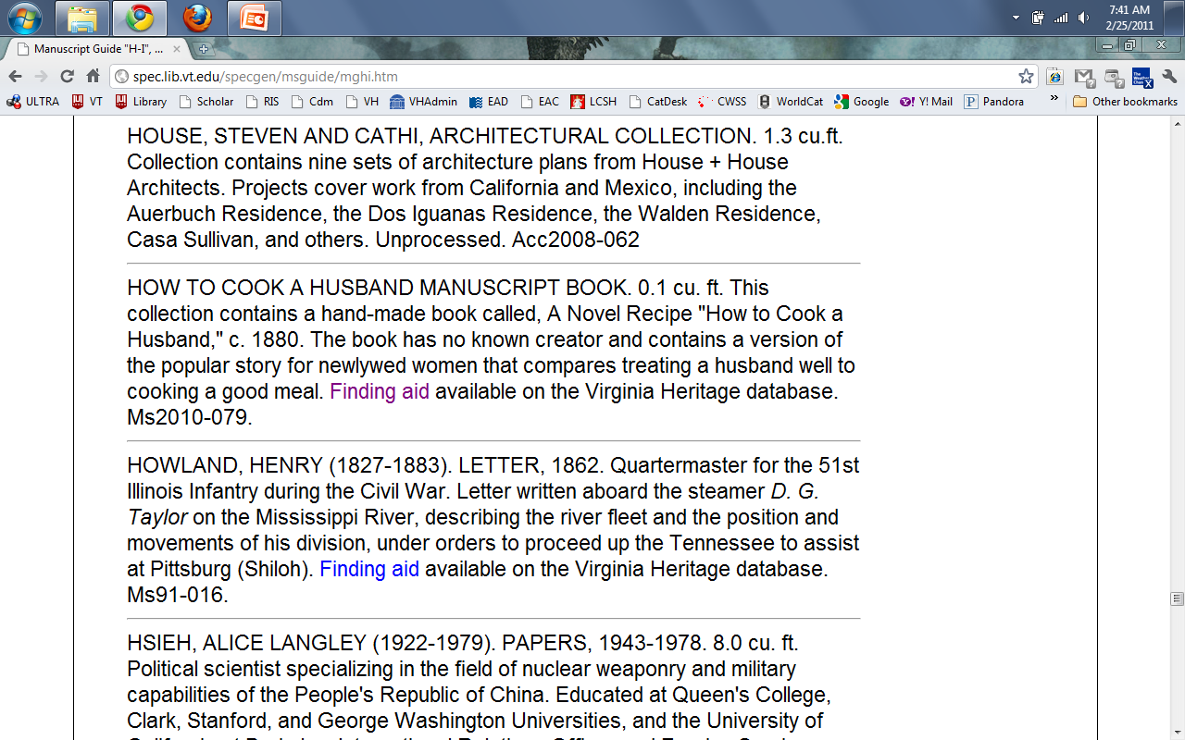
Screenshot: Short Description of Ms2010-079

Slide 18
Reference/Instruction/Outreach
Recent Reference Requests
  Approaches to children’s nutrition through cookbooks in the mid-20th century
  Preservation methodologies (pickling)
Recent Exhibits
  Common Book Project
Future Possibilities
  Getting to classes to us!

Slide 19
Potential Research
Changing approaches to cooking, nutrition, and health over time
Depictions and expectations of gender roles
History of food processes and technologies
Relationships between food and economy

Slide 20
The Culinary History Collection really is more than “just” cookbooks…
Especially if you want run your household and kitchen the “right” way…
As long as you keep in mind that there are as many “right” ways as there are publications.

Slide 21
“Management is an art that may be acquired by every woman of good sense and tolerable memory.”
Introduction to
The Virginia Housewife: or, Methodical Cook, 1820

Slide 22
From the 17th to 19th Centuries
Emphasis on
  Recipe books with household tips
  “How-to” manuals and advice
  Detailed information about how food affects people
  Managing household staff and resources for the family’s best interests

Slide 23
“Bean taffy easily takes first rank among all the taffies—vegetable or otherwise. The taste is good beyond words, and the consistency is pleasingly ‘chewy’ without being tenacious to the point of teeth pulling! Lima beans are the best to use…”
From Mary Elizabeth Hall’s Candy-making revolutionized; confectionery from vegetables. New York: Sturgis & Walton Co., 1912

Slide 24
Through the World Wars
Emphasis on
  Economy, economy, economy
  Stretching limited food supplies
  Preservation
  Community

Slide 25
“Twenty years ago everybody ate pie and nearly everybody had dyspepsia. Jell-O had not been heard of. Now there is scarcely a housewife in America who does not make and serve Jell-O desserts, and stomach-ache is not so common as it used to be.”
Jell-O and the Kewpies: America’s Most Famous Dessert, 1915

Slide 26
The Rise of the Modern Kitchen (Post WWII)
Emphasis on
  Entertaining
  New appliances
  Getting out of the kitchen!
  Convenience/Speed
  Increasing numbers of “how-to” pamphlets and publications
  Diet/Nutrition

Slide 27
“Waiting is a department of woman’s work which is capable of being greatly improved and raised to a higher standard.”
From The expert waitress: a manual for the pantry, kitchen, and dining-room. Anne Frances Springsteed and Margaret Armstrong. New York: Harper & Bros., 1894

Slide 28
Men? In the Kitchen?
Number of Roles:
  As authors
  As audience/readers
  As cooks at home
  As household managers
  As parents

Slide 29
“I would say to housewives, be not daunted by one failure, nor by twenty. Resolve that you will have good bread, and never cease striving after this result until you have effected it. If persons without brains can accomplish this, why cannot you?”
Housekeeping in Old Virginia, c.1879

Slide 30
Show & Tell
Please join us in the Special Collections Conference Room to view some of our recent and/or favorite acquisitions!
This is a wonderful opportunity to see the variety in the collection!

Slide 31
Questions?
Kira A. Dietz
Acquisitions and Processing Archivist
Special Collections
kadietz@vt.edu
Background Image: Pages from Ms2008-024, “Book of Receipts” Recipe Book, 1731. Recipes in this manuscript book include those for picking and preserving, baking, drinks, and several household remedies.

