Slide 1
Qatar Content Classification
Client
Tarek Kanan
tarekk@vt.edu
Presenter
Mohamed Handosa
handosa@vt.edu
VT, CS6604
May 6, 2014

Slide 2
About The Project
Funded by QNRF (http://elisq.qu.edu.qa)
Started at VT in 1/1/2013, and running through 12/31/2015.
A project to advance digital libraries in the country of Qatar.
Collaborating institutes: Penn State, Texas A&M, and Qatar University.

Slide 3
Project Plan
Build Arabic collections using Heritrix crawler
Build a universal taxonomy for Arabic newspapers
Use different classifiers to classify Arabic documents
Use Apache Solr to index and search Arabic collections
Evaluate the performance of the classifiers on Arabic data

Slide 4
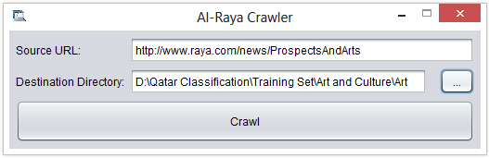
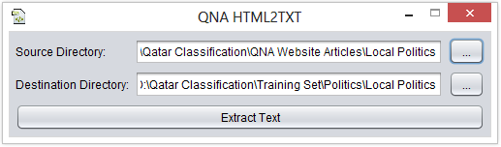
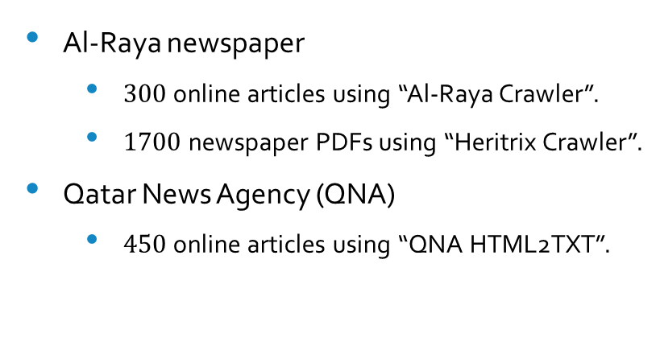
Building Arabic Collections
Data Sources
Al-Raya newspaper
  $300$ online articles using “Al-Raya Crawler”.
  $1700$ newspaper PDFs using “Heritrix Crawler”.
Qatar News Agency (QNA)
  $450$ online articles using “QNA HTML2TXT”.

Slide 5
Arabic Newspapers Taxonomy
Arabic Newspaper
Economy
Politics
Society
Sport
Art
150 instances
(Al-Raya)
150 instances
(QNA)
150 instances
(QNA)
150 instances
(Al-Raya)
150 instances
(QNA)

Slide 6
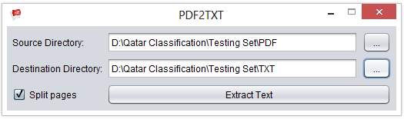
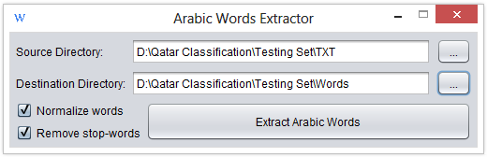
Collection Preprocessing
Extracting Arabic words
Normalizing Arabic words (optional)
Stemming Arabic words (optional)

Slide 7
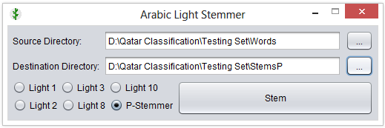
Stemming Arabic Words
Root Stemmers – too abstract.
  “مقصد”, “الاقتـصاد” → “قصد”
Light Stemmers – widely used.
  “مباحث”, “المباحثـات” → “مباحث”
P-Stemmer – even better ☺.
    “مباحث” → “مباحث”
    “المباحثات” → “مباحثات”

Slide 8

Multiclass Classification (21 Classifiers)

Slide 9
Binary Classification (15 Classifiers)

Slide 10

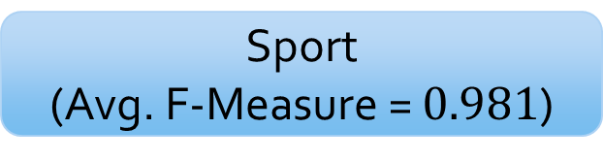
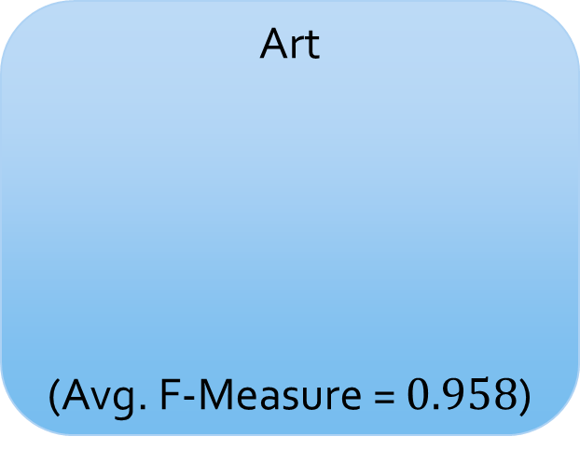
Arabic Newspapers Classification Framework
Art
(Avg. F-Measure = $0.958$)
F-Measure
SVM (SMO)
Naïve Bayes
Random Forest
Document
Ranker
Sport
(Avg. F-Measure = $0.981$)

Slide 11
Uploading Collections to Apache Solr
1700 Newspaper PDF Files
Solr Cores
Splitted into PDF text
Converted to clean Arabic text
Stemmed using proposed P-Stemmer.
Classified using 5 SVM binary classifiers.
Classified using a SVM multiclass classifier.
11 Solr cores were created
For each of the five binary classifiers
  Positive instances were uploaded to a core
For the multiclass classifier
  Instances of each class were uploaded to a core
All instances were uploaded to the last core

Slide 12
Contributions
Building a collection for Arabic newspapers.
Developing a set of tools to process Arabic text.
Proposing P-Stemmer, an Arabic light stemmer.
Comparing different text classification techniques.
Proposing a framework for Arabic Newspapers Classification.
Creating 11 Solr cores, 2 per class and 1 containing all instances.

Slide 13
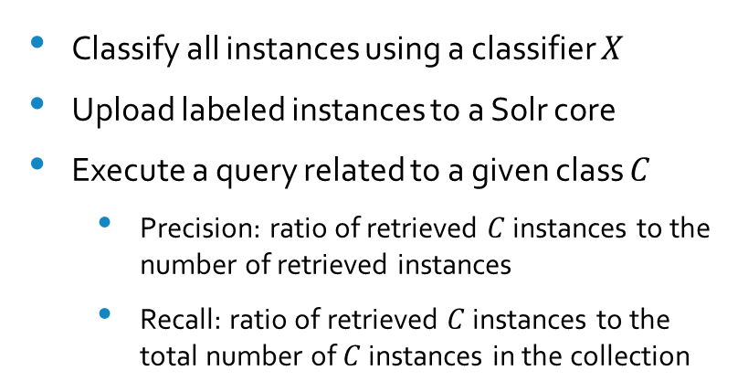
Future Work
Prepare Testing Set using Solr
Evaluate Classifiers using Solr
Upload all instances to a Solr core
Execute a query related to a given class
Label search outputs as belonging to that class
Use the labeled instances to test the classifiers
Classify all instances using a classifier $X$
Upload labeled instances to a Solr core
Execute a query related to a given class $C$
  Precision: ratio of retrieved $C$ instances to the number of retrieved instances
  Recall: ratio of retrieved $C$ instances to the total number of $C$ instances in the collection

Slide 14
Thank You

