Slide 1
CS5604 Front End TEAM
Final Presentation
Yusheng Cao, Reza Mazloom
Makanjuola Ogunleye
Instructed by Professor Edward A. Fox
Assisted by Satvik Chekuri and the Digital Library Research Laboratory
Virginia Polytechnic Institute and State University
Blacksburg, VA 24061
December 7th 2020

Slide 2
Previous Project
Built website for 2 types of content (Tobacco settlement and ETD) that allowed:
End-users searching either of the 2 types of content
Login and register for one type of user.

Slide 3
Project Goal
Build a front end website for 3 types of content (ETD, Tweet, Webpage) that allows:
End-users searching any of the 3 types of content
Researchers/curators managing the collections
Interface to Reasoner and Knowledge Graph
Admin functionalities, user types, and user roles

Slide 4
Project Milestones
4 stages
IR1 - Analysed previous project code; Researched needed tools, and built frontend prototype to search ETD metadata
IR2 - Built filter and keyword search for each Elasticsearch index, extended search to TWT and WP metadata
IR3 - Improved system to search ETD, WP, TWT indices.
Final Phase - Improved internal Admin functions, Curation and Knowledge graph functionalities.

Slide 5
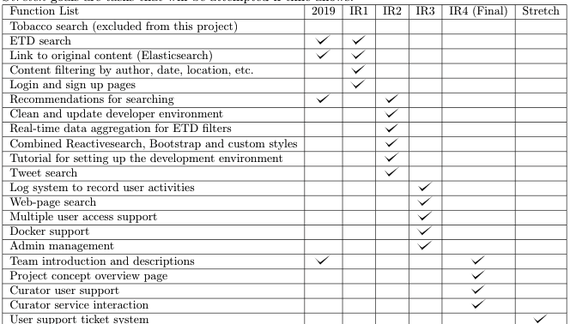
What we add

Slide 6



Design & Tools
Back End
MySQL or PostgreSQL
Docker
Dynamic Configurations and Environment Variables
Front End
Flask
Reactive Search
Bootstrap

Slide 7
Future Work
Use the Flask backend as a proxy for Reactivesearch requests
Use HTTPS and using a proxy for external services to avoid CORS problems
Allow searching through multiple indices and group indices based on structure
Using a secure production web-server making use of the Flask base
View and edit services/goals to admin and/or curator users visually with a graphical UI
Create standards for service/index/goal usage and design

Slide 8
What we learned
How to use React to create UI dynamically with the Elasticsearch
Common information retrieval and storage techniques
Elasticsearch
Collaboration Tools (Trello, Ally)
Database
Dynamic website design with multiple types of user access

Slide 9
Demo

Slide 10
Special Thanks
Dr. Edward A. Fox for his mentorship, and members of the Digital Library Research Laboratory at VT
All other participating teams in the class: INT, ETD, TWT, and WP
Two agencies for supporting the project:
Institute of Museum and Library Services (LG-37-19-0078-19)
National Science Foundation (CMMI-1638207 and OAC-1835660)

