Slide 1
Child labor and household land holding: Theory and empirical evidence from Zimbabwe
Ali Reza, Jeffrey Alwang and Nic Tideman
Presentation at SCAU, Guangzhou, China
December 18 2018

Slide 2
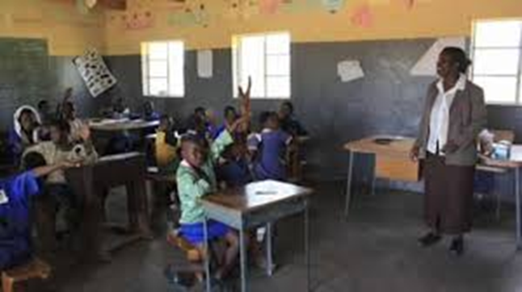
Background
About 30% of children aged 5-14 are employed in Sub-Saharan Africa
Majority are in rural areas and working on their parents’ farms
Concerns for short-run outcomes such as abusive conditions, age equity, schooling
Implications for long-term accumulation of human capital, poverty reduction, and economic mobility of young populations
Policy makers are interested in determinants of child labor and what policies might be used to reduce it
Wealth in SSA is closely linked to land holding and, more broadly, performance in agriculture is partially determined by land holding and land tenure relationships
Wide variation in land tenure systems (communal, free-hold, leasehold; dual systems)
Evidence of inverse productivity relationship—smaller land holdings tend to be more intensively farmed
Relationship between land holding sizes and use of child labor is complex (theory and empirical evidence)

Slide 3
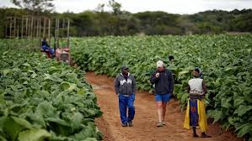
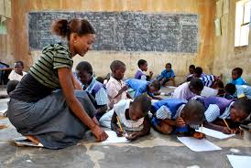
Background
Since Independence in 1980, Zimbabwe has prioritized schooling to alleviate poverty, promote equity and economic development
Through 2000s, education indicators in Zimbabwe far exceeded those in neighboring countries (Larochelle, Alwang and Taruvinga 2016)
Land and access to it has been a central policy focus throughout Z
At Independence about 45% of arable land was owned by fewer than 10,000 white farmers
As a part of Independence negotiations, an agreement outlined a process to redistribute land from white European Zimbabweans to blacks
During the 1980s, land re-distribution occurred on a willing buyer, willing seller basis, with funds from donors
Beginning in 2000, landless blacks began to invade white-owned farms. Government began a fast track land resettlement program, acquiring most of the invaded farms and resettled the invaders. Subsequently, more than 3,100 farms were distributed among 214,340 black farmers (Mabaye, 2005).

Slide 4
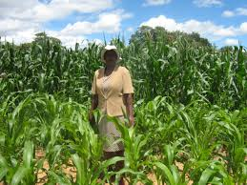
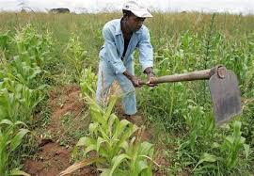
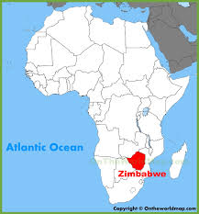
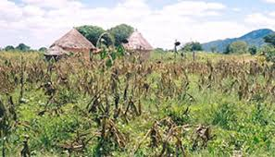
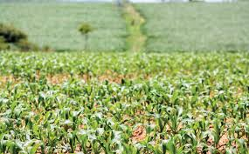

Slide 5
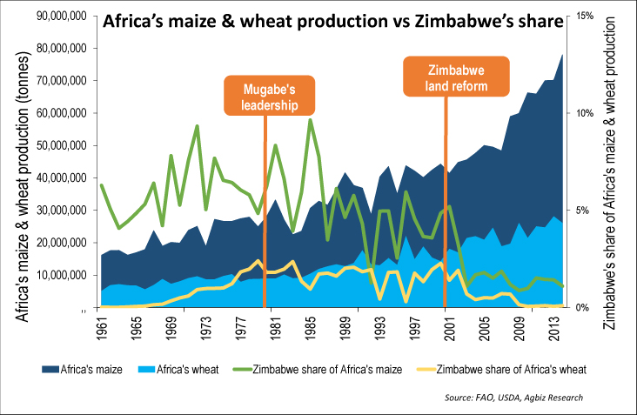
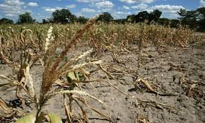
Background
Economic difficulties arose after 2001
Growing inflation, collapse of the agricultural economy, land grabs by war veterans
Continued environmental uncertainty (recurring drought)
Culminating in hyperinflation, abandonment of Zimbabwean dollar and adoption of the US dollar in 2008

Slide 6
Inflation in 2007 & 2008

Slide 7
More inflation

Slide 8
Hyperinflation?

Slide 9
Hyperinflation!

Slide 10
Objectives
Present a simple theoretical model explaining the relationship between landholding and incentives for child labor
Apply model to data from three national surveys in Zimbabwe (2001, 2007/8 and 2011/12)
Understand whether the landholding/labor relationship holds under different economic conditions (is economic stress associated with a different relationship?)

Slide 11
Theoretical background
Many papers have argued that the main cause of child labor is poverty; lack of resources, together with factors such as credit constraints, income shocks, and parental attitudes toward education are associated with increased child labor (Durea & Arends-Kuenning, 2003; Ersado, 2005; Jacoby & Skoufias, 1997; Weir, 2011)
Parents prefer not to send their children to work. This is the luxury axiom, proposed by Basu and Van (1998). Much evidence supports it (Edmonds, 2005; Basu, 1999; Basu & Tzannatos, 2003)
Also evidence of a “wealth paradox”: as landholding size increases, child labor grows (Sarkar & Sarkar, 2016; Friebel, et al. 2015; Dumas, 2007; Kruger, 2007; Francavilla et al. 2013; Kambhampati & Rajan, 2006 )

Slide 12
Theoretical background
Relationship between land holding size and child labor involves a substitution and an income effect:
In imperfect labor markets, the productivity of a child laborer increases with landholding (substitution effect), increasing demand for child work
More land is associated with higher incomes, decreasing demand for child labor and increasing demand for schooling (income effect)
According to this basic background, how child work changes with household landholding is an empirical question.
Does the income effect or the substitution effect dominate?
Does one of the effects always dominate or is the pattern of the dominance nonlinear?
Can we formalize these concepts?

Slide 13
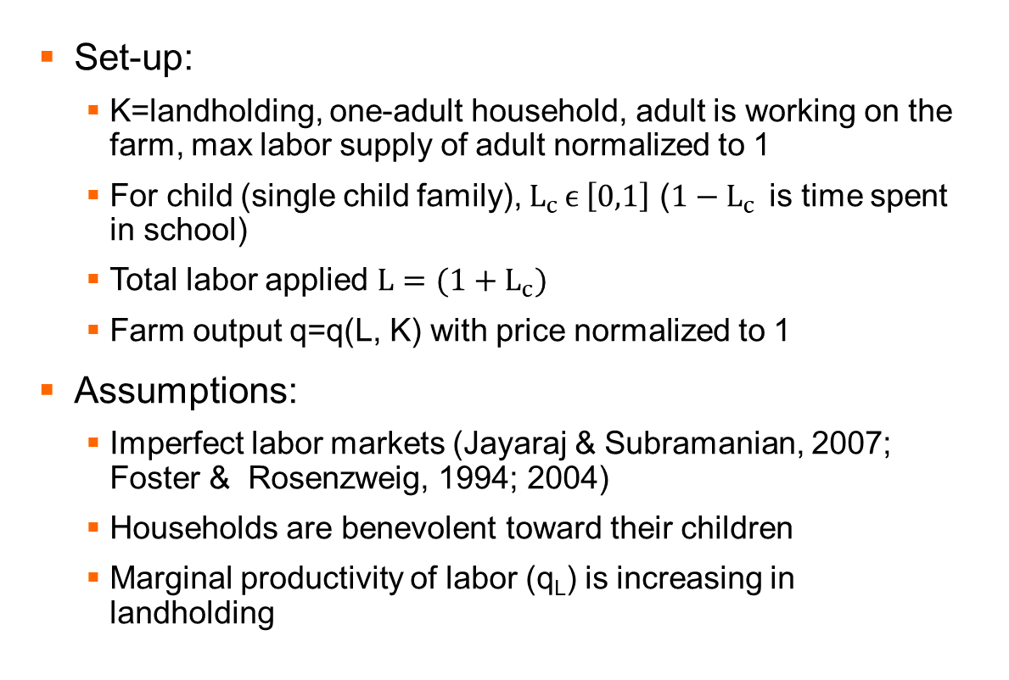
Theory
Set-up:
K=landholding, one-adult household, adult is working on the farm, max labor supply of adult normalized to 1
For child (single child family), $L_{c }ϵ \left[0,1\right]$ (${1−L}_{c }$ is time spent in school)
Total labor applied $L=(1+L_{c})$
Farm output q=q(L, K) with price normalized to 1
Assumptions:
Imperfect labor markets (Jayaraj & Subramanian, 2007; Foster & Rosenzweig, 1994; 2004)
Households are benevolent toward their children
Marginal productivity of labor (q_{L}) is increasing in landholding

Slide 14
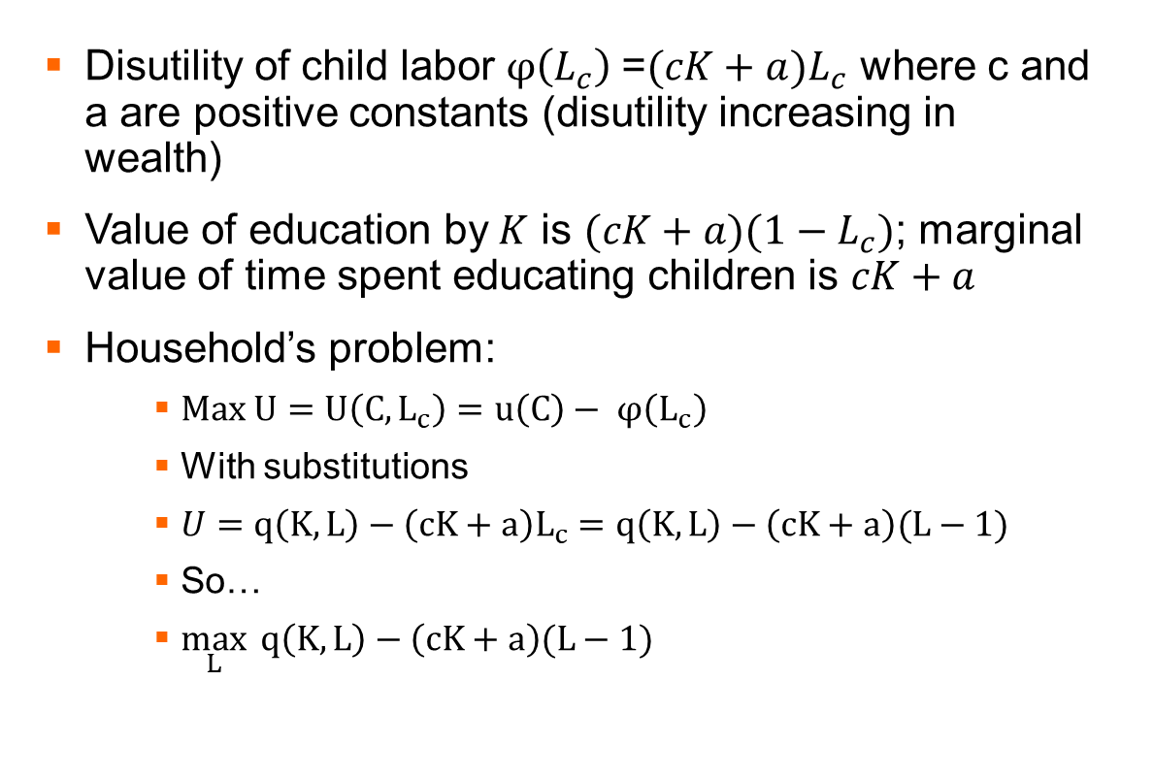
Theory
Disutility of child labor $φ\left(L_{c}\right)$=$(cK+a)L_{c}$ where c and a are positive constants (disutility increasing in wealth)
Value of education by$K$ is $(cK+a)(1−L_{c})$; marginal value of time spent educating children is $cK+a$
Household’s problem:
$Max U=U\left(C,L_{c}\right)=u\left(C\right)− φ\left(L_{c}\right)$
With substitutions
$U=q\left(K,L\right)−\left(cK+a\right)L_{c}=q\left(K,L\right)−\left(cK+a\right)(L−1)$
So…
$\max_{L}{ q\left(K,L\right)−\left(cK+a\right)(L−1)}$

Slide 15
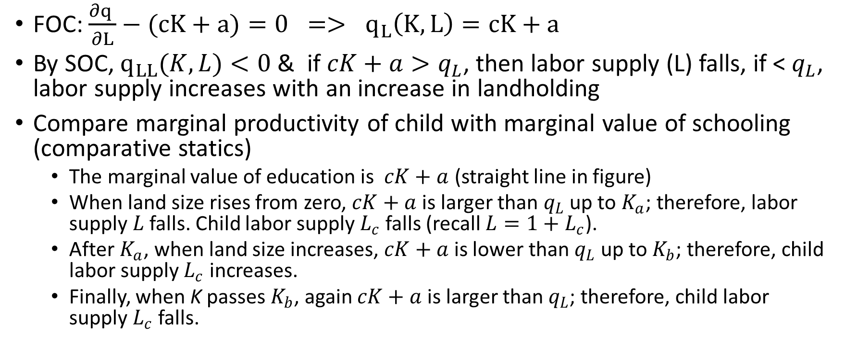
Theory…
FOC: ${\frac{∂q }{∂L}−(cK+a)=0 => q}_{L}\left(K,L\right)=cK+a$
By SOC, $q_{LL}(K,L)<0$ & if $cK+a>q_{L}$, then labor supply (L) falls, if < $q_{L}$, labor supply increases with an increase in landholding
Compare marginal productivity of child with marginal value of schooling (comparative statics)
The marginal value of education is $cK+a$ (straight line in figure)
When land size rises from zero, $cK+a$is larger than $q_{L}$ up to $K_{a}$; therefore, labor supply $L$ falls. Child labor supply $L_{c}$ falls (recall $L=1+L_{c}$).
After $K_{a}$, when land size increases, $cK+a$is lower than $q_{L}$ up to $K_{b}$; therefore, child labor supply $L_{c}$ increases.
Finally, when K passes $K_{b}$, again $cK+a$is larger than $q_{L}$; therefore, child labor supply $L_{c}$ falls.

Slide 17
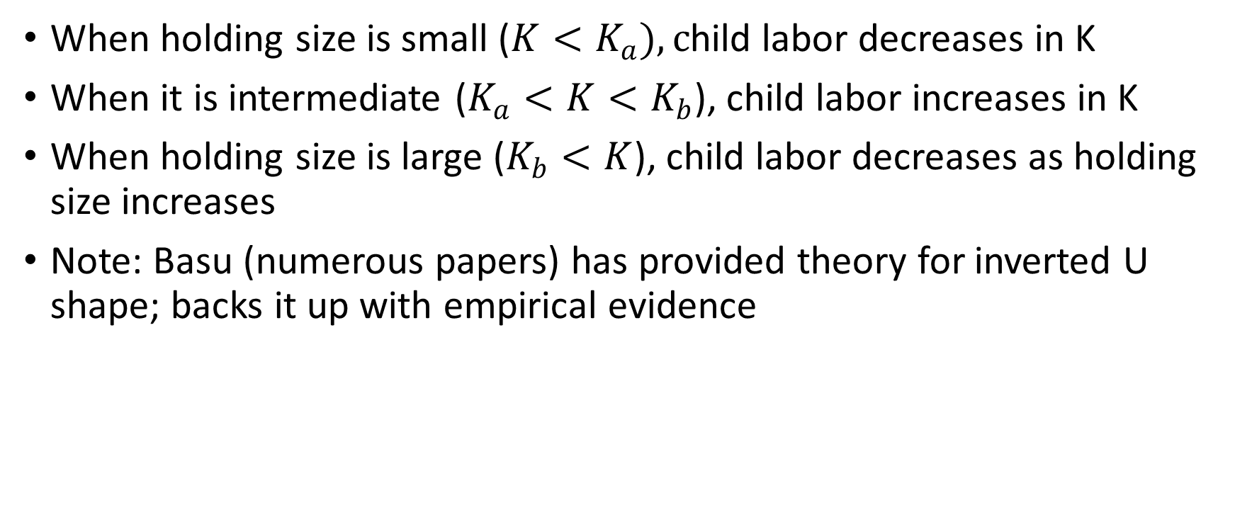
Implications
When holding size is small ($K<K_{a}), c$hild labor decreases in K
When it is intermediate ($K_{a}<K<K_{b}$), child labor increases in K
When holding size is large ($K_{b}<K$), child labor decreases as holding size increases
Note: Basu (numerous papers) has provided theory for inverted U shape; backs it up with empirical evidence

Slide 19
Data
Three nationally representative household surveys conducted by ZIMSTAT are employed for the analysis.
The Incomes, Consumption and Expenditure Surveys (ICES) were conducted from January 2001 to January 2002 and from June 2007 to December 2007 (the 2007/8 ICES survey was intended to be conducted from June 2007 to May 2008, but, because of the economic crisis, it was not completed and a few observations were collected in 2008)
The Poverty, Incomes, Consumption and Expenditure Survey (PICES), using an identical questionnaire, was conducted from June 2011 to May 2012
There are 12806, 11615 and 25052 surveyed households respectively in 2001, 2007 and 2011, from rural areas. These surveys use similar sampling designs and questionnaires and are representative at the provincial and higher levels
Sample cleaning issue: About one percent of households who are among top 2 percent of land owners, stated that they do not own any assets. These observations represent mis-measurement and are dropped. Most of these same households did not answer other questions

Slide 20
Empirical issues
Two ways to define child labor:
From question: Has (name) ever attended school? Answers are: 1) never been; 2) at school; and 3) left school. If a child has left school, then there is another question which asks about the reason. If a child aged 7-14 has never gone to school or has left school and this leaving is not because of illness then he/she is considered to be a child laborer. Problem: in school and working
Main activity of each individual during the past 12 months. This definition holds that if the main activity of a child aged 7-14 is working, then he/she is considered as a child laborer. Problem: missing observations
How to define landholding (and potential endogeneity): (i) total; (ii) owned; (iii) rented; (iv) borrowed or other arrangement:
Use land owned due to limited potential for endogeneity
Note on land tenure in Zimbabwe
Non-land wealth controlled for through MCA-generated asset index

Slide 21
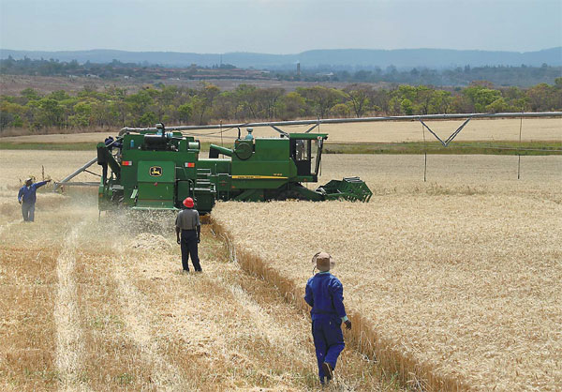

Slide 22
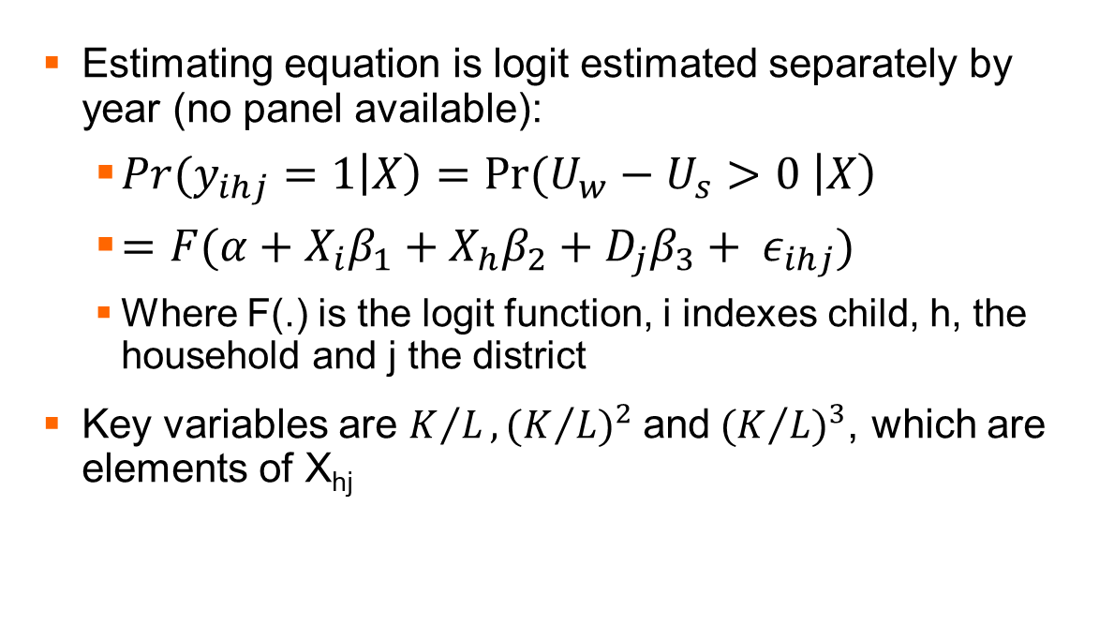
Empirical issues
Estimating equation is logit estimated separately by year (no panel available):
${Pr(y}_{ihj}=1\left|X\right)=Pr⁡(U_{w}−U_{s}>0 \left|X\right)$
$=F(α+X_{i}β_{1}+X_{h}β_{2}+D_{j}β_{3}+ ε_{ihj})$
Where F(.) is the logit function, i indexes child, h, the household and j the district
Key variables are $K/L, {(K/L)}^{2}$and${(K/L)}^{3}$, which are elements of X_{hj}

Slide 23
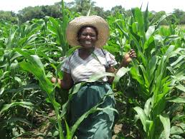
Results
Coefficients and marginal effects are all as expected, coefficients on the key variables are highly significant and consistent with the theoretical pattern (decreasing, increasing, decreasing)
Pattern holds for all survey years
At means, the bump begins to emerge around 0.6, 1 and 0.9 hectares per household member and it peaks on average about 1.3, 2.7 and 2.9 hectares per household member respectively in 2001, 2007 and 2011
Shape is similar, but location of “bump” changes: probability of putting children to work for medium land-holding households increased about 5 percentage points during the shock and then fell by about 4.5 percentage points
When land holding is very small, the probability of working was about 9.5%, 11% and 5% respectively in 2001, 2007 and 2011. Therefore, the probability increased by 1.5 percentage points during the economic crisis and then fell by about 6 percentage points
Results suggest that incentives for putting children to work increased during the crisis for both middle and poor wealth class households, but it increased a lot more in the middle wealth class, because they have sufficient lands to employ their children profitably

Slide 26
Results
Inverted U shape will miss important action at the middle part of the land distribution
Asset wealth has negative effect on child labor
When land productivity is accounted for (dry, humid areas of country), we find the income (land wealth) effect to be strong
Different pattern of peak labor indicates that in humid (productive) areas, very small landholders are more likely to put children to work
In dry areas, medium-land households are more likely
Sex bias: boys are more likely to be put to work than girls (educational achievements for girls have been especially prominent in Zimbabwe)

Slide 27
Summary
Landholding size and child labor use in agriculture shows an interesting and complex pattern
Driven by a complex relationship between the marginal productivity of child on a farm and the marginal value of his/her education at different levels of wealth
Theory is born out
Findings are robust to specifications
Child labor use increased during economic crisis of 2007/8, but returned to its earlier level following resolution of crisis
Programs to promote school attendance need to target different households in different areas; the “bump” is important

Slide 28
Questions?/Comments?

Slide 29
Thank you!
谢谢
waita hako

