Slide 1
Python4ML
An open-source course for everyone
Team: James Hopkins | Brendan Sherman | Zachery Smith | Eric Wynn
Client: Amirsina Torfi
Instructor: Dr. Edward Fox
CS 4624: Multimedia, Hypertext, and Information Access
Virginia Tech, Blacksburg VA 24061
5/12/2019

Slide 2
Outline
Summary
Deliverables
Documentation
Testing Plans
Post-Semester Work
Lessons Learned

Slide 3
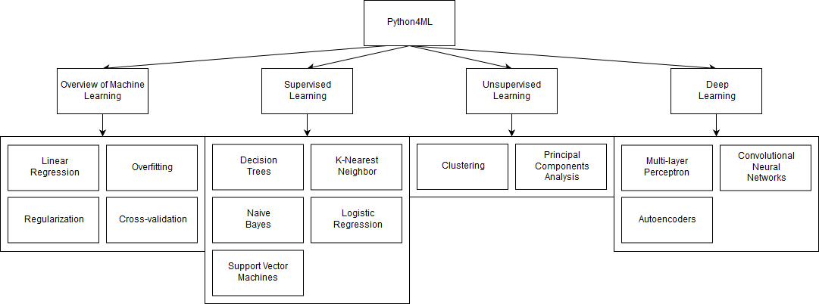
Summary
Creating an open-source guide to Machine Learning using Python

Slide 4
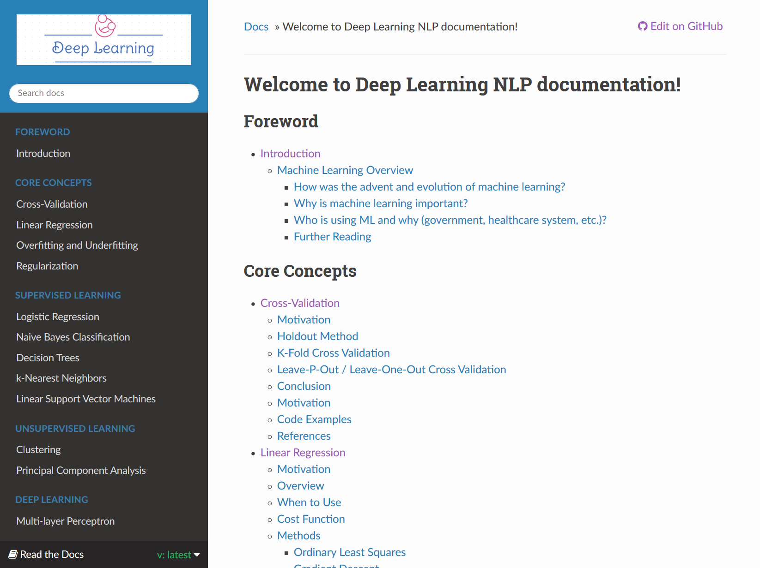
Deliverables
Course website
Contains all module write-ups
Entire site can be downloaded as PDF or other formats
Links to code examples on GitHub

Slide 5
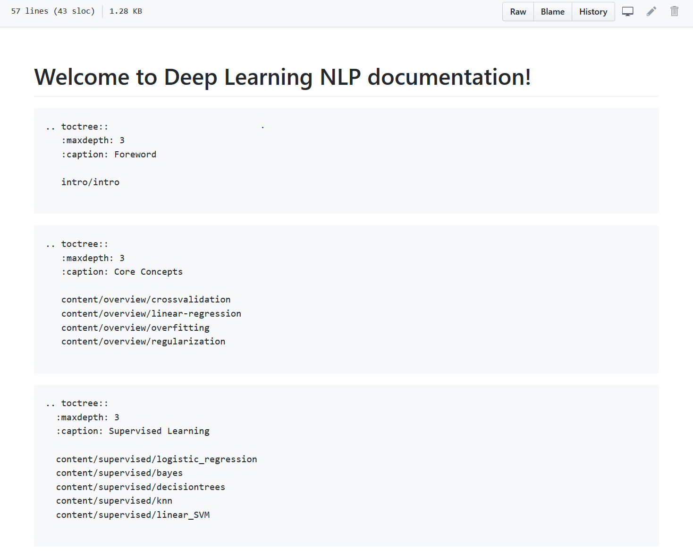
Deliverables
GitHub repository
All course content is open-source
Anyone can contribute and suggest changes
Highly structured system for files

Slide 6
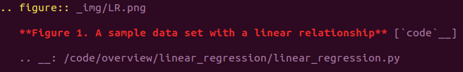
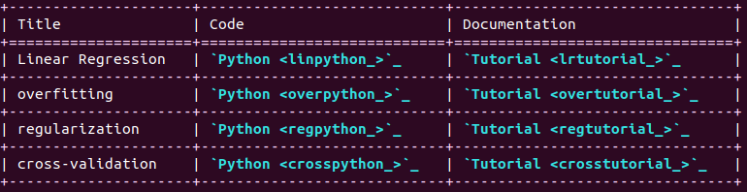

Documentation
Documentation written in reStructuredText (rST), a form of markup
Seamless integration with Sphinx
Annotated, linked figures
Clean tables
Embeddable code

Slide 7
Demo
Project Stats
https://machine-learning-course.readthedocs.io/en/latest/
6500+ lines of content
100+ pages of course documentation (another 60+ in the final report)
70+ sources
25+ unique python examples

Slide 8
Testing Plans
We have been testing scripts as they are added, but the whole team will come together to re-test each one for the final deliverable.
Every navigation link in the site needs to be tested.
We had sample users go through the modules and provide us with feedback.

Slide 9
End of Semester Plans
Complete the last two topics on Neural Networks
Build final site, test navigation, and test every script
Get feedback from user testing

Slide 10
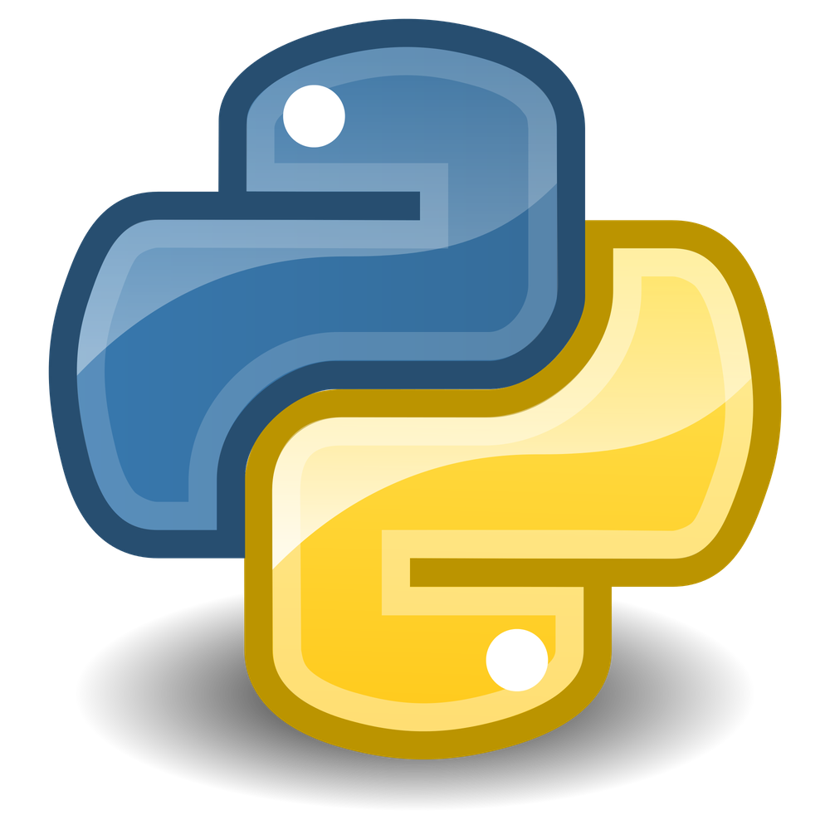
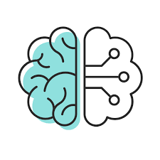
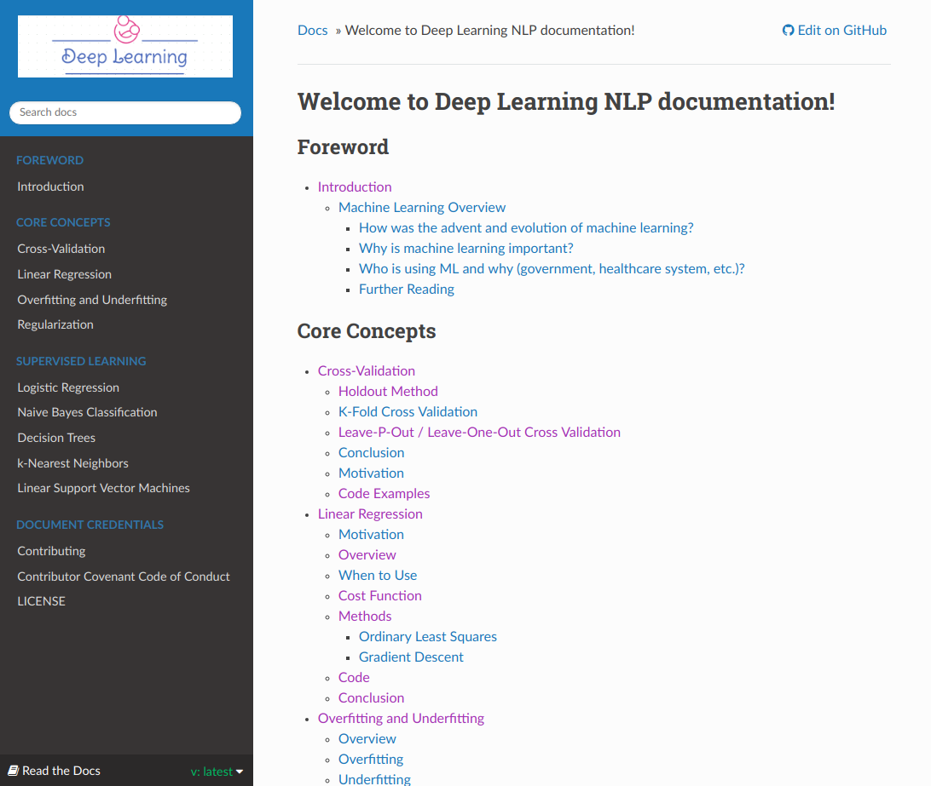
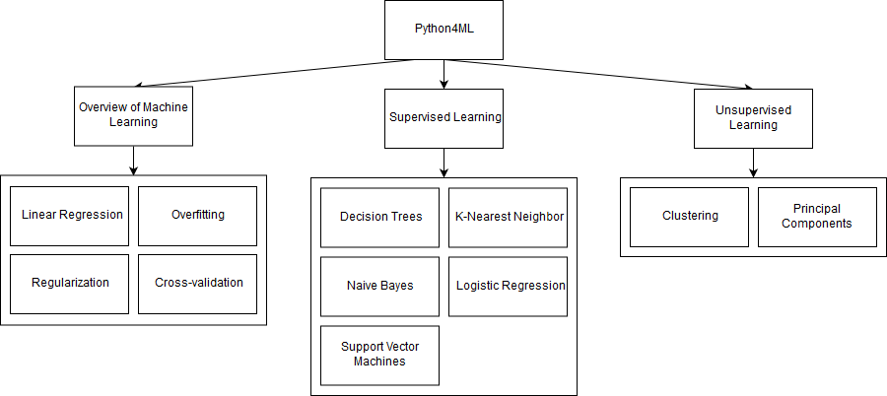
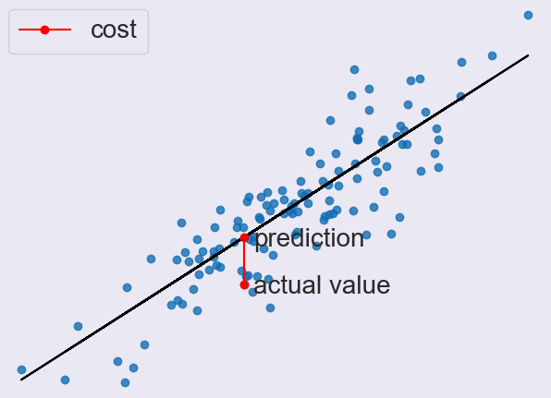
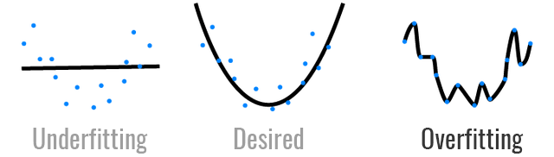


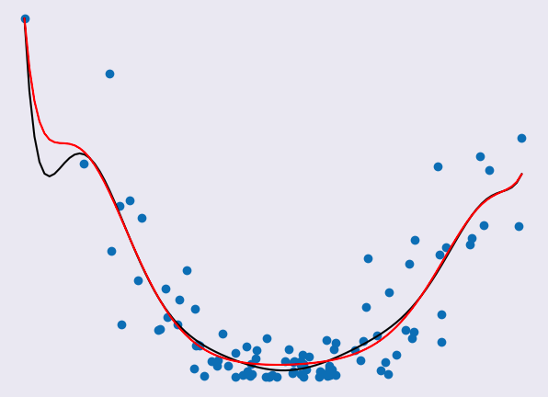
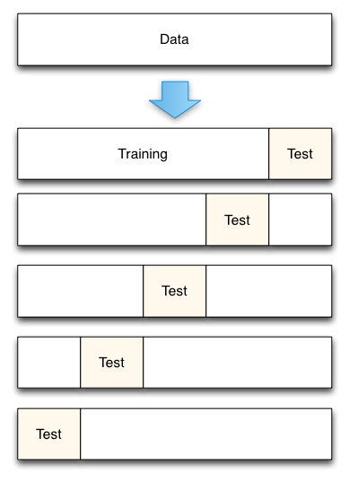
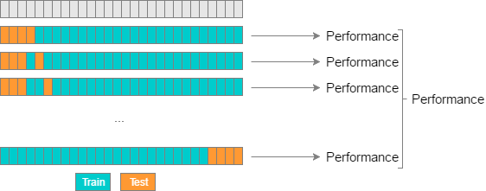
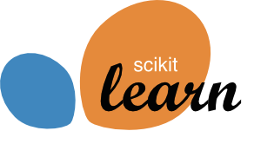

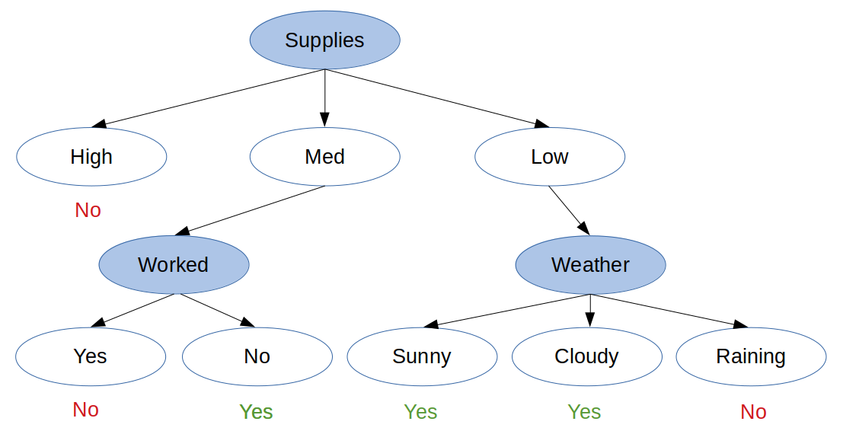
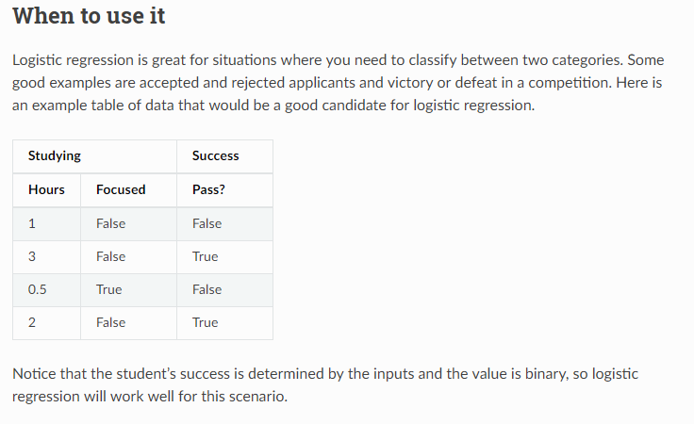
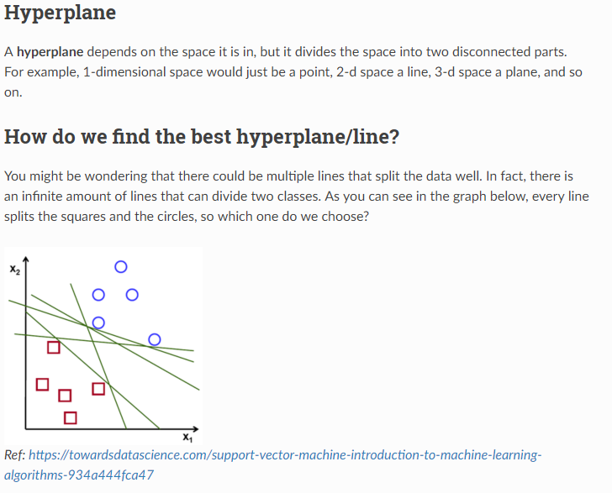
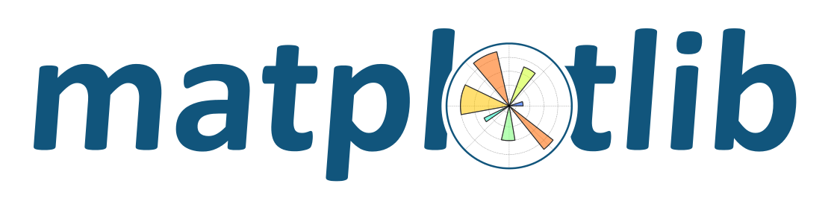
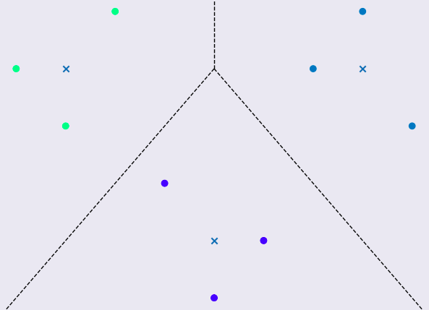
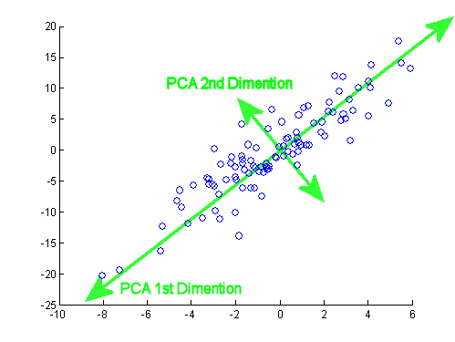
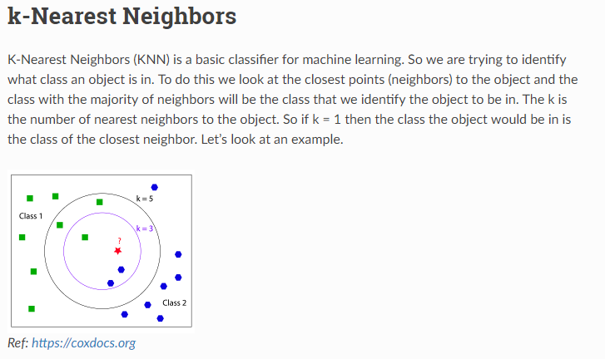
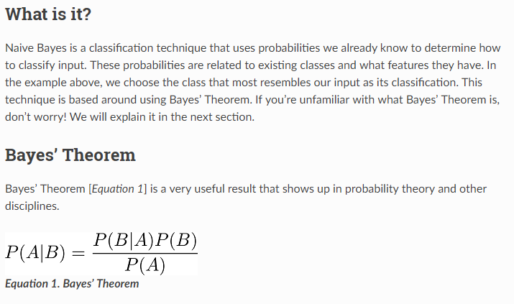
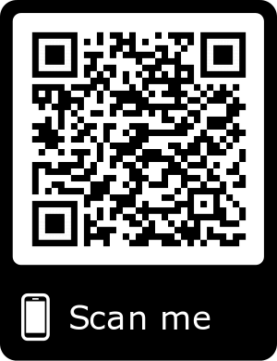
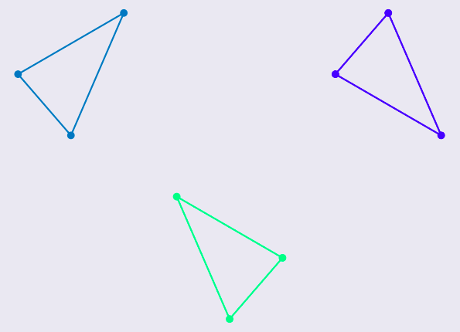
Python4ML
A Machine Learning Course for Everyone
Live Course Site
Topics
WHAT?
Python4ML is an open-source course for machine learning using the Python programming language.
WHO?
This course is being developed with Virginia Tech’s Open Source for Science organization, led by our client Amirsina Torfi.
HOW?
The course is made up of reStructuredText documents and example programs written in Python, using libraries such as scikit learn.
WHERE?
The course is available on GitHub. The code and live course site can be found by scanning the QR code on this poster.
Overview
Technologies
Linear Regression
Overfitting / Underfitting
WHY?
The course is aimed at those with little knowledge of machine learning. We want to facilitate education in an open-source context, bringing important topics together in a high-level overview of ML.
Regularization
Cross Validation
Supervised Learning
Decision Trees
Logistic Regression
Support Vector Machines
Unsupervised Learning
Clustering
Principal Component Analysis
Learn More
K-Nearest Neighbors
Naive Bayes
Team: James Hopkins, Brendan Sherman, Zachery Smith, and Eric Wynn
Client: Amirsina Torfi,
Head of Open Source for Science @ VT
4/30/2019
Instructor: Edward A. Fox

Slide 11
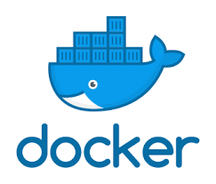
Post-Semester Work
This course can be expanded outside this capstone or in future semesters by:
Writing more example scripts and content
Integrating the project with Docker:
A containerized system, similar to virtual machines
Can pre-package dependencies together for each section and provide users with a single command to run scripts
Users won’t need python OR dependencies installed

Slide 12
Lessons Learned / Takeaways
Importance of high quality documentation
As important as or more important than actual code
Makes reviews faster and documents easier to understand
Teaching about a subject requires deep understanding
Had to know why specific decisions were made at every step
Required lots of research on the topics

Slide 13
Lessons Learned / Takeaways
Importance of finishing personal assignments in a timely manner
Several reviewing stages that required individual approval
Delayed when someone doesn't respond or approve changes

Slide 14
Acknowledgements
Client: Amirsina Torfi
PhD student in Computer Science
Focused on deep learning, neural networks
Scikit-Learn
Open-source Python Machine Learning library

