Slide 1



Open Connections: Regional and Local Community Building for Equity and Sustainability
Anita Walz, Assistant Director of Open Education & Scholarly Communication Librarian
Open Education Southern Symposium - Keynote Presentation
July 12, 2021
With the exception of brand names, logos and unless otherwise noted, this presentation is released under a Creative Commons Attribution 4.0 license.
OESS logo by Rebekah McDaniel.

Slide 2



Getting to Know You
Go to www.menti.com and use the code 1593 0745
or, use the QR code:
Image: Public Domain
Notes:
https://www.menti.com/x3kyyq9yq8
Live results: https://www.mentimeter.com/s/9336e2019c950e7e7372bf826338d316/ea99929b6911

Slide 3
Go to www.menti.com and use the code 1593 0745
➔I’m just learning about open education
➔I have a strong understanding
➔I feel strong philosophical alignment
➔I’m pragmatic about its applications
➔I’m skeptical but listening
➔I’m not sure what to do next
➔I have a vision and a plan

Slide 4
About your role
Go to www.menti.com and use the code 1593 0745
Faculty / Instructor
Instructional designer
Librarian
Publishing expert
Administrator
Student
Nonprofit or consortium manager
Other

Slide 5

A bit about my role . . .
Image: Pixabay

Slide 6
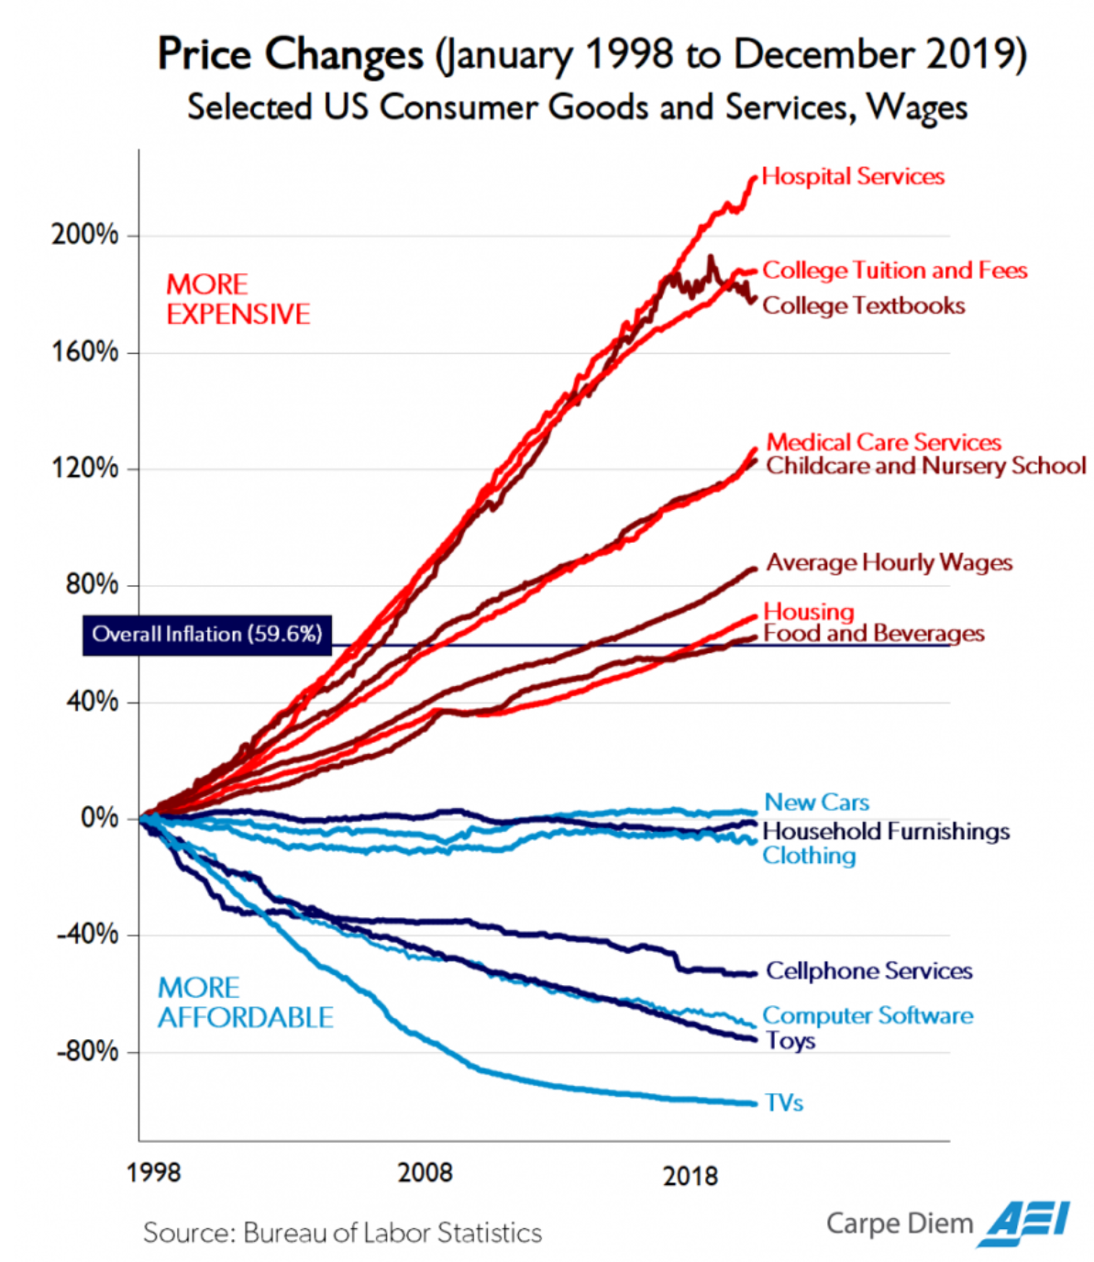
On Cost: Student Spending
on Course Materials
$481 / year in 2020-21
Down from $590 in 2010 but still far above
the rate of inflation
. . . equivalent to a month of rent?
Student Monitor Lifestyle & Media Reports: https://www.studentmonitor.com
Mark Perry/AEI https://www.aei.org/carpe-diem/chart-of-the-day-or-century-3/
(Used with permission)

Slide 7
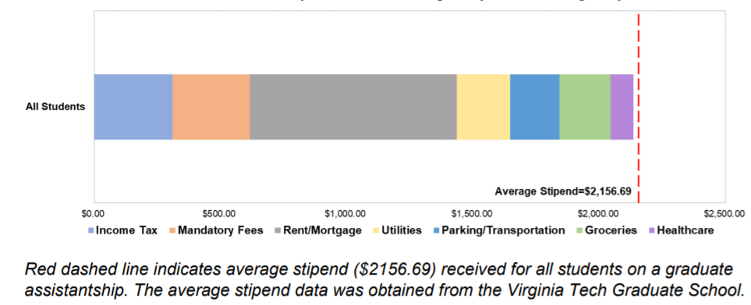
Course material costs are an issue
Graduate student reported cost of living compared to average stipend (not including course materials)
2020-21 Graduate Student Assembly Cost of Living Report https://gsa.vt.edu/advocacy/2020-2021-advocacy/2021-cost-of-living-survey-results.html

Slide 8
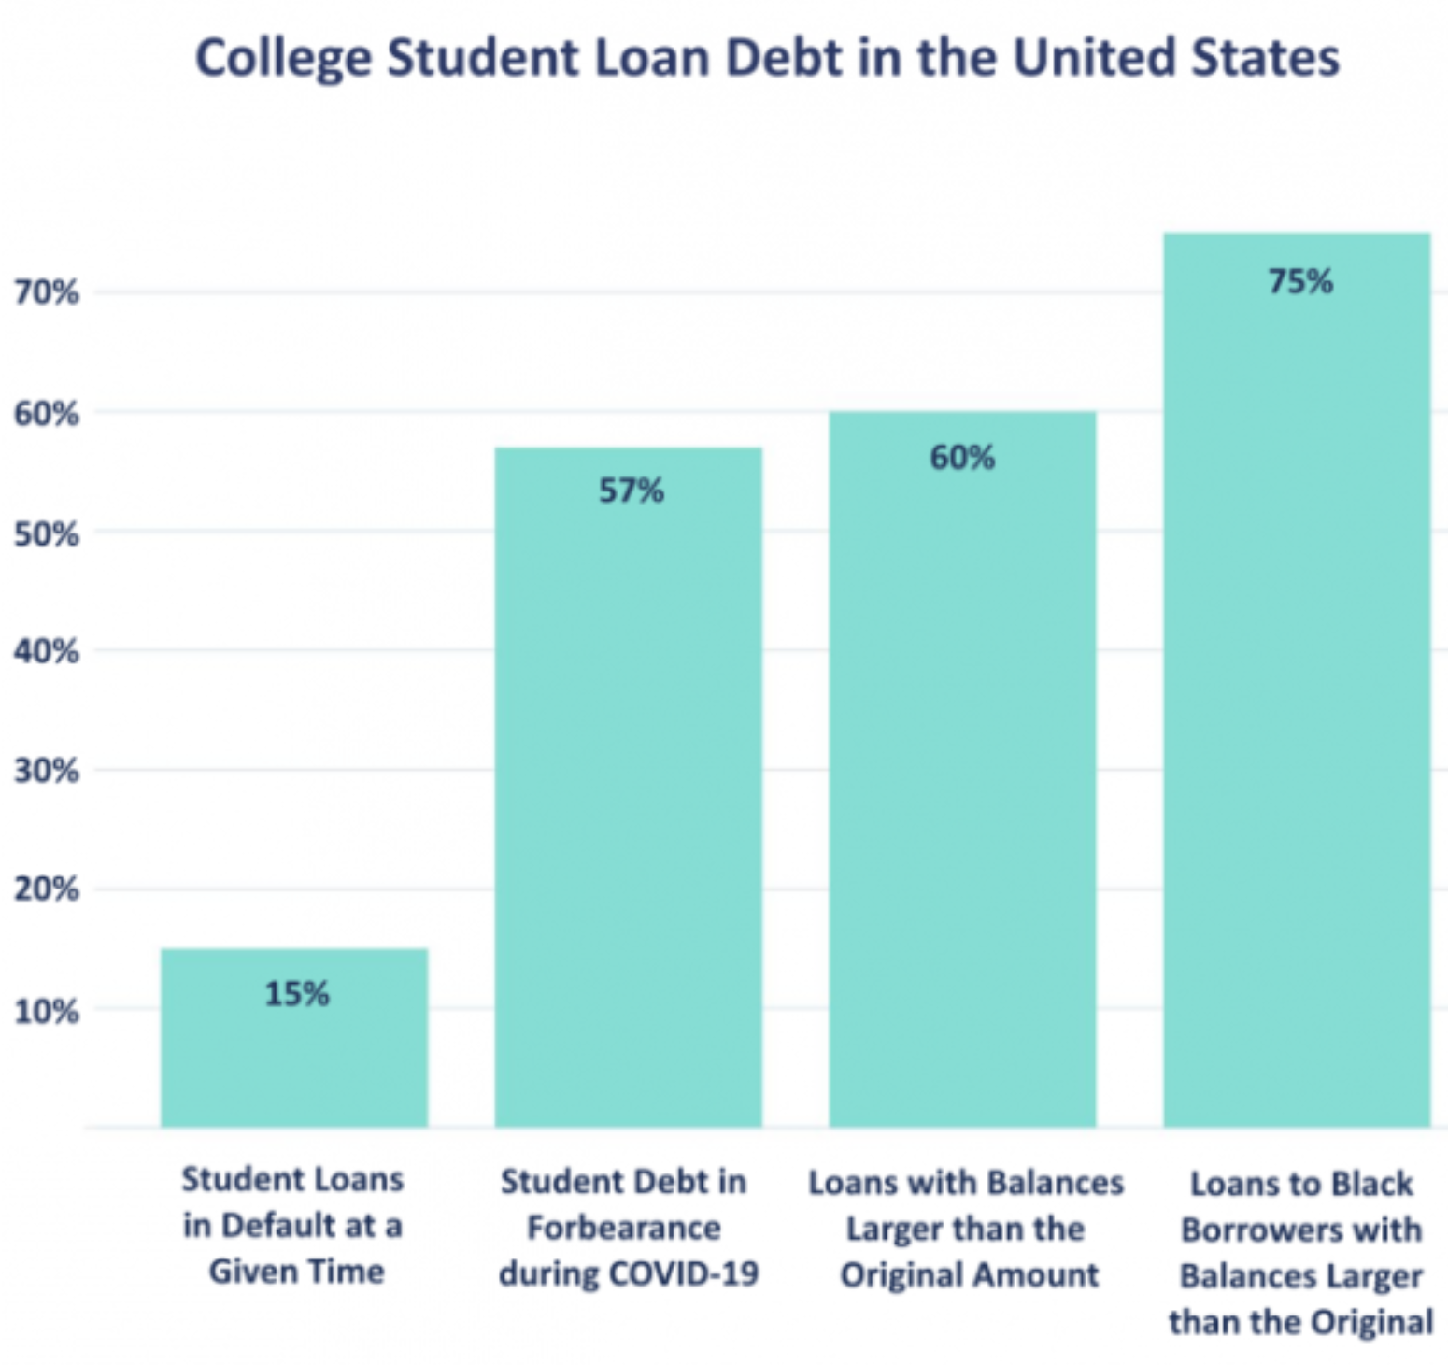
Total U.S. student debt by the end of 2020:
$1.7 trillion
100% increase in student debt since 2010
https://www.aacu.org/aacu-news/newsletter/snowballing-summer-recent-data-accelerating-student-debt-crisis

Slide 9
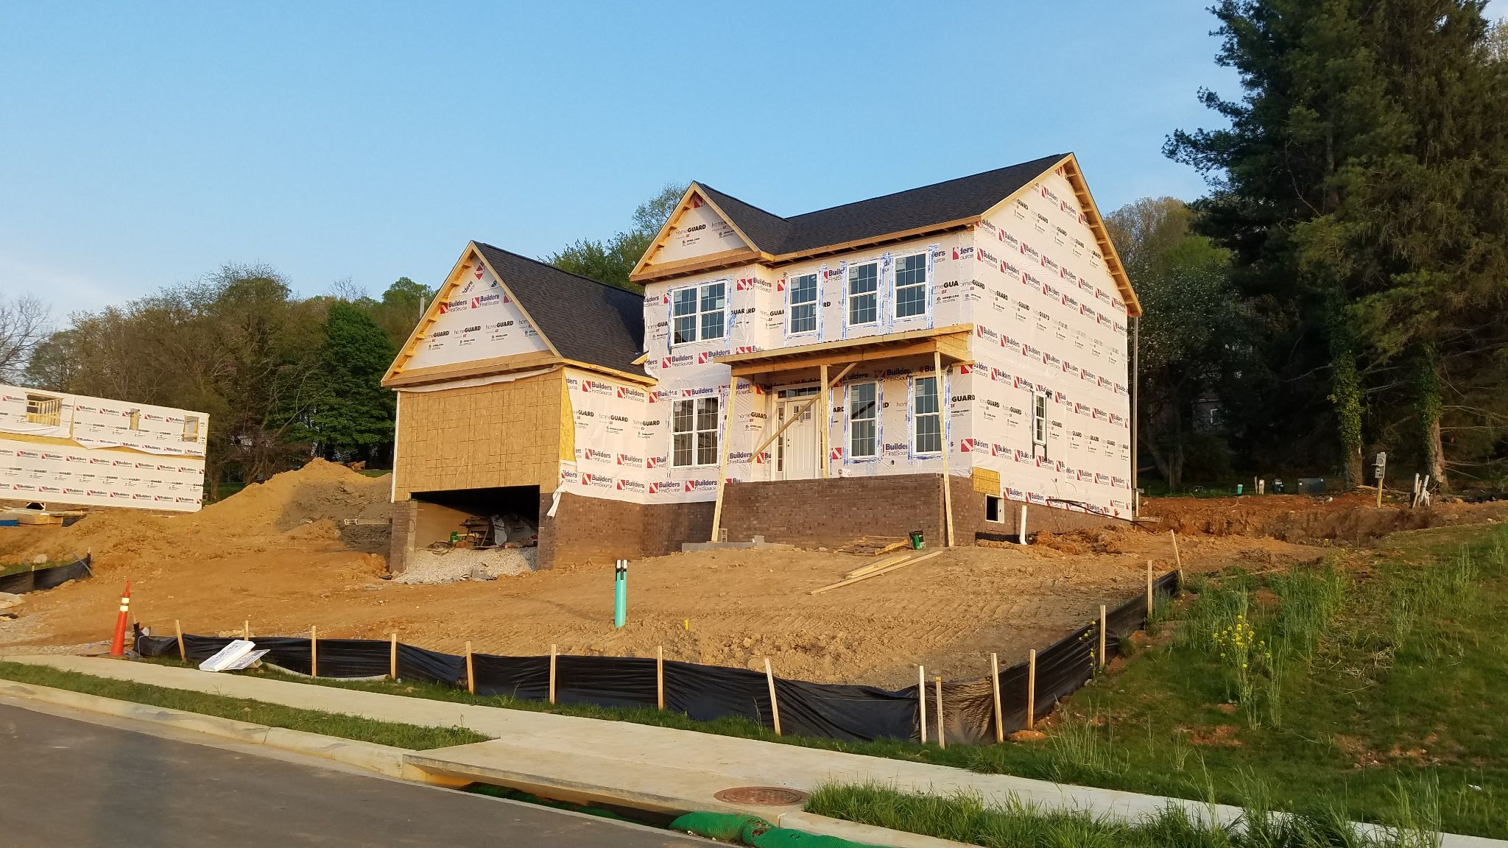
On Equity -- and Sustainability: For OER and communities
For whom is it created?
Are potential users involved in its creation? Who else?
Does it work effectively for all members of its intended audience? What would make it work better?
How long is it expected to be maintained? What will it take to “keep it going?” How will that work be done/shared?
Who or what is missing from our plan?
Photo by Anita Walz CC0

Slide 10

Screenshot from “A Review of the Effectiveness & Perceptions of Open Educational Resources As Compared to Textbooks” https://youtu.be/SX0K0hb_xKE © Open Education Research Group. CC BY 4.0

Slide 11
Open Education is also about . . .
Being outward facing
Removing barriers
Holding a posture of learning
Implementing new ideas in teaching & learning
Respect and giving credit where due
Leveraging technology in critical and ethical ways
Open education is not a replacement for adequately-funded institutions
Most of all, open education is about people
But, Open education is not a solo venture
Hare, S. (2020) A Critical Take on OER Practices. Open at the Margins. Retrieved from https://press.rebus.community/openatthemargins/chapter/a-critical-take-on-oer-practices-interrogating-commercialization-colonialism-and-content
McKernan, R., Skirko, T., & West, Q. (2015) Librarians as open education advocates: Readings on being an open advocate. Retrieved from https://openedadvocates.pressbooks.com/chapter/definition-of-open-education

Slide 12
Keys to Community Building
An endless welcome!
Many types of expertise on your team
Sharing, transparency and telling the truth regarding your limits
Transparency, trust, and willingness to raise difficult issues
Selflessness (It’s not about you!!)
Acceptance of risk, likely conflict, and potential failure
Vulnerability and sincere apologies when you fail

Slide 13
Case Studies on Building Community (randomized order)

Slide 14

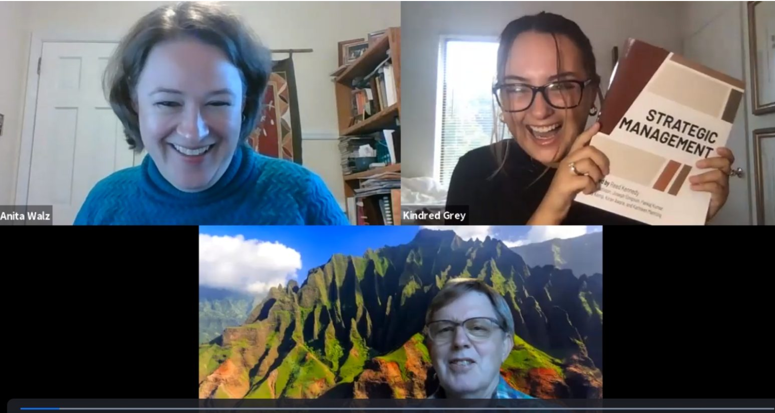
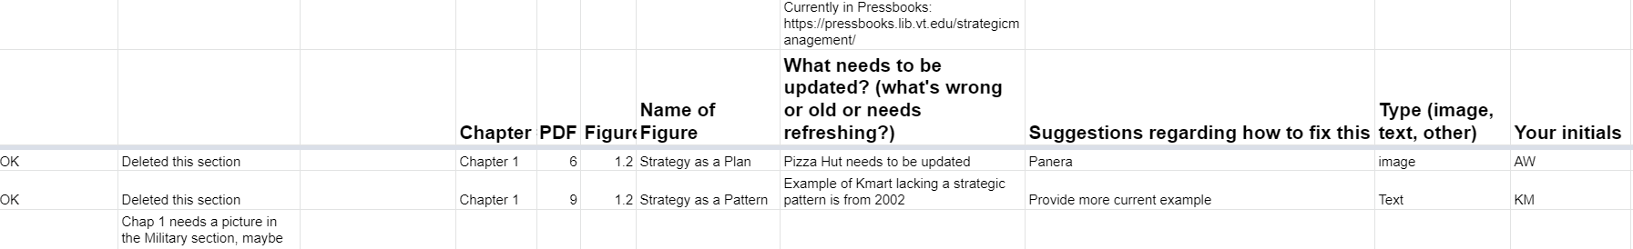
Local Collaboration: Adapting Strategic Management
Subject matter
Experts (includes a student)
Editorial team (includes students)
Production team
(includes students)
https://blogs.lt.vt.edu/openvt/2020/09/15/announcing-open-textbook-strategic-management
https://pamplin.vt.edu/news/2020/10/pamplin-managementopen.html

Slide 15
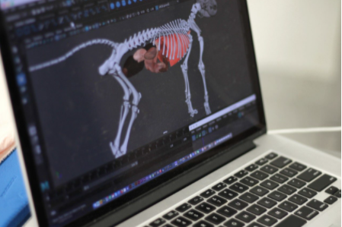
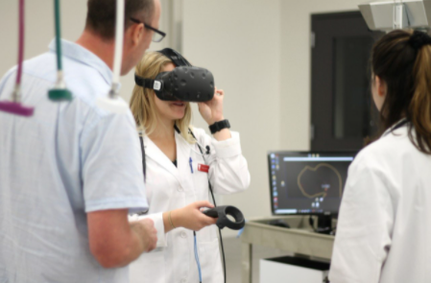



Local Collaboration: Virtual Reality Animals
Images © Virginia Tech
https://guides.lib.vt.edu/vetmed/vranatomy
https://lib.vt.edu/research-teaching/vr-research-projects.html

Slide 16







Local Collaborations: Student Book Projects
Faculty + students
Welcome to the Beatles!
Production
Book proposal / info form
Consultation
Agreements
Production
https://publishing.vt.edu/site/books/series/virginia-tech-student-publications
Book cover images used under fair use.
Notes:
Organized, authored, and edited over the course of five months by a class of eighteen Virginia Tech undergraduate students, Welcome to the Beatles represents their collective contribution to the larger scholarship on the most important band in rock history.

Slide 17
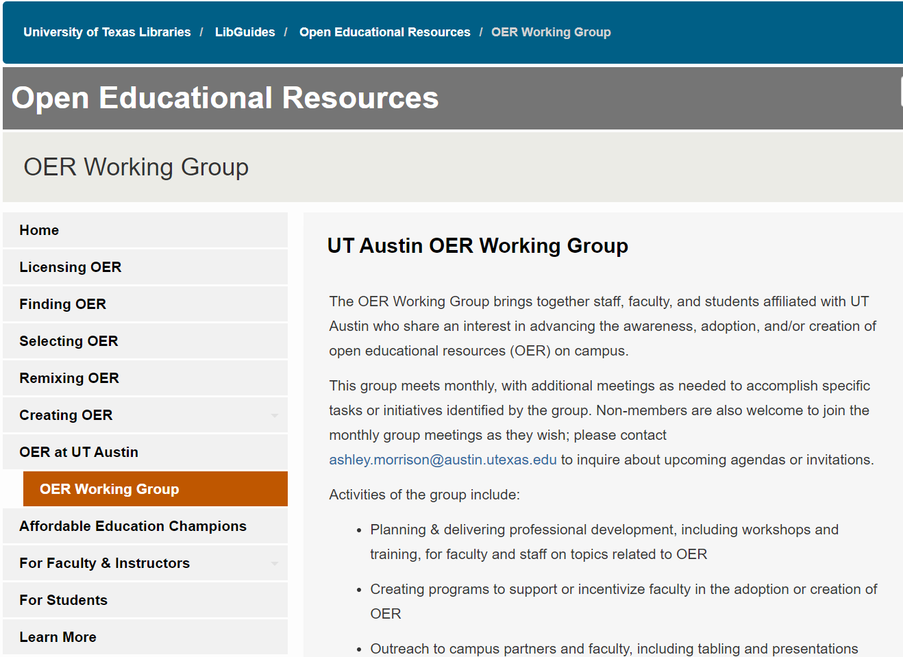
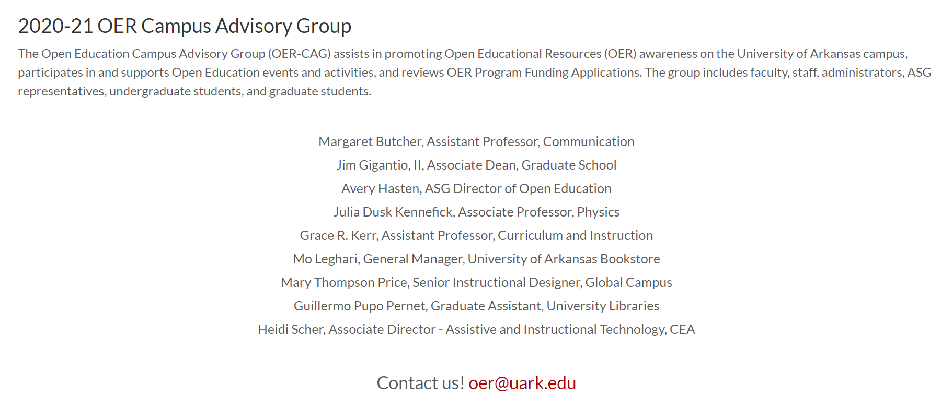
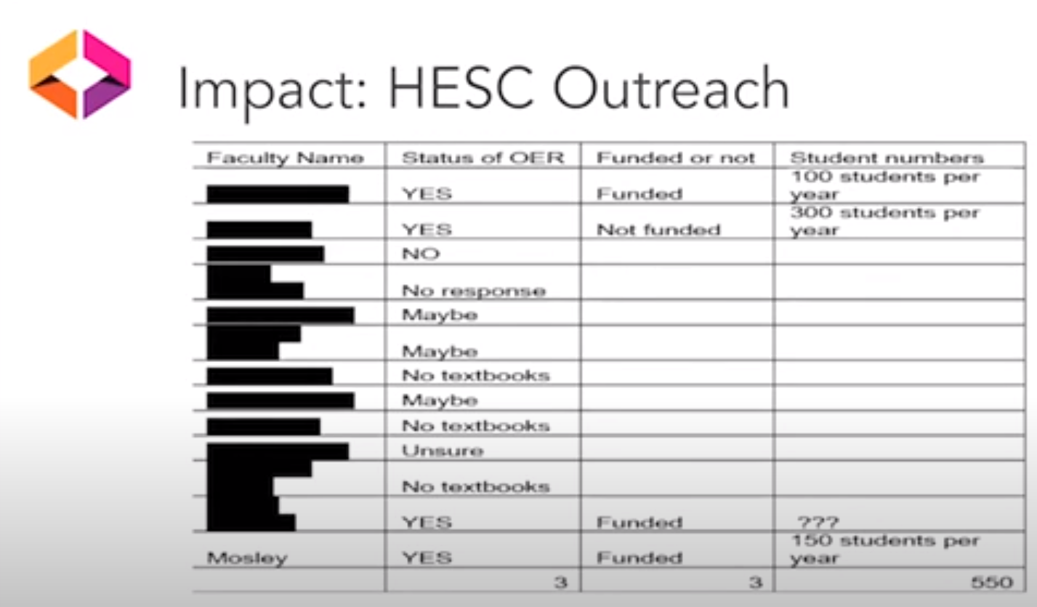
Local Collaborations: Campus Advisory Groups, Linking to
DEI initiatives & Faculty Liaisons
Outreach Liaisons
Video: Advancing Social Justice and DEI on Campus through OER
Elaine Thornton & Jacquelyn Mosely https://youtu.be/COp8QBZWTEQ

Slide 18
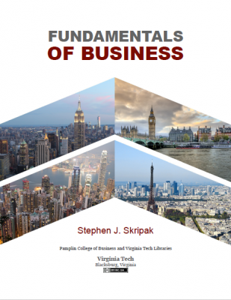
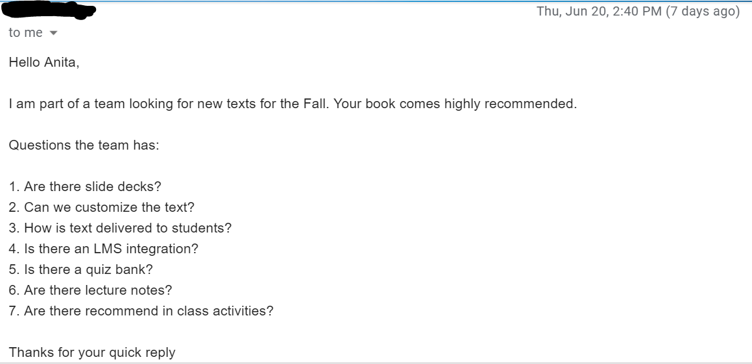
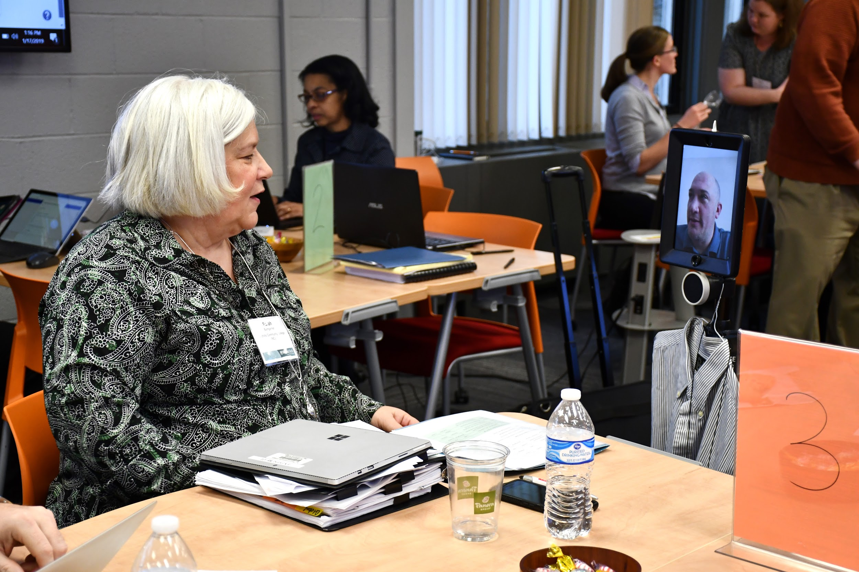
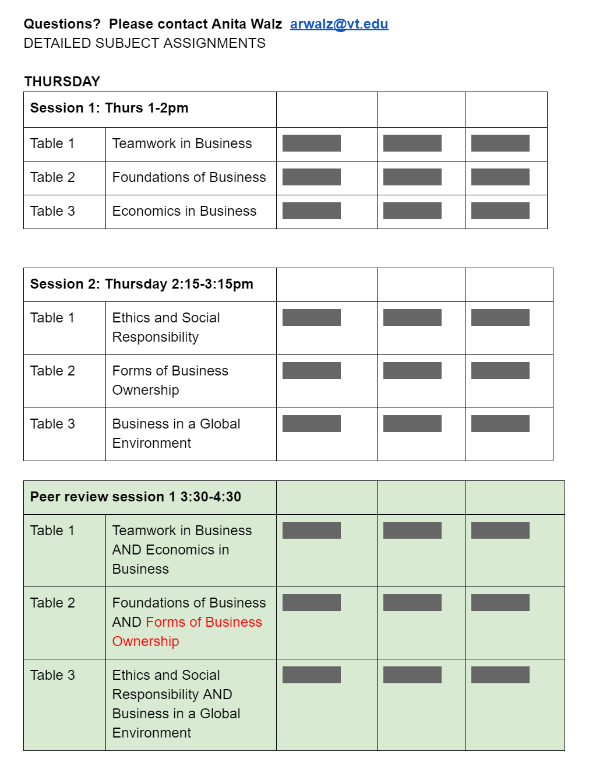
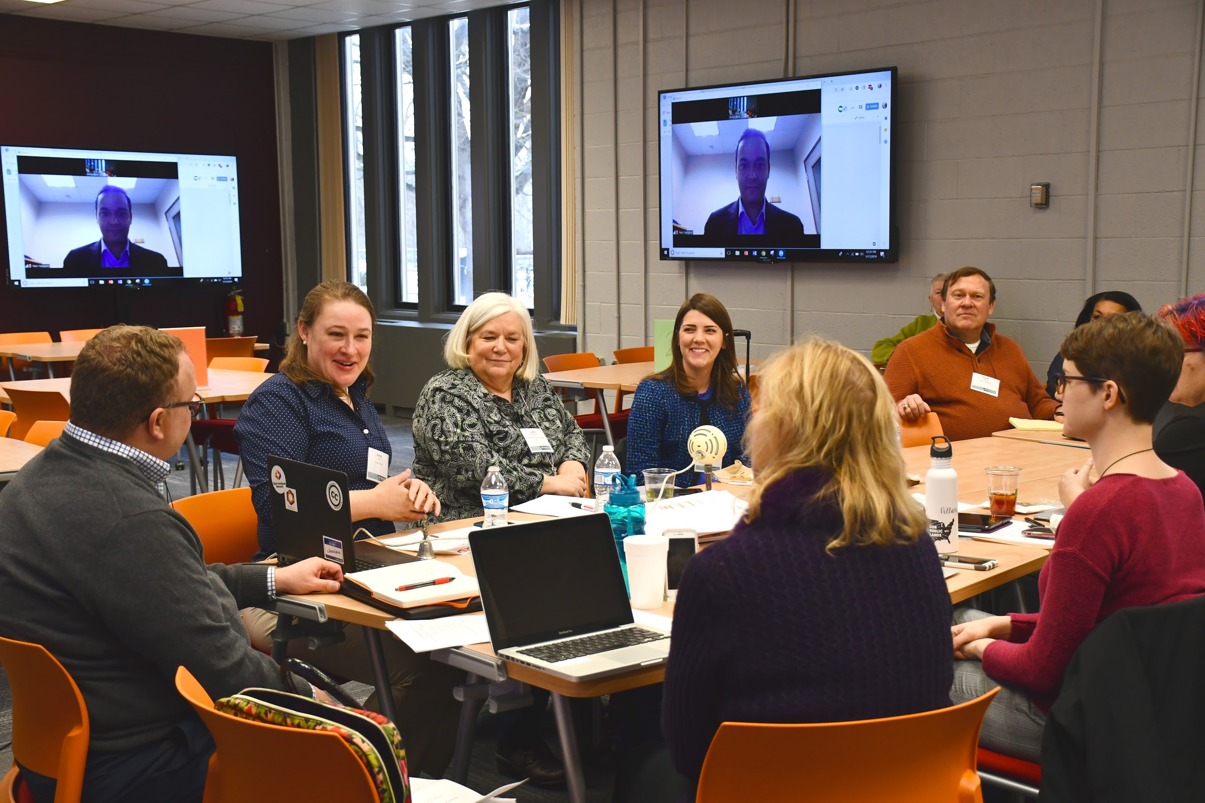
Regional Collaboration: Testbank Sprint for Fundamentals of Business
More info on the sprint: http://hdl.handle.net/10919/91377

Slide 19

Regional Collaborations: Consortium-led
Open and Affordable Course Content Committee + subcommittees and task forces
Open Education Network Coordinating Committee [community calls]
Course mapping project Task Force [collaboration with DOE + VCCS]
Virginia Course Materials Survey Task Force
Annual Forum Planning Committee
VIVA Open Grants [emphasis on multi-institutional projects and DEI]
* Equal representation among institution-types! *
Open and Affordable Initiatives https://vivalib.org/va/open

Slide 20
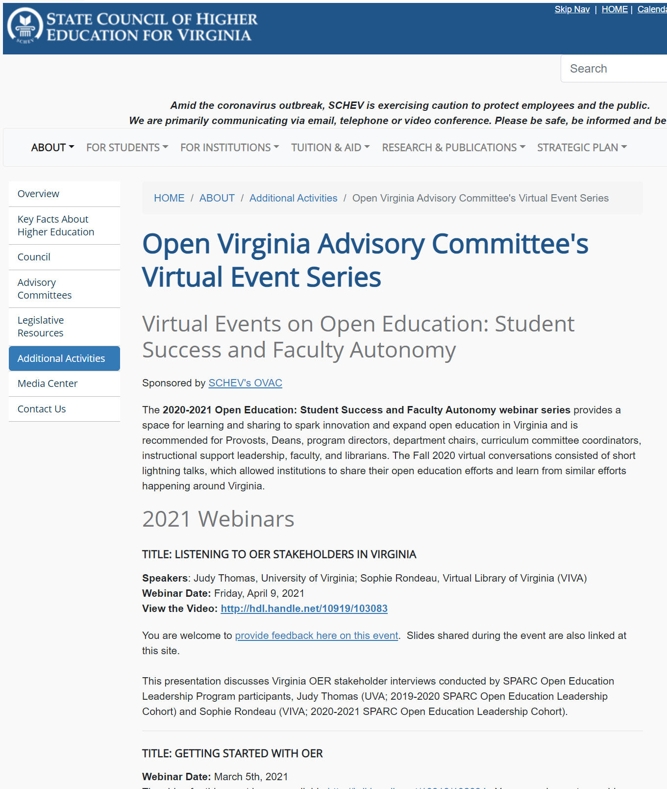
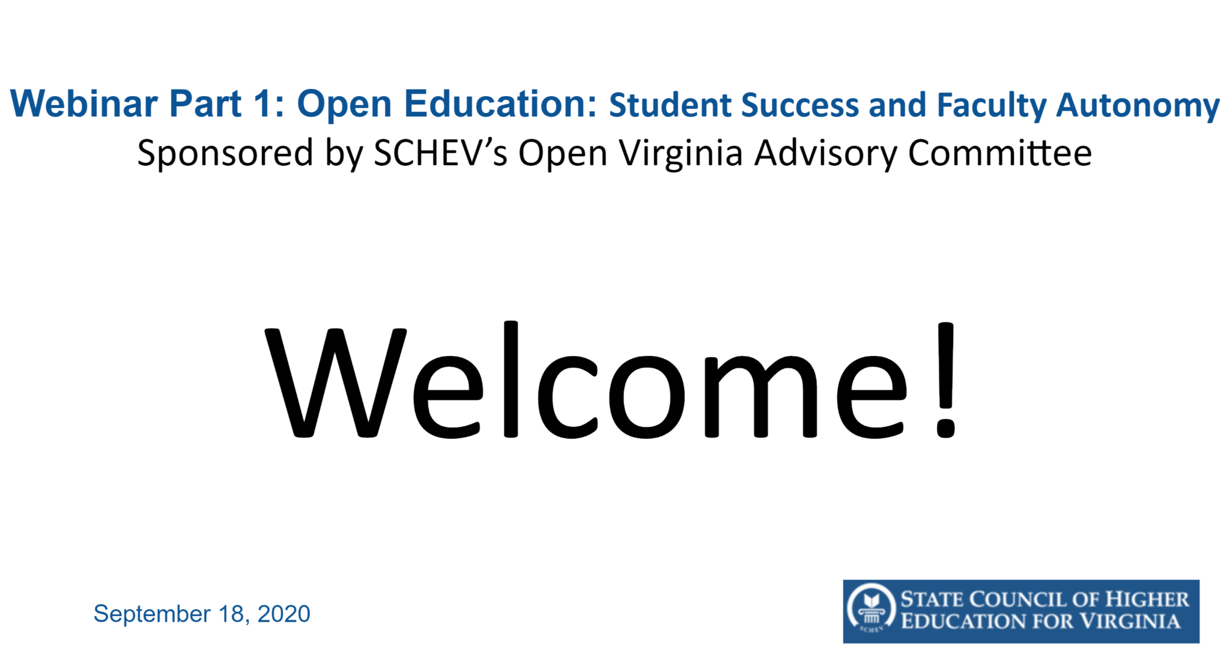

Regional Collaboration: SCHEV Open Virginia Advisory Committee
https://www.schev.edu/index/agency-info/advisory-committees#eb61a750-bece-61ae-b256-ff000079de01
https://www.schev.edu/index/agency-info/advisory-committees/open-virginia-advisory-committee
https://schev.edu/index/agency-info/additionalactivities/open-virginia-advisory-committee's-virtual-event-series

Slide 21


Regional Collaborations: Learning & Outreach
Need-based Learning Communities:
BC OER Librarians Group https://bccampus.ca/wp-content/uploads/2016/04/DLS-Conference.pdf https://bccampus.ca/2014/10/30/four-ways-librarians-are-essential-to-the-future-of-open-textbooks-and-oer/
Washington - “Librarians as Open Education Leaders” (2014-2017) LSTA funded http://libraryasleader.org
State-level coordination of Open Education Week events
Colorado: https://masterplan.highered.colorado.gov/oer-week
Idaho: https://sites.google.com/isu.edu/open-ed-week-2021-id/home
Many others . .
How Consortia are building around Open Education Network training

Slide 22
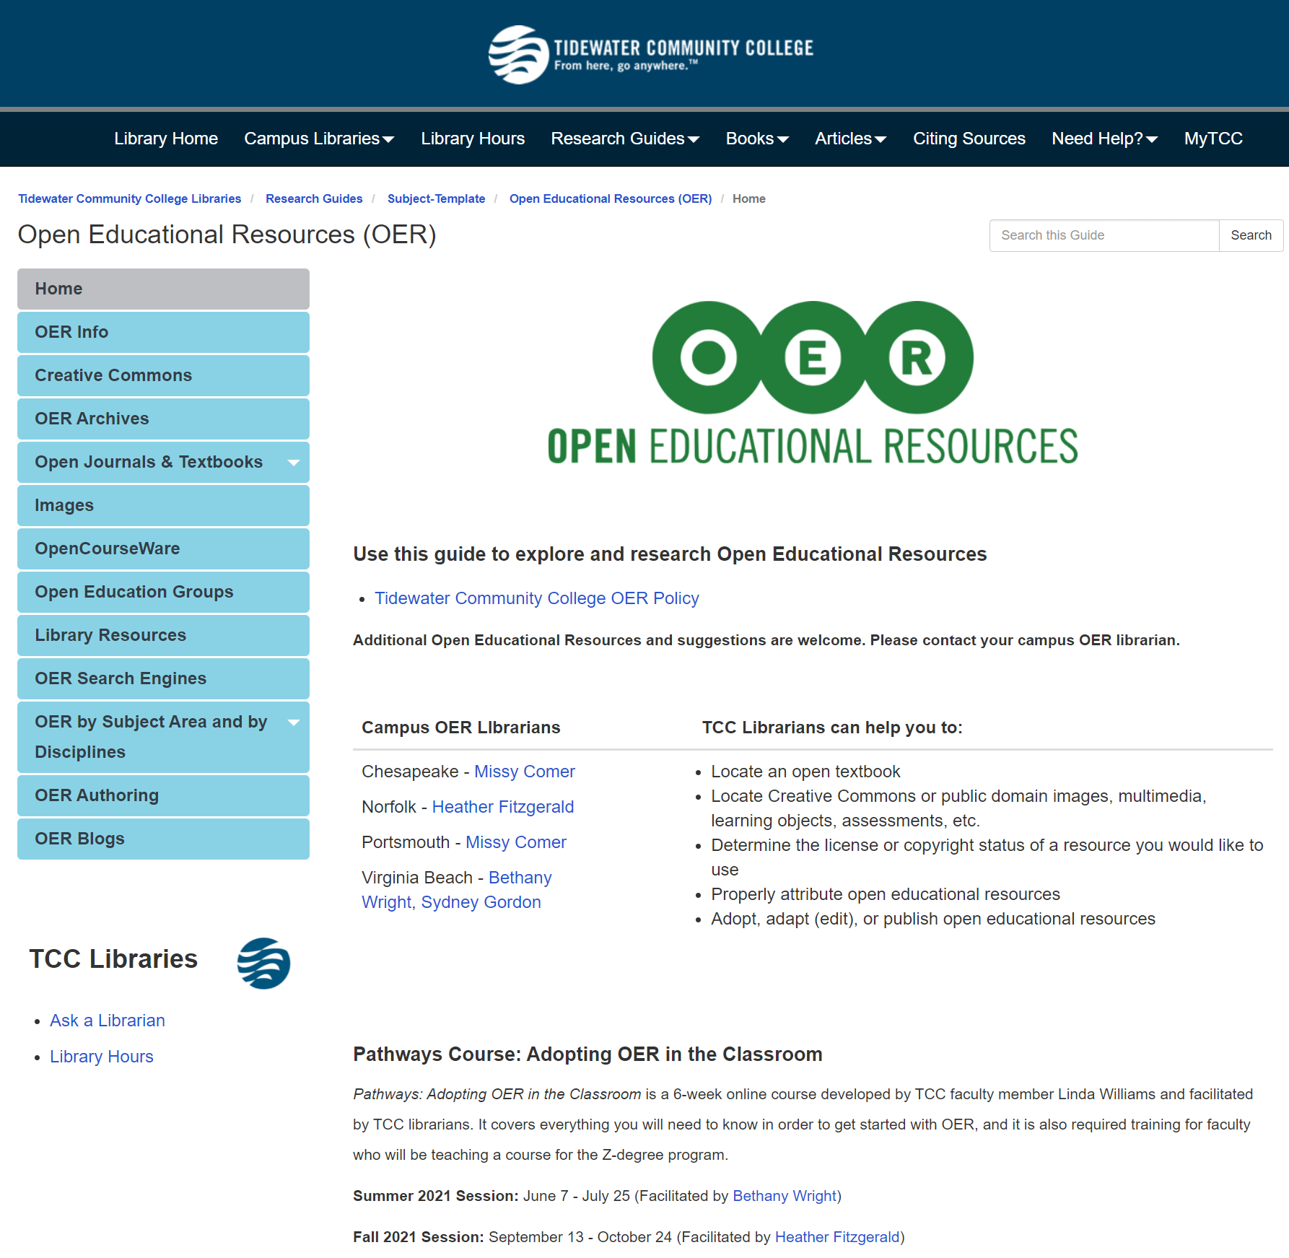
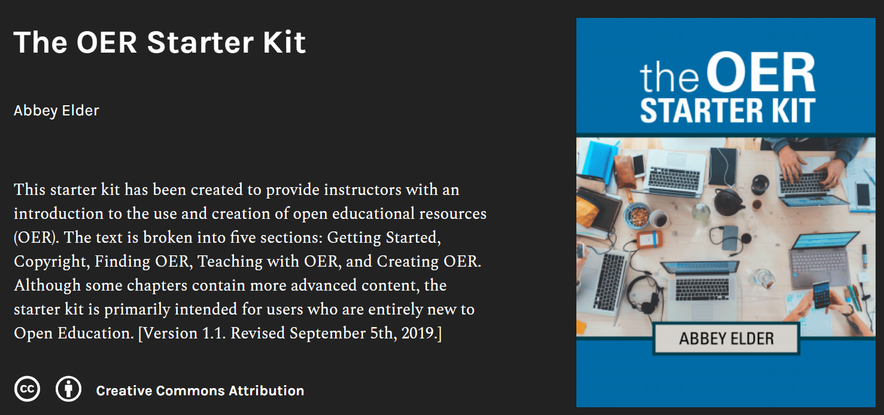

Local/Regional Collaborations: Getting Started with OER
https://iastate.pressbooks.pub/oerstarterkit
Webinar recording: Abbey Elder “Getting Started with Open Educational Resources”
http://hdl.handle.net/10919/102634
Collaborative VIVA/OEN Virtual Workshops
Delivering a virtual, asynchronous open textbook workshop; Liz Thompson (James Madison University) and Kyle Binaxas (Richard Bland College)
Workshop link
Outline link
Lightning Talk Notes
Lessons learned from a synchronous multi-institution online OTN workshop; Heather Blicher (Northern Virginia Community College) and Anita Walz (Virginia Tech)
Summary of Lessons Learned link
Workshop recording link
https://libguides.tcc.edu/faculty/OER

Slide 23

Regional Collaborations: NonProfits / HE Compacts
Higher Education Compacts: OER for Higher Education and PK12
SREB’s Open Educational Resources in Dual Enrollment webinar series.
https://www.sreb.org/topic-open-educational-resources
For national collaboration see also: https://www.mhec.org/policy-research/open-educational-resources

Slide 24
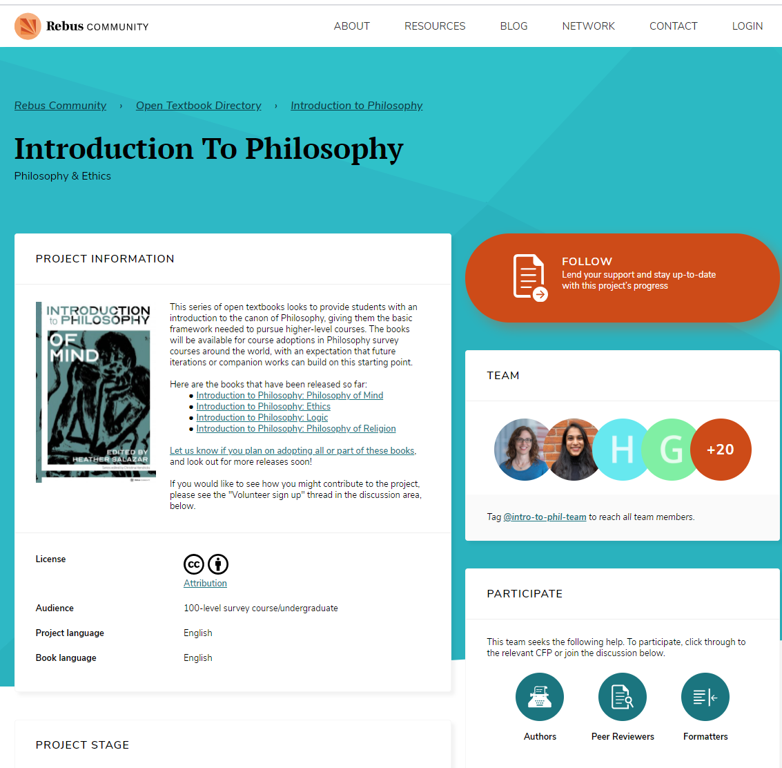
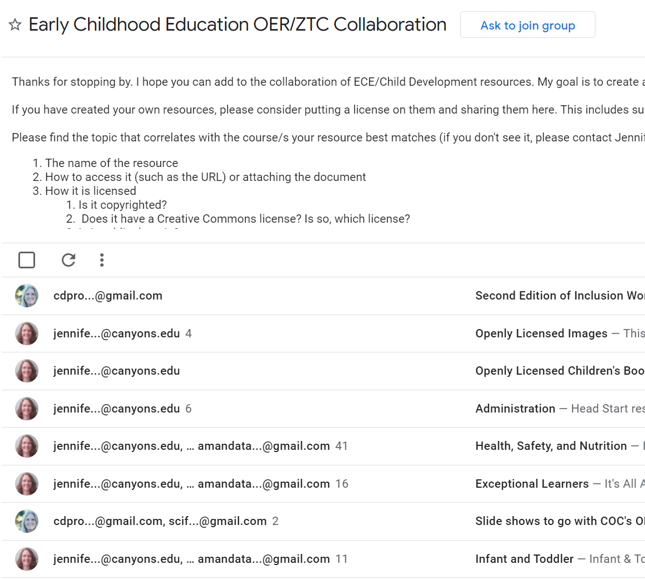

National / International Collaborations: Discipline-Focused
Open Social Work Education: https://opensocialwork.org
Early Childhood Education https://groups.google.com/g/early-childhood-education-oer-collaboration
  https://www.rebus.community/c/open-textbooks-in-development/10
Philosophy (series of 9 books!) https://www.rebus.community/c/open-textbooks-in-development/introduction-to-philosophy/214
https://www1.rebus.community/#/project/4ec7ecce-d2b3-4f20-973c-6b6502e7cbb2

Slide 25
Thank you!
Anita Walz, Assistant Director of Open Education & Scholarly Communication Librarian
arwalz@vt.edu
@arwalz
With the exception of brand names, logos and unless otherwise noted, this presentation is released under a Creative Commons Attribution 4.0 license.

