Slide 1
Community Events
Team C
Stanislaw Antol, Souleiman Ayoub, Carlos Folgar, Steve Smith
CS 4984 - Computational Linguistics
12/08/2014
Virginia Polytechnic Institute and State University
Blacksburg, VA

Slide 2
Outline
Problem Statement
Complications
Approach
Results
Interesting Findings
Lessons Learned
Summary

Slide 3
Problem Statement
Generate a summary of events within Blacksburg
This primarily requires being able to identify who, what, where, and when. This proved to be rather difficult.

Slide 4
Complications
The number of event types are non-fixed and unknowable in their entirety ahead of time.
Equivalent in some ways to handling multiple disasters of unknown type and quantity

Slide 5
Complications
Time management issues
Scheduling conflicts
Differences in type and kind of data necessitating differences in approach - we were unable to apply the techniques most other groups were finding successful.

Slide 6
Complications
Early errors lead to compounding issues later in the project
  Proper data cleaning is a notable example - insufficiently cleaning the data early lead to nearly unusable results later on.

Slide 7
Approach
Attempted a variety of filtering options
  RegEx parsing
  Classification
  POS Tagging + CFG
  Clustering
  NER Tagging

Slide 8
Approach - Alternatives
RegEx Parsing
  Useful for templates, but we did not use templates
  Used to help with NER tagging
Classification
  Previous work was unsatisfactory
  Could be useful with more classifiers
POS Tagging + CFG
  Novel idea, but would take too long to implement

Slide 9
Approach - NER Tagging
Determine if a sentence is “good”
  Location
  Date/Time - Using RegExp
  Person/Organization
Use with Clustering
  Future refinement will make use of NER in conjunction with sub-clusters to find the best sentence based both on nearness to the centroid and existence of key named entity types.

Slide 10
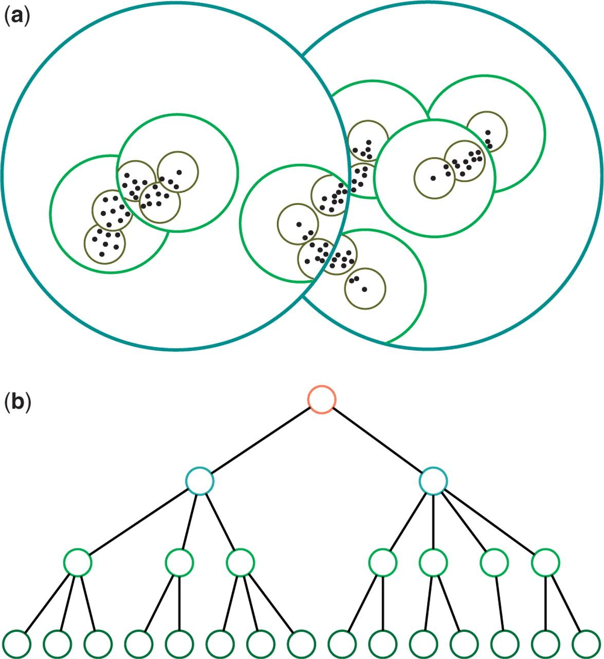
Approach - Clustering
Collection
  Major Cluster (50 Total)
    Sub-cluster (10 Per)
      Sentence cluster (10 Per)
        One sentence chosen from each sentence cluster
        Closest to cluster centroid
Image Credit: http://nar.oxfordjournals.org/content/early/2011/05/19/nar.gkr349/F1.large.jpg

Slide 11
Approach - Clustering
Settled on four major clusters based on observation.
Local festivals, etc.
Crime/Police
Weather
Virginia Tech events

Slide 12
Results
The following slides showcase some examples of the results we achieved by picking sentences close to the centroid of the deepest sub-clusters of each major cluster. With further refinement we feel confident we could extract a unique and distinct sentence that would summarize the event with clarity.

Slide 13
Results for Local/Festival Cluster
Kick off the Spring Season and your Easter Holiday with fun craft activities as Main Street Radford hosts the annual Bunny Trail in East Downtown on Saturday March 31 2012 from 10:30 a.m. to 1:00 p.m.
The Montgomery County Educational Foundation will presents its First Annual Benefit Concert at the Blacksburg Presbyterian Church on Saturday Feb 2 at 3pm.

Slide 14
Results for Crime/Police Cluster
Police had investigated 16 reports of peeping and spying.Christiansburg police charged Walrond with three felonies -- breaking and entering grand larceny and the unlawful video recording of a child younger than 14 -- and one misdemeanor count of peeping into an occupied dwelling.
A Pulaski County man will serve 15 years for his role in a drug-related hammer assault Radford Commonwealth Attorney Chris Rehak said in a release.Lorne Rivens 42 of Dublin was charged with armed burglary attempted robbery and malicious wounding stemming from an April 19 2011 incident according to the release.Rehak said Rivens went to Radford to settle a drug debt but got the address wrong.

Slide 15
Results for Weather Cluster
Winter storm warnings above 3000 feet for Alleghany and Bath counties and west of Interstate 77 Cold air circulating around the storm as it moves inland combined with thick moisture wrapping around it will lead to heavy snow in higher elevations near the Virginia-West Virginia line.
Power outages swept the area over the weekend leaving hundreds in Franklin Henry and Montgomery counties without power at times.
Appalachian did not return calls Sunday to say when power may be restored or if the outages were related to high winds in the area.

Slide 16
Results for VT cluster
Five-member team made up of faculty members from three different colleges has received the 2012 XCaliber Award for excellence as a group involved with technology-assisted teaching.
Members of the Virginia Tech Rescue Squad placed first in the Advanced Life Support Skills competition at the National Collegiate Emergency Medical Services Foundation Conference in Baltimore on Feb 25-26.

Slide 17
Interesting Findings
Used cosine distance measure
  Originally used Euclidian distance (c = √(a²+b²))
  Found better results using cosine difference as a distance metric
The sentences found were often one of the earlier sentences in a document
  It makes sense to put important information about an event close to the beginning of documents about said event so that readers don’t have to search.

Slide 18
Lessons Learned / Summary
Make sure data is clean
Our topic was significantly different than other groups and therefore required a significantly different approach
Multiple cluster levels yielded best results

Slide 19
Acknowledgments
Special thanks to:
Dr. Fox for providing this opportunity
Our TAs for their assistance throughout the semester
The National Science Foundation for their grant (NSF DUE-1141209) which enabled this course to be offered

