Slide 1
Powdery Mildews vs. Downy Mildews
Shawn Appling
Associate Extension Agent, ANR, Horticulture
Virginia Cooperative Extension
Serving Culpeper, Madison, and Orange Counties

Slide 2
Powdery Mildew Identification
Common Hosts: azalea, crabapple, crape myrtle, dogwood, phlox, euonymus, lilac, rose, snapdragon, dahlia, vegetables, zinnia
Identification:
  talcum powder-like appearance on upper surface of leaves
  New growth may be dwarfed; shoots curled
Symptoms on crape myrtle
Photo by R. C. Lambe, VCE Publication: 450-603

Slide 3
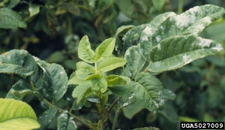
Powdery Mildew Biology
Warm dry days followed by cool nights can lead to infection
  As the air cools at night the humidity rises which allows the spores to germinate and infect tissue
Spores can be spread by wind or splashing water
  Overhead irrigation can contribute to spread of disease
Spores can infect new plant tissue in 3 – 5 days under favorable conditions
Can overwinter in plant debris
Symptoms on rose
Photo by Jody Fetzer, New York Botanical Garden,
www.forestryimages.org

Slide 4
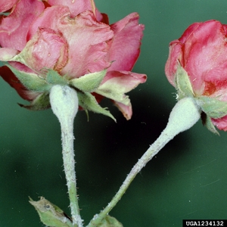
Powdery Mildew Cultural Control
Reduce humidity: pruning to increase air flow, avoid watering late in the day
Remove old plant debris
Avoid overhead watering if possible
For resistant cultivars consult VCE Publication 450-616, Powdery Mildew-Resistant Woody Ornamentals
Symptoms on rose buds and flowers
Clemson University - USDA Cooperative Extension Slide Series,
www.forestryimages.org

Slide 5
Powdery Mildew Chemical Control
Fungicide active ingredients:
  azoxystrobin, trifloxystrobin, pyraclostrobin, copper-based fungicides, dodemorph, propiconazole, mancozeb, myclobutanil, thiophanate methyl, triadimefon, triforine, triflumizole, potassium bicarbonate
Always read and follow label before applying
Symptoms on cantaloupe
Photo by Mary Olsen,
Arizona Cooperative Extension: AZ1033

Slide 6
Downy Mildew Identification
Hosts can either be wide spread or in a very narrow range
  Ex. members of the mint family or single genus like roses or impatiens
  Symptoms can vary by species and even by cultivar in roses
  General symptoms include brown or black lesions on leaf surfaces
  For roses and impatiens, whitish to gray spores on underside of leaves
  For impatiens also: downward leaf curling, leaf yellowing, defoliation and flower drop, stem rot
Symptoms on roses
Photo by Janna Beckerman,
Purdue Extension Publication: BP-68-W

Slide 7
Downy Mildew Biology
Warm, humid days can lead to infection
Wet plant material enable spores to spread plant to plant
Spores can be spread by splashing water
  Overhead irrigation can contribute to spread of disease
Spores can infect new plant tissue in 3 – 7 days under favorable conditions
Can overwinter in plant debris
Be brought in on transplanted cuttings
Some species can survive in soil for 8 – 10 years
Symptoms on Impatiens walleriana ,
Photo by M. A. Hansen, VCE Publication PPWS-19NP

Slide 8
Downy Mildew Cultural Control
Reduce humidity: pruning to increase air flow, avoid watering late in the day
Remove old plant debris
Remove impatiens from area
Do not compost infected material
Avoid overhead watering if possible
Downward leaf curling on Impatiens walleriana ,
Photo by M. A. Hansen, VCE Publication PPWS-19NP

Slide 9
Downy Mildew Chemical Control
Fungicide active ingredients: azoxystrobin, trifloxystrobin, pyraclostrobin, cyazofamid, fenamidone, dimethomorph, mancozeb, copper
Always read and follow label before applying
Symptoms on rudbeckia
Photo by Janna Beckerman,
Purdue Extension Publication: BP-68-W

