Slide 1
What’s in your repository?
Gail McMillan
Director of scholarly communication
Notes:
Thank you for coming. As you may know from the conf. abstract, I’m interested in discovering if we can determine if the resources in an IR reflect the work being done at the institution.
The type of IR I’m referring to manages and preserves institutional community assets, gray lit as well as peer-reviewed publications. It is a digital library and showcase.
I’m wondering if examining a microcosm of the IR can indicate how successful it is in representing the activities and work of its primary population and have we avoided unconscious bias? My report is not about a strict scientific study but a foray into one aspect of how we assess our institutional repositories..
After I present the findings from a study of VTechWorks, Virginia Tech’s digital repository, I’m hoping for your input, such as suggestions for research methodologies that might prove more revealing and possible collaborators who would like to compare and contrast across institutions.

Slide 2
How do we determine if the collections in our IR are representative of the work being done in the university community?
Amanda Rust, “Design for Diversity.” IMLS grant report to CNI, Dec. 2017
Rebekah Scoggins, “Broadening Your Library’s Collection: Implementing a LGBTQIA Collection Development Project.” C&RL News, March 2018
Sam Winn, “The Hubris of Neutrality in Archives.” On Archivy, April 2017
Notes:
These presentations and articles triggered my inquiry, particularly R’s. Her report struck me as well aimed but incomplete because she only looked at what we think of as the “library collection” (i.e., purchased books, serials, multimedia, etc.), and she didn’t mention the IR. She determined that her library was not meeting the needs of its users because it was out-of-date and incomplete. Her article made me ask, “how would I know if that was also the case for my IR?”
Collection development policies and procedures are well established for libraries’ traditional collections, and are largely assessed by the number itscontents.
Therefore, I thought an appropriate assessment Q would be to ask, “Does my IR represent the activities and work being done at my university?” and not how many items does it have and many times were they downloaded. That data is already available.

Slide 3
What’s in my IR, VTechWorks?
DSpace repository software
70,000 items
  VT research and scholarship, unit pubs, historical docs
  Born digital and scanned/OCR’d
  85% text
Acquisitions
  Creators ‘donate’ by choice or edict—course work, ETDs
  Staff discover, scan/OCR, deposit
  Automating harvest, mediated deposit: SWORD; Symplectic Elements
96% publicly accessible
Notes:
My IR includes works related to the education, research, service, extension activities, or works of historical value to the Virginia Tech community, and were produced, submitted, or sponsored by its faculty, staff, administrators, alumni, or students.
VTechWorks is a locally hosted 7 year old DSpace repository. Format agnostic: full text i.e., word searchable and indexed by Google
images 14% (~9600
audio (38, >.1%
video (328, >.5%)
datasets (84, ~.1%)]
ACQUISITIONS: IRs generally do not have librarians with subject specialists, are not dependent on budgets to purchase publications, but on people with the time to find and deposit appropriate items
Faculty deposit (voluntary), directly into IR or through integrated systems (e.g., Elements)
Graduate students are mandated to submit ETDs through our Graduate School system
IR staff select and deposit sometimes randomly (e.g., reading the daily VT News) and systematically (e.g., OASF, SWORD)

Slide 4
Vocabularies (handout)
Scoggins’ article in C&RLNews
Virginia Tech’s Safe Zone training
University of Massachusetts, Amherst, Stonewall Center
County of San Mateo [CA]: LGBTQ Commission
Progressive’s Style Guide from SumOfUs
Notes:
After reading Rebekah Scoggins article, I chose to address the question of whether the collections in our IR are representative of the work being done in the university community, by examining a microcosm, works about LGBTQ. I built a vocabulary of search terms and phrases from these sources.
HANDOUT

Slide 5
Terms and phrases: searching VTechWorks
Fuzzy (e.g., close matches: generate/generational)
Stemming (e.g., sexuality/sexual, biases/bias)
Quotes “around phrases”
Too broad or generic (e.g., unconscious bias) eliminated
Biological terms kept
Results: 159 terms
  96 terms in VTechWorks, 1940-2019
Notes:
I eliminated some search terms because DSpace, which uses the Solr search platform, uses “fuzzy” logic and stemming.
Some of the terms were unusable because they have very different meanings inside and outside the LGBTQ frame or have changed over time, such as gay and queer.
Similarly, some terms had to be eliminated because they were too broad, such as underrepresented groups, discrimination, and unconscious bias.
Of course, some additional terms and phrases didn’t present themselves in time to be considered, e.g., same sex couples (Jan. 24, 2019). But, from the combined vocabularies I ended up with 159 terms, which I searched in VTechWorks and got hits on 96 of them.

Slide 6
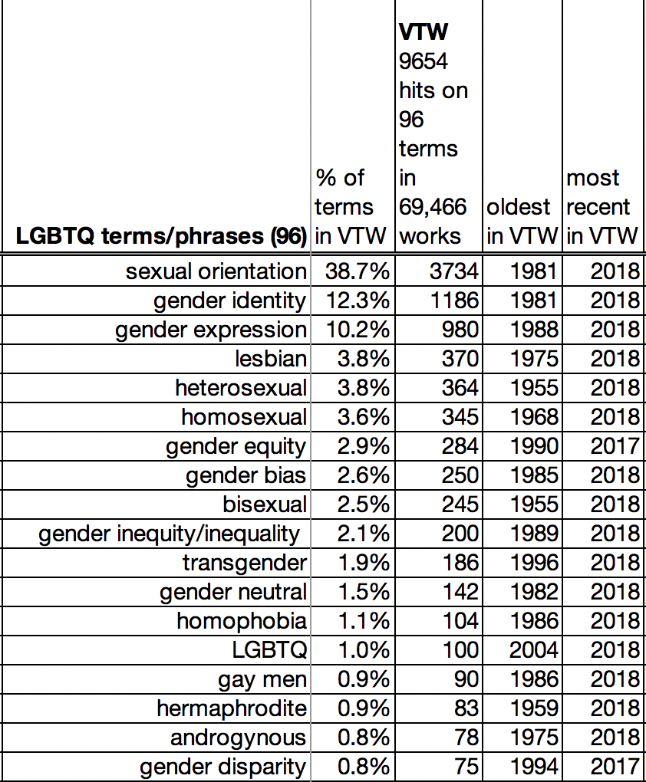
VTechWorks https://vtechworks.lib.vt.edu
Notes:
I created lots and lots of spreadsheets. In VTechWorks I got 9, 654 hits on the 96 terms that appeared in 69,466 works. These are the 18 terms and phrases with the highest number of hits. But what did this data mean?.
I decided to see if groups of authors or publications in VTechWorks would help to give some context to the data.

Slide 7
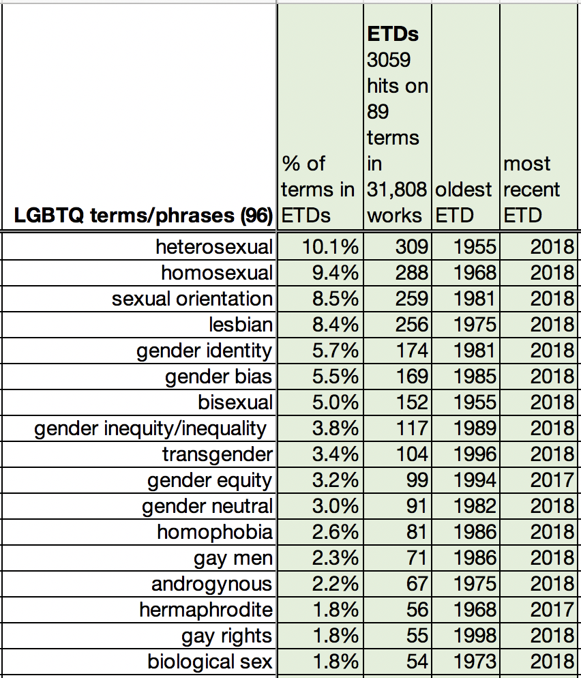
ETDs
Notes:
ETDs are an established collection. VT was the first university to require its grad studs to deposit their theses and dissertations electronically. Our collection of 31,808 ETDs got 3,059 hits on 89 of the 96 terms in VTW.
These 17 terms got nearly 80% of the hits (78.5%)

Slide 8
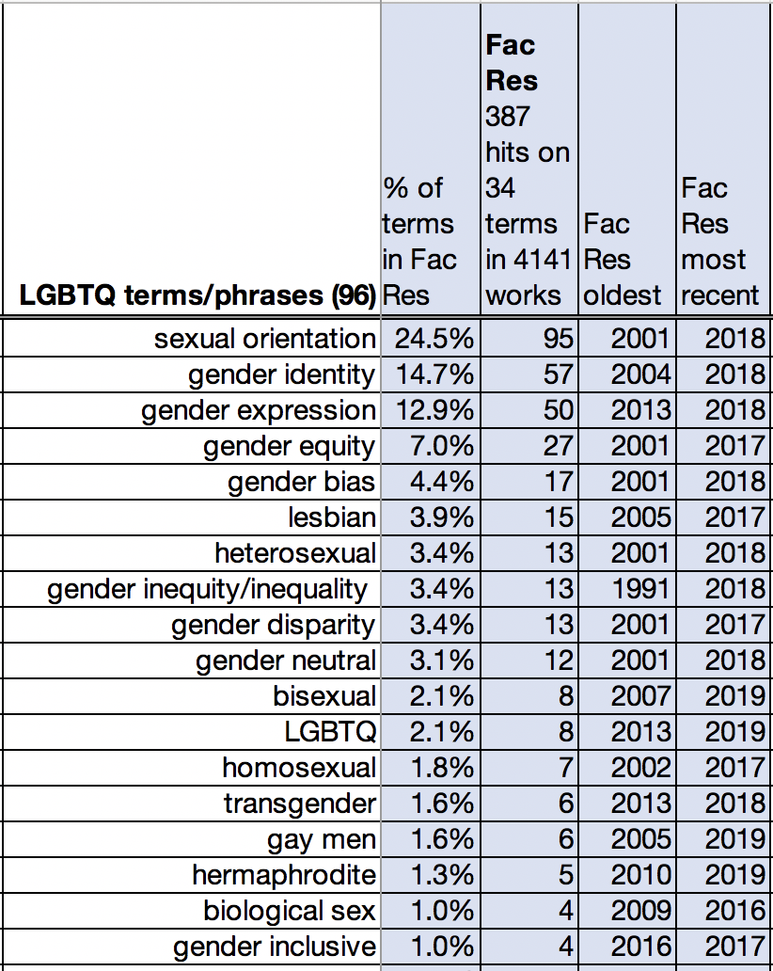
Faculty Research
Notes:
Then I decided to see if the faculty were using these terms in their research and writing. But I didn’t have a straightforward way to gather their publications together because they are scattered throughout the IR in a variety of collections. So I created a virtual collection by combining
The 1689 publications from Elements, our Electronic Faculty Activity Reporting System (EFARS)
330 journal articles supported by our Open Access Subvention Fund
962 Journal articles harvested by the SWORD protocol from
BioMed Central and SpringerOpen [404]
Hindawi Press [227]
Multidisciplinary Digital Publishing Institute (MDPI) [331]
And, 1072 works in the Destination Areas (DAs) and Strategic Growth Areas (SGAs) collection, which represents a high-profile VTinitiative called Beyond Boundaries begun in September 2017.
34 of the 96 terms got 387 hits in the Faculty Research Collection of 4,141 works. These 18 terms got 93% of the hits.

Slide 9
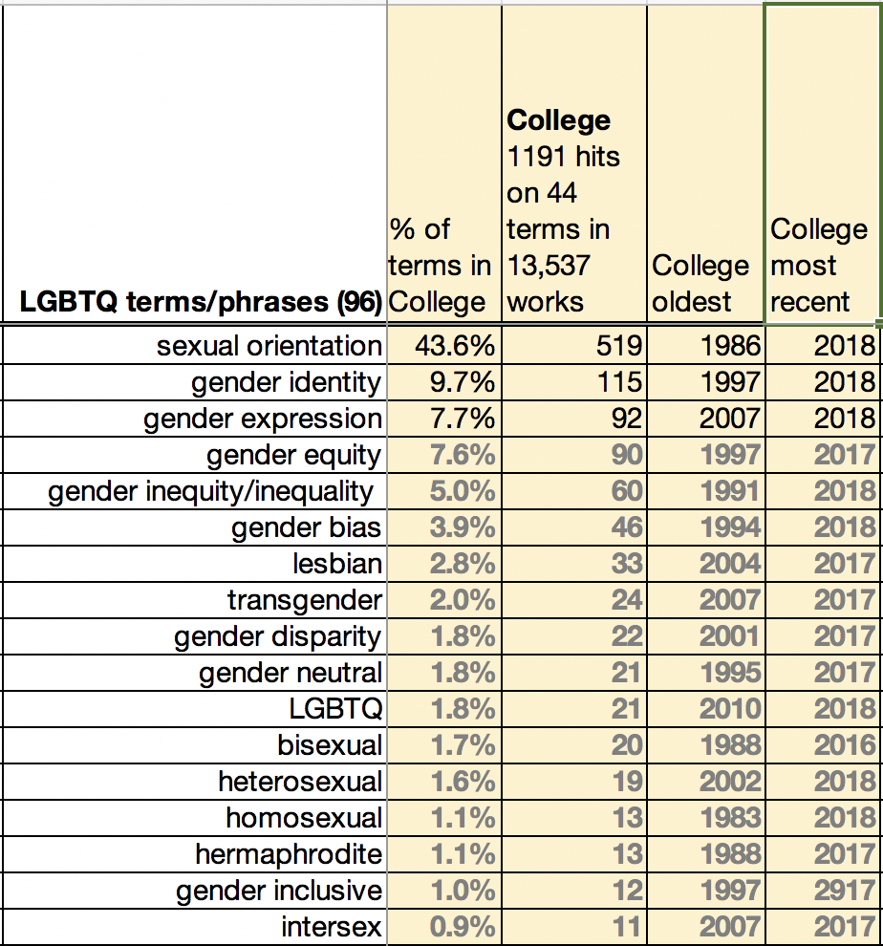
VT’s 9 Colleges
Notes:
I decided to create another virtual collection to add yet another perspective, made up of VT’s 9 colleges, which include all academic units and the library.
44 of the 96 terms got 1191 hits in 13,537 works in the Colleges collection. These 17 terms make up 95% of the hits in this collection.
College of Agriculture and Life Sciences
College of Architecture and Urban Studies
College of Engineering
College of Liberal Arts and Human Sciences
College of Natural Resources and Environment
College of Science
Pamplin College of Business
Virginia-Maryland Regional College of Veterinary Medicine
Virginia Tech Carilion School of Medicine and Research Institute

Slide 10
But what does all this data mean?
Compare collections? NO
  31,000 – 4000 items
  Oldest items: 1940 – 2016
Compare collections? YES
  Percentages within each collection
  Percentages across collections
VTechWorks in the context of Virginia Tech
  VT website (vt.edu) as an indicator of university community’s activities and ‘publications’
Notes:
But I was still struggling with what this data meant in terms of the work being done at the university. The only comparison I’ve come up with was to search the 96 terms on the university website. We use a local Google search engine, and I used an algorithm to eliminate VTechWorks from the vt.edu search strategy.
https://www.google.com/search… [term] site:vt.edu -site:vtechworks.lib.vt.edu
Using VT-VTW (VT minus VTW) as the measure of LGBTQ work being done at the university, I speculated that a comparison of the percentage of hits in VTechWorks to the percentage of hits at VT may provide some evidence as to whether VTechWorks is representative of the university community’s work in this area. [I’m really looking forward to your thought on this.]

Slide 11
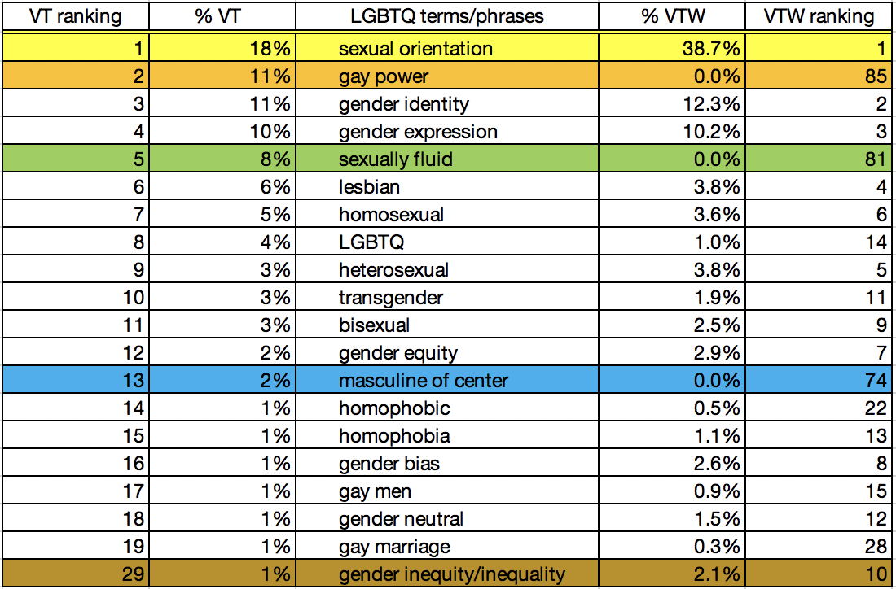
What are they researching and writing about?
Notes:
90 terms got hits in VT website.
You can see there were some wide discrepancies. For example, gay power got 11% of the hits in VT but only 0.01% in VTechWorks. Similarly, sexually fluid got 8% of the hits in VT but only 0.02% in VTW. While sexual orientation got the most hits in both sources, in VTechWorks it got 38.7% of the hits but a much smaller percentage in VT, 18%.
BUT 3 OF THE TOP 4 TERMS >>>>

Slide 12
SEXUAL ORIENTATION
GENDER IDENTITY
GENDER EXPRESSION
Virginia Tech does not discriminate against employees, students, or applicants on the basis of age, color, disability, gender, gender identity, gender expression, national origin, political affiliation, race, religion, sexual orientation, genetic information, or veteran status … or any other basis protected by law.
Notes:
APPEAR WIDELY IN DISCRIMINATION DISCLAIMERS.
sexual orientation appears in the non-discrimination statement in 31% of the Virginia Water Resources Research Center publications beginning in 1986
The Virginia Cooperative Extension (VCE) disclaimer includes sexual orientation in 50% of its publications beginning in 1990s.
The VCE disclaimer was broadened in about 2015 to include gender identity and gender expression
Virginia Tech Magazine, a publication for alumni, has a similar statement. SO appears in 79% beginning in 2007. GI and GE were added in 2014 and appears in 27% of the pubs in VTW.
So I thought about excluding these phrases from my results. Especially since

Slide 13
Disclaimer or research topic?
Notes:
these phrases also appear very infrequently in ETDs.
BUT, we can see from the % of hits on these phrases in the Faculty Research Collection, it was a topic USED IN faculty PUBLICATIONS, THOUGH not among the graduate students.
[These phrases make up 61% of the hits in VTechWorks (and 38% in vt.edu)]
I chose not to exclude (i.e., include) these phrases.

Slide 14
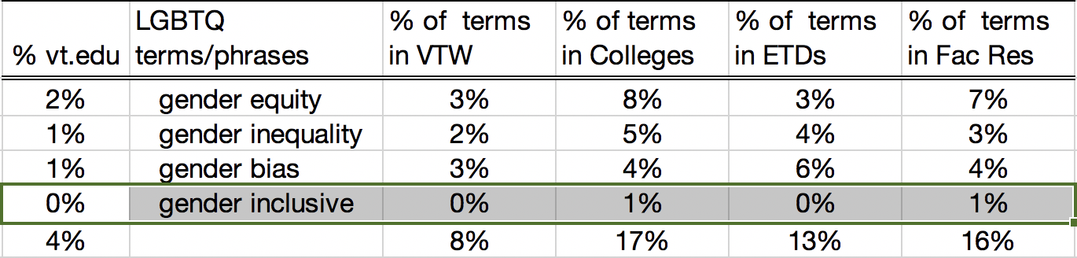
Selected terms for comparisons
Notes:
Here are some sample comparisons. These terms are more widely used in VTW than at Vt.

Slide 15
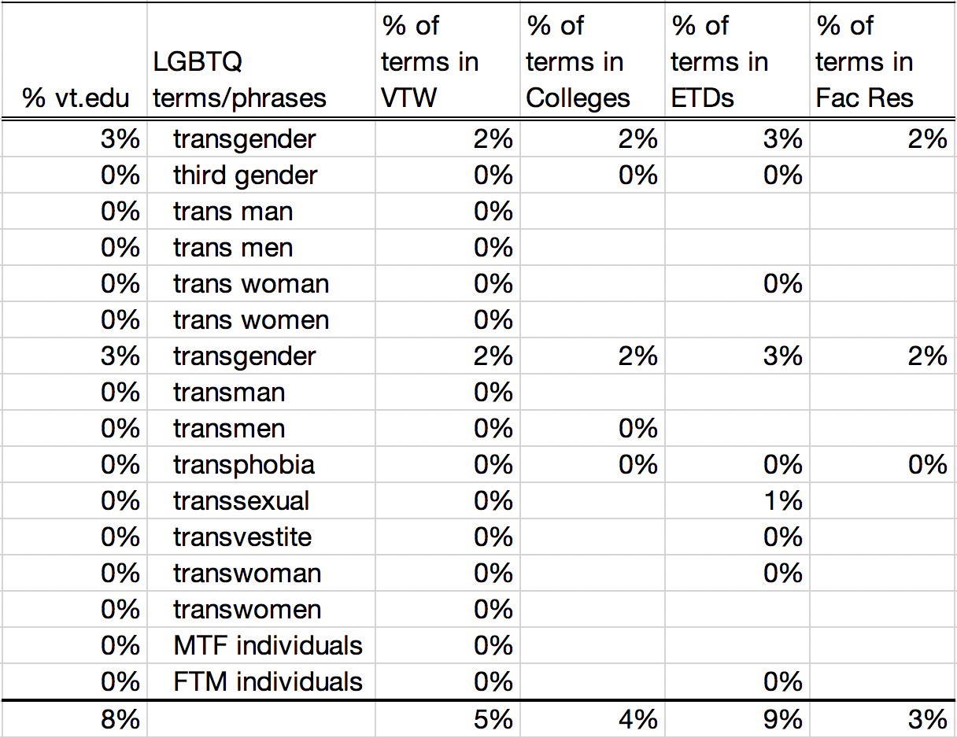
Selected terms for comparisons
Notes:
Here we see that graduate students have written about trans-terms about the same as others being published on the VT web site. However, faculty and the colleges much less frequently use trans-terms in their publications.

Slide 16
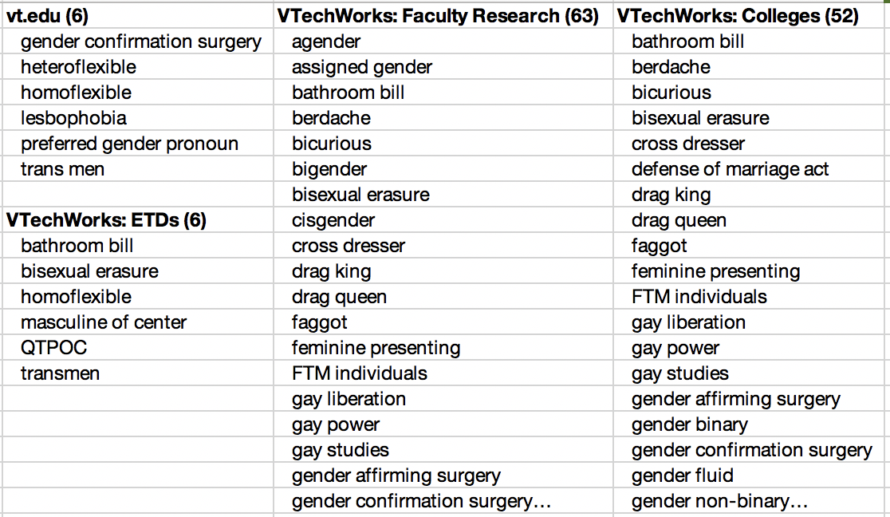
What aren’t they researching and writing about?
Notes:
I don’t know what this data says;>(

Slide 17
94% terms in VT.edu are in VTechWorks
94% of LGBTQ terms (90) in VTechWorks have <2% difference in the percentage hits from the LGBTQ terms’ hits in VT.edu
Therefore, I concluded that the LGBTQ microcosm in VTechWorks is representative of the work being published on the VT website.
But, is this microcosm in VTechWorks representative of the work being done at Virginia Tech?

Slide 18
Where to go from here?
Is this a valid method to begin to determine if an IR adequately reflects the work and activities of its university community?
Should we assess IRs based on different criteria?
Are any of you interested in looking at your IRs and sharing the results?
Thank you, Gail McMillan
gailmac@vt.edu
Notes:
Is this a valid method to begin to determine if an IR adequately reflects the work and activities of its university community?
Should we assess IRs based on different criteria?
Are any of you interested in looking at your IRs and sharing the results?
What are your thoughts on comparing the IR with the institutional website?

