Slide 1
Katrina Database
SearchKat
University: Virginia Tech
Course: CS 4624 (Multimedia, Hypertext, and Information Access)
Professor: Edward A. Fox
Date: April 30, 2015
Group: Matthew Chittum, Kyle He, Gary Li, Tanvir Rahman
Location: Blacksburg, VA 24061, USA

Slide 2
Introduction
A cross-disciplinary project combining linguistics with Computer Science.
Create a searchable database of interviews of Hurricane Katrina victims.
Supports Thematic Searching
  Search by word association
    synonyms, antonyms, etc. - query expansion
    client specific word association

Slide 3
Client
Dr. Katie Carmichael
  Assistant Professor in the English Department
    College of Liberal Arts and Human Sciences at VT
  Ph.D from Ohio State University, master’s and bachelor's degree from Tulane University
  Works in 407 Shanks Hall
  181 Turner St NW, Blacksburg, VA 24061, United States
  Phone: 540-231-7712
  email: katcarm@vt.edu
Search ‘Katie Carmichael’ at http://www.vt.edu/
Notes:
source http://www.vtnews.vt.edu/articles/2014/09/091714-clahs-katiecarmichael.html

Slide 4
Project Phases
Phase 1: Removing Markings
Phase 2: Word Count
Phase 3: Search Implementation
  Basic Searching
  Thematic Searching/ Query Expansion

Slide 5
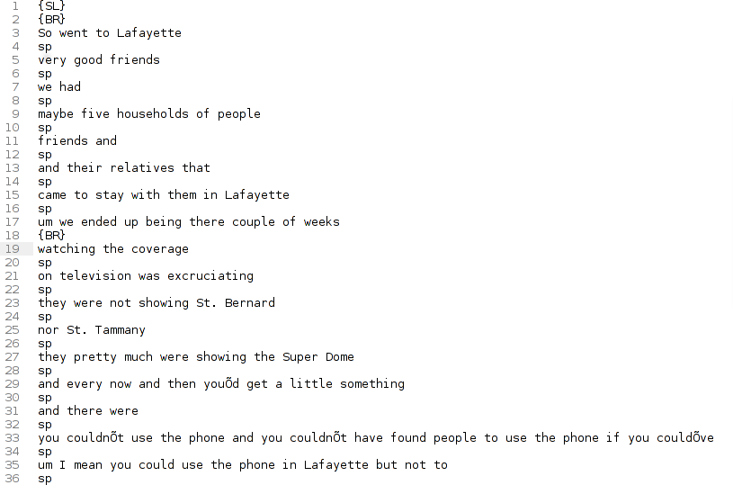
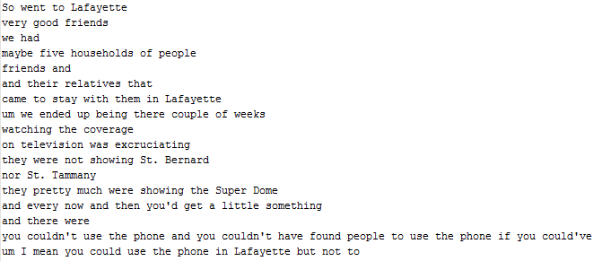
Phase 1: Remove Markings
Remove unnecessary markings from documents.
Before
After

Slide 6
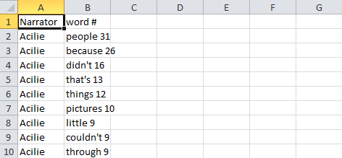
Phase 2: Word Count
Find word frequency across all documents.
  Using the results, Dr. Carmichael picked certain words to be used in query expansion.
  ex: ‘people’ appeared 31 times in document X

Slide 7
Word Groupings
Social class
  (Social class, academic, college, contest, income, palmisano, tulane, tuition).
Victims/refugees
  (Damage, damaged, damages, denied, destroyed, devastating, refugee, refugees).

Slide 8
Phase 3: Search Implementation
First run for searching
  Customize desired displayed category for with search results.
  Customize desired display categories for search results.
  Display the line of text that contains the search term
  Many results are too short, reflect very little contextual information

Slide 9
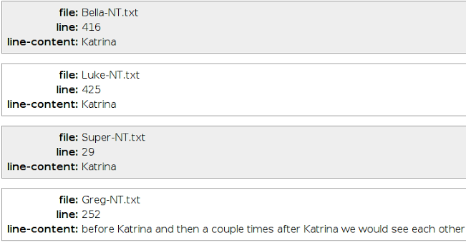
Phase 3: Search Implementation

Slide 10
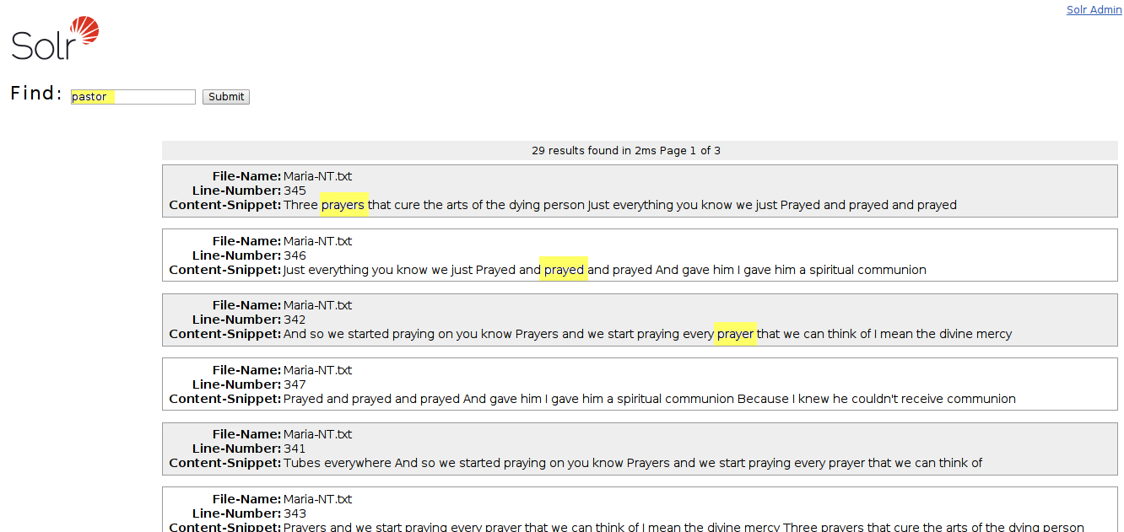
Thematic Searching
Able to search by word groupings.
Group religion contains: pastor, prayed, prayer, prayers, etc..

Slide 11
Interesting Results
Some initial query results were only one word.
Solr needs fields for its search results. If not specified, it will try to retrieve them from the source files.
Converting original documents to CSV files with specified fields (filename, line content, etc.) helps Solr to return desired search results.

Slide 12
Lessons Learned
Learned to utilize Solr
Learned about major concepts of search engine: indexing, result filtering, running query, query expansion, etc.
Project reports suck

Slide 13
Acknowledgements
Katie Carmichael
Edward A. Fox
Mohamed Magdy Gharib Farag

