Slide 1
Virginia Tech
Blacksburg
CS 4624
IDEAL Pages
Mustafa Aly & Gasper Gulotta
Client: Mohamed Magdy

Slide 2
Background
The IDEAL Project aims to provide convenient access to webpages related to various types of disasters
Currently this information is stored in about 10TB of Web Archives
Need to extract this information efficiently and index it
Provide a user interface for easy to use access

Slide 3
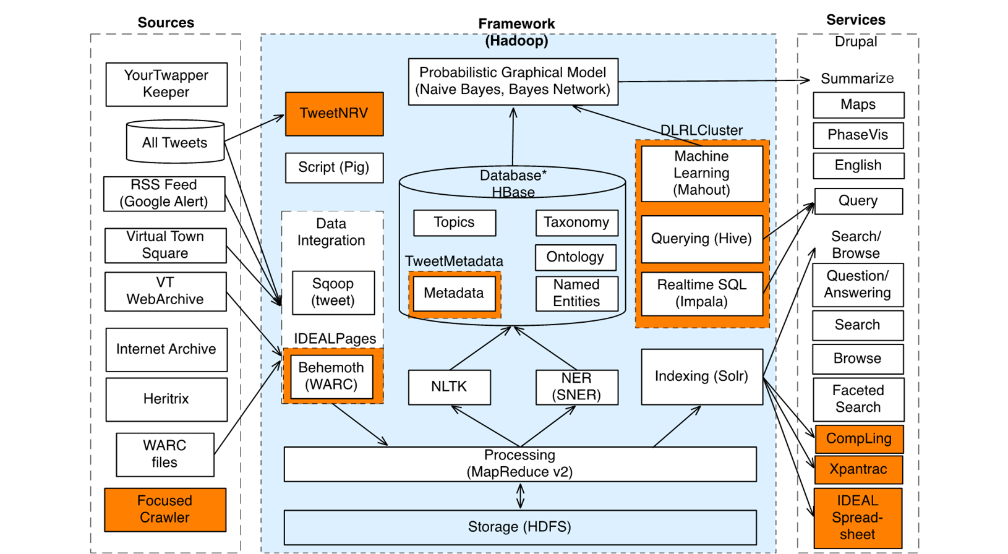
IDEAL Project – (Borrowed FROM SUNSHIN LEE)

Slide 4
Solution Approach
Automate the process of:
  Extracting the Web Archives (.warc files)
  HTML parsing and indexing into Solr
Use of Hadoop for distributed processing
Webpages for displaying Solr search results and sorting disasters by category
Make the process reusable on other archives

Slide 5
Project Architecture
Event crawled by Heratrix Cralwer
WARC Files
Webpage Files
HTML Files
Interface
Browsing
Visualizing
Categories
Solr
Hadoop

Slide 6
Our Roles
.warc file extraction
Filtering of HTML files
Text extracting from HTML files
Indexing information into Solr
Map/Reduce Script for Hadoop

Slide 7
Work Completed
Set up Python environment
Obtained a set of test .warc files
Simplified the process of extracting a .warc file
Identification of HTML files from the resulting extraction
Expand process of extracting .warc files to multiple files/directories
Extracting text from HTML files
Indexing information into Solr

Slide 8
Extracting Warc File
Integrated Hanzo Warc Tools (https://pypi.python.org/pypi/hanzo-warc-tools/0.2)
  Only takes one warc file at a time
  Unpacks warc file into HTTP folder and HTTPS folder
  Creates text file to be used later
Created script to allow for full directory to be unpacked

Slide 9
Warc Extraction Example Output
warc_file | warc_con_len | warc_uri_date | warc_subject_uri | uri_content_type | outfile
fn.warc.gz | 3284 | 2013-04-21 | www.vt.edu/robots.txt | text/plain | /Users/http/robots/txt
fn2.warc.gz | 1023 | 2013-04-21 | www.vt.edu/cs.html | text/html | /Users/https/cs.html
fn3.warc.gz | 4983 | 2013-04-21 | www.vt.edu/logo.png | image/jpg | /Users/http/logo.png

Slide 10
HTML Extraction
Find HTML documents based on uri_content_type column in text file
Use the outfile column to locate where the file is an extract HTML file

Slide 11
INDEXING FILES INTO SOLR
Text extracted from HTML files using BeautifulSoup4 (http://www.crummy.com/software/BeautifulSoup/)
Indexed into Solr using solrpy (https://code.google.com/p/solrpy/)
Use fields for:
  id
  content
  collection_id
  event
  event_type
  URL
  wayback_URL

Slide 12
Work Remaining
Work with client to integrate the process with Hadoop

Slide 13
Questions?

