Slide 1
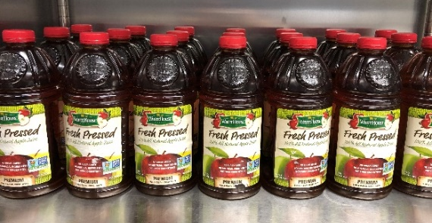
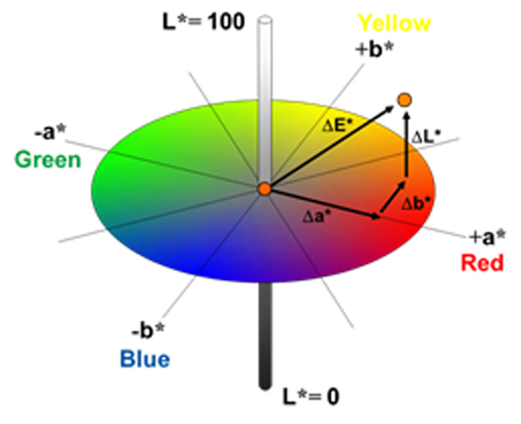
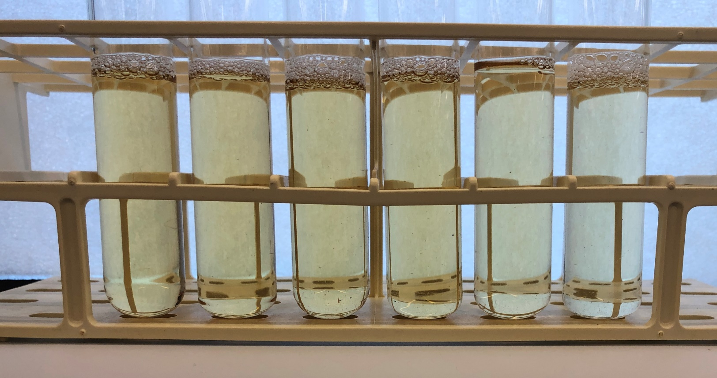
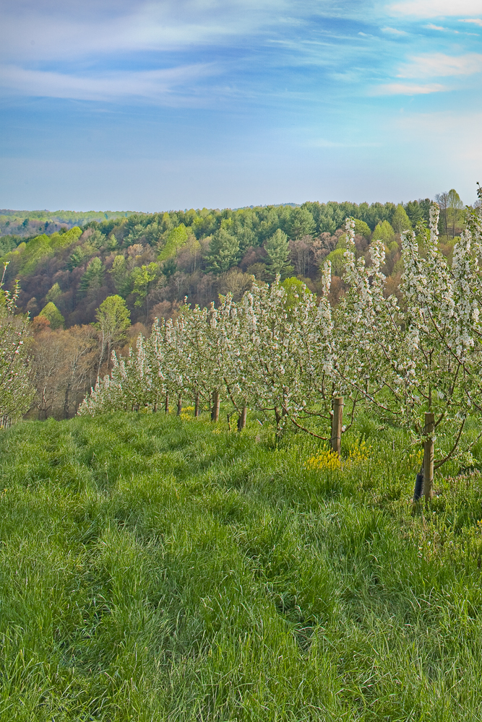
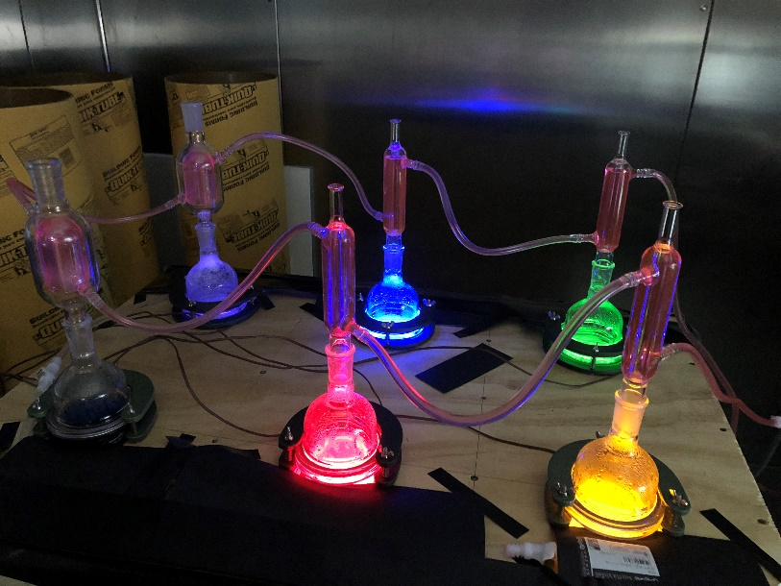
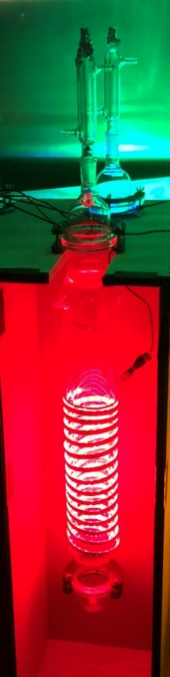
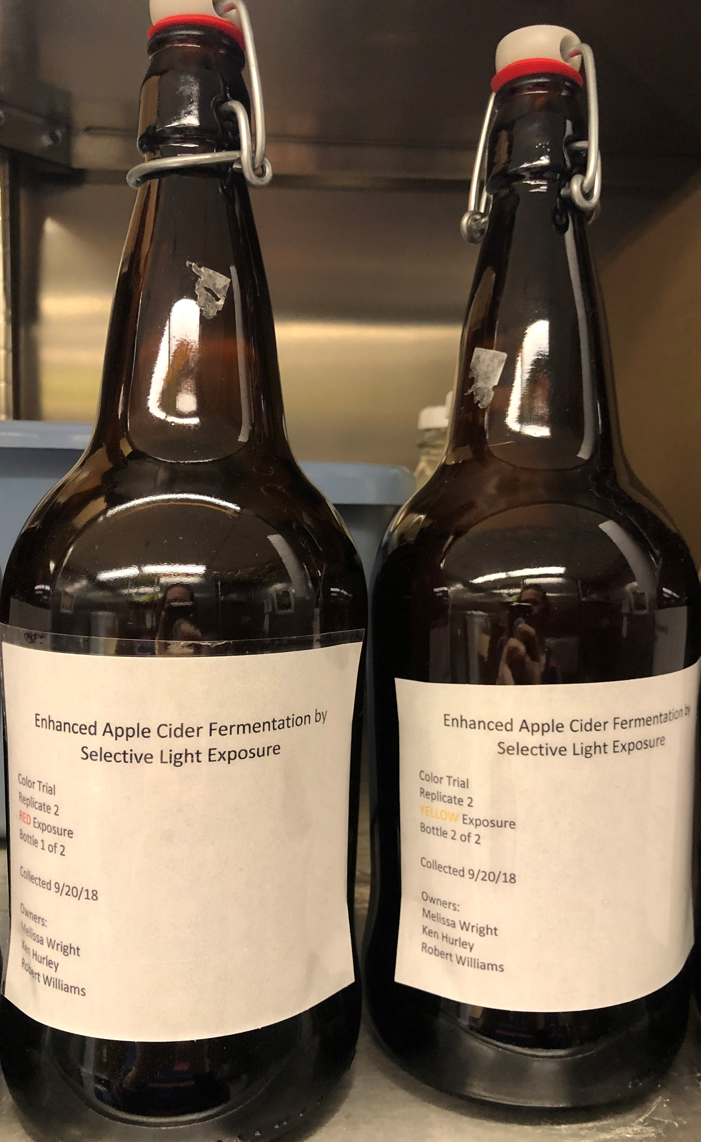
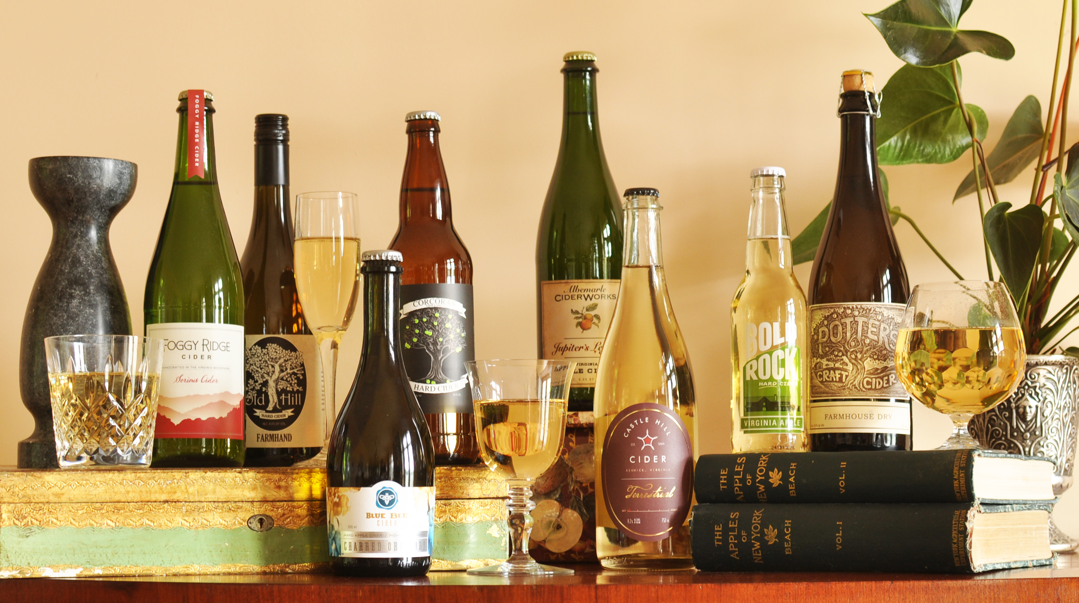

Enhanced Apple Cider Fermentation by Selective Light Exposure
M.S. Wright, E.K. Hurley, R.C. Williams, J.D. Eifert, J. Lahne
Department of Food Science & Technology, Virginia Tech, Blacksburg, VA
Objective
Fermentation Materials and Methods
Appearance Methods and Results
The objective was to determine if measurable sensory impacts would occur in fermenting apple juice exposed to multiple colors and intensities of light.
Juice was purchased, commercially packaged WhiteHouse brand Fresh Pressed 100% All Natural Apple Juice
Majority of the apples used in Winchester production facility are from Virginia
Not from concentrate
No added sugar or artificial ingredients
Yeast culture was Lavlin W15TM (Saccharomyces cerevisiae cerevisiae)
Moderate fermentation speed and short lag phase
Low potential for creation of sulfide off-aromas
Additional Nitrogen sources
Fermaid® O added at a rate of 40 g/hL
Diammonium phosphate added at a rate of 30 g/hL
Custom made tubular vessels were used to house two-liter fermentation batches. Each vessel is jacketed for temperature control and can be fitted with a condenser.
Fermentation vessels were suspended in a wooden box designed to keep all other light sources from reaching the fermenting cider.
Vessels were wrapped in 5-meter LED light strips with 60 lights per meter.
Fermentation was allowed to continue for 187 ± 3 hours at 18°C.
Ciders were centrifuged and collected in 1 liter amber glass bottles for sensory analysis and polypropylene tubes for all other analysis.
Relevance
Photo credit: Melissa S. Wright
Agriculture is the largest sector of Virginia’s economy, with approximately $70 billion generated and 334,300 jobs statewide (Raphann, 2017).
Virginia is 6th in the amount of acreage devoted to apple production in the United States (Virginia Tourism Corporation, 2019).
According to the Virginia Association of Cidermakers (2019), there are at least 19 cideries in the state, with ten having been started since 2006.
Photo credit: Melissa S. Wright
Photo credit: http://pce-instruments.com
Figure 2. Color trial replicate 1 samples (left to right): dark control, red light, yellow light, green light, blue light, UV light
Variations in color to the naked eye led to analysis of L*a*b* values
Variation was observed in values for Δb*, which ranges from negative (blue) to positive (yellow), and a*, which ranges from negative (green) to positive (red)
Photo credit: Melissa S. Wright
 | Red | Yellow | Green | Blue | UV
Δb* (as compared to control) | 0.62 | 0.14 | 0.50 | 1.36 | 1.63
a* | 0.52 | 0.27 | 0.39 | 0.01 | -0.51
Photo credit: https://virginiacider.org/
Photo credit: Melissa S. Wright
Between 2013 and 2017, gallons of cider bottled increased 144% nationally, but 428% in Virginia (TTB 2014 – 2018).
If there are indeed positive measurable impacts present in the hard cider, selective light exposure could be used by Virginia cider producers to create optimized products that may have a potential advantage over traditionally fermented products.
Sensory Methods and Results
Conclusion
Volunteer panelists were asked to rank blind samples from color trials on two different scorecards with scales as shown below (n = 13).
Exposure of fermenting juice to different colors of light affects the appearance and flavor characteristics of the hard cider finished product as well as consumer preference. Fermenting juice exposed to UV light was preferred over hard cider produced using traditional dark fermentation.
Potential Applications
Test 1: Rank samples in order of preference, with 1 being “liked most of all” and 6 being “liked least of all”
Test 2: Evaluate five samples against a known control, with 10 being “very different from control and 1 being “not different from control”
The potential exists for interest in scaling up this model to fit large production environments and producing a completely optimized product unlike any other on the market. This growth potential could be outstanding for Virginia apple growers, cideries and consumers alike.
Future Work
Manipulation of light exposure cycles (2-hour and 12-hour)
Further sensory panel testing of all remaining batches
Characterization of volatile compounds present using SPME and GC-MS
Quantification of alcohol content, malic acid and sugars
Manipulation of color exposure and measurement of consumer perception to the resulting color differences
Identification of reasons for resulting color differences
History
The relationship between ultraviolet (UV) light and living cells has been widely researched and the general conclusion is that exposure can and usually does result in damage to the cells.
Unlike plants, yeasts do not have photoreceptors. This leads to the assumption that these organisms would exhibit no measurable response to light inputs.
Some research has found that exposure of yeast to wavelengths of light in the blue-green range can significantly impact the metabolism (Robertson, 2013), which presumably would effect the yeast’s normal waste outputs, including aromatic esters.
Figure 1. Chart showing mean values of color-exposed cider
Acknowledgements
This research was conducted with funding from the Virginia Agricultural Council. Additional support was provided by the Virginia Agricultural Experiment Station.
References
Cider in Virginia. Richmond, VA: Virginia Tourism Corporation; 2019 [accessed 19 January 2019]. https://www.virginia.org/cider/
Explore Cider: Virginia Cideries. Virginia: Virginia Association of Cidermakers; 2019 [accessed 19 January 2019]. https://virginiacider.org/explore-cideries/
Rephann, Terrance J.: The Economic Impact of Virginia’s Agriculture and Forest Industries. Weldon Cooper Center for Public Service – University of Virginia; May 2017.
Robertson JB, Davis CR, Johnson CH. Visible light alters yeast metabolic rhythms by inhibiting respiration. Proc Natl Acad Sci U S A. 2013; 110(52): 21130-5.
TTB: Wine Statistics. Cincinnati, OH: Alcohol and Tobacco Tax and Trade Bureau; 7 April 2014 – 27 April 2018 [accessed 11 February 2019]. https://www.ttb.gov/wine/wine-stats.shtml
Photo credit: https://www.virginiacider.org
Photo credit: Melissa S. Wright
Notes:
Copyright Colin Purrington (http://colinpurrington.com/tips/academic/posterdesign).

