Slide 1
Up-Standing Norms,
Technology, and Disability
Ashley Shew, Assistant Professor, Virginia Tech
shew@vt.edu
techanddisability.com

Slide 2
This talk is about standing and not standing --
To be an upstanding or upright citizen, as a substitute for good or model,
To stand tall, as in having dignity,
Lameness, used as a substitution for awful or bad,
Crippled, as a substitution for held back or substantially hurt by,
And invalid looks a lot like invalid.
[Many words that were once about disabilities are actually used as language to indicate negative things and put other people down.]

Slide 3
Wheelchairs with Lifts

Slide 4
Why would wheelchairs need lifts?

Slide 5
Stair Climbing Wheelchairs

Slide 6
Why would wheelchairs need to climb stairs?

Slide 7
Exoskeletons

Slide 8
Why are exoskeletons being developed?

Slide 9
Bill Peace:

Slide 10
Harriet McBryde Johnson

Slide 11
Up-Standing Norms
Are biases ingrained in our social institutions and design.
Suggest we develop technological fixes to social ignorance and poor/thoughtless environmental designs.
See bodies as projects to be fixed as the route to solving larger problems of infrastructure.
Reinforce the medical model of disability, rather than the social model of disability.
Allow us to continue building homes and environments that may easily become inaccessible to us as we age, keep disabled people from integrating into public life, and reinforce stigmas and differences.

Slide 12
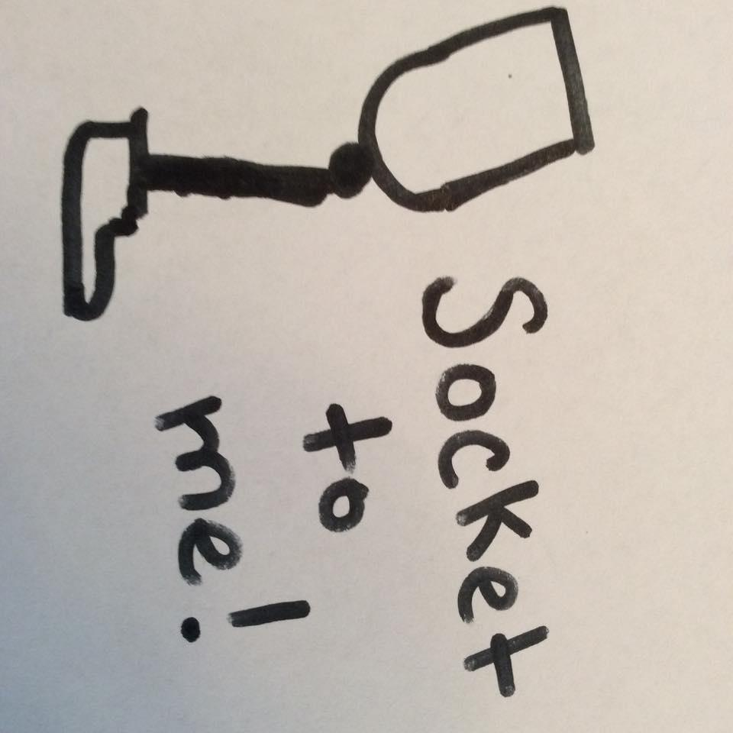
Questions?
shew@vt.edu

Slide 13
For further interest --
If you are interested in language and disability, the Autistic Hoya provides a great reference on ableist words and language preferences in the context of disability: http://www.autistichoya.com/p/ableist-words-and-terms-to-avoid.html
Bill Peace blogs at http://badcripple.blogspot.com/
Harriet McBryde Johnson’s memoir Too Late To Die Young is fantastic, as is her fictional book Accidents of Nature. You should definitely read them.

