Slide 1
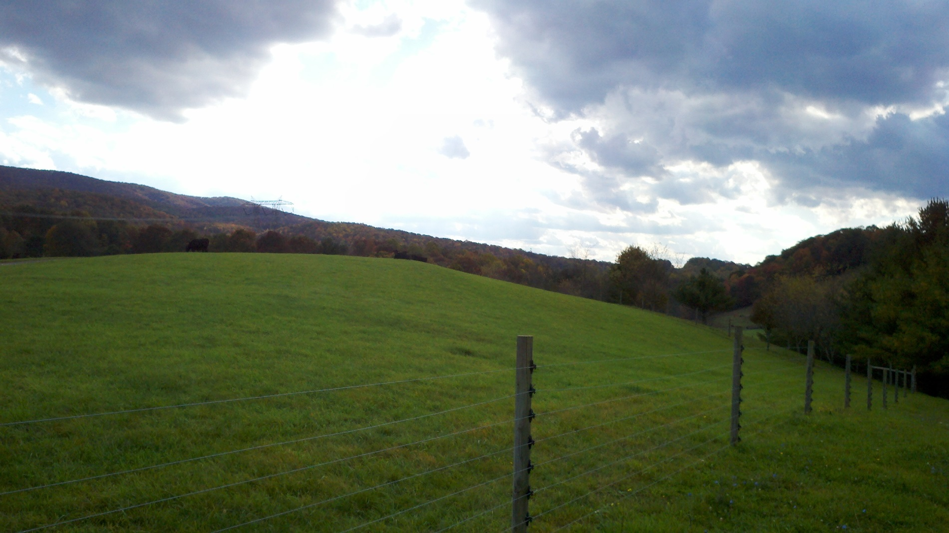
Agriculture in Smyth County Growing the Future
Dr. Andy Overbay
Senior Extension Agent
Agriculture and Natural Resources
Smyth County

Slide 2
Quick Facts about Smyth County Farms
792
166,656
210
50
46
10
Farms in County
Acres of Farmland
Average acres/farm
% of farms 50-500 A
Farms over 1000 A
% farms female owned

Slide 3
Quick Facts about Smyth County Farms
258
109
326
66
57.9
54.1
Farms w/ sales under $2,500
Farms w/ sales over $100,000
Total of full-time operations
Average farm expense in 1000
Total Ag Sales in Million
Total from Cattle in Million

Slide 4
Quick Facts about Smyth County Farms
31,652
65,365
50,272
People in County
Cattle in County
Cattle and calves sold/year

Slide 5
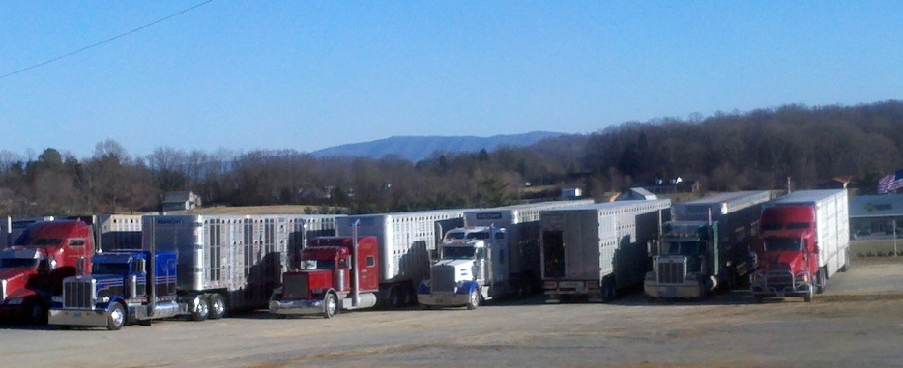
Virginia Quality Assured Feeder Calf Sales
Abingdon Feeder Cattle Association’s

Slide 6

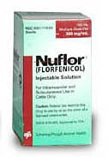

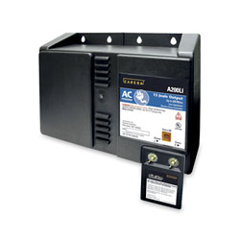
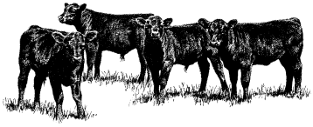
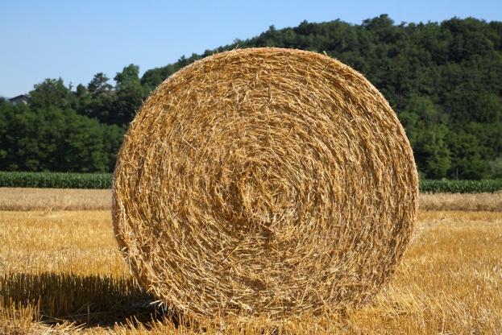
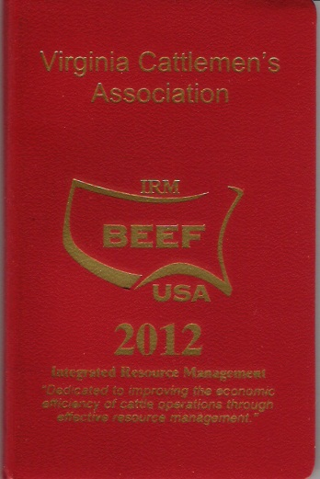



Slide 7
Reasons to use the Tel-O-Auction System to market feeder cattle
Differentiate “high-quality calves” from everyday cattle in the marketplace
To have access to more buyers
To get what they are worth and hopefully get a PREMIUM!

Slide 8
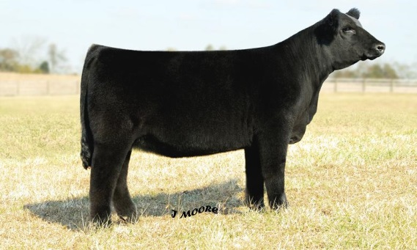
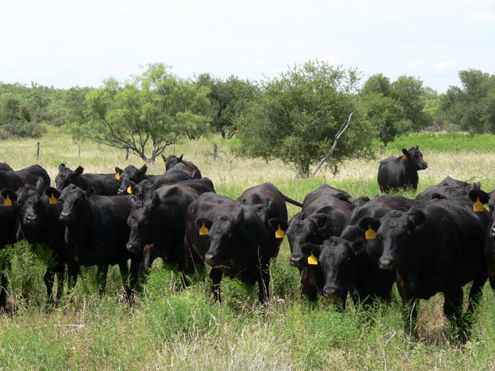
The Hard Fact
Buyers want at least a trailer load of “like” cattle…..50,000 pounds

Slide 9
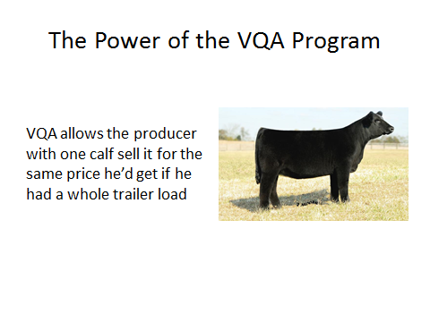

Slide 10
Abingdon Feeder Cattle Association’s VQA Sales
Program began in October 2005
Sold total of 35,347 preconditioned calves
Increased sales revenues by $3,028,875.72

Slide 11
How it works?
Calves are weaned 45 days, vaccinated,
and fed at home.
Cattle are graded on the farm by the Virginia Department of Agriculture
Calves are grouped according to weight and size into load lots (47,000 - 50,000)
Sale is conducted on the VA Tel-0-Auction
Take-Up Day is announced and held at Tri-State
Weigh, sort, sort, and sort some more!
Market handles the transaction and writes checks

Slide 12
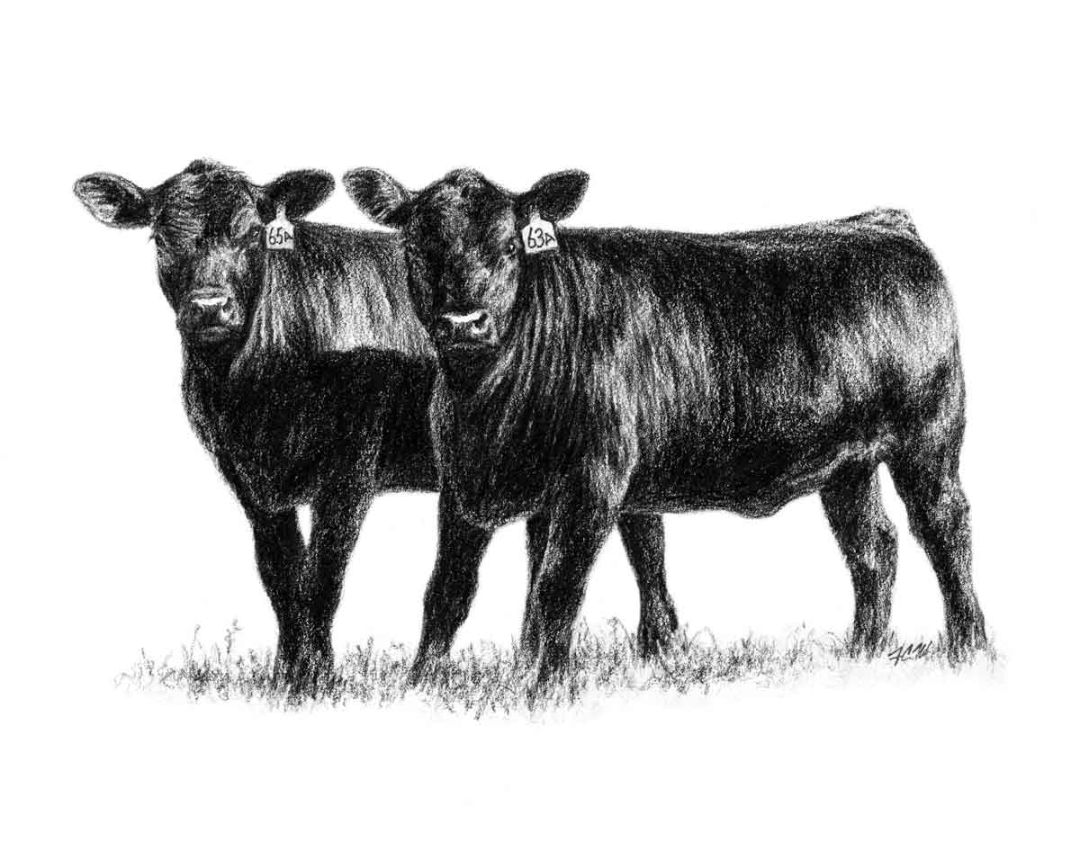
2015 Statistics
Sold 9,020
Added $863,910.41 to sales revenues
+$95.78 premium/calf

Slide 14
Tractor-trailer loads of VQA calves shipped

Slide 15
VQA Premium History

Slide 16
VQA Standards
Blacks, BWF, Charolais-X (No “Pink noses”)
#1 and upper end of the #2 Cattle
Discounts: (-$5.00 / Cwt)
Reds
Off-colors
White tails
Excessive white on legs & belly
Reject:
Roan, Brindle
Small Frames, Lower end of #2 cattle

Slide 17
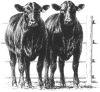
March 2016
1,147 head
16.5 Loads
Added Value = $139,188.92
+$121 / head
Increased Sale Gross by 12.2%

Slide 18
March 2016
Steers
Premium over VA Sales = +$18.68 / Cwt
Heifers
Premium over VA Sales = +$17.91 / Cwt

Slide 19
 |  |  | VQA | Week of | Week of
Data Source: USDA-AMS Market News + Tri-State Market – Abingdon, VA |  |  | 3/28/16 | 4/1/2016 | 4/10/2015
 |  |  |  | $/cwt
5-Area Fed Steer | all grades, live weight |  |  | $133.83 | $164.34
 | all grades, dressed weight |  |  | $214.83 | $261.56
Boxed Beef | Choice Price, 600-900 lb. |  |  | $222.46 | $257.50
 | Choice-Select Spread |  |  | $9.55 | $6.26
700-800# Feeder Steers | Montana 3-market |  |  | $158.05 | $223.13
 | Nebraska 7-market |  | $165.07 | $165.54 | $225.62
 | Oklahoma 8-market |  |  | $159.12 | $219.87
500-600# Feeder Steers | Montana 3-market |  |  | $189.72 | $276.12
 | Nebraska 7-market |  | $194.60 | $205.70 | $287.66
 | Oklahoma 8-market |  |  | $192.42 | $283.05
Feed Grains | Corn, Omaha, NE, $/bu |  |  | $3.35 | $3.73
 | DDGS, Nebraska, $/ton |  |  | $131.00 | $177.25

Slide 20
Maximum value per calf
COOPERATIVE EXTENSION
VIRGINIA
CATTLEMEN’S
ASSOCIATION
VDACS
PRODUCERS
LIVESTOCK
MARKETS
BUYERS

Slide 21
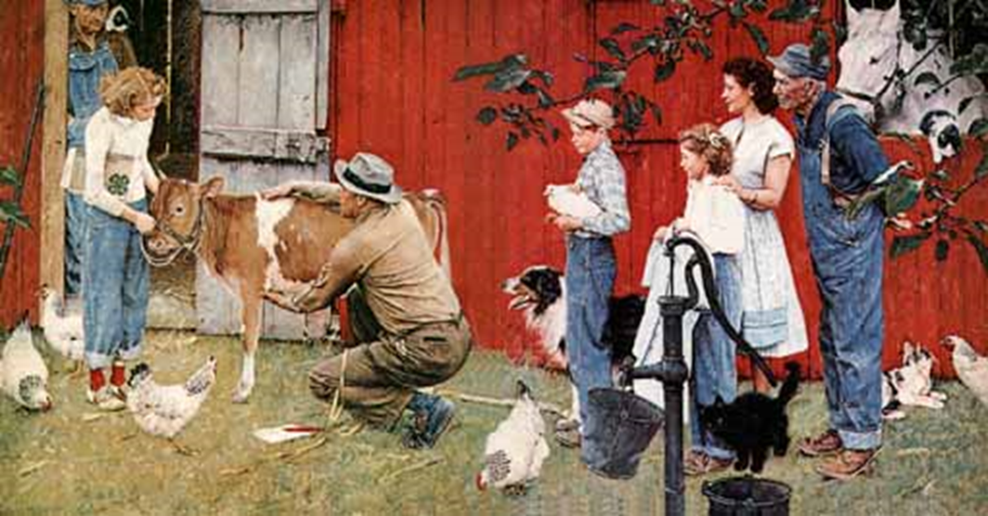
Our Challenge

Slide 22
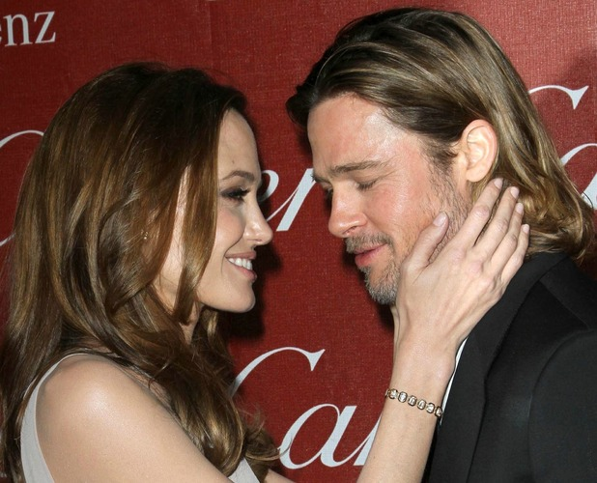
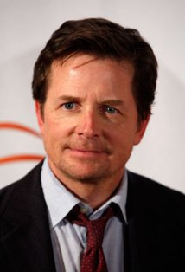
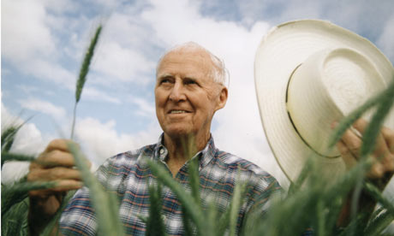
Identify These People
Notes:
"You know, out of all the Lower 9th homes we built, all are producing more energy than they are consuming. They're all pollution-free. This is an amazing story to me.

Slide 23
Actor Defeats Newton’s Third Law of Thermodynamics
"You know, out of all the Lower 9th homes we built, all are producing more energy than they are consuming. They're all pollution-free. This is an amazing story to me. “
Brad Pitt

Slide 24
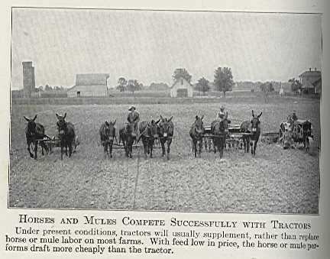

Slide 25
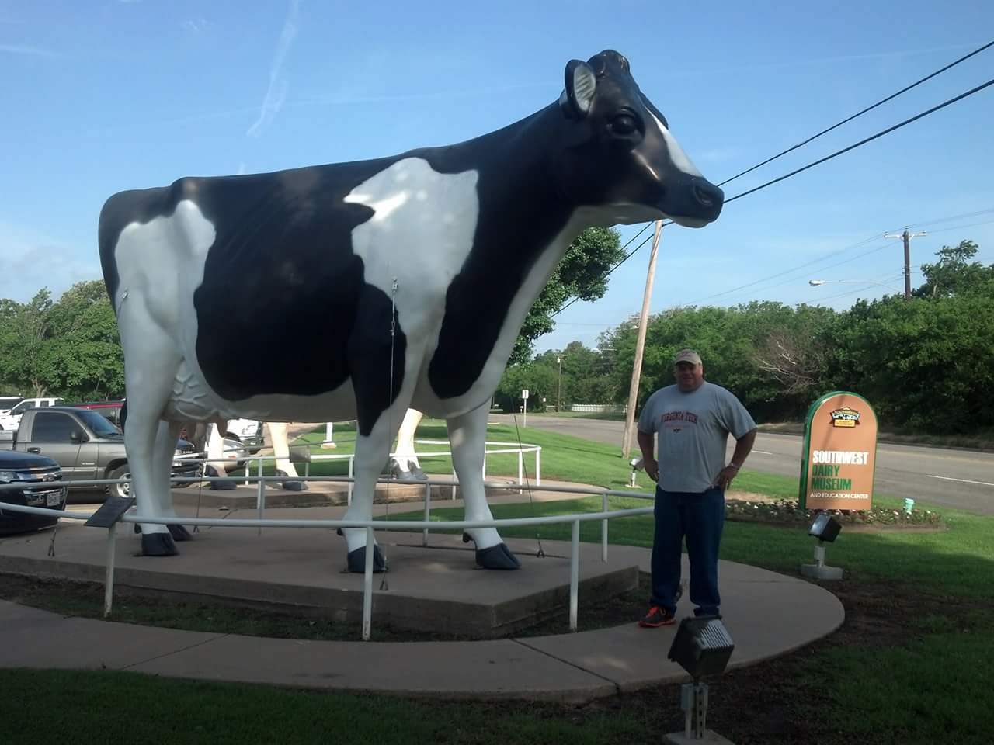

Slide 26
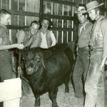
Grand Champion of the 1959 Missouri State Fair appearing on Rawhide set with Clint Eastwood – in his first television role.

Slide 27
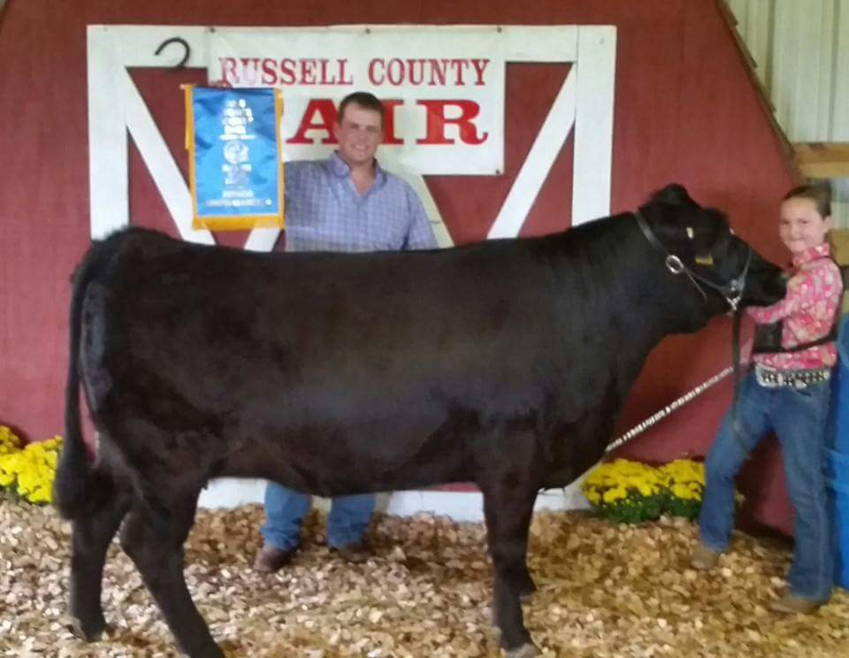

Slide 28
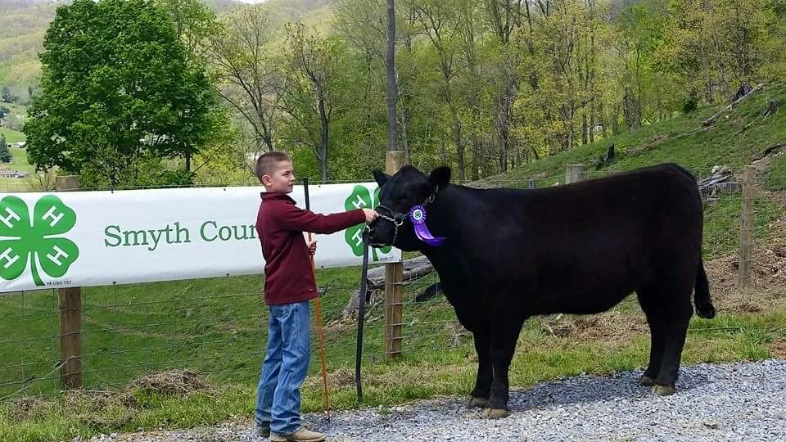

Slide 29
