Slide 1
Where are we now?
Digitizing the Onsite Map Collection at Virginia Tech’s Newman Library
Julia Westblade
Digital Imaging Coordinator

Slide 2



Newman Library
Main branch of the University Libraries whose mission is to
“Provide and promote access to information resources for the achievement of the university’s objectives in learning, discovery, and engagement.”

Slide 3
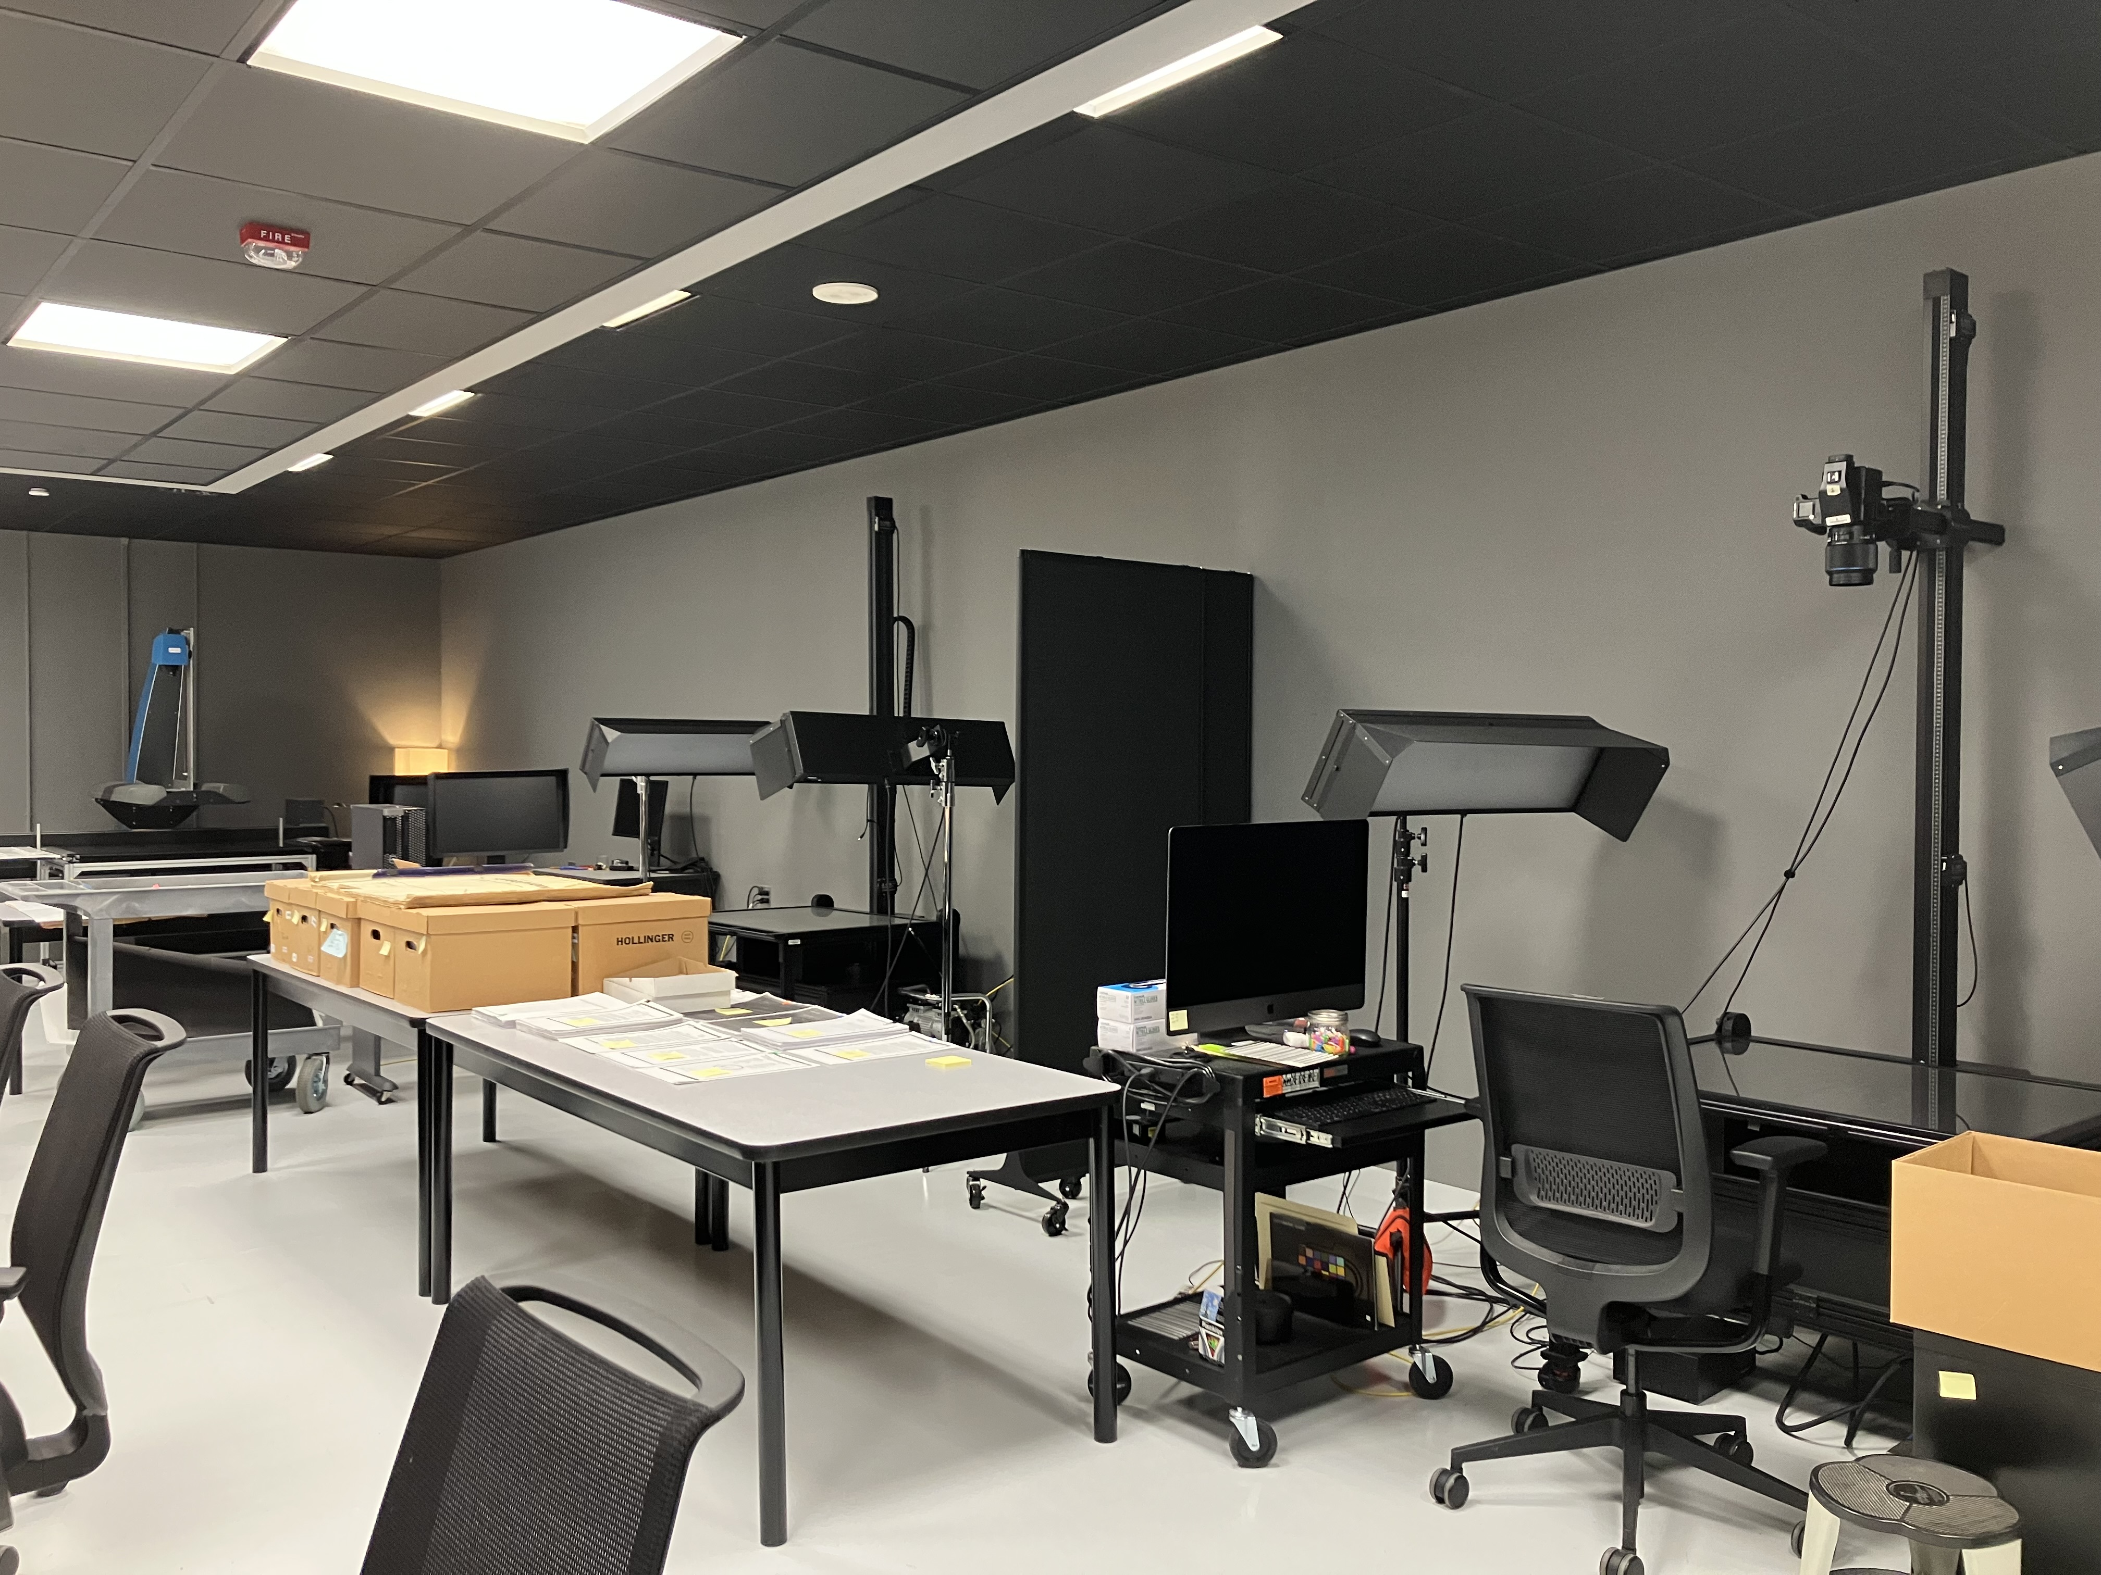

The Digital Imaging Lab
Established in 2018 as a centralized service for the library and the university
Two full-time faculty and a team of students scan and process materials in a variety of formats
Adhere to FADGI 3 Star
PhaseOne cameras with Capture One Cultural Heritage
I2s Quartz Map Scanner

Slide 4
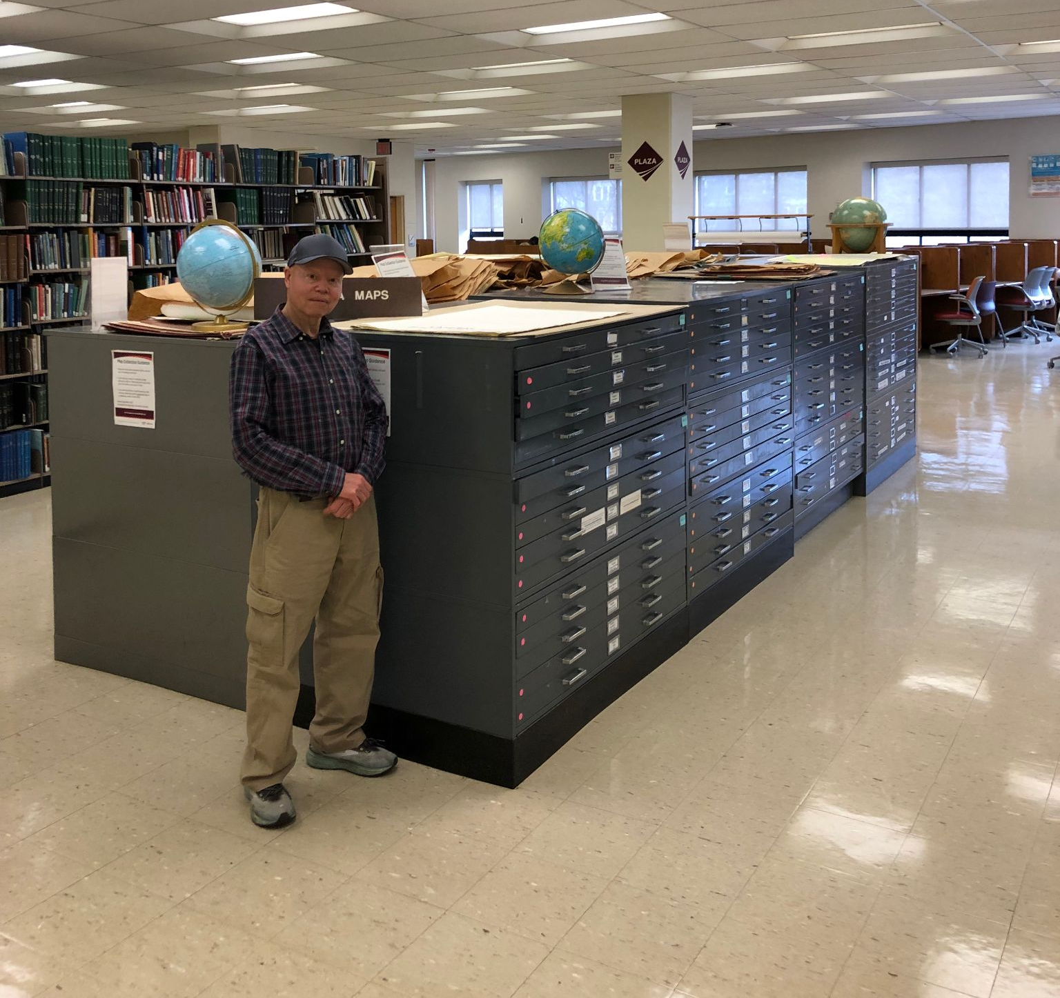
The Newman Map Collection
23 map cases on the third floor of the library
The collection is maintained by the Geospacial Data team
Contains local, state, national, international, historical, and even lunar maps
Had never been officially cataloged which made tracking usage and identifying collection value a challenge
Collection metadata wasn’t recorded anywhere outside of employees’ institutional knowledge

Slide 5
How do materials get digitized?
Advisory Council for Digital Collections
Digital Collections Implementation Team
Committee meets once a month to review proposal submissions
Evaluate projects based on feasibility, need, urgency, resource availability,
Includes colleagues in the project management cycle as well as outside the process to provide additional perspective
Committee meets every other week to review the status of active projects
Stakeholders can attend to ask or answer questions about projects
Includes colleagues from the whole life cycle of the project
Maintains documentation for all completed projects

Slide 6
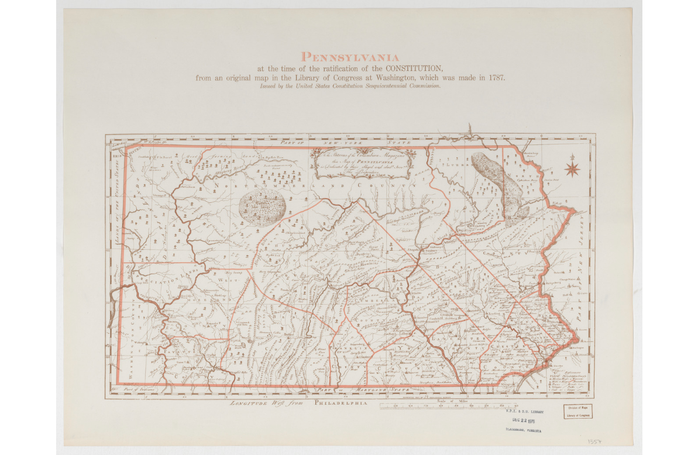
Digitizing the Newman Map Collection
The Geospacial Data Team asked us to digitize the collection, but we needed a list of the maps before we could begin
We knew that if we waited for the whole collection to be inventoried before we started scanning, it would have added years to the project
We worked with Ed and his team to bring materials to the lab in batches and our processes worked simultaneously
1937 Pennsylvania - nmcst013318

Slide 7
Inventory
Each drawer was inventoried individually
Maps were listed in the order they appeared and a numbered sticky note was placed on each one
Using an Excel command, maps were sorted by publisher, title, and date
Then the physical maps were rearranged with the help of the sticky notes
OLD ORDER
Map A [1]
Map B [2]
Map C [3]
Map D [4]
Map E [5]
Map F [6]
Map G [7]
Map H [8]
Map I [9]
Map J [10]
NEW ORDER
Map B [2]
Map C [3]
Map F [6]
Map A [1]
Map J [10]
Map I [9]
Map D [4]
Map E [5]
Map G [7]
Map H [8]

Slide 8
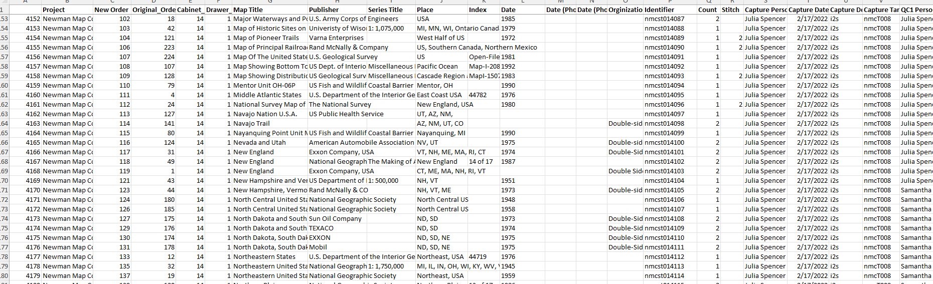
Inventory
Ed and his students created a master list on Google with a sheet for each drawer
Students were assigned a drawer and they added additional information for each map – Series and Index information, if a map was double sided, any additional dates, etc.
My team could then pull this information and copy it into our digitization guide where we added our metadata
When a drawer was ready, they would notify us and bring it down to the lab for scanning

Slide 9
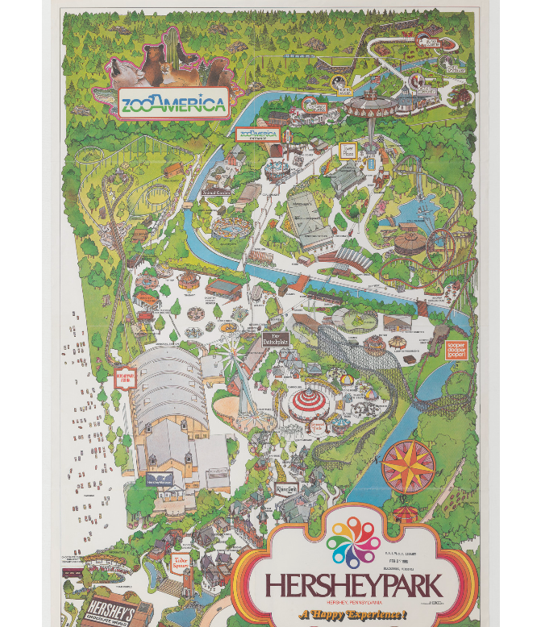
File Naming Convention
The lab uses a consistent file naming convention for each project with three levels of order
Originally planned to have the levels denote cabinet > drawer > map
…and then we got a double sided map
So we changed it to cabinet > map > image
This map of Hershey Park the is front (or only) side of the second map in the eleventh cabinet
1980 Hershey Park – nmcst011002001

Slide 10
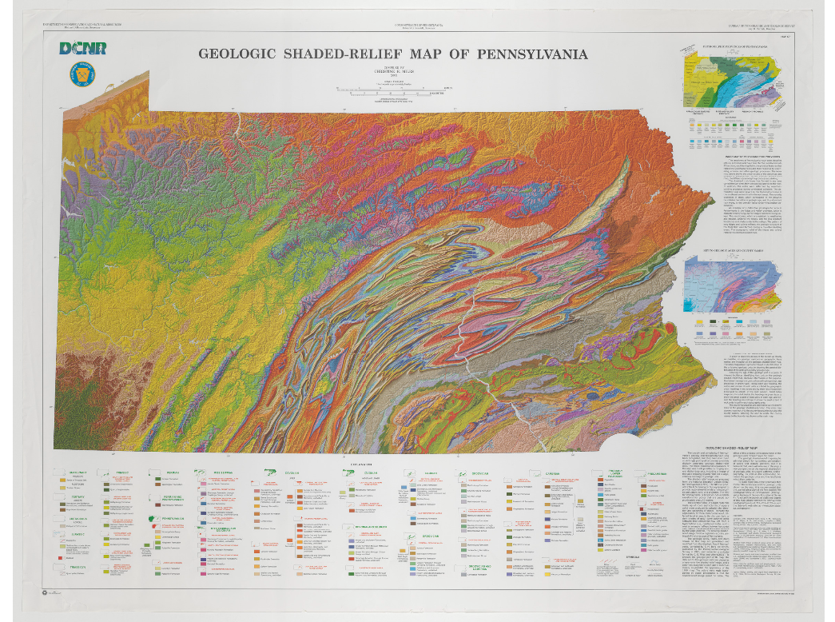
Scanning Process
Maps scanned on the i2s Quartz Map scanner
Scanned as a tif – 400ppi
Most of the maps were scanned in a single image
  About 20% (1667 of 7905) maps were large enough that they had to be scanned in sections
Check the backs of each map
  If the library had written a note or call number on the back we skipped that
  Any published content was scanned
2003 Geologic Shaded-Relief Map of Pennsylvania – nmcst017165001

Slide 11
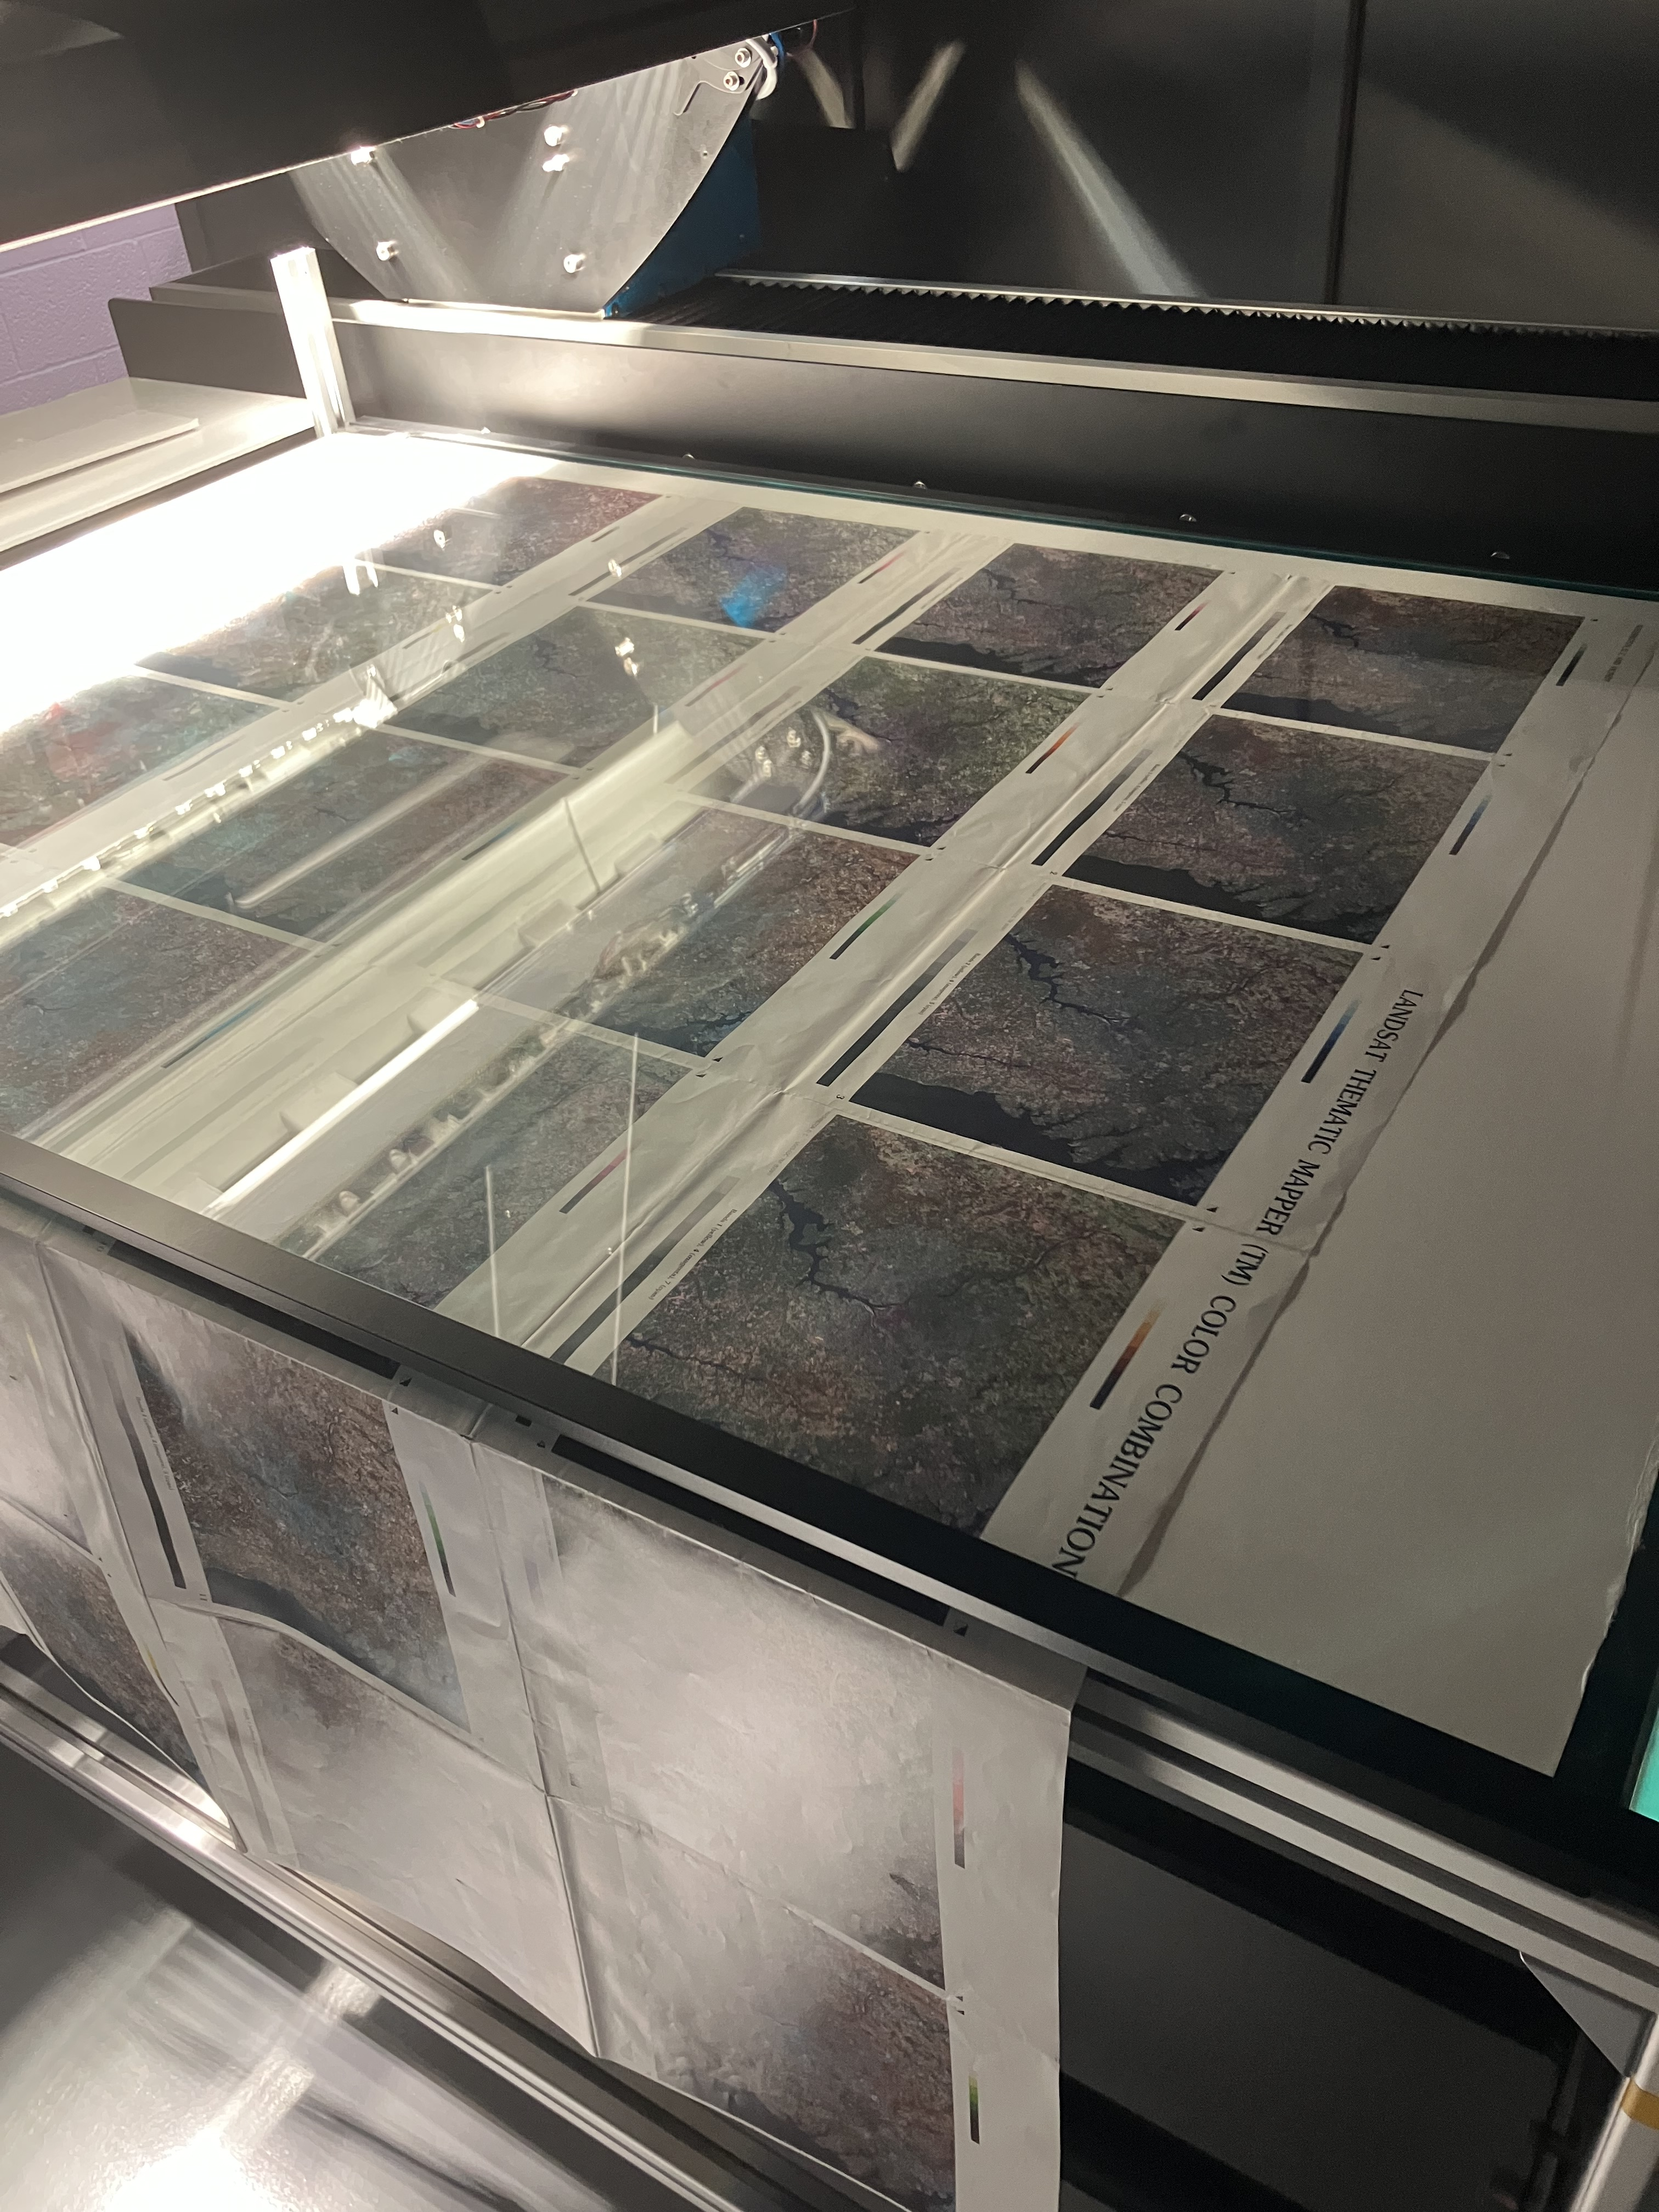
Scanning Process
Inventory began in Fall of 2021
Scanning took place from November 2021 through August 2024
875+ hours of work
7905 maps and 10,944 images
During production, all files are stored on a local server with access limited only to people who have a part in the workflow

Slide 12
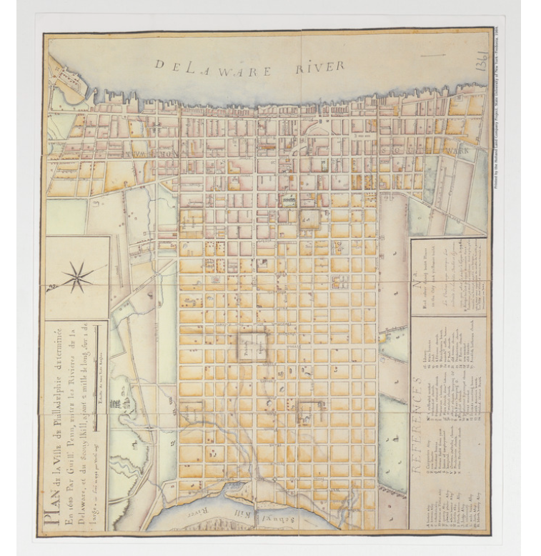
Quality Control
Images are straightened and cropped in Photoshop leaving a border around the edge of the item
Check the image for any focus issues
  Does the title on the digitization guide match the image?
  Does the number of images match what’s listed?
Digitization guide lists who did each step of the process so we can monitor patterns
Once tifs are QCd, we built a Photoshop script to batch process jpg derivates
Plan de la Ville de Philadelphie determine en 1683 Par Guill – nmcst017121

Slide 13
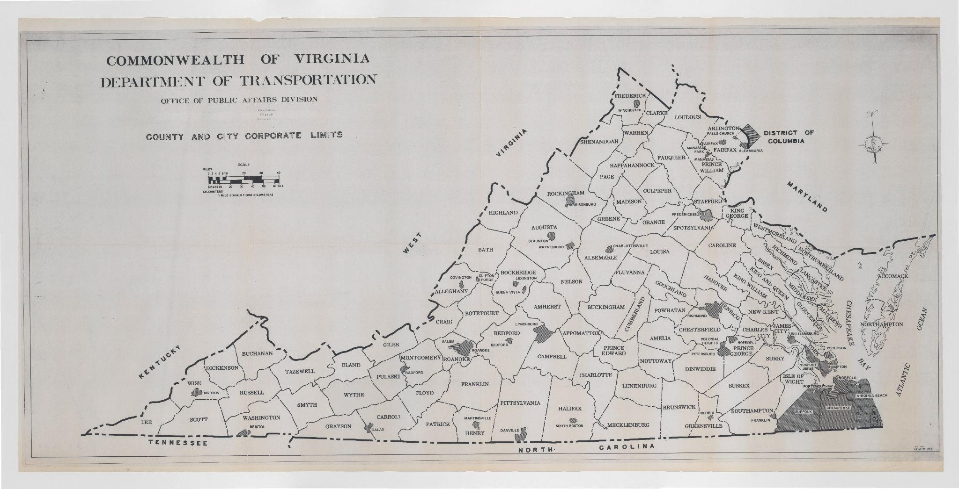
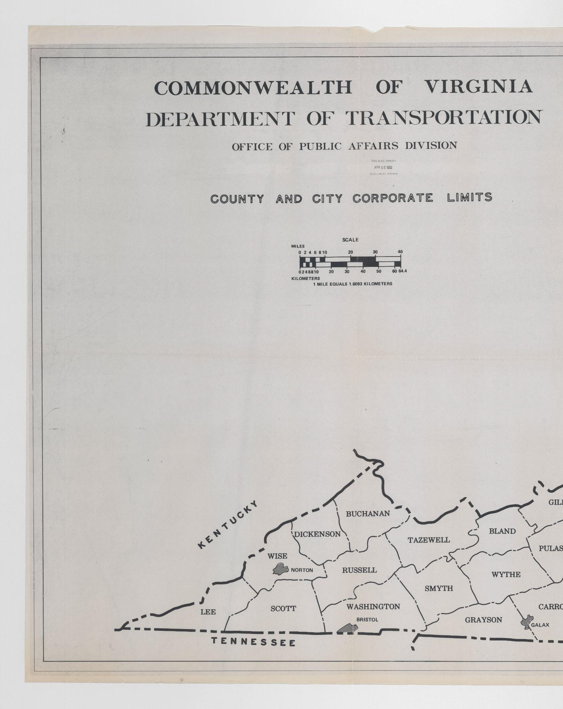
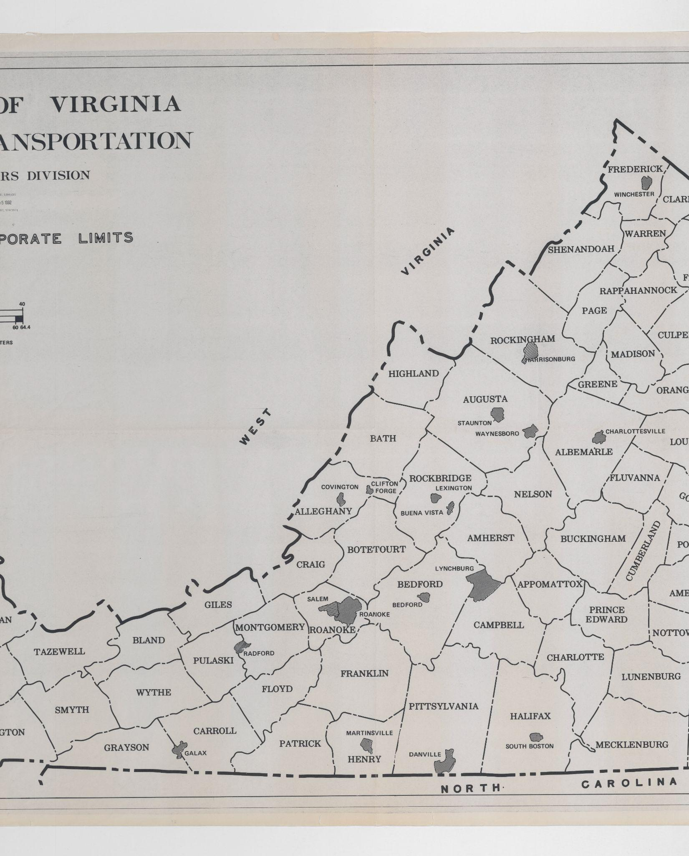
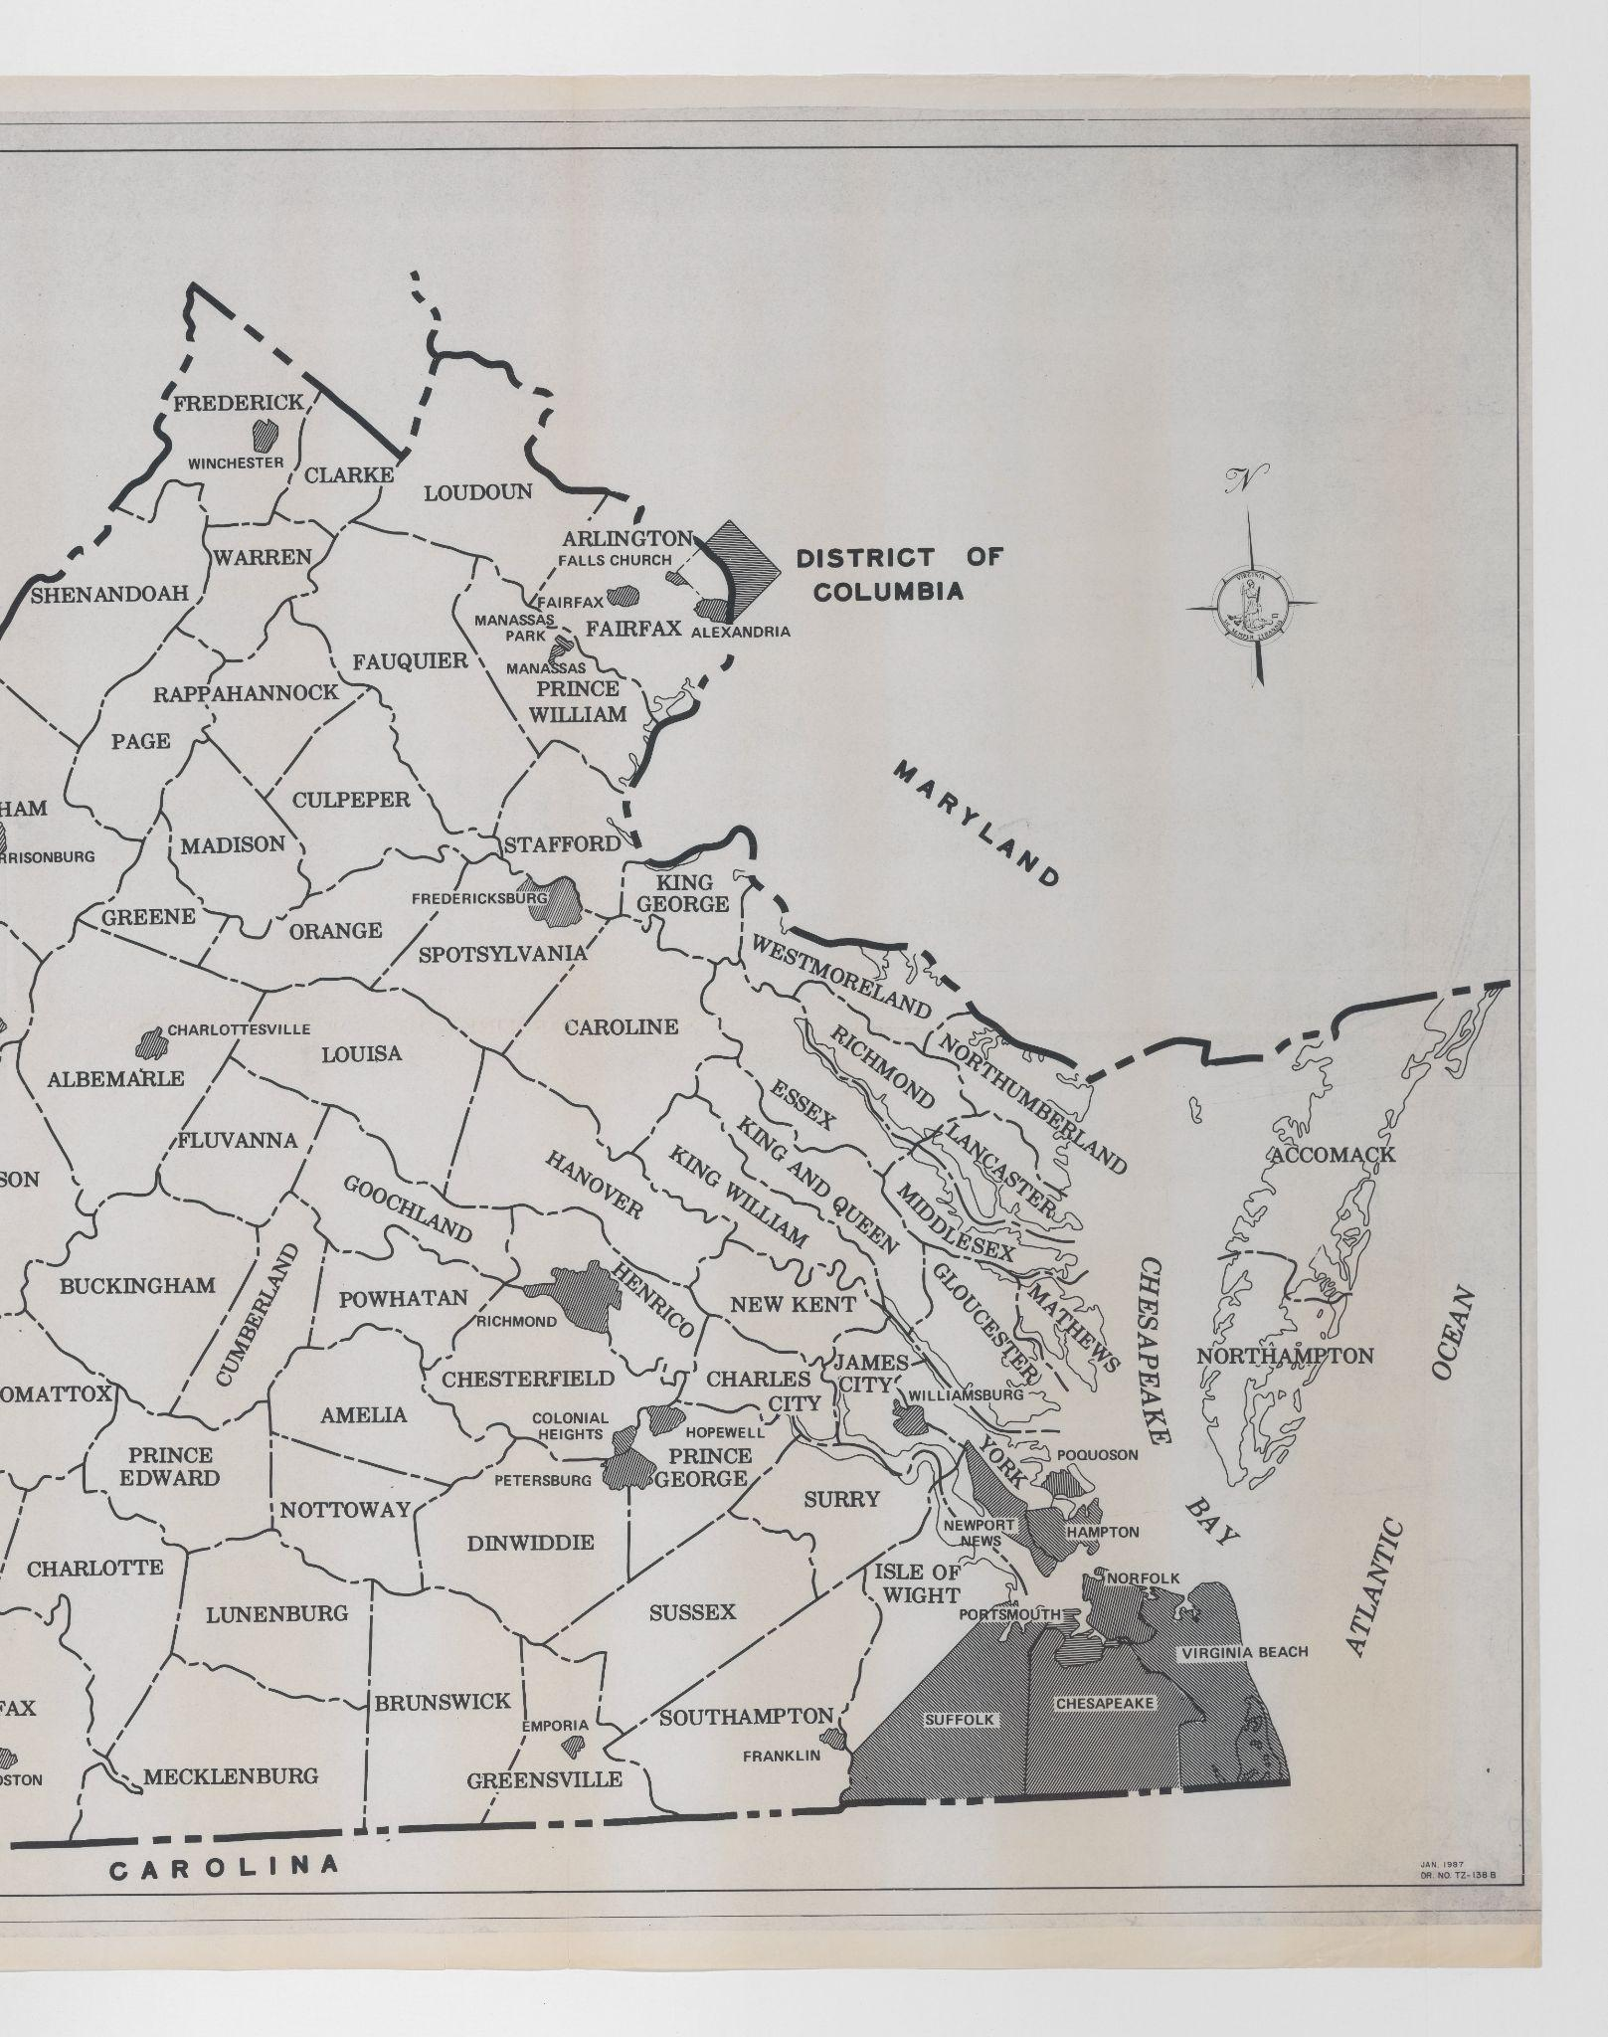
Stitching
1987 County and City Corporate Limits – nmcst001157001 and parts

Slide 14
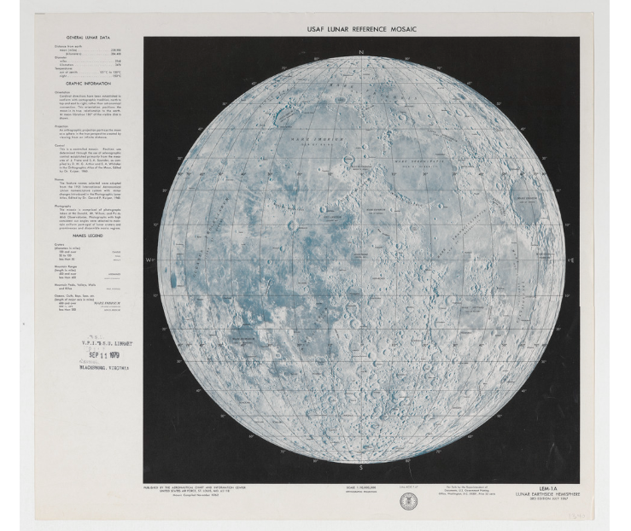
Metadata
Images went back to Ed and Jon for metadata creation
Original list was just a simple inventory, so this was the time to go back and fill out more data
Colleagues who work with metadata offered support and correction to make sure it met the standards
Challenge with Excel changing things like dates and formatting can cause issues further down the line
1967 USAF Lunar Reference Mosaic – nmcst019023001

Slide 15
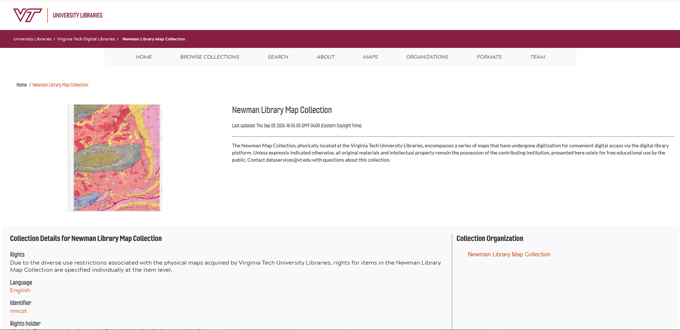
Digital Library Platform
Early stages launched in 2019
New platform introduced in 2024
There are currently 16 collections live on the site and more coming soon
digital.lib.vt.edu

Slide 16
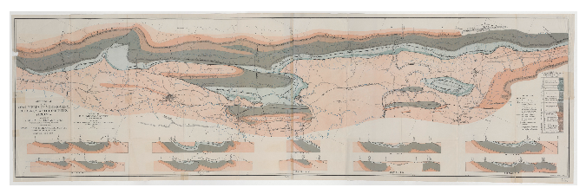
Digital Library Platform
Note: I am not a developer and can only speak in generalities about the DLP
Cloud-Native and serverless
  Over 45 TB of data stored in AWS S3
  Minted NOIDs for digital asset management
  Focused on long-term preservation
Two-dimensional and three-dimensional objects
Newman Map Collection Ingest
First Ingest – 4/2024
  48 records
Second Ingest – 6/2024
  297 records
Third Ingest – 11/2024
  2347 records
Fourth Ingest – 1/2025
  5217 records
Check out the digital library at digital.lib.vt.edu!
1924 Geologic Map of Coal Field of Montgomery, Pulaski, and Wythe County Virginia – nmcst010092001
Notes:
NOID = Nice Opaque Identifier – non-human readable persistent, unique identifier. Not-human readable
No local copies on prem (premise)
Things built in to double check AWS – fixity service – checking the integrity of the service against us and against AWS
use SHAW 256 for fixity because we have a lot of large complex object (like the maps) MD5 is not suitable for ongoing integrity checks for large, complex objects
Up and coming audit service to be able to track what is happening to each file over the course of it’s lifespan like the initial fixity check and ongoing fixity checks, ingest, migration, deletion, and restoration
This is tracked with a dashboard designed using a modified version of PREMIS – preservation metadata
Number of copies
We have one hot (S3) and one cold (Glacier) hopefully one in APTrust in the future
Preserve the tif they are tiled prior to deposit and that’s what people can see on the website the jpgs are derivatives
AWS calls these microservices – we are building in and around these features

Slide 17
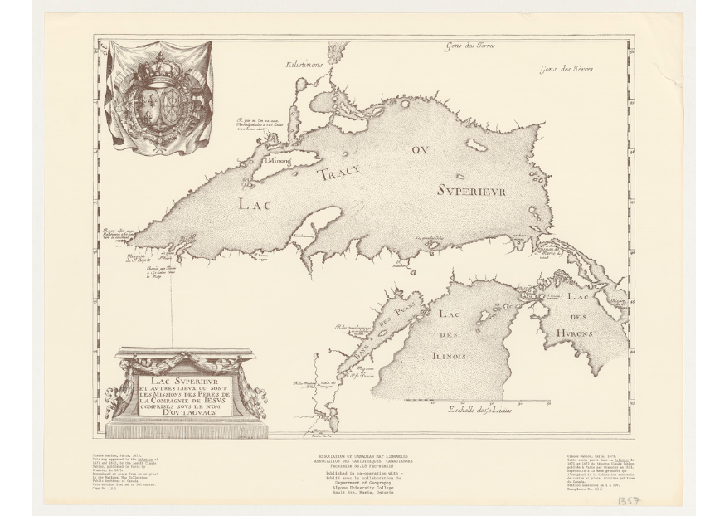
Preservation
Note: I am not a preservation specialist and can only speak in generalities about our strategies
We keep tifs as the archival format
  Files are tiled into jpgs for access
No local copies on-premise
  Keep one hot copy on S3 and one cold copy on Glacier
We use a locally developed fixity service to double-check the integrity of AWS
  Use sha-256 for fixity because we have a lot of large, complex items (like the maps) and md5 is not suitable for ongoing integrity checks for such materials
Up and coming audit service to be able to track what is happening to each file over the course of its lifespan
  This is tracked with a dashboard designed using a modified version of PREMIS
1673 Lac Superieur et Autres Lieux ou Sont Les Missions des Peres De La Compagnie de Iesus Comprises sous le nom D’outauacs – nmcst013205001

Slide 18
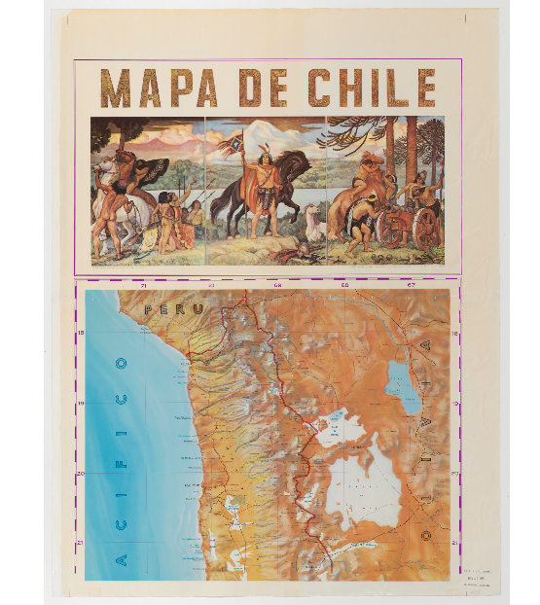
Successes
Easier access for researchers and the general public
Future improvements for the DLP
Cross-departmental collaboration
We know what maps we have now!
Established a workflow for future projects with the Geospacial Data Team
  Already completed a spin-off project for them where we digitized a large collection of Aerial photographs
  Talking about more maps stored off-site
Mapa De Chile – nmcst013111001

Slide 19
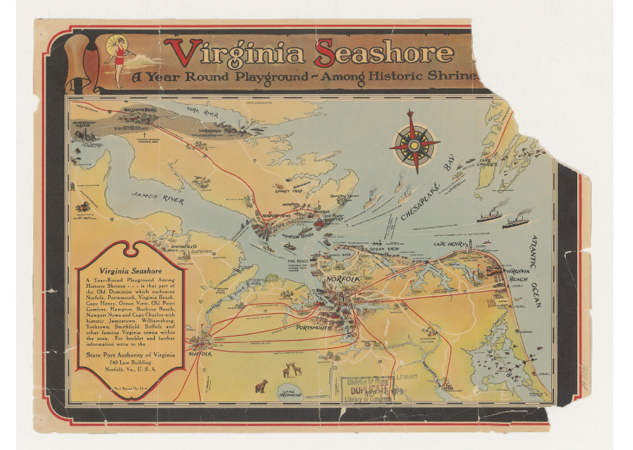
Challenges
Physical condition of the maps
Aspects of the project evolved as work progressed
Because of the change in the file naming convention, some of our automated features didn’t work as smoothly
  Scanning parts also threw off the automated numbering system so we had to manually name each file
Removing the drawer number from the file name meant all drawers had to be scanned in order within each cabinet
1940 Virginia Seashore: A Year Round Playground – Among Historic Shrines – nmcst012025001

Slide 20
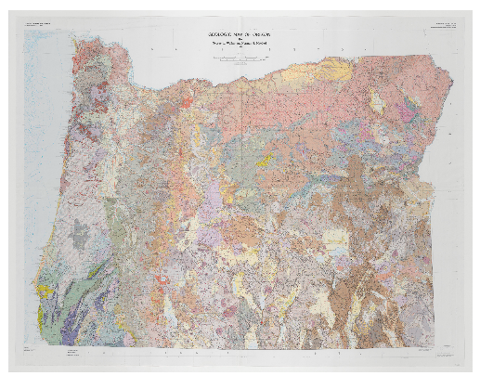
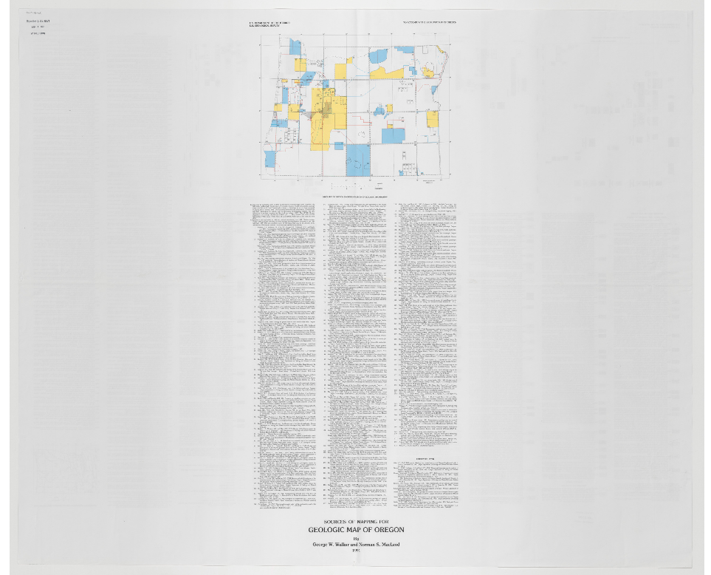
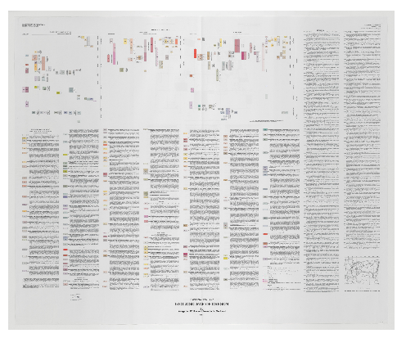
Challenges – multipage items
A few items had more than one page
When we’re scanning, we get into a rhythm and don’t notice that a different page may not be a different item, so the inventory team started flagging them by coloring the line on the spread sheet
Geologic Map of Oregon – nmcst017166001, nmcst017166002, nmcst017166003

Slide 21
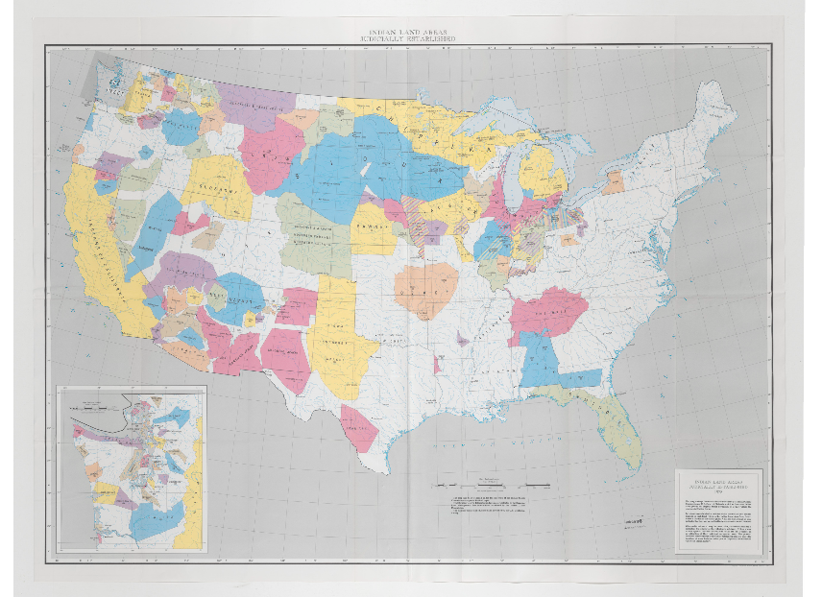
Challenges – color coding
Then they started color coding everything and it slowed us down as we had to stop to figure out what each color meant and why an item was flagged
Colors were not used consistently between students or between issues
For example…
1978 Indian Land Areas Judicially Established – nmcst014637

Slide 22
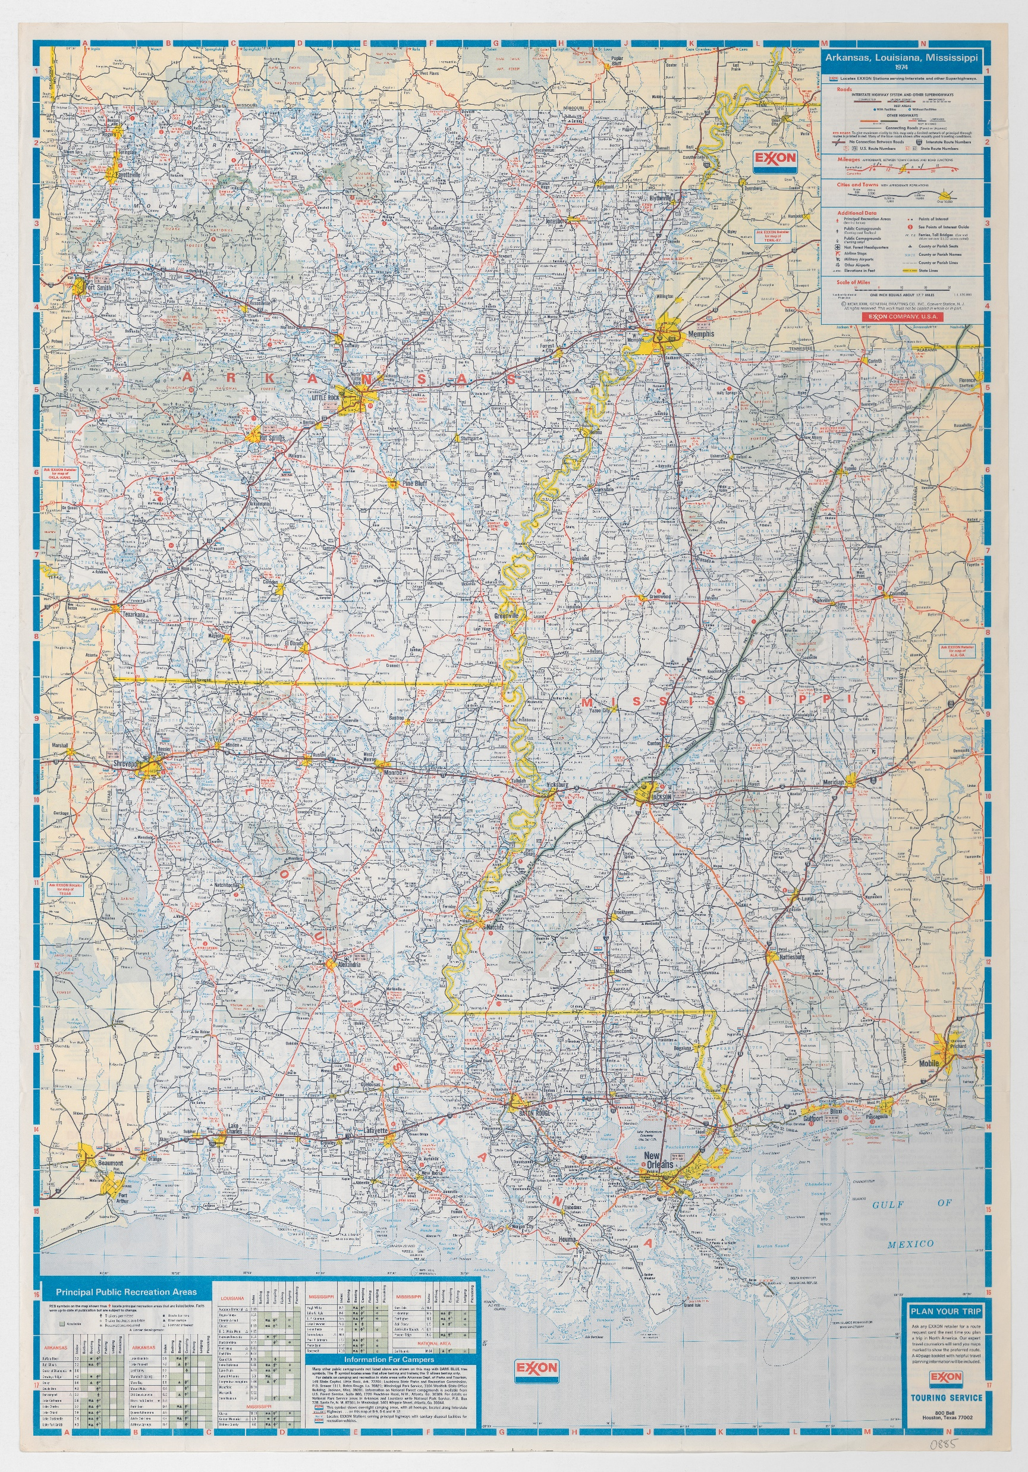
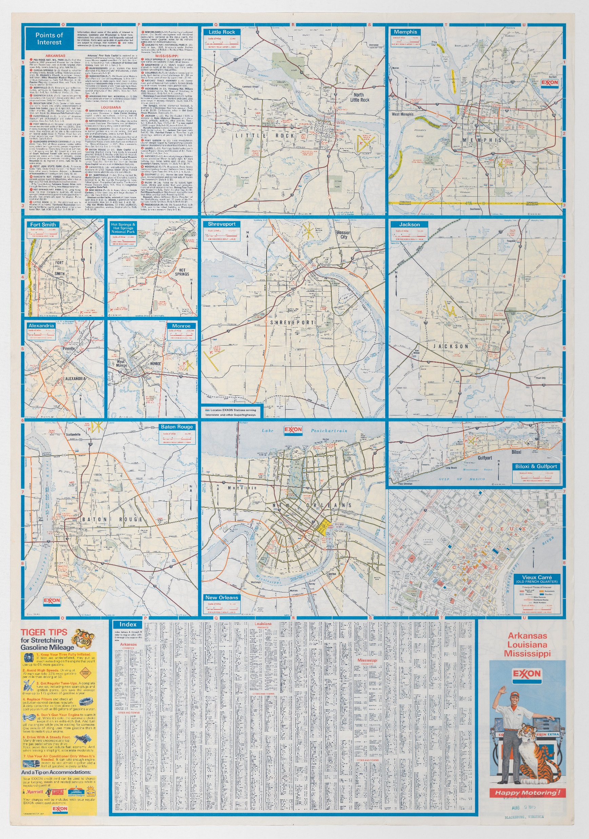
nmcst014014 - unmarked

Slide 23
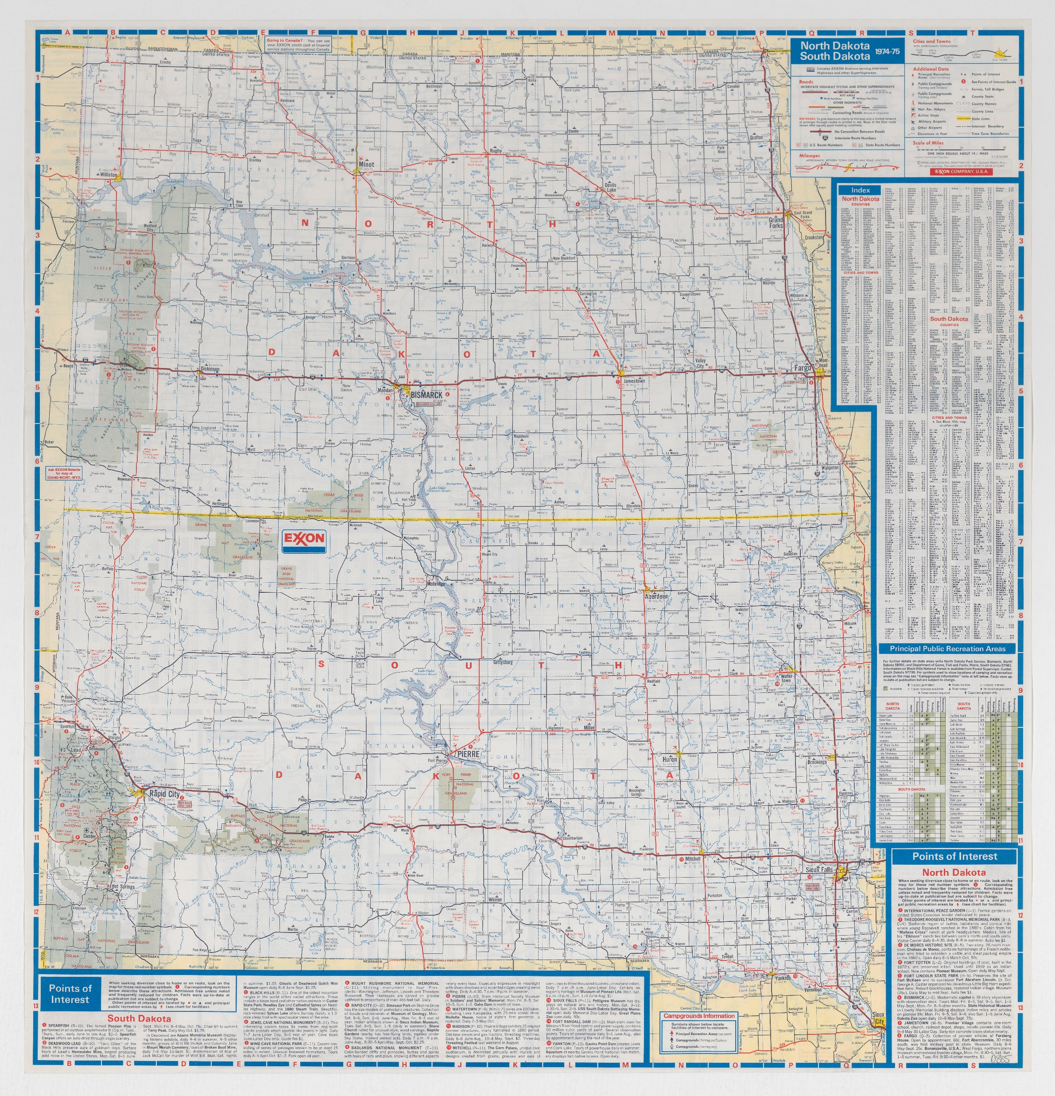
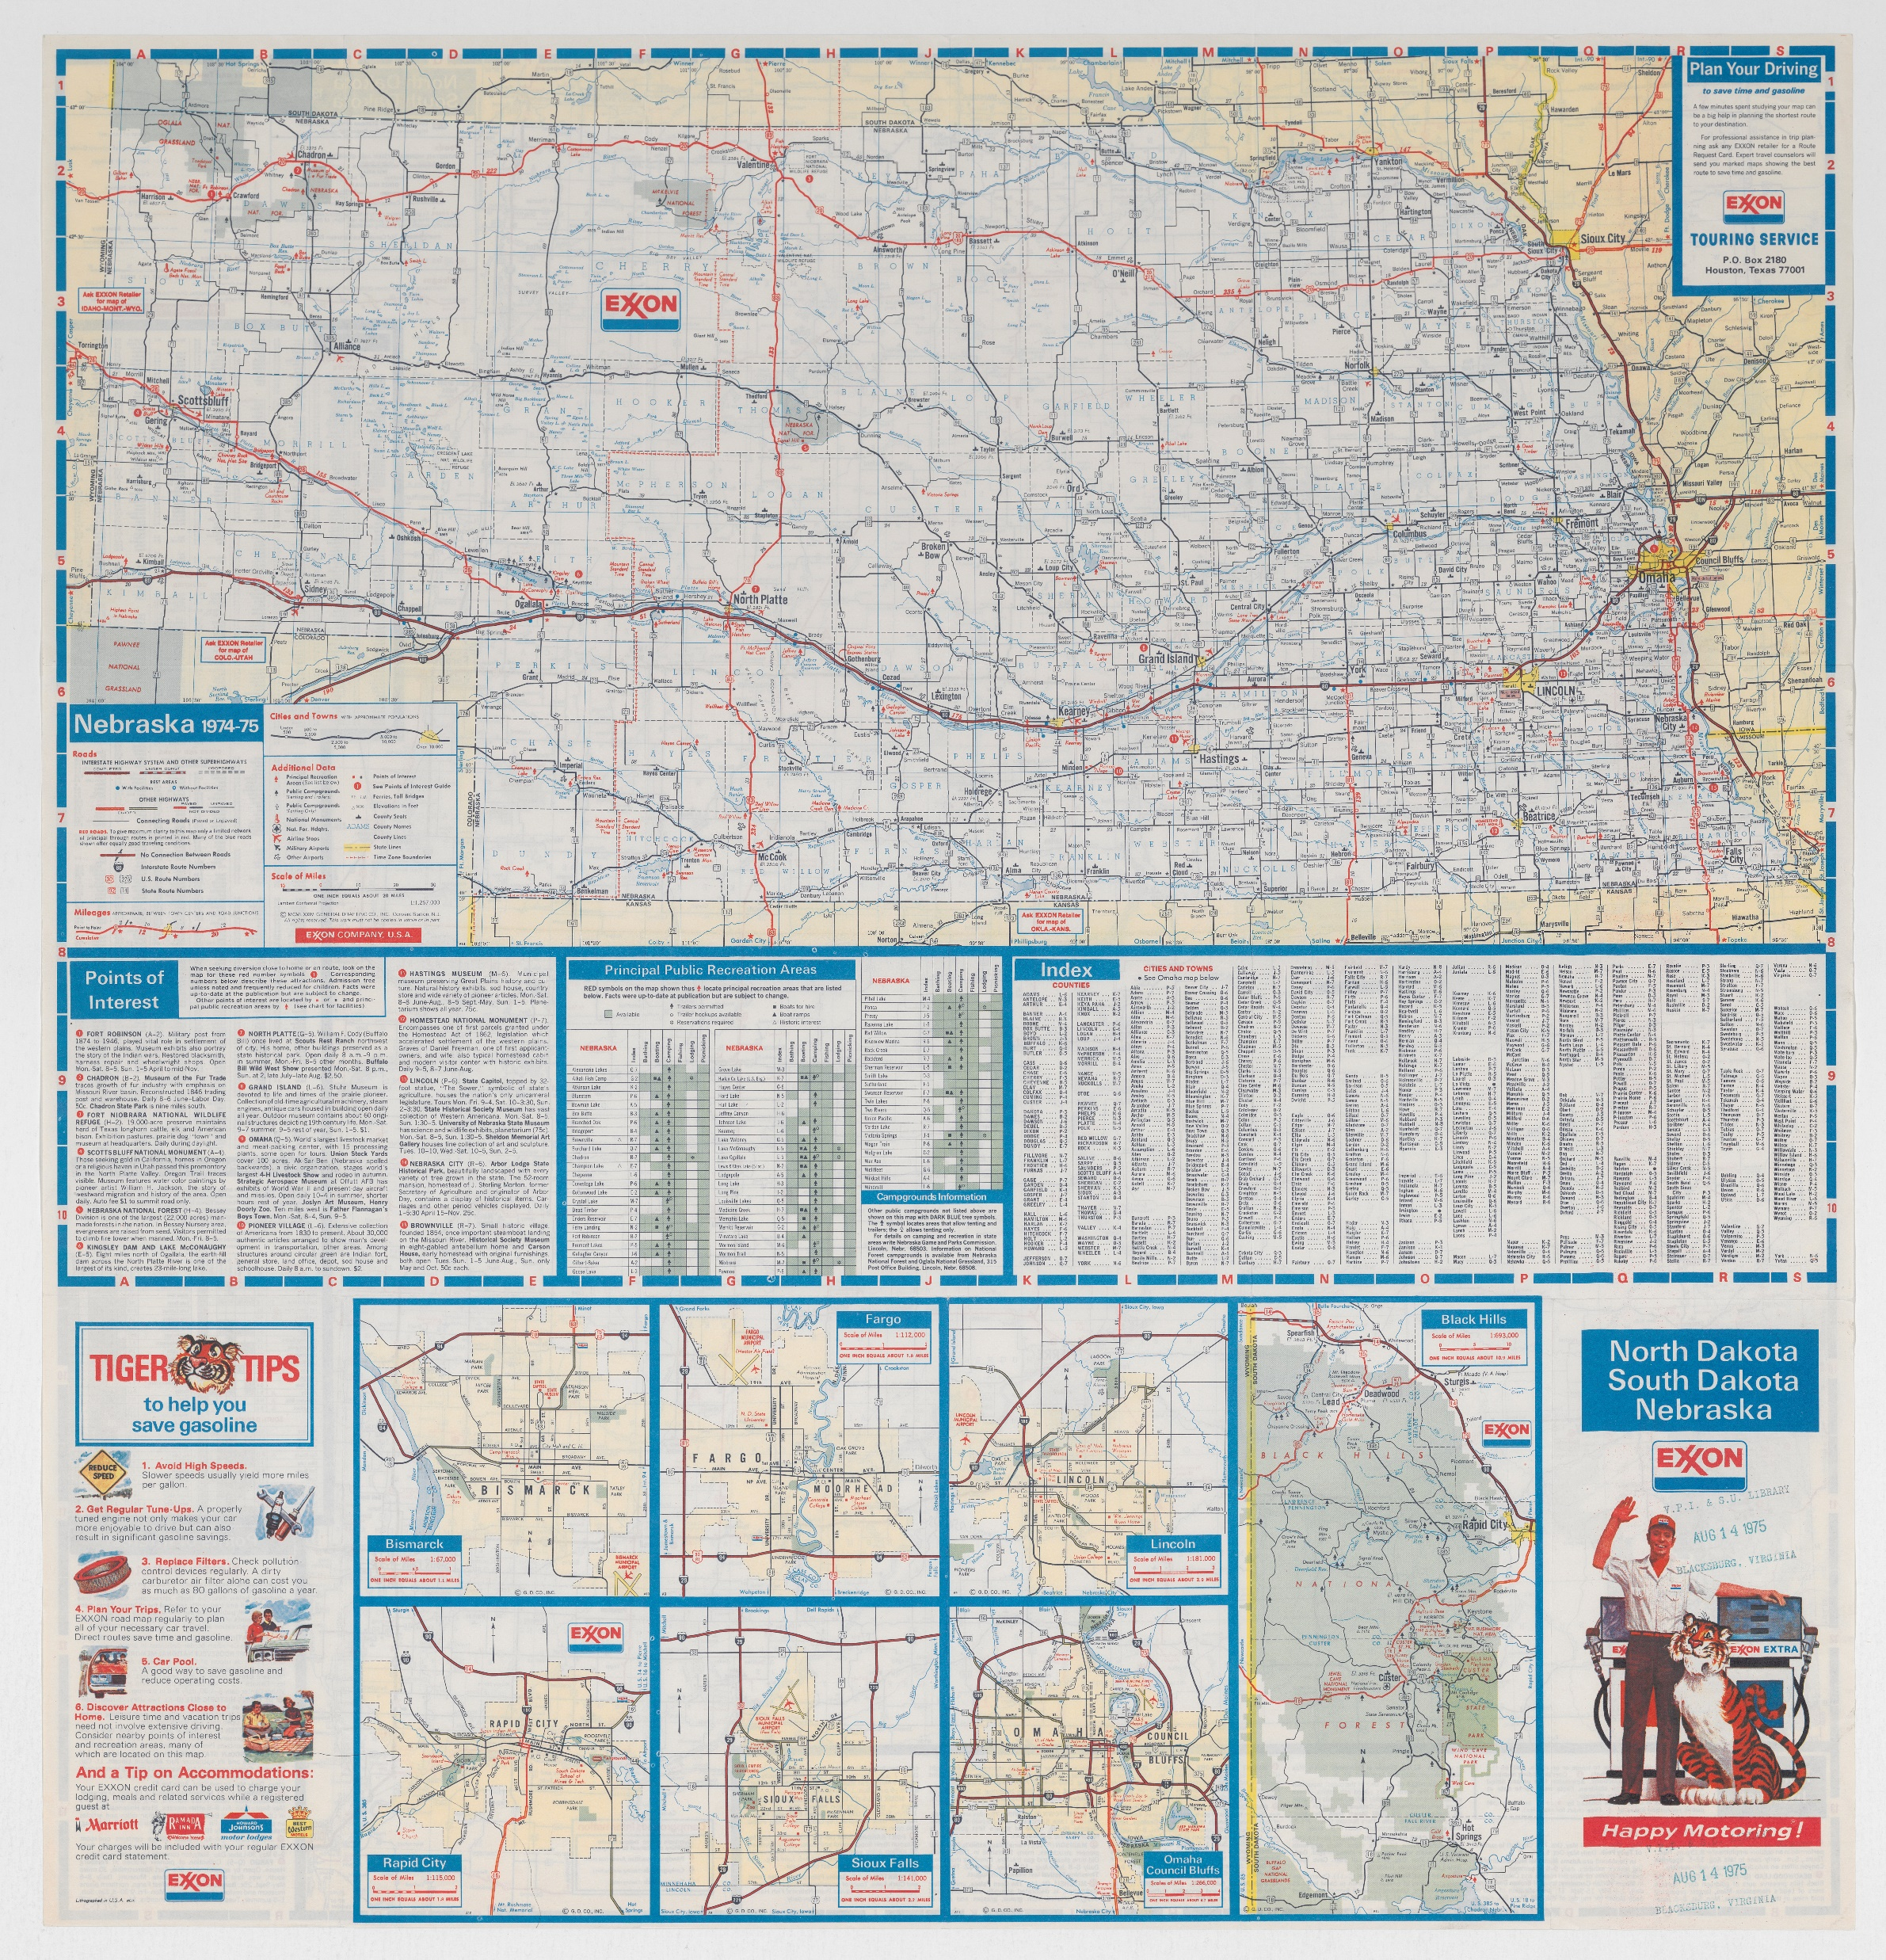
nmcst014110 – coded blue

Slide 24
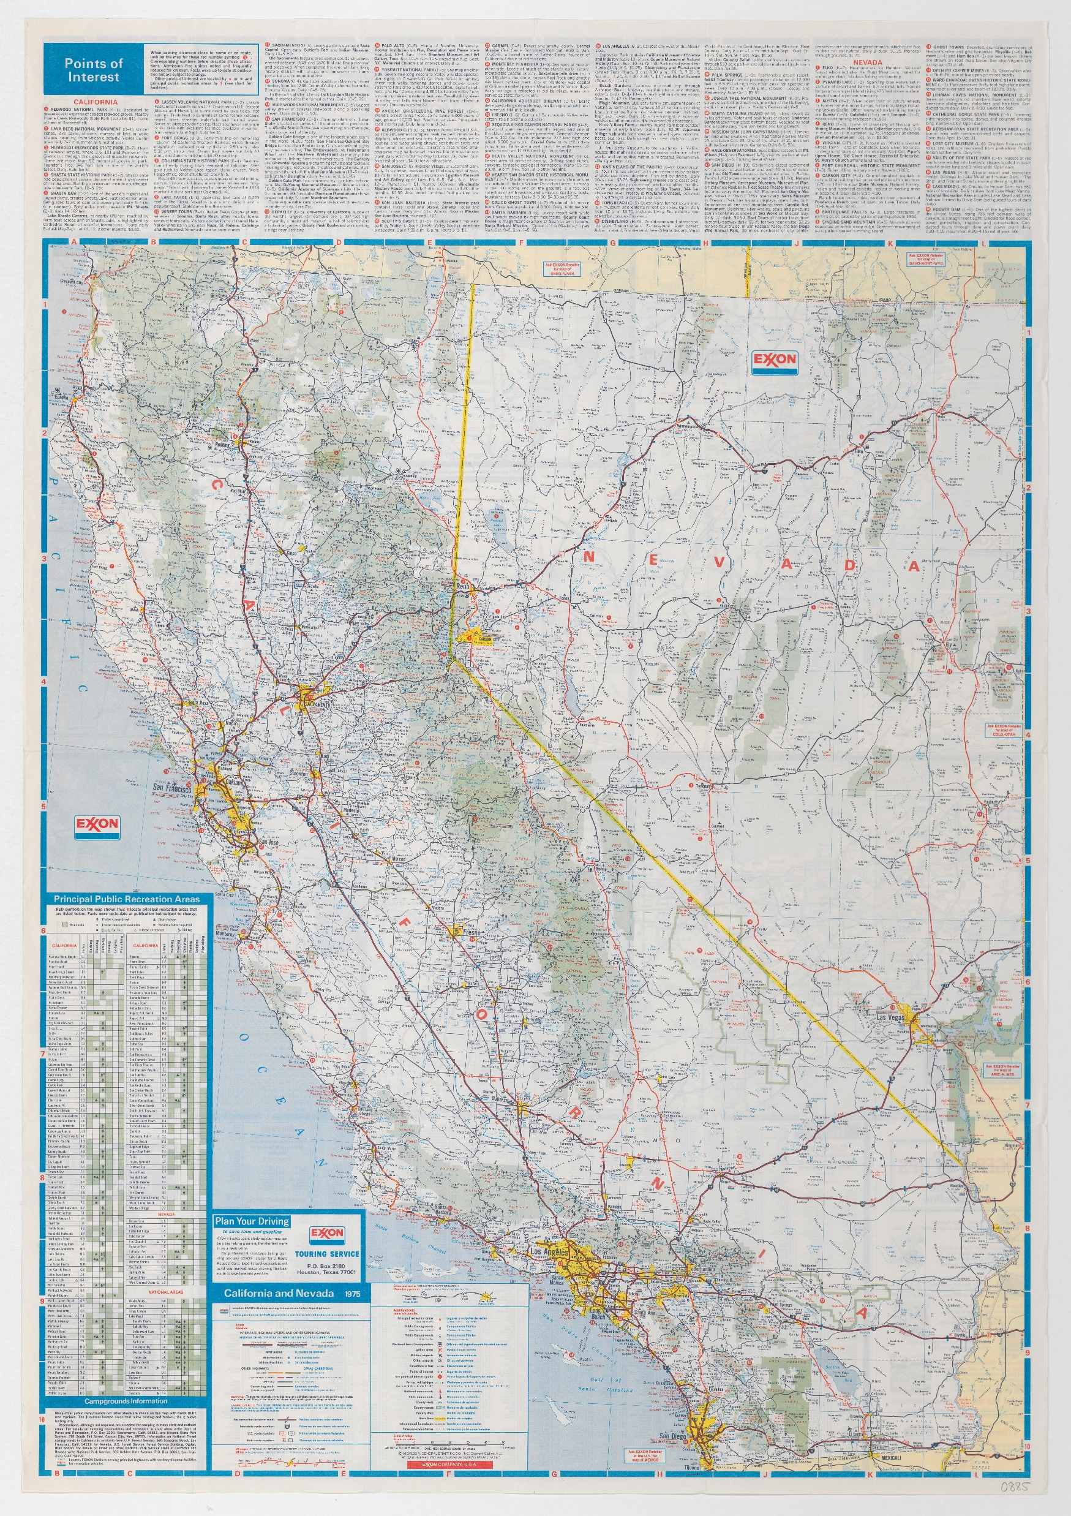
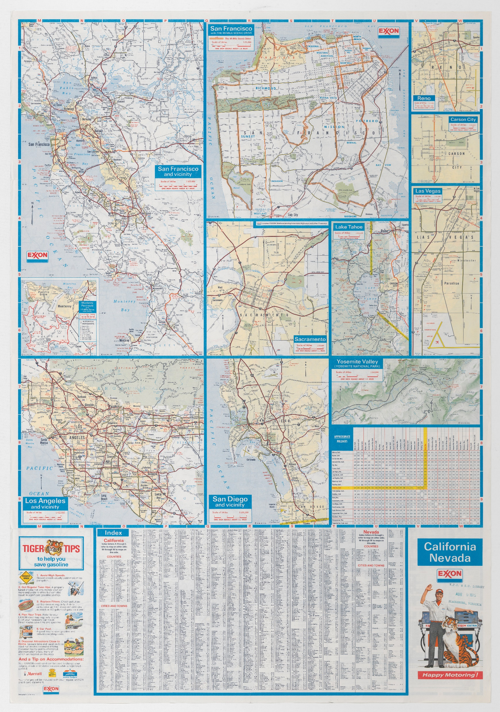
nmcst014027 – coded yellow

Slide 25
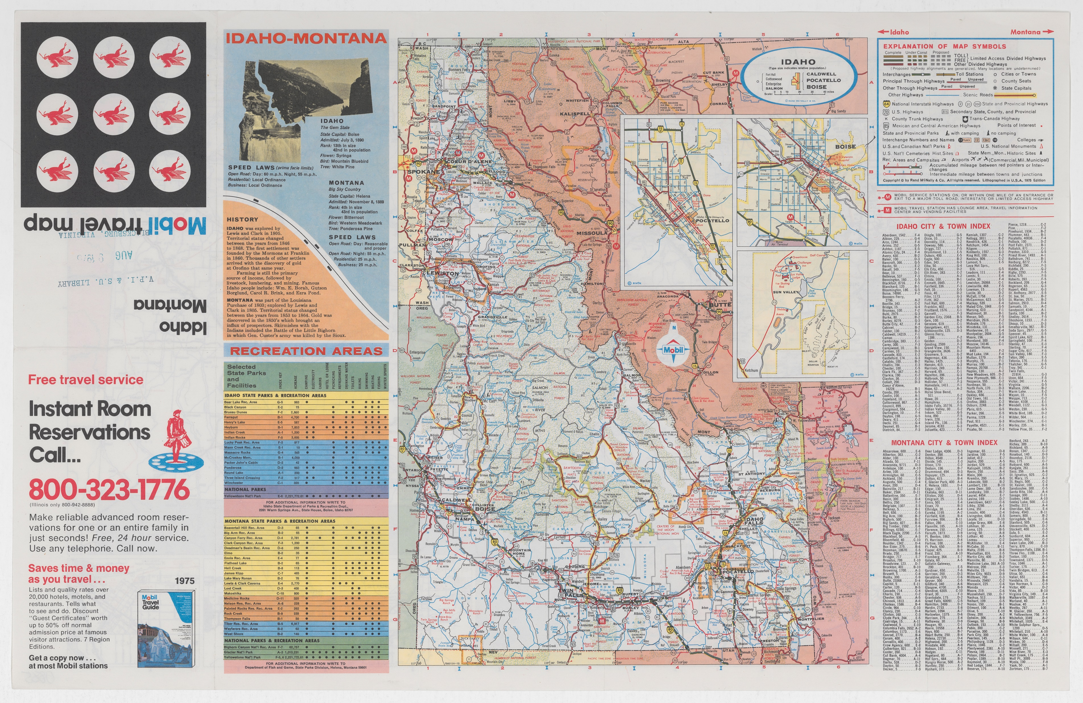
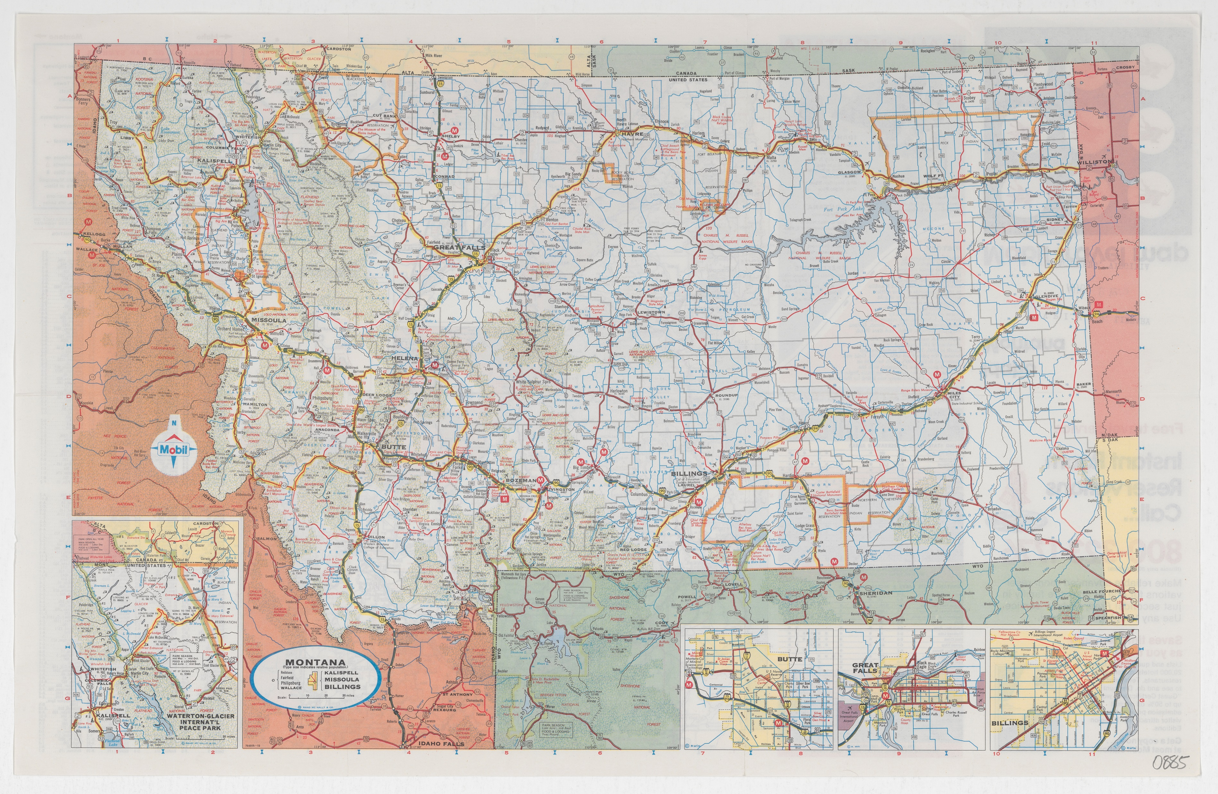
Challenge – Students grew up in a world of GPS
Students might be unfamiliar with fundamentals of physical maps. This was flagged as “two unrelated maps” on opposite sides of the page
Mobil Travel Map of Idaho and Montana – nmcst014063001 and nmcst014063002

Slide 26
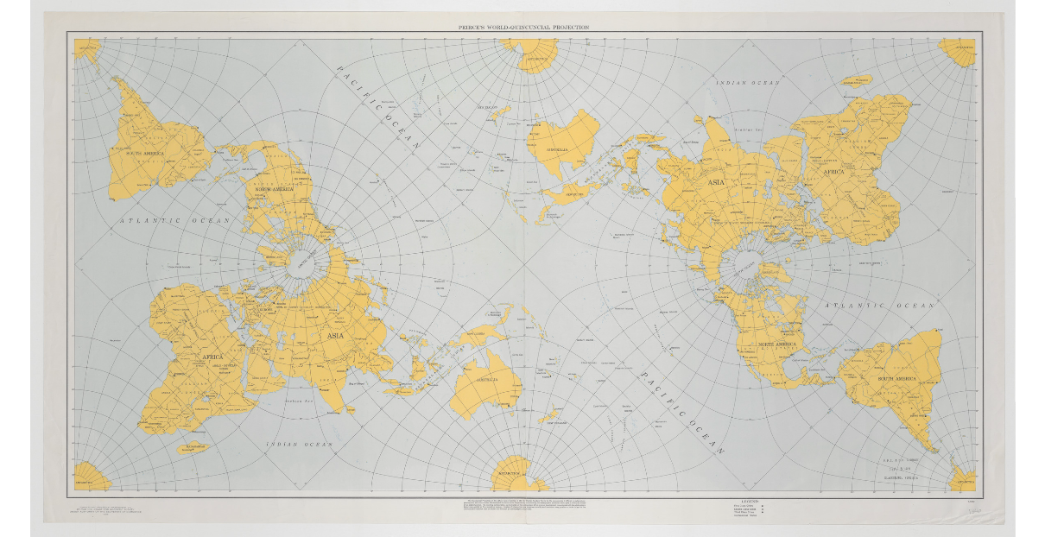
Challenge – working in batches
Because the inventory and scanning happened simultaneously, we didn’t know how many maps there were and had a hard time gauging how close we were to the end
Material arrived in the lab at inconsistent intervals – sometimes we’d go a few weeks without a new drawer and then we’d get five drawers at once
1945 Peirces World – Quincuncial Projection – nmcst019042001

Slide 27
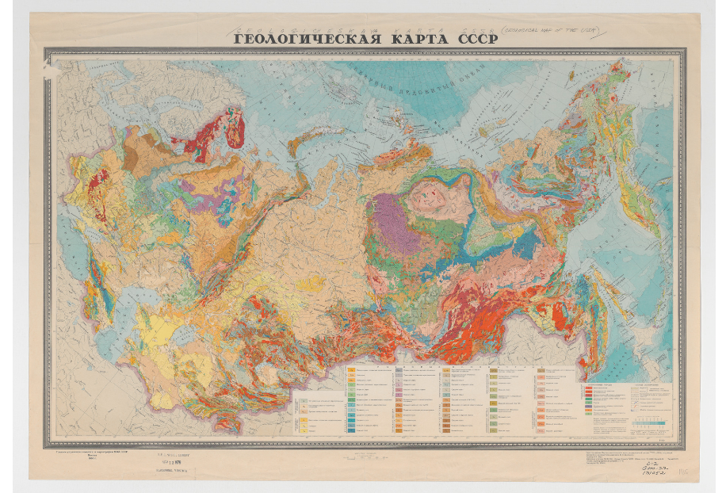
Challenges – Foreign alphabets
Makes it difficult to find the information for the inventory when the map isn’t in English
Non-standard characters present challenges throughout the process
1960 Geological Map of the USSR (1:10,000,000) – nmcst021169

Slide 28
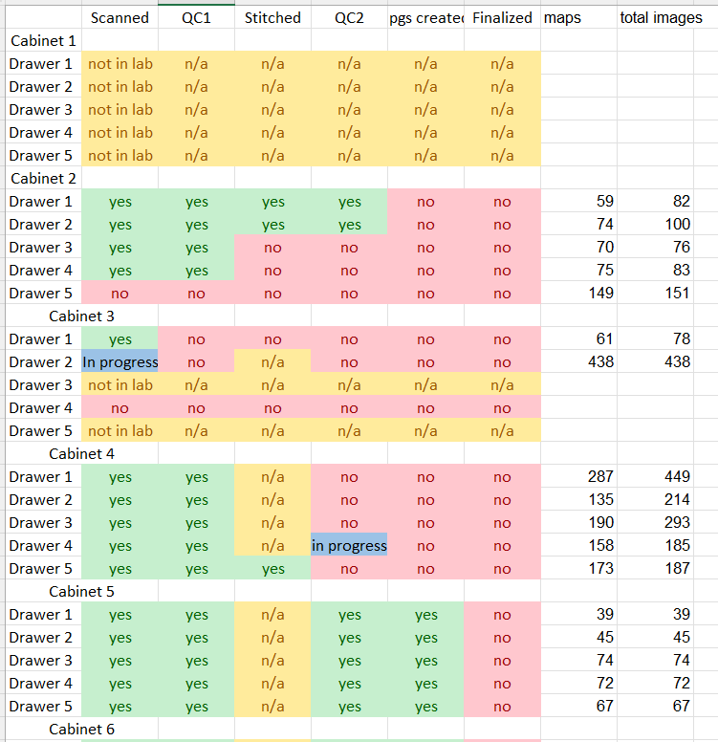
Challenges – General Project Management
10,000+ maps is a lot of maps to keep track of and wrapping your mind around where each piece is in the process is difficult
As we got close to the end of the project, I created a separate drawer-level tracking spreadsheet to make it easier to see the project as a whole
But that meant updating in multiple places as each step moved forward

Slide 29
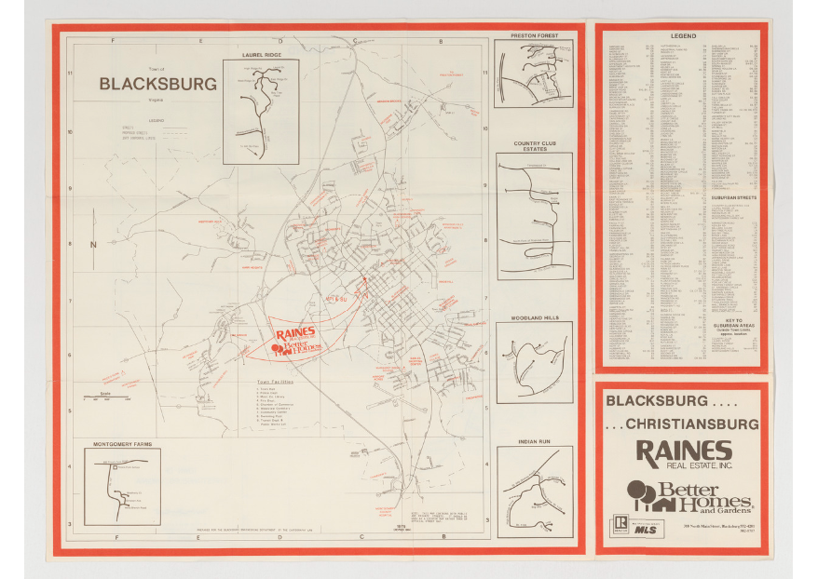
Takeaways
Break large and overwhelming projects into manageable pieces
8,000 maps is a lot to grapple with but 23 map cases and 5 drawers per map case is doable
When we talked with the inventory team we’d talk in terms of drawers
The developers also uploaded the maps to the DLP in batches
1978 Town of Blacksburg – nmcst002249001

Slide 30
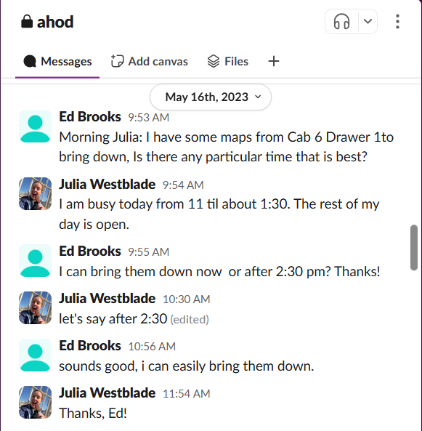
Takeaways
Communication is crucial
  We had a dedicated slack channel for the DIL and the Geospacial Data team
Committees met often to talk about how things were going and to work through concerns and bottlenecks
When we had questions about specific maps we could reach out quickly

Slide 31
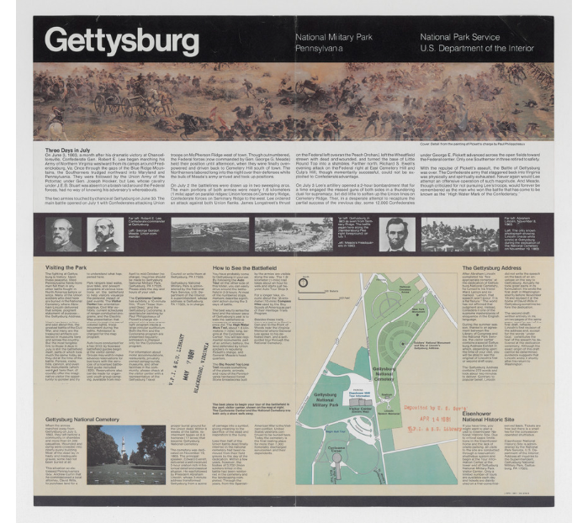
Takeaways
Documentation!! It helps everyone
Does not need to be anything fancy. We primarily used Google Sheets and Excel.
Early on I tried using a Trello board to track the status of each drawer and it worked but no one else used it and I ended up phasing it out
DCIT creates a postmortem for each project to that collects all the thoughts from the stakeholders
1981 Gettysburg National Military Park Map – nmcst018151001

Slide 32
I can’t take all the credit!
Jennifer Goyne, Lee Hunter, Wen Nie Ng, Astha Dhakal and the DLP Team
Asha Chiraghdin, Ed Brooks, Jon Petters, Mike Adamo, Shane Coleman
So many students
Y. Ashjazadeh
M.M. Billah
S.A. Chintalapudi
A. Courtney
J. Downs
R. Godfrey
S. Hultgren
F. Khojasteh far
C. McKeller
D. Myakala
A. Prieto
M. Scarborough
C. Owens
L. Heppard
R. Nash
E. Heilbronner
Z. Behl
B. McCormack
S. Furry
C. Terlizzi
A. Stack
V. Burvis
C. Tutt
B. Ivanytsia
M. Oickle
L. Sherman

Slide 33
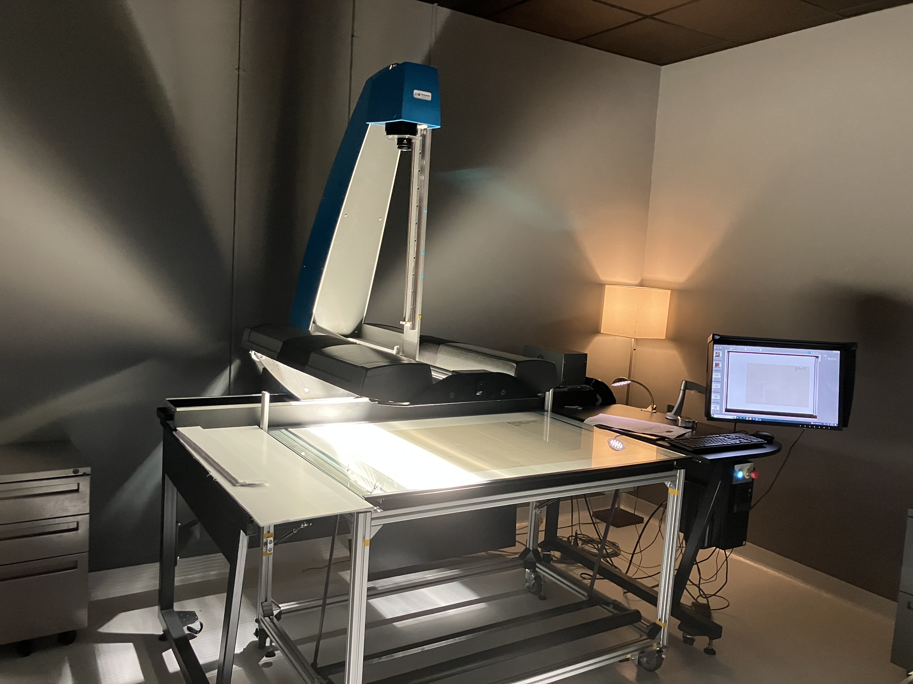
Questions?
Contact Me!
juliags@vt.edu

Slide 34
THANK YOU

