Slide 1
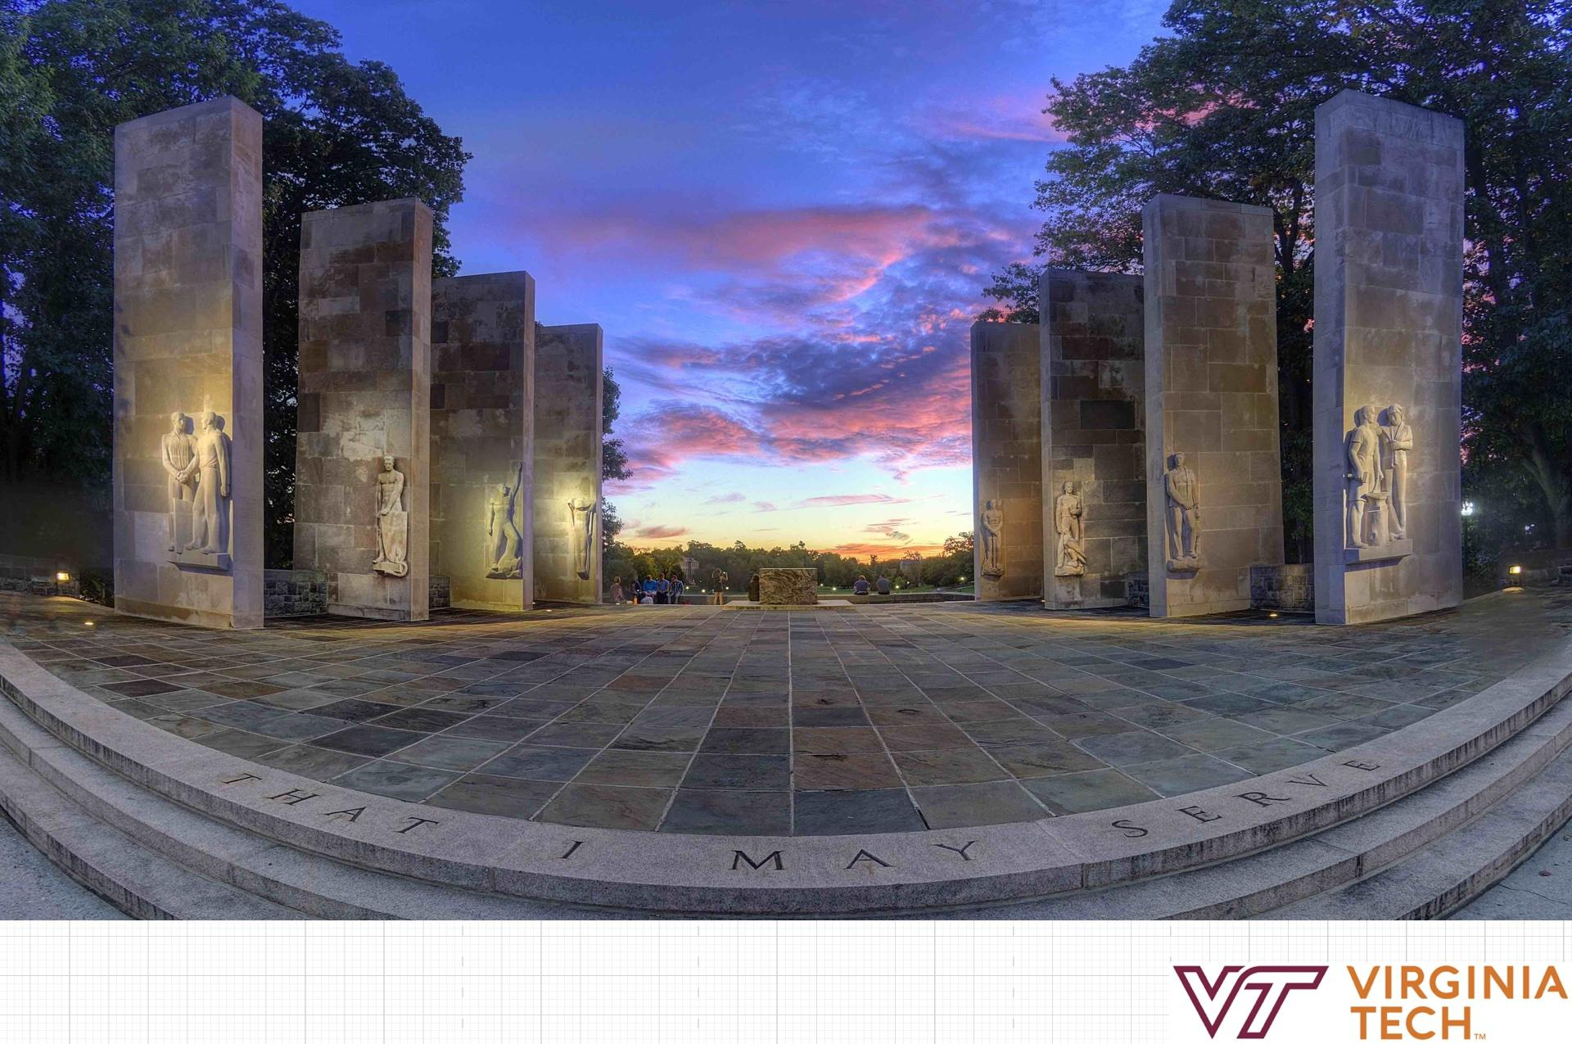
US State Tourism
By Ashutosh Bhattarai, Shane Grishaw, Abhinav Verelly, David Gruhn
CS 4624 - Multimedia, Hypertext, and Information Access
Dr. Edward A. Fox
Virginia Tech, Blacksburg VA 24061
4/29/21

Slide 2
Outline
Introduction
ER Diagram
Data Extraction
Data Visualization
Lessons Learned
Future Work
Acknowledgements
References

Slide 3
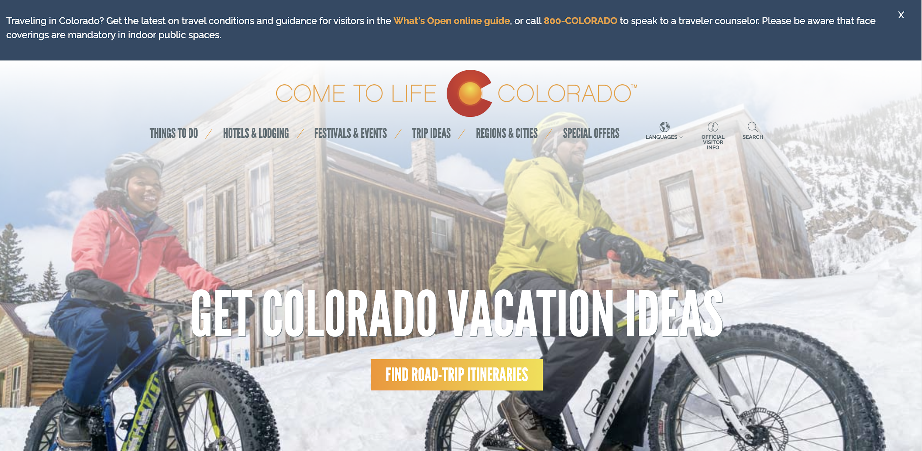
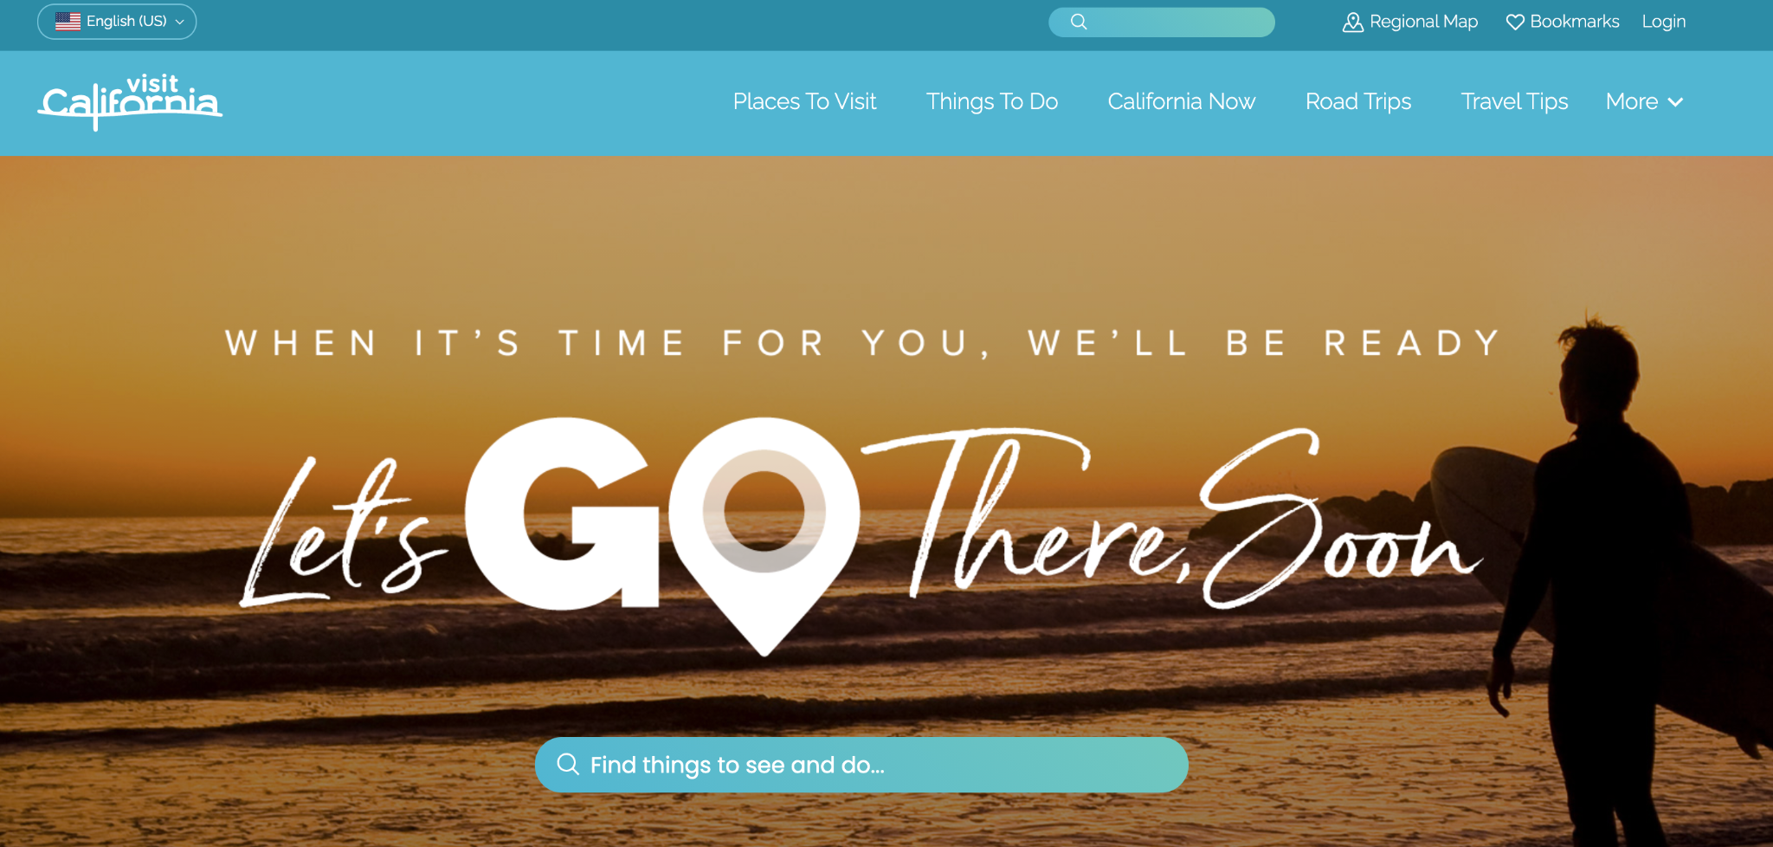
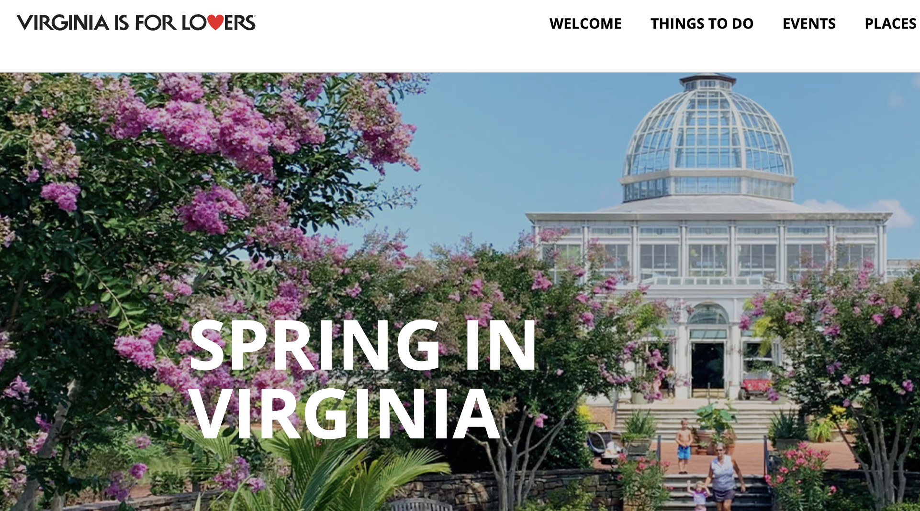
Introduction
Destination Management Organization
  Funds future tourist attractions
  Provides understanding of tourist habits

Slide 4


Project Goals
Parse through snapshots of the states of California, Colorado and Virginia that are stored by the Internet Archives
Perform data extraction on desired data
Visualize the data in an easy to read format

Slide 5
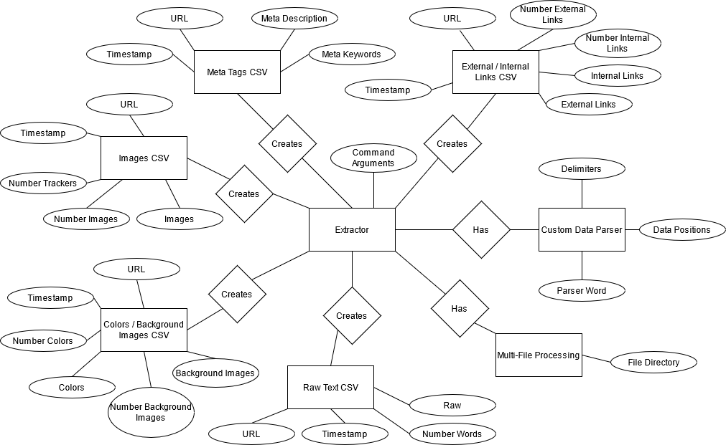
ER Diagram

Slide 6
Data Extraction
Extraction Processes Completed:
External and Internal Links
Meta Tags
Images and Trackers
Colors and Background Images
Raw Text and Word Count
Log File
Configuration Arguments Created
Multi-CSV Parsing
Multi-File Processing
Custom Data Parser

Slide 7
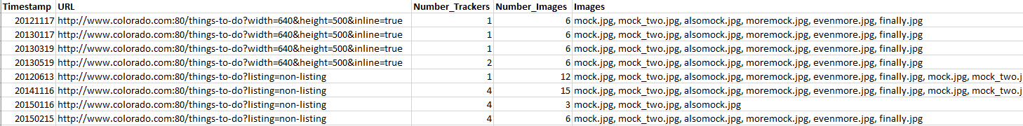
Data Extraction - Images
Note: Most CSVs will have a counter before lists to allow for easier parsing of the list

Slide 8
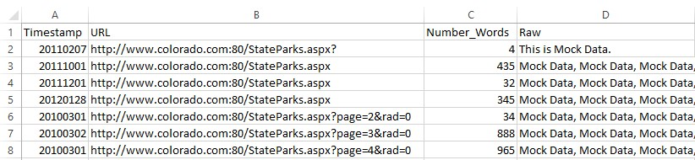
Data Extraction - Raw Text

Slide 9
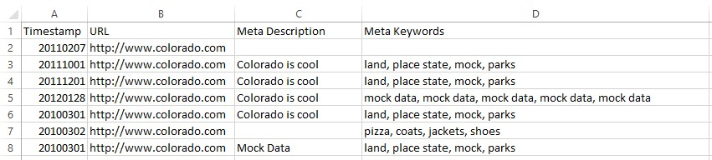
Data Extraction - Meta Tags

Slide 10
Data Extraction - External/Internal Links

Slide 11
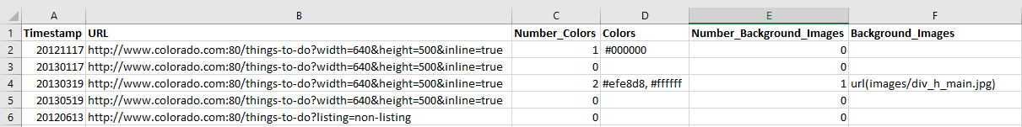
Data Extraction - Colors
Note: Colors in the list can appear as plain text too i.e. white, black, blue

Slide 12
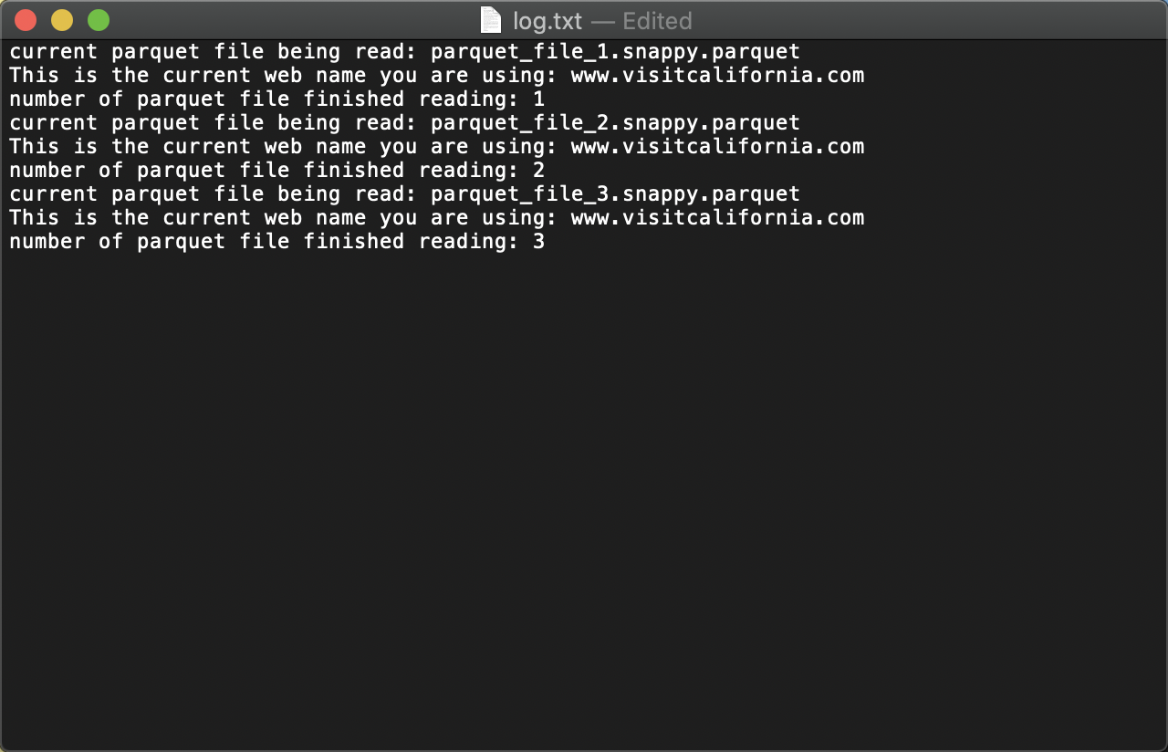
Data Extraction - Log File

Slide 13

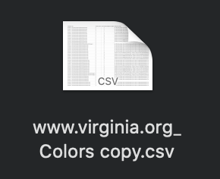

Data Visualization: Extraction for data
Create stacked bar charts for each of the three states.
Using Matplotlib, get colors in the Hex-Color format.
Create a nested dictionary
Format of dictionary, {year : {#color : freq} }
Notes:
Went through all the color CSV files from data extraction to create Stacked bar charts for each of the three states.
Using Matplotlib, we were able to get colors in the Hex-Color format.
Created a nested dictionary to hold the data needed for the visualization of the data, as well as, create a JSON object from the dictionary.
Dictionary holds, year of the corresponding websites, the colors present for that year, and the frequency of the colors within that year.

Slide 14
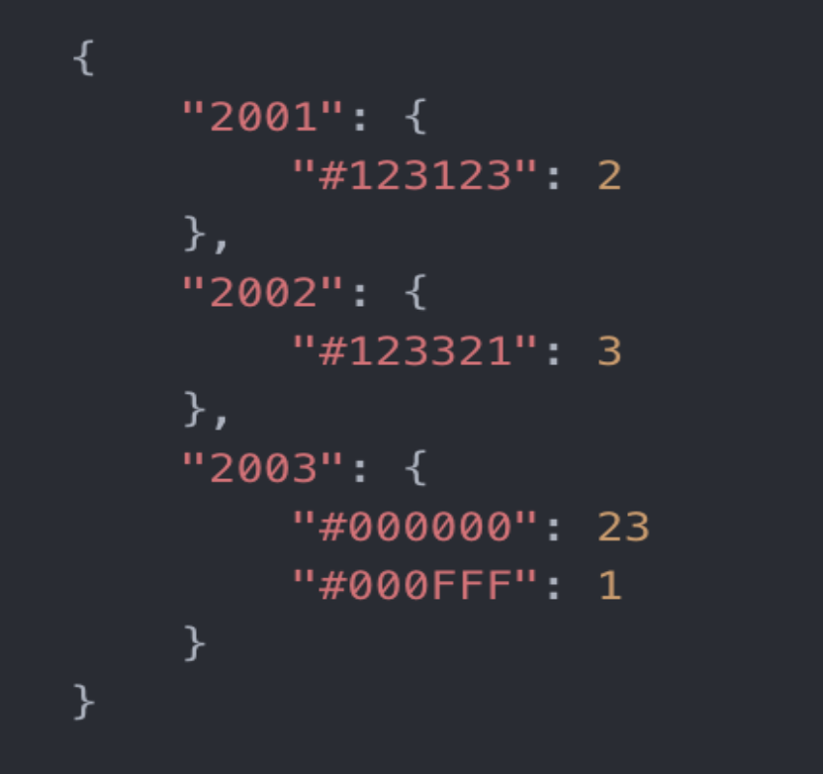
Data Visualization: JSON File

Slide 15
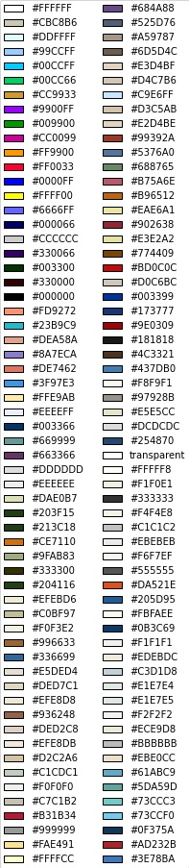
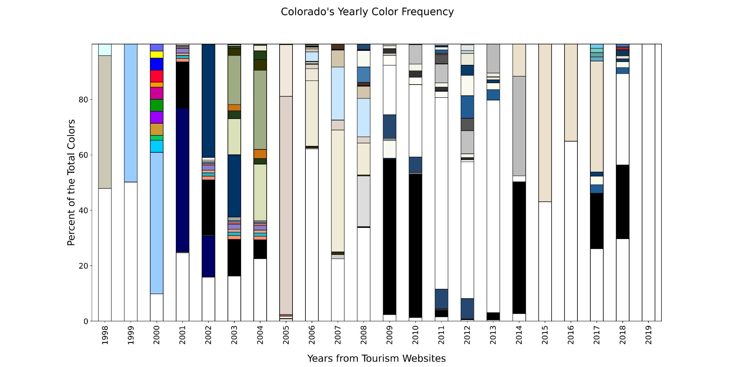
Data Visualization: Stacked Bar Chart

Slide 16
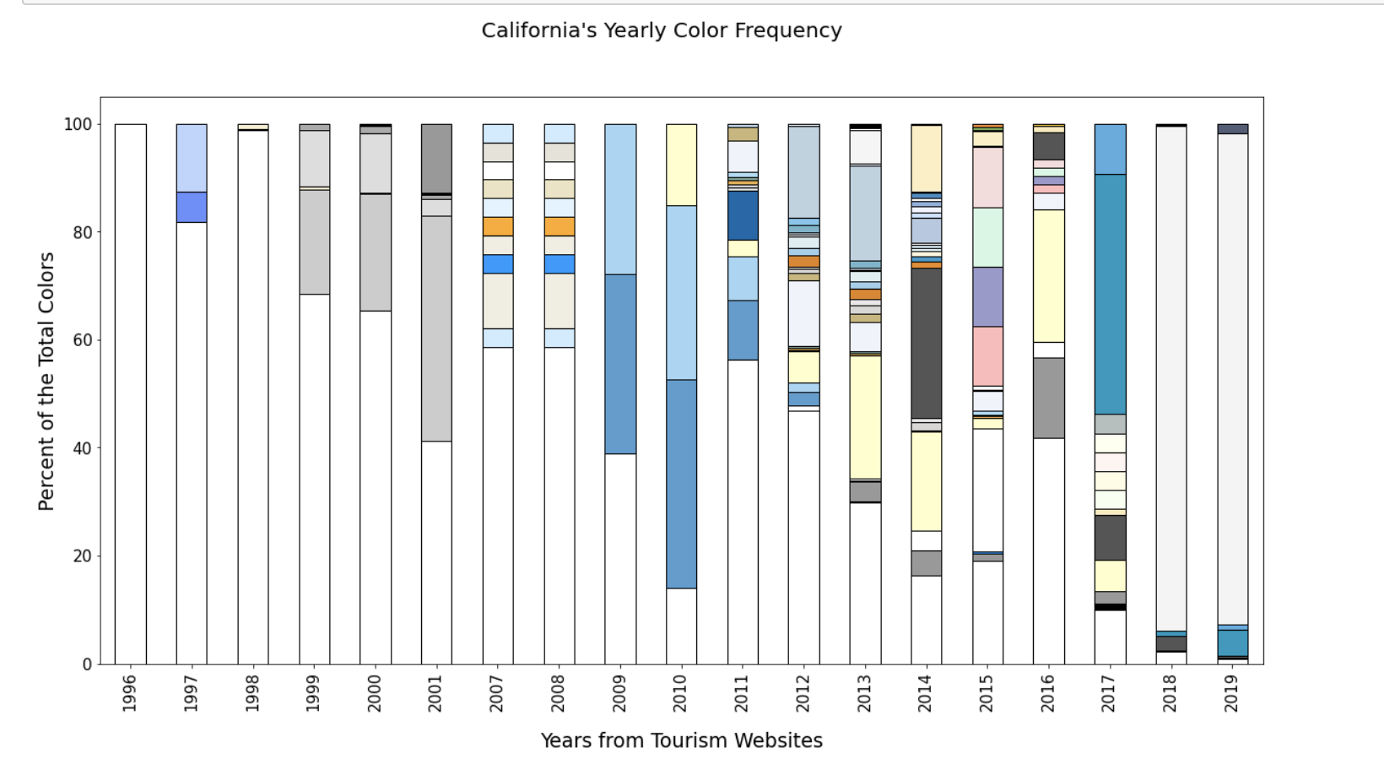
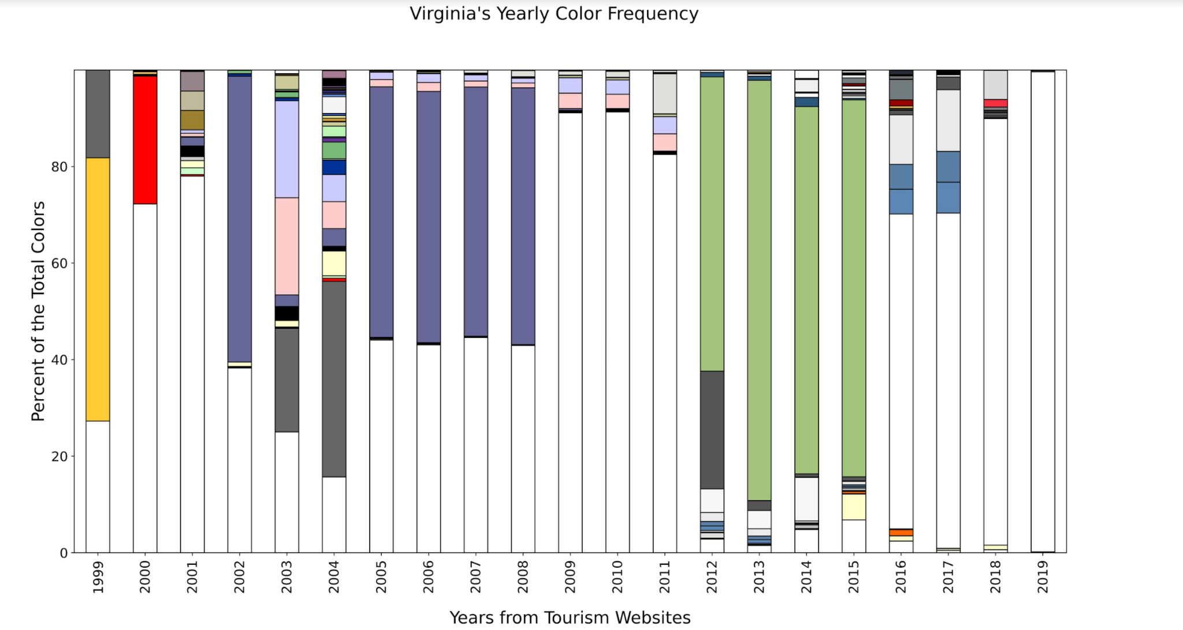
Data Visualization for Virginia and California

Slide 17

Lessons Learned
Full Online Collaboration
Python
Jupyter Notebook for Data Analysis
Understanding Parquet Files
BeautifulSoup Parsing

Slide 18

Future Work
Refactor code for performance
Refactor code to be more abstract and easier to navigate and understand
  Cleaning up comments / Redundant coding
Create more error checking
Process frequency count file extensions from Image CSV
Process top keywords from Raw Text CSV

Slide 19
Acknowledgements
Florian Zach, PhD, <florian@vt.edu>, Assistant Professor, Howard Feiertag Department of Hospitality and Tourism Management, Pamplin College of Business, Virginia Tech, Wallace Hall 362, Blacksburg VA 24061 USA
Edward Fox, PhD, <fox@vt.edu>, CS4624 Professor, Department of Computer Science, College of Engineering, 2160G Torgersen Hall, Blacksburg VA 24061 USA
US State Tourism Spring 2020 Team, http://hdl.handle.net/10919/98257
US State Tourism Spring 2019 Team, http://hdl.handle.net/10919/92622
NSF IIS-1619028, Global Event and Trend Archive Research (GETAR)
NSF CMMI-1638207, Coordinated, Behaviorally-Aware Recovery for Transportation and Power Disruptions (CBAR-tpd)

Slide 20
References
Doan, Viet, et al. “Tourism Destination Websites.” VTechWorks, Virginia Tech, 8 May 2019, https://vtechworks.lib.vt.edu/handle/10919/92622
Shere, Danya, et al. “US State Tourism Websites.” VTechWorks, Virginia Tech, 11 May 2020, https://vtechworks.lib.vt.edu/handle/10919/98257

Slide 21
Questions?

