Slide 1
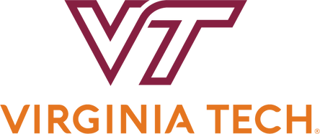
“OUT THERE,” ANYWHERE:
DIGITAL PROXIES FOR THREATENED CULTURAL HERITAGE SITES AND STRUCTURES
E. Deisa, S. Tucker, A. Kinnaman, T. Ogle

Slide 2

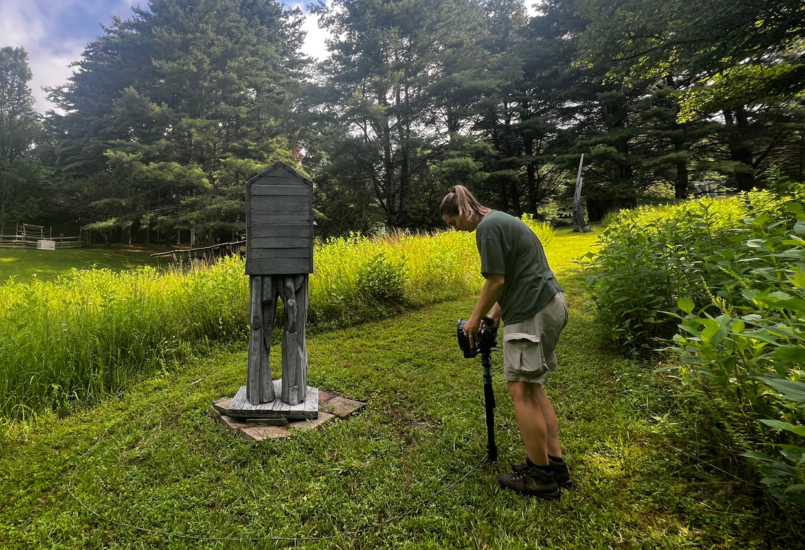
RISKS TO CULTURAL HERITAGE
Remote & hard to access
Decaying materials
Artist’s vision loss
Climate & environmental damage

Slide 3




CAPTURING THE TRAIL IN 3D
SCULPTURES
ENVIRONMENT
PRESERVATION
Photogrammetry
Gaussian Splats & Spatial Audio
Digital Library

Slide 4
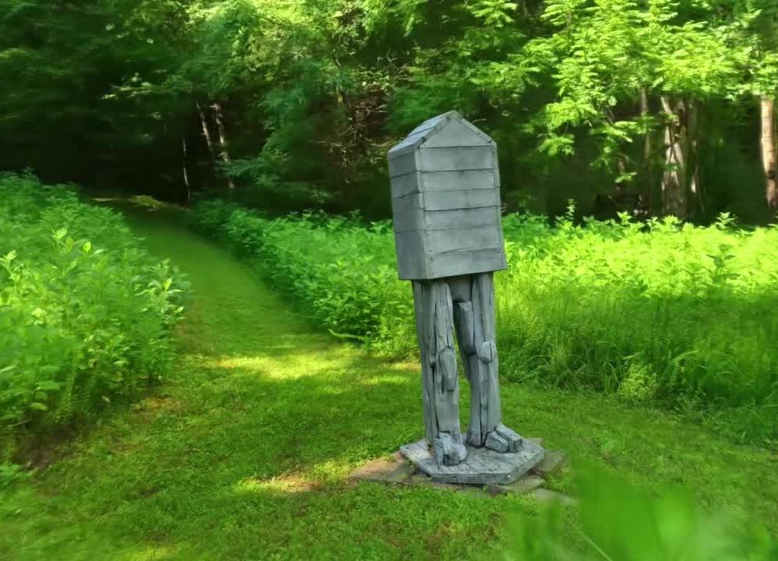
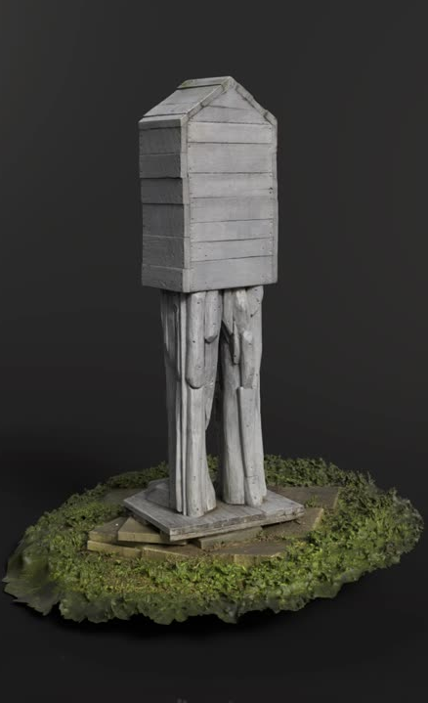

Slide 5
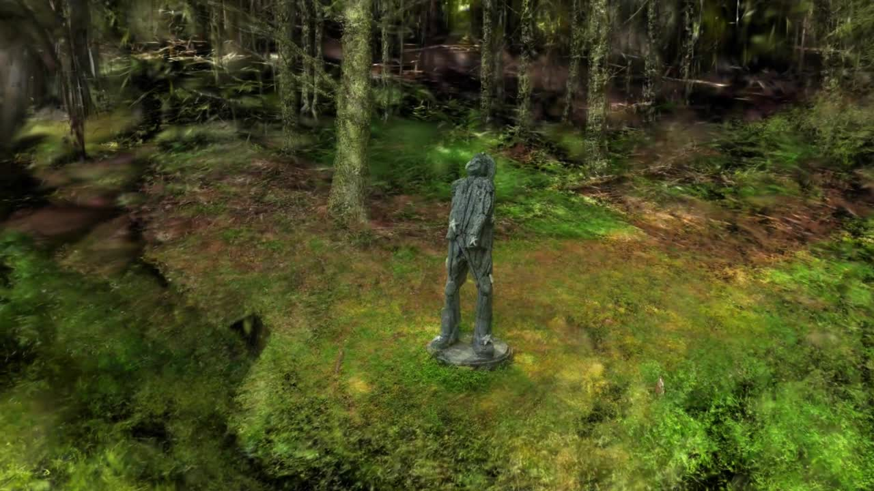
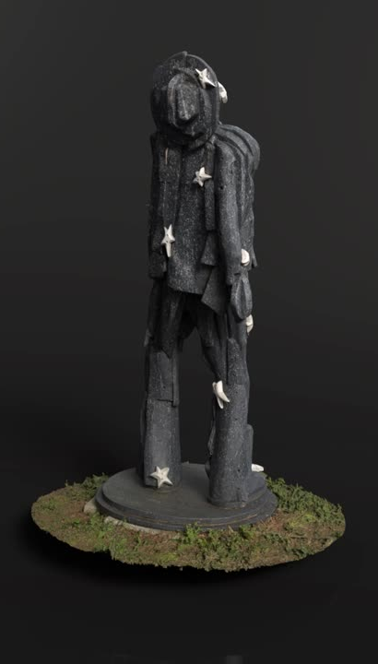

Slide 6
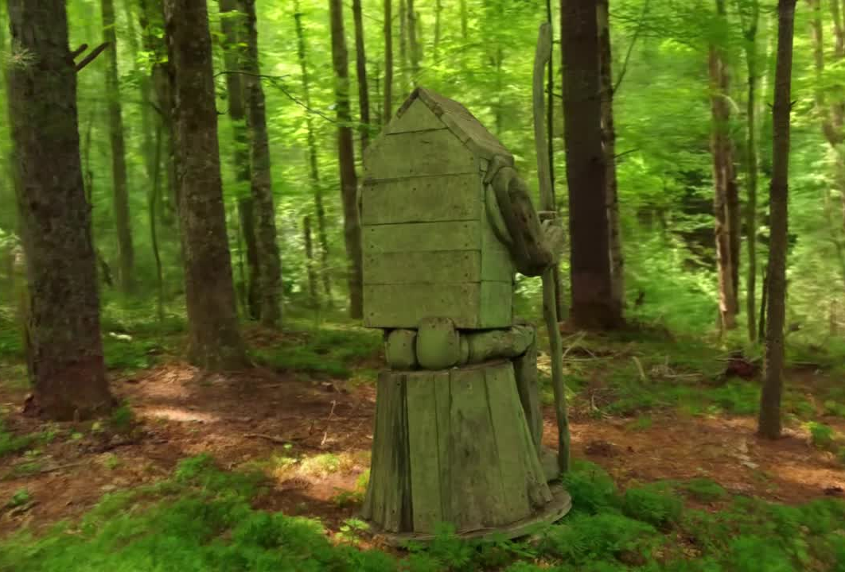
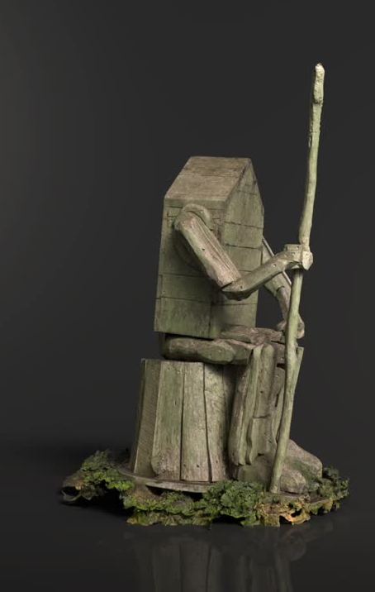

Slide 7

Accessibility & Impact

Slide 8



DIGITAL LIBRARY
PERSISTENCE
MAINTENANCE
STORAGE
Unique, persistent identifiers assigned
Preservation activities to prevent corruption, e.g. fixity
AWS storage for access and preservation
Notes:
Our preliminary preservability results based on the formats we've investigated landed us to these choices in what formats we will use for long-term preservation based on their sturdiness - X3D is an ISO standard, PLY and OBJ and widely adopted in this field, PNG and JSON are used widely in many fields - and for access based on their size and low-latency rendering - glTF and lower-vertice PLY are much lighter, and MP4 is also widely used.

Slide 9
DIGITAL PRESERVATION
GOAL: Packages that are openable in the near future as-is and reconstructable in the next 5-7+ years
Challenges
New technology = new formats
No best (or good) recommended practices
Large/complex packages
Documentation
Descriptive / archival
Technical / provenance
Preservation
READMEs
File Format Priorities
Open/non-proprietary
Uncompressed
Adopted
Supported
Interoperable
Size
Notes:
So we have these beautiful multi-modal models, what do we do with them? For complex packages like this, our strategy is future reconstruction rather than emulation. We want something that is openable as is in the next few years, and reconstructable in the next 5-7.
We look closely at file formats for this, specifically: is it open or proprietary, uncompressed, widely used and adopted, well-supported, and storage considerations.
This is easy with standard image formats. The challenges with all XR objects is that they are built with new technology and new formats that constantly evolve, meaning that they by nature, we lack best or good recommended practices. They're also large in size, taking up a valuable and expensive resource.

Slide 10
THANK YOU
Eva Deisa, edeisa@vt.edu
Sarah Tucker, sarahat2@vt.edu
Alex Kinnaman, alexk93@vt.edu
Todd Ogle, jogle@vt.edu

