Slide 1
Feeding America: Southwest Virginia
Website Conversion & Virtual Food Drive
Virginia Tech
Blacksburg, VA
Multimedia and Hypertext Capstone
Edward A. Fox
Bradley Bailey Sarah Dotson
Taehee Han Hunter Shepherd
Susan Feng Sean Kelley

Slide 2
Goals
To transition from Joomla to Drupal per client request
  To make a more dynamic and easily updated web site
  To create a virtual food drive
To make minor requested improvements to content of the original website

Slide 3
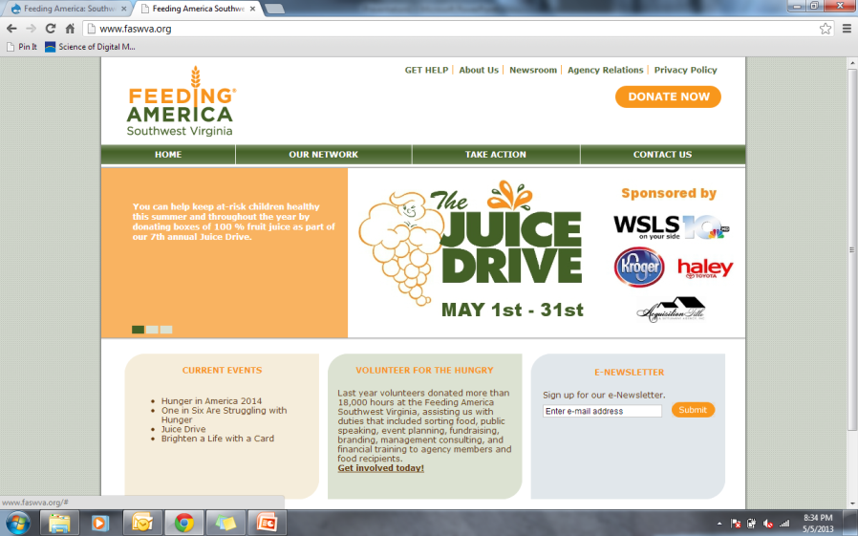
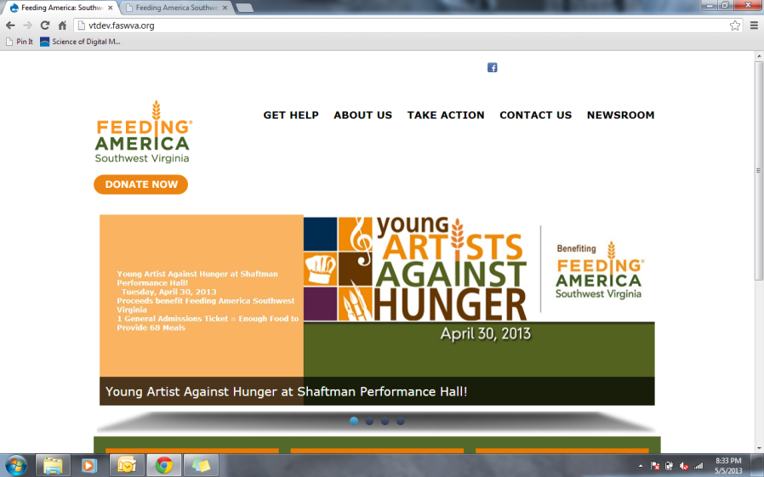
Home page
Joomla!
Drupal

Slide 4
Website
Converting Joomla! to Drupal

Slide 5

Before

Slide 6
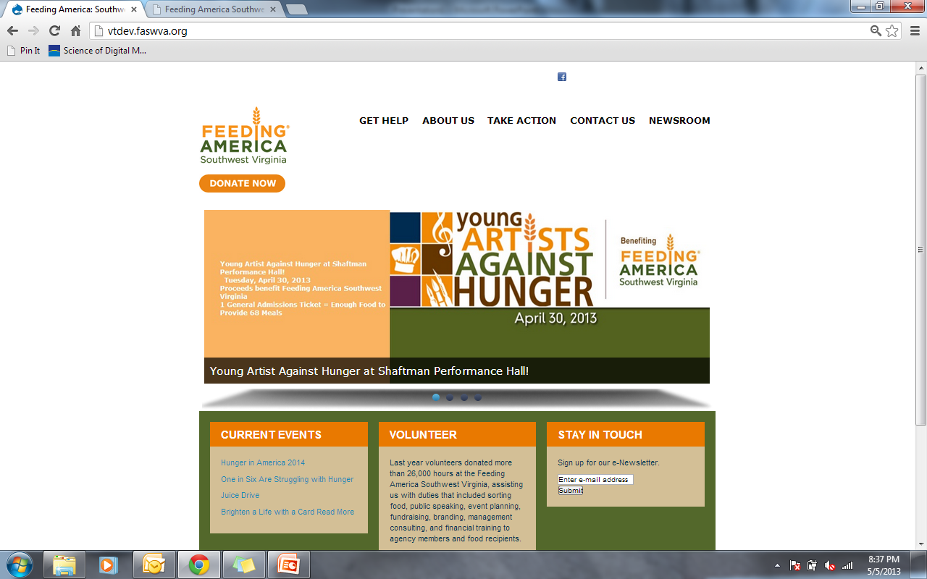
After

Slide 7
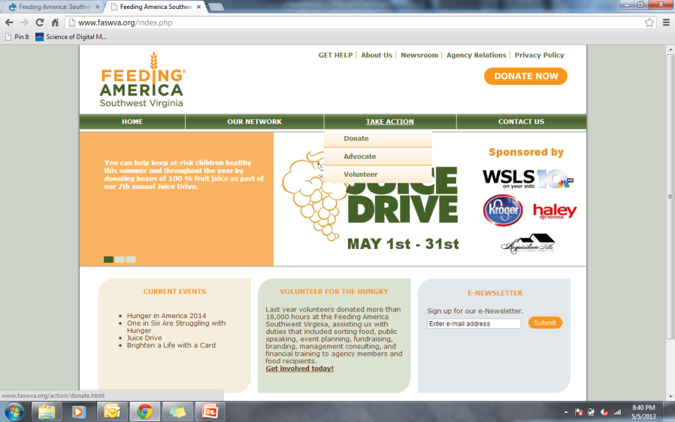
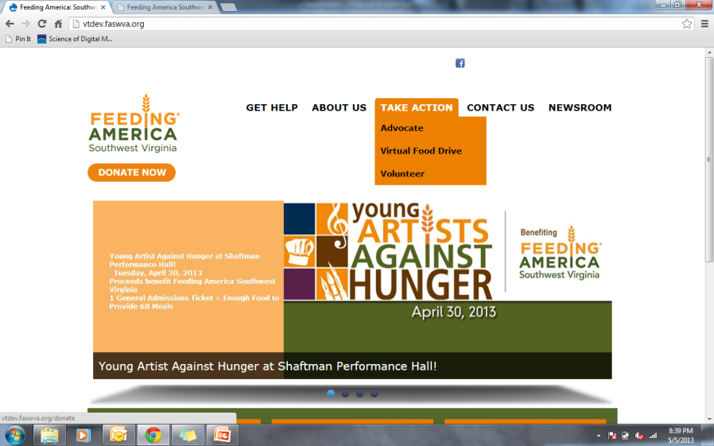
Menu
Joomla!
Drupal

Slide 8
Drupal Site

Slide 9
Editing Manual

Slide 10
Editing
Flaws with Joomla Site
New Site:
    To produce an easier way to update the website without changing structure
    To be able to make dynamic changes quickly
    More of a click and drag type of editing

Slide 11
Adding New Content
Description: Adding new Content to your site and placing it under the right directory.
Instructions for adding new content:
  On your browser go to the Drupal Site.
  Go to Content -> Add Content. Here you can select either an article or a basic page.
  Fill in your content in the appropriate spaces.

Slide 12
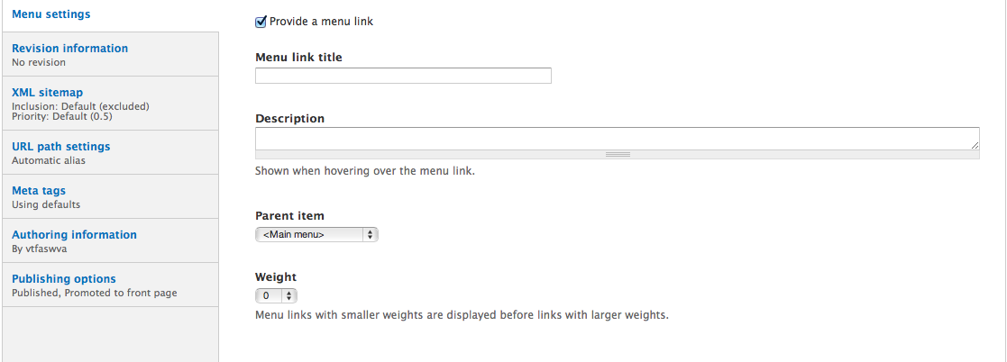
Adding New Content
  4. To specify under what menu option the content should belong, go to Menu Settings and enable the “Provide a menu link.”

Slide 13
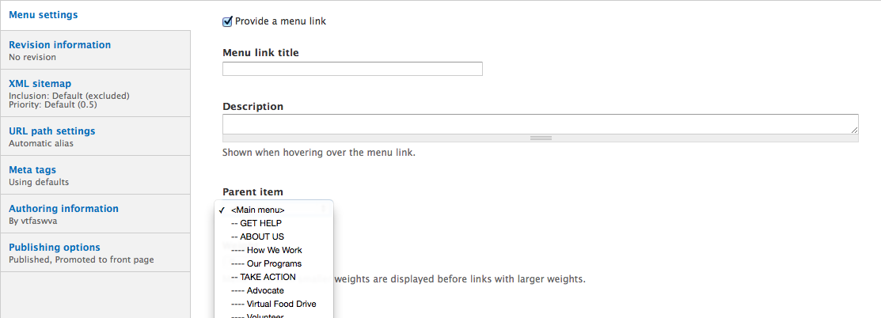
Adding New Content
5. Under Parent Item you should now be able to select which option you would like your new content to go under.

Slide 14
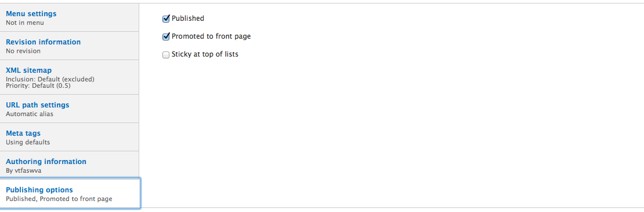
Adding New Content
6. Under Publishing options unclick “Promoted to front page.” Save your content.

Slide 15
Virtual Food Drive

Slide 16
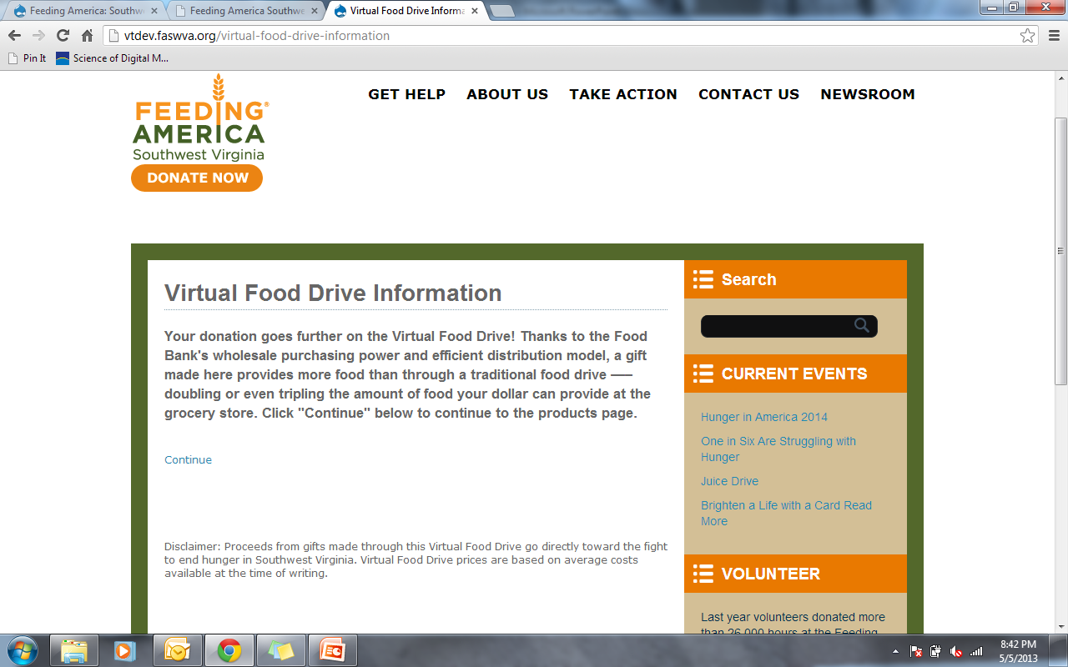
Virtual Food Drive

Slide 17
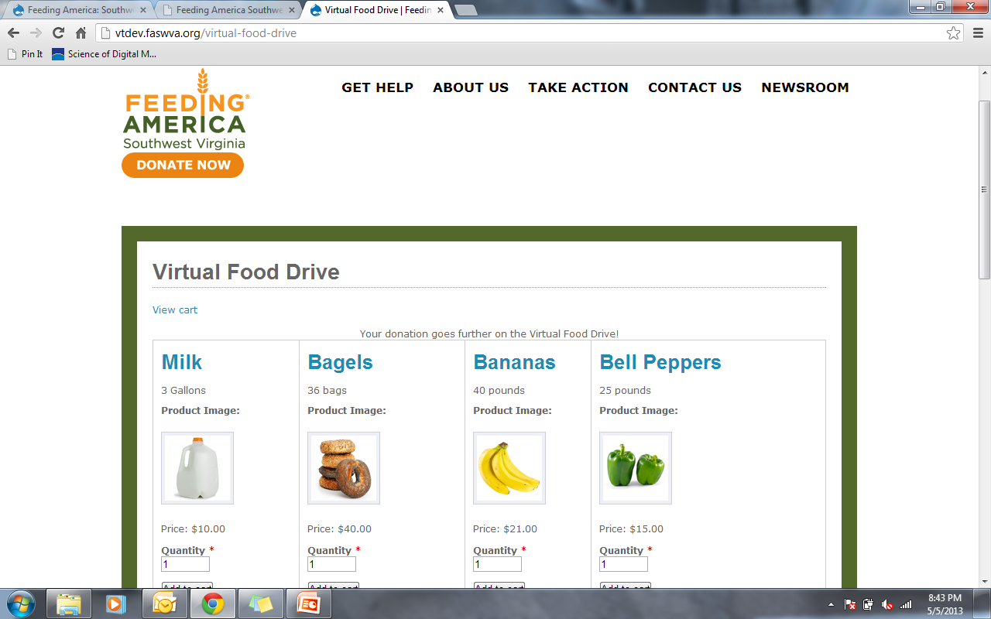

Slide 18
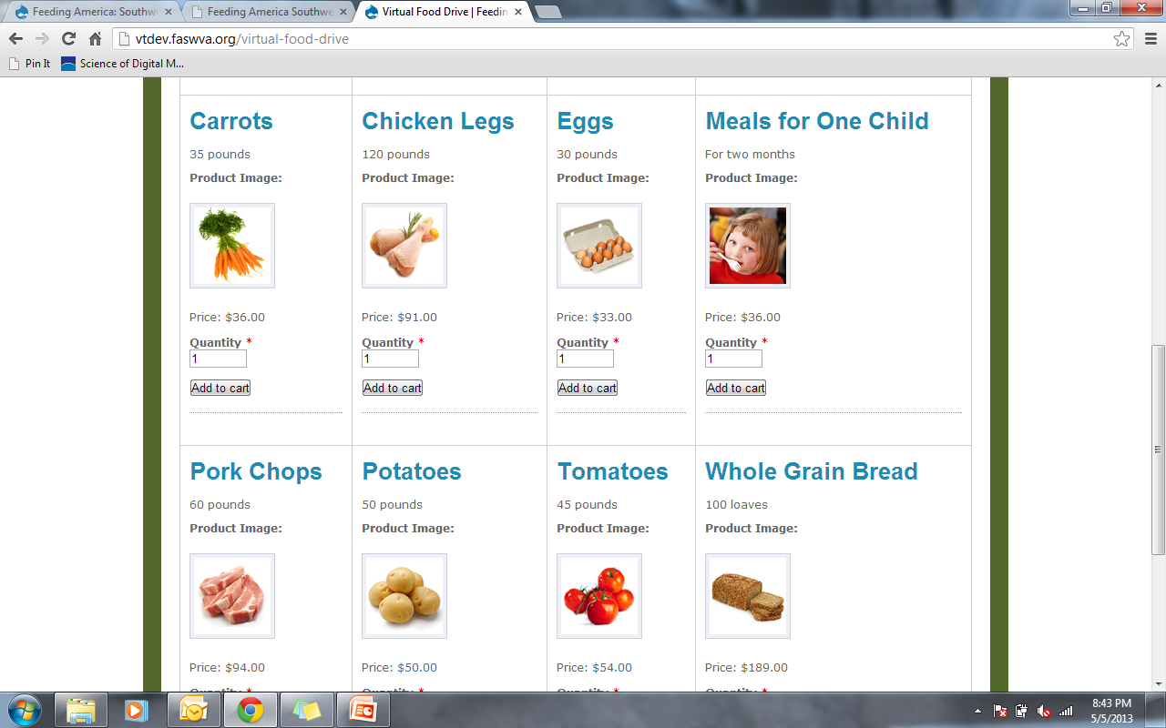

Slide 19
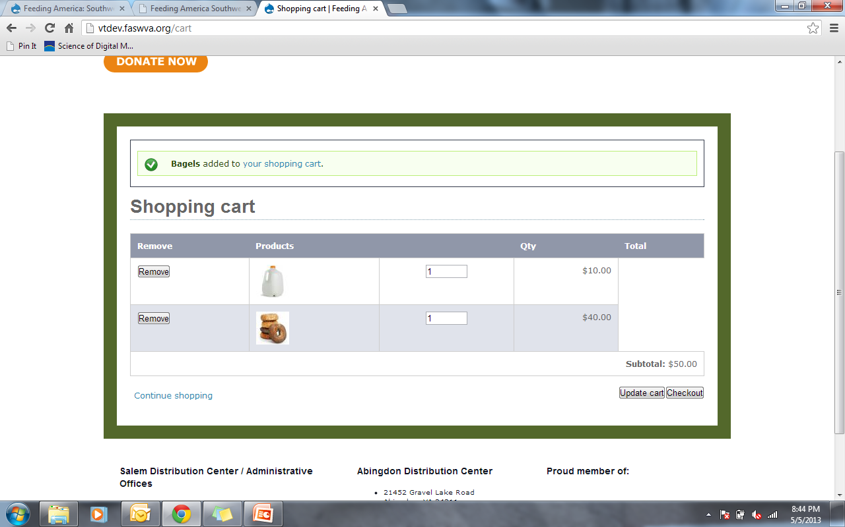
Cart

Slide 20
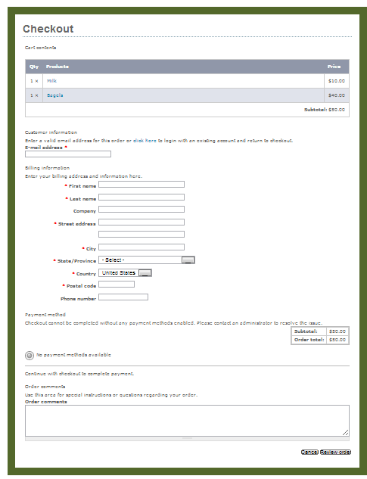
Checkout

Slide 21
In Summary
Migrated website from Joomla to Drupal as per client request
  Eased addition of new content
  Updated design
Added Virtual Food Drive capability
All goals accomplished

