Slide 1

Twitter Collection
Matt Gonley, Ryan Nicholas, Griffin Knock, Nicole Fitz, Derek Bruce
Professor Edward A. Fox
CS 4624: Multimedia, Hypertext, and Information Access
Virginia Tech, Blacksburg VA 24061
5/10/2022

Slide 2
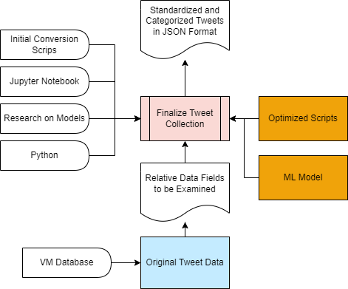
Outline
Recap
Timeline
Deliverables
Comparison
Data Scale
Work Completed
Changes
Optimization
Challenges
Acknowledgment
References

Slide 3



Overview
Optimization
Classify Data
Convert Data
SQL scripts from previous semesters capstone group
Classify Tweets to Corresponding Collections
Convert Data to Finalized JSON Schema

Slide 4
Timeline
Classify & Convert Data
Classify tweets to corresponding collections and run scripts
Finalize Schemas
YTK, DMI-TCAT, SFM
March
May
February
April
Optimize Scripts
Improve upon last semesters conversion scripts
Write Documentation
Create final report and thoroughly comment code

Slide 5
Deliverables
Optimized Scripts
  Code cleaned up & documented
  Fixed missing components
Converted JSON data
ML Model
Report & Presentation

Slide 6

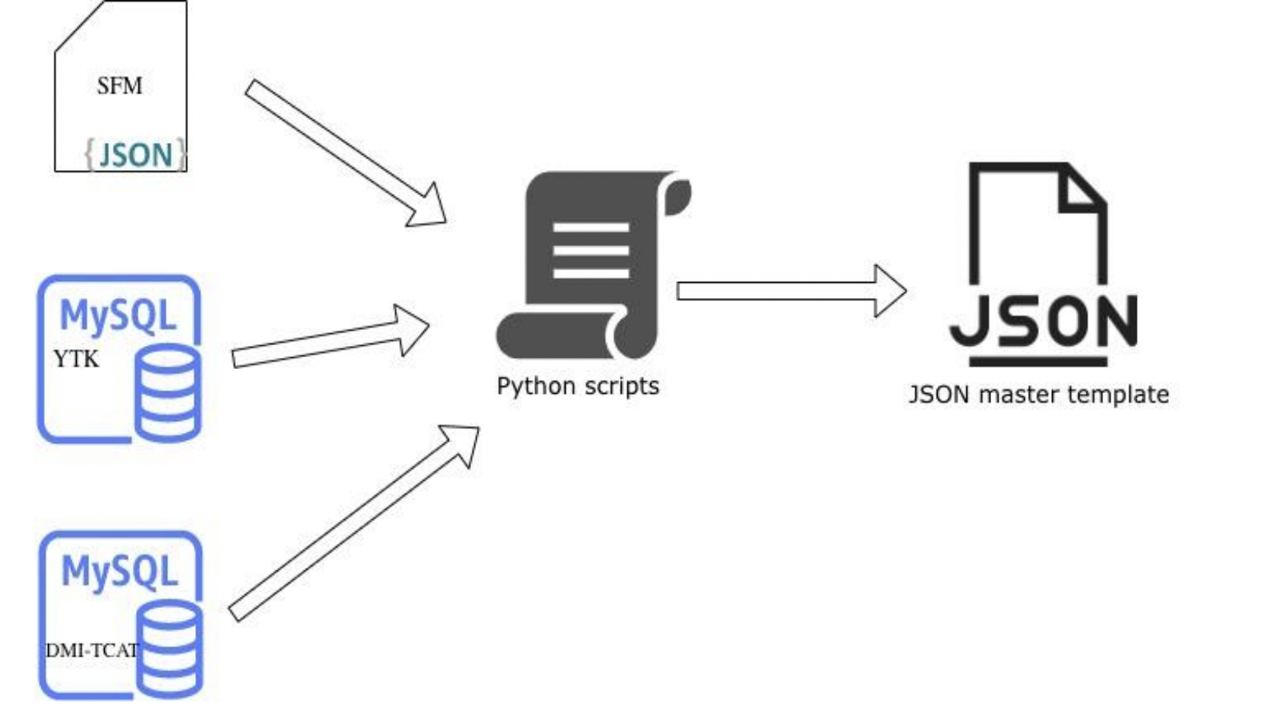
Comparison: DMI vs. YTK vs. SFM

Slide 7
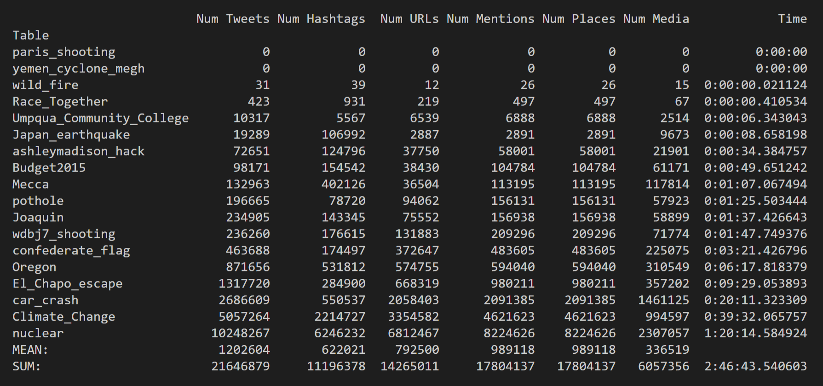
Data Scale: DMI

Slide 8
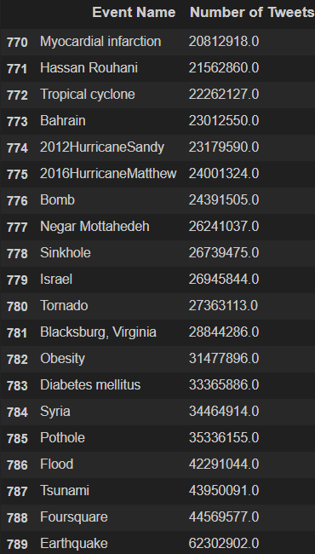
Event Data Scale: YTK

Slide 9
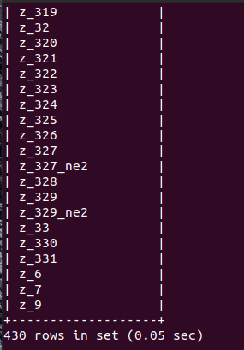
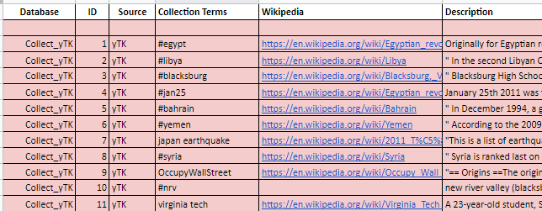
YTK Organization

Slide 10
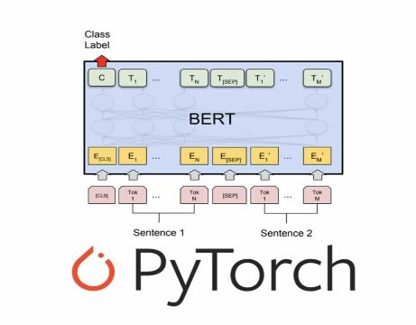
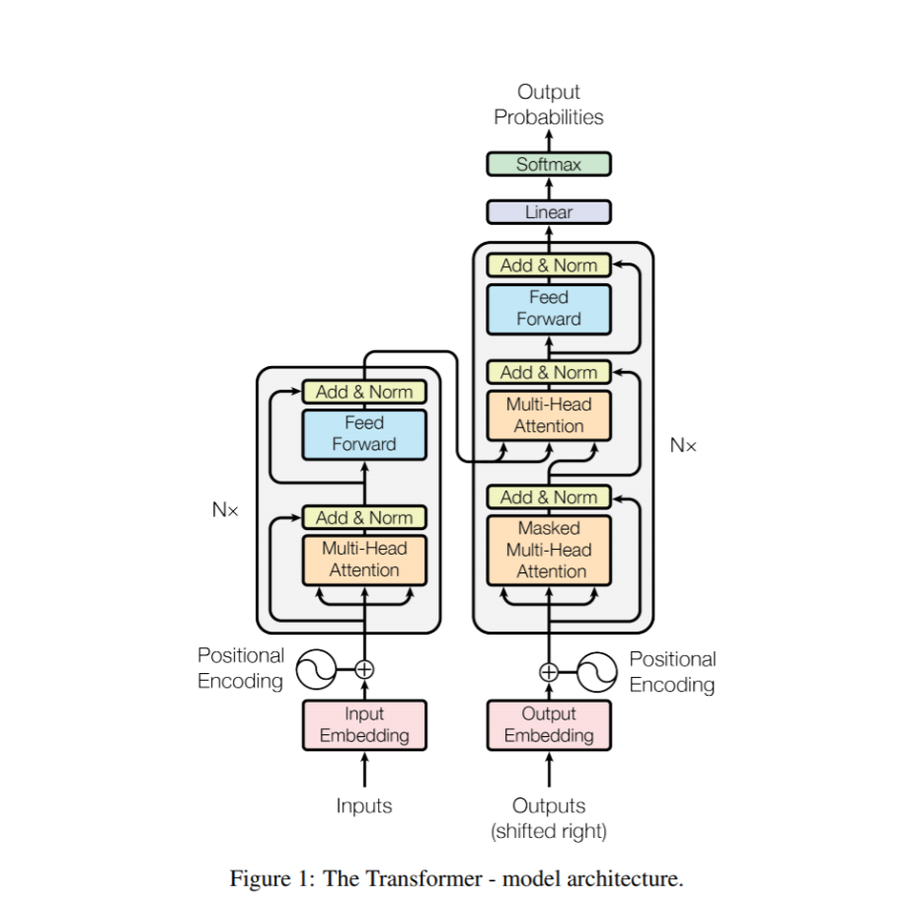
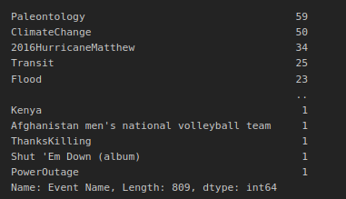
Machine Learning
Goal: Classify Tweets to Events
Naive Bayes Model
BERT + Transformer Neural Network
  Learns contextual relations between words (or sub-words) in a text bidirectionally

Slide 11
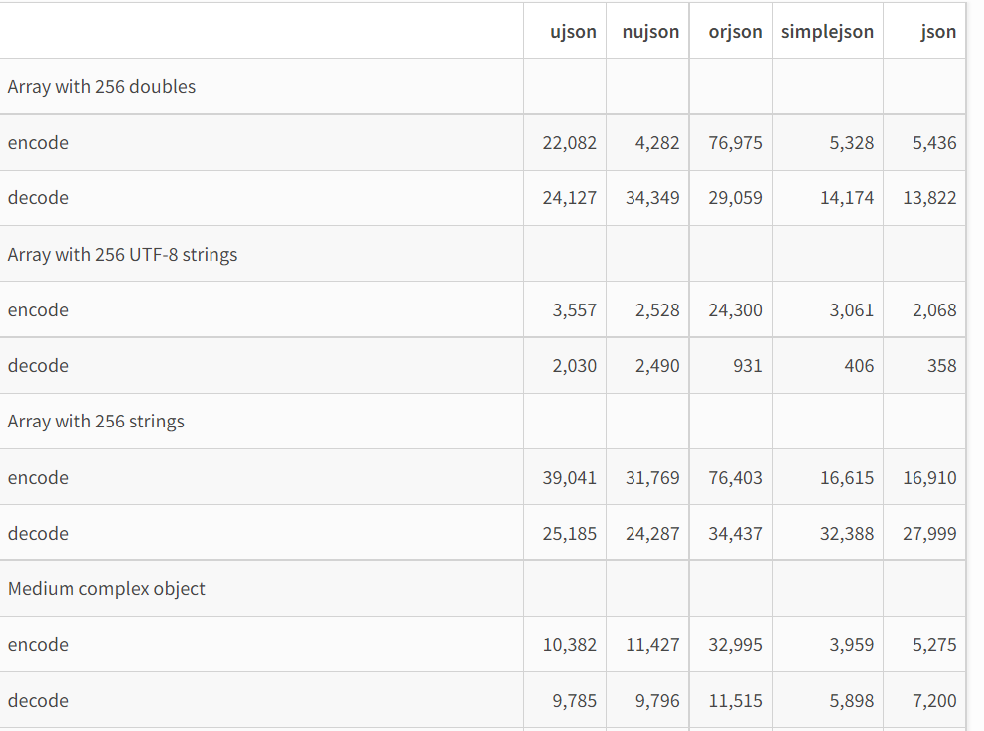
UJSON
Updated JSON API
Tested Conversion + Writing on 1 Million Tweets
  Finished in 14 seconds
  Standard JSON took 112 seconds

Slide 12
Changes
Commented Code
Modified for Scale
  UJSON vs. JSON Python package
Fixed issues in schema
Added Hashtags for YTK
Corrected YTK Collection

Slide 13
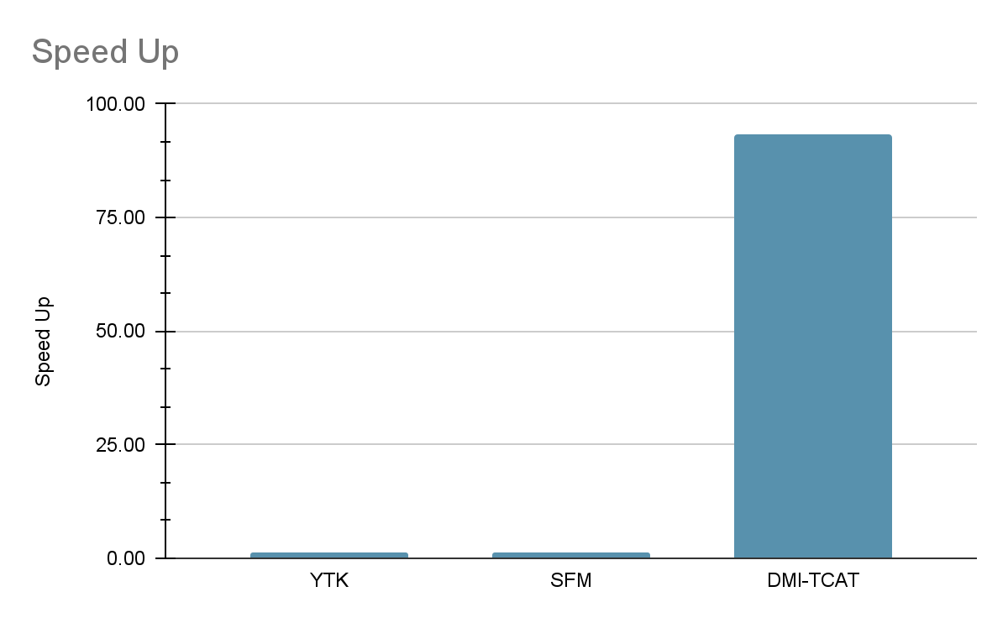
Optimization
Original Scripts:
Optimized Scripts:
Format | Number of Tweets (Sample Data) | Time Taken (seconds) | Tweets per Second | Time Taken (seconds) | Tweets per Second
DMI | 98,171 | 4,398.700 | 22.30 | 47.05 | 2086.52
YTK | 750,052 | 179.060 | 4021.28 | 123.01 | 6097.48
SFM | 200,171 | 27.999 | 7149.20 | 19.24 | 10403.90

Slide 14
Results
Format | Number of Tweets | Time Taken (seconds) | Tweets per Second | File Size (GB)
DMI | 21,646,879 | 9,780 | 2,213.3 | 43.13
YTK | 791,601,941 | 157,920 | 5,012.7 | 992.98
SFM | 200,171 | 19.24 | 10,403.9 | 0.42

Slide 15
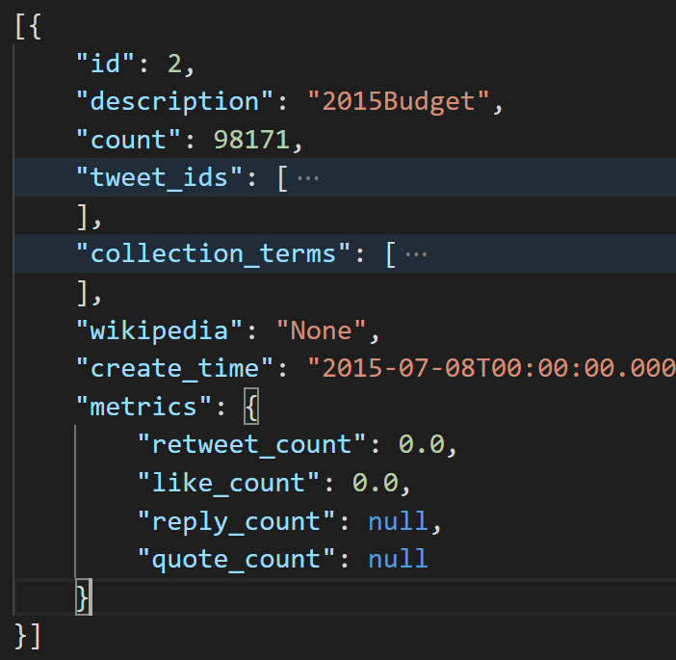
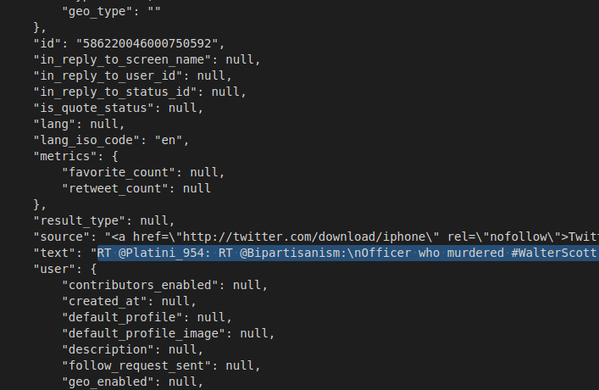
Converted JSON Data
Collection Information
Individual Conversion

Slide 16

Challenges
Scalability:
Data Size
Access:
VPN
Script Runtimes

Slide 17

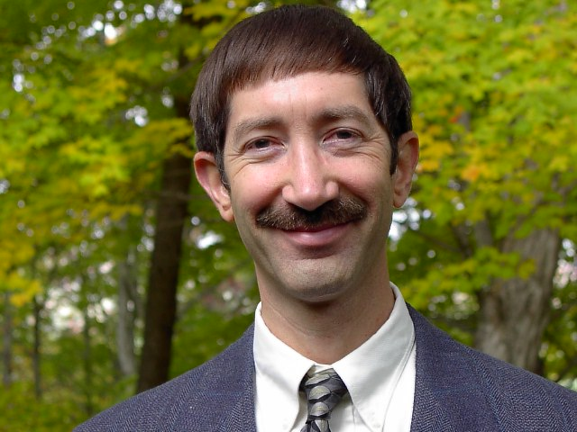
Acknowledgements
Our Client, Xinyue Wang , our Mentor Pranav Chimote, TA Ryan Wood,
and Professor Fox.

Slide 18
References
Last Semester’s Work on the Tweet Conversion
  Library Tweet Conversion, Edward Fox & Xinyue Wang
Events Archiving
  http://eventsarchive.org/
PyTorch
  https://pytorch.org/docs/stable/index.html
Transformers - BERT Documentation
  https://huggingface.co/docs/transformers/index
UJSON
  https://mpython.readthedocs.io/en/master/library/pythonStd/ujson.html

