Slide 1

PromptLibrary
Ryan Wang, Brandon Hoang, Daniel Shin, Gabriel Shin
CS4624 - Multimedia, Hypertext, and Information Access
Dr. Edward A. Fox
Virginia Tech @ Blacksburg, VA, 24061
May 4th, 2024
Notes:
Add an more visual timeline and add dates,Add the interesting info page, Add an reference page.
Tools: Should we update to clarify that these are possible?
Lessons learned
Prompt examples

Slide 2
Contents
Recap
Design and Implementation
  Frontend
  Backend
Issues
Plans
Acknowledgements
References
Notes:
done

Slide 3
Recap

Slide 4

What is it?
PromptLibrary is a digital library where users can submit and download prompts for LLMs like GPT or Gemini.

Slide 5
Deliverable
A web application that supports:
User authentication
Content management
Searching for prompts
Prompt storage
Prompt export

Slide 6
Design
&
Implementation

Slide 7







Planned Toolsets
AWS Amplify [1]
Vue [2]
Docker [3]
Hosting service
Framework for front end development
Dockerized environment
GraphQL [4]
Prisma [5]
DynamoDB [6]
PostgreSQL [7]
Query language
ORM
NoSQL database
Relational database

Slide 8

Finalized Toolset
NodeJS/Express [8]
Vue
Docker
Backend framework
Framework for front end development
Dockerized environment
PostgreSQL
Prisma
Relational database
ORM

Slide 9
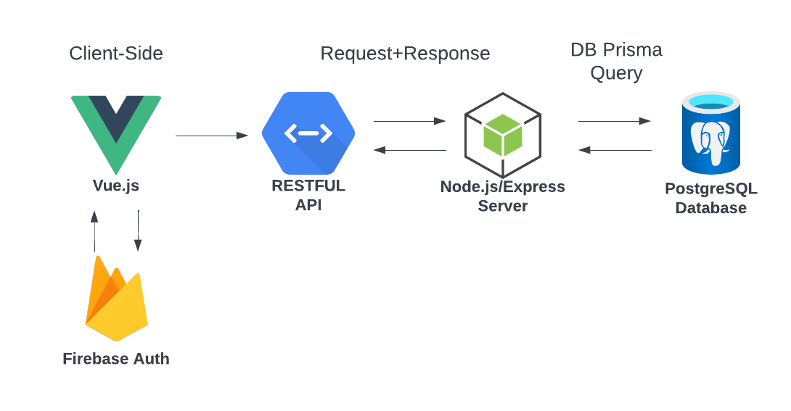
Overall Structure
[9]

Slide 10
Frontend

Slide 11
Frontend
Overview
Authentication
Searching
Prompt Export

Slide 12
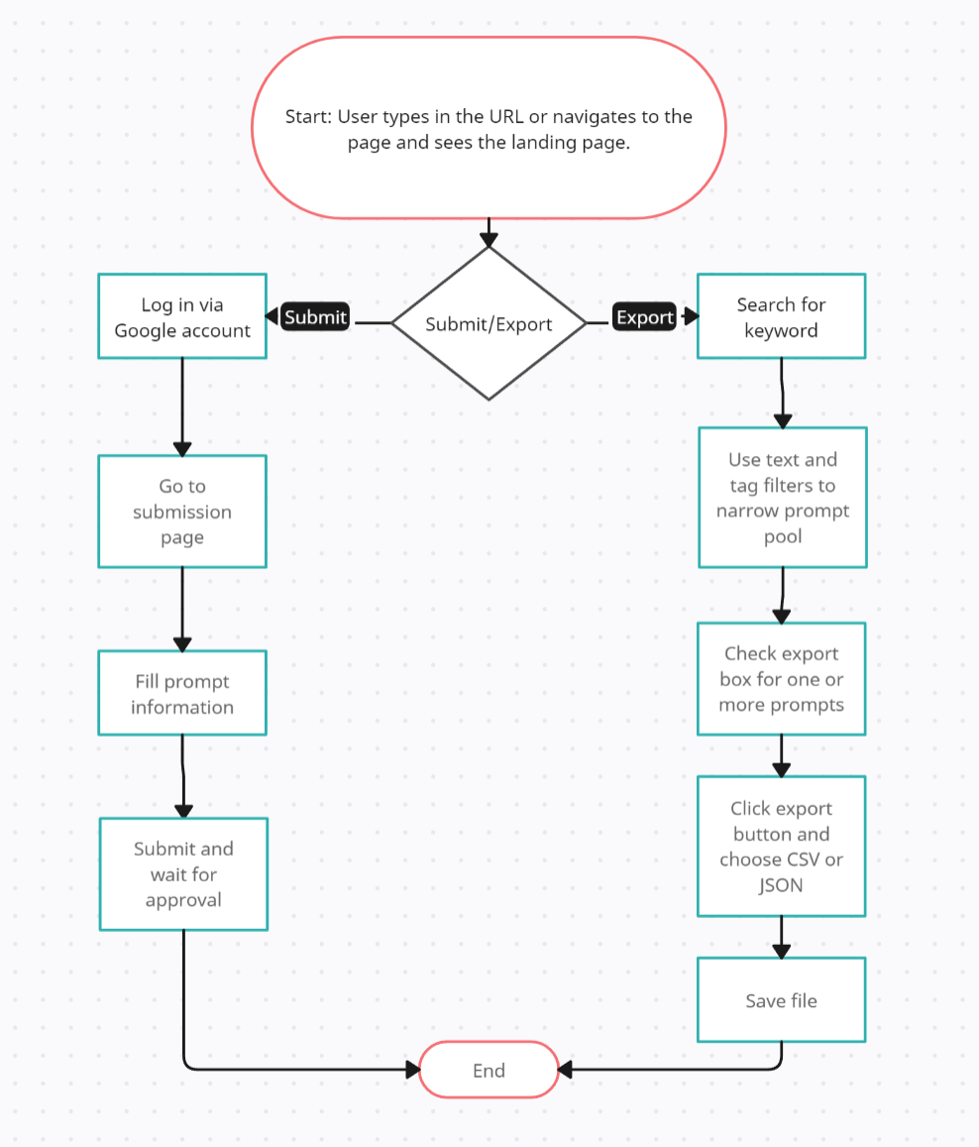
Normal
User Interaction Diagram

Slide 13
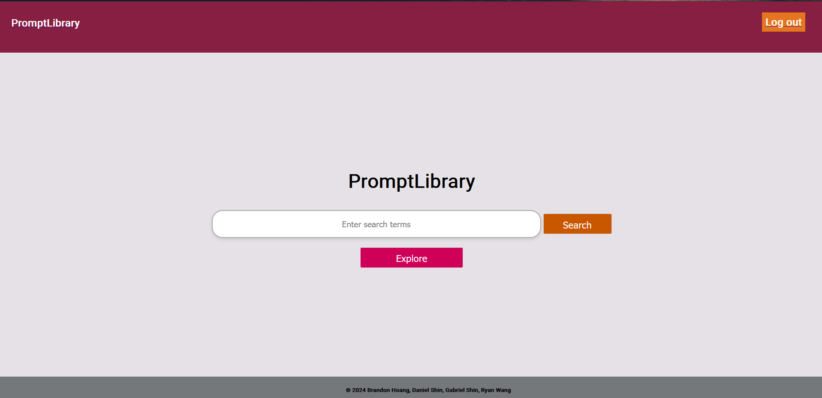
Notes:
Landing Home Page
Search for prompts
Explore all approved prompts

Slide 14
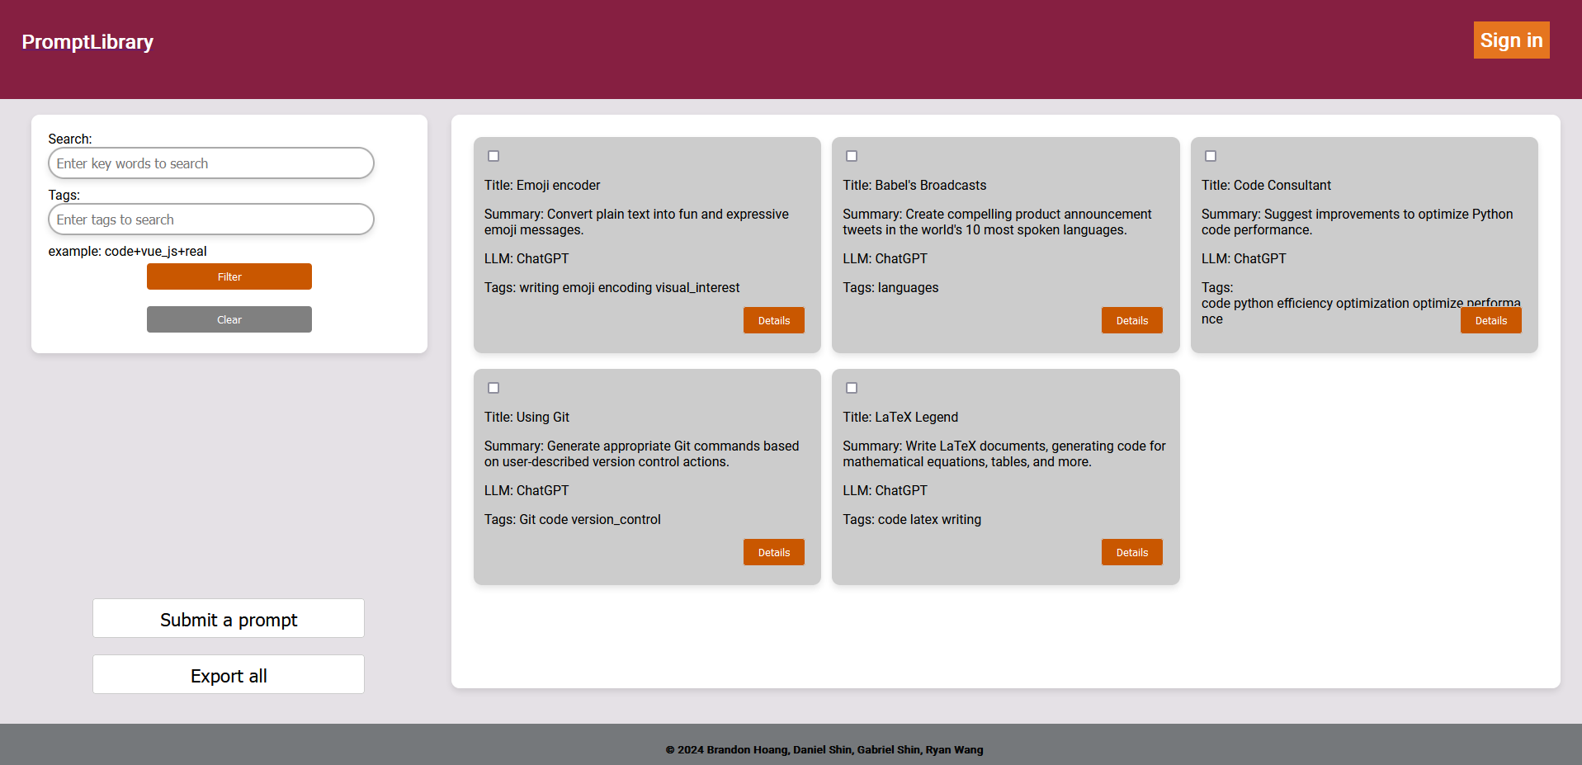
Notes:
Display approved prompts
Filter by text or tag
Export all prompts by default, or just selected prompts

Slide 15
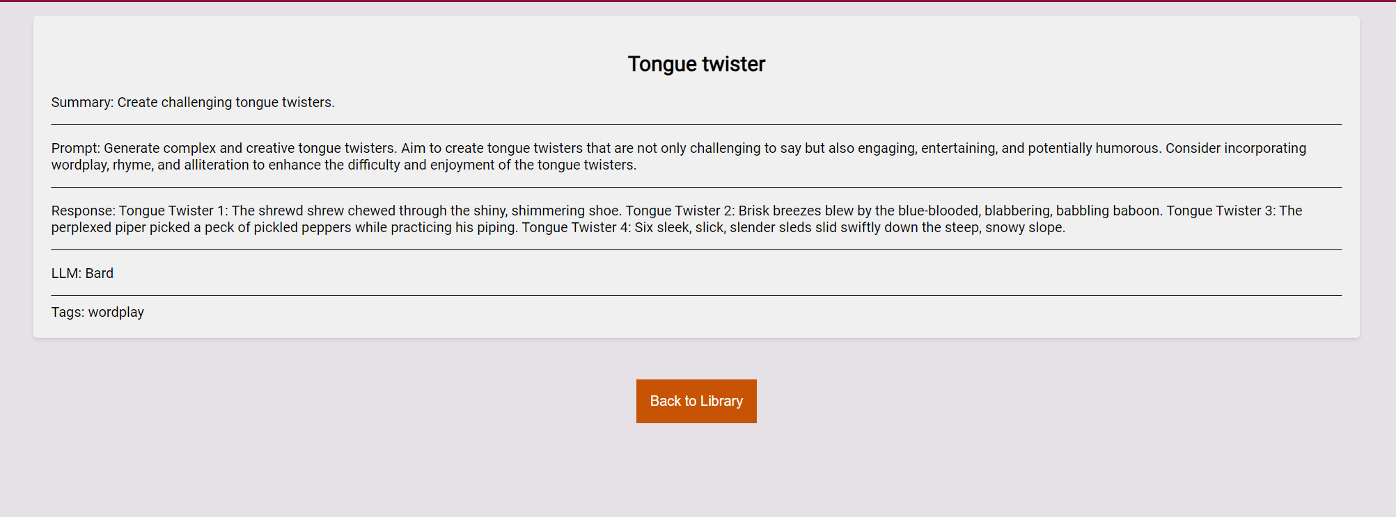
Notes:
Accept or reject from details

Slide 16
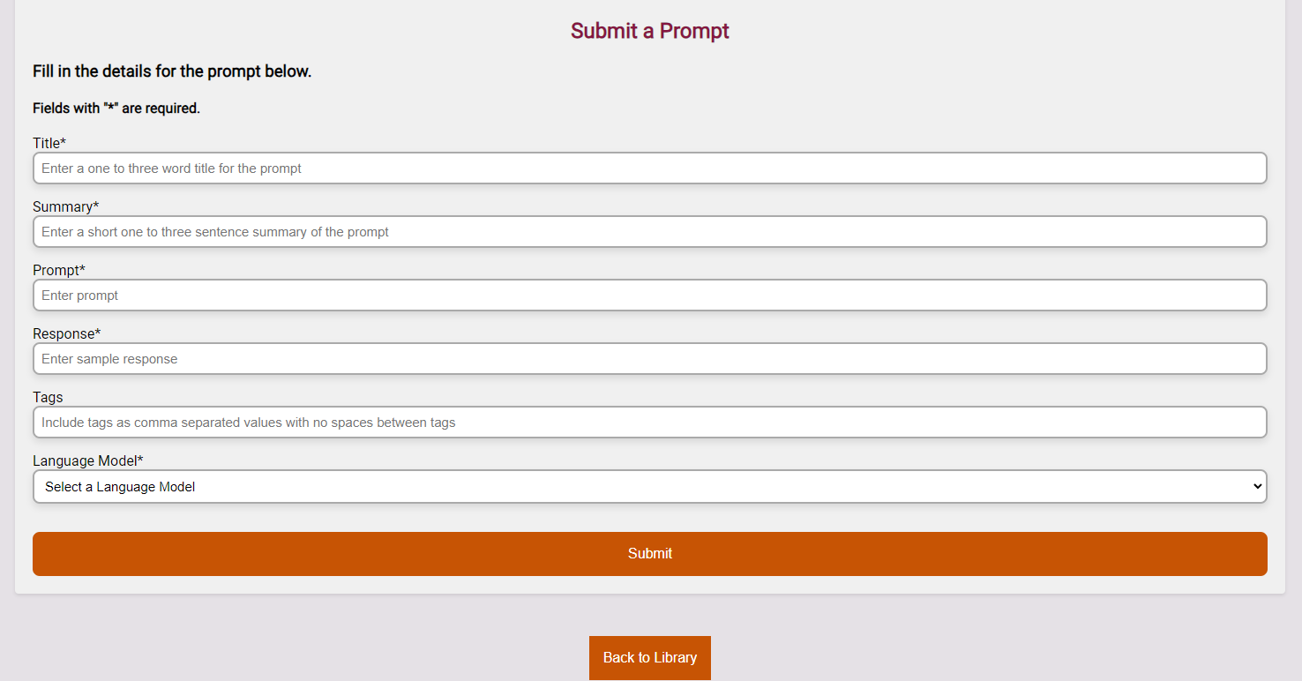
Notes:
Prompt submission
Title
Summary
Prompt
Output
Tags
LLM

Slide 17
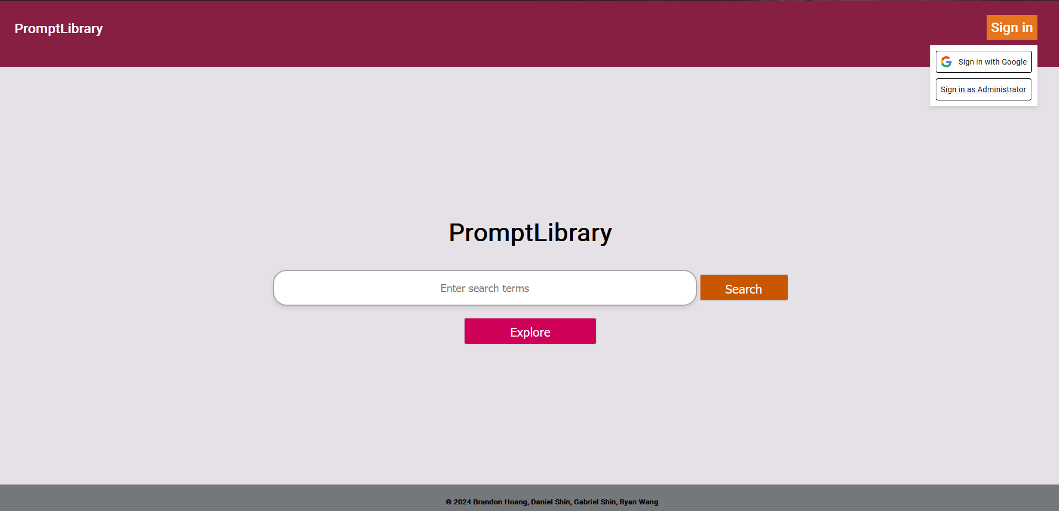

Slide 18
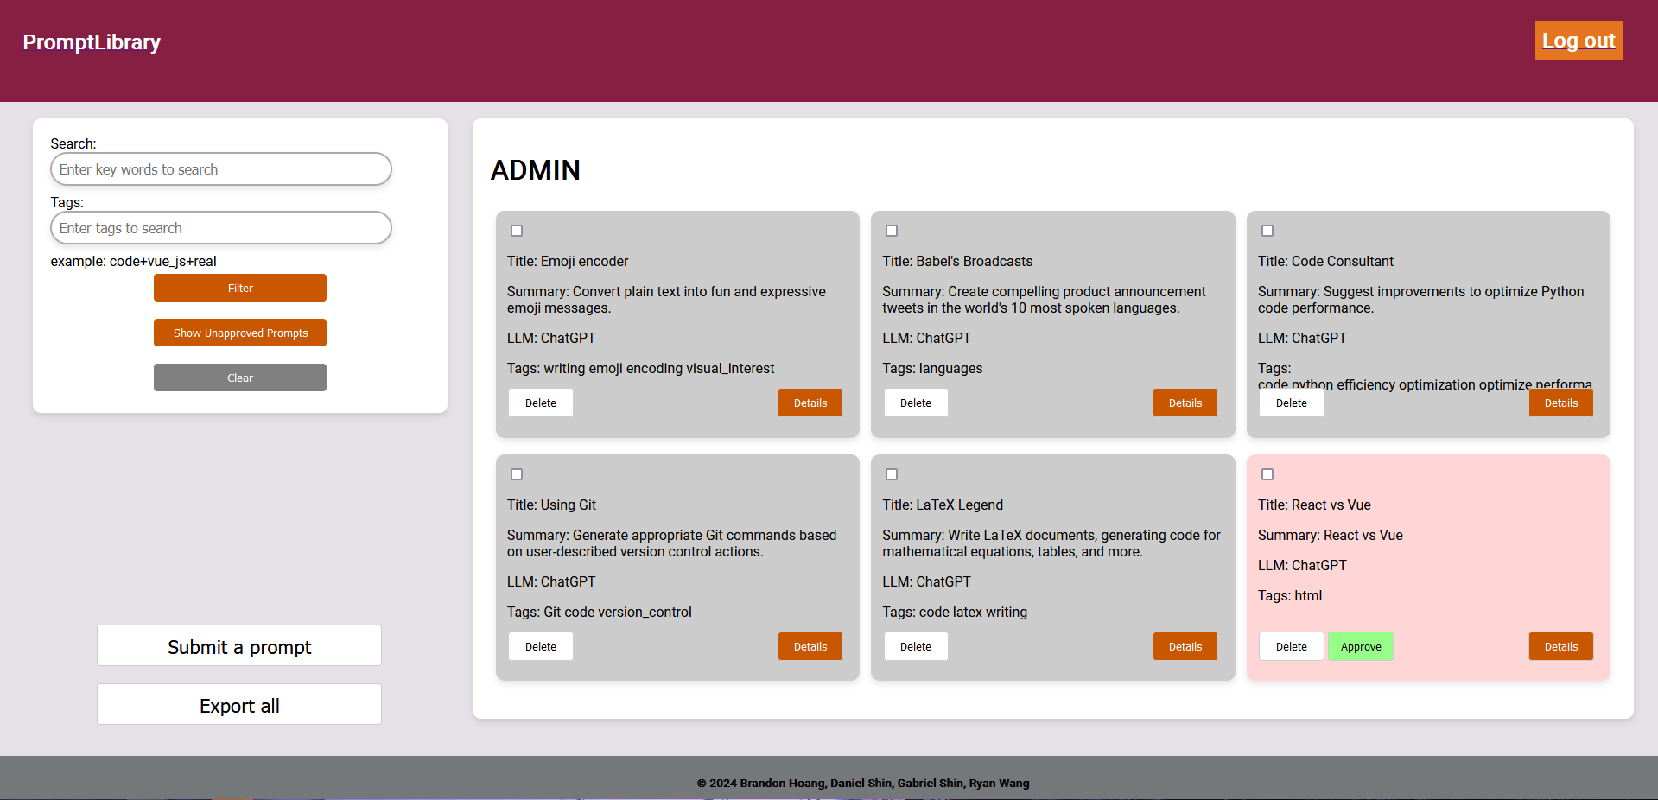
Notes:
Display unapproved prompts
Manage prompts

Slide 19
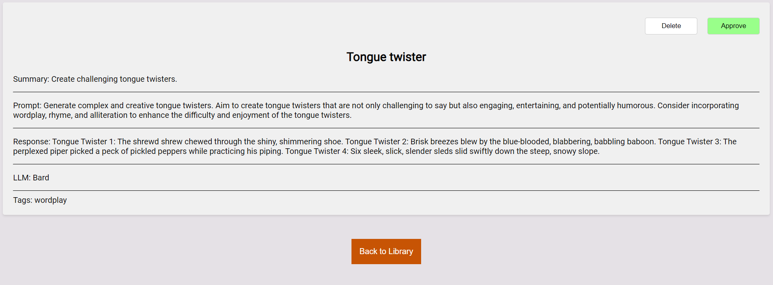
Notes:
Approve or delete from details page

Slide 20
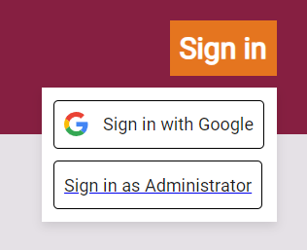
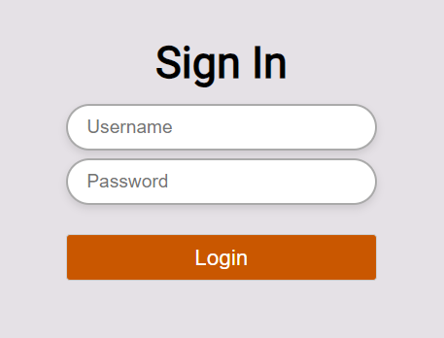
Authentication
Normal users
  Google accounts
  Handled by Firebase
Administrators
  Preset accounts
  Handled in backend

Slide 21
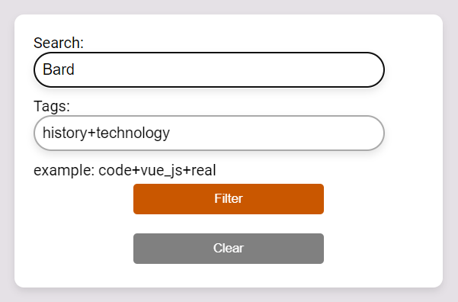
Searching
Search by text
  Contains keyword
Search by tag
  Has queried tags
Search by text and tag

Slide 22

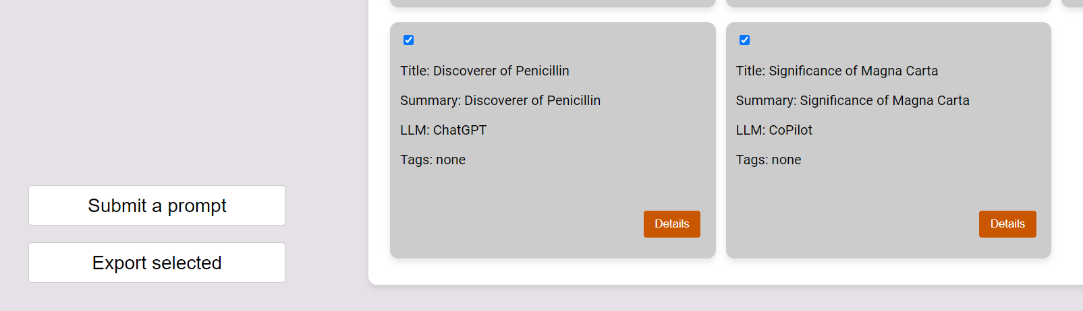
Prompt Export
Export the selected prompts into a JSON file
  Export all by default

Slide 23
Backend

Slide 24
Backend
Basic CRUD operations for each table
Export prompts feature
Tag search
Full text search
Administrator account creation
Basic cybersecurity
Deployment
Notes:
I’ll cover basic crud and searches. Gabe can cover cyber and docker? Idk

Slide 25
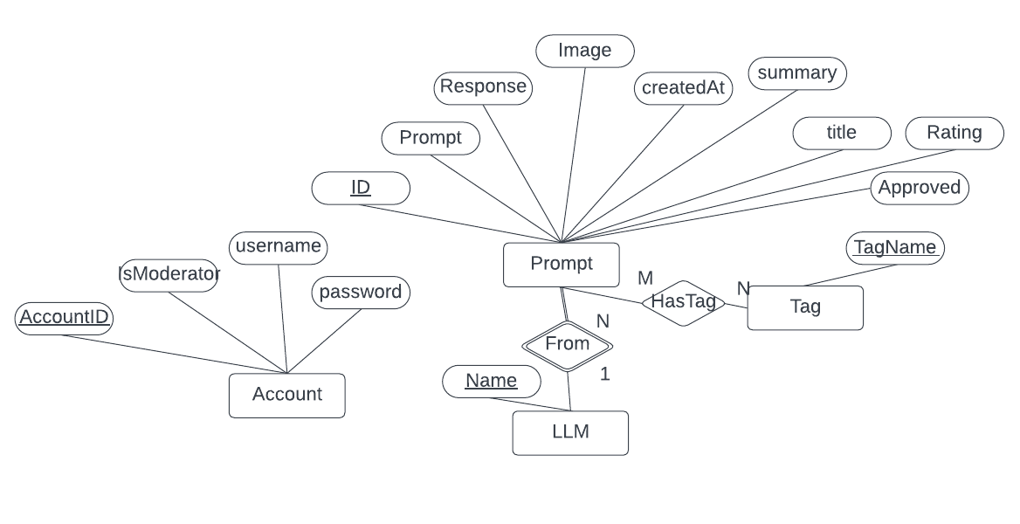
Backend
Entity Relationship diagram for the PromptLibrary database.

Slide 26
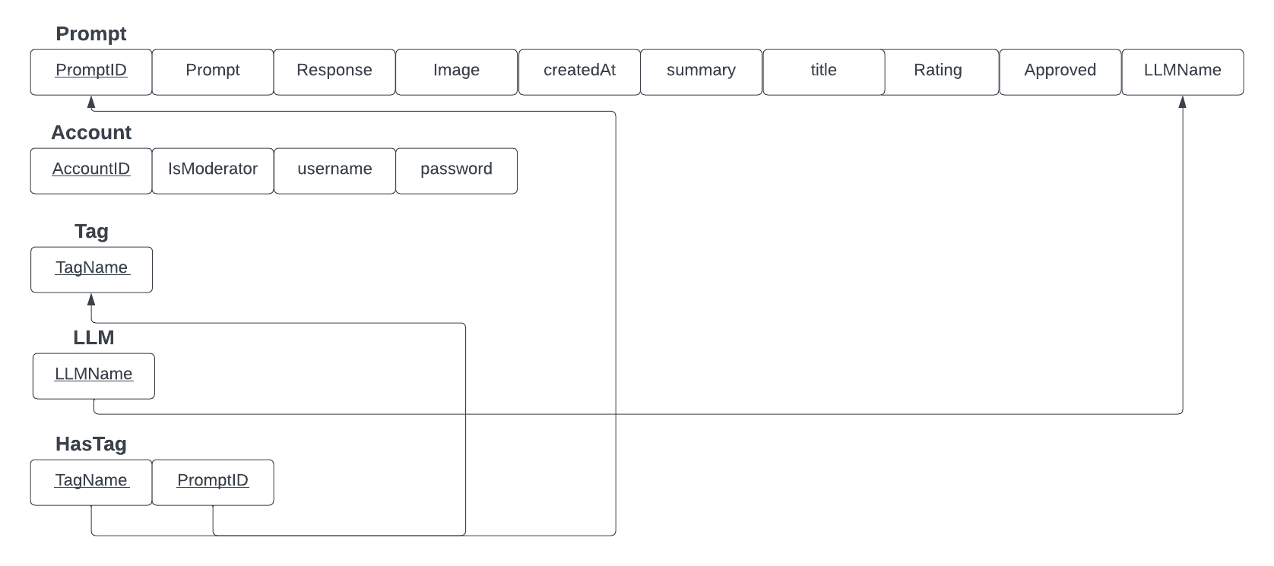
Relational Table for the PromptLibrary database.

Slide 27
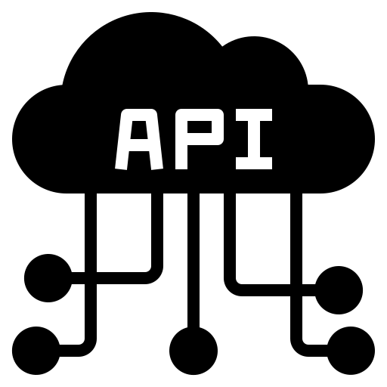
Basic CRUD and Search
CRUD Operations
  POST, GET, PATCH, DELETE
Search:
  Tag search
  Full text search
Export:
  Large POST request
  Doesn’t cache
Notes:
done

Slide 28
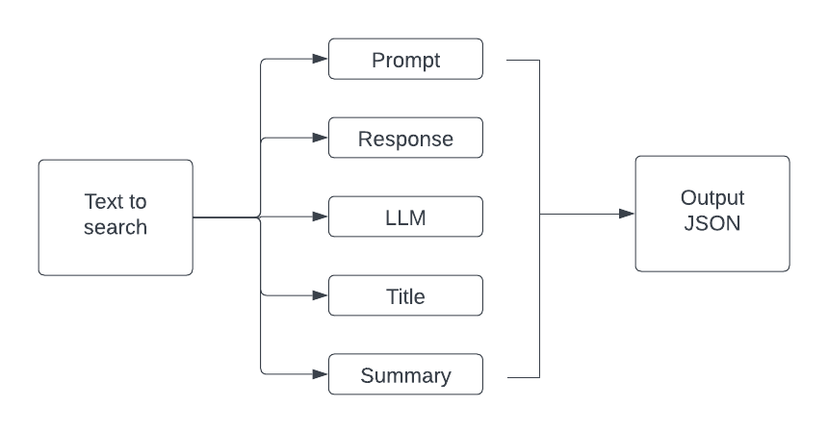
Full Text Search

Slide 29
Administrator and Cybersecurity
Admin Account
  Basic table
  Manually created
  Hashed: Argon2
Cybersecurity
  SQL Injection protection
  Ransomware

Slide 30
Deployment
Dockerized
  Not AWS Amplify
  Flexibility
  Multiple container options
Server
  Intended to use Vercel
  Client only wants the Docker container

Slide 31
Overall

Slide 32
Issues
AWS Compatibility and the Stack
  Docker
  Node.js/Express.js
Backend
  Lack of experience
Frontend
  CSS styling
  Connection with backend

Slide 33
Development
Delivery
Begin full stack development
Hand off final product to client
Jan
Feb
Mar
Apr
Planning
Deployment
Initial meeting and drafting
Host the database and continue development

Slide 34
Future Work
More effective searching
Direct integration of accounts
Scaling up the database
Proper rating system
Further improve CSS styling

Slide 35

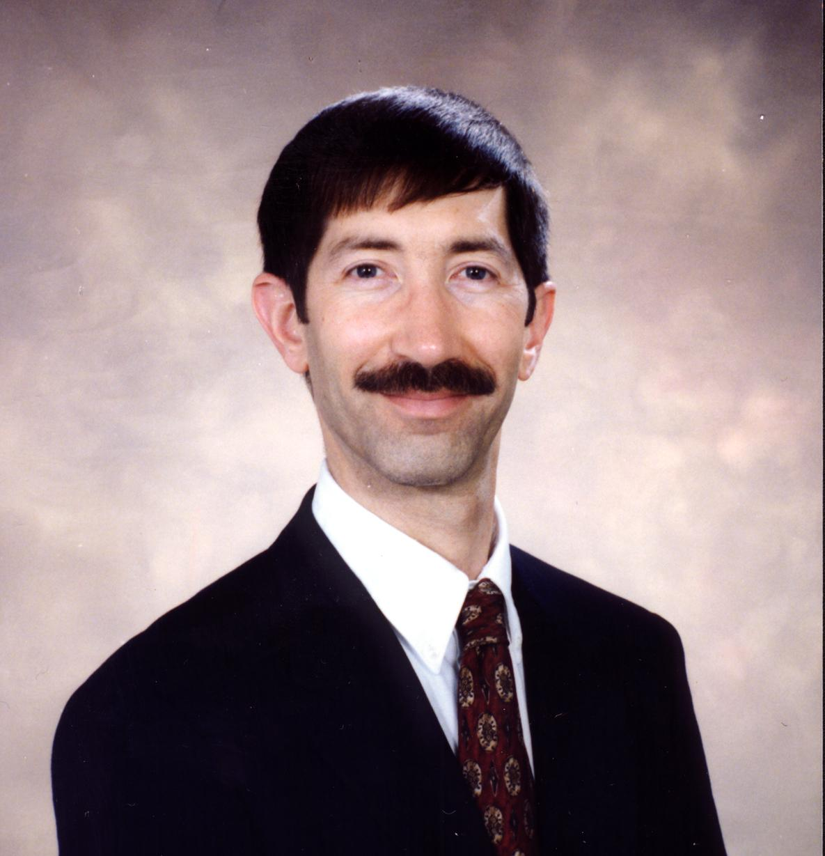
Acknowledgements
Dr. Yinlin Chen
  Assistant Director and Assistant Professor for the Center for Digital Research and Scholarship
Dr. Edward Fox
  Professor for the Department of Computer Science at Virginia Tech and the Director of the Digital Library Research Laboratory

Slide 36
References
[1] Amazon Web Services, “AWS Amplify Documentation,” Amazon Web Services, 2024. Available: https://docs.aws.amazon.com/amplify/. [Accessed: Apr 30, 2024]
[2] E. You, “Vue.js,” Vue.js, 2014. Available: https://vuejs.org/. [Accessed: Apr. 30, 2024]
[3] Docker, “Docker overview,” Docker Documentation, Apr. 17, 2024. Available: https://docs.docker.com/get-started/overview/. [Accessed: Apr. 30, 2024]
[4] The GraphQL Foundation, “Introduction to GraphQL,” GraphQL, 2024. Available: https://graphql.org/learn/. [Accessed: Apr. 30, 2024]
[5] Prisma Data, “Prisma Documentation,” Prisma, 2024. Available: https://www.prisma.io/docs/. [Accessed: Apr 30, 2024]
[6] Amazon Web Services, “Amazon DynamoDB Documentation,” Amazon Web Services, 2024. Available: https://docs.aws.amazon.com/dynamodb/. [Accessed: Apr 30, 2024]
[7] The PostgreSQL Global Development Group, “PostgreSQL 16.2 Documentation,” PostgreSQL, Feb. 08, 2024. Available: https://www.postgresql.org/docs/16/index.html. [Accessed: Apr 30, 2024]
[8] OpenJS Foundation “Node.js v21.7.3 Documentation,” Node.js, 2024. Available: https://nodejs.org/docs/latest/api/. [Accessed: Apr. 30, 2024]
[9] Firebase developers, “Authenticate Using Google with JavaScript,” Firebase, Apr. 16, 2024. Available: https://firebase.google.com/docs/auth/web/google-signin. [Accessed: Apr. 30, 2024]

Slide 37
Q & A

