Slide 1

Team 7 → Final Presentation
CS4984/CS5984 Big Data Text Summarization
November 29, 2018
Blacksburg, Va 24061
Anuj Arora
Jixiang Fan
Yi Han
Shuai Liu
Chreston Miller

Slide 2
Roadmap
Introduction
Project Management
Motivation
Golden Standard
Article Collection
Pre-Processing Data
Deep Learning for Summarization
Post-Processing
Lessons Learned
Conclusion
Notes:
give highlights

Slide 3
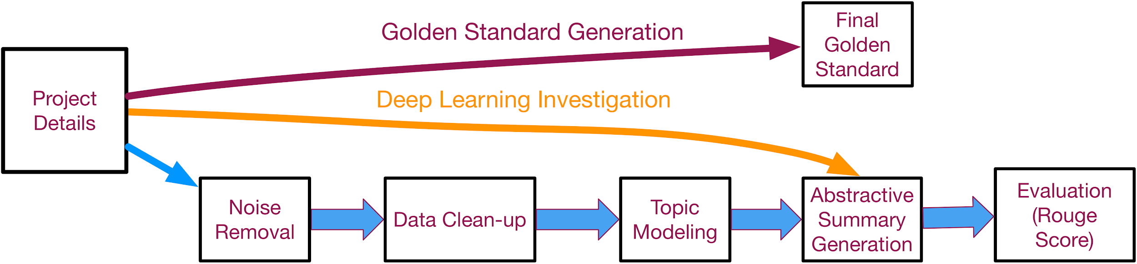
Introduction

Slide 4

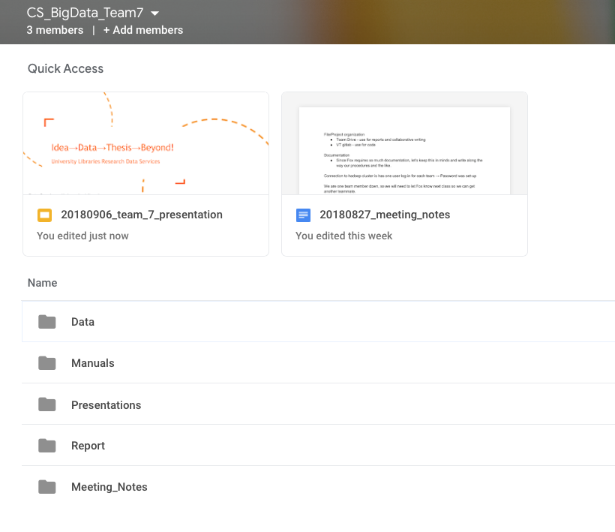

Project Management
Slack
Team Drive
Code
…and Weekly Team Meetings
Notes:
Github image from: https://goo.gl/images/fsZaaq

Slide 5
Motivation
How do we summarize multiple articles, when manually reading through each of them becomes impractical?

Slide 6
Golden Standard
Create outline
Use Solr and Google search related material
Update outline
Built-in summary tools in Mac OS
Finish first draft
Read feedback
Update summary

Slide 7
Article Collection - NeverAgain
Collection of articles concerned with and focused around school shootings and gun policy
The following table shows the article counts before and after the cleanup
Dataset | Before Noise Removal | After Duplicate Removal | After noise filtering | Duplicate Percentage | Total Reduction Percentage
NeverAgain | 12,111 | 7,631 | 3,669 | 37% | 69%

Slide 8
Pre-Processing
Raw Data Conversion and Indexing (WARC/CDX to JSON)
Duplicated Entries Removal
Noise Filtering
  Iteration 1: Word Filtering
  Iteration 2: jusText and Word Filtering
  Iteration 3: jusText and more restrictive Word Filtering
  Stopwords, Punctuation Removal and Part of Speech Tagging
  Lemmatization and Tokenization

Slide 9
Exploratory Results
After tokenization, we came up with a list of the most frequently occuring words in the cleaned corpus. The top words are shown below
Word | Frequency
gun | 25,009
school | 21,726
people | 12,853
student | 12,234
shoot | 10,838

Slide 10
Exploratory Results
NLTK’s Named Entity Chunker was used to generate named entities, the most frequent of which are shown below
Named Entities | Frequency
(’ORGANIZATION’, ’NRA’) | 4,510
(’GPE’, ’Parkland’) | 4,265
(’GPE’, ’Florida’) | 2,470
(’PERSON’, ’Trump’) | 2,234
(’GPE’, ’U.S.’) | 2,233

Slide 11
Topic Modelling
The tokenized sentences were vectorized using the Bag of Words (BOW) approach
Gensim was used to implement the LDA (Latent Dirichlet Allocation) algorithm
Topic | Keywords
Topic 0 (Santa Fe) | 0.024*"school" + 0.021*"police" + 0.019*"shoot" + 0.012*"people" + 0.012*"kill" + 0.011*"2018" + 0.011*"high" + 0.010*"santa" + 0.010*"fe" + 0.010*"shot"
Topic 1 (General Shootings) | 0.030*"school" + 0.021*"student" + 0.014*"gun" + 0.011*"people" + 0.010*"shoot" + 0.010*"high" + 0.009*"parkland" + 0.008*"life" + 0.008*"like" + 0.008*"violence"
Topic 2 (Policy) | 0.025*"gun" + 0.012*"state" + 0.008*"nra" + 0.008*"law" + 0.007*"trump" + 0.006*"people" + 0.006*"year" + 0.005*"use" + 0.005*"right" + 0.005*"firearm"

Slide 12
Deep Learning
Method Exploration
Separate summaries based on LDA identified topics
Pointer-Generator Network
  Hyperparameter tuning
Training data - CNN/Daily Mail
  Used a pre-trained model - saved much time
Processing
  Local Ubuntu server with a high power graphics card (GPU)

Slide 13
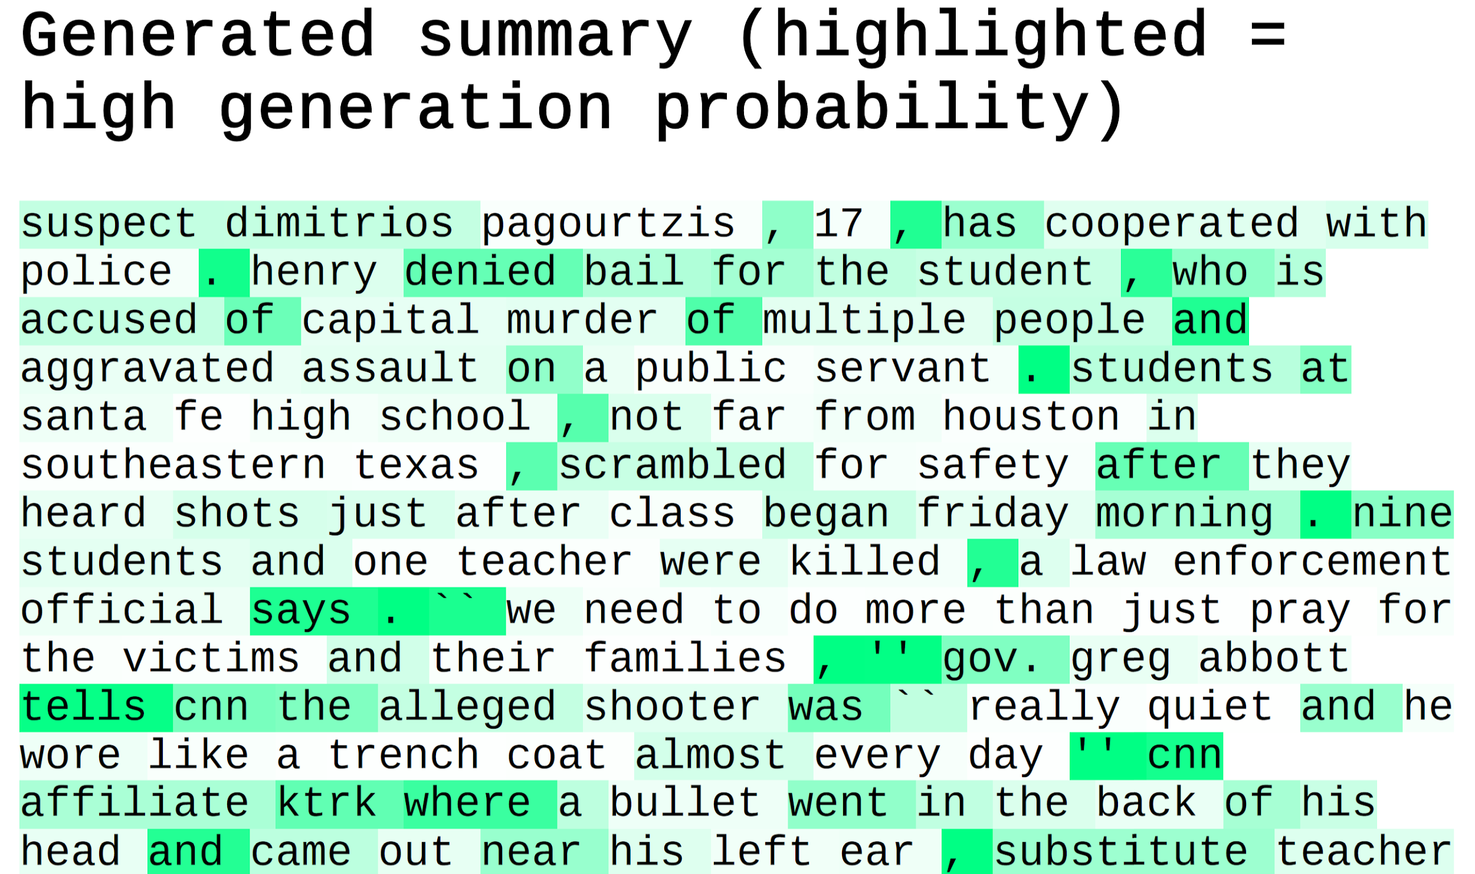
Deep Learning Visualization
Generated Summary
  Highlighted = High Generation Probability

Slide 14
Post-Processing
Removing redundancy
Fixing flow issues
Rearranging sentences
Given the separate topics, arranging them in a logical order and creating transitions between them

Slide 15
Lessons Learned
GPU acceleration - surprisingly did not need a cluster
Software versions are very important
Ubuntu Virtual Machine would not work with GitHub
  This was using Parallels virtualization software
How to use Docker
How to use Solr
Pre-processing large datasets to extract meaningful information
Deep Learning architectures

Slide 16
Conclusion
Abstractive summarization is challenging
Careful pre-processing is necessary for filtering articles
Deep learning solutions/approaches are available via open source repositories
  Provides a working foundation
Current methods for abstractive summarization are not a complete solution, however, techniques continue to improve

Slide 17
Questions!
Anuj Arora: aarora23@vt.edu
Jixiang Fan: jfan12@vt.edu
Yi Han: hy@vt.edu
Shuai Liu: shuail8@vt.edu
Chreston Miller: chmille3@vt.edu

