Slide 1
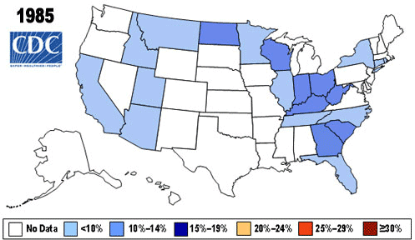
Chorobesity
Dr. M. Farag - Virginia Tech, Blacksburg, VA, 24061
CS 4624 – Multimedia, Hypertext, and Information Access
November 14th, 2023
Chorobesity
Modern insight to An enduring epidemic
Bharathi Ganesan, Van Ha Nguyen, Sarah Burnett
Bradley Freedman, Roshan Ravindran
Notes:
Roshan

Slide 2
INTRODUCTION
PROJECT TIMELINE
APPLICATION DEVELOPMENT: ARCHITECTURE
APPLICATION DEVELOPMENT: DATA Management
APPLICATION DEVELOPMENT: COLOR-CODED MAP
APPLICATION FEATURES
DEMO
COMPLETED WORK
Future work
ACKNOWLEDGEMENTS
REFERENCES
OUTLINE
Notes:
Rathi

Slide 3
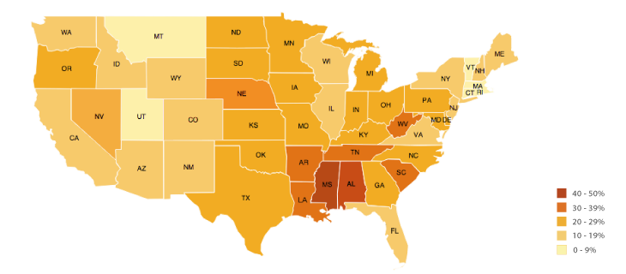
Introduction
Problem:
  According to the American Diabetes Association: “Being overweight raises your risk for type 2 diabetes, heart disease, and stroke.”[4]
  Our client wants to utilize a geographical representation tool to do further research into prevalent health conditions:
    Obesity
    Diabetes
Questions:
  Is there a geographical correlation between obesity and diabetes?
  How do we show this correlation?
Example Choropleth Map
Notes:
Roshan
Slide Description:
Introduction to the Project as a whole:
-what is the client looking for?
-what is a choropleth map?
-why are we doing this project in the first place?
Question: In other words, can data represented on a map show us correlations between these two health conditions?
Client Requirements:
-AT LEAST Virginia + counties choropleth map
-mouse hover with more information
-identity a usable dataset

Slide 4





Project Timeline
STAGE
STAGE
STAGE
STAGE
STAGE
01
02
03
04
05
Conceptualize and finalize the project's requirements
Establish a
management
framework
Development:
Front-end,
Back-end, Initial Testing
Final touches, thorough testing, and creation of User Manual
Complete report and launch project.
September 15
September 29
October 3
November 10
November 14
Notes:
Roshan
Slide Description:
After identifying what the client wants from the project, the team formulated a timeline for the duration of the project (as seen on this slide)
Requirements
Framework
Development
Final touches
Launch Project
The next three slides will explore details of the development process and give background into the application itself.

Slide 5
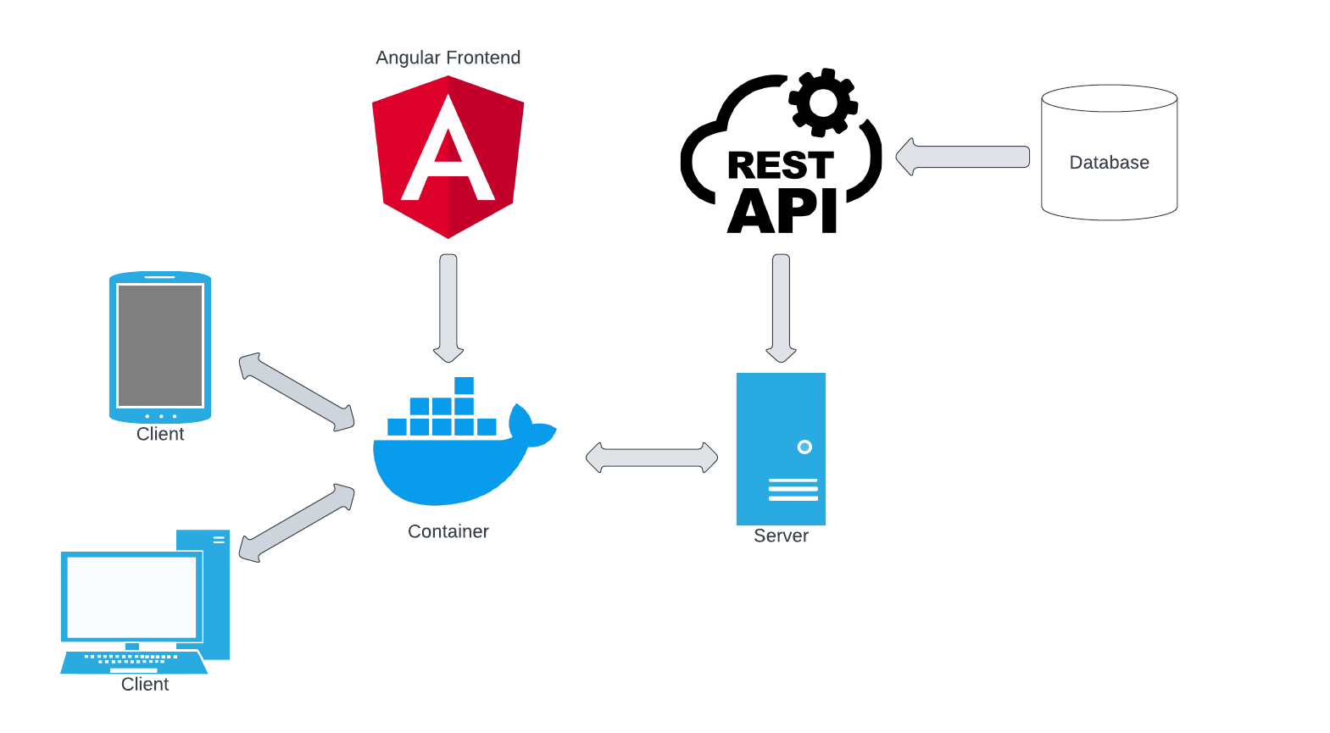
Application Development: Architecture
Notes:
Bradley
Slide Description:
The initial system architecture that underlies the workings of the Chorobesity application

Slide 6
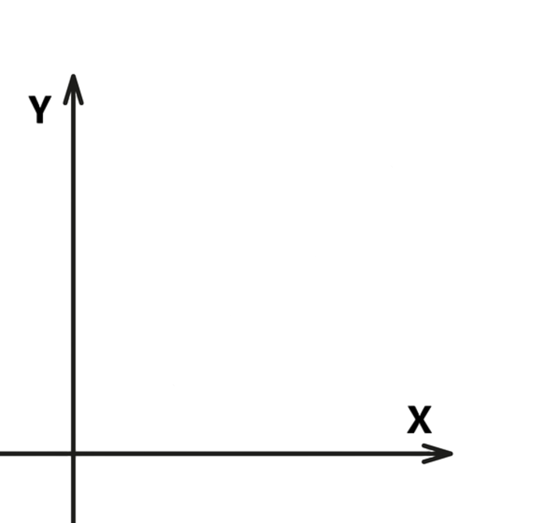
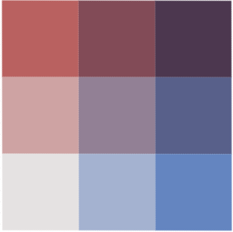
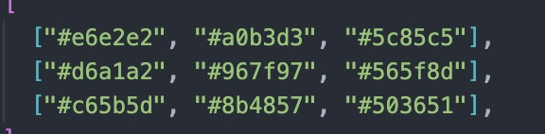
Application Development: Color-Coded Map
Color Key: the “key” to the map display
  Obesity Scale (red)
  Diabetes Scale (blue)
  Bivariate Scale (both health conditions)
Integration of the Key with the Data
  Normalization of data
  Calculate mean and standard deviation
  Create ranges for which data points will fall
  Associate data with a color on the map
Bivariate Choropleth Color Generator[2]
Obesity Percentage
Lessons Learned: Color Key in Front-End vs Back-End
Diabetes Percentage
Notes:
Sarah Burnett

Slide 7


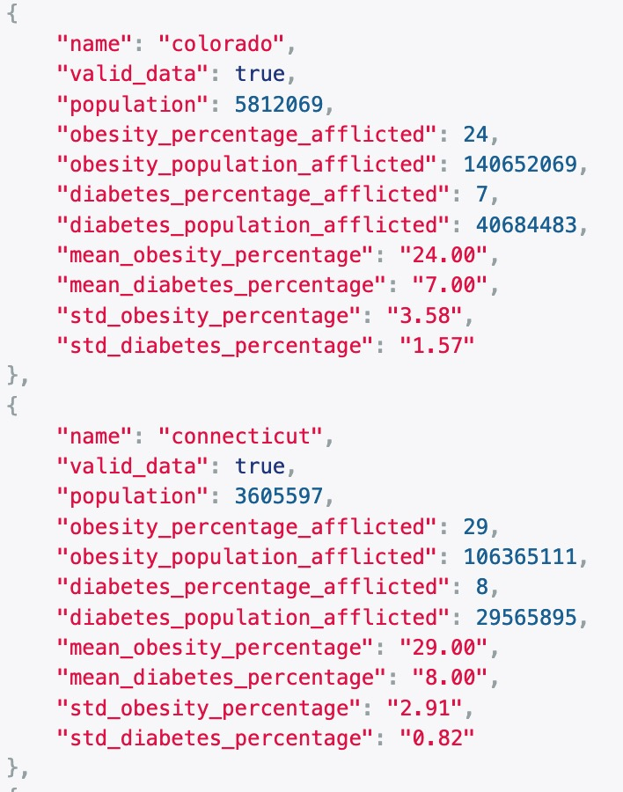
Application Development: Data Management
Data Acquisition: Initial
Find a comprehensive dataset
  County Health Rankings
Select data points that were relevant to the scope of the project:
  County names
  Obesity Percentage
  Diabetes Percentage
  Population
Creation of our own, relevant Excel document for initial data points and testing
Data Processing: Final
Translate Excel data into JSON format directly from source
The JSON file is the bedrock to implementing the choropleth map on the front-end
Stores calculations needed to display a corresponding color on the front-end map
Challenges: Data Consistency, Data Validation, Integration with Visualization Tools.
Notes:
Slide Description:
In addition to creating an application to show health correlations, we needed real-life data we could use to illustrate this correlation
Data Consistency: Ensuring that data extracted from Excel maintains its integrity when converted to JSON.
Data Validation: Implementing checks to ensure data accuracy throughout the conversion process.
Integration with Visualization Tools: Seamless integration of JSON with mapping libraries (e.g., Leaflet.js, D3.js) to produce the interactive health map.

Slide 8
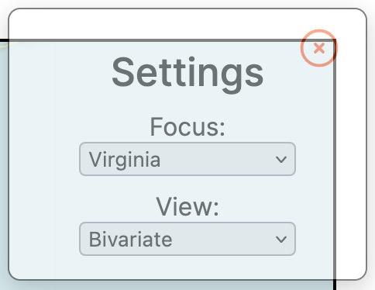
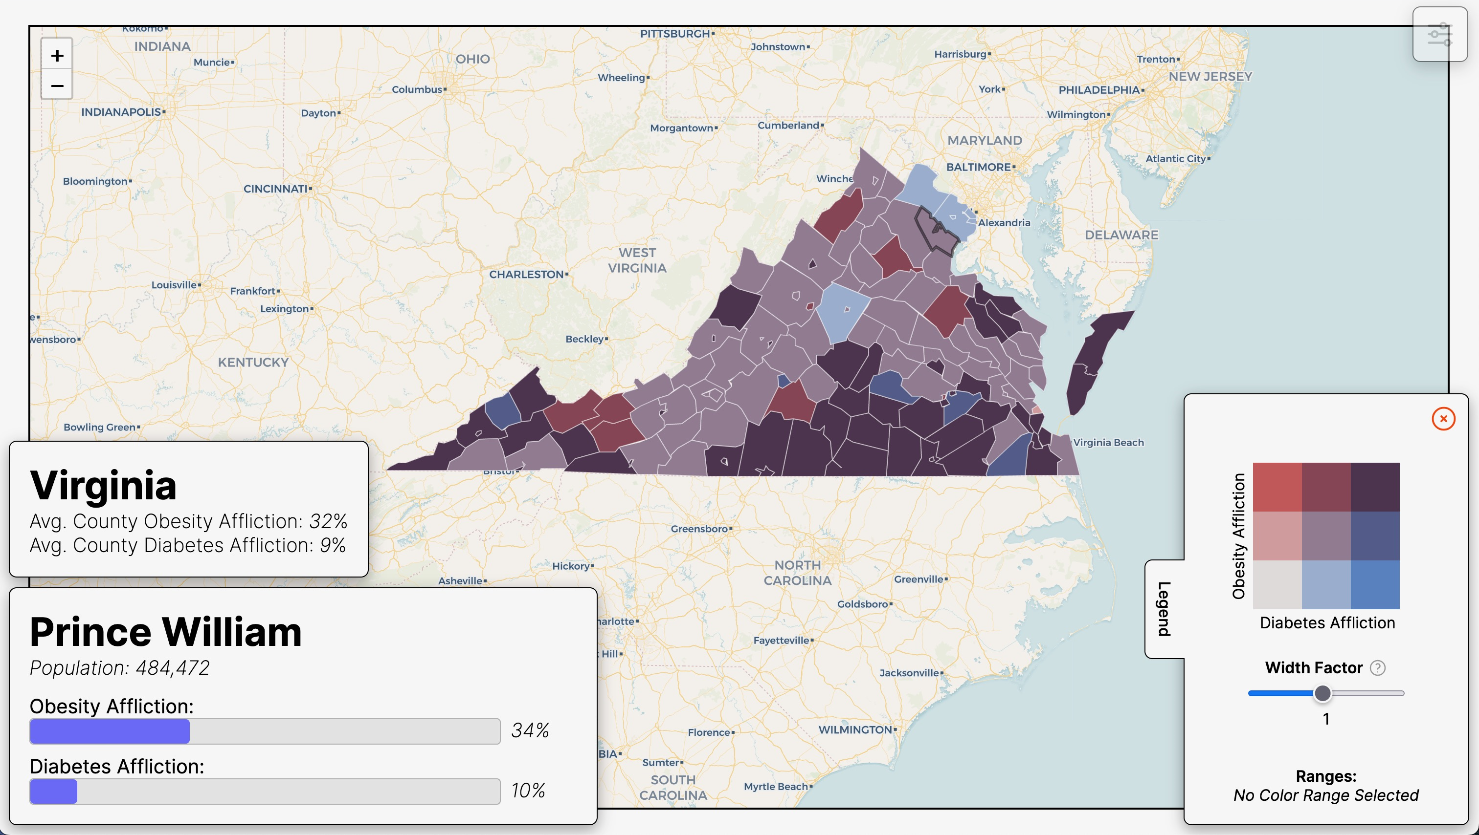
APPLICATION FEATURES
Interactive State and Color Key Filter
View Options:
National: 50 states
Single-state: county outlines
Color Key Options:
Obesity
Diabetes
Bivariate
Data Representation
Legend Features:
Choropleth Key
Width Factor
Range Display
Interactivity
Mouse Hover Feature:
State/County health data
Clicking on Legend colors to view ranges
Notes:
Sarah Burnett
A primer to the completed project before showing the full capabilities to the audience with the demo

Slide 9
DEMO
OF THE APPLICATION
Notes:
☺

Slide 10
Initial Objectives:
Choropleth map of Virginia + counties [met]
Mouse hover with further information [met]
Identify initial dataset(s) [met]
Extended Achievements:
Choropleth map for the entire United States
Choose between different scopes to view data
Choose between different choropleth keys
Technical Accomplishments:
Integration of comprehensive datasets into a user-friendly platform
Utilization of cutting-edge web technologies for real-time data visualization and responsiveness
Provided a valuable tool for stakeholders in healthcare and policy to visualize and analyze regional health trends.
COMPLETED WORK
Notes:
Sarah Burnett

Slide 11
Containerization:
  Build and bundle the application to run anywhere
Mobile Integration
  Implement the application to be adaptable on all devices
File Upload (Front-End Support)
  Finish the necessary front-end infrastructure for users to upload files to the application
FUTURE WORK
Notes:
Van Ha:
Building on our success in expanding the Health Map from the initial goal of having Virginia only to a national level, our next steps are focused on innovation and accessibility.
Firstly, we plan to employ containerization. This method will encapsulate our application in containers, ensuring it runs smoothly across different computing environments.
Next, we are set to improve adaptability and responsiveness. Our goal is to make the Health Map not just viewable, but fully functional on any device.
Furthermore, we will develop a user-friendly file upload feature. This addition will allow users to contribute their own health data, enhancing community engagement and data richness.

Slide 12

ACKNOWLEDGEMENTS
Dr. Lynn Abbott is a professor at Virginia Tech and is the sponsoring client of the Chorobesity project. He received his B.S. at Rutgers University before earning his M.S. at Stanford and finally his Ph.D in Computer Vision and Electrical Engineering.
His research interests lie in his field of doctoral studies, as well as in biometrics and autonomous vehicle systems. His publications in this work have received over 3,000 citations.
CHENYU
MAO
Chenyu Mao, currently pursuing his Master's in Computer Science and Applications at Virginia Tech, previously earned his Bachelor's degree from the same institution.
He is a sponsoring client of the Chorobesity project. He has contributed significantly by providing a visual depiction of the anticipated outcome. This visual guide has served to unify the team's direction, ensuring all members are aligned with the intended objectives.
Notes:
Van Ha
as we conclude our presentation, we would like to thank our clients for the support and for trusting us with the realization of such a significant project.
: Dr. Lyn Abbott and Chenyu Mao; we want to acknowledge that without Dr. Abbott's scholarly excellence and Mr. Mao's practical foresight, the Chorobesity project would not have reached the heights it has today.

Slide 13
REFERENCES
[1] 2023 County Health Rankings Virginia Data - v3. (n.d.). County Health Rankings & Roadmaps. https://www.countyhealthrankings.org/
[2]BVG Software (@benjaminadk). (2019, July 17). Bivariate Choropleth color generator. Observable. https://observablehq.com/@benjaminadk/bivariate-choropleth-color-generator
[3]Cartography vectors. (n.d.). Cartography Vectors. https://cartographyvectors.com/map/1129-virginia-with-county-boundaries
[4] "Extra Weight, Extra Risk | ADA." American Diabetes Association | Research, Education, Advocacy, diabetes.org/health-wellness/weight-management/extra-weight-extra-risk.
[5] "Choropleth Map." The Data Visualization Catalogue, datavizcatalogue.com/methods/choropleth.html.

Slide 14
Questions?

