Slide 1
Diversity Summit Presentation
August 15, 2017

Slide 2
Charlottesville Victim’s Mother
“Heather was not about hate, Heather was about stopping hatred. Heather was about bringing an end to injustice. I don’t want her death to be a focus for more hatred. I want her death to be a rallying cry for justice and equality and fairness and compassion.” Susan Bro, Virginia Tech employee

Slide 3
theme
INSTITUTIONALIZING DIVERSITY AND INCLUSION AT VIRGINIA TECH

Slide 4
Diversity imperative and opportunity
Our nation is changing, and our higher education institutions need to reflect this diversity. More than half of all U.S. babies today are people of color, and by 2050 our nation will have no clear racial or ethnic majority
According to Census Bureau projections, by 2050 one in two workers will be a person of color. As our nation becomes more diverse, so too does our workforce
Diversity in the workforce fosters innovation and competitiveness in business. Studies consistently show that diversity drives innovation and fosters creativity. In a Forbes survey, 85 percent of respondents said diversity is crucial for their businesses, and approximately 75 percent indicated that their companies will put more focus during the next three years to leverage diversity to achieve their business goals

Slide 5
Key Message:
Sustainable transformation is needed at Virginia Tech around diversity and inclusion
Employers and Alumni recognize value of diversity and excellence
  VT needs to be a destination for the recruitment of a diverse workforce
  VT needs to be a destination for preparing leaders to serve in the spirit of community, diversity, and excellence

Slide 6
timeline
February 1, 2016: First Day
Spring-Summer, 2016: Structuring for Sustainable Transformation
Fall-Spring 2016-2017: Strategic Diversity Implementation
Fall-Spring 2017-2018: Continued Implementation

Slide 7
Three Step Process
Step 1: Clarify the Vision
  Relationship between InclusiveVT, Ut Prosim, and Principles of Community
Step 2: Create the Structure
  Sustainable Transformation Across All Dimensions of Diversity
Step 3: Begin Implementation
  Implement Programs, Policies, Procedures, Practices, and Processes that can begin to actualize the vision
Notes:
1st: clarify the vision and relationship between inclusivevt, ut prosim, and the principles of community
2nd; create a structure to support the vision
3: implement programs, policies, procedures, practices, and processes to actualize the vision

Slide 8
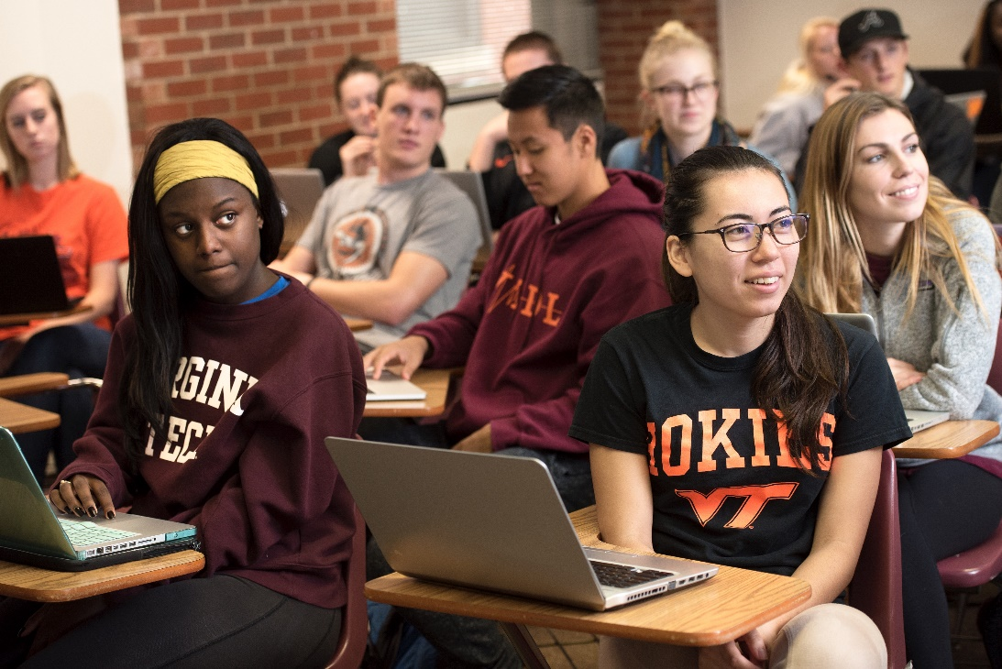
Vision: Definition of InclusiveVT
InclusiveVT is the institutional and individual commitment to Ut Prosim (that I may serve) in the spirit of community, diversity, and excellence.
Notes:
We have a definition of InclusiveVT that incorporates both Ut Prosim and the Principles of Community.

Slide 9
Four Inclusivevt institutional goals
1. Institutionalization: Institutionalizing structures to promote sustainable transformation
2. Representational Diversity: Increasing faculty, staff, and student diversity
3. Inclusive Climate: Ensuring a welcoming, affirming, safe, and accessible campus climate
4. Academic Mission: Preparing students for leadership and service (consistent with Ut Prosim) through an understanding of issues of identity, the human condition, and life chances

Slide 10
Goal 1: Institutionalizing structures
  President’s INCLUSIVEVT Executive Council
  Office of Inclusion and Diversity
    Courage. Commitment. Community.
  Diversity Committees and Diversity Plans (College and Department)
  InclusiveVT Representatives (College/Department/Students)
  ADVANCEVT/INCLUSIVEVT Faculty Committee
  Caucuses and Alliances
  Commission on Equal Opportunity and Diversity
  Cultural and Community Centers
Notes:
We’ve made progress on each goal….we have existing and new structures that are institutionalized.

Slide 11
Goal 1: Institutionalizing structures
  Cultural and Community Centers
  Black Cultural Center
  El Centro (Latinx/Hispanic)
  Native American and Indigineous Community Center
  Asian American and Pacific Islander Center
  LGBTQ+ Resource Center
  Intercultural Engagement Center
Notes:
We’ve made progress on each goal….we have existing and new structures that are institutionalized.

Slide 12
Goal 2: Increasing faculty, staff, and student diversity
Representational Diversity

Slide 13
Undergraduate Students

Slide 14
Virginia High School Graduates, Race/Ethnicity and Economic Status as % of Total, 2009-2015
The number of underrepresented and economically disadvantaged high school graduates has increased steadily since 2009.
Note: American Indian and Native Hawaiian constitute less than 0.5% of Virginia High School graduates
Source: Virginia Department of Education

Slide 15
Undergraduate Students, Percent Enrollment by Race/Ethnicity, 1987-2016
Since 1987, Virginia Tech’s enrollment of underrepresented students has increased from 4.9% to 12.5%,
at a rate of 0.25% per year.
Source: Institutional Research and Effectiveness, Fall census

Slide 16
Percent Enrollment by Race
(Total enrollment of undergraduate, graduate, and professional students on and off campus)
American Indian or Alaska Native students | <0.1%
Asian students | 8%
Black or African-American students | 4%
Hispanic students of any race | 5%
Native Hawaiian or Pacific Islander | <0.1%
White students | 65%
Two or more races | 4%
Not reported | 3%

Slide 17
Undergraduate Students, Percent Enrollment for pell recipients and first generation students, 1997-2016
Source: Institutional Research and Effectiveness, Fall census
First generation student data not collected prior to 2006

Slide 18
Underrepresented in-state first-time freshmen who enrolled in four-year public institutions, 2016-17
In 2016-17, 12% of Virginia Tech’s freshman enrollees were underrepresented Virginia high school graduates.
Source: State Council of Higher Education for Virginia (SCHEV)

Slide 19
Project 2022 Goals: 25% by 2022
By 2022, Virginia Tech projects a goal of:
  25% underrepresented minority students
  15% underserved students (low-income and first generation)
  40% total underrepresented and underserved

Slide 20
Virginia Tech Undergraduate Students,
% Continued to 2nd Year, 2002-15
Source: Institutional Research and Effectiveness, Fall census

Slide 21
Virginia Tech Undergraduate Students,
4 Year Graduation Rate, 2002-15
Source: Institutional Research and Effectiveness, Fall census

Slide 22
Virginia Tech Undergraduate Students, 6 Year Graduation Rate, 2002-15
Source: Institutional Research and Effectiveness, Fall census

Slide 23
Graduate Students

Slide 24
Graduate/PROFESSIONAL Student Enrollment by Race/Ethnicity, 1987-2016
Source: Institutional Research and Effectiveness, Fall census

Slide 25
Tenured/Tenure Track Faculty

Slide 26
Tenured/Tenure Track Faculty, % by Race/Ethnicity, 1997-2016
Source: Institutional Research and Effectiveness, Fall census

Slide 27
Tenured/Tenure Track Faculty, % by gender, 1997-2016
Source: Institutional Research and Effectiveness, Fall census

Slide 28
New tenured/tenure track faculty hires, 2012-16, 2017 projected
By Race/Ethnicity
By Gender
Source: Institutional Research and Effectiveness, Fall census

Slide 29
Academic Professional Faculty/Staff

Slide 30
ADMINISTRATIVE/PROFESSIONAL Faculty, % by Race/Ethnicity, 1997-2015
Source: Institutional Research and Effectiveness, Fall census

Slide 31
Staff, % by Race/Ethnicity, 1997-2016
Source: Institutional Research and Effectiveness, Fall census

Slide 32
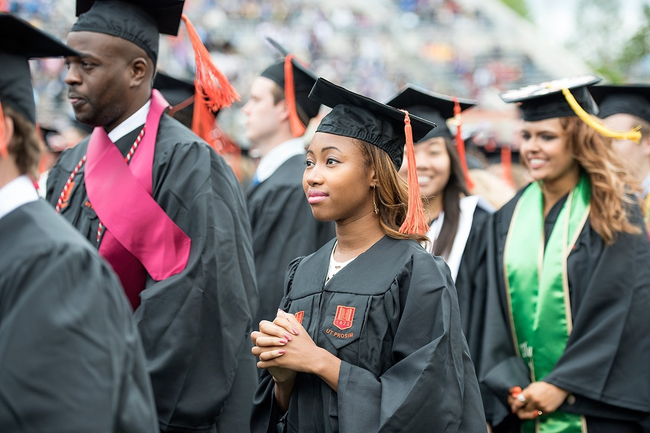
Goal 2: Increasing diversity: students
InclusiveVT Project 2022
  Enrollment Management, Advancement,
  Faculty/Staff Caucuses
College Access Collaborative,
Student Academic Success Work Group
  Review of successful programs
Science Mentoring Program and Research Project
  College of Science, College of Agriculture and Life Sciences, and College of Natural Resources & Environment
Notes:
We started InclusiveVT Project 2022 to increase recruitment of underrepresented students and we also are engaged in retention efforts.

Slide 33
Increasing diversity: students
InclusiveVT Project 2022
  Summer Experiences
  Alumni Engagement
  Scholarships
Black College Institute
ExploreVT Summer Experience
Hispanic College Institute
Vice Provost for Enrollment Management
Notes:
We started InclusiveVT Project 2022 to increase recruitment of underrepresented students and we also are engaged in retention efforts.

Slide 34
Enhancing Faculty Diversity
PIBB (budget model): Each college and vice president will report annually on faculty diversity (composition) and experiences of faculty from underrepresented groups (climate).
  The PIBB model will provide budget allocations for success. Partnership planning funds will be used for needed improvements or for special initiatives with matching funds.
  Faculty Success Scorecard will measure a number of diversity metrics, emphasizing the importance of diversity as a university strategic goal.
Cluster hiring: cluster ads will invite contributions to diversity (scholarship, experiences) and will cast a broad net for expertise.
  Cluster search committees will include a diversity advocate and a representative from the AdvanceVT/InclusiveVT Committee.

Slide 35
InclusiveVT Faculty Diversity Program
Target of Talent Program
  Future Faculty Fellows
  Post-doctoral fellowships
  Senior Faculty
  Visiting Faculty
  Director of Faculty Diversity Recruitment

Slide 36
InclusiveVT Faculty Diversity Program
Required Search Process Education
  DiversityEdu – Unconscious Bias Search Committee
  Equity and Accessibility Search Committee
  Search Chair and Diversity Advocate

Slide 37
Goal 3: Ensuring a welcoming, affirming, safe, and accessible campus climate
Welcoming new members to our community
Reconnecting with current faculty, staff, and students
Forming new relationships and collaborations
Retention
Notes:
Miraculously, through amazing commitment and engagement of campus and partnership with student affais, implemented diversity Edu for 93% of freshman class and thanks to support of BOV, it will be formally required of all entering students this coming fall

Slide 38
Goal 3: Ensuring a welcoming, affirming, safe, and accessible campus climate
DiversityEdu
  Online course required for all students
  Explains the Virginia Tech Principles of Community, provides definitions of key concepts, and encourages students to develop courageous friendships across difference; engage safe spaces and stretch spaces
  FYE, Student Affairs, Housing/Residence Life, Graduate and professional schools
Notes:
Miraculously, through amazing commitment and engagement of campus and partnership with student affais, implemented diversity Edu for 93% of freshman class and thanks to support of BOV, it will be formally required of all entering students this coming fall

Slide 39
Goal 3: Ensuring a welcoming, affirming, safe, and accessible campus climate
InclusiveVT Representatives
  College and Department
Inclusive Pedagogy/HHMI Grant
InclusiveVT Student Representatives
  Graduate and Undergraduate
Notes:
Efforts related to climate include an inclusive pedagogy series for faculty and campus-wide programs through VTunfinished

Slide 40
Goal 3: Ensuring a welcoming, affirming, safe, and accessible campus climate
LGBTQ Concerns
Climate Survey
Gender Identity workgroup/facilities
Banner Preferred Name
Notes:
Miraculously, through amazing commitment and engagement of campus and partnership with student affais, implemented diversity Edu for 93% of freshman class and thanks to support of BOV, it will be formally required of all entering students this coming fall

Slide 41
Recent Discussions on VT Women’s Issues
AdvanceVT Session (Jan. 2016)
Women’s Alliance Formed
Survey for Formation of Alliance
(Feb. 2016)
Pay Equity Study Resolution (Feb – April, 2016)
Proposal for Council on Status of Women at VT
(Fall 2016 – Spring 2017)
Information Gathering with VT Women Faculty and Graduate Students (Feb 2017)
Burruss Data Meeting (Nov 2015)
VT Faculty Salary Equity Study Results (Nov 2015)
HR Restructure Presentation / Burruss Data Meeting (Mar 2017)
Notes:
Conversations and stories around campus seemed to suggest that there is various experiences for women on our campus, including salary equity, differential implementation of policy, hiring processes, development opportunities, etc.
VT Faculty Salary Equity Study Results (Nov 2015)
Page 4 quote: “Preliminary descriptive statistics indicate that the average nine-month equivalent salary for males within the population is approximately $108,400, compared to roughly $92,900 for females. Thus, without controlling for other factors, male salaries average 17% higher than female salaries. The average salary for underrepresented minorities ($92,270.80) is 88% of the average salary for other faculty members ($104,913.94)… from the analysis, we were able to conclude that as mediating factors are introduced into the models, the influence of gender, as well as race/ethnicity, on salary seems to dissipate to negligible levels”
Page 7 quote: “While women comprise a relatively small proportion (28%) of the full-time instructional faculty population at Virginia Tech, this does reflect an increase over the proportions achieved in the early 2000’s. Women are achieving parity in salary when compared with male faculty with similar characteristics. However, factors that did contribute significantly to explaining differences in salary were attained more often for men than for women. Holding the rank of full professor and holding the Eminent Scholar/University Distinguished Professor status were two factors that significantly affected salary, but were achieved by a greater percentage of men than women. Part of this is reflective of the historical hiring patterns at the university, specifically, the predominance of men in the faculty thirty to forty years ago.
Study only conducted on tenure track/tenured faculty
Study does not look at climate issues
Questions: While salary across faculty ranks seem to wash out, is it because there are low numbers of women in certain ranks/departments? What about other job classifications (research faculty, instructors, staff, AP faculty)? Are women more likely to be hired in lower paying jobs than men?
Burruss Data Meeting (Nov 2015) – Mary Beth Dunkenberger and Anna LoMascolo met with several administrators to discuss women’s issues on campus.
AdvanceVT Session / Women’s Alliance Formed (Jan 2016)
Conversation session at AdvancedVT (~60 people in attendance)
Several themes emerged to inform an internal survey
Survey for Formation of Women’s Alliance (Feb 2016) - Priority Needs:
Work-life balance
Support for Women in Leadership Roles – advancement within VT vs. leaving for other institutions
Support women as mentors for new employees and students / Empower mentors to speak up on behalf of mentees
Childcare
Equality in leave and pay for both staff and faculty
Promotion of education and training opportunities
Address gender-based violence and harassment
Teaching faculty should be more representative of student population
P&T guidelines – interpret consistently across colleges/departments
THERE SEEMS TO BE A GAP BETWEEN QUANTITATIVE REPORTS AND STORIES OF WOMEN ON CAMPUS
Pay Equity Study Resolution to CEOD (Spring 2016) – requested more in depth, qualitative survey from external reviewer
Proposal for Council on Status of Women (2016-2017) – requested advisory council to review status of women at VT
Conversations w/ VT Faculty and Graduate Students (Feb 2017) – Priority Themes
HR Restructuring Presentation / Burruss Data Meeting (Mar 2017)
HR Presentation: “Inequity in Pay and Other Employment Terms: Policies are broad or ill-defined at central HR and units have made their own decisions and policies to fit their needs, resulting in differing pay and other practices across the institution”
Data Meeting: Salary in good shape regarding tenure-track/tenured faculty and staff; not sure about AP faculty because of too many variances in job titles and responsibilities
Jack agreed to look in to data related to dual hiring practices, who comes in as tenured, modified duty variations
Women’s Alliance is asking for intentionally and accountability across the university
Questions to consider: Are women hired at lower ranks than men? How can we make sense of data with small sample numbers? How can we capture and work on women’s climate and perceptions?
Conversations with AP Faculty and Staff (April 2017)

Slide 42
Women’s Conversations: Key themes
College/Departmental leadership on addressing women’s issues
Qualified, trained mentors and advisors; supportive networks
Equitable allocation and recognition of service responsibilities
Clear criteria for promotion/tenure, employee evaluation
Greater job security and professional advancement opportunities
Work/life balance
Doctoral student success and mentoring
Greater diversity among leaders, faculty, and students
Notes:
College/Departmental Leadership on addressing women’s issues
Qualified, trained mentors and advisors; supportive networks
Equitable allocation and recognition of service responsibilities
Clear criteria for promotion/tenure, employee evaluation
Greater job security and professional advancement opportunities
Work/life balance
Doctoral Student Success and Mentoring
Greater diversity among leaders, faculty, and students

Slide 43
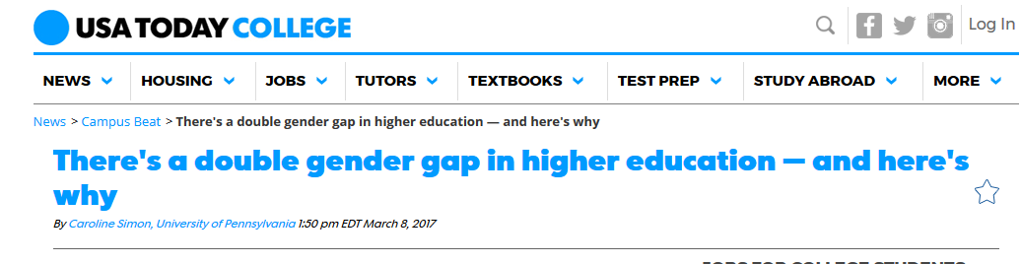

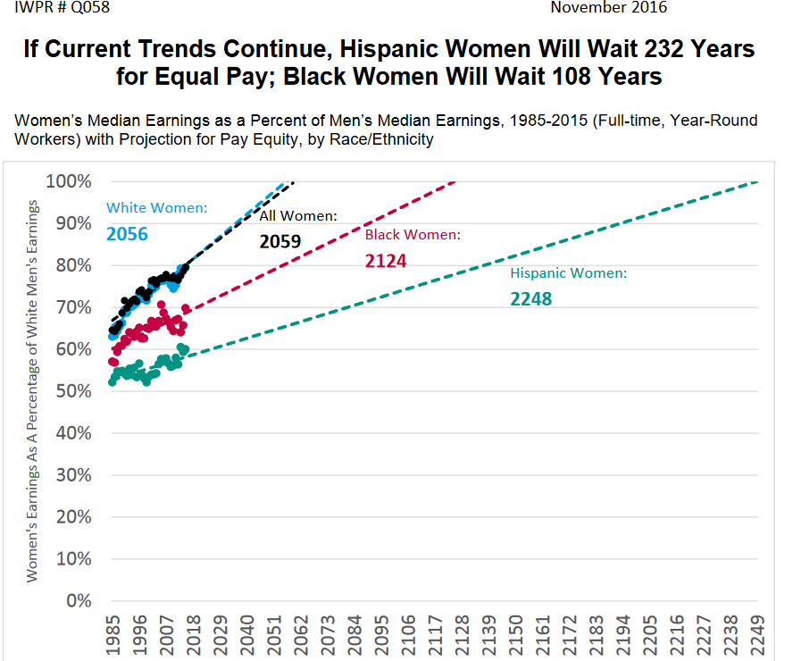
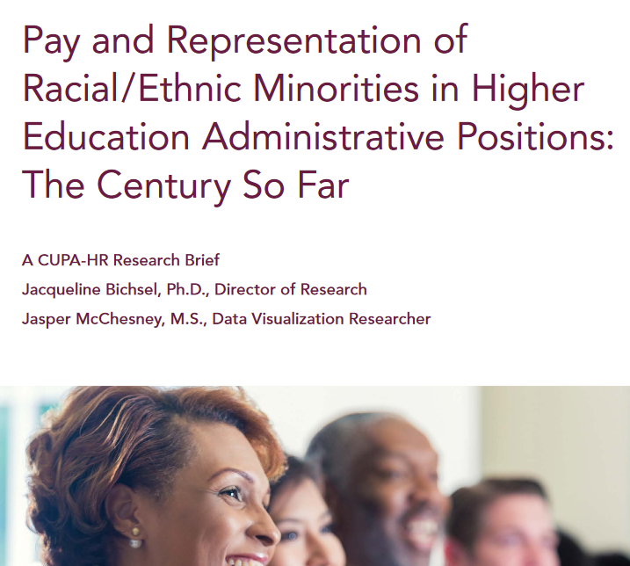

VT is Not Alone…
'Equal Means Equal' women's rights film shown in Harrisonburg
Zachary Harris I The Breeze 13 hrs ago
  Liz Strauss I The Breeze
After the film, a panel of Harrisonburg women opened up discussions on positive change for women's rights.
  JMU students and people from the Harrisonburg community gathered in Grafton-Stovall Theater for a viewing of "Equal Means Equal." The documentary discussed various women's issues including wage discrimination, international women's rights, sex trafficking and America's current legal system.
Notes:
Added some recent gender equality headlines
JMU in Harrisonburg – viewed film “Equal Means Equal” about women’s issues just yesterday.
CSU unveiled climate report on March 20th – shows that women face pervasive fear of retaliation, sexist insinuations and inconsistent applications of earned benefits such as parental leave
Reports from CUPA-HR show that there is a still a pay gap across gender and racial lines

Slide 44
New Initiative
InclusiveVT Executive Council Work Group on Gender Issues
Co-chairs: Sally Morton, Dean
Andrew McCoy, Department Head

Slide 45
Goal 3: Ensuring a welcoming, affirming, safe, and accessible campus climate
Different Abilities
  Facilities and Access
  Student Support
Notes:
Miraculously, through amazing commitment and engagement of campus and partnership with student affais, implemented diversity Edu for 93% of freshman class and thanks to support of BOV, it will be formally required of all entering students this coming fall

Slide 46
Veterans and diversity
Veterans represent an important opportunity to enhance diversity as students and as employees
Course credit for service
Veteran’s recognition as a campus
Admissions pipeline and resources for veterans

Slide 47
Goal 3: Ensuring a welcoming, affirming, safe, and accessible campus climate
First Generation/Economic Status/Rural Appalachia
Student Support
Resources
Climate
Notes:
Miraculously, through amazing commitment and engagement of campus and partnership with student affais, implemented diversity Edu for 93% of freshman class and thanks to support of BOV, it will be formally required of all entering students this coming fall

Slide 48
InclusiveVT Week of Commitment
September 11 – 16: College/Unit Level Events of Commitment
September 12: Professor Mary Beth Gasman
September 13: #VTUnfinished
September 14: Still Concerned (TBA)
September 16: Corps of Cadets

Slide 49
Institutional partnerships
HBCU Summit: October 15-16
  Virginia State University continuing partnership
  Several new potential partners
Native Summit: May, 2017
  11 tribal nations

Slide 50
Goal 4: Preparing students for service -- understanding of issues of identity, the human condition, and life chances
Pathways Core Learning Area: Critical Analysis of Identity and Equity in the United States: 3 credit hours - required for all VT students
Strategic Growth Area: Equity and Social Disparity in the Human Condition
  Explore the ways in which issues of identity, equity, and social disparity impact multiple academic disciplines, fields of study, and areas of inquiry
Advancing the Human Condition Conference: November 28-30,2017
Notes:
We also made great progress with a new strategic growth area: equity and social disparity in the human condition as part of original destination area vision. Pathways curriculum is moving through governance and hope to have resolution to university council this spring.

Slide 51
Today’s Objectives
Vice Provost for Enrollment Management
Responding proactively to social, cultural, and political factors influencing diversity and inclusion at Virginia Tech
Lunch
Break Out Groups
Student Success
Faculty Diversity
Inclusive Climate
Academic Mission
Next Steps

Slide 52
Dr. Luisa M. Havens joined Virginia Tech on August 1.
Prior to joining VT, she was Vice President for Enrollment Services at Florida International University (FIU) for almost 5 years.
Prior to FIU, she served as Executive Director for Enrollment Services at The University of Texas at El Paso (UTEP). She began her career as a student recruiter at her Alma Matter, the University of Idaho. She has served in leadership roles in the areas of admissions, recruitment, registration, international admissions, graduate admissions, financial aid and enrollment services.
She served as the Vice President for Access and Equity in the Board of Directors of the American Association of Collegiate Registrar and Admissions Officers (AACRAO) from 2010 to 2013 and is an institutional delegate to the College Board.

Slide 53
Originally from Honduras, she holds a BS degree in Radio and TV production, a Master's degree in Resource Recreation and Tourism and a Ph.D.in Education with an emphasis in Higher Education Administration from the University of Idaho.
Throughout her career, Dr. Havens has worked with diverse, underrepresented and/or at-risk populations. Such experiences contributed to her doctoral research focus on at-risk student persistence.
Experience at serving transfer students, military veterans, low SES populations and first generation college students.
She frequently presents at local, regional and national forums on varied topics such as applying strategic enrollment management practices at urban universities, process reengineering in enrollment services, staff development and training and leadership/management development.

Slide 54
Dr. Luisa Havens,
Vice Provost for Enrollment Management

Slide 55
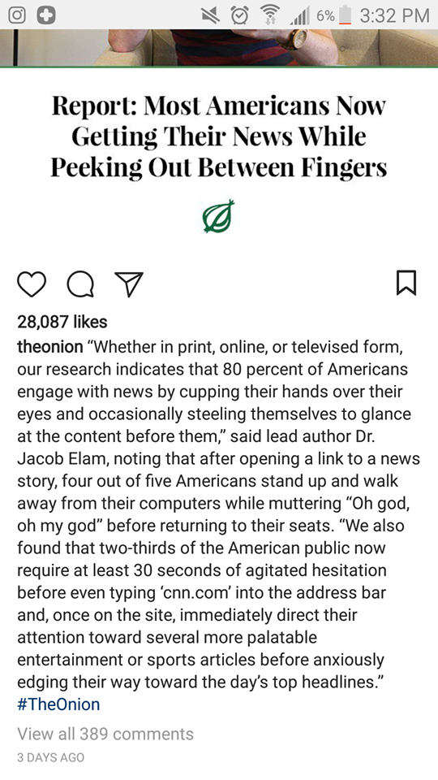

Slide 56
Conceptual Framework: Multicontextual
Diversity Learning Environment Model (DLE)
Hurtado, S. Milem, J. F., Clayton-Pedersen, A. R., Allen, W. A. (1998). Enhancing Campus Climates for Racial/Ethnic Diversity: Educational Policy and Practice.
Notes:
Last year’s conceptual framework to guide the work of diversity, inclusion and equity at Virginia Tech
Tasked with reminding those of us who were here … and briefly share with those of us who are new at Tech

Slide 57
Seminal framework, a distillation of more than 30 years of research
Research on race, ethnicity, as well as collaborations with other scholars to include study of undergraduate, graduate students, faculty, staff, and experiences of women, LGBTQ+ students, international students, religious groups
Includes areas of curriculum, policies and resources
Includes multiple dimensions/contexts to show how various campus communities experience campus climate and the influence on learning outcomes
Notes:
Little scholarship exists to establish an empirical link between structural support ant the institutional level and campus racial climate
Adopted by other universities, Michigan, Penn …
Rare for all campus to assess all dimensions
Measure the impact of changing policies, Michigan Student Body, 2008)

Slide 58
“No policy can be isolated from the social arena in which it is enacted” (Tierney, 1997, p. 177)
Notes:
Sharing a quote from last year’s summit

Slide 59
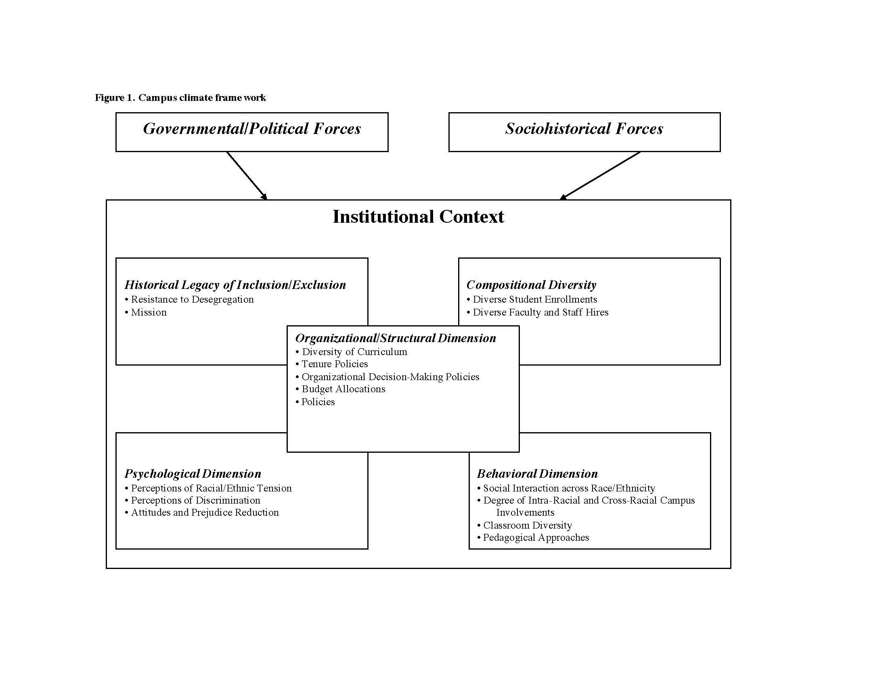

Slide 60
Table Discussion
In light of the current social/political context, what might be some implications and challenges for advancing diversity and inclusion in higher education? (20 minutes)
What proactive steps can Virginia Tech take to mitigate, respond to the challenges and become a leader in advancing diversity and inclusion? (20 minutes)
Report Out-share what might be one proactive response (30 minutes)
Notes:
For the next 30 minutes, please address the following questions at your tables
Report out … harvest the wisdom from the room

Slide 61

Thank you for your commitment!
Notes:
It is important to me to develop the people with whom I work and design specific plans to achieve goals.

