Slide 1

Wind Farm Layout Optimization Considering Commercial Turbine Selection and Hub Height Variation
The Department of
Mechanical and Manufacturing Engineering
Mamdouh ABDULRAHMAN
PhD Student
Supervisor:
Prof. David Wood

Slide 2
500 MW x $2 million/MW (in average) = $1 billion
400 MW x $2 million/MW (in average) = $0.8 billion
400 MW for only $0.65 billion or $1.625 million/MW
100 MW for $0.35 billion or $3.5 million/MW
HOW ABOUT EXPLORING TRADE-OFF RANGE ?
Providing that
ALL CALCULATIONS ARE BASED ON DATA OFFERED BY MANUFACTURERS & DEVELOPERS

Slide 3
Presentation Outline
WFLO - a background.
Research Objectives.
Wake Modelling
Commercial Turbines & Coefficients.
Power Calculations.
Simple Cost Analysis.
Optimization.
Results and Discussion.
Conclusions.
Further Work.

Slide 4
1- WFLO, a background (1)
WFLO
It is the problem of how to design a wind farm so that desirable quantity (P, CF, etc.) is maximized and/or undesirable quantity (cost, noise, etc.) is minimized.
Design Variables
Constraints
Optimization Methodology
Objective Function(s)
N
Turbines’ siting
Turbines’ sizes
Turbines’ heights
Owners’ Decision
N
Farm Area
Total Cost
Noise Level
GA
Other Bio-Inspired
MILP & MINLP
MCO
PSO
other
P
Cost Of Energy
CF
Noise Level
Land Usage
Multi-Objective

Slide 5
1- WFLO, a background (2)
The first WFLO work has been published in 1994,
1994-2005: no significant contributions have been added,
2005-2009: few remarkable contributions,
2009-2014: wide awareness and variety in approaches,
Very few studies considered turbine selection and/or hub height variation,
Nobody implemented COMMERCIAL turbine selection,
Nobody implemented general realistic C_{T} representation,
Nobody considered more than TWO objective functions.

Slide 6
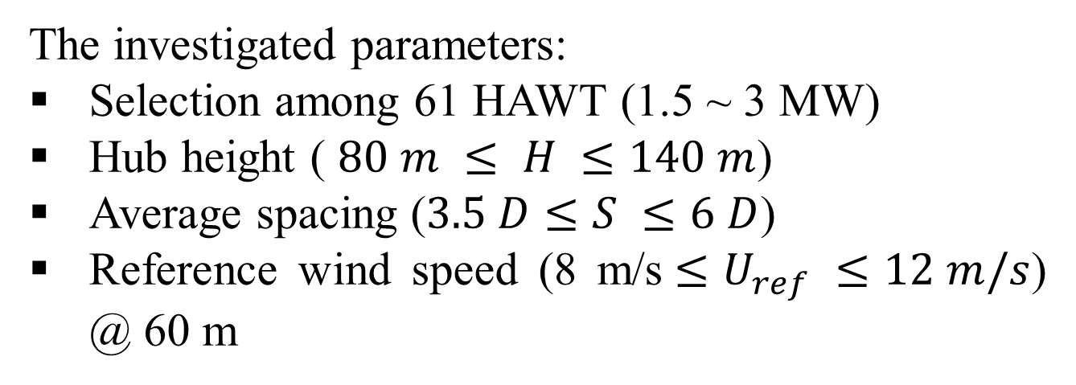
2- Research Objectives
“The proposed work aims to add the commercial turbine selection and general realistic C_{T} representation to the WFLO, combined with hub height variation and considering three objective functions”
The investigated parameters:
Selection among 61 HAWT (1.5 ~ 3 MW)
Hub height ( $80 m ≤ H ≤140 m$)
Average spacing ($3.5 D≤S ≤6 D$)
Reference wind speed (8 m/s$≤U_{ref} ≤12 m/s$) @ 60 m

Slide 7
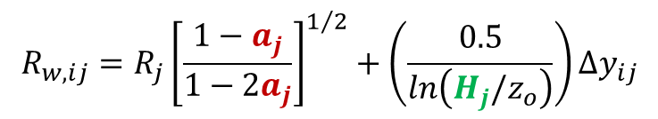
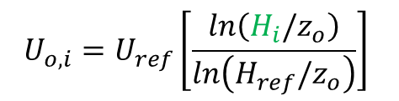

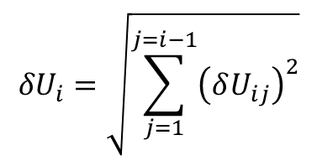
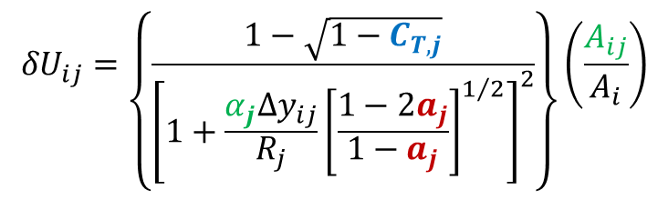
3- Wake Modelling
Jensen’s Wake Model: Jensen (1983), Katic et al. (1986), and Frandsen (1992)
$$R_{w,ij}=R_{j}{\left[\frac{1−a_{j}}{1−2a_{j}}\right]}^{1/2}+\left(\frac{0.5}{ln\left(H_{j}/z_{o}\right)}\right)∆y_{ij}$$
R_{i}
A_{ij}
$${δU}_{ij}=\left\{\frac{1−\sqrt{1−C_{T,j}}}{{\left[1+\frac{α_{j}∆y_{ij}}{R_{j}}{\left[\frac{1−{2a}_{j}}{1−a_{j}}\right]}^{1/2}\right]}^{2}}\right\}\left(\frac{A_{ij}}{A_{i}}\right)$$
O_{ij}
R_{w,ij}
$${δU}_{i}=\sqrt{\sum_{j=1}^{j=i−1}{{\left(δU_{ij}\right)}^{2}}}$$
H_{i}
H_{j}
Δx_{ij}
$$U_{i}= U_{o,i}\left(1−{δU}_{i}\right)$$
$$U_{o,i}=U_{ref}\left[\frac{ln\left(H_{i}/z_{o}\right)}{ln\left(H_{ref}/z_{o}\right)}\right]$$
Ground level
A Schematic front view, parallel to the wind direction, Y.

Slide 8
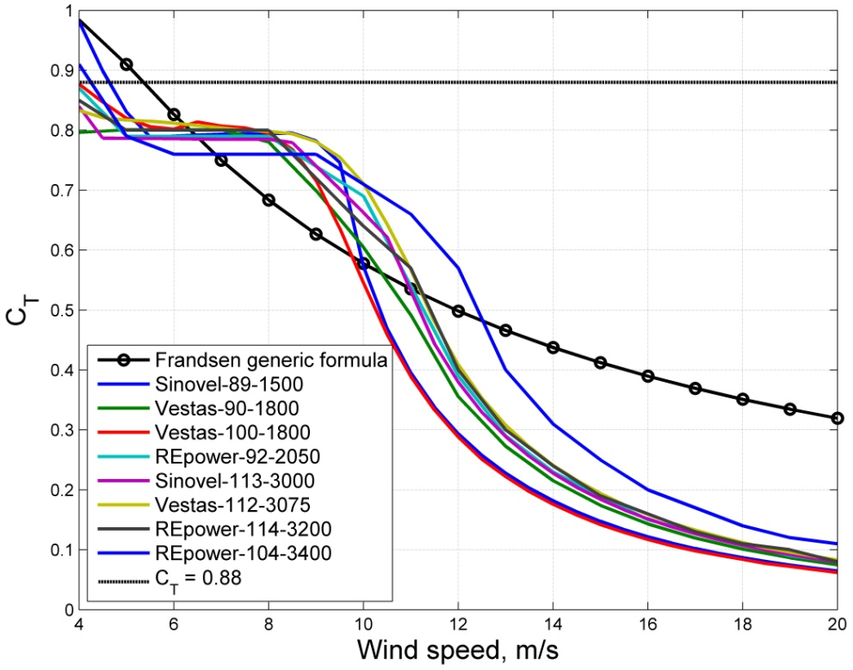
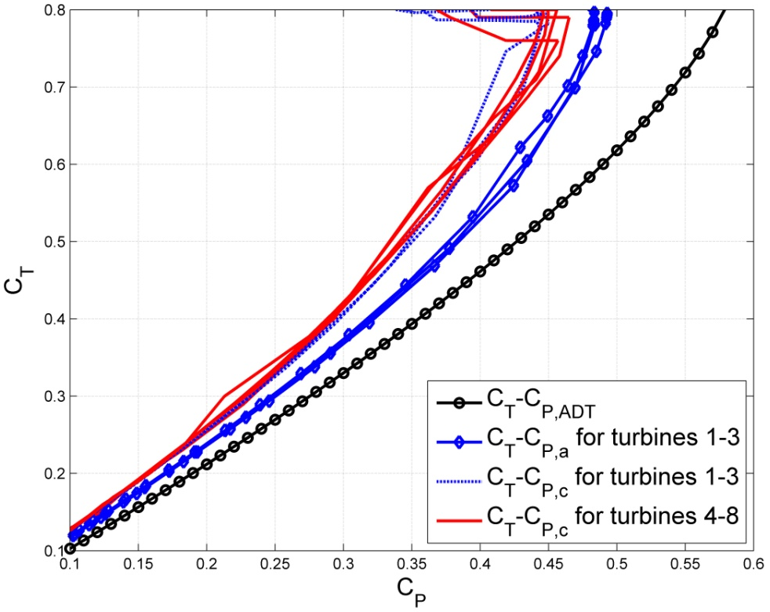
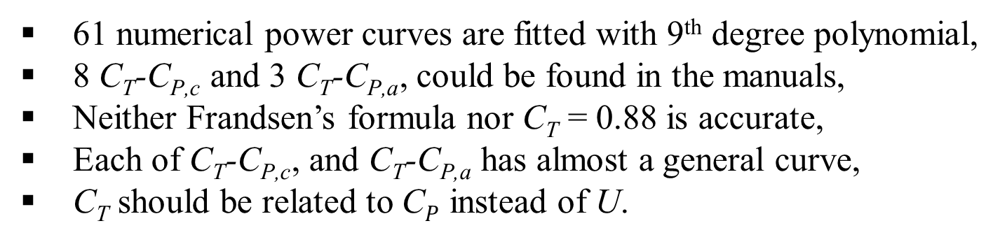
4- Commercial Turbines & Coefficients
61 numerical power curves are fitted with 9th degree polynomial,
8 $\text{C}\text{T}$-$\text{C}\text{P}\text{,}\text{c}$ and 3 $\text{C}\text{T}$-$\text{C}\text{P}\text{,}\text{a}$, could be found in the manuals,
Neither Frandsen’s formula nor $\text{C}\text{T}$ = 0.88 is accurate,
Each of $\text{C}\text{T}$-$\text{C}\text{P}\text{,}\text{c}$, and $\text{C}\text{T}$-$\text{C}\text{P}\text{,}\text{a}$ has almost a general curve,
$\text{C}\text{T}$ should be related to $\text{C}P$ instead of U.

Slide 9
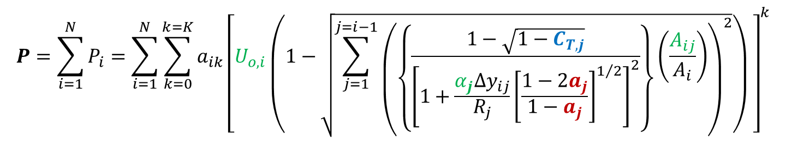
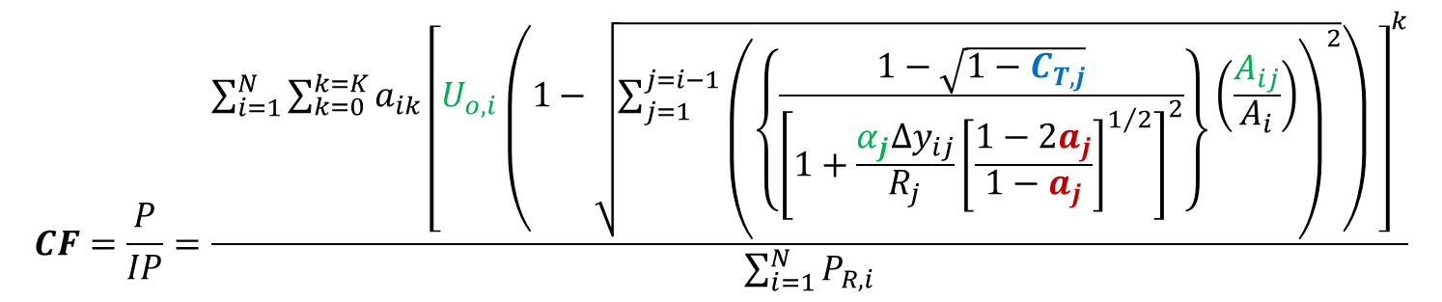
5- Power Calculations
Total output power
$$P=\sum_{i=1}^{N}{P_{i}}=\sum_{i=1}^{N}{\sum_{k=0}^{k=K}{a_{ik}{\left[U_{o,i}\left(1−\sqrt{\sum_{j=1}^{j=i−1}{{\left(\left\{\frac{1−\sqrt{1−C_{T,j}}}{{\left[1+\frac{α_{j}∆y_{ij}}{R_{j}}{\left[\frac{1−{2a}_{j}}{1−a_{j}}\right]}^{1/2}\right]}^{2}}\right\}\left(\frac{A_{ij}}{A_{i}}\right)\right)}^{2}}}\right) \right]}^{k}}}$$
Farm capacity factor
$$CF=\frac{P}{IP}=\frac{\sum_{i=1}^{N}{\sum_{k=0}^{k=K}{a_{ik}{\left[U_{o,i}\left(1−\sqrt{\sum_{j=1}^{j=i−1}{{\left(\left\{\frac{1−\sqrt{1−C_{T,j}}}{{\left[1+\frac{α_{j}∆y_{ij}}{R_{j}}{\left[\frac{1−{2a}_{j}}{1−a_{j}}\right]}^{1/2}\right]}^{2}}\right\}\left(\frac{A_{ij}}{A_{i}}\right)\right)}^{2}}}\right) \right]}^{k}}}}{\sum_{i=1}^{N}{P_{R,i}}}$$
IP Installed Power P_{R} Rated Power

Slide 10
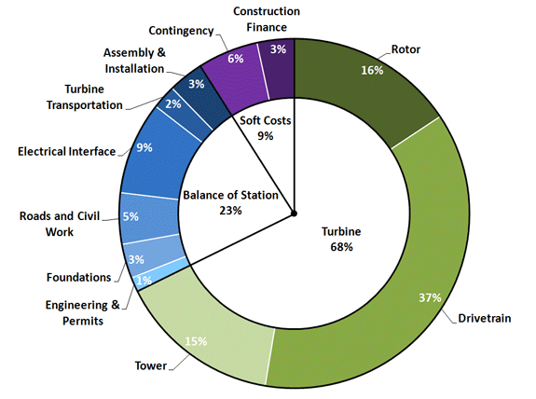
6- Simple Cost Analysis (1)
Only the ICC is considered,
Turbines’ cost is the major cost component,
The ICC of 1 MW at H = 80 m is considered unity and denoted Capital Cost Index (CCI ),
The tower cost = 0.15/0.68
= 0.2206 of the CCI ,
Typical Installed Capital Cost (ICC) breakdown of an onshore wind power project [2011 Cost of Wind Energy Review, NREL Report, 2013].
An increase in H by 1 m costs 0.2206/80 = 0.0027575 of the CCI ,

Slide 11
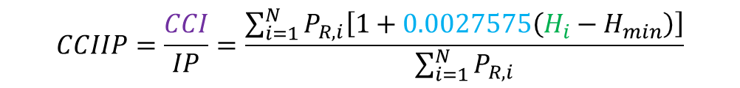
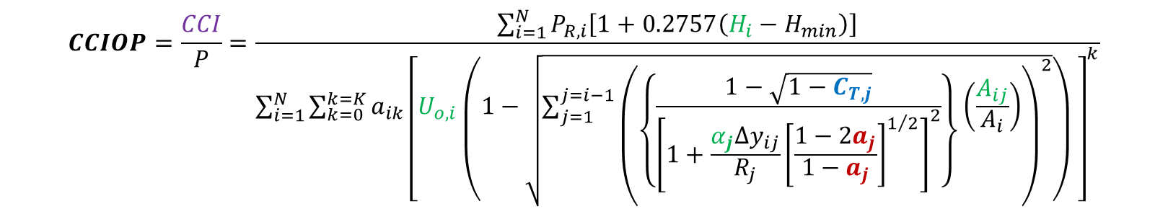
6- Simple Cost Analysis (2)
Capital Cost Index per Installed Power
$$CCIIP=\frac{CCI}{IP}=\frac{\sum_{i=1}^{N}{P_{R,i}\left[1+0.0027575\left(H_{i}−H_{min}\right)\right]}}{\sum_{i=1}^{N}{P_{R,i}}}$$
Capital Cost Index per Output Power
$$CCIOP=\frac{CCI}{P}=\frac{\sum_{i=1}^{N}{P_{R,i}\left[1+0.2757\left(H_{i}−H_{min}\right)\right]}}{\sum_{i=1}^{N}{\sum_{k=0}^{k=K}{a_{ik}{\left[U_{o,i}\left(1−\sqrt{\sum_{j=1}^{j=i−1}{{\left(\left\{\frac{1−\sqrt{1−C_{T,j}}}{{\left[1+\frac{α_{j}∆y_{ij}}{R_{j}}{\left[\frac{1−{2a}_{j}}{1−a_{j}}\right]}^{1/2}\right]}^{2}}\right\}\left(\frac{A_{ij}}{A_{i}}\right)\right)}^{2}}}\right) \right]}^{k}}}}$$

Slide 12
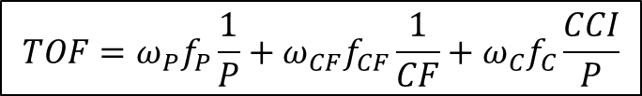

7- Optimization
The 3 objective functions are scaled, adapted, weighted, and combined into one Total Objective Function:
Scaling: turning all terms in to the same order of magnitude,
Minimum turbines’ proximity = 3 D
TolFun = 10⁻¹⁵ (default = 10⁻⁶),
ConFun = 10⁻⁹ (default = 10⁻⁶),
PopulationSize = 10 ~ 50 nvars & Generations = 3,000.
$$TOF=ω_{P}f_{P}\frac{1}{P}+ω_{CF}f_{CF}\frac{1}{CF}+ω_{C}f_{C}\frac{CCI}{P}$$
$$ω_{P}+ ω_{CF}+ ω_{C}=1.0$$

Slide 13
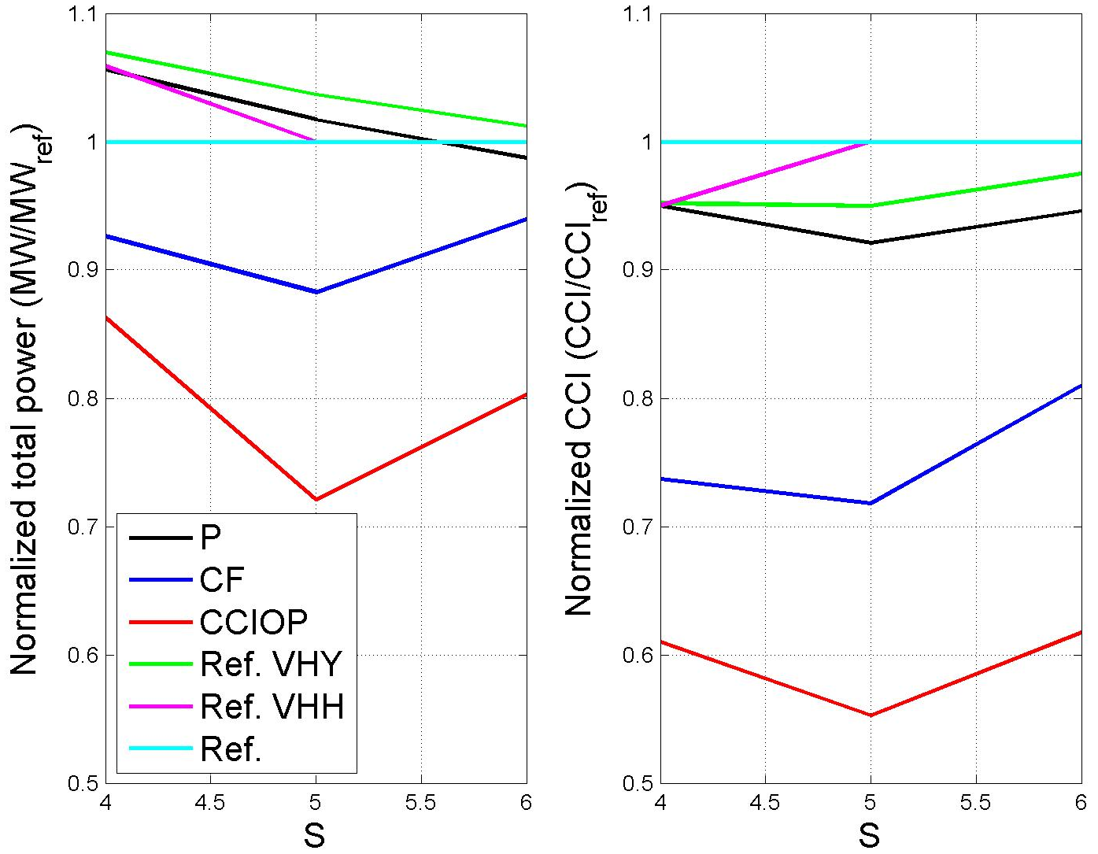
8- Results and Discussion (1)
Case 1: Turbines In Line (parallel to wind direction), N = 6
Normalized P & CCI for case 1, U_{ref.} = 8 m/s @ 60 m.

Slide 14
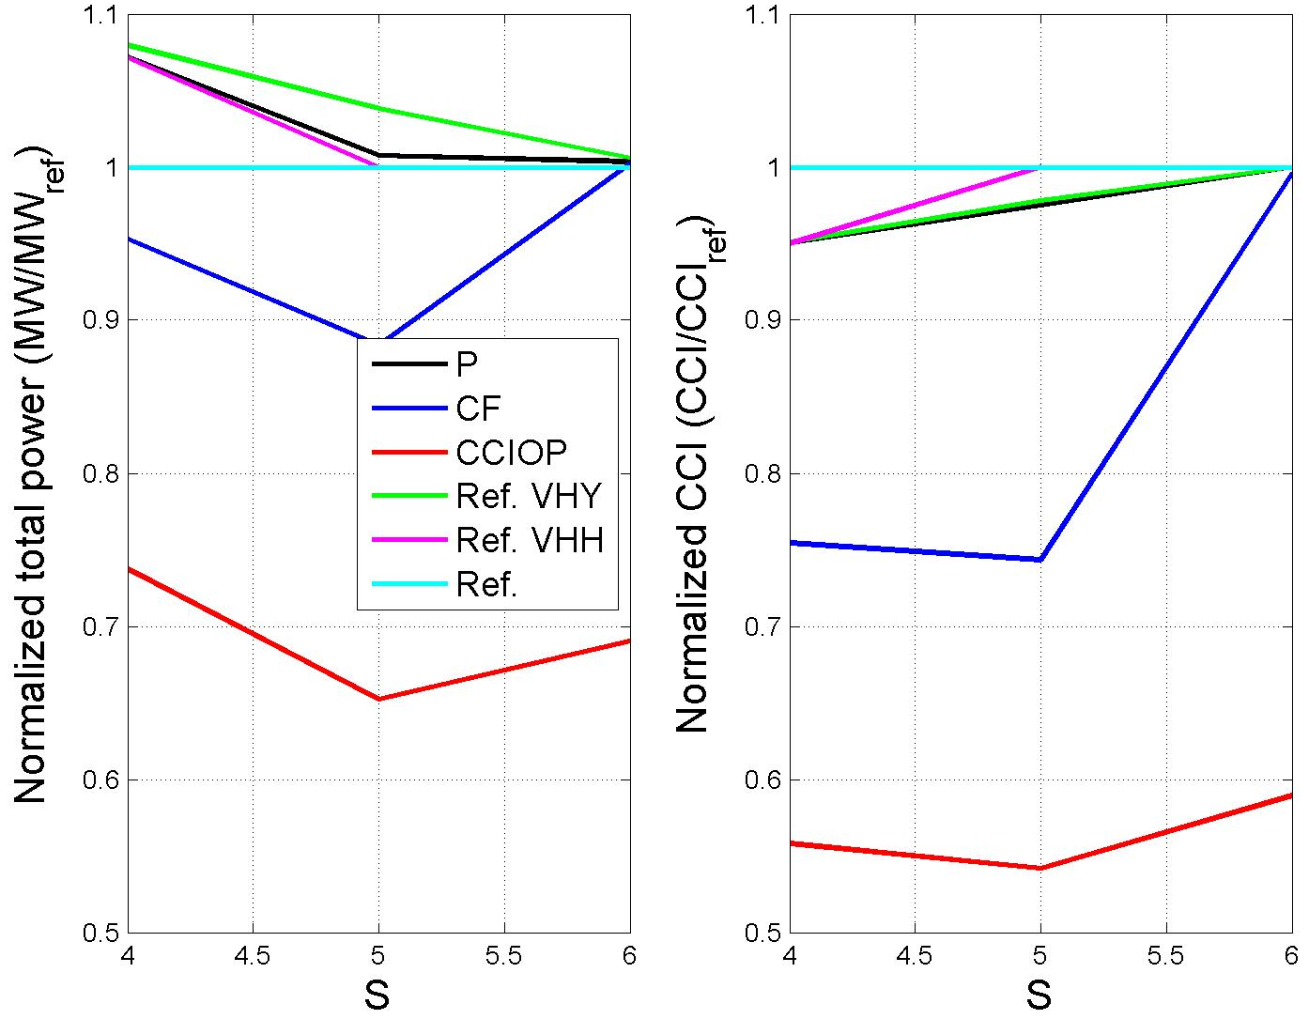
8- Results and Discussion (2)
Case 1: Turbines In Line (parallel to wind direction), N = 6
Normalized P & CCI for case 1, U_{ref.} = 10 m/s @ 60 m.

Slide 15
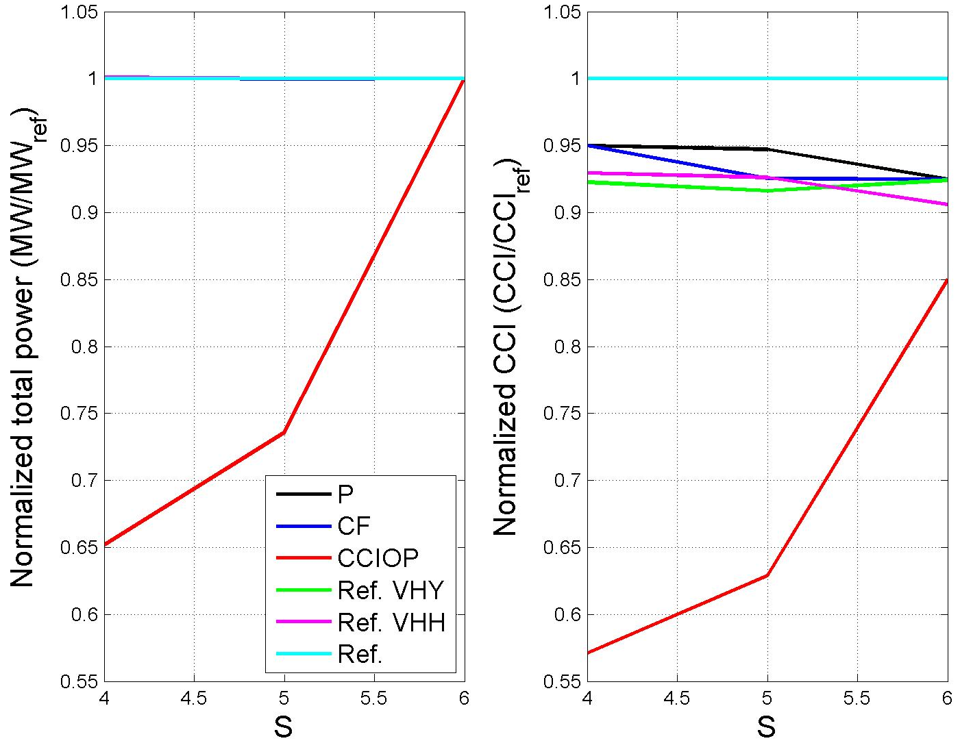
8- Results and Discussion (3)
Case 1: Turbines In Line (parallel to wind direction), N = 6
Normalized P & CCI for case 1, U_{ref.} = 12 m/s @ 60 m.

Slide 16
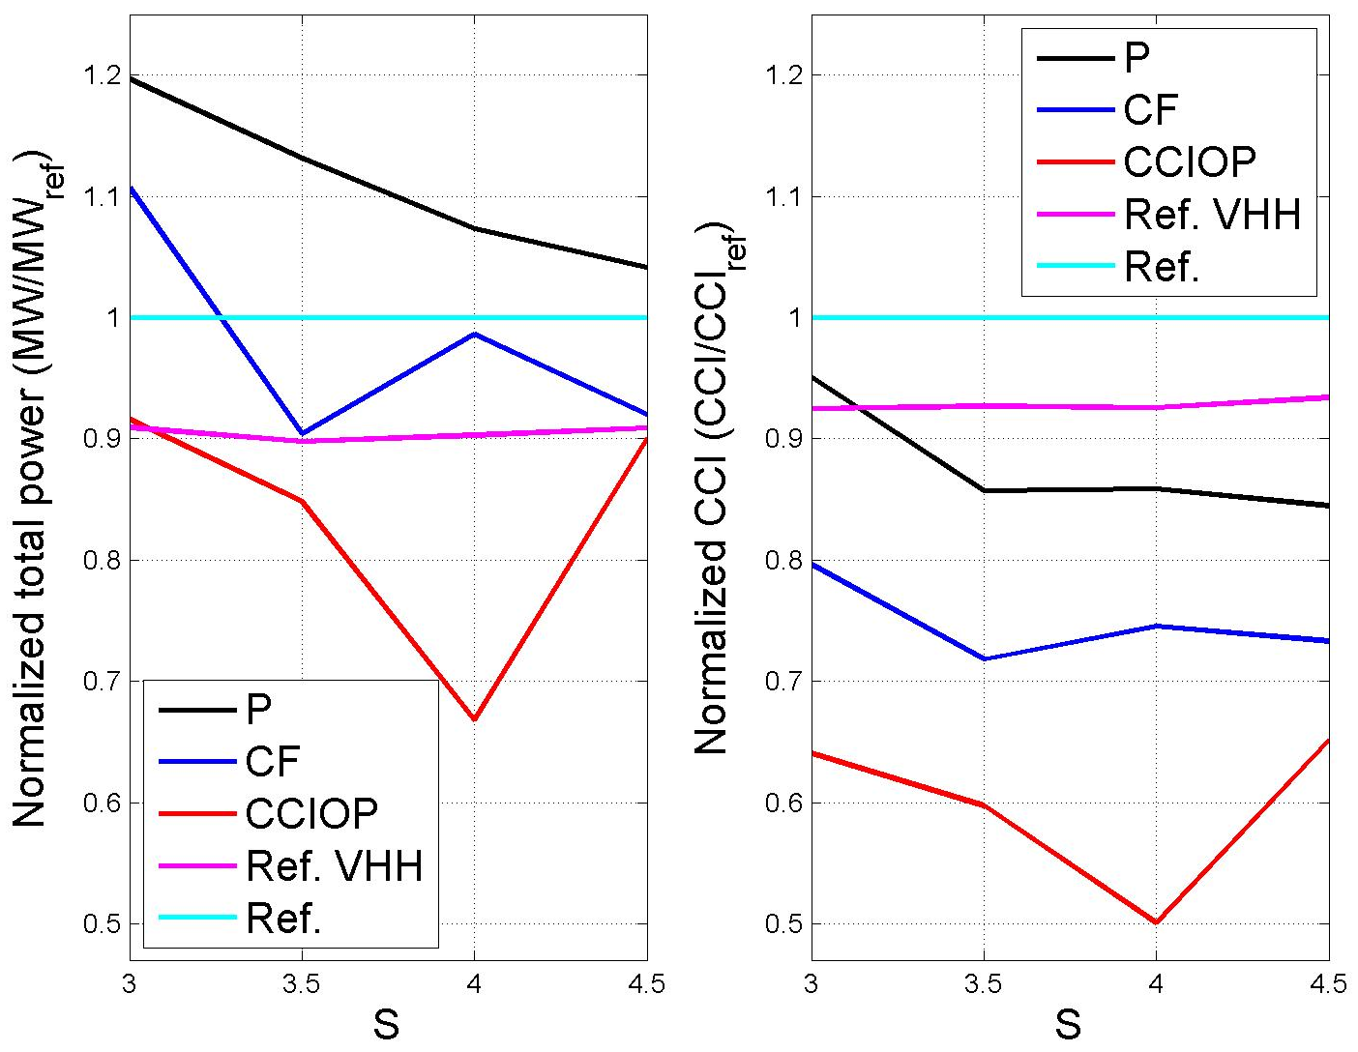
8- Results and Discussion (4)
Case 2: Small Rectangular Wind Farm, N = 18
Normalized P & CCI for 3x6 WF, U_{ref.} = 8 m/s @ 60 m.

Slide 17
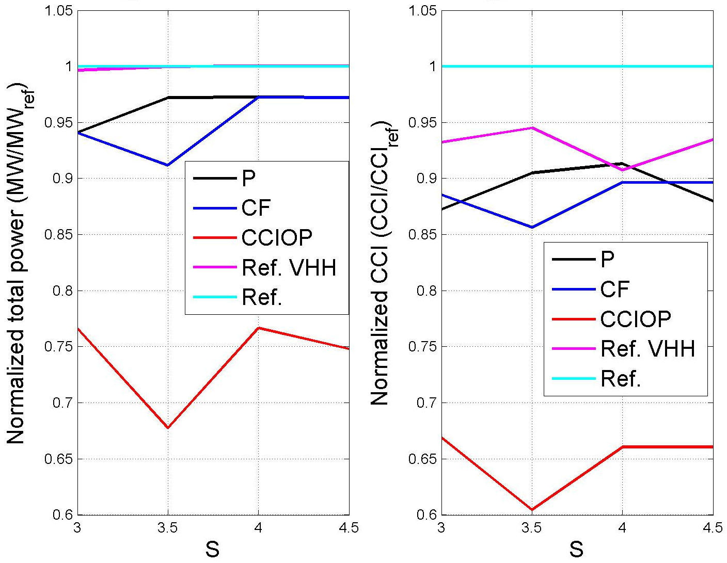
8- Results and Discussion (5)
Case 2: Small Rectangular Wind Farm, N = 18
Normalized P & CCI for 3x6 WF, U_{ref.} = 12 m/s @ 60 m.

Slide 18
8- Results and Discussion (6)
The dependence of P and CCI on U and S is not smooth, which is expected, because the problem is not continuous, as the turbines’ data are not. So, the results should be understood qualitatively not necessarily quantitatively.
There is a wide margin of trade-off between power output and capital cost, so the weighting factors should be adjusted according to the design priorities in order to obtain the desirable optimum layout.
At high wind speeds, all optimizations (except for minimum CCIOP) tend to develop almost the same output power as the reference case while costing less ICC.

Slide 19
8- Results and Discussion (7)
The range of trade-off between power and cost can be summarized as:
Case 1 | P/P_{ref} |  | CCI/CCI_{ref}
 | from | to | from | to
CF | 0.88 | 1.00 | 0.72 | 1.00
CCIOP | 0.65 | 1.00 | 0.57 | 0.85
Case 2 | P/P_{ref} |  | CCI/CCI_{ref}
 | from | to | from | to
CF | 0.91 | 1.10 | 0.72 | 0.90
CCIOP | 0.68 | 0.91 | 0.50 | 0.66

Slide 20
9- Conclusions
Wind farm design with identical turbines or even with different turbines from one manufacturer should be abandoned in favour of the turbine selection optimizations described in this proposal.
A wide band of optimum designs can be obtained according to the optimization preferences and priorities.
The representation of C_{T} in terms of the wind speed is not the right way.
The lack in C_{T} data could be overcome for multi-MW HAWT by generalization of the available data.

Slide 21
9- Conclusions
The proposed methodology is suitable for large scale WFs as well as for compact designs.
Taller towers are needed, not only to reach higher wind speeds, but also to reduce the wake effects in the compact WF designs.
The manufacturers should show more flexibility and accept the fair competition by providing more wind turbine designs and more accurate technical data.

Slide 22
10- Further Work
Real case large wind farm.
Modified wake model.
More realistic wind profile.
Noise Level minimization.
TOF with different weighting factors.
Optimization.

Slide 23
REFERENCES
Archer, R.; Nates, G.; Donovan, S.; Waterer, H. (2011), Wind turbine interference in a wind farm layout optimization mixed integer linear programming model, Wind Engineering, 35, pp. 165-178.
Barthelmie, R.J.; Folkerts, L.; Larsen, G.C.; Rados, K.; Pryor, S.C.; Frandsen, S.T.; Lange, B.; Schepers, G. (2006), Comparison of Wake Model Simulations with Offshore Wind Turbine Wake Profiles Measured by Sodar, Journal of Atmospheric & Oceanic Technology, 23(7), pp. 888-901.
Beaucage, P.; Robinson, N.; Brower, M.; Alonge, C. (2012), Overview of Six Commercial and Research Wake Models for Large Offshore Wind Farms, Proceedings of the EWEA conference, Copenhagen.
Black & Veatch (2012), Cost And Performance Data for Power Generation Technologies, Prepared for the National Renewable Energy Laboratory (NREL).
Brusca, S.; Lanzafame, R.; Messina M. (2014), Wind Turbine Placement Optimization by Means of the Monte Carlo Simulation Method, Modelling and Simulation in Engineering Volume 2014.
Burton, T.; Sharpe, D. (2011), Wind Energy Handbook, John Wiley & Sons Ltd, ISBN 0-471-48997-2, Chichester, 2nd edition.
Chen, L.; MacDonald, E. (2011), A New Model for Wind Farm Layout Optimization with Landowner Decisions, In: Proceedings of the ASME 2011 International Design Engineering Technical Conferences and Computers and Information in Engineering Conference, pp. 303-314.
Chen, L.; MacDonald, E. (2012), Considering Landowner Participation in Wind Farm Layout Optimization, Journal of Mechanical Design, 134, 084506-1:6.
Chen, L.; MacDonald, E. (2014), A System-Level Cost-Of-Energy Wind Farm Layout Optimization with Landowner Modeling, Energy Conversion and Management, 77, pp. 484-494.
Chen, Y.; Li, H.; Jin, K.; Song, Q. (2013), Wind Farm Layout Optimization Using Genetic Algorithm With Different Hub Height Wind Turbines, Energy Conversion and Management, 70, pp. 56–65.
Chowdhury, S.; Messac, A.; Zhang, J.; Castillo, L.; Lebron, J. (2010), Optimizing the Unrestricted Placement of Turbines of Differing Rotor Diameters in a Wind Farm for Maximum Power Generation, ASME 2010 International Design Engineering Technical Conferences and Computers and Information in Engineering Conference, Paper No. DETC2010-29129, pp. 775-790.
Chowdhury, S.; Tong, W.; Messac, A.; Zhang, J. (2012a), A Mixed-Discrete Particle Swarm Optimization Algorithm with Explicit Diversity-Preservation, Structural and Multidisciplinary Optimization, 47(3), pp. 367-388.
Chowdhury, S.; Zhang, J.; Messac, A.; Castillo, L. (2012b), Unrestricted Wind Farm Layout Optimization (UWFLO): Investigating Key Factors Influencing the Maximum Power Generation, Renewable Energy, 38(1), pp. 16–30.
Chowdhury, S.; Zhang, J.; Messac, A.; Castillo, L. (2012c), Characterizing the Influence of Land Area and Nameplate Capacity on the Optimal Wind Farm Performance, In ASME 2012 6th International Conference on Energy Sustainability, San Diego, pp. 1349-1359.
Chowdhury, S.; Zhang, J.; Messac, A.; Castillo, L. (2013), Optimizing the Arrangement and the Selection of Turbines for Wind Farms Subject to Varying Wind Conditions, Renewable Energy, 52, pp. 273-282.
Crespo, A.; Hernandez, J.; Frandsen, S. (1999), Survey of Modelling Methods for Wind Turbine Wakes and Wind Farms, Wind Energy, 2, pp. 1–24.
Donovan, S. (2005), Wind farm optimization, In: Proceedings of the 40th annual conference of the Operations Research Society, Wellington.
Donovan, S. (2006), An Improved Mixed Integer Programming Model for Wind Farm Layout Optimisation, In: Proceedings of the 41st annual conference of the Operations Research Society, Wellington.
Emami, A.; Noghreh, P. (2010), New Approach on Optimization in Placement of Wind Turbines Within Wind Farm by Genetic Algorithms, Renewable Energy, 35, pp. 1559–1564.
Engström, S.; Lyrner, T.; Hassanzadeh, M.; Stalin, T.; Johansson, J. (2010), Tall Towers for Large Wind Turbines, Report from Vindforsk project V-342 Höga torn för vindkraftverk. Elforsk rapport 10:48.
Eroğlu, Y.; Seçkiner S.U. (2012), Design of Wind Farm Layout Using Ant Colony Algorithm, Renewable Energy, 44, pp. 53-62.
Fagerfjäll, P. (2010), Optimizing Wind Farm Layout: More Bang for the Buck Using Mixed Integer Linear Programming, MSc Thesis, Chalmers University of Technology and Gothenburg University.
Frandsen, S. (1992), On the Wind Speed Reduction in the Center of Large Clusters of Wind Turbines, Journal of Wind Engineering and Industrial Aerodynamics, 39, pp. 251-265.
Frandsen, S. (2007), Turbulence and turbulence-generated structural loading in wind turbine clusters, Risø National Laboratory Report Nr. Risø-R-1188(EN).
Frandsen, S.; Barthelmie, R.; Pryor, S.; Rathmann, O.; Larsen, S.; Højstrup, J.; Thøgersen, M. L. (2006), Analytical Modelling of Wind Speed Deficit in Large Offshore Wind Farms, Wind Energy, 9, pp. 39–53.
Frandsen, S.; Chacon, L.; Crespo, A.; Enevoldsen, P.; Gomez-Elvira, R.; Hernandez, J.; Højstrup, J.; Manuel, F.; Thomsen, K.; Sørensen, P. (1996), Measurements on and Modelling of Offshore Wind Farms, Editor: Frandsen, S., Risø-R-903(EN), 100 p.
Frohboese, P.; Schmuck, C. (2010), Thrust Coefficients Used For Estimation of Wake Effects For Fatigue Load Calculation, European Wind Energy Conference and Exhibition, Warsaw, Poland.
Global Wind Statistics 2014 (2015), Global Wind Energy Council GWEC.
González, J.S.; Gonzalez Rodriguez, A.G.; Mora, J.C.; Santos, J.R.; Payan, M.B. (2010), Optimization Of Wind Farm Turbines Layout Using an Evolutive Algorithm, Renewable Energy, 35(8), pp. 1671-1681.
Grady, S.A.; Hussaini, M.Y.; Abdullah, M.M. (2005), Placement of Wind Turbines Using Genetic Algorithms, Renewable Energy, 30(2), pp. 259-270.
Herbert-Acero, J-F.; Franco-Acevedo, J-R.; Valenzuela-Rendon, M.; Probst-Oleszewski, O. (2009), Linear Wind Farm Layout Optimization through Computational Intelligence, Proceedings of 8th Mexican International Conference on Artificial Intelligence, pp. 692–703.
Hou-Sheng, H. (2007), Distributed Genetic Algorithm for Optimization of Wind Farm Annual Profits, International Conference on Intelligent Systems Applications to Power Systems, ISAP 2007, Kaohsiung, Taiwan.
http://en.wikipedia.org/wiki/Wind_turbine [last accessed: April 2015].
http://mecometer.com/topic/electricity-installed-generating-capacity/ [last accessed April 2015].
http://www.abo-wind.com/com/wind-energy/reference-list.html [last accessed: April 2015].
http://www.thewindpower.net [last accessed: April 2015].
Ituarte-Villarreal, C.M.; Espiritu, J.F. (2011), Wind Turbine Placement in a Wind Farm Using a Viral Based Optimization Algorithm, Procedia Computer Science, 6, pp. 469–474.
Jensen, N.O. (1983), A Note on Wind Generator Interaction, Risø-M-2411, Risø National Laboratory.
Katic, I.; Hojstrup, J.; Jensen, N.O. (1986), A Simple Model for Cluster Efficiency, In Proceedings of the European Wind Energy Association Conference and Exhibition, pp. 407–410.
Kiani, A.; Abdulrahman, M.; Wood, D. (2014), Explicit Solutions for Simple Models of Wind Turbine Interference, Wind Engineering, 38(2), pp. 167-180.
Kwong P.; Zhang P.Y.; Romero D.A.; Moran J.; Morgenroth M.; Amon C.H. (2012), Wind Farm Layout Optimization Considering Energy Generation and Noise Propagation, In Proceedings of the ASME International Design Engineering Technical Conferences.
Marmidis, G.; Lazarou, S.; Pyrgioti, E. (2008), Optimal Placement of Wind Turbines in a Wind Park Using Monte Carlo Simulation, Renewable Energy, 33, pp. 1455–1460.
Mortensen, N.G.; Heathfield, D.N.; Myllerup, L.; Landberg, L.; Rathman, O. (2005), Wind Atlas Analysis and Application Program: WAsP 8 Help Facility. Risø National Laboratory, Roskilde, Denmark.
Mosetti, G.; Poloni, C.; Diviacco, B. (1994), Optimization of Wind Turbine Positioning in Large Wind Farms by Means of a Genetic Algorithm, Journal of Wind Engineering and Industrial Aerodynamics, 51, pp. 105-116.
Nielsen, P. (2006), The WindPRO Manual Edition 2.5, EMD International A/S.
Oke, T.R. (1987), Boundary Layer Climates, 2nd Edition, Methuen, London.
Oteri, F. (2008), An Overview of Existing Wind Energy Ordinances, National Renewable Energy Laboratory Technical Report, NREL/TP-500-44439.
Ozturk, U.A; Norman B.A. (2004), Heuristic Methods for Wind Energy Conversion System Positioning, Electric Power Systems Research, 70, pp. 179–185.
Renewables 2014: Global Status Report, REN21 Secretariat, Paris, France.
Rivas, R.A.; Clausen, J.; Hansen, K.S.; Jensen, L.E. (2009), Solving the Turbine Positioning Problem for Large Offshore Wind Farms by Simulated Annealing, Wind Engineering, 33, pp. 287–297.
Salcedo-Sanz, S.; Gallo-Marazuela, D.; Pastor-Sánchez, A.; Carro-Calvo, L.; Portilla-Figueras, A.; Prieto L. (2014), Offshore Wind Farm Design with the Coral Reefs Optimization Algorithm, Renewable Energy, 63, pp. 109-115.
Samorani, M. (2010), The wind farm layout optimization problem, Technical Report, Leeds School of Business, University of Colorado.
Schlez, W.; Neubert, A. (2009), New Developments in Large Wind Farm Modelling, Proceedings of the EWEA Conference, Marseille.
Şişbot, S.; Turgut, Ö.; Tunç1and, M.; Çamdalı, Ü. (2010), Optimal Positioning of Wind Turbines on Gökçeada Using Multi-Objective Genetic Algorithm, Wind Energy, 13(4), pp. 297–306.
Sørensen, T.; Nielsen, P.; Thøgersen, M.L. (2006), Recalibrating Wind Turbine Wake Model Parameters–Validating the Wake Model Performance for Large Offshore Wind Farms, EMD International A/S.
Sørensen, T.; Thøgersen, M.L.; Nielsen, P.; Jernesvej, N. (2008), Adapting and Calibration of Existing Wake Models to Meet the Conditions Inside Offshore Wind Farms, EMD International A/S.
Tegen, S.; Lantz, E.; Hand, M.; Maples, B.; Smith, A.; Schwabe, P. (2013), 2011 Cost of Wind Energy Review, NREL Report No. TP-5000-56266.
Tesauro, A.; Réthoré, P-E; Larsen, G.C. (2012), State of the Art of Wind Farm Optimization, Proceedings of European Wind Energy Conference & Exhibition, European Wind Energy Association (EWEA 2012), Copenhagen, Denmark.
Tong, W.; Chowdhury, S.; Mehmani, A. Messac, A. (2013), Multi-Objective Wind Farm Design: Exploring the Trade-Off between Capacity Factor and Land Use, 10th World Congress on Structural and Multidisciplinary Optimization, Orlando, Florida.
Turner, S.D.O.; Romero, D.A.; Zhang, P.Y.; Amon, C.H.; Chan, T.C.Y. (2014), A New Mathematical Programming Approach to Optimize Wind Farm Layouts, Renewable Energy 63(c), pp. 674–680.
Wan, C.; Wang, J.; Yang, G.; Zhang, X. (2010), Optimal Micro-Siting of Wind Farms by Particle Swarm Optimization, In: Advances In Swarm Intelligence, Berlin, Heidelberg, pp. 198-205.
Zhang, P.Y.; Romero, D.A.; Beck, J.C.; Amon, C.H. (2014), Solving Wind Farm Layout Optimization with Mixed Integer Programming and Constraint Programming, EURO Journal on Computational Optimization, 2(3), pp. 195-219.

Slide 24
ACKNOWEDGEMENTS
This research is part of a program of work on renewable energy funded by the Natural Science and Engineering Council (NSERC) and the ENMAX Corporation. The student acknowledges Prof. David Wood for his continuous support, help, guidance, and patience. The student also acknowledge the Egyptian Government for the participation in funding a part of this work as well as Prof. El-Adl El-Kady for sharing the supervision during the early (and the important) part of this work.

Slide 25

QUESTIONS ?

