Slide 1
Community-Owned-
and-Operated
Amplifying Cultural Heritage through Inter-Institutional Collaboration
Alex Kinnaman, Virginia Tech University Libraries
Ashley Palazzo, Christiansburg Institute, Inc

Slide 2
Agenda
Introductions
History of Greater Southwest Virginia Digital Collective (GSDC)
Building a Community Advisory Board
GSDC Strategy
Collaboration
Case Studies
Q & A

Slide 3
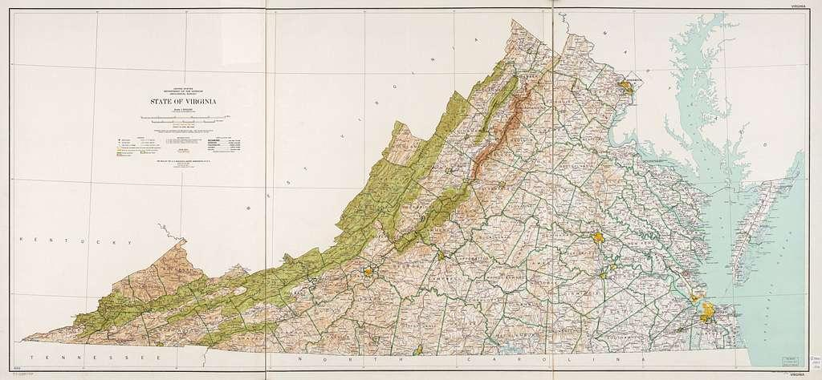
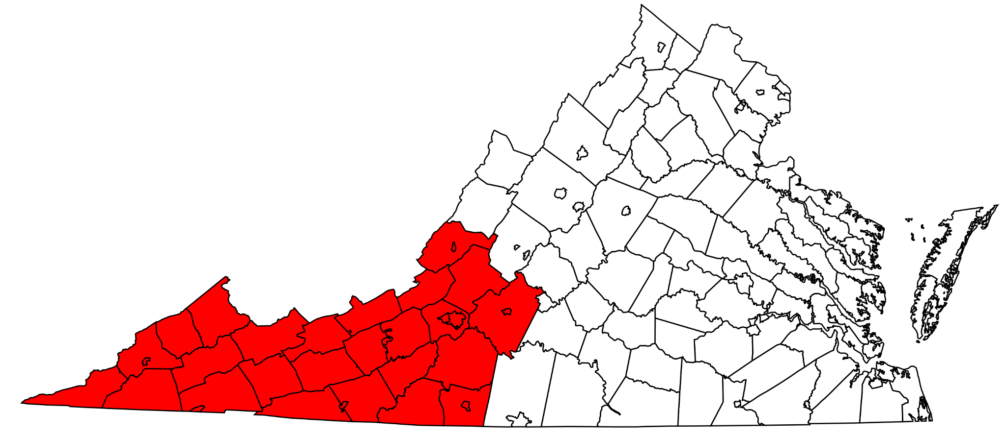
Southwest Virginia
Coal country v. Environmental activism
Black Appalachia & education
Local museums & libraries
Nonprofits
Above: “State of Virginia, base map with highways and contours.” Library of Congress, Geography and Map Division
Below: “Locator map showing Southwest in Virginia.” MediaWiki, CC BY-SA 4.0
Notes:
This presentation is largely contextualized by our geographical location in Southwest Virginia, nestled in the New River Valley and the Appalachians in Montgomery County which is the little red dot on the top map. This southwest section of Virginia has a long history at odds with itself - there’s a history of coal and mining, and in contrast, in environmental activism; a rich history of Black Appalachia and educational institutions, and also played a large part in the Civil War; plus dozens of local museums, public libraries, historical societies, and non-profits, and therefore, a vibrant and unique history that is largely buried in small, physical archives.

Slide 4
The Problem
There is a gap between well-resourced libraries with robust digital infrastructure and smaller community organizations, many of which produce analog and digital media across multiple platforms but often without a preservation strategy.
Notes:
So what is the problem we are trying to solve? Well, there is a gap between well-resourced libraries with robust digital infrastructure and smaller community organizations, many of which produce analog and digital media across multiple platforms but often without a preservation strategy.

Slide 5






Our Solution
The Greater Southwest Virginia Digital Collective (GSDC)
Advisory Board composed of community members and Virginia Tech University Library (VTUL)
Goal to build relationships with the cultural heritage communities from within the community and offer free resources to curate their collections
Notes:
Our solution? The Greater Southwest Virginia Digital Collective or GSDC for short since our name is definitely a mouthful!
GSDC is essentially an advisory board composed of community members and Virginia Tech University Libary. Some community members include the Calfee Community Center, The Floyd County Historical Society, the Montgomery-Floyd Regional Library system, and the organization I am part of, Christiansburg Institute, inc.
GSDC’s goal is to build relationships with the cultural heritage communities from within the community and offer free resources to curate their collections digitally.

Slide 6
Building the GSDC

Slide 7
How to Build a Community Advisory Board: Part I
Build interest, gather needs and perspectives
VTUL wanted a community collections program
  IMLS Community Catalyst Planning Grant “Community Development Model for Digital Community Archives” (IMLS Community Catalyst grant (LG-15-19-0137-19)
Bring cultural heritage communities, organizations, and individuals together for a series of forums
Call to Action: Form an advisory board to liaise directly with VTUL in order to build trust, accountability, and aligned values
Notes:
I wanted to walk through the process we took to build this community advisory board from the perspective of the larger institution. Prior to either of us even being in Virginia, my previous supervisor was highly invested in our community culture, particularly non-profits, historical societies, and museums. He started building relationships with folks from various cultural heritage organizations in 2016 to gauge interest in community collaborations. We received an IMLS Community Catalyst grant in 2019 where the primary focus was a series of 4 forums that brought together stakeholders in cultural heritage organizations, individual collectors, VT Libraries, and the university.
The final call to action from participants was to form an advisory group that would define and establish a community advisory board in collaboration with VTUL that centered on trust, accountability, and aligned values in order to better preserve and make accessible the region’s cultural collections.

Slide 8
Select Values from Forums
1
Protection
2
Access
3
Longevity
-Understanding of liability, copyright, tiered access, etc.
-Protecting sensitive information and physical collections
-Resilience from political and economic shifts
Institutional Partners:
-address institutional racism
-transparency
-Internal/external divisions on promoting access (community trust, $)
-Digital infrastructure
-Protect ability to collect in the future
-Continued and broadened relevance to regional politics and culture
-Maintenance and stewardship
Anonymized transcripts from all forums: http://hdl.handle.net/10919/112782
Previous presentation on forum results: http://hdl.handle.net/10919/111080
Notes:
Just to give a very brief sense of some of the values we identified in the grant forums, these three were plucked from our grant presentation a few years ago. Links to that presentation and the entire set of anonymized transcripts from those forums are linked here.
These three highlight values we’ve brought into the GSDC.
Protection of the organization is a primary motivator – there must be mutual understanding and protection of mutual liability, copyright, access, and ownership, as well as consideration of PII and physically fragile collections. Another thread that’s especially relevant is resilience from political and economic shifts - resources come and go as they please, and getting this content into a safe place is key.
Access is usually the number one priority for the organizations we work with, and not just end-user access, but access to the backend infrastructure, access to resources, and access to preservation services.
Finally, longevity, which is our area of expertise as digital preservationists and archivists, is the ongoing maintenance, stewardship, and protection of the collections that are most important to the greater community.

Slide 9
How to Build a Community Advisory Board: Part II
Design the CAB
Used remaining grant funding to hire Katherine Skinner as a consultant on forming governance
Participating representatives: 5 community and 3 VTUL
Outcome: Bylaws, Mission, Vision, and Values
Elected first advisory board members (Chair, Treasurer, Secretary, Members-at-Large, and VT Liaisons)
Notes:
Once the forum concluded, we had several volunteers and we spent almost a year in regular meetings designing the advisory board. Using the last chunk of grant funding, we hired Katherine Skinner (formerly of Educopia Institute and currently at Invest in Open Infrastructure) as a consultant in developing governance documentation. This group consisted of 5 community members, 3 VTUL members, and 1-2 consultants. The deliverables were a set of Bylaws, Mission, Vision, and Values statements, and our name. We also successfully elected the first advisory board members in summer of 2023, including a Chair, Treasurer, and Secretary, as well as 3 members-at-large and 2 VT liaisons.

Slide 10
How to Build a Community Advisory Board: Part III
Build the community [in progress!]
Outreach
  Conferencing, web presence, connecting with known partners
Project management
  Championing projects with VTUL
Funding
  Supporting travel, supporting in-house work, quality handouts, better website
Recruitment to Advisory Board
  Sub-committees
Notes:
Since then, we’ve spent a lot of time simply building up the community and grounding ourselves in our new roles. Outreach has been a primary function – we have started a small website outlining the process and showing our governance documents and supporting documentation, the process, and showing off our partners. We also have a new logo (shoutout to my nerdiest friend who is actually a Richmond local). We’ve produced a first round of literature [brochure!] and have been getting into conference circuits to spread the word and get feedback.
We’re beginning to broach into project management that is led more by the community than just VTUL. This is key for ongoing advocacy and keeping communication lines open and people accountable.
Funding, which we’ll get into more later, is an ongoing barrier, but we want to support travel and offer supplemental funding for partners, as well as boost our own reputation with quality handouts and website during our outreach efforts.
Finally, we also want to recruit more folks to the Advisory Board, largely to get people invested, but also to support broader subcommittees to meet more community needs.

Slide 11
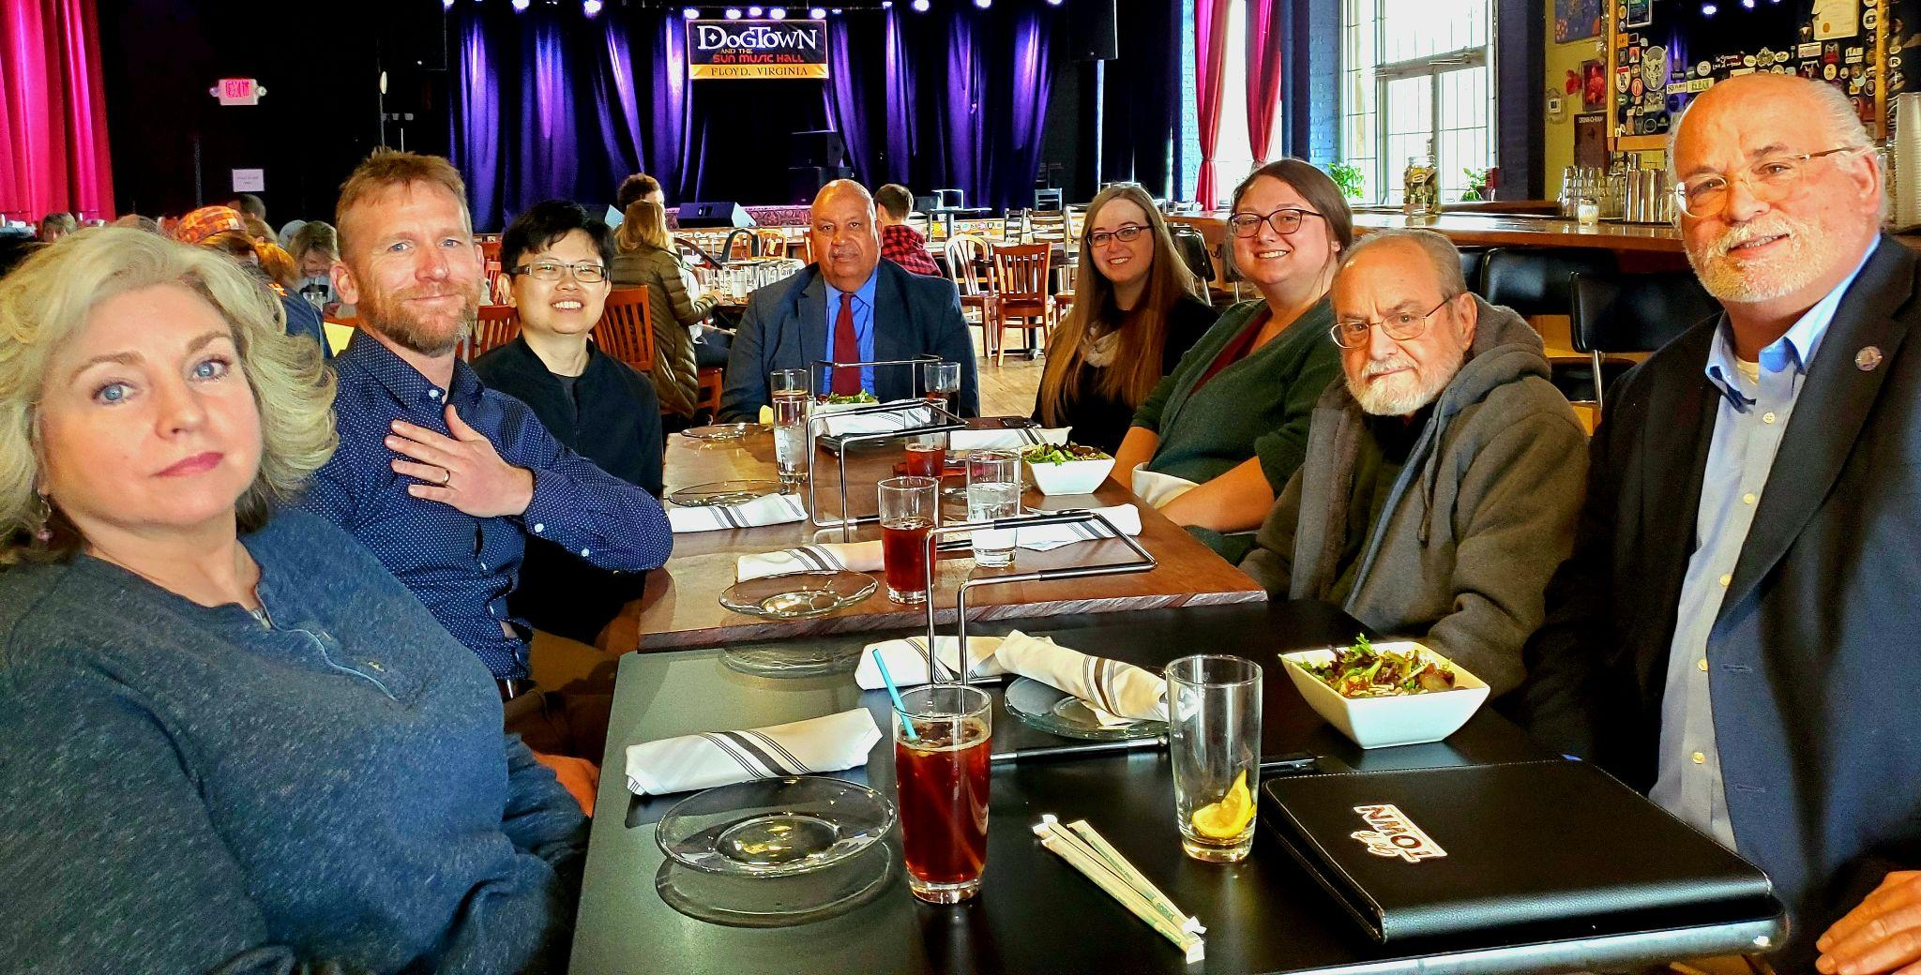
OG Advisory Planning Committee
Notes:
And just for fun, this was our original advisory board that mapped out the GSDC advisory board for our first in-person gathering in Floyd, VA. Ann-Margaret, our current chair, is missing from this event, but left to right, Sherri, Nathan, Wen, Mickey, myself, Jenny, Ralph, and David were all heavily involved and most are still involved in the Advisory Board.

Slide 12
GSDC Strategies

Slide 13
Greater Southwest Virginia Digital Collective
Empowering partners to share primary source materials in a sustainable program that provides access to the region’s unique archival resources. We connect communities and facilitate online access to significant collections within greater Southwest Virginia.
Notes:
We spent a lot of time and energy producing our Mission, Vision, and Values, and we wanted to share the mission with you specifically.

Slide 14
Roles & Responsibilities
GSDC
Outreach
Review projects for aligned scope
Champion projects
Virginia Tech
Paperwork & documentation
Digitization (if needed)
Metadata support
Ingest to Digital Library
Community Partner
Proposal form (structured, 2 pages)
Provide metadata
Provide access to materials
Notes:
Here we can see the different roles and responsibilities of the moving parts that make GSDC work.
The main role of GSDC as a group is to get in touch with community partners and potential partners to explain the process and see if their project fit with the aligned scope. This means the advisory board members get to check out cool community projects and see if they would be a good fit for joining GSDC. Additionally, GSDC champions the community partners’ projects and shares them to our network.
Virginia Tech’s roles and responsibilities include all the paperwork and documentation for the community partners' projects, digitization (if needed), helping with any metadata support, and finally the ingest process into VA Tech’s Digital Library platform.
The community partners’ roles include filling out the basic intake proposal form which is 2 pages, providing all the metadata (the data about the stuff!), and if digitization is included, providing access to the collections.

Slide 15
Our Strategy
Outreach / Referral
Paperwork
& Revisions
Curation
Defined in MOA
Quality Control
Yes
No
Yes
No
In Scope?
VTUL
Proposal
Content Transfer
Materials, metadata
No
Yes
To and from VTUL
Refer Elsewhere
Consultation
with GSDC
Yes
No
Yes
No
Ingest
Access Platform
Tiling
Preservation
Partner
MOA
No
Partner Agreement
Yes
Publish
Notes:
The process all starts with GSDC’s outreach or a referral to us. We then determine if the project is within scope, if not we will refer elsewhere. But if the project is within the scope we will then set up a consultation with GSDC which includes the community partner agreement.
Virginia Tech steps in and goes through all the necessary paperwork including the 2-page proposal and the MOA to determine the next steps.
Then begins the next part of the process, curation of the materials as defined in the MOA paperwork which will include content transfer whether that be sending materials over to Tech for digitization or just the metadata content transfer to Tech for the ingest process.
Quality control is a key part of the GSDC strategy going through Virginia Tech University Library as well as the community partners themselves. If all looks great we then will publish the project on the Virginia Tech Digital Library Database.

Slide 16
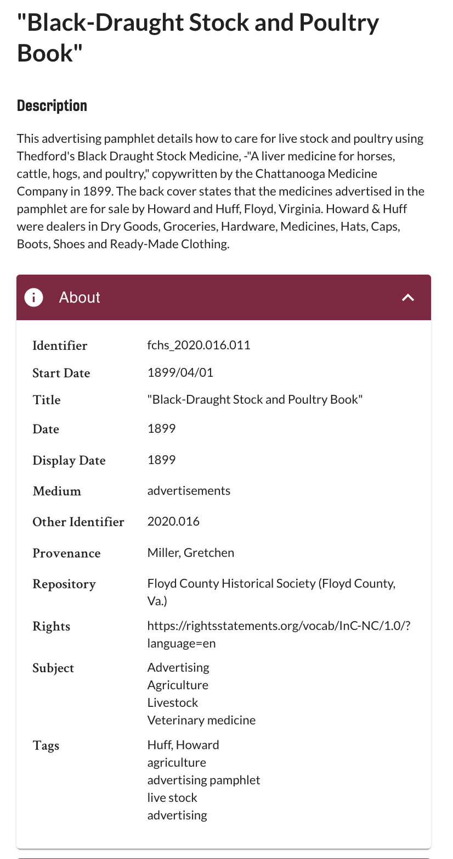
GSDC Foundations: Collaboration
Partner-provided
Partners dictate how collections are:
Organized
Described
Copyrighted
VTUL dictates how collections are:
Cited
Displayed
The identifier is the only element chosen by VTUL
Partner-provided
Notes:
One question I’ve gotten before from other presentations is, why have a whole board when people can just contact the library directly? My answer, as many of you may familiar with, is that they don’t even know they can do that, and even if they do, they connect with the person they know rather than the person that can help.
GSDC allows for open collaboration because the values are set and we build trust from within the community rather than VT saying “oh just trust us.” Successful partners can confirm to new partners that the owning organization dictates how collections are organized, described, copyrighted, and generally displayed to the public. VTUL dictates how they’re formally cited in the bibliographic sense, and how they are displayed through our infrastructure.
This screenshot is from the Floyd County Historical Society collection on the VT Digital Library. I wanted to show that all of the metadata is provided by FCHS with the one exception of our internal identifier. We support some choices, like how to choose tags and subjects, choosing the rights statement URI, and how we structure dates, but none of the content is produced by VT.

Slide 17
Strategy: Operationalize Equity
Digitization ability
Partner Resources
VTUL Support
Metadata support
Advocacy
Notes:
The strategy we are trying to embody is operationalizing equity. We want the content in our digital library to be of equal quality, but getting there requires a balance in equity. For example, if a community has some digitization equipment and all we need to do is advise on FADGI standards and do some QC, that’s where we want to meet them. Maybe they have no resources to create or manage metadata, we want to provide the resources to get minimal descriptive metadata. This will look differently for every community collaboration and the idea is to bring all of them to the same level.

Slide 18
Collaboration Types
“Full Package”
Digitization
Metadata
Ingest
EX: Salem Fire Department
Resources
External funding for in-house digitization & metadata
Collection promotion
Metadata mapping
EX: Christiansburg Institute, Inc.
Ingest-Only
Previously digitized items & metadata transferred to us for processing and organization
EX: Floyd County Historical Society
Notes:
That said, we don’t limit what types of collaboration either. We might have a “full package” collab where they bring us some stuff and want the works and we support everything from processing assistance, digitization, metadata development, ingest, and QC. Salem Fire Department is a good example of this. Another type might be to help the organization find external resources like a grant to perform in-house digitization and metadata development. In this case, with our favorite partners at Christiansburg Institute, we’ve been assisting in promoting their collection and we’re in the process of mapping metadata and correcting things in our pre-production site. The last example might be one where the items were digitized long ago by the owning organization and we just map metadata, transfer the items digitally for digital curation and ingest.

Slide 19
GSDC Foundation: Engagement
Ongoing dialogue
Iterative improvement of documentation based on feedback
Iterative metadata development
Partner approval before going live
Equitable participation in GSDC Advisory Board
Notes:
As I hope we’ve made abundantly transparent, engagement is not just aspirational, but it is borderline compulsory. The way we achieve accurately described and community-oriented collections is through an active, ongoing dialogue WITH the community. This offers VTUL a chance to improve documentation through feedback, and offers partners resources for metadata bottlenecks and active participation in the QC and approval process. It also allows for equitable participation in the GSDC Advisory Board and community where we make decisions around collection scope and who we advocate for.

Slide 20
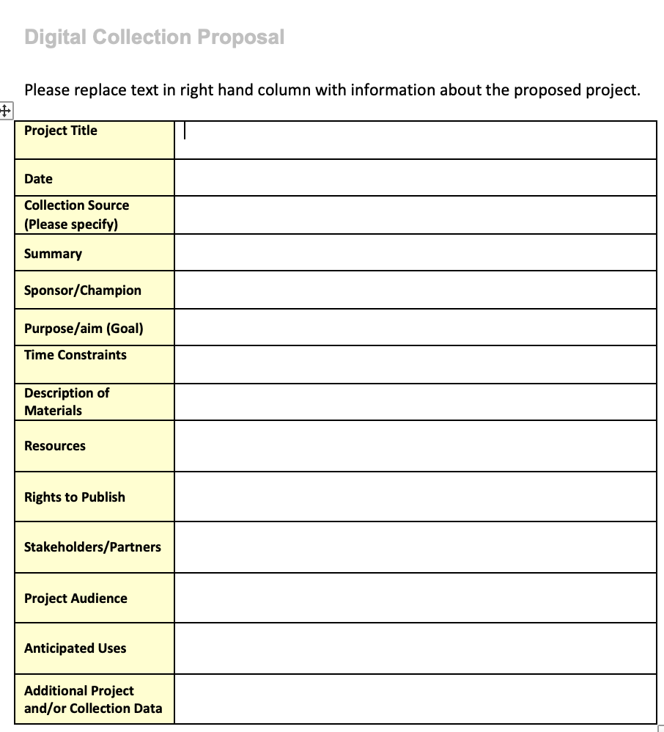
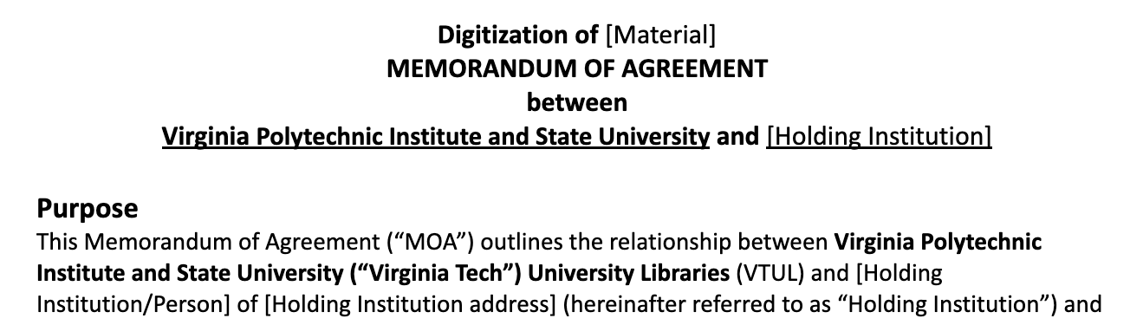
Documentation
Proposal form: 1-2 pages
Used by GSDC to confirm scope
Used by VTUL to define proposed work and design an MOA
MOA
Written handshake
Defines resources, scope of work, timeline, terms of termination, contact info
Notes:
One form of engagement I wanted to highlight is documentation, which I personally love so now you get to hear about it briefly too, because it’s so important BUT we don’t want it to be a heavy lift for partners. We require two formal pieces of project documentation. The first is a proposal form. It’s 2 pages max, sectioned out with written guidance (not shown in this screenshot) and is used for GSDC to confirm appropriate scope for a greater southwest virginia collection. It’s also used for VTUL to make decisions on resourcing, prioritization, and developing a Memorandum of Agreement, or MOA.
The MOA is much longer and full of legalese, but essentially it’s just a formal handshake that is not legally enforceable and designed to scope the work, give a timeline, any details on the transportation of material, terms of termination, contact info, etc. We have a resource that actually translates the legal crap into plain English, and notes what sections can be modified or struck with links to better explain bits of Library jargon.

Slide 21
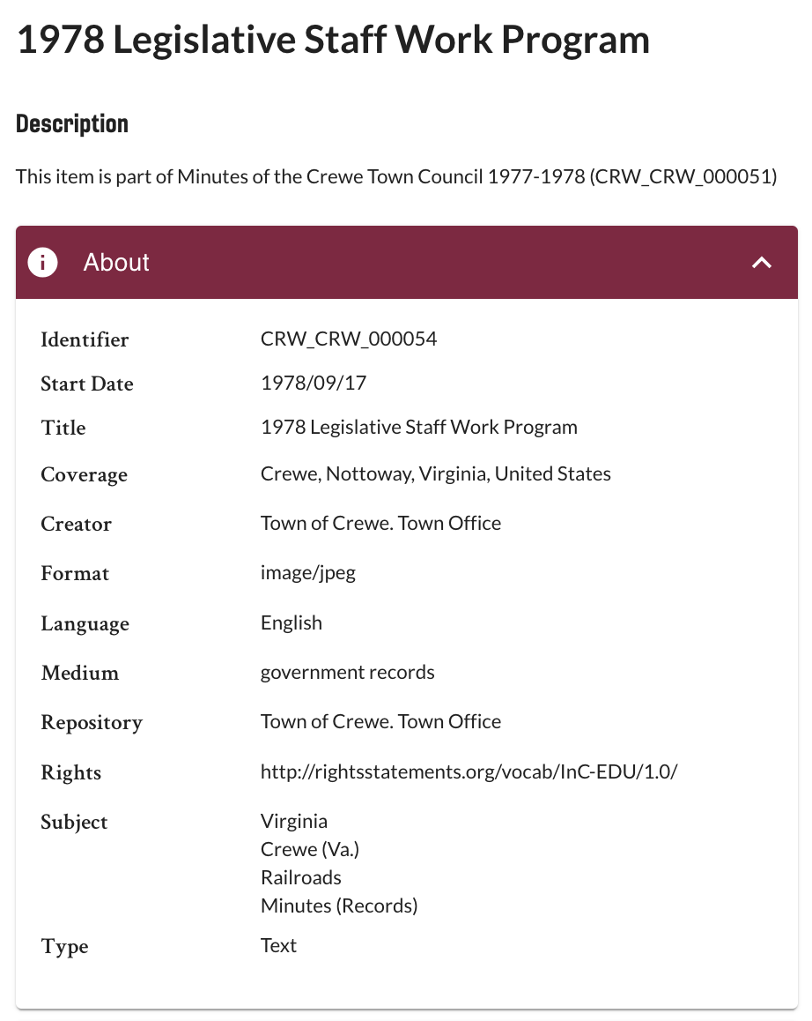
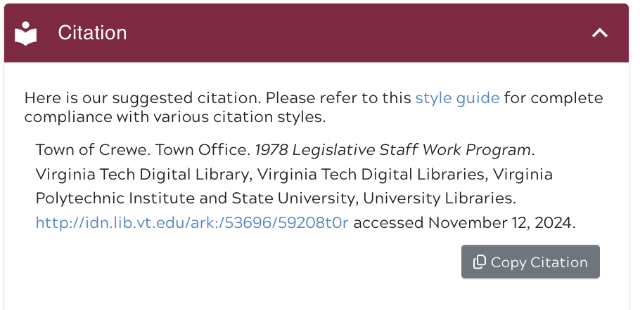
GSDC Foundation: Promotion
of Collections
Open access items
Permalinks at item-level and collection-level
R1 Institution-level access point and promotion
No restriction from VTUL on how partner can use items
Notes:
Lastly, the goal here is the get these collections into the digital hands of users and promote their organizations. We’ve touched on copyright and ownership quite a bit today, and I wanted to show another digital library metadata screenshot from the Town of Crewe Council Minutes. I’ll note that we’re working on additional UI/UX updates in the digital library so the optional written rights statements some partners want to provide are not currently visible, but they exist. Mainly I wanted to show the rights URI link from rightsstatement.org - this is In Copyright - Educational Use Permitted license, meaning the Town of Crewe copyrighted it, but has given it to VT who can [legally] have anything on the Digital Library for educational use. Should the partner not want something open/accessible, all they need to do is not give it to VT. Second, I wanted to show the unique, persistent identifier in the left screenshot there. Even if this item is removed, we will have a tombstone page to show that it was there and no other item will be assigned this permalink. These two things support the greater sharing and promotion of these collections long-term.

Slide 22
Benefits of Joining GSDC
Ownership
Networking
Sharing resources & filling gaps in resources
Advocacy for collections
Direct line to VTUL
Translations/resources of library and developer jargon
No fees, dues, or other financial compensation paid to anyone at VTUL

Slide 23
Costs of Joining GSDC
Staffing, labor, time → processing, metadata, meetings, generating buy-in
Willingness to engage and participate → metadata requirements, documentation
Patience → the VT Digital Library is new and many features are still in development or beta form
Trust → Larger institutions traditionally take ownership; MOAs are daunting

Slide 24
GSDC Challenges
Rural area (internet access, physical travel)
Reaching organizations
Staffing & human labor
Education about Digital Humanities
Technology literacy
Distrust of larger institutions

Slide 25
GSDC Successes
People
  Support system, collaboration
Collection discovery
Organization and collection promotion
Advocacy
Transparency around processes and rights
Notes:
Even with all these challenges, creating GSDC has been a success and has created more opportunities than challenges. Over the past year and some change, GSDC has already seen success in our model.
This model has allowed us to connect with people face-to-face to discuss their community partner projets. GSDC has connected not only orgnaizations, but people as well.
This model has allowed increased discoverability of our community partners’ collections. As well as promotion to the GSDC network of the community partners’ collection and to spread the word about these awesome cultural heritage sites that may have never been seen by these audiences.
This model allows for smaller community organizations to advocate for themselves with the gentle support of a large academic institution as well as support from other community partners that may have similar challenges as them.
This model also allows for transparency around the processes and the rights of the community partners. This allows trust to be built between the community partner and the large academic institution (VA Tech).

Slide 26
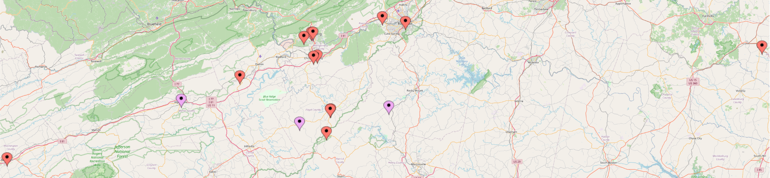


Current & Potential Partners
12 - Current partners in GSDC Advisory Board and/or with collections in or in progress
3 - Potential partners in beginning discussions
Notes:
Of the 12 red dots (some are hard to see), 1 is Virginia Tech, and the other 11 either already have collections with us, are currently collaborating with us to prepare collections, and/or are engaged in the GSDC Advisory Board. The 3 folks in pink are ones we’ve reached out to and are considering projects.
This is a good time to highlight why we are the “Greater” SWVA Digital Collective – the Town of Crewe, for example, is beyond the formal margins for southwest Virginia, and we plan to extend reach into other areas and bordering states as we grow. We want to be as flexible as possible for partners that need the resources and community we have.

Slide 27

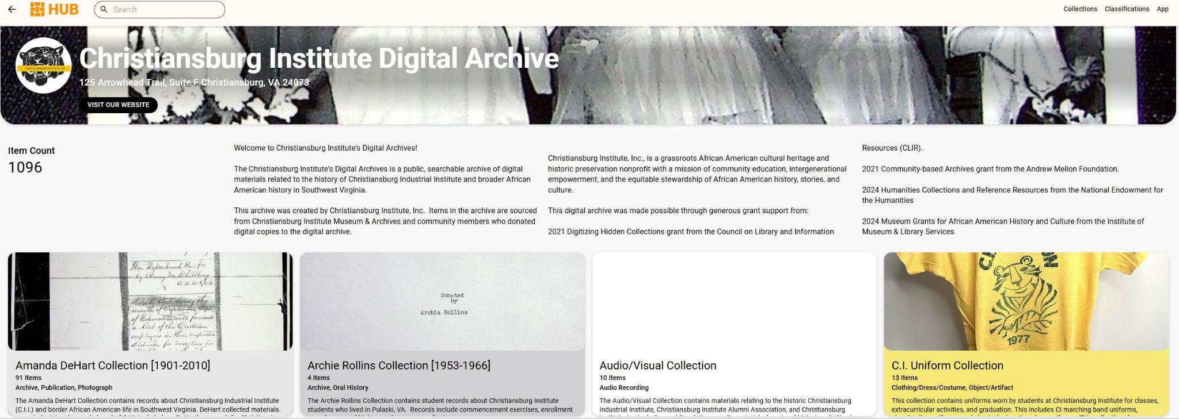
Testimonial: CIDA (Christiansburg Institute, Inc)
The goal of Christiansburg Institute Digital Archives (CIDA) is to collect and preserve the multitude of African American stories in Southwest Virginia.
VTUL Partnership:
Shining a Light Exhibit
Southwest Virginia Digital Archive Ingest
Digitized On-Site
Metadata Support
Notes:
I can personally attest to the power of joining GSDC and the great success we at Christiansburg Institute, Inc have seen since our involvement. For those that remember all the way back to the first presentation of the day where I discussed our digital humanities project, the Christiansburg Institute Digital Archive, we partnered with Virginia Tech Library to accomplish this project.
We did all the digitization work on-site at our museum and archives in Christiansburg, VA and I completed all the metadata work, after Alex came and took a copy of all the digital files and metadata to put on deck for ingest into the Southwest Virginia Digital Archive run through Virginia Tech Library. I believe we are slated so you all will be able to see the Christiansburg Institute Digital Archive on their digital platform soon!
In the meantime, you can check out our full digital archive on CatalogIt Hub!
Being involved with GSDC has been a great experience for our organization. We have been able to network with the other community members apart of GSDC, spark new ideas, and learn about other cool collections that sometimes even connect with ours!

Slide 28
Testimonial: VTUL
Resourcing: 3 FTE Faculty Members at 1-5 hours per month directly engaged with GSDC + 3 developers, 2 digitization managers, and an army of students dedicated to collections
Buy-in: Mixed, it competes with AND complements our Special Collections & University Archives; it competes with other collections in the queue
Education & Training: Materials (current and in-development) to assist in processing and describing
Project Management: On-site management of digitization and ingest processes
Notes:
VTUL is the host institution and we’ve had a wild ride so far. Right now, in terms of resourcing, we have 3 FTE faculty members dedicating 1-5 hours per month directly with GSDC and project management, plus a department of 3 developers, 2 digitization managers, and an army of students dedicated to overall collection management.
Buy-in is a question I’ve been asked before as well, and to be honest, it’s mixed. Community collections both compete with AND complement our Special Collections and University Archives, and they add to competition in the queue for digitization and ingest prioritization.
Education and training is something we’re working on but it’s been slow - Wen Ng, our Digital Collection Librarian, created a thorough and informative Metadata Application Profile; we’ve created submission information package specifications to show how collections should be organized and what partners need to include and what is optional; and we of course work a lot with GSDC.
Project management is where we’re very strong, we have really developed our Digital Libraries and Preservation department to increase developers on the team, purchase updated equipment, support student work, and smooth out all of the processes to lower the barrier to entry.

Slide 29
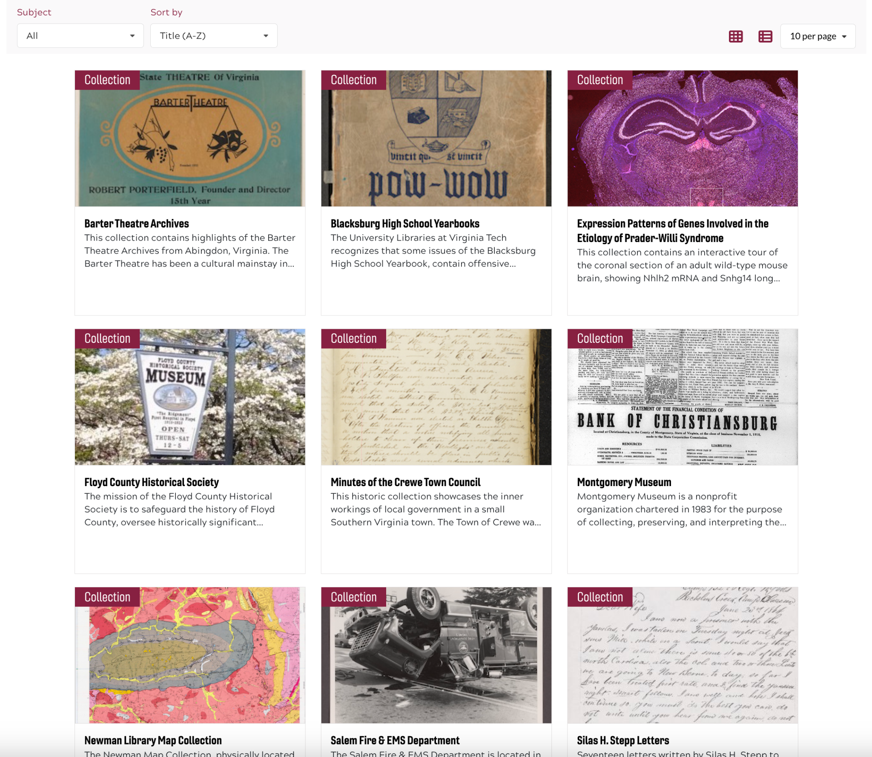
VTDL
5 Community Collections live
2 being migrated
2 on deck
3 more contacted and/or in planning stages
Notes:
This is a screenshot of the first collections page of the Virginia Tech Digital Library. Right now I’m very pleased to say that our developers have ingest 5 community collections successfully and have 2 more being migrated from a previous instance; we have 2 more on deck and in processing; and GSDC has 3 more partners contacted or in the planning stages.

Slide 30
What’s Next for GSDC?
Near to Mid-Term
Social media promo
Expanding to more communities and organizations
Backend uploading to SWVA database
Networking!
Long-Term
Secure consistent funding, possibly as a 501(c)3
More resources for partners to promote collections (physical & digital exhibits)
More resources for digital curation training

Slide 31
Q&A

Slide 32
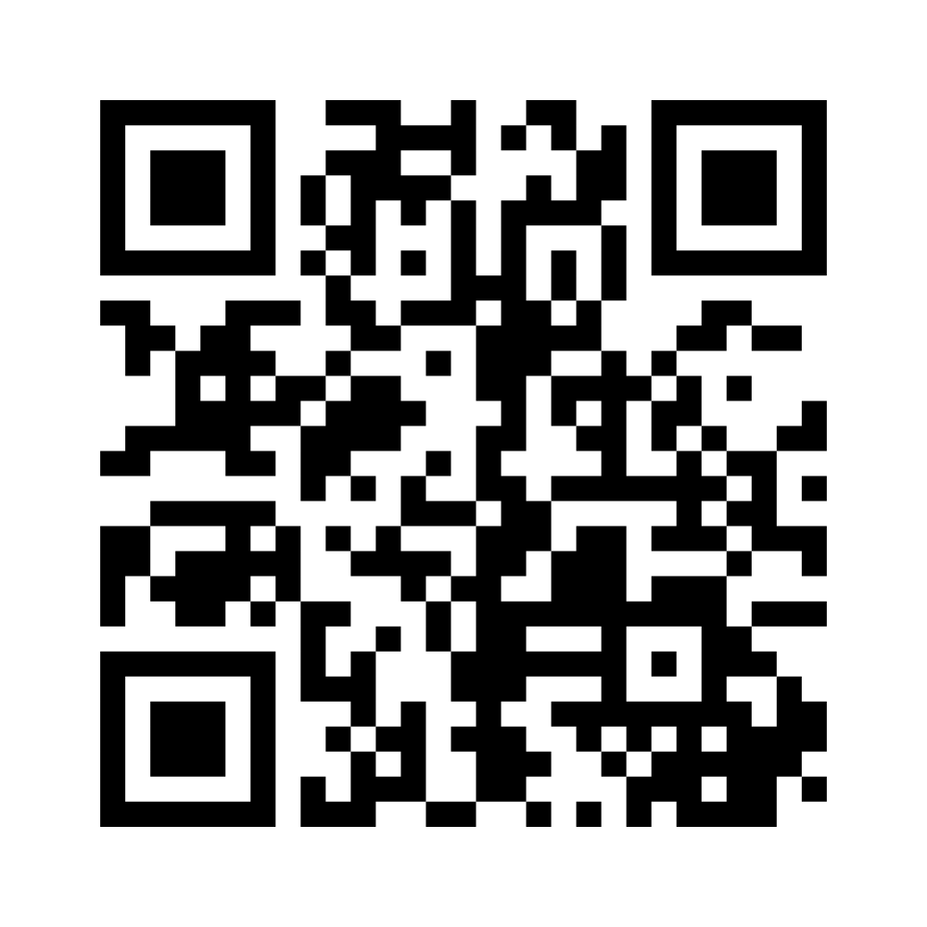
www.menti.com
Participation Code: 2947 7911
Notes:
https://www.menti.com/aln4z37kw2zo
https://www.mentimeter.com/app/presentation/n/al3bf6ym28jx2tqtpezu7qxk2rxd2m5w/edit?question=d6itzj65njvv

Slide 33
Acknowledgements
GSDC Advisory Board Members
Ann-Margaret Shortt (MFRL)
Mickey Hickman (CC&CC)
Jenny Nehrt (CII)
Sherri Huffman (BRH)
David Rotenizer (BRIM)
Wen Nie Ng (VTUL)
Anthony Wright de Hernandez (VTUL)
Previous Leaders & Consultants
Nathan Hall, PhD (Penn State)
Ralph Lutts (ret. BRH)
Katherine Skinner (IOI)
Additional Support
Rob Barrowclift - website & logo
Scott Fralin - exhibits & printing
Grant Support
IMLS Community Catalyst LG-15-19-0137-19
Notes:
As we wrap up, we want to thank several folks.
Ann-Margeret, Mickey, Jenny, Sherri, David, Wen, and Anthony are our fellow GSDC Advisory Board members and have been in this for the long haul, but no one as long as Nathan Hall, our original fearless leader who started the seeds of this program 8 years ago; Ralph Lutts, a highly-regarded community consultant; Katherine Skinner, a community-building consultant; friends of the GSDC Rob and Scott for their free labor in helping with outreach; and I think I’m obligated to thank IMLS for funding the first big stage of this initiative.
And a big thank you to the DAIC Conference Planning Committee for giving us the opportunity to speak today.

Slide 34
Thank you!
Alex Kinnaman
Interim Assistant Director, Digital Libraries & Preservation, Virginia Tech
alexk93@vt.edu
Ashley Palazzo
Archivist, Christiansburg Institute, Inc.
archivist@christiansburginstitute.org
GSDC Website: www.gswvadc.org
GSDC Email: greaterswvadigitalcollective@gmail.com
Virginia Tech Digital Library: digital.lib.vt.edu
Notes:
Thank you so much for being here and engaging, we appreciate it. Feel free to reach out to use directly or to the GSDC Advisory Board, to check out our budding website, and the Virginia Tech Digital Library!

