Slide 1
Video: Contemplative Practices for a Technological Society
Kyle Stevens, Val Komarov, and Yin Zhou
May 8th, 2013
CS 4624 - Multimedia, Hypertext, and Information Access
Virginia Tech
Blacksburg, VA
Client: Dr. Doug Lindner

Slide 2

History
Conference: Contemplative Practices for a Technological Society
http://www.cpe.vt.edu/cpts/
Question: How can we reconnect with our own humanity in the midst of a rapidly evolving technological society?

Slide 3
Goals
Interview prominent instructors and practitioners of various contemplative practices
Create a short documentary advocating contemplative practices
Capture and store video content

Slide 4
Roles
Shared responsibilities:
Scheduling interviews
Obtaining and checking equipment
Interview setup and teardown
Capturing videos of the conference
Editing videos
Notes:
Scheduling interviews involves: 2 of the 3 of us being available, our video expert Parke being available, and our interviewer Scott being available. And of course the interviewee.
We borrow our equipment from Innovation Space. Batteries have to be checked and/or charged. We have to make sure all components work together we need and expect them to.
When scheduling the interview we have to account for 30 minutes before and after to setup and teardown our equipment.

Slide 5
Project Phases
Phase 1: Pre-conference interviews
Phase 2a: Filming of the conference
Phase 2b: Gathering interviews from conference attendees
Phase 3: Editing of interviews
Phase 4: Publishing of content

Slide 6
Results
18 video interviews
Over 700 photos
B-roll footage
Edited interview videos

Slide 7
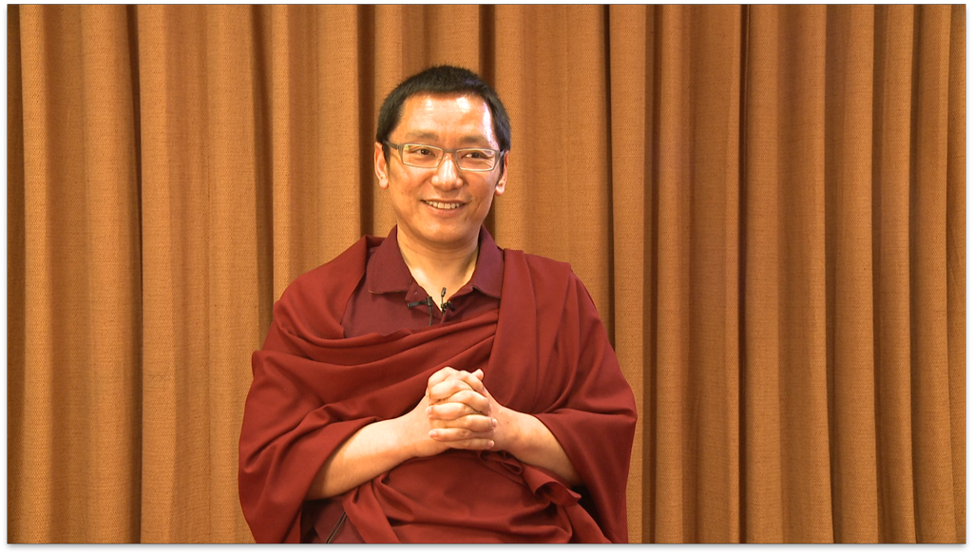
Results

Slide 8
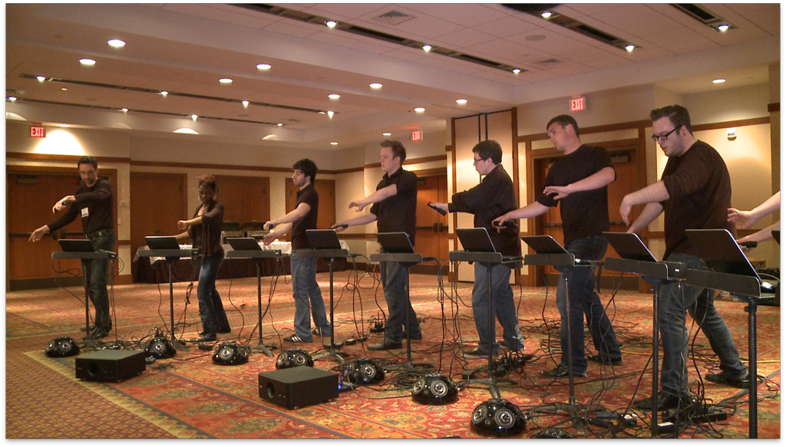
Results

Slide 9
Reflection
Contemplative practices
How to conduct a proper interview
Lighting a set
Using various recording equipments
Editing videos and sound

Slide 10
Questions?

