Slide 1
Risk Prediction Sentiment Analysis 3
CS 4624 Multimedia, Hypertext, and Information Access - Dr. Fox
Virginia Tech, Blacksburg, VA 24061
5/10/22
Kaustubh Kale, Jaswant Kasinedi, Sagar Mehta, Parvesh Samayamanthula, Arjun Vashistha

Slide 2
Outline
Project Overview
Timeline
Frontend
Backend
Lessons Learned
Future Work
Acknowledgments
References

Slide 3
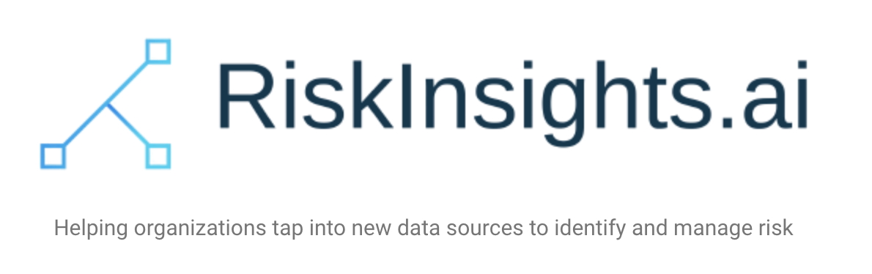
Project Overview
Hypothesis: Worker sentiment in the workplace indicates the overall safety of the workplace
Intuitive web app for users to upload worker responses and get sentiment analysis results
Client

Slide 4
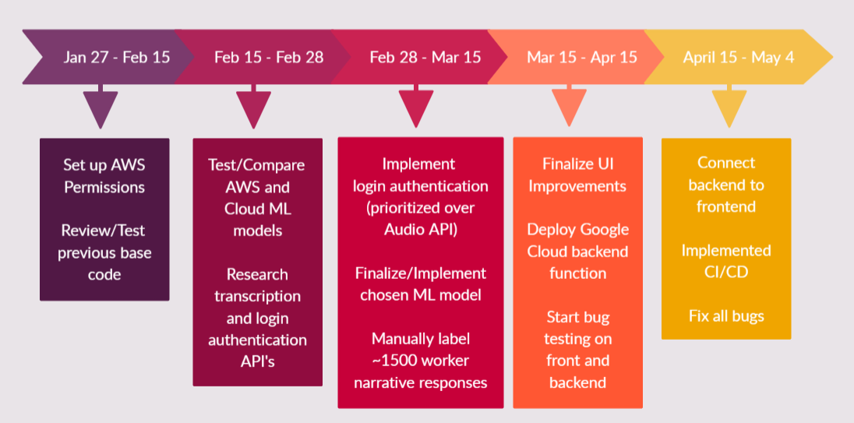
Timeline

Slide 5
Frontend

Slide 6
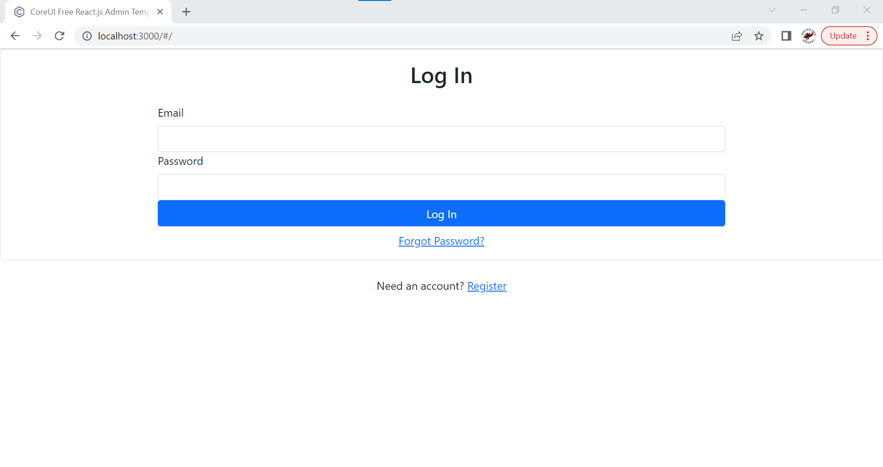
Log In

Slide 7
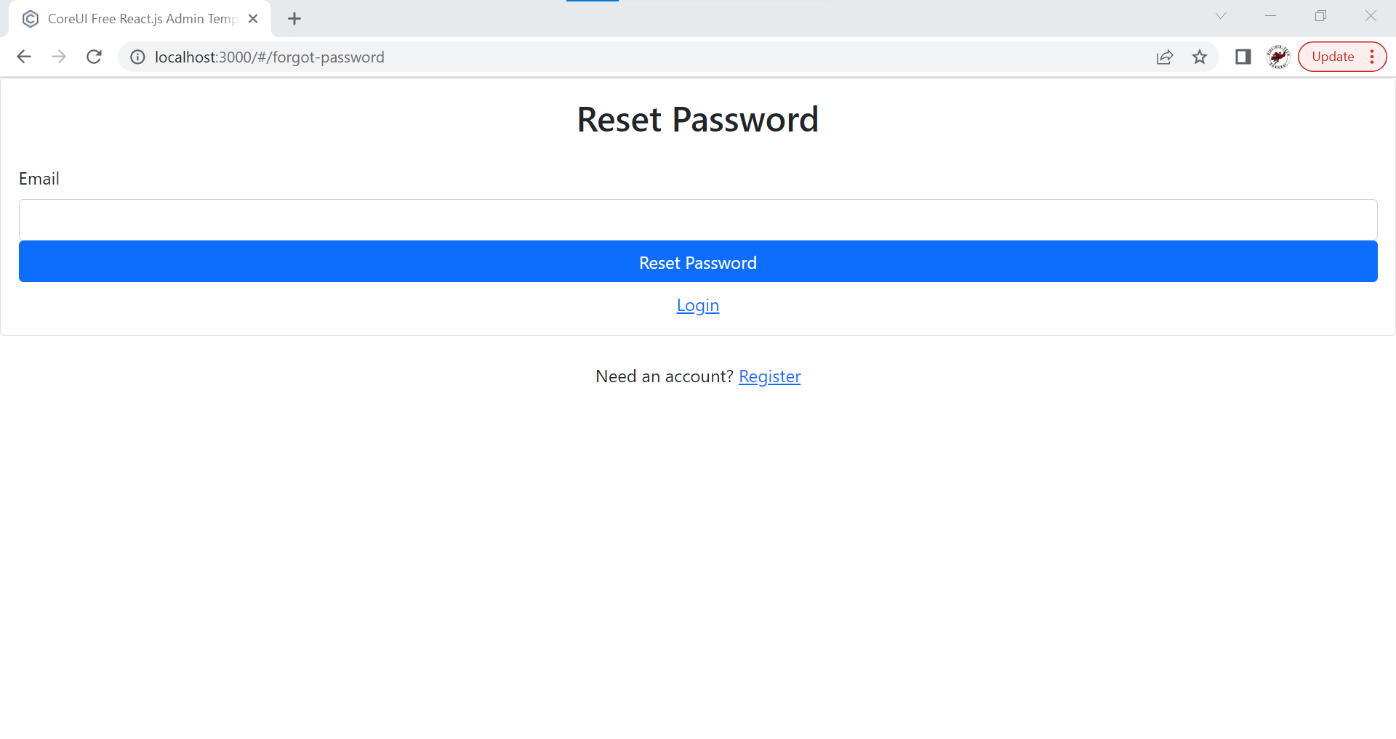
Reset Password

Slide 8
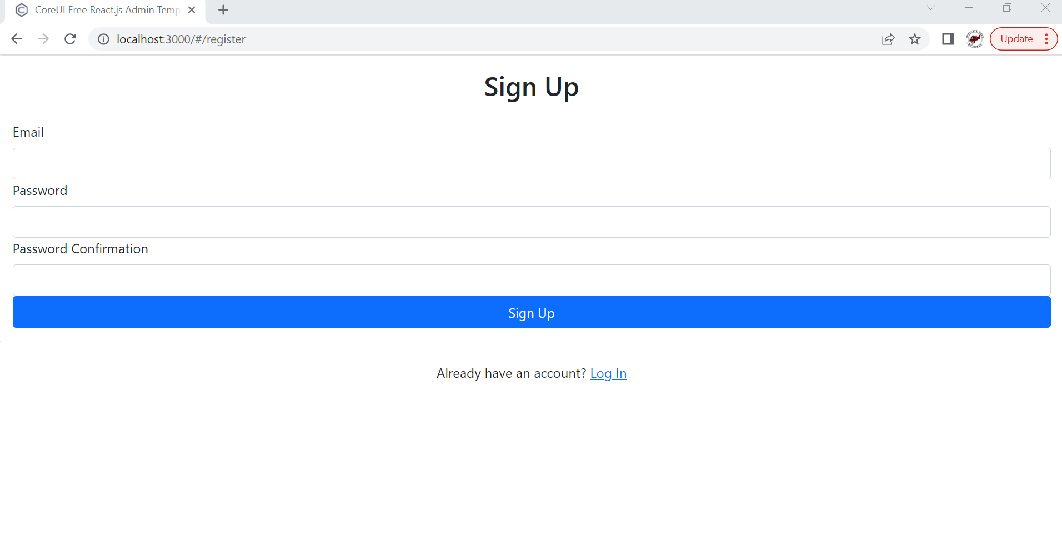
Sign Up

Slide 9
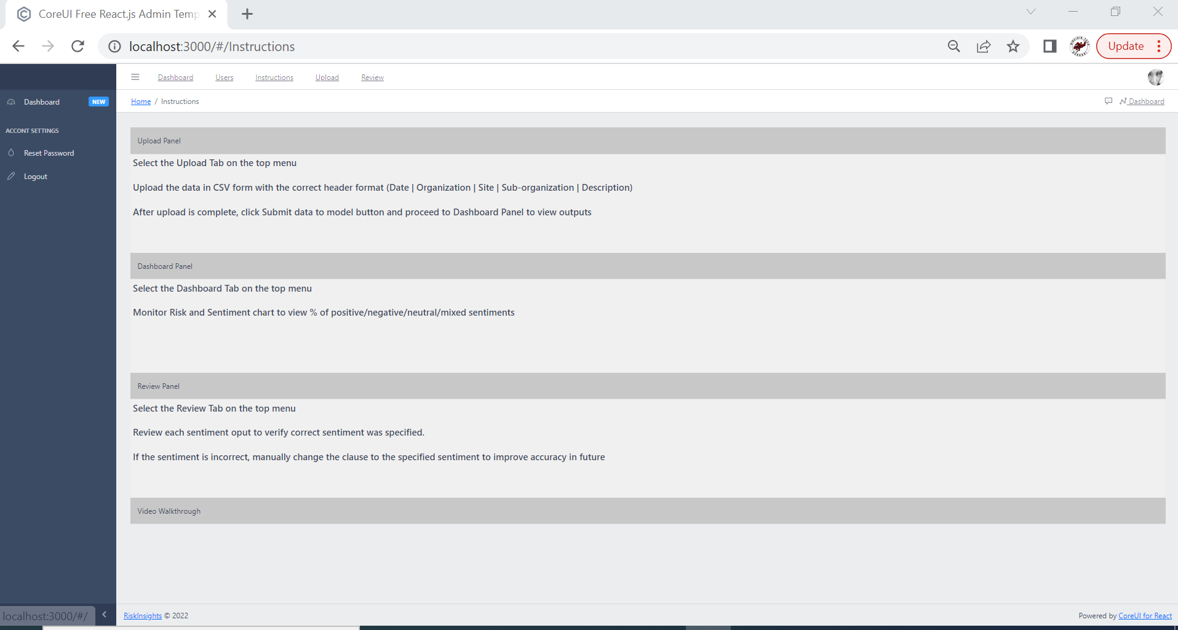
Instructions

Slide 10
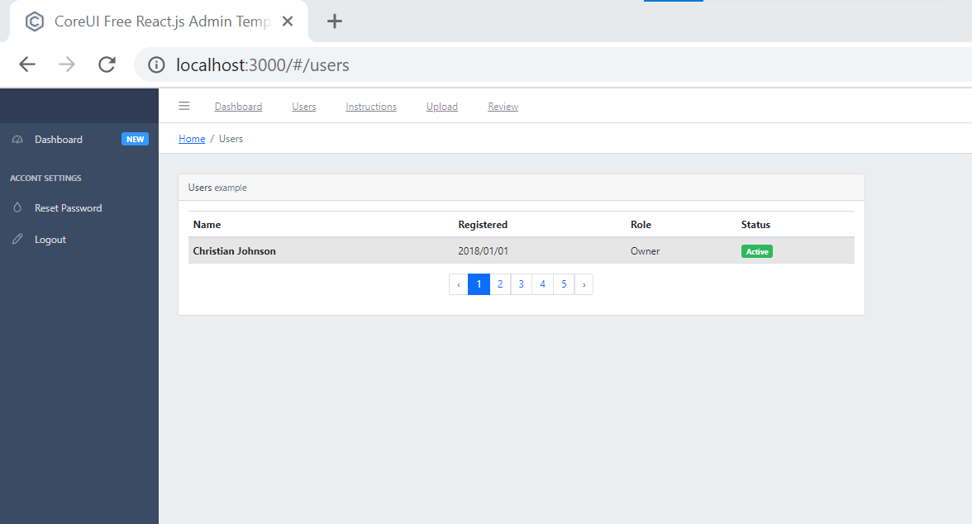
Users

Slide 11
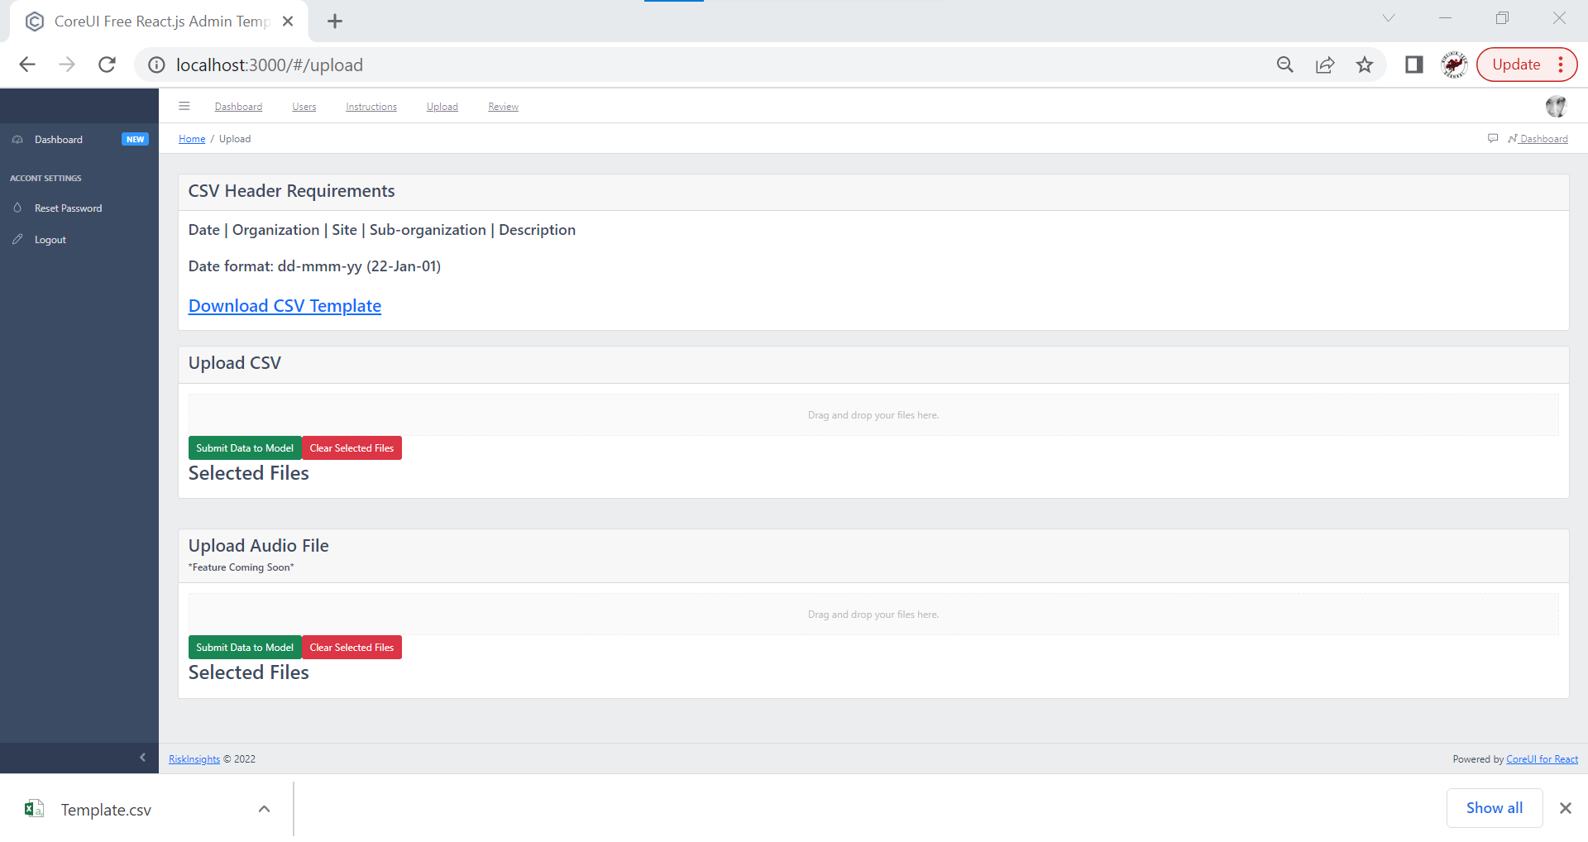
Upload

Slide 12
References
Backend

Slide 13

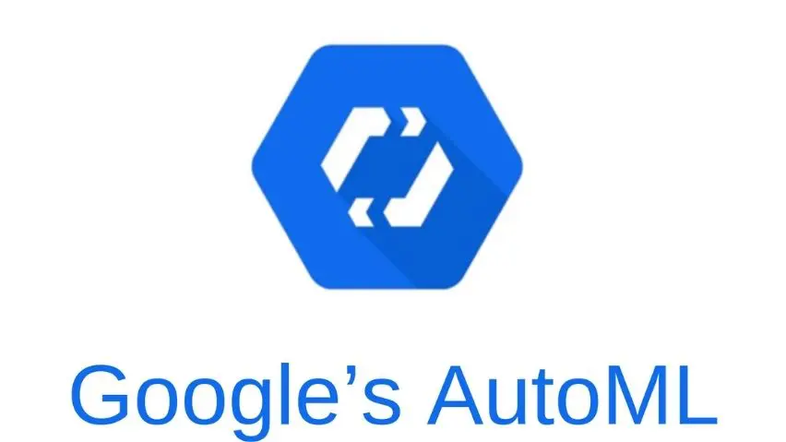
Sentiment Analysis
Services tested: Microsoft Azure, Google Cloud Platform
Chose GCP for its custom AutoML Service
Accepts range of sentiment scores and labeled data (Ex: 0-4)

Slide 14
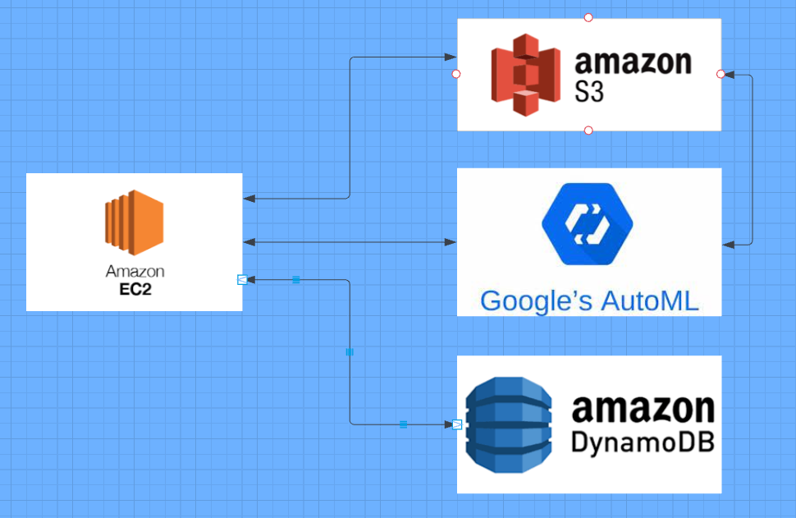
Backend Infrastructure

Slide 15
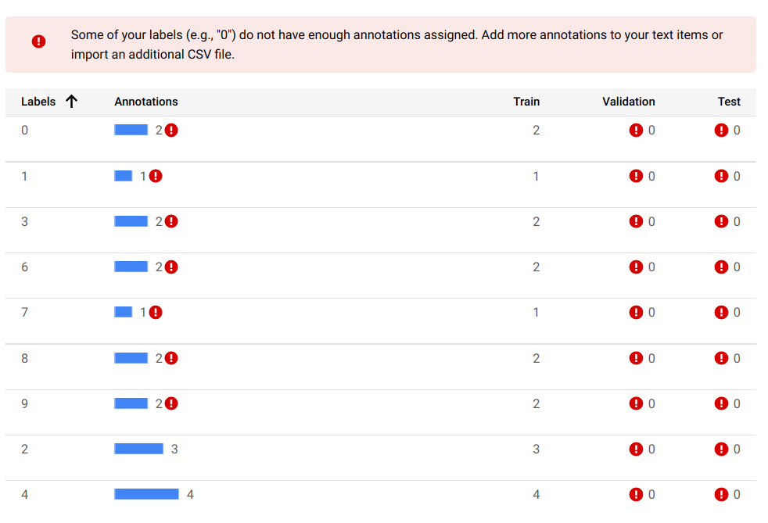
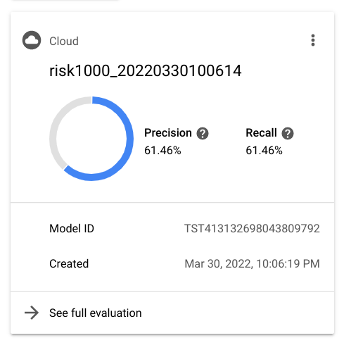
AutoML Sentiment Analysis
Labeled 1544 worker responses for supervised learning
Initially tried a sentiment range of 0-10
Settled on a range of 0-4

Slide 16
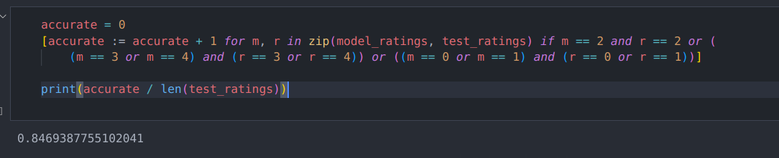
Revised Accuracy Evaluation
Accuracy of predicting whether worker responses are positive or negative

Slide 17
Input.csv
Date | Organization | Site | Sub-organization | Description
2018-09-18 | Global Operations | Site B | Wetmill | Asked Wetmill/Feedhouse team if machine guarding audits have been completed. Not aware of a recent audit. Removable gate in question should have a lock on it. Notified Area Technologist and Area Engineer and asked that the chain be replaced at the DSL dryer.
2018-10-04 | Global Operations | Site B | Office area | Talked to employee about their immediate work space and the ergonomic impact of monitor position.
2018-10-20 | Global Operations | Site C | Operations | Great job and clean up

Slide 18
Upload Page Workflow
User uploads input CSV to upload page
CSV gets sent to the backend, is parsed, and worker descriptions are sent to the Google Cloud model
Sentiment results are sent back from the model and appended to input CSV
New output CSV is sent back to frontend, where it’s automatically downloaded

Slide 19
Output.csv
Date | Organization | Site | Sub-organization | Description | Sentiment Score | Overall Sentiment
2018-09-18 | Global Operations | Site B | Wetmill | Asked Wetmill/Feedhouse team if machine guarding audits have been completed. Not aware of a recent audit. Removable gate in question should have a lock on it. Notified Area Technologist and Area Engineer and asked that the chain be replaced at the DSL dryer. | 2 | Neutral
2018-10-04 | Global Operations | Site B | Office area | Talked to employee about their immediate work space and the ergonomic impact of monitor position. | 2 | Neutral
2018-10-20 | Global Operations | Site C | Operations | Great job and clean up | 4 | Positive

Slide 20
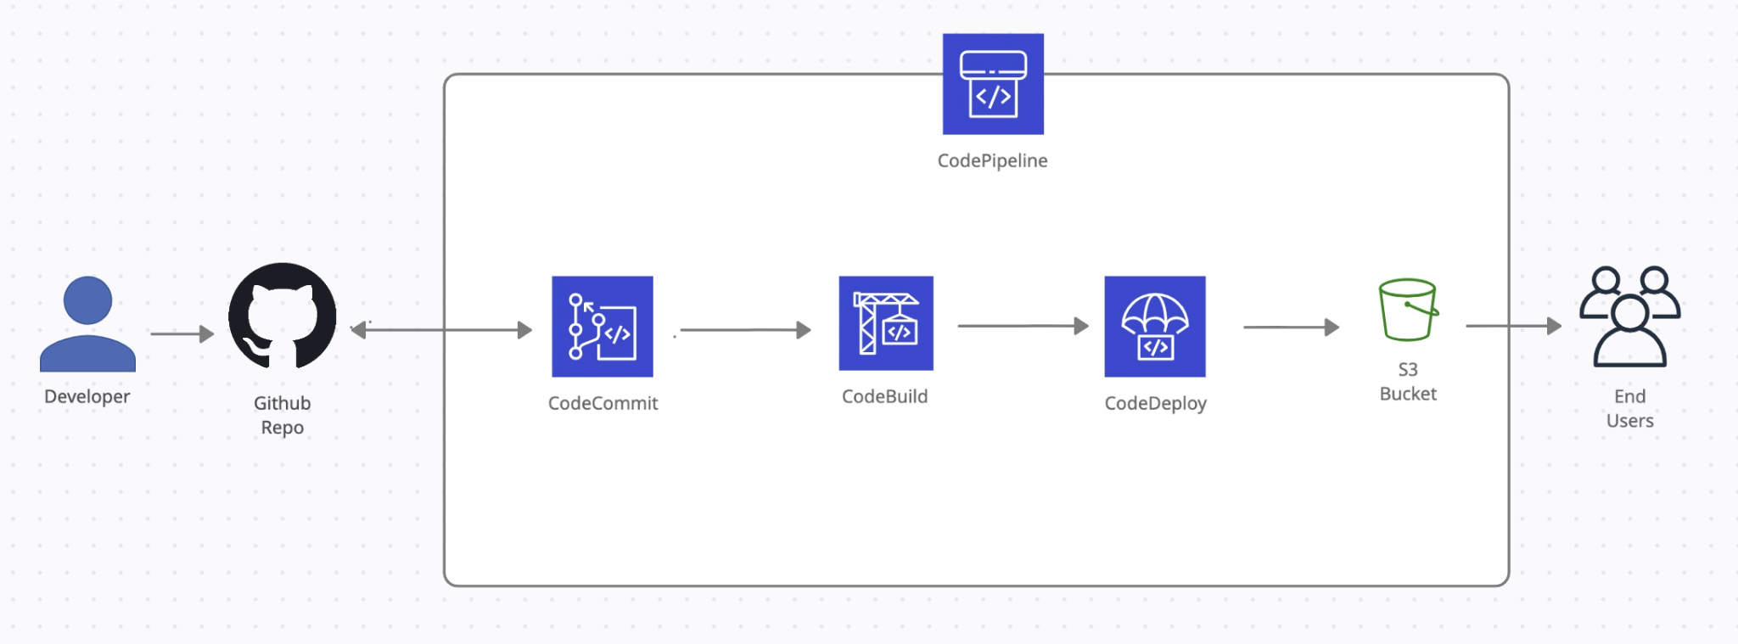
CI/CD

Slide 21

Lessons Learned
Time management - gauging which features to prioritize and the time to implement them
Quality of data - skewed data results
Building on previous team’s work and ideas

Slide 22

Future Work
Audio transcription
Continuous learning/improvement of ML model
Testing and feedback tool
Better visualizations UI for sentiment data

Slide 23


Acknowledgements
Dr. Fox
  Mentor
Christian Johnson
  Client

Slide 24
References
[1] 360training. New Survey Reveals Rise In Workplace Safety Concerns. https://www.360training.com/blog/new-survey-reveals-rise-workplace-safety-concerns#:~:text=Top%20Workplace%20Safety%20Concerns%20in%202019&text=Electrical%20Hazards%20(13%25),Falling%20Objects%20(6%25), 2022. Accessed: 30-Jan-2022.
[2] Oxford Language. Oxford Languages and Google. https://languages.oup.com/google-dictionary-en/, 2022.
[3] Google Firebase. Firebase Documentation. https://firebase.google.com/docs, 2022. Accessed: 10-Mar-2022.
[4] Amazon Web Services. Set Up a CI/CD Pipeline on AWS. https://aws.amazon.com/getting-started/hands-on/set-up-ci-cd-pipeline/, 2022.
Accessed: 17-Apr-2022.
[5] Google Cloud. AutoML beginner's guide. https://cloud.google.com/vertex-ai/docs/beginner/beginners-guide, 2022.
Accessed: 20-Feb-2022.
[6] Google Cloud. Sentiment Analysis Tutorial https://cloud.google.com/natural-language/docs/sentiment-tutorial, 2022.
Accessed: 20-Feb-2022.
[7] Amazon Web Services. Bucket policy examples. https://docs.aws.amazon.com/AmazonS3/latest/userguide/example-bucket-policies.html, 2022, Accessed: 21-Feb-2022.
[8] Google Cloud. APIs and references. https://cloud.google.com/speech-to-text/docs/apis, 2022.
Accessed: 21-Feb-2022.
[9] Google Firebase. Authenticate Using Google with JavaScript. https://firebase.google.com/docs/auth/web/google-signin, 2022. Accessed: 10-Mar-2022.
[10] CoreUI. Free bootstrap admin templates - CoreUI. https://coreui.io/ , 2021.
Accessed: 15-Feb-2022.
[11] Himler, Tom; Sharma, Pranav; Taing, Eriq; Akula, Akshay; and Joaquin, Evan. Risk Prediction Sentiment Analysis. 2021. CS4624 submission to VTechWorks, Virginia Tech, Blacksburg, VA 24061 USA. http://hdl.handle.net/10919/107004, accessed May 3, 2022.
[12] Christian Johnson. Risk Insights AI. https://riskinsights.ai/, 2022. Accessed: 15-Feb-2022.
[13] Amazon Web Services. AWS Comprehend. https://aws.amazon.com/comprehend/, 2022. Accessed: 28-Feb-2022.
[14] Amazon Web Services. AWS DynamoDb. https://aws.amazon.com/dynamodb/, 2022. Accessed: 15-Mar-2022.
[15] NodeJs. NodeJs. https://nodejs.org/en/, 2022. Accessed: 20-Feb-2022.
[16] Microsoft. Microsoft Azure Text Analytics. https://azure.microsoft.com/en-us/free/cognitive-services/, 2022. Accessed: 21-Feb-2022.

