Slide 1


Strategic Management
Course Introduction and Introduction to Strategic Management
Unless otherwise noted, this slide deck is (c) Virginia Polytechnic Institute and State University. It is released under a Creative Commons Attribution NonCommercial ShareAlike 3.0 license (CC BY NC-SA 3.0)
Instructor Name | Name of Institution
http://hdl.handle.net/10919/102735
Photo by Jon Sailer on Unsplash

Slide 2
Today’s Agenda – Date Here
Why Strategic Management
Introductions
Syllabus/Course Structure/Expectations
Strategic Management Introduction
http://hdl.handle.net/10919/102735

Slide 3
Why Strategic Management
I’m an accountant, IT person, marketing person… whatever
Your role always involves _________!
Your and your company’s goal is always to achieve __ _____________ _________.
http://hdl.handle.net/10919/102735
Notes:
Strategy!
A Competitive Advantage

Slide 4
Introductions
Instructor Name
  Office: Phone: (NNN-NNN-NNNN
  Email: xxxxxxx@school.edu
  Office Hours: Wednesday 8:30 AM – 12:00 PM, or by appointment
You (complete form)
INSTRUCTOR’S PHOTO HERE
http://hdl.handle.net/10919/102735

Slide 5
Course Structure
Syllabus High Points
Please read the entire syllabus
Teams
Email me if there is someone you do not want to work with
Technology policy
http://hdl.handle.net/10919/102735

Slide 6
Course Requirements
Exams (2 @ 15% each) 30%
TCAs (2 @ 15% each) 30%
Class and Preparation Activities 30%
  Quizzes and homework 15%
  Class contribution/attendance 10%
  Current Event Presentation 5%
Case Performance Analysis Presentation 5%
ETS Exam 5%
TOTAL 100%
http://hdl.handle.net/10919/102735

Slide 7
Class Contribution Points
Participation Points
Good contribution that shows preparation 85 to 100 points
Attends class but does not participate in discussion 80 points
Attends class but does not engage in team discussion 60 points
Absent from class, no excused absence 0 points
Excused absences are illness with documentation, an email from a potential employer regarding specifics about an interview, a letter from the Dean of Students, etc..
Daily Attendance - Exit Slip
http://hdl.handle.net/10919/102735

Slide 8

Class Schedule
In Canvas
Tour Canvas
Trademarked image.
http://hdl.handle.net/10919/102735

Slide 9
Required Course Materials
  Textbook: Free e-textbook, Strategic Management.
    PDF version: https://doi.org/10.21061/strategicmanagement
    WordPress version: https://pressbooks.lib.vt.edu/strategicmanagement
    Print versions available HERE B&W - $8.52 Color - $22.72
    Case pack: The case pack is also required and can be purchased online or at the bookstore. The online version is less expensive.
      Please note: there are no used casebooks—the cases change each semester, so please do not buy a “used” casebook. It must be the [year] version.
See the syllabus for how to obtain textbook and casebook.
    Print copies of the text and case pack are on 2-hour reserve at the Library.
http://hdl.handle.net/10919/102735

Slide 10
Course Exam Dates
Midterm Exam – In Class, Monday/Tuesday, October 14th/15th
Final Exam exam – As scheduled during final exam period
Note: Must get a C- or better or retake the course
http://hdl.handle.net/10919/102735

Slide 11
Additional Course Notes
Presentations slides posted after each class day
Can come to a different section if necessary
Office Hours
http://hdl.handle.net/10919/102735

Slide 12


What’s on the Mind of a Functional Manager?
Accounting
Finance
Real Estate
BIT
Management
Marketing
Majors - created around functions: accounting, marketing, finance, production and operations, human resource management, etc…
My Functional Area
Why? Specialization - making you an expert in a specific area.
Shapes how you think & how you see the world and the organization; likely in ways that you are not cognizant of.
Brain © Pupot Nugroho, ID CC BY 3.0
http://hdl.handle.net/10919/102735

Slide 13
A Short Exercise on Functions
“Company profits are down significantly.” WHY?
  Develop a list of 3-5 possible explanations based on your area of functional expertise (i.e., your major) to the statement above.
  Consider:
    Possible causes relating to your area
    Time horizons your use in your area
    The unit of analysis – what your function focuses on
    You have two minutes to complete this.
http://hdl.handle.net/10919/102735

Slide 14
Functions Exercise Answers
“Company profits are down significantly” Functional Explanations:
  Possible causes
  Time horizons
  Unit of Analysis
  Which is it? Which matters (most)? Which needs to be addressed?
Brain © Pupot Nugroho, ID CC BY 3.0
http://hdl.handle.net/10919/102735

Slide 15
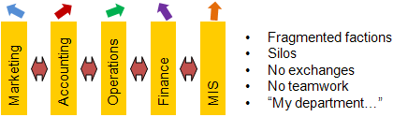
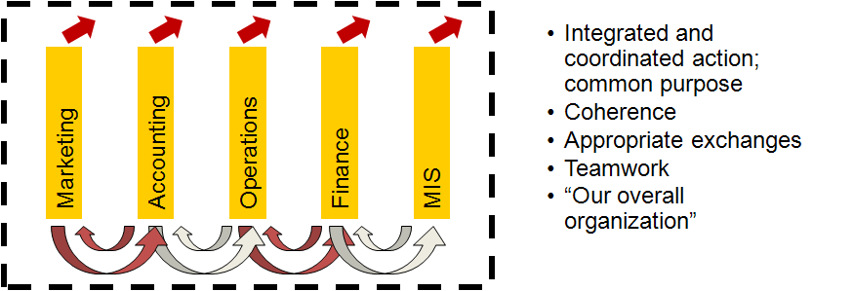
Outcome of Being Solely Focused on Functionalization
Very likely conflict over:
  Key tasks and issues and priorities
  Different ways of seeing the organization
The specialized training you’ve received does make you an expert in an area… but at the price of a general view of the firm overall
  This is what the course is about
http://hdl.handle.net/10919/102735

Slide 16
Changing Perspective from Functional to a Strategic View of Organizations
Accounting
Finance
Real Estate
Management
Marketing
BIT
Which is it?
Which matters?
Which needs to be addressed?
Can any one function alone see the big picture?
Brain © Pupot Nugroho, ID CC BY 3.0
http://hdl.handle.net/10919/102735

Slide 17
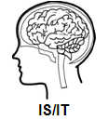
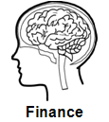
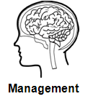

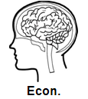



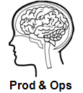
Changing Perspective from Functional to a Strategic View of Organizations (CONTINUED)
The General Manager
Responsible for the firm overall: new unit of analysis - majors don’t cover this - extends your area expertise.
Analytical & strategic thinking; identifying and solving problems
Requires: expertise of all functional areas + additional tools & concepts + synthesize into coherent system
Brain © Pupot Nugroho, ID CC BY 3.0
http://hdl.handle.net/10919/102735

Slide 18
A Short List of Tools & Concepts of Strategy
Vision, Mission & Objectives
Firm-Environment Interface
Internal Environment
Resources, Capabilities and Core Competencies
Value Chain
External Environment
Industry Structure
Strategic Groups
Market Positioning
Willingness to Pay
Business Level Strategy
Market Entry
Competitor Analysis & Dynamics
Corporate Level Strategy
Diversification & Scope
Vertical Integration
Mergers & Acquisitions
International Strategy
Implementation
Functional Level Strategies
Strategic Change
Firm Performance
Market Share
ROS, ROA, ROE, ROIC
Shareholder Value
Stock Market Returns
http://hdl.handle.net/10919/102735

Slide 19
Portion of Time Devoted to Functional Activities vs. Management & Strategy
Portion of annual time spend on
Functional Activities – Accounting, Finance, Marketing, Operations, etc.
Managing & Strategy
http://hdl.handle.net/10919/102735

Slide 20
Learning Our Model – The Basic Analysis Framework
Strategic Management & Business Frameworks & Tools
Symptoms
Phenomenon
Problems (?)
Key Issues
Causes need to address
List of Alternatives
Per issue
Criterion
Rank alts upon
Mutually excl?
This is an analytical thinking process
Recs/Options
Timelines, costs
Responsibilities
Fallback option
Must be a collaboration: Review analyses, integrate & synthesize to understanding and create meaning; Sense making
http://hdl.handle.net/10919/102735

Slide 21
What’s the Point?
Functional perspectives & cognitive bias
  We look at the same issue from different perspectives.
  We interpret the same issue in different ways.
  Both typically lead to different conclusions.
We develop cognitive shortcuts – to deal with repeated exposures and complexity. These affect our ability detect change.
How do we overcome these?
  In organizations
  In the course?
http://hdl.handle.net/10919/102735

Slide 22
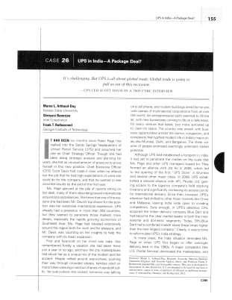
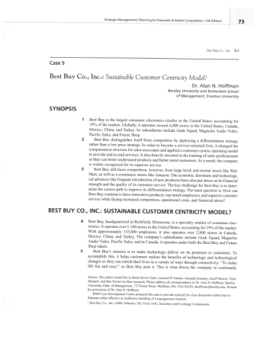

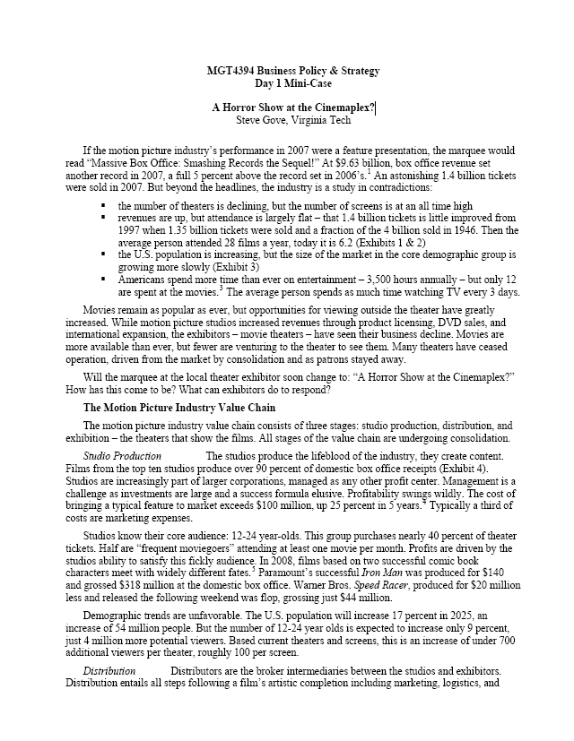
Overcoming Functionalism and Cognitive Limitations to Think Strategically?
  In Organizations
  Use cross-functional teams – multiple perspectives, are experts
  Multiple analytical tools to force different perspectives
  Lots of discussion & integration to reveal different insights
In This Course
Same as in organizations plus…
The case method / pedagogy
The majority of our in-class time will be spent on discussion of cases. It is a process: knowing the final answer prepares you very little for the future.
Focus on thinking – analytical skills that you can use for any topic
Class contribution is a very significant aspect
Must be prepared to contribute
http://hdl.handle.net/10919/102735

Slide 23
Studying Business – The Box Exercise
Studying Business – as opposed to accounting, BIT, entrepreneurship, finance, management, marketing, etc. Those are your specialization.
Pick a business.
Explain how the business works, why some firms succeed, why others fail.
Now, think outside the box. Come up with something original for that business that is economically viable to create competitive advantage.
By the end, you’ll understand how many businesses work; understand many boxes
Movie Theaters
Cola Wars
Sports Drinks
Under
Armour
Starbucks
Kraft Foods
Walt
Disney
General Electric
Philips &
Matsushita
Arcelor &
Mittal
Costco
Blue Nile
http://hdl.handle.net/10919/102735
Notes:
CEO John Flannery, Aug. 2017

Slide 24
Team Assignments
I will assign teams of about 5-6 students each, randomly with diversity across majors.
Let me know if there is someone you do NOT want to work with, via email, confidentially.
http://hdl.handle.net/10919/102735

Slide 25
MGT 4394 Course Objectives
Developing your general management skills that integrate across functional areas;
Understanding how firms gain and sustain competitive advantage;
Analyzing strategic business situations and formulating strategy; and
Implementing strategy and organizing the firm for strategic success.
Strategic Management & Business Frameworks & Tools
Symptoms
Phenomenon
Problems (?)
Key Issues
Causes need to address
List of Alternatives
Per issue
Criterion
Rank alts upon
Mutually excl?
Recs/Options
Timelines, costs
Responsibilities
Fallback option
http://hdl.handle.net/10919/102735

Slide 26
What is Strategic Management?
Strategic Management - an ongoing process used by firms to set an organizational vision, analyze the external, competitive, and internal environments, and develop strategies for success
Four key aspects:
  Directs the organization toward overall goals and objectives – commonly statements of vision, mission & strategies
  Includes multiple stakeholders in decision making
  Needs to incorporate short-term and long-term perspectives
  Recognizes trade-offs between efficiency and effectiveness
http://hdl.handle.net/10919/102735

Slide 27
The AFI Strategy Framework
Analyze (A)
Formulate (F)
Implement (I)
The traditional planning questions:
  Where are we?
  Where are we going?
  How are we going to get there?
http://hdl.handle.net/10919/102735

Slide 28
Recap & Look Ahead
Today
Next Class: See Schedule
What the course is about: Analytical thinking; Perspective of General Manager
What strategic management is
  Integrating across functions
  Organizational coherence – functions, vision/mission/objectives
  The performance of the firm as a whole
How we will learn it - learn content then apply to cases with extensive in-class discussions / class contribution
Topics:
  Introduction to case analysis
  Quantitative analysis
  Strategic decision making
Deliverables
  How to Conduct a Case Analysis Handout
  Chapter 1
In-class quiz on Chapter 1…Must bring a laptop!
http://hdl.handle.net/10919/102735

