Slide 1
CS 5604: Information Storage And Retrieval
Final Presentation
ETD Team
Instructor: Prof. Edward A. Fox
Department of Computer Science, Virginia Tech
Blacksburg, Virginia - 24061
December 9, 2020
Aarathi Raghuraman
Alex Nguyen
Javaid Manzoor
Jiahui Fan
Nicolas Hardy
Sam Furman
Grant: IMLS LG-37-19-0078-19
Notes:
Do we have metrics on how much of the data each service can work on?
Chapter segmentation
60% of dissertation subset
Text Extraction
All docs

Slide 2
AGENDA
Summary Statistics
ETD Architecture
ETD Services
  Validate Input
  Figure/Table Extraction
  Chapter Segmentation
  Text Extraction
  Classification
  Metadata Ingestion (ELS)

Slide 3
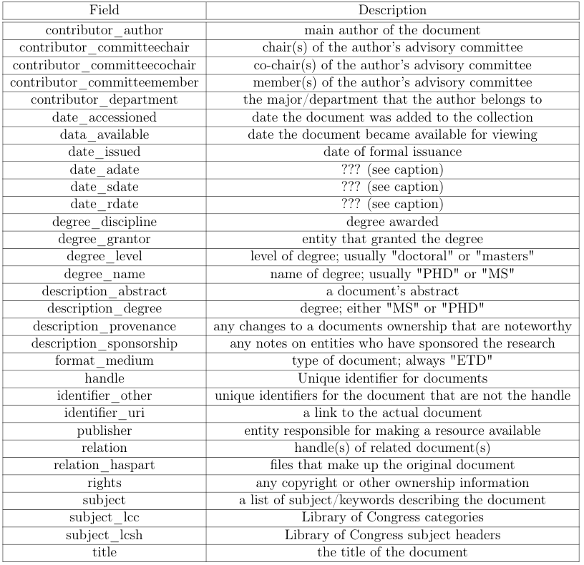
Summary Statistics
etd_filename
etd_uri
figures_folder_uri
figures_total_count
tables_folder_uri
tables_total_count
subject [append unique]
Collection contains 19,779 theses and 14,691 dissertations.
  Subsets contain 410 theses and 282 dissertations
19% and 32% of the 31 attributes are empty for theses & dissertations respectively
We add attributes to ETD Metadata and create metadata for chapters
chapter_number
chapter_uri
subject
chapter_fulltext_uri
pages
page_number
Notes:
For simplicity we are continuing our analysis on the subsets assuming that they are a representation of the complete dataset’s distribution
Note all subject data is from 2017
Of the missing data some columns overlap -- subject_lcc, lcsh, relation, relation_haspart, description_sponsorship, data_available
To the existing etd metadata we added 6 attributes, updated 1 & created chapter metadata with 6 attributes
RT
https://towardsdatascience.com/exploratory-data-analysis-for-natural-language-processing-ff0046ab3571
Histograms
Word Clouds

Slide 4
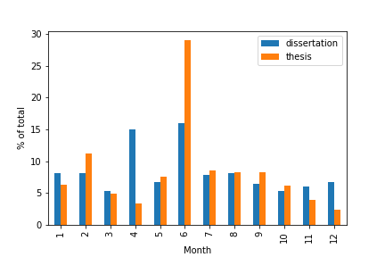
Summary Statistics
Collection contains 19,779 theses and 14,691 dissertations.
  Subsets contain 410 theses and 282 dissertations
19% and 32% of the 31 attributes are empty for thesis & dissertations respectively
We add attributes to ETD Metadata and create metadata for chapters
Fact Check: Issue Date highest in June
Notes:
For simplicity we are continuing our analysis on the subsets assuming that they are a representation of the complete dataset’s distribution
Note all subject data is from 2017
Of the missing data some columns overlap -- subject_lcc, lcsh, relation, relation_haspart, description_sponsorship, data_available
To the existing etd metadata we added 6 attributes, updated 1 & created chapter metadata with 6 attributes
RT
https://towardsdatascience.com/exploratory-data-analysis-for-natural-language-processing-ff0046ab3571
Histograms
Word Clouds

Slide 5
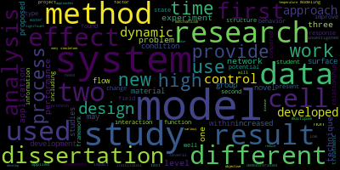
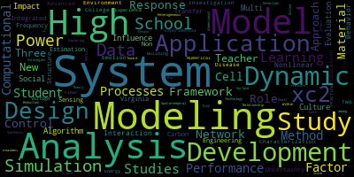
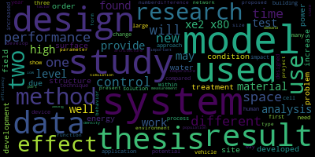
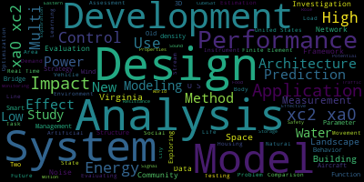
Summary Statistics
Dissertations
Theses
ABSTRACTS
Titles
Notes:
Even those the titles have similar words highlighted, the abstracts are quite different

Slide 6

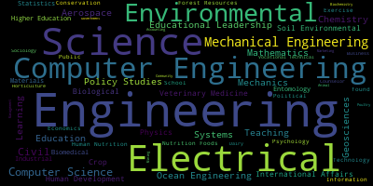
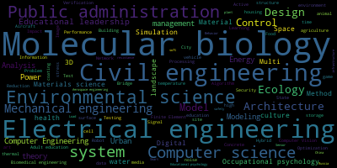
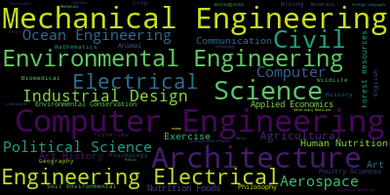
Summary Statistics
Dissertations
Theses
SUBJECTS
AutHOR DEPARTMENT
Notes:
There is more diversity in subjects since you can qualify for more than one subject per ETD
Theses is more diverse than dissertations as expected

Slide 7
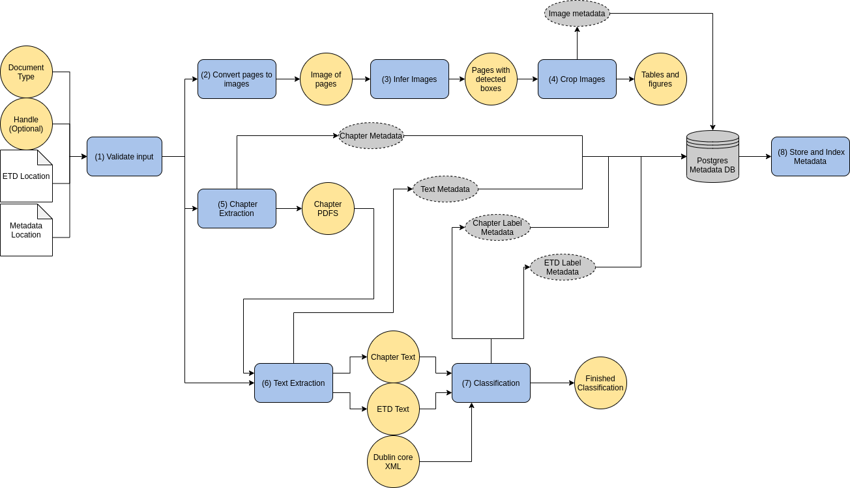
ETD Pipeline Architecture
Notes:
-- inorder to populate the new metadata fields we have 8 services.
-- the primary inputs are the existing metadata & etd pdf
-- we will now walk through the pipeline starting with validate input

Slide 8


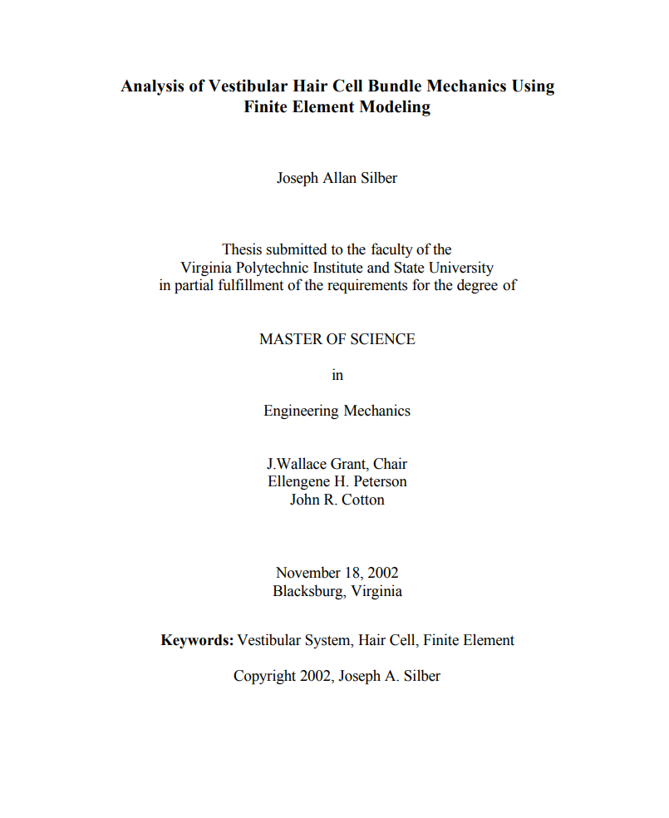
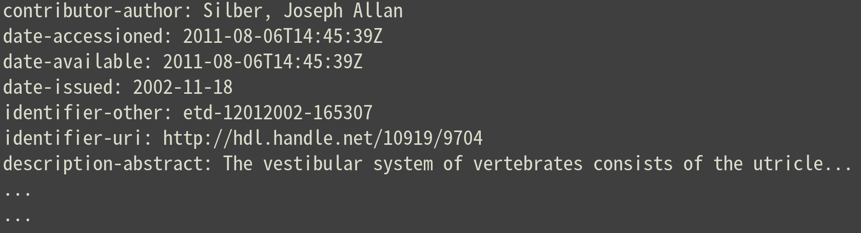
Validate Input
Tested & Containerized
Creates a new row in the database for the incoming document.
handle
doc_type
INSERT INTO metadata...
Postgres DB
ETD
metadata
Notes:
Nick

Slide 9
Validate Input
Tested & Containerized
Creates a new row in the database for the incoming document.
handle
doc_type
INSERT INTO metadata...
Postgres DB
Future Works
Add support for more forms of ETD metadata (e.g. JSON, XML)
ETD
metadata
Notes:
Nick

Slide 10
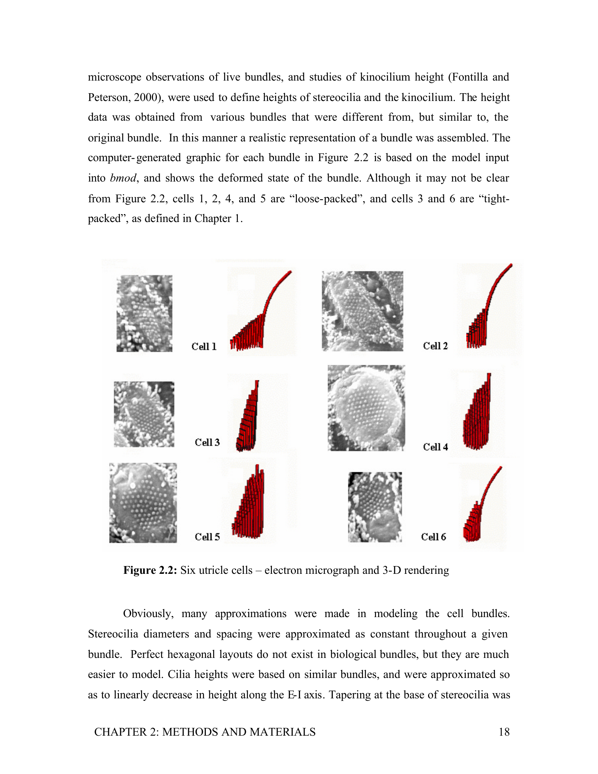
Table/Figure Extraction: Image to PDF
Tested & Containerized
First we convert pdfs to an image format that is amenable to inference
ETD
Page image(s)
Notes:
Sam

Slide 11
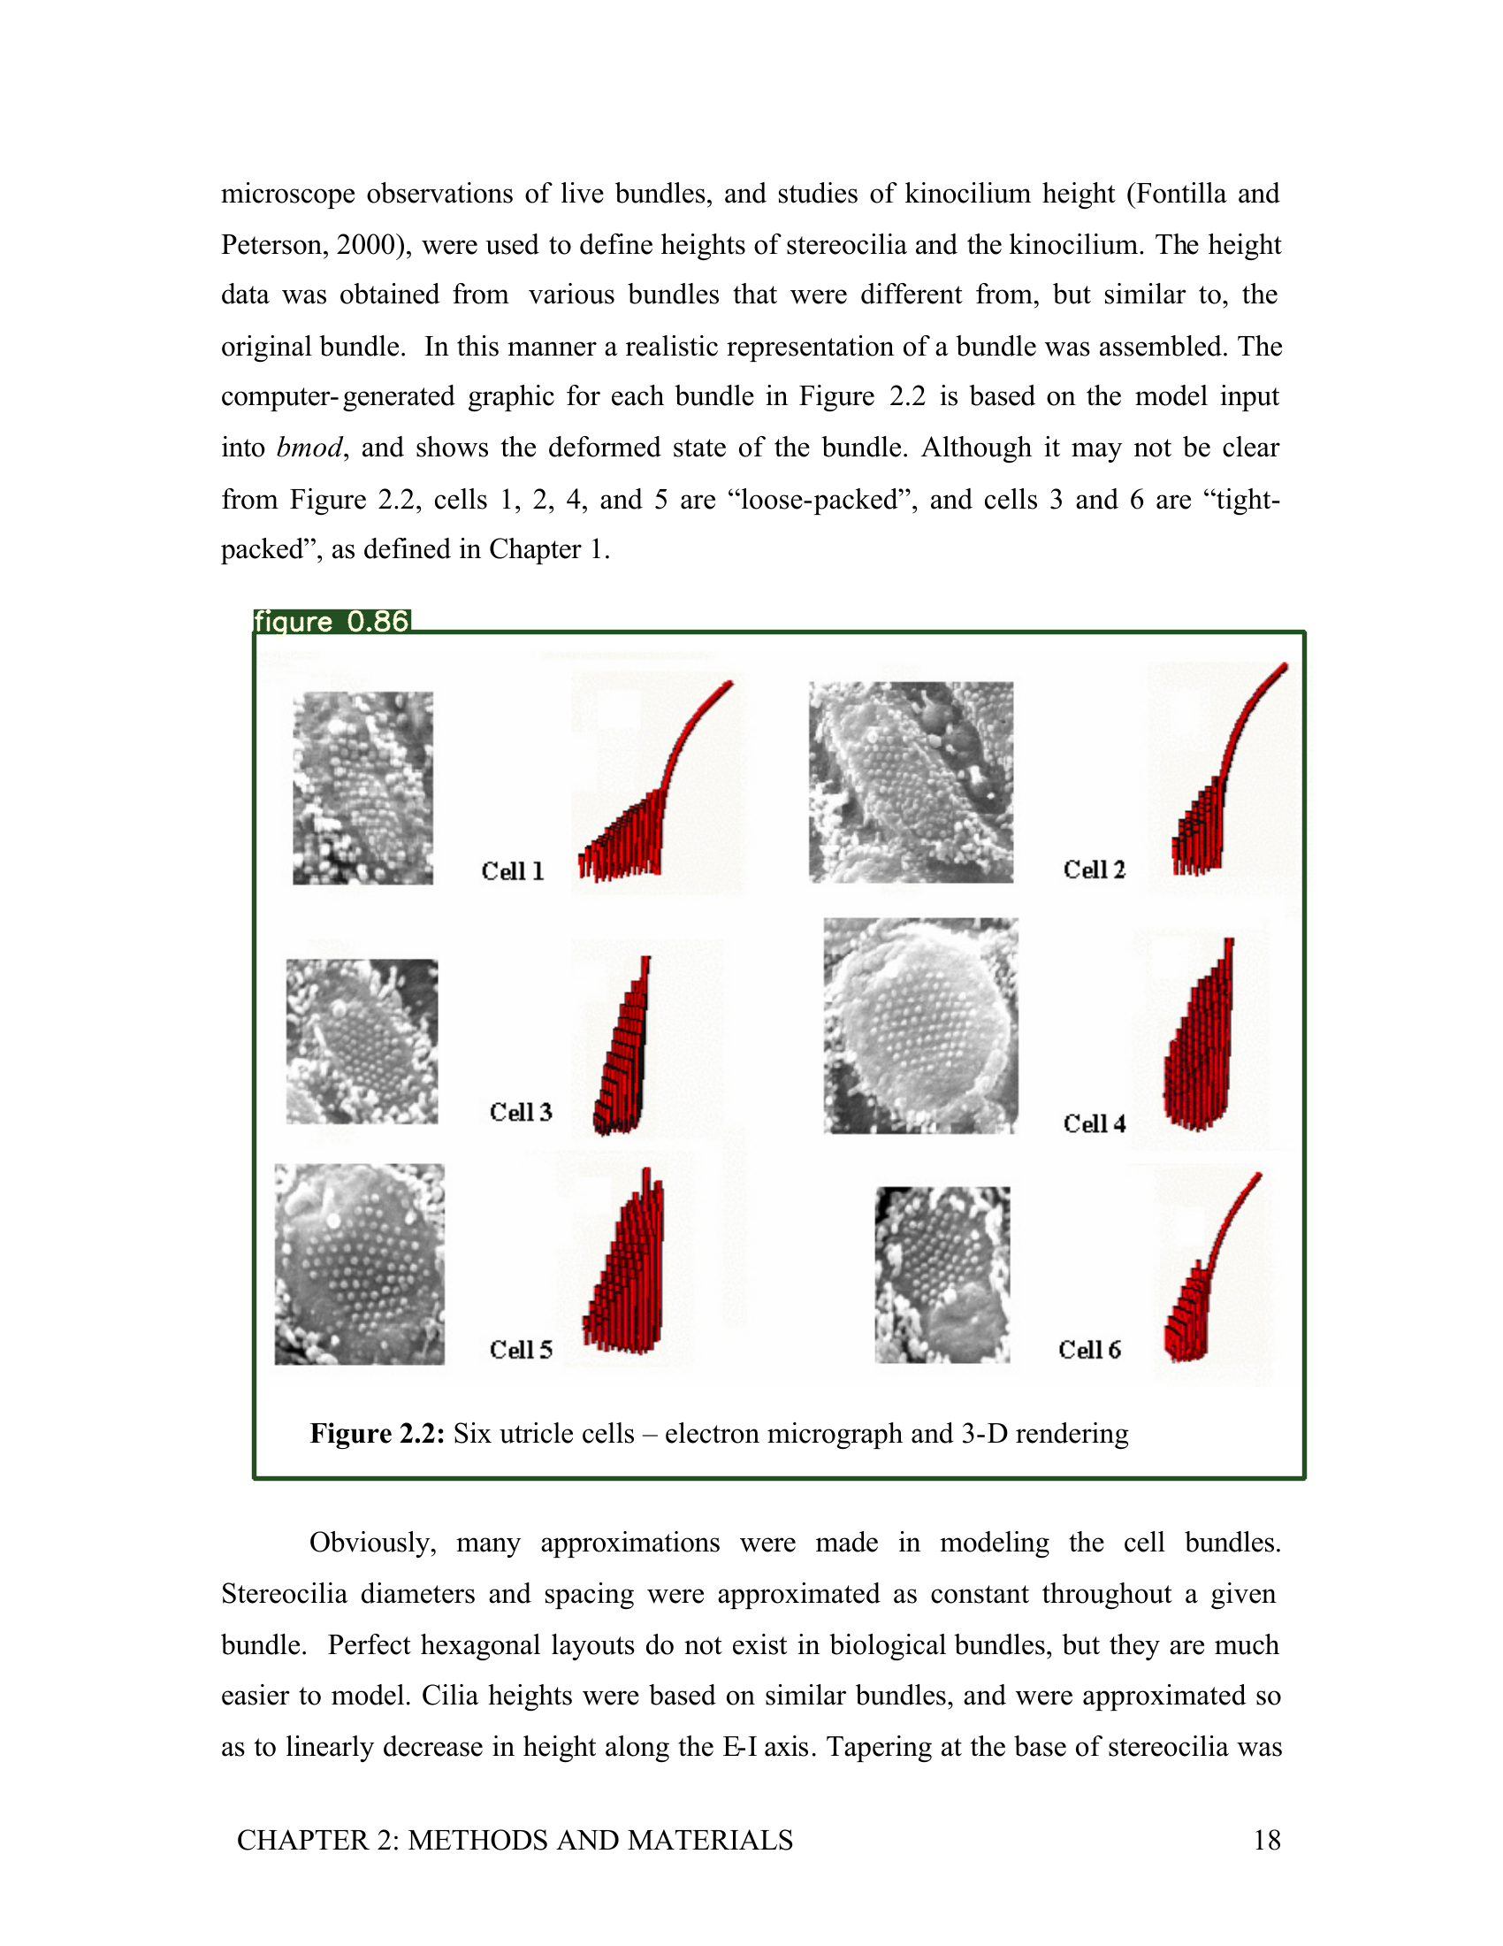
Table/Figure Extraction: Image Inference
Tested & Containerized
Inference is accomplished via the best performing model trained by Sampanna and others
Page image(s)
Page image(s) with image bound information
Notes:
Sam

Slide 12
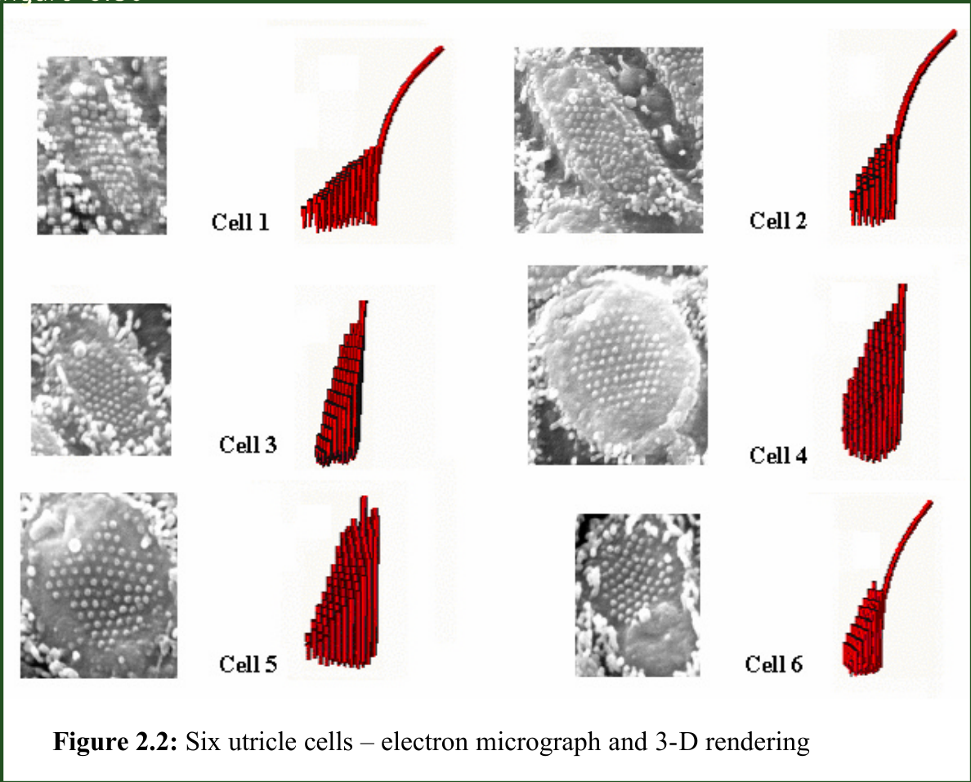
Table/Figure Extraction: Image Cropping
Tested & Containerized
The model outputs bounding boxes that can be used to crop images
Cropped images
Page image(s) with image bound information
Notes:
Sam

Slide 13
Table/Figure Extraction
Tested & Containerized
The model outputs bounding boxes that can be used to crop images
Future Works
Adapt the full deepfigures-open pipeline to Airflow
Expose services to train and evaluate new figure extraction models
Notes:
Sam

Slide 14
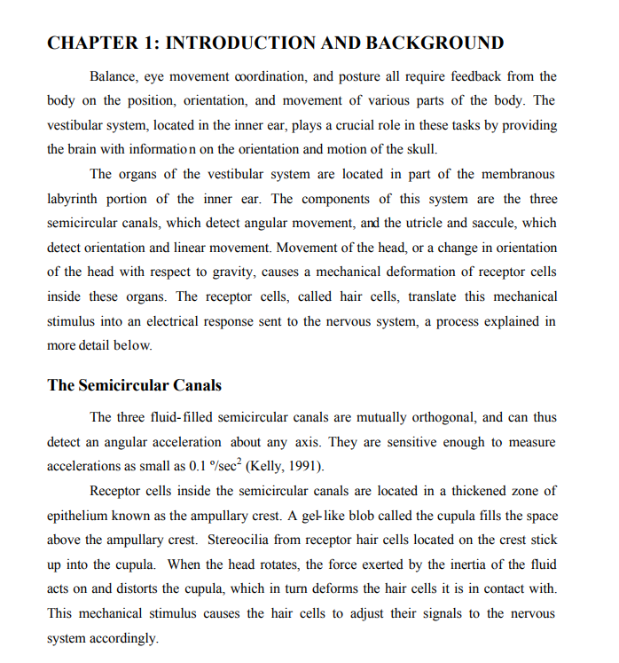
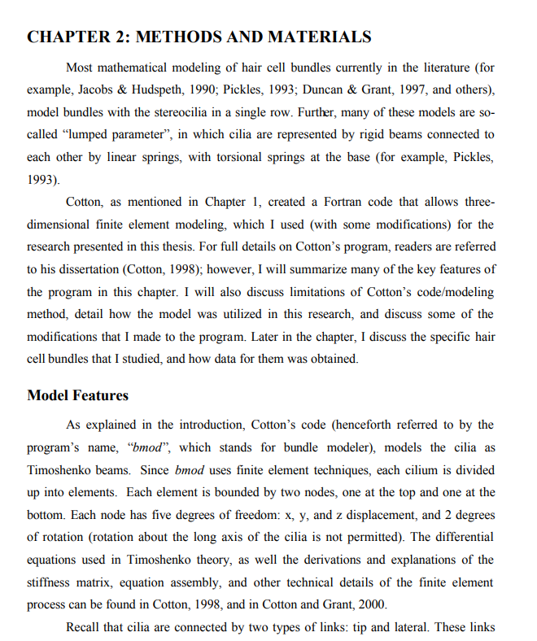
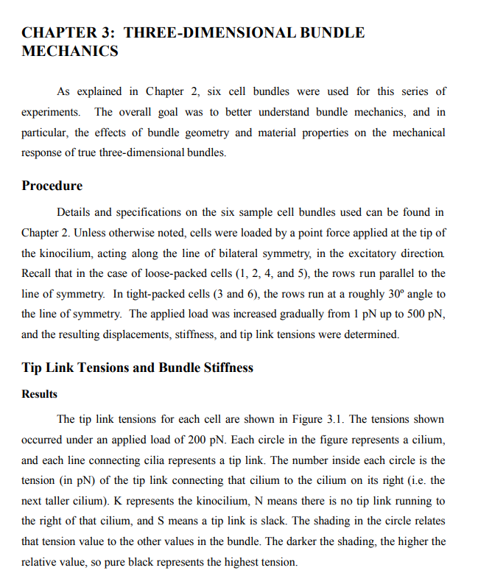
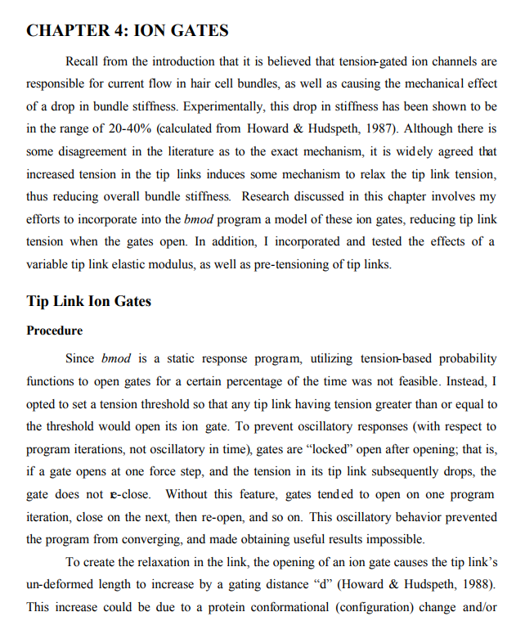

Chapter Segmentation
Median 7 Chapters
80% under 20 chapters
60% coverage of test data
ETD
handle
doc_type
Chapter fulltext
Notes:
Alex
Input: etd pdf, handle id, document type
Output: chapter pdfs

Slide 15
Chapter Segmentation
Median 7 Chapters
80% under 20 chapters
60% coverage of test data
Future Works
Further testing
Improve coverage and accuracy
PyMuPDF
ETD
handle
doc_type
Chapter fulltext
Notes:
Alex
Input: etd pdf, handle id, document type
Output: chapter pdfs

Slide 16
Text Extraction
Tested (API version containerized)
OR
Chapter fulltext
ETD
handle
doc_type
Notes:
Jiahui
For text extraction, we extract text from both pdf chapters and the whole pdf.

Slide 17
Text Extraction
Tested (API version containerized)
Get one page from PDF file.
Notes:
Jiahui
This is an example of how to extract the whole pdf. First, take one page from pdf file,

Slide 18
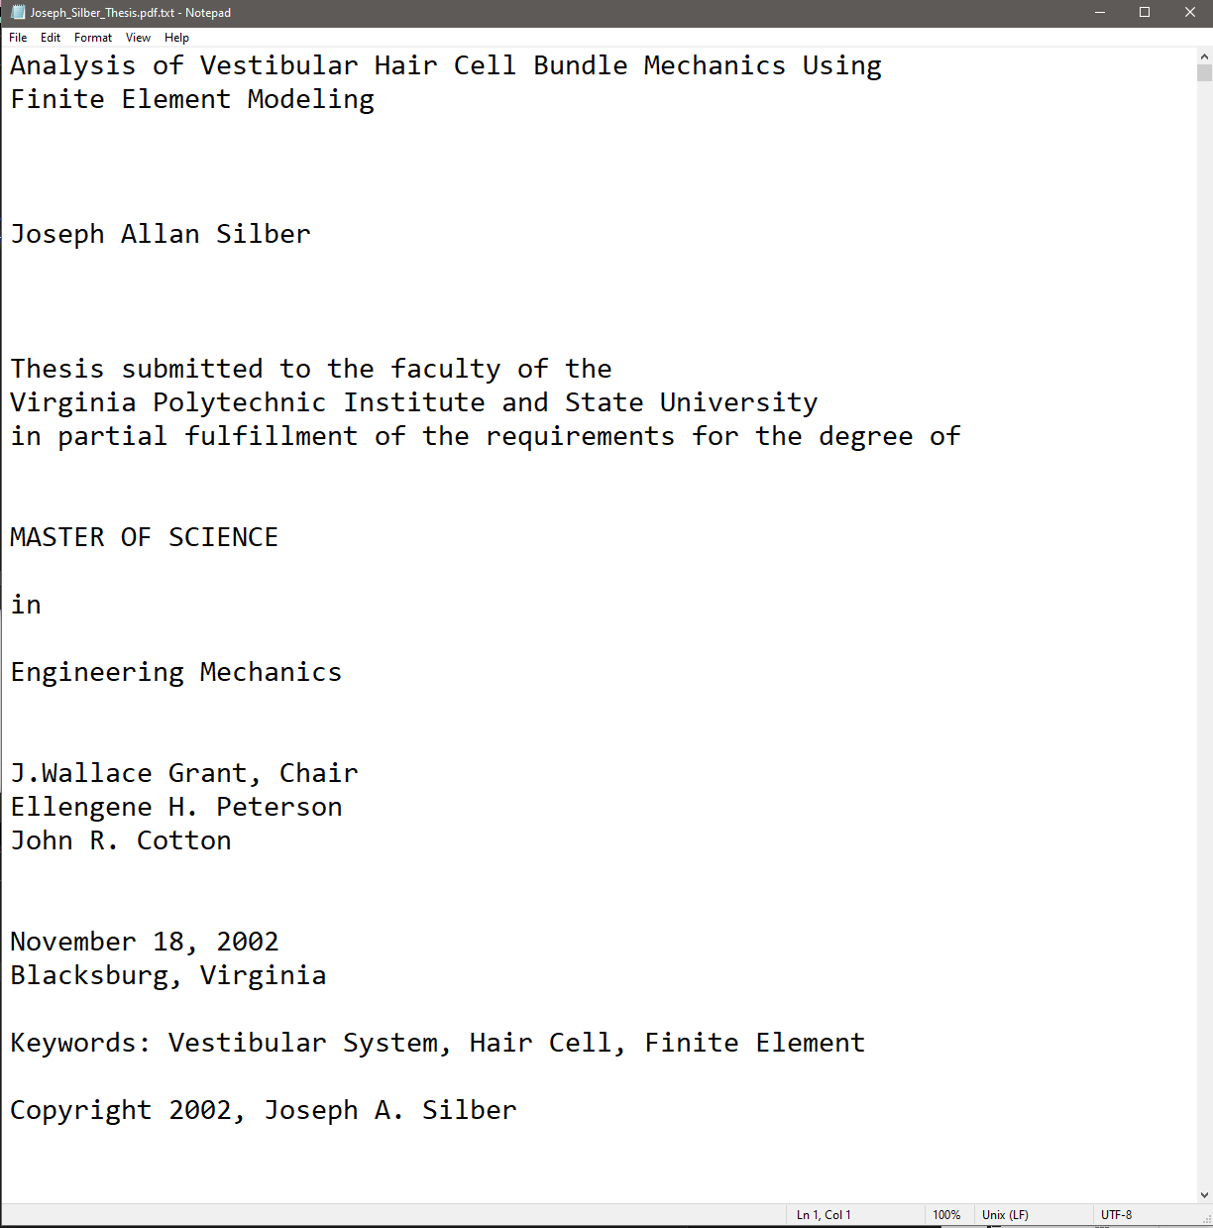
Text Extraction
Tested (API version containerized)
Extract text from this PDF page. And then, write the text into a .txt file. Repeat this steps until finish all PDF pages.
Extracted Text
Notes:
Jiahui And then extract text from this page and store it into a txt file. And it will repeat this steps until finish all pdf page.And then extract text from this page and store it into a txt file. And it will repeat this steps until finish all pdf page.
And then extract text from this page and store it into a txt file. And it will repeat this steps until finish all pdf page.

Slide 19
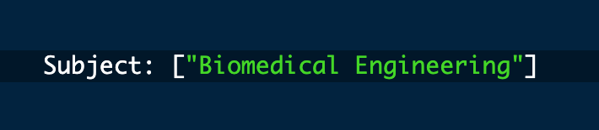
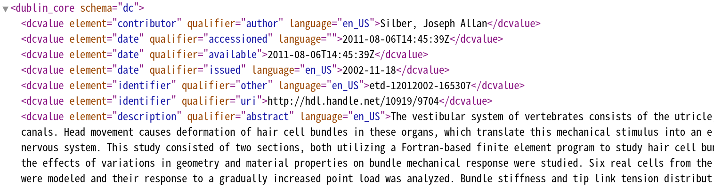
Classification
Tested (API version containerized)
Classifier
Labels for ETD
Extracted Text
Dublin Core XML
Notes:
Hey guys, so here’s a brief high-level overview of our classification service.
So once the text-extraction service extracts all the ETDs and Chapters we are ready for the classification task.
For our full-etds we run them through the classifiers with their full-text and meta-data dublin core file to generate it’s prediction.
For the chapters we simply run the chapter text through the classifier to generate each chapter’s prediction.
And for anyone interested this service has an API that has been containerized

Slide 20
Classification Architecture
PQDT DATASET
Statistics
Ecology
Forestry
Training Classifier
  Vectorizers trained on each label
  Focused Text uses: title, abstract, and keywords
  Used Logistic Regression to generate label probabilities per n word segment
Implementing Classifier on data
  Segment ETD into n word blocks
  Classify each segment
  Cumulate per label probability over segments
  Pick top k labels based on top 5 labels’ variance
StatVect
EcoVect
ForeVect
StatLR
EcoLR
ForeLR
ETD
n
n
n
n
n
n
Notes:
So now I just wanted to help a little intuition on how our classification pipeline is designed.
We are training our classifier by segmenting the vectorizers. Each vectorizer is trained on it’s departments’s data-set so it can build intution on term weighting within it’s own department. We train them using field’s we considered focused. This includes titles, keywords, abstracts.
We used logistic regression as our baseline model to generate class probabilities.
As far as implementing the classifier on our data goes, we did this by segmenting each ETD into n segments.
We classified each segment and generated cumulative probabilities for each category.
Finally we pick top k labels based on variance.

Slide 21
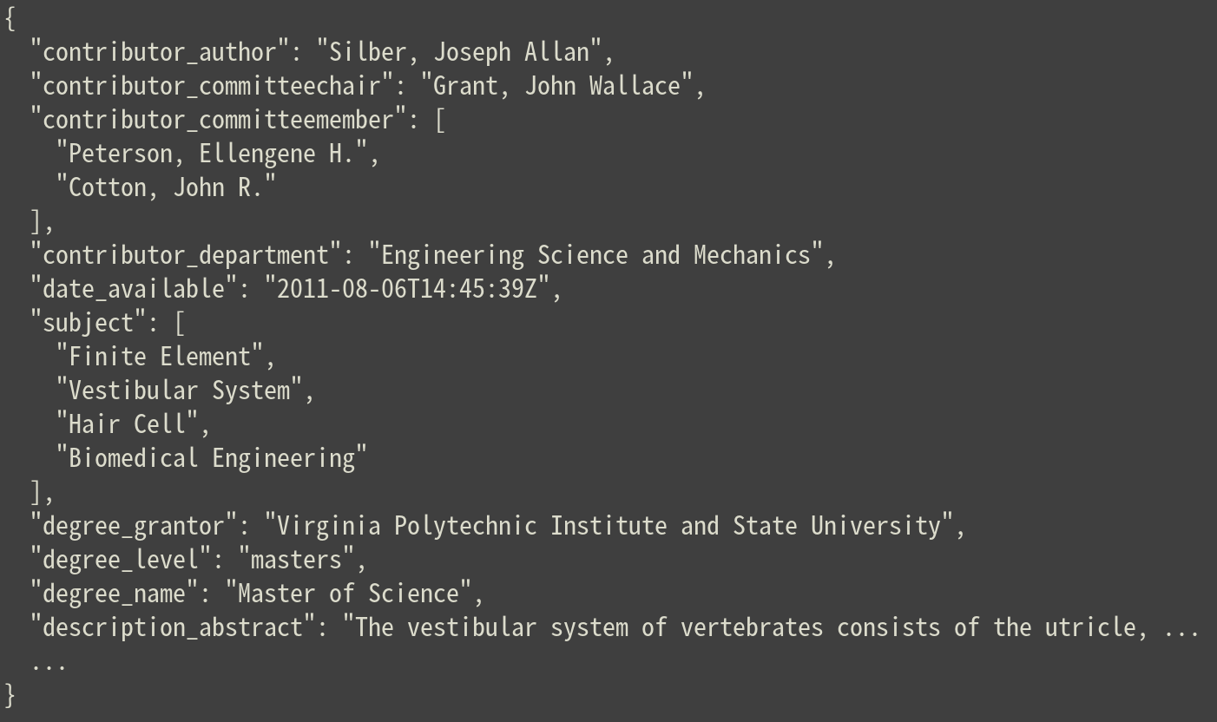
Ingestion
Tested & containerized
Read metadata from Postgres and index into Elasticsearch
Postgres
Elasticsearch
Elasticsearch-ready record
Notes:
Nick

Slide 22
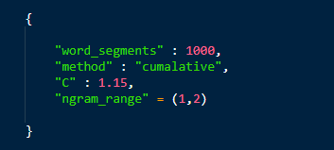
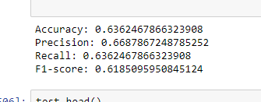
Classification Metrics
Tested (API version containerized)
Classifier
Labels for ETD
Extracted Text
Future Works
Test classifier with varied set of hyper-parameters
Implement zones for metadata weighting
Try different baseline models
Dublin Core XML
Notes:
Lastly, I just wanted to talk about the classifier recorded metrics and some future work recommendations
First we classified our ETD’s using 1000 character segments and a regulization of 1.15, and we are vectorizing the text with bigrams and single words.
The classifier accuracy was fairly consistent across all scores.
The bigger I created the standard deviation acceptance range, the higher the recall would get, but it would lower the precision, which is expected.
Finally for Future works
I wish I could test the classification pipeline with a varied set of hyper-parameters
Also maybe implement a zone system to weight metadata fields based on importance
And Lastly, I wish I could have implemented the system using different baseline models. Something like SVMs or KMeans.

Slide 23
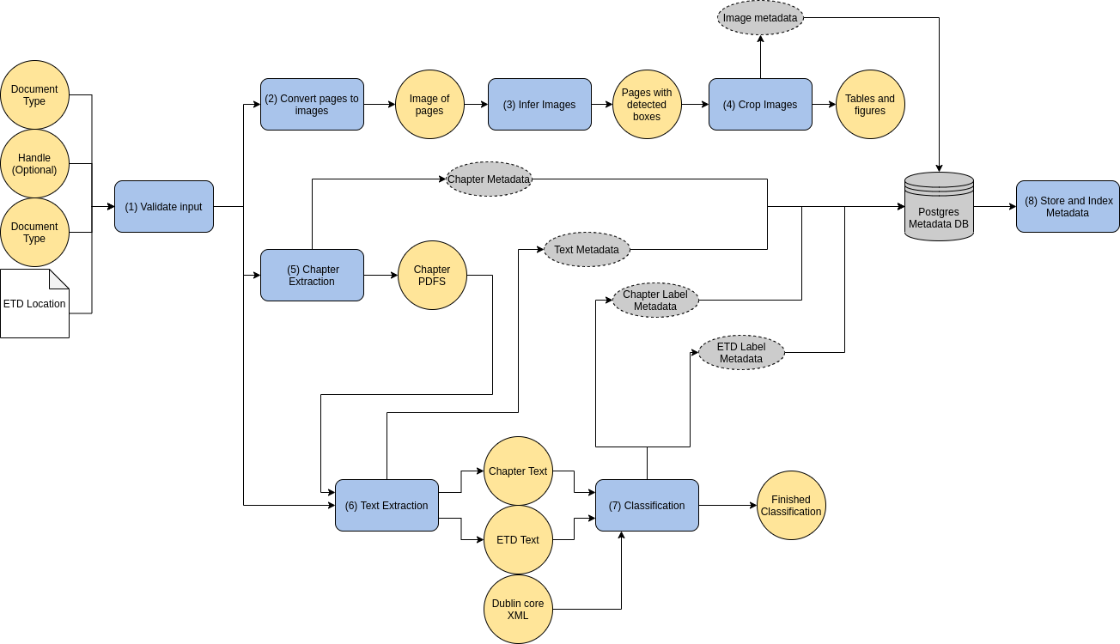
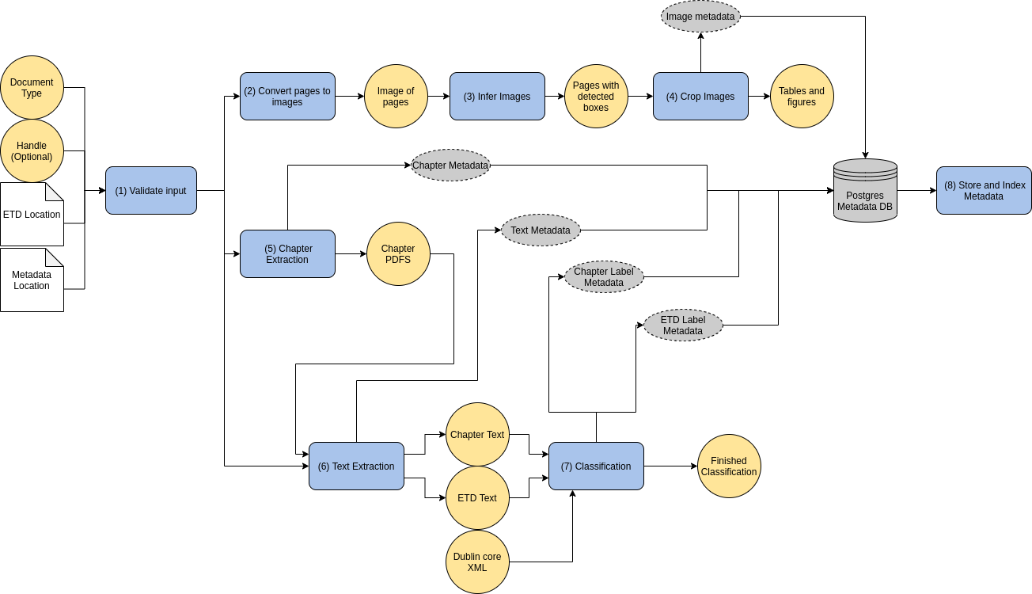
Review

Slide 24
Lessons Learned
Next Steps
Understand Intended Structure Early
Microservices Workflow
Cross-team Communication
Expose more Airflow goals to provide further customization
Expose new Airflow goals to allow for separate collections in Elasticsearch

