Slide 1
Blockchain Etextbook
Arib Ali, Liam Gillies, Elizabeth Mulvaney
CS 4624 Multimedia, Hypertext, and Information Access
Professor: Dr. Edward Fox
Virginia Tech
Blacksburg, VA 24061
12/02/2021

Slide 2

Outline
Overview of Topic
Timeline
Deliverables
Hard Forks
Proof of Stake
Crypto Hacking
Ethereum Virtual Machine
Ethereum Summary
Testing
Challenges & Lessons Learned
Future Work
Acknowledgments
References
[1]

Slide 3
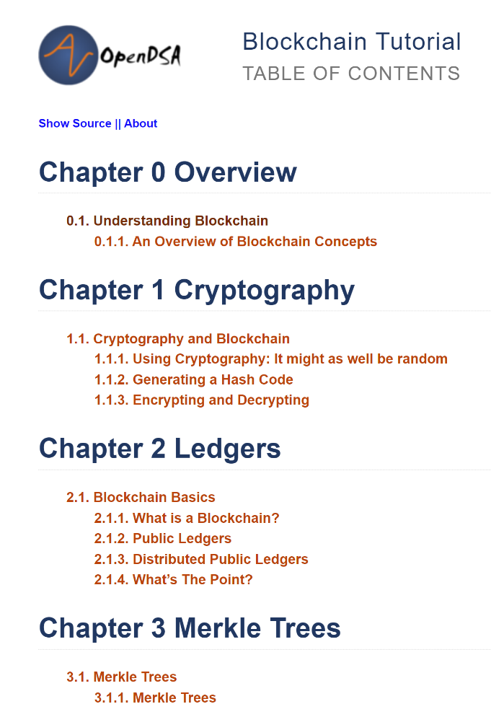
Overview of Topic
OpenDSA Blockchain Textbook - Ethereum
Our task:
Ethereum Content and Exercises
Format
RST File for Content, HTML/JavaScript for Exercises

Slide 4
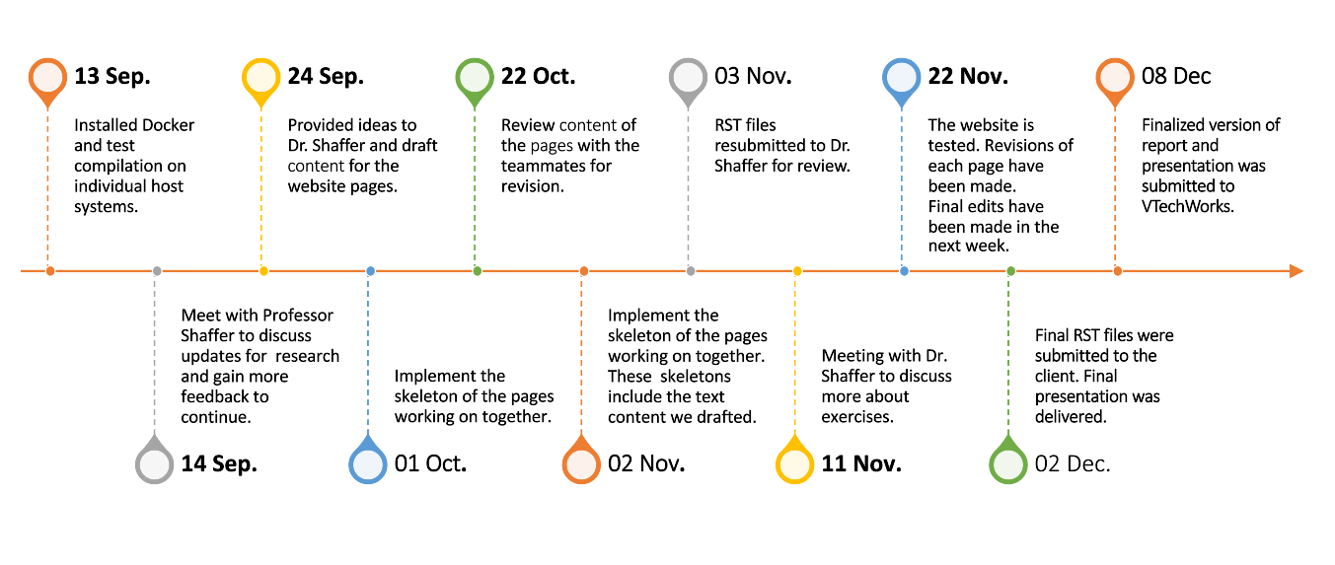
Timeline

Slide 5
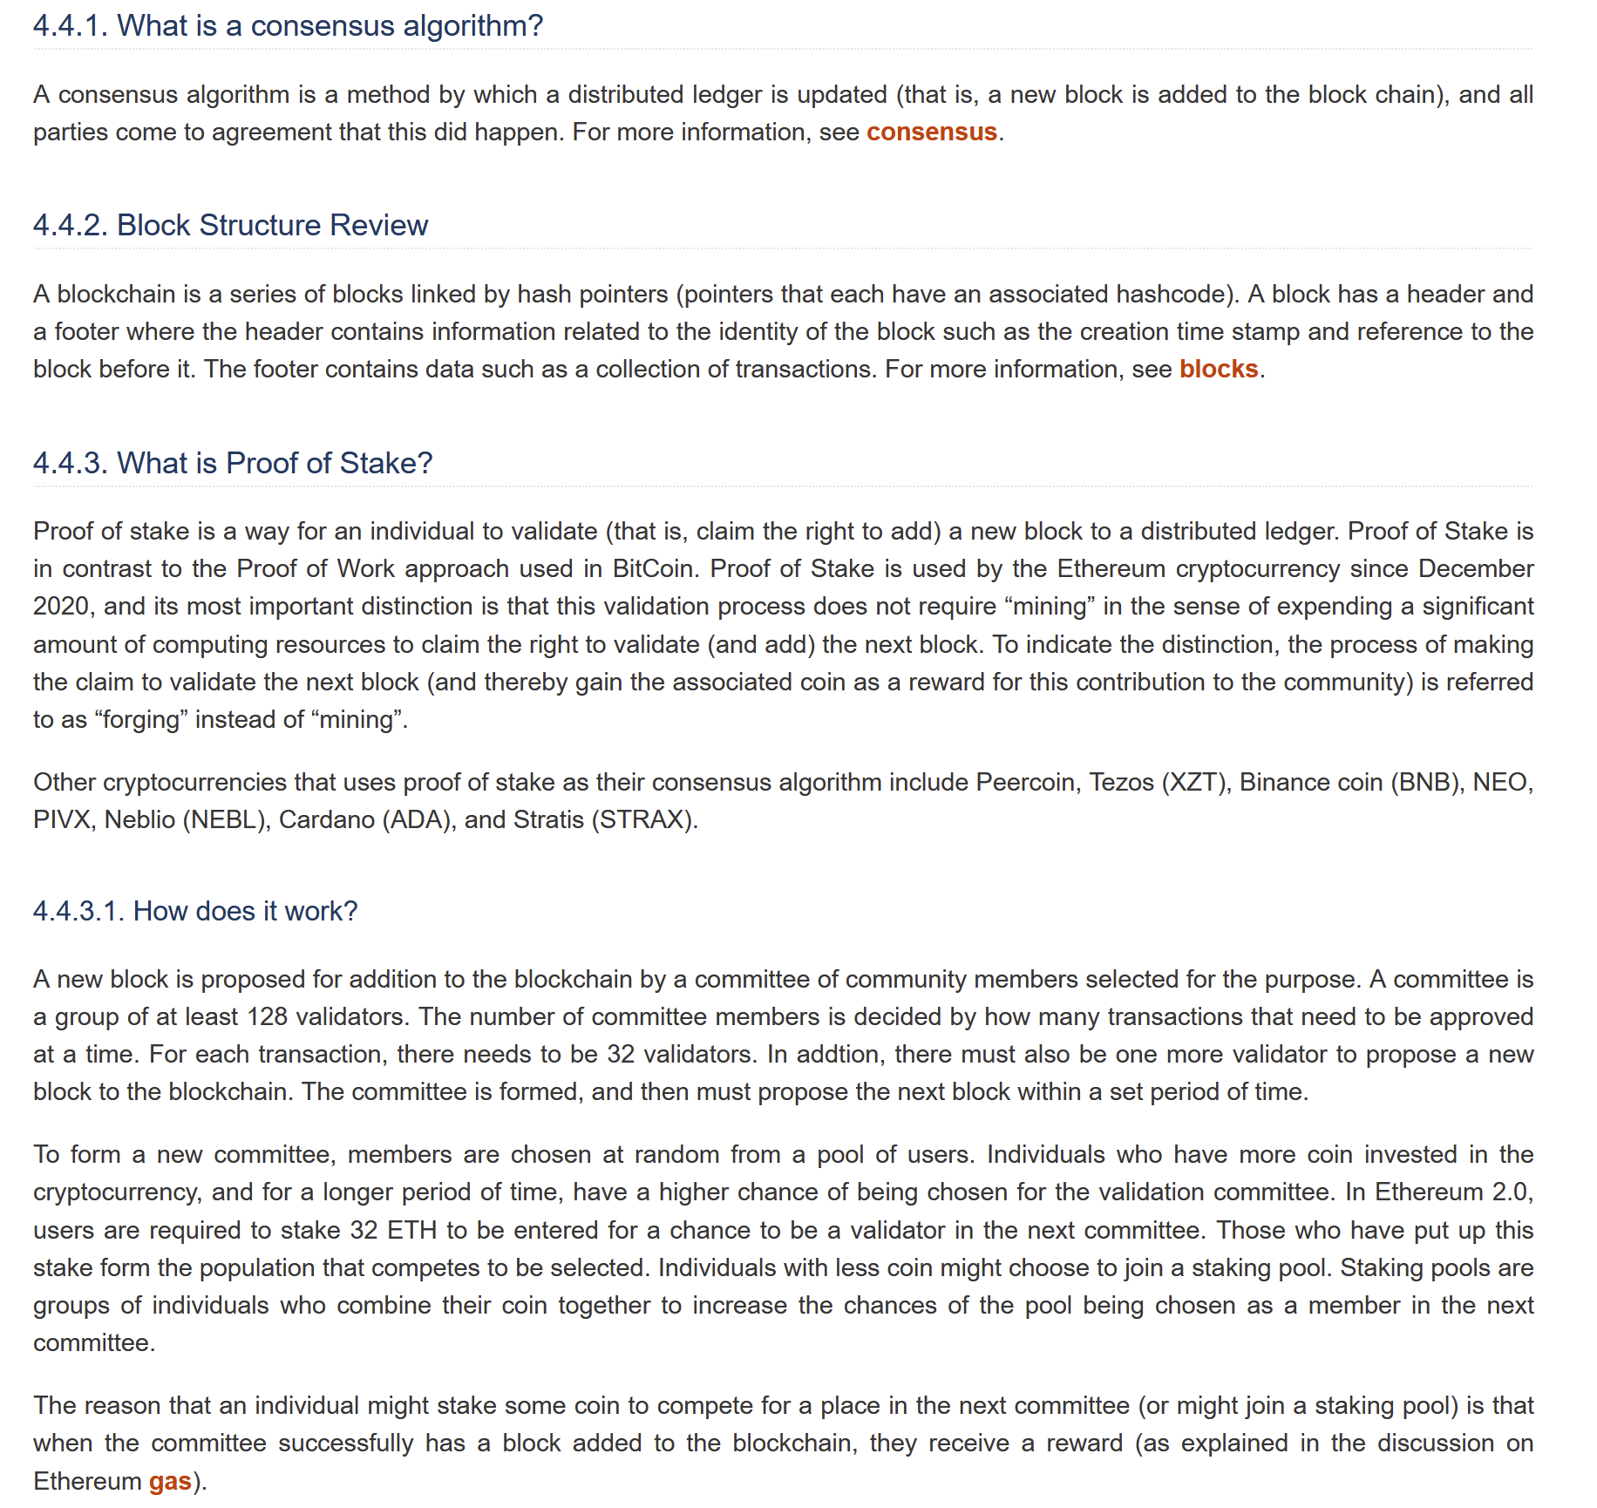
Proof Of Stake
2 Quiz Groups
Details
How It Works
Proof of Stake vs. Proof of Work
Reviewing Previous Sections

Slide 6
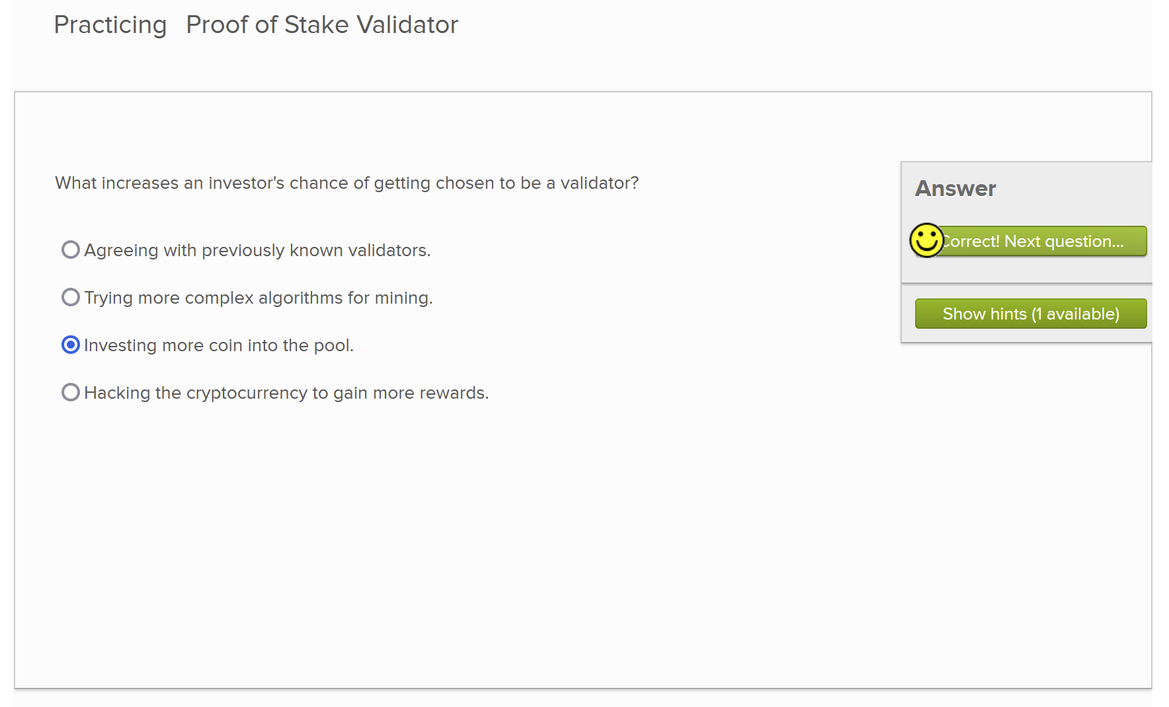

Slide 7
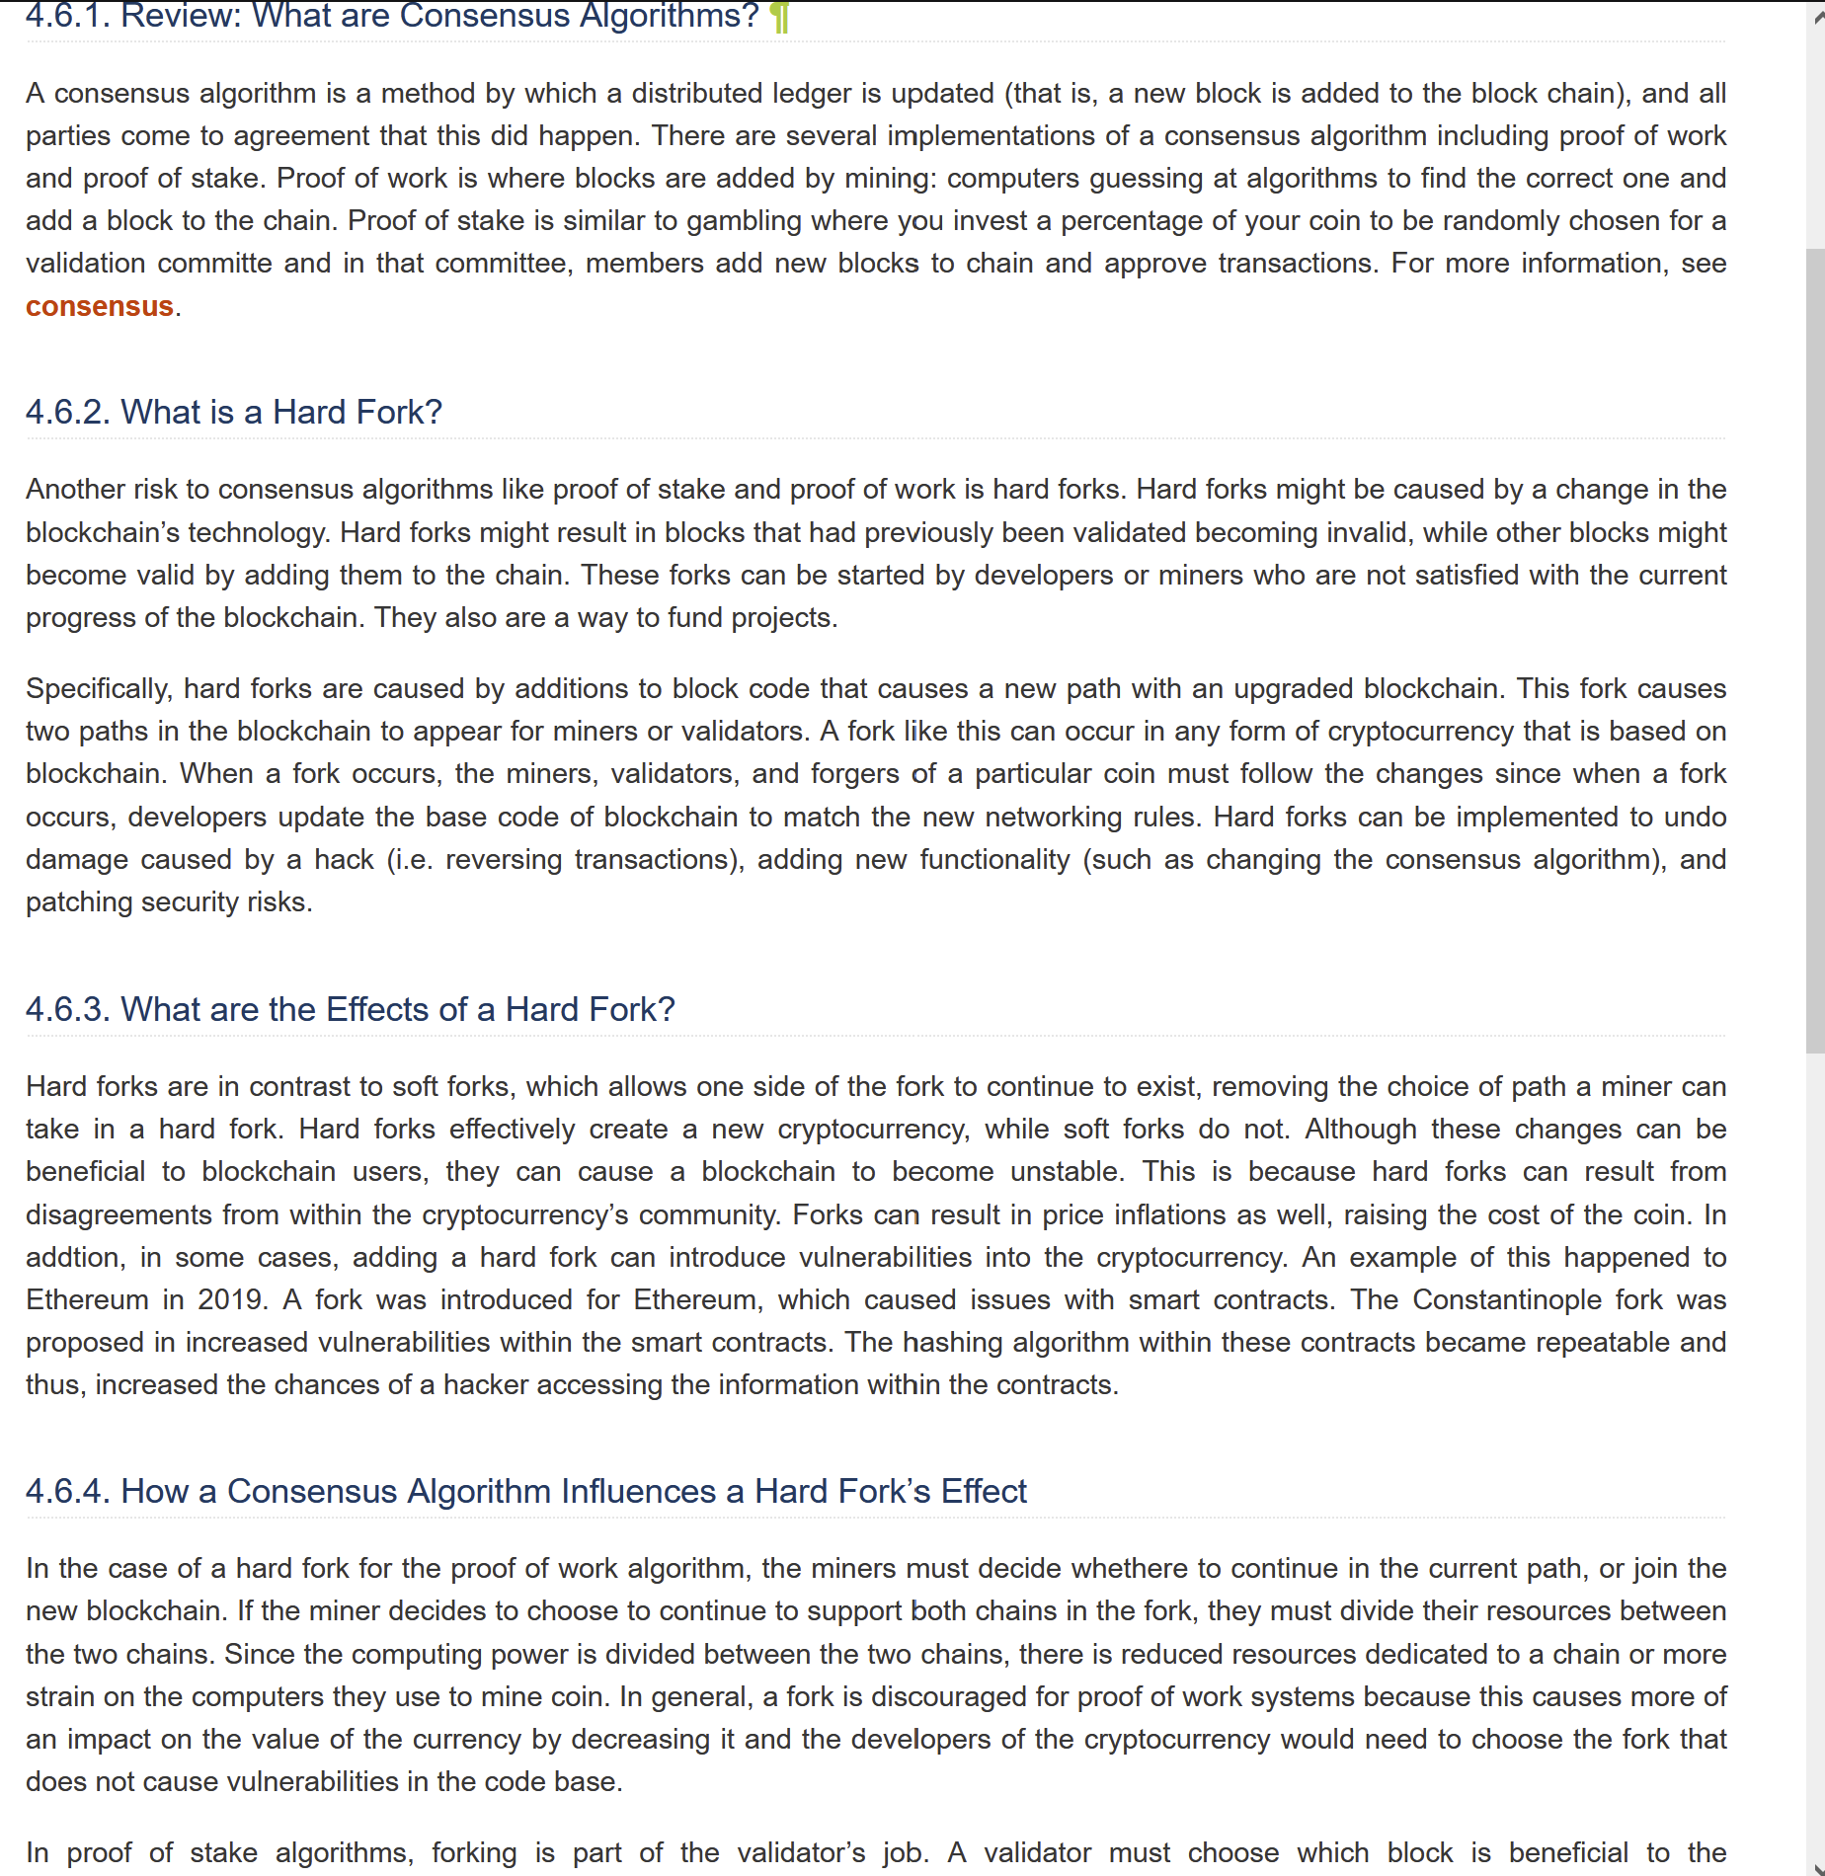
Hard Forks
Details
Review: Consensus Algorithms
What Is a Hard Fork
What are the Effects of a Hard Fork?
How a Consensus Algorithm Influences a Hard Fork’s Effect
Quiz: Details of what a hard fork does

Slide 8
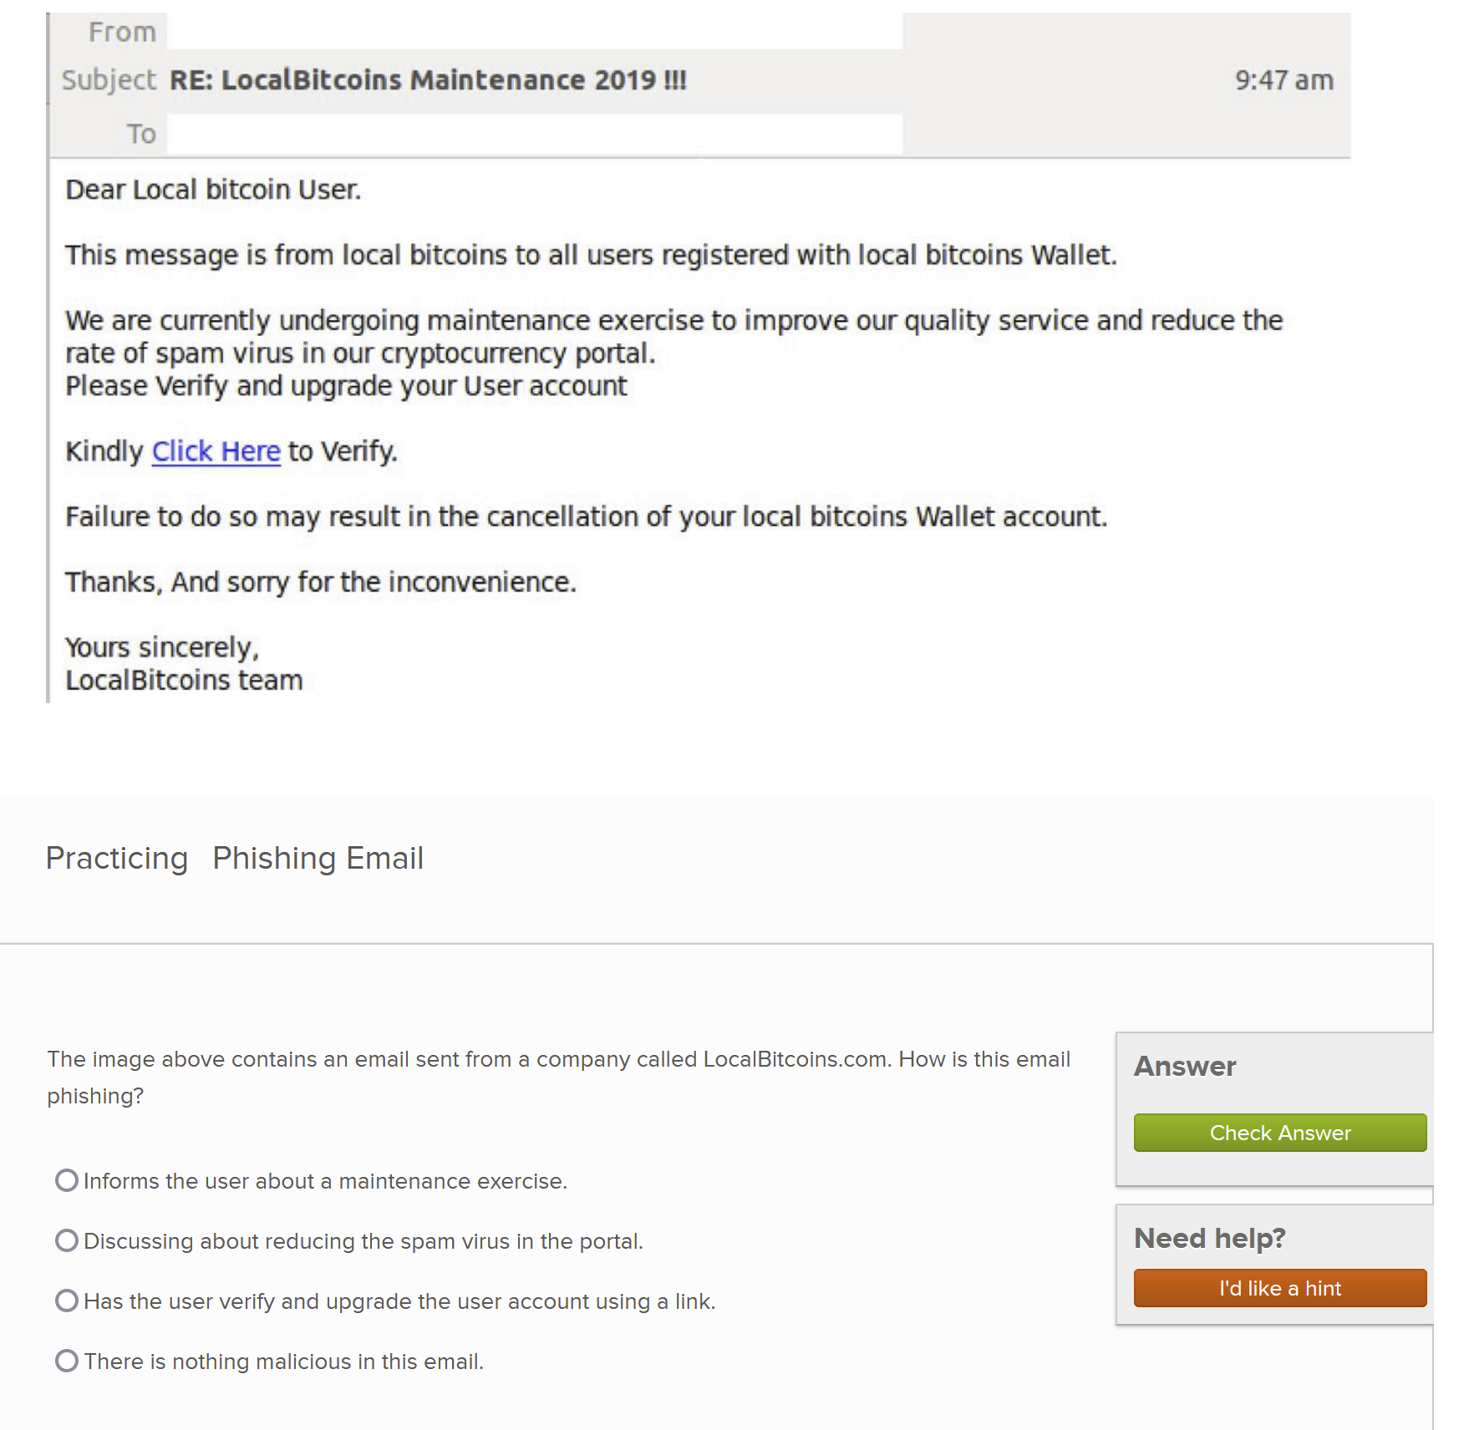
Crypto Hacking
Quiz for Identifying Phishing
Sections on:
What is Crypto hacking
Hacking Strategies
Phishing Attacks
51% Attacks
Cryptojacking
How to Mitigate Risk

Slide 9
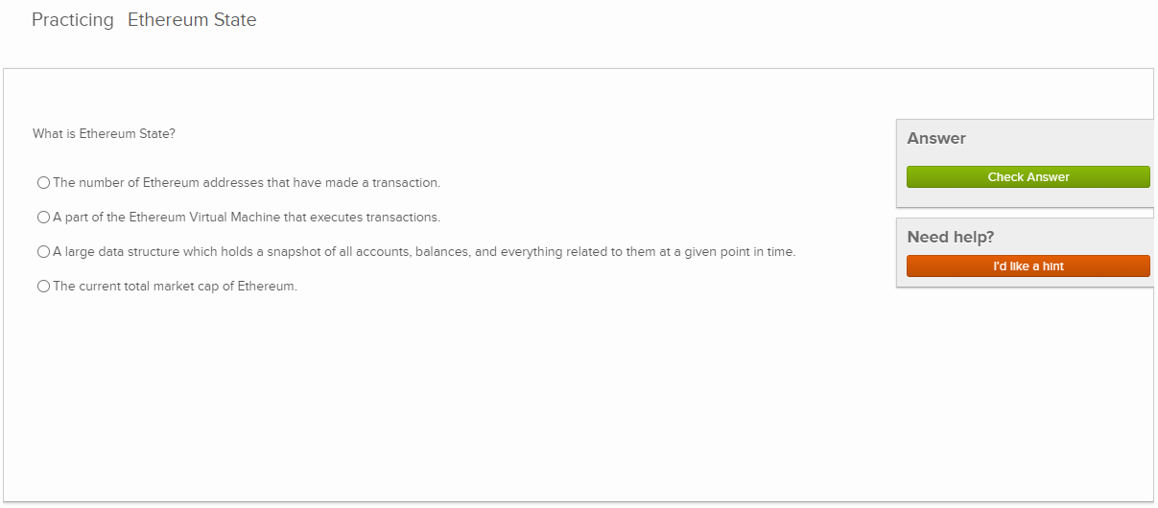
Ethereum Virtual Machine (EVM) and Gas
Researched online and read Ethereum.org’s official documentation
Wrote prose about both subjects
Designed exercises and visualizations

Slide 10
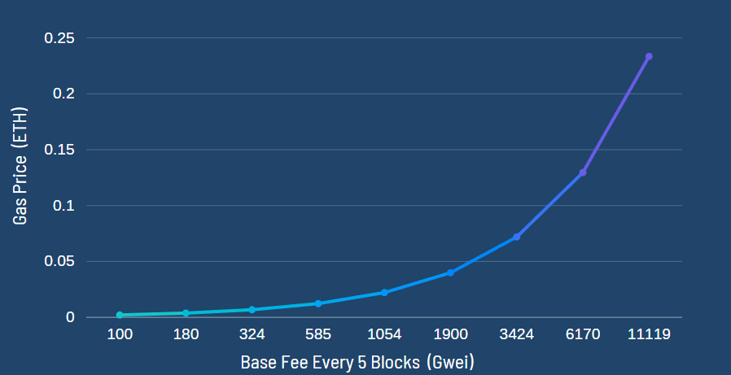
Visualization

Slide 11
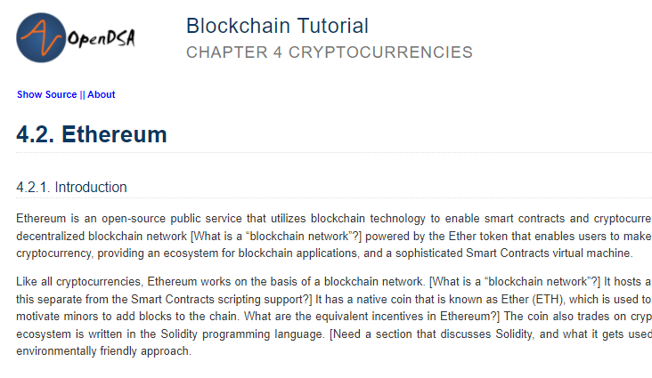
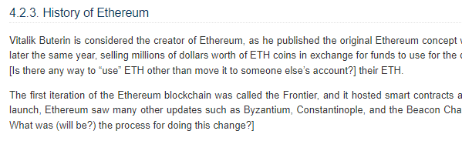
Ethereum’s Fundamentals
History of Ethereum
Early days
The rise of the Ethereum blockchain
Future
Key differences between BTC and ETH
Currency vs. Platform
Bitcoin: a credible alternative to traditional fiat currencies
Ethereum: A platform to run programmatic contracts and applications via Ether.
Average Block time
Bitcoin: 10 minutes
Ethereum: 10-15 sec

Slide 12
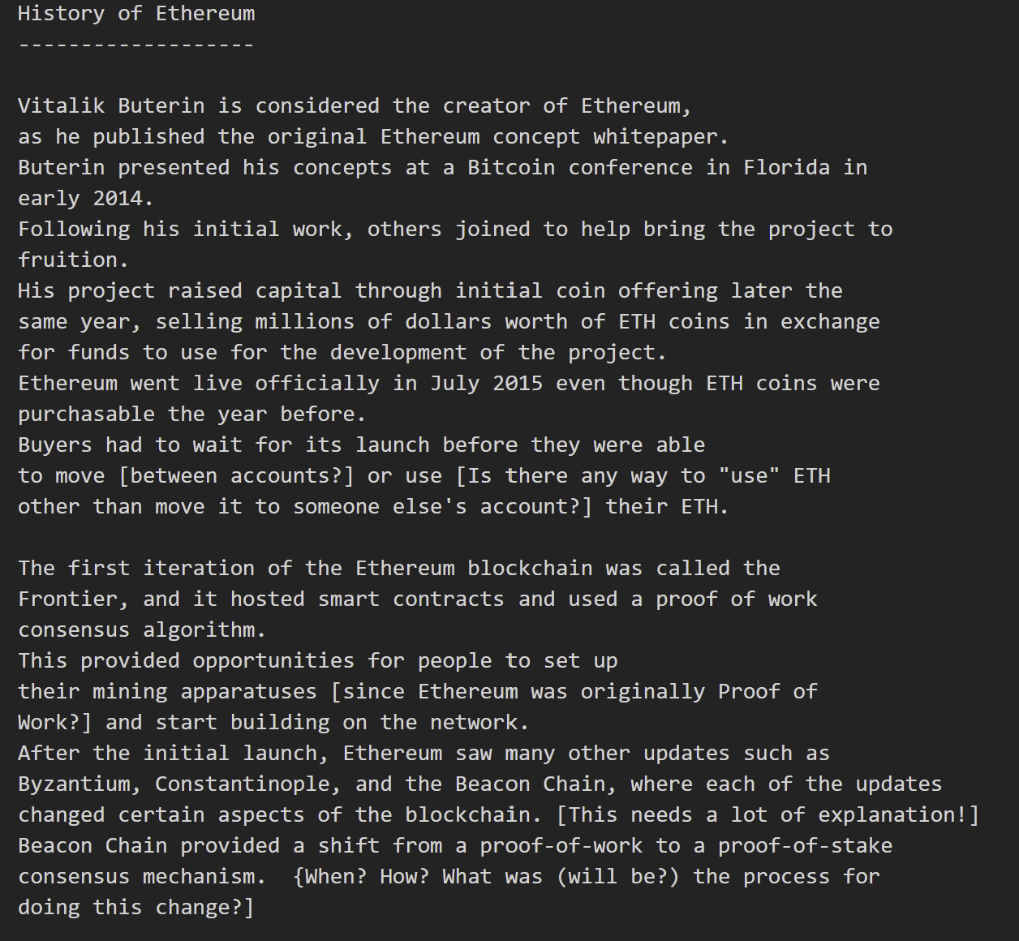
Testing
Docker
Make Book
Exercises: Ensure working properly
RST files
Editing
Dr. Shaffer reviewed RST files
Edited ourselves
Referenced people with no knowledge of Blockchain

Slide 13
Challenges & Lessons Learned
Group leader dropped class
Writing textbook prose is more difficult than it appears
Researching Blockchain content consumes plenty of time due to limited information available

Slide 14
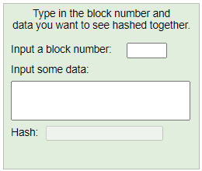
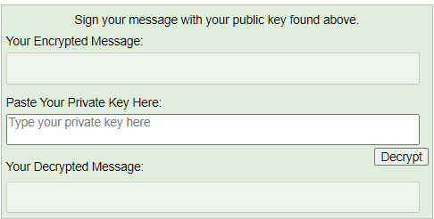
Future Work
[4]
Update information as it becomes available
Other consensus algorithms
Other cryptocurrencies
Legislation
Newer visualizations
[5]

Slide 15

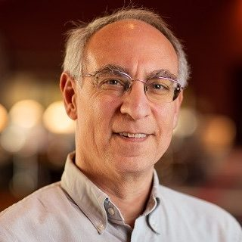
Acknowledgements
Benjamin Parr - M.S. Machine Learning and B.S. Computer
Science from Carnegie Mellon Blockchain and Machine Learning Researcher
[6]
Dr. Fox - Professor of CS 4624
[7]
Dr. Clifford Shaffer - Professor and Associate Department Head for Graduate Studies

Slide 16
References
[1] MIT, “Algorand uses a unique blockchain architecture developed by MIT Professor Silvio Micali to offer a decentralized, secure, and scalable platform,” MIT News. Cambridge, MA, United States: Massachusetts Institute of Technology. [Image]. Available: https://news.mit.edu/2021/unlocking-potential-blockchain-0616 Accessed on: Nov. 1, 2021.
[2] Ethereum, "Proof-of-stake (PoS)", ethereum.org, 2021. Accessed on: Oct. 15, 2021. [Online]. Available: https://ethereum.org/en/developers/docs/consensus-mechanisms/pos/. .
[3] J. Frankenfield, "What Is a 51% Attack?", Investopedia, 2021. Accessed on: Oct. 28, 2021. [Online]. Available: https://www.investopedia.com/terms/1/51-attack.asp.
[4] OpenDSA, “Blockchain tutorial,” 0.1. Understanding Blockchain - Blockchain Tutorial. Accessed on: Dec. 02, 2021. [Online]. Available: http://lti.cs.vt.edu/LTI_ruby/Books/Blockchain/html/Introduction.html.
[5] OpenDSA, “Blockchain tutorial,” 0.2. Cryptography and Blockchain - Blockchain Tutorial. Accessed: Dec. 08, 2021. [Online]. Available: http://lti.cs.vt.edu/LTI_ruby/Books/Blockchain/html/Cryptography.html.
[6] E. Fox, “Dr. Fox,” Edward A. Fox Information Page. Blacksburg, VA, United States: Virginia Tech. [Photograph]. Available: https://fox.cs.vt.edu/foxinfo.html. Accessed on: Nov. 2, 2021.
[7] C. Shaffer, “Dr. Clifford Shaffer,” Virginia Tech Computer Science. Blacksburg, VA, United States: Virginia Tech. [Photograph]. Available: https://cs.vt.edu/people/faculty/cliff-shaffer.html. Accessed on: Nov. 2, 2021.

